Slide 1
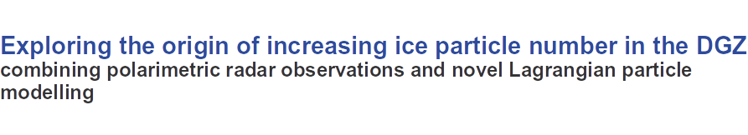
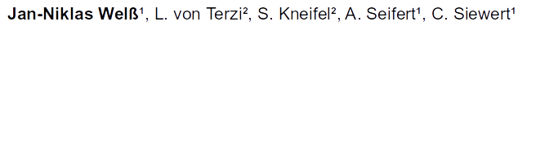
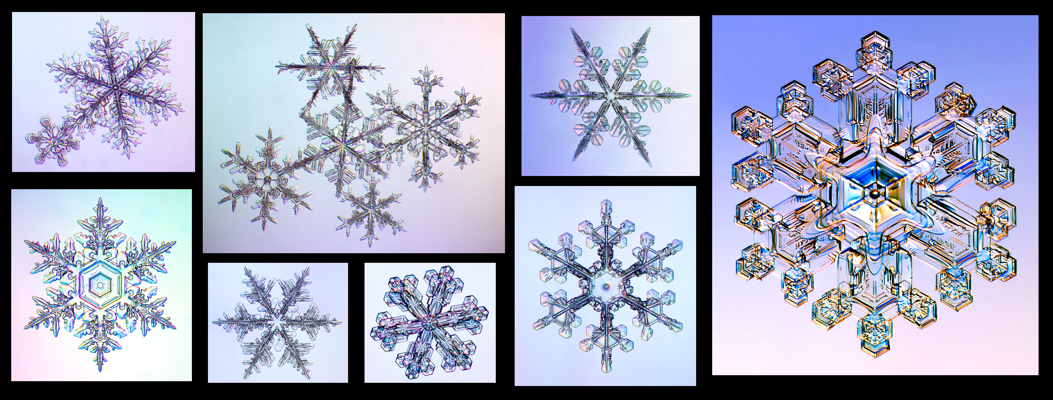

EGU 2022, AS1.14 25.05.2022

Slide 2
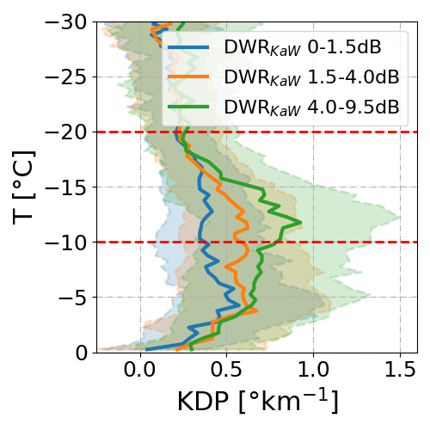
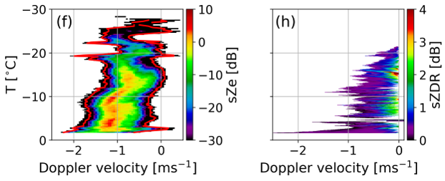
Does dendritic growth trigger something else?
Concentration of small particles continuously increases in DGZ
Spectral ZDR indicates non-spherical particles at slow edge
→ Where do these particles come from?
von Terzi et al, 2022, (in review)
2
EGU 2022, AS1.14 25.05.2022

Slide 3



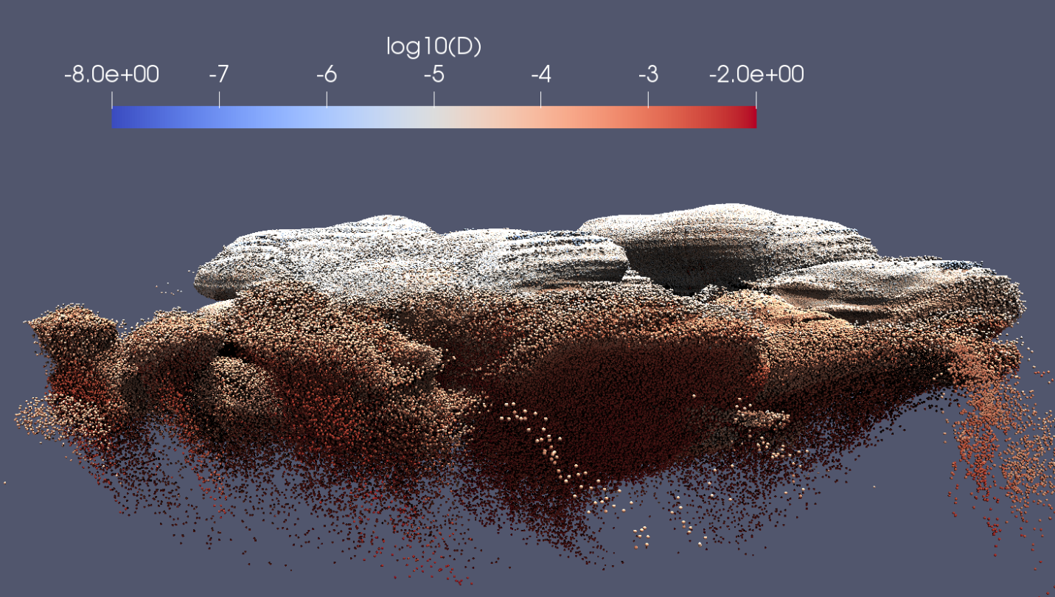
The LPM McSnow
Monte-Carlo ice-microphysics model using a Super particle approach
Ice microphysical Processes:
Sedimentation,
Deposition / Sublimation,
Riming
Aggregation
Freezing / Melting,
SIP (Fragmentation & rime splintering)
Operating modes:
Box model
1D snow-shaft
2D/3D microphysics by coupling McSnow with ICON
habit dependant
3
EGU 2022, AS1.14 25.05.2022

Slide 4
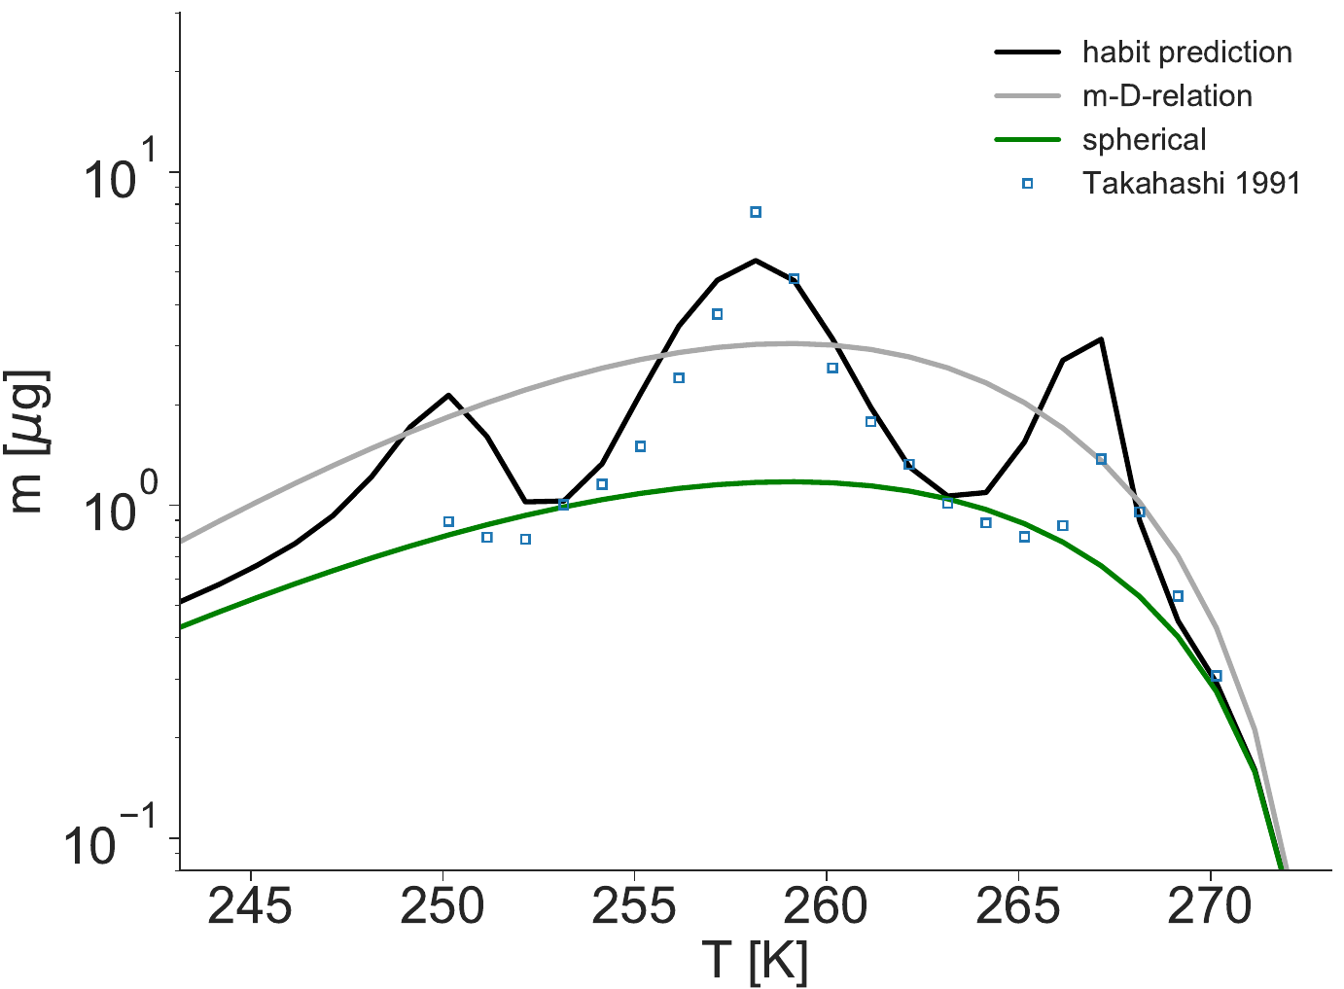
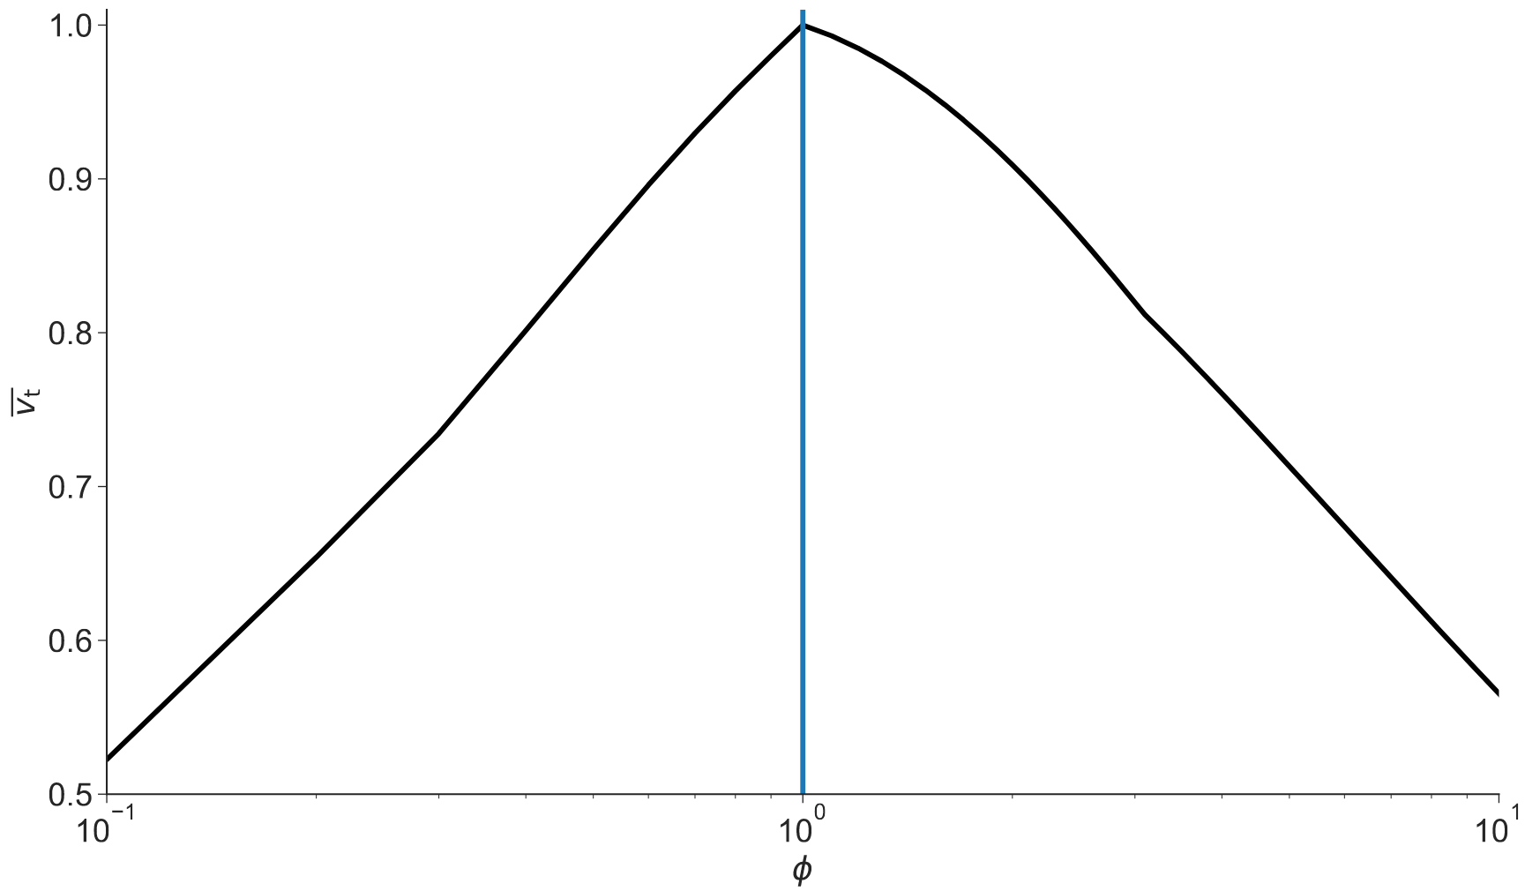
Deposition
Sedimentation
Riming & Aggregation
4

Slide 5

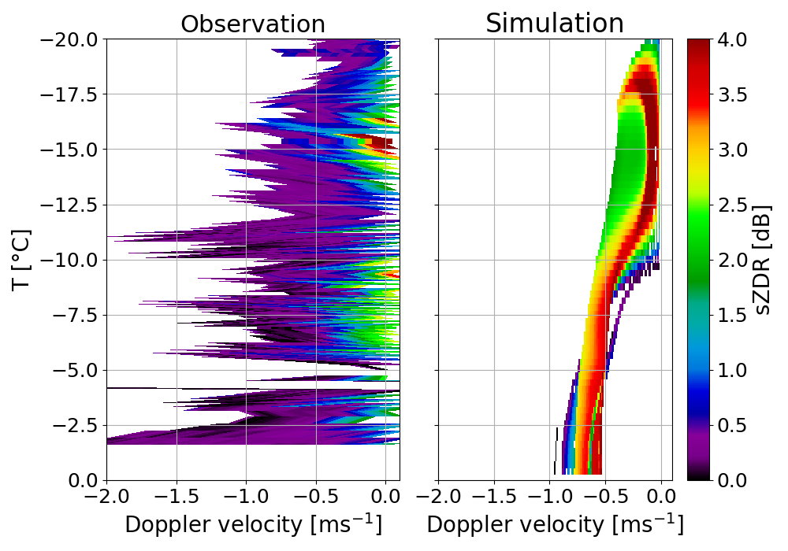
Modelling the DGZ
McRadar
(using T-Matrix)
(Strong) sZDR: Particle habits match but they must nucleate in oblate-favouring conditions
DWR: can be hard to match, representing Aggregation in 1D can be complicated
Fragmentation as a source
Possible but could benefit from habit dependency
5
EGU 2022, AS1.14 25.05.2022

Slide 6
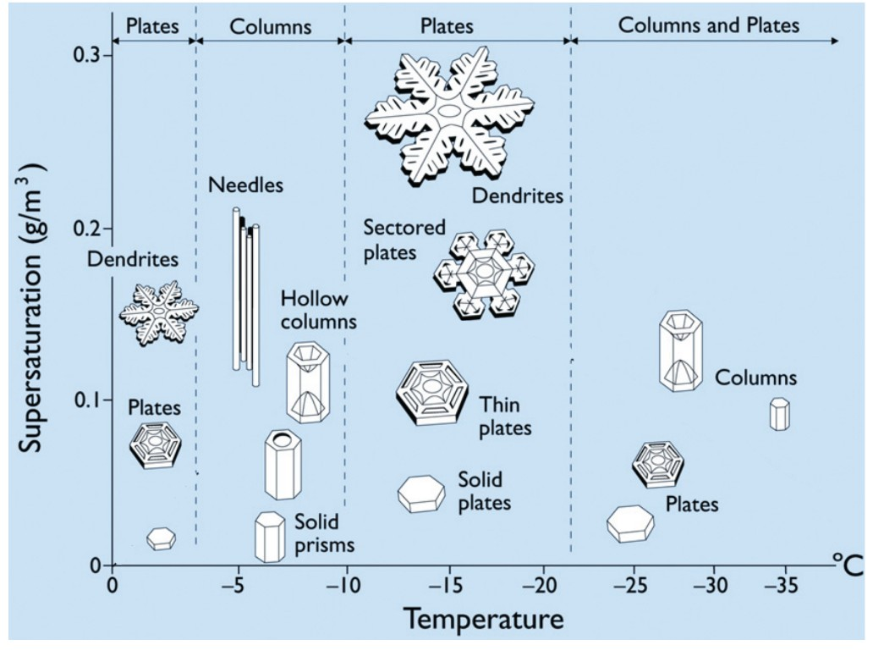
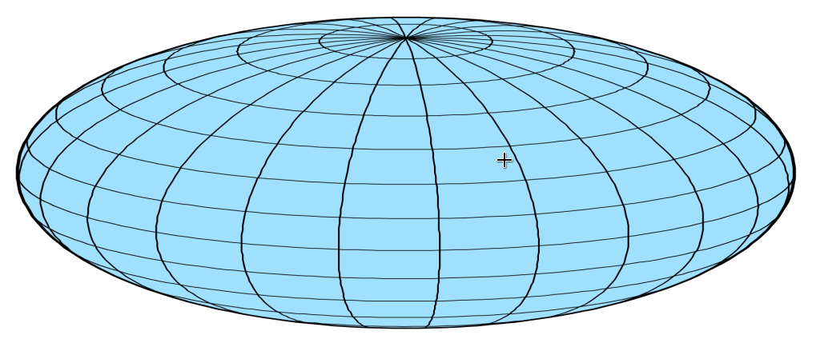
Libbrecht, 2005
A1
EGU 2022, AS1.14 25.05.2022

Slide 7

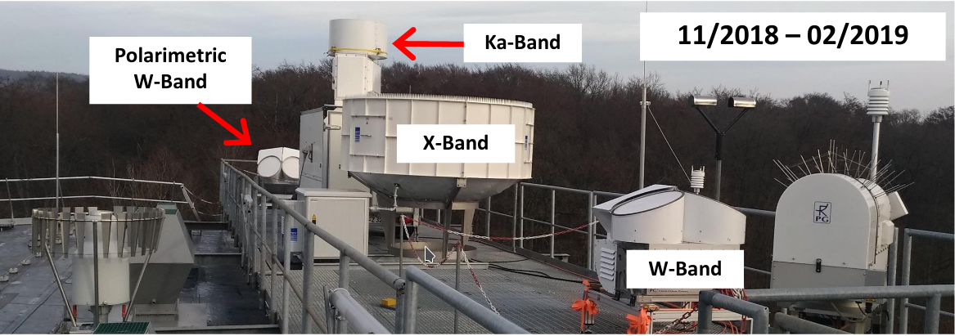
Rich observations
Two campaigns at Jülich ObservatorY for Cloud Evolution Core (JOYCE-CF)
Triple-frequency Doppler and cloud radar + polarimetric radar observations (Dias Neto et al, 2019, ESSD)
Complementary ICON-LES simulations
2nd campaign: ~ 50 radiosondes for atmospheric state
A2
EGU 2022, AS1.14 25.05.2022

Slide 8
Title
Text
3
EGU 2022, AS1.14 25.05.2022

Slide 9
Title
Text
3
EGU 2022, 25.05.2022

