Slide 1
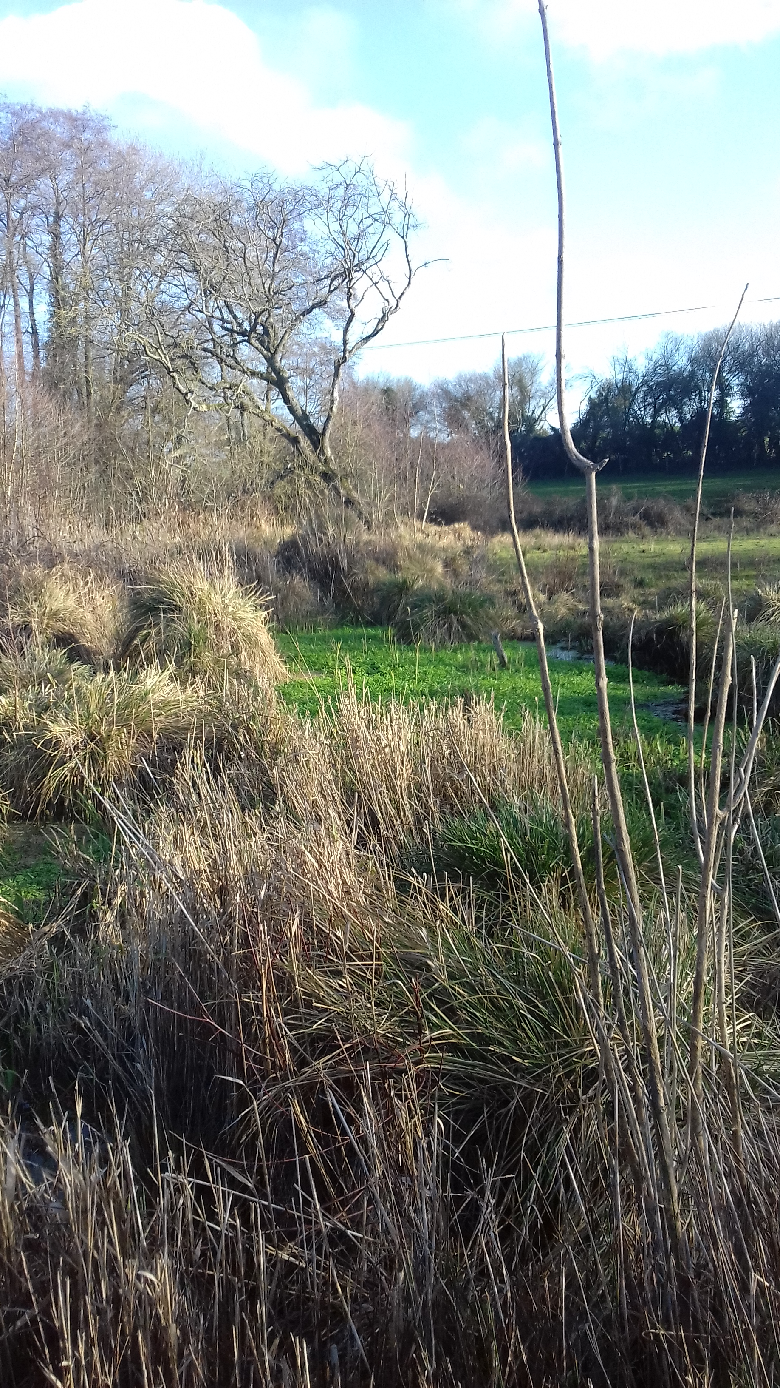




How tree management affects water levels and peat properties in a groundwater fed peatland
EGU 23/5/22
Elaine Halliday
Joanna Clark, Anne Verhoef, Debbie Wilkinson (SEW), David Macdonald (BGS)

Slide 2
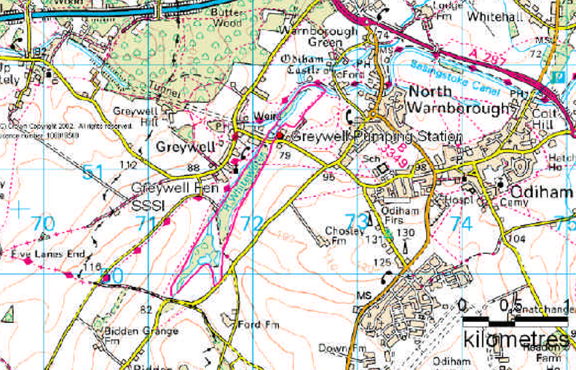
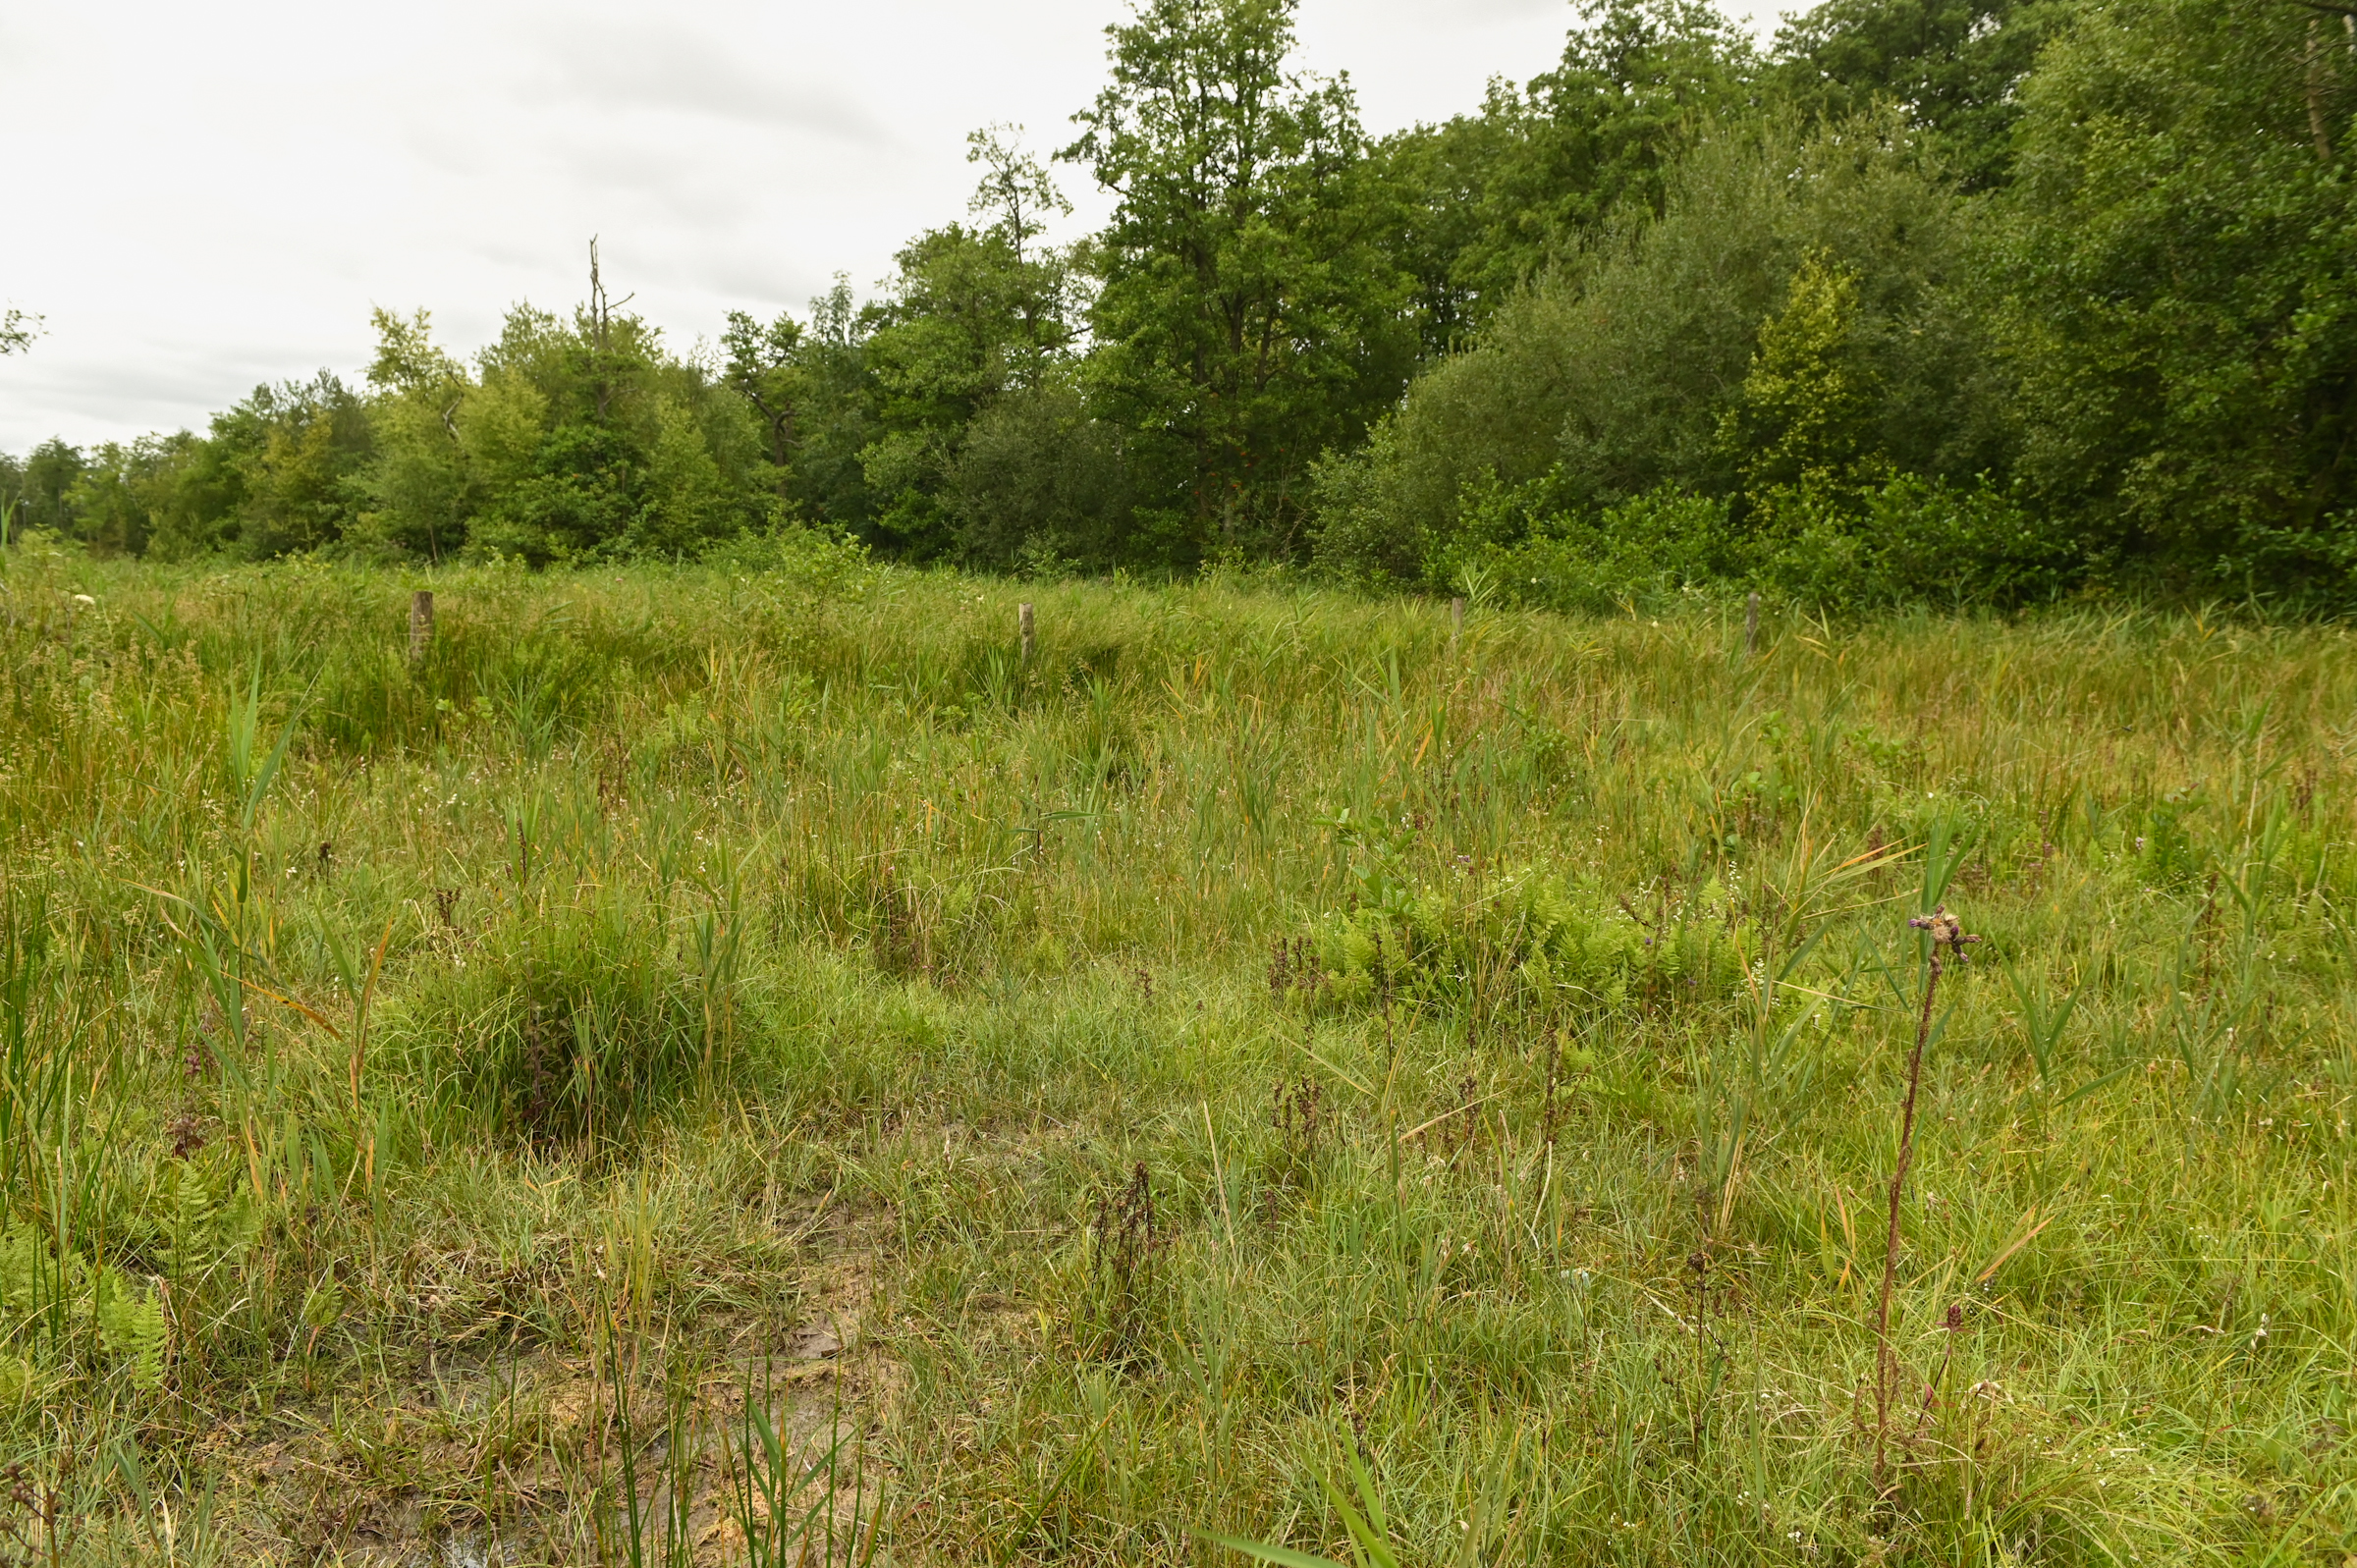
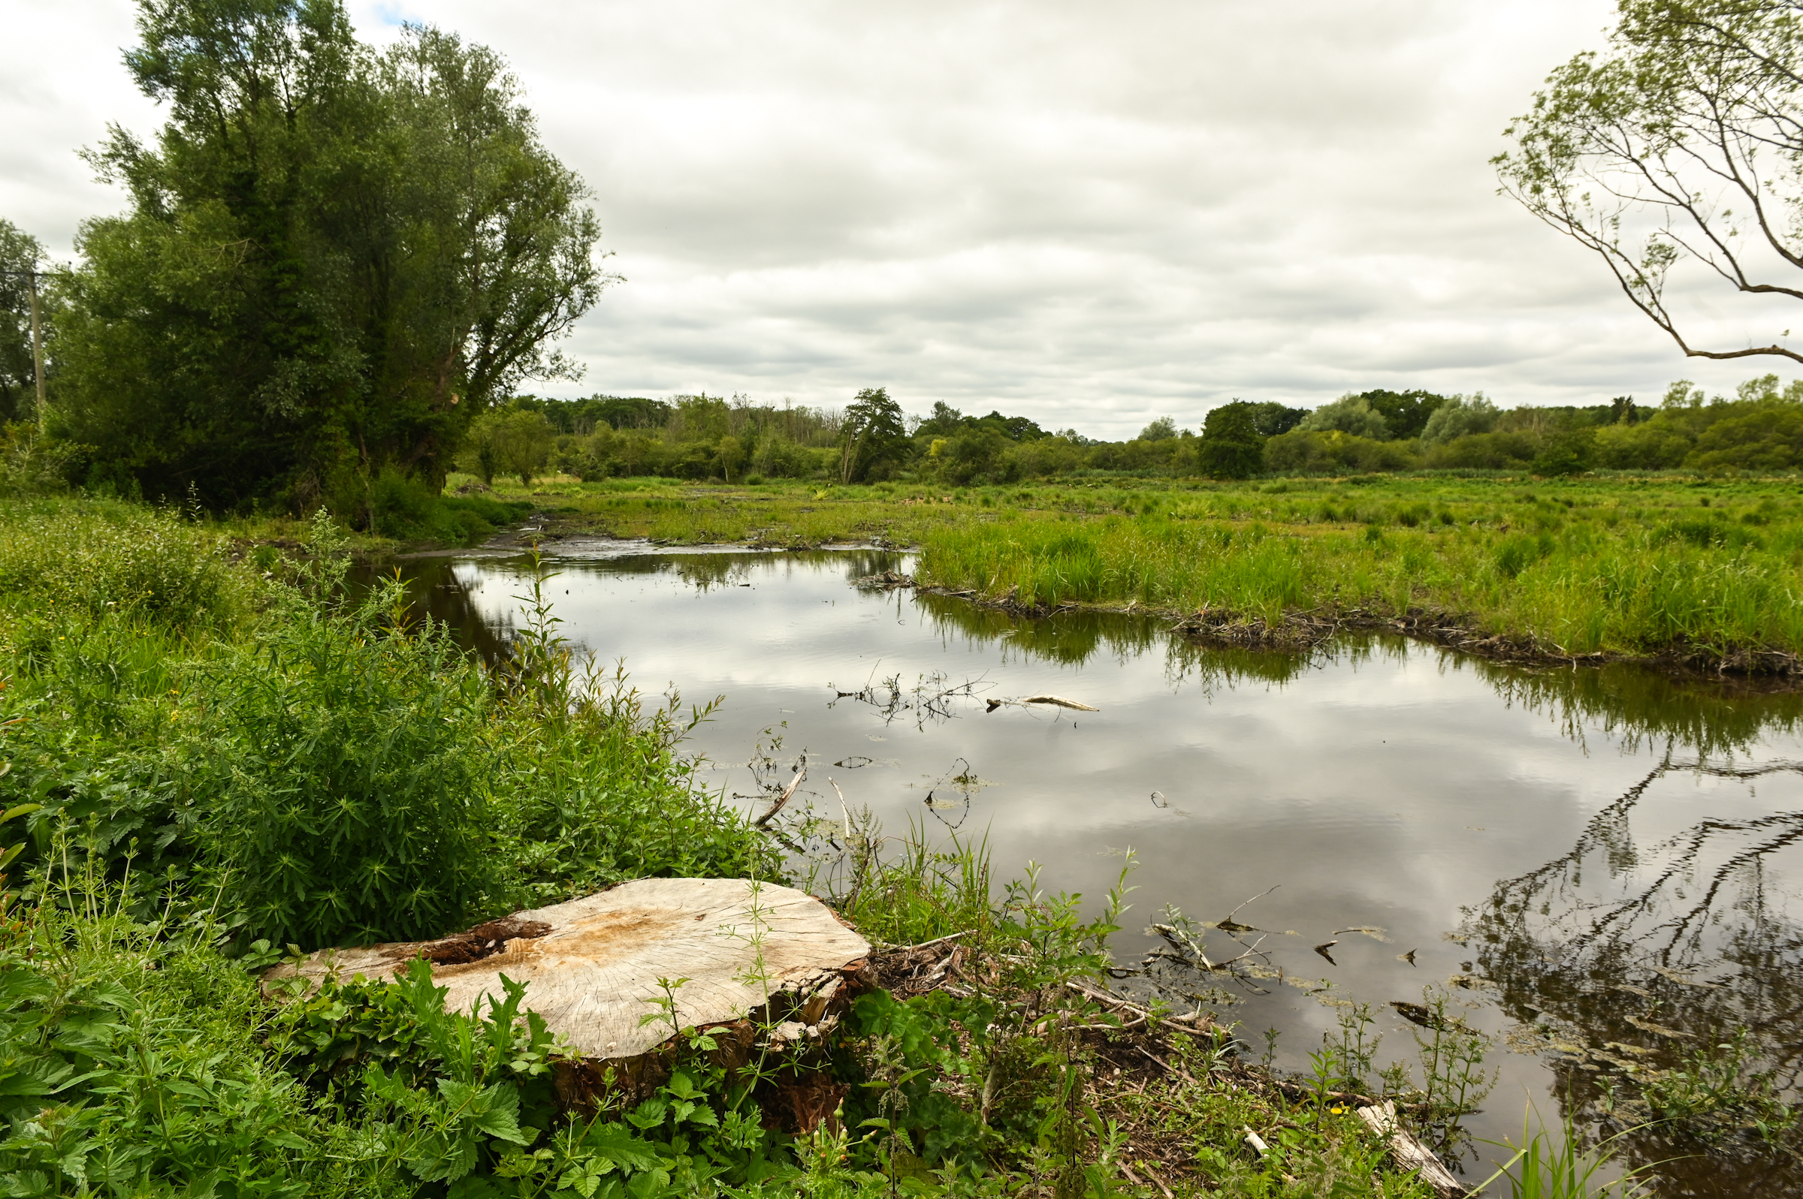
Greywell Fen
North Hampshire, South England
Lowland calcareous peatland
0.3 km², 2 km long
Peat from 30 cm to > 6 m
SSSI
POTENTIAL THREATS
Groundwater abstraction
Afforestation
Nutrient enrichment
MANAGEMENT
Grazing
Tree clearance
Scrub clearance

Slide 3
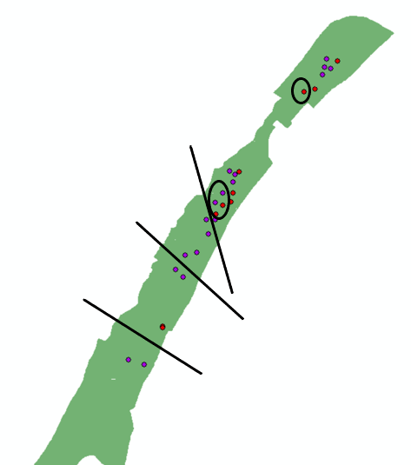
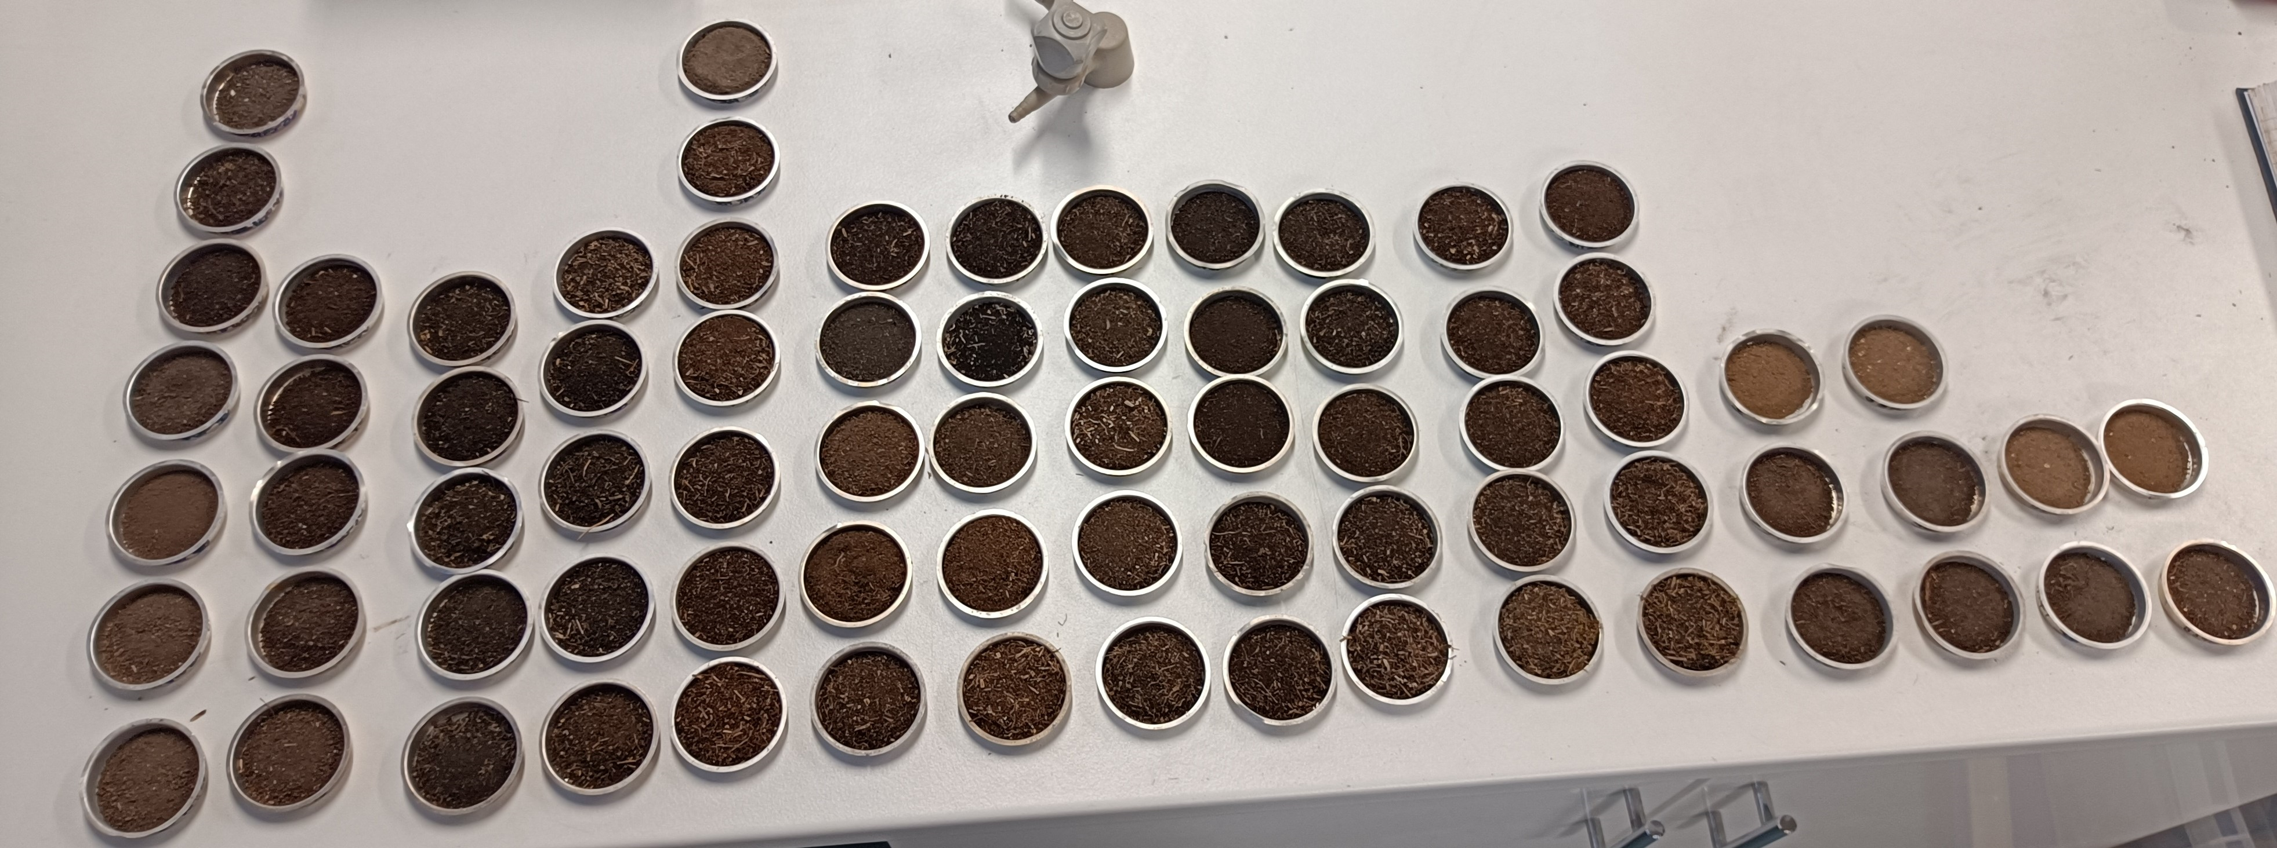
Detailed surveying
Determine if Trees are:
- Affecting water levels
- Changing rainfall/ GW proportions
- Changing soil properties
Recently Cleared
Trees
Historic Trees
Pristine
North
Fen

Slide 4
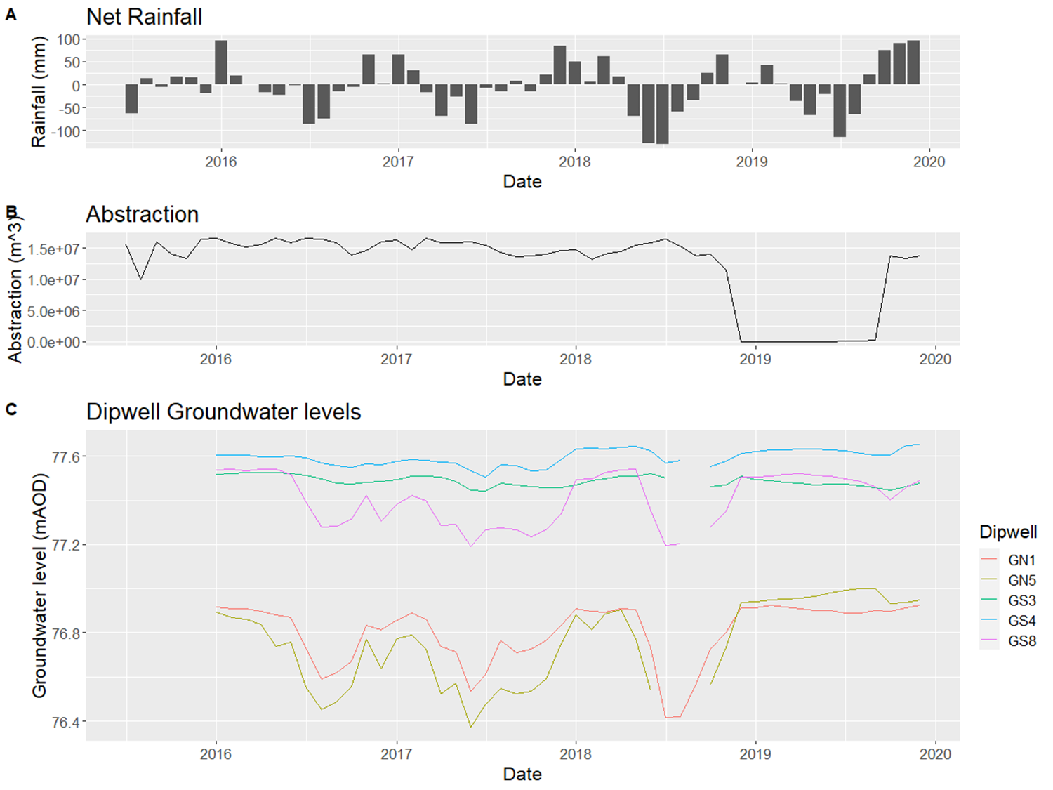
Effects on water levels

Slide 5
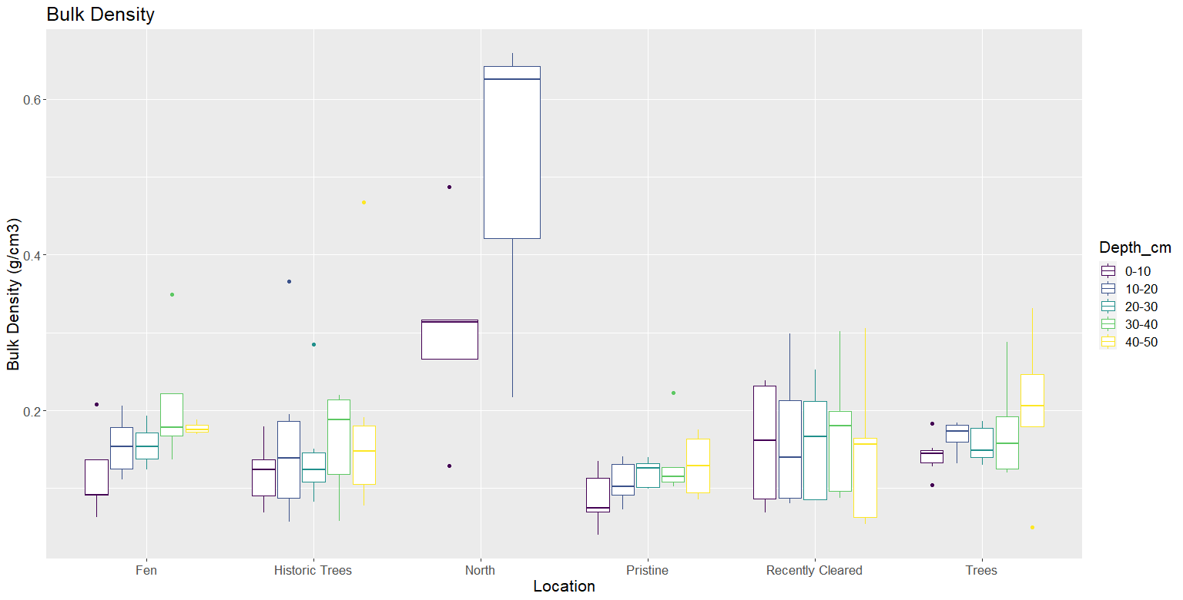
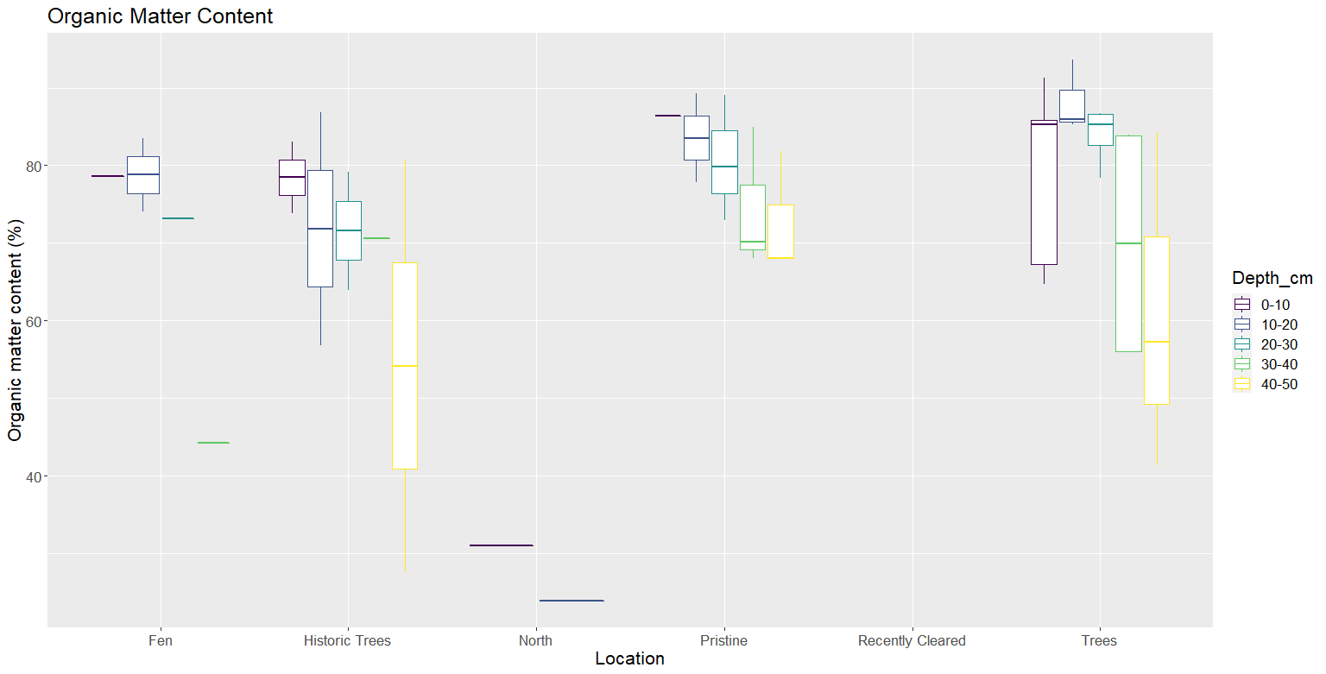
Effects of Trees on peat
Some evidence of increased bulk density
No change in organic matter content

Slide 6
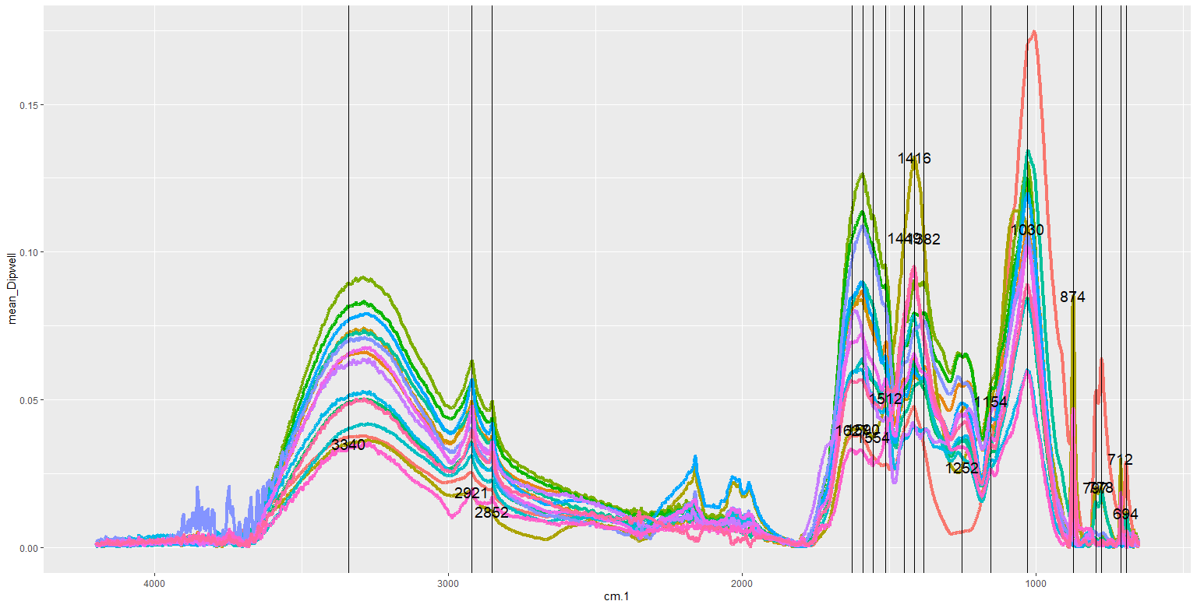
IR spectra
Functional groups present: C=C, C-O, CH, COO⁻, Si-O
Ratio of stable aromatic groups to easily degraded aliphatic groups as an indicator of decomposition

Slide 7
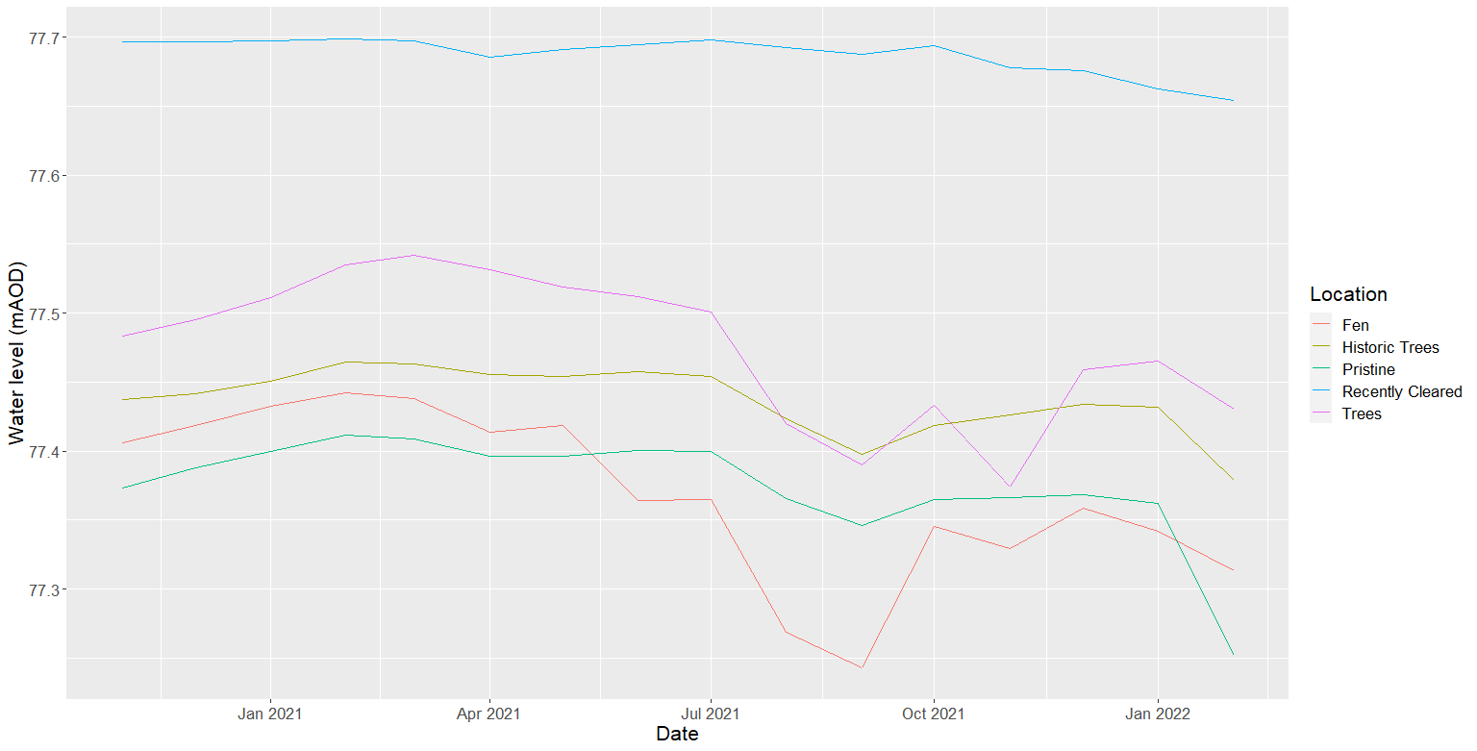
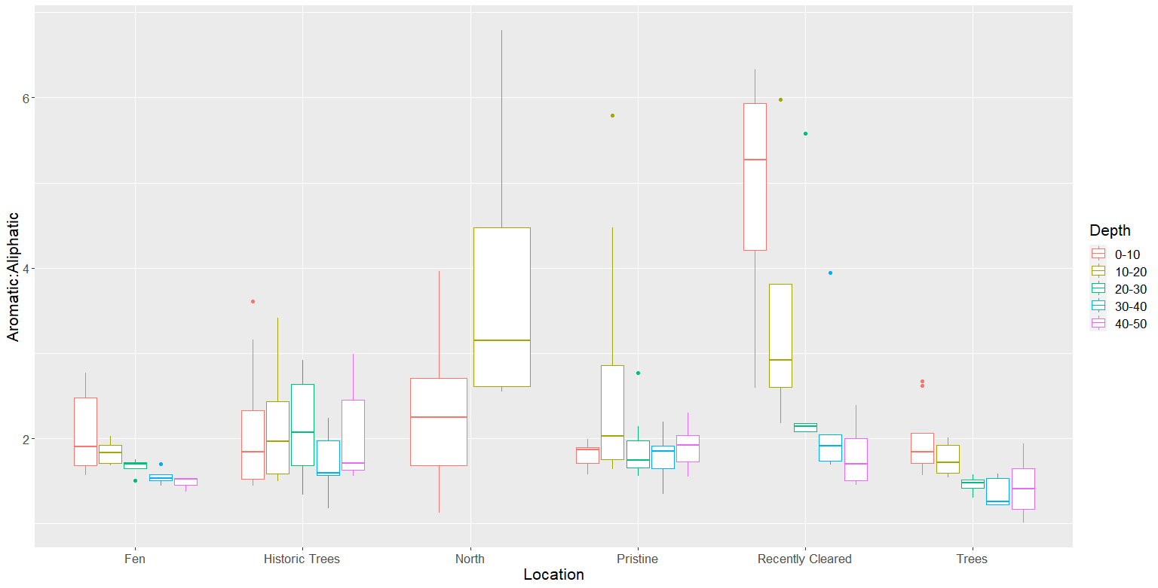
Effects of trees
No impact on absolute water levels
Possible reduction in resilience to changes in water levels
Increased rates of decomposition in upper peat layers

Slide 8
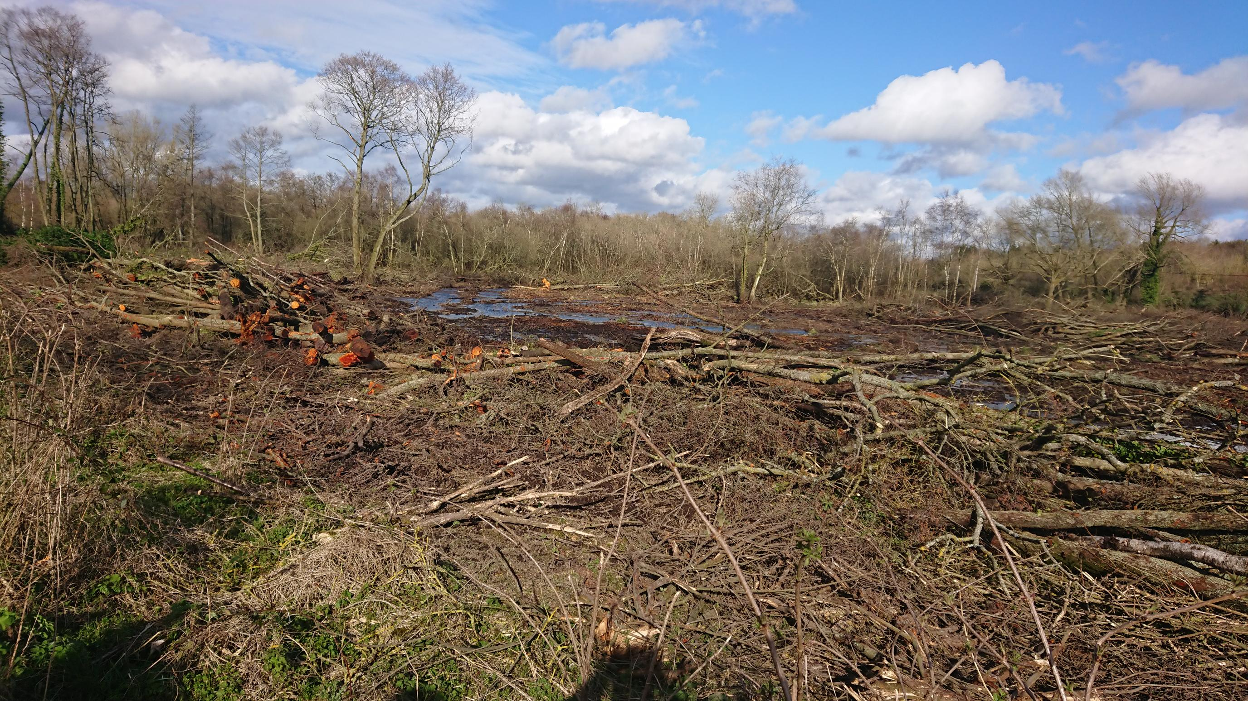
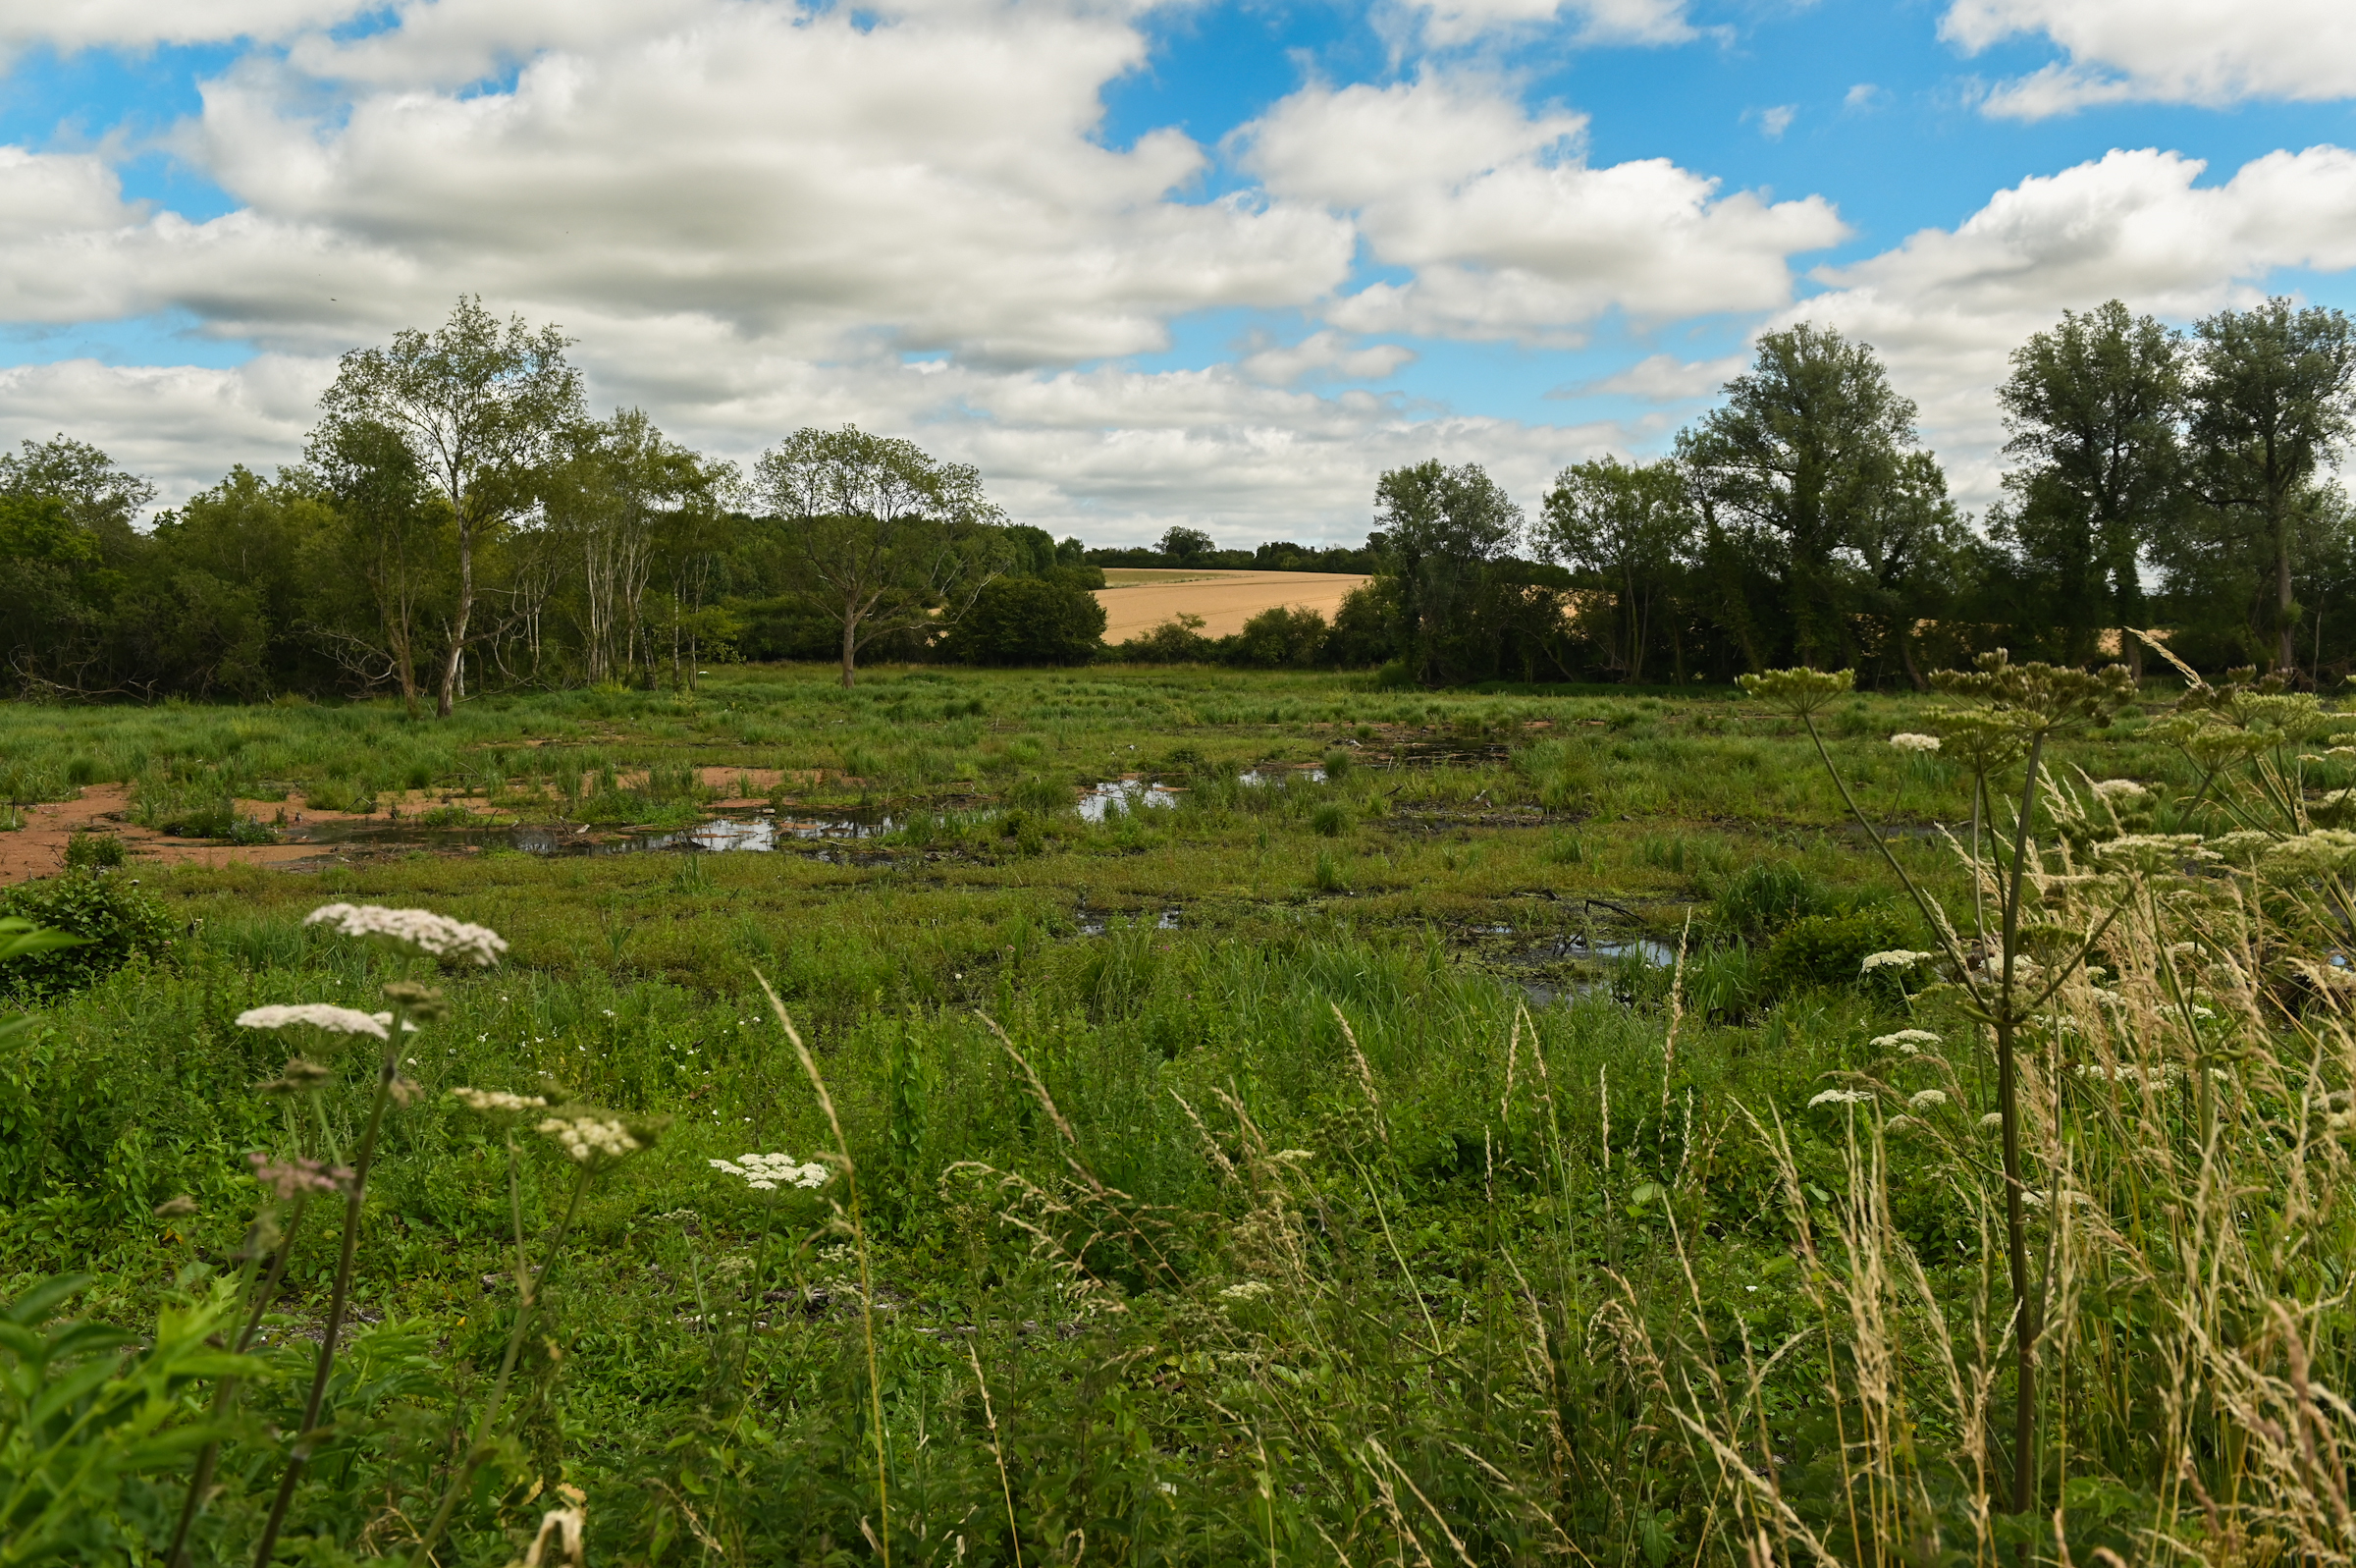
summary
Tree clearance has improved fen vegetation
BUT
Competition, water levels, or peat production?
SEW, 2020

