Slide 1







NMR investigation of boundary condition effects on spontaneous imbibition in shale
EGU22-5185
Yong Liu^{1,2}, Yanbin Yao¹, Chi Zhang²
¹China University of Geosciences, Beijing
²University of Vienna
EGU General Assembly 2022, Vienna
26 May, 2022
1
Notes:
Thanks for EGU2022，I have the chance to give an oral presentation to present my research work in this session. I am Yong Liu，and the title of my report is ‘NMR investigation of boundary condition effects on spontaneous imbibition in shale’. This study is completed by my and my co-authors.

Slide 2

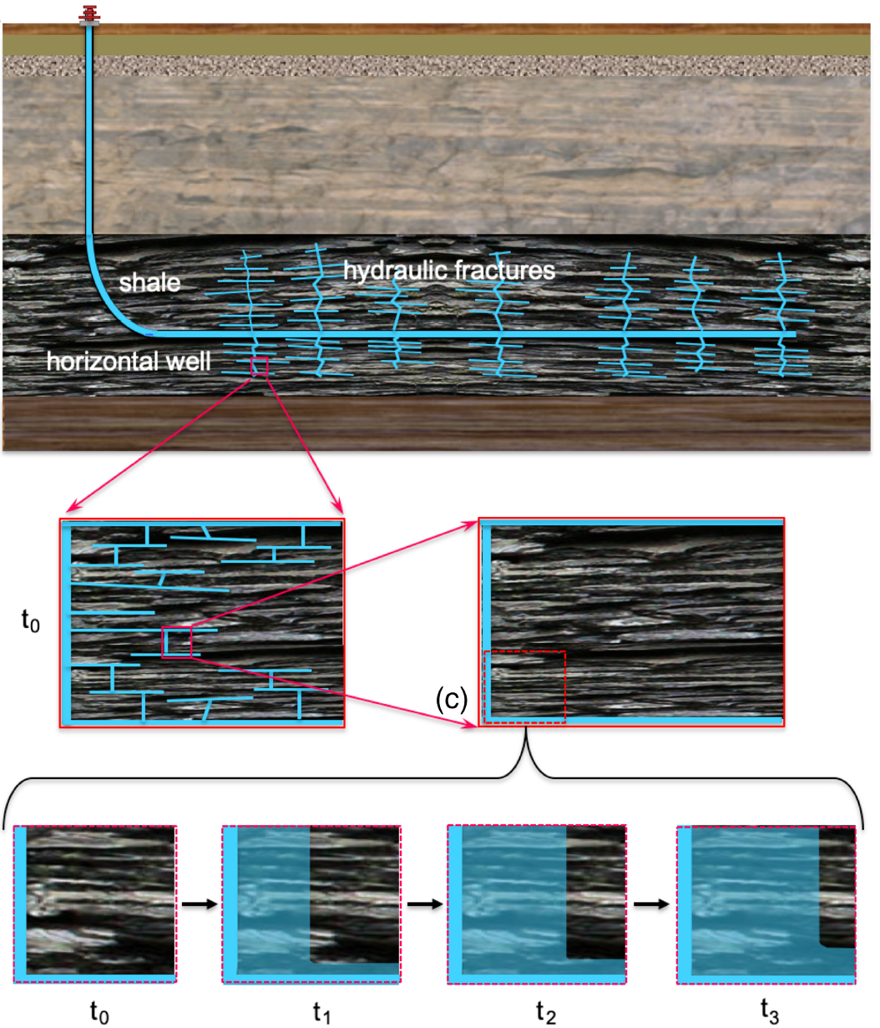
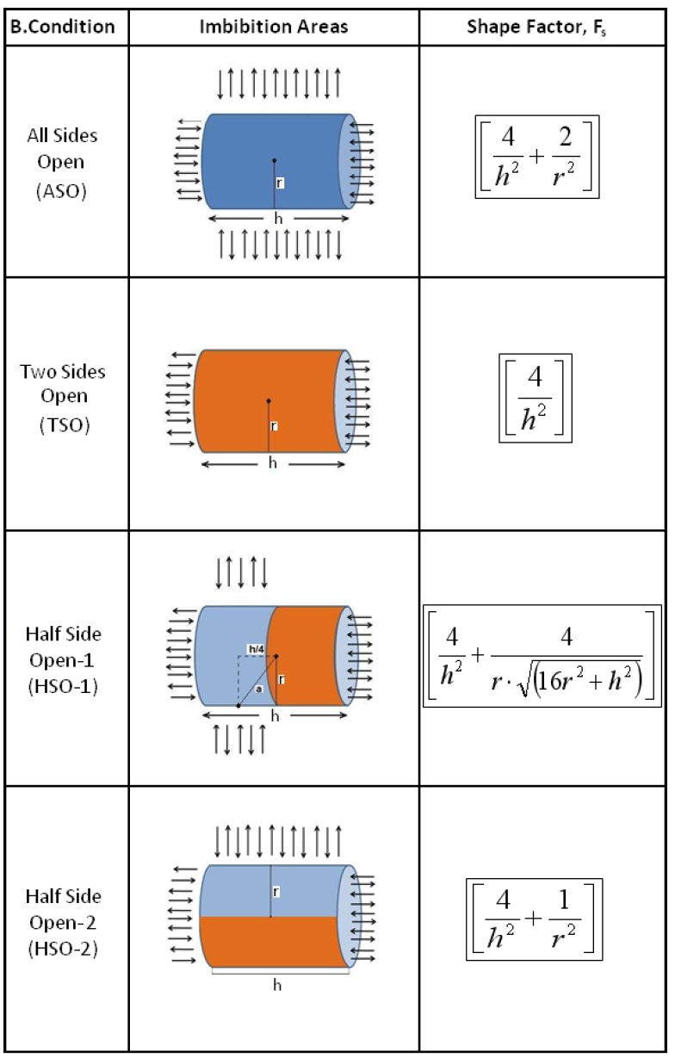
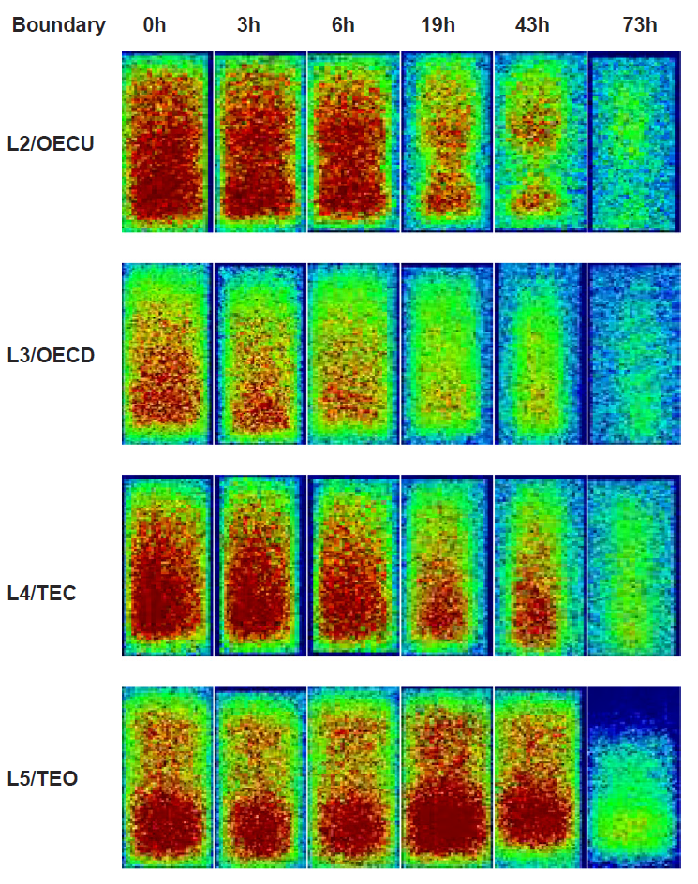

Background: boundary effects on spontaneous imbibition
Scientifi problems: How do boundary conditions influence shale imbibition dynamics?
Conceptual model of water imbibition from fractures
into shale matrix（Tokunaga, 2020）
Cores Boundary Conditions and imbibition
Shape Factors （Ghedan et al., 2009）
2D-NMR images during water-oil imbibition
under four boundaries （Lyu et al., 2019）
Notes:
Hydro-fracturing is extremely important for production of shale gas, during which lots of fluids were pumped into the reservoir.
The fluids imbibition, especially in the shut-in period, has important influence on gas production.
In the underground in-situ reservoir, the boundary condition is complex. In current researches， boundary effects are mainly focused on oil-water imbibitions. XXXX The right graph shows the 2D-NMR images during water-oil imbibition under four boundaries.
However，Boundary conditions on gas-water imbibitions are not well considered. Our goal is to investigate How boundary conditions influence shale imbibition dynamics?

Slide 3
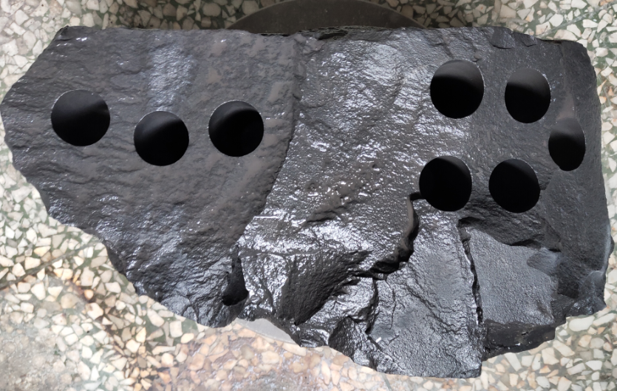
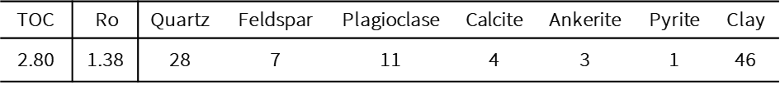
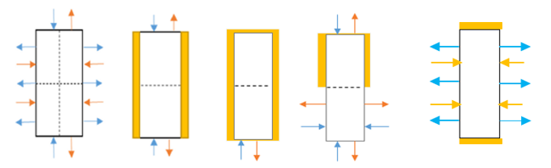
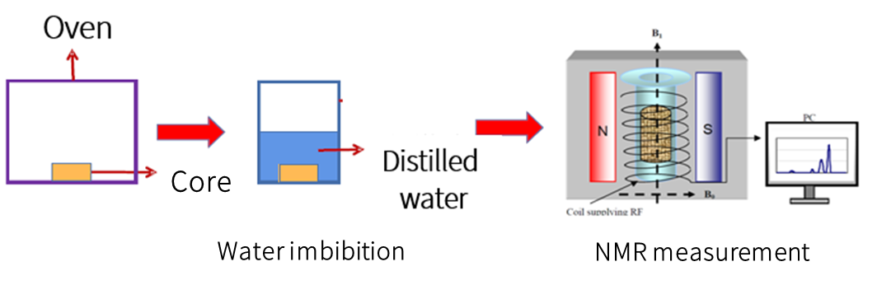
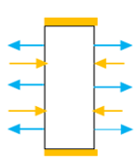
Experiment: Five boundaries of spontaneous imbibition
Five sets of experiments were conducted to investigate the imbibition dynamics.
Mineral compositions of Longmaxi parallel samples
NMR parameters of imbibition experiments
Item | frequency | echo spacing | waiting time | scan number | Echo number
Value | 12.76 MHz | 0.12 ms | 1500ms | 64 | 12000
Longmaxi shale outcrop
ASO TSO OSO HSO TEC
Por. 4.28% 4.34% 4.32% 4.43% 4.37%
Perm. 658nd 672nd 679nd 662nd 675nd
Note that: all-side-open (ASO), two-side-open (TSO), one-side-open (OSO) ,
half-side-open (HSO), two-end-close (TEC) .
Notes:
In this study, we conduct five sets of imbibition experiments with NMR technology to investigate imbibition dynamics of five models including ASO, TSO, OSO, HSO and TEC. Longmaxi parallel shales are handled with nonmagnetic polytetrafluoroethylene （PTFE）to get the corresponding boundaries. NMR parameters of imbibition experiments are listed in the table.

Slide 4
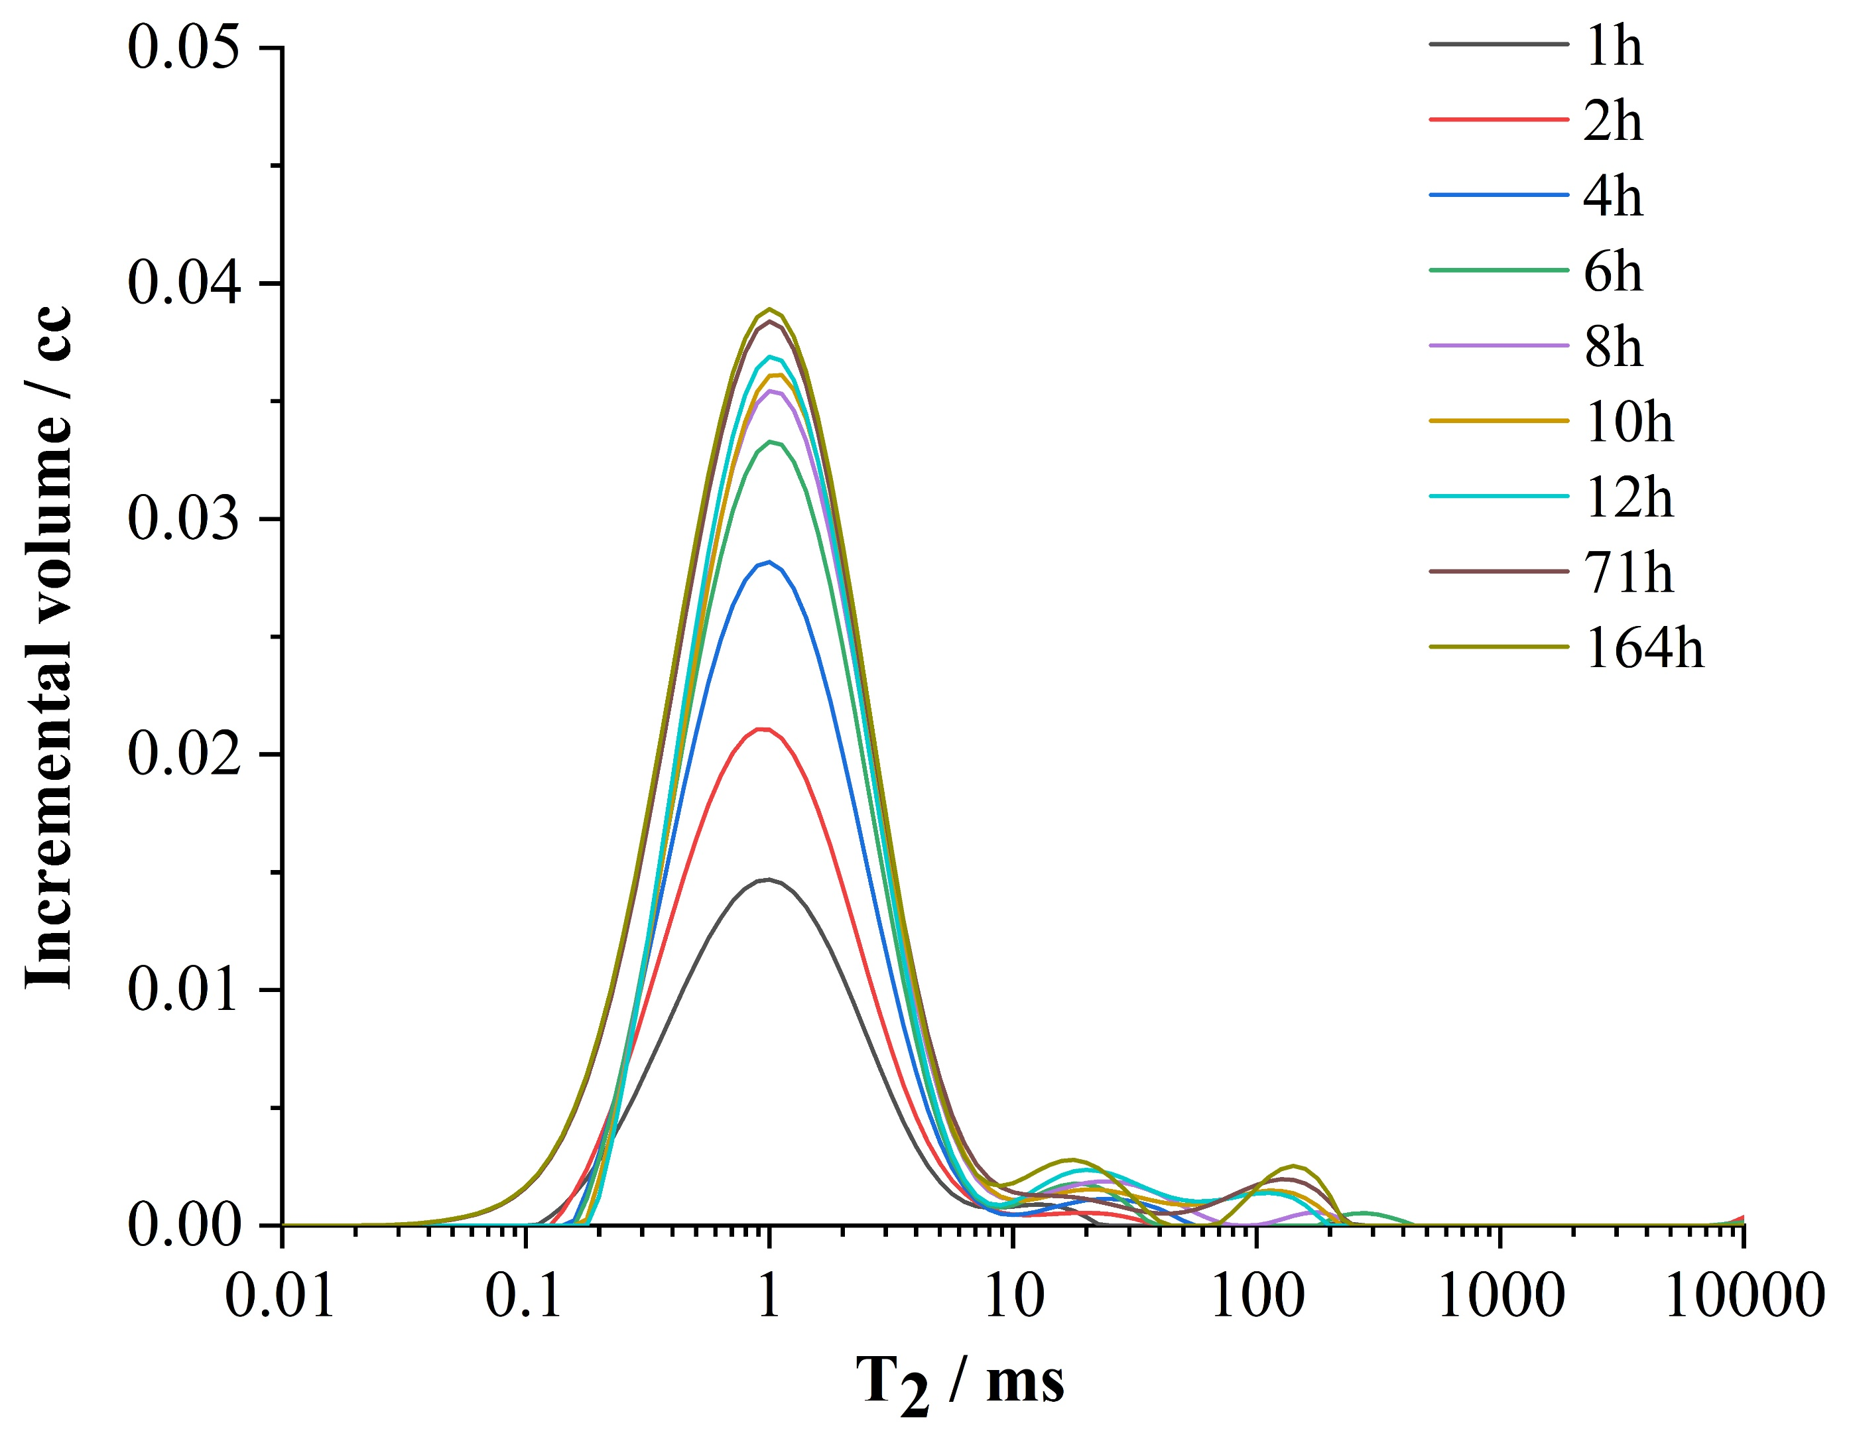
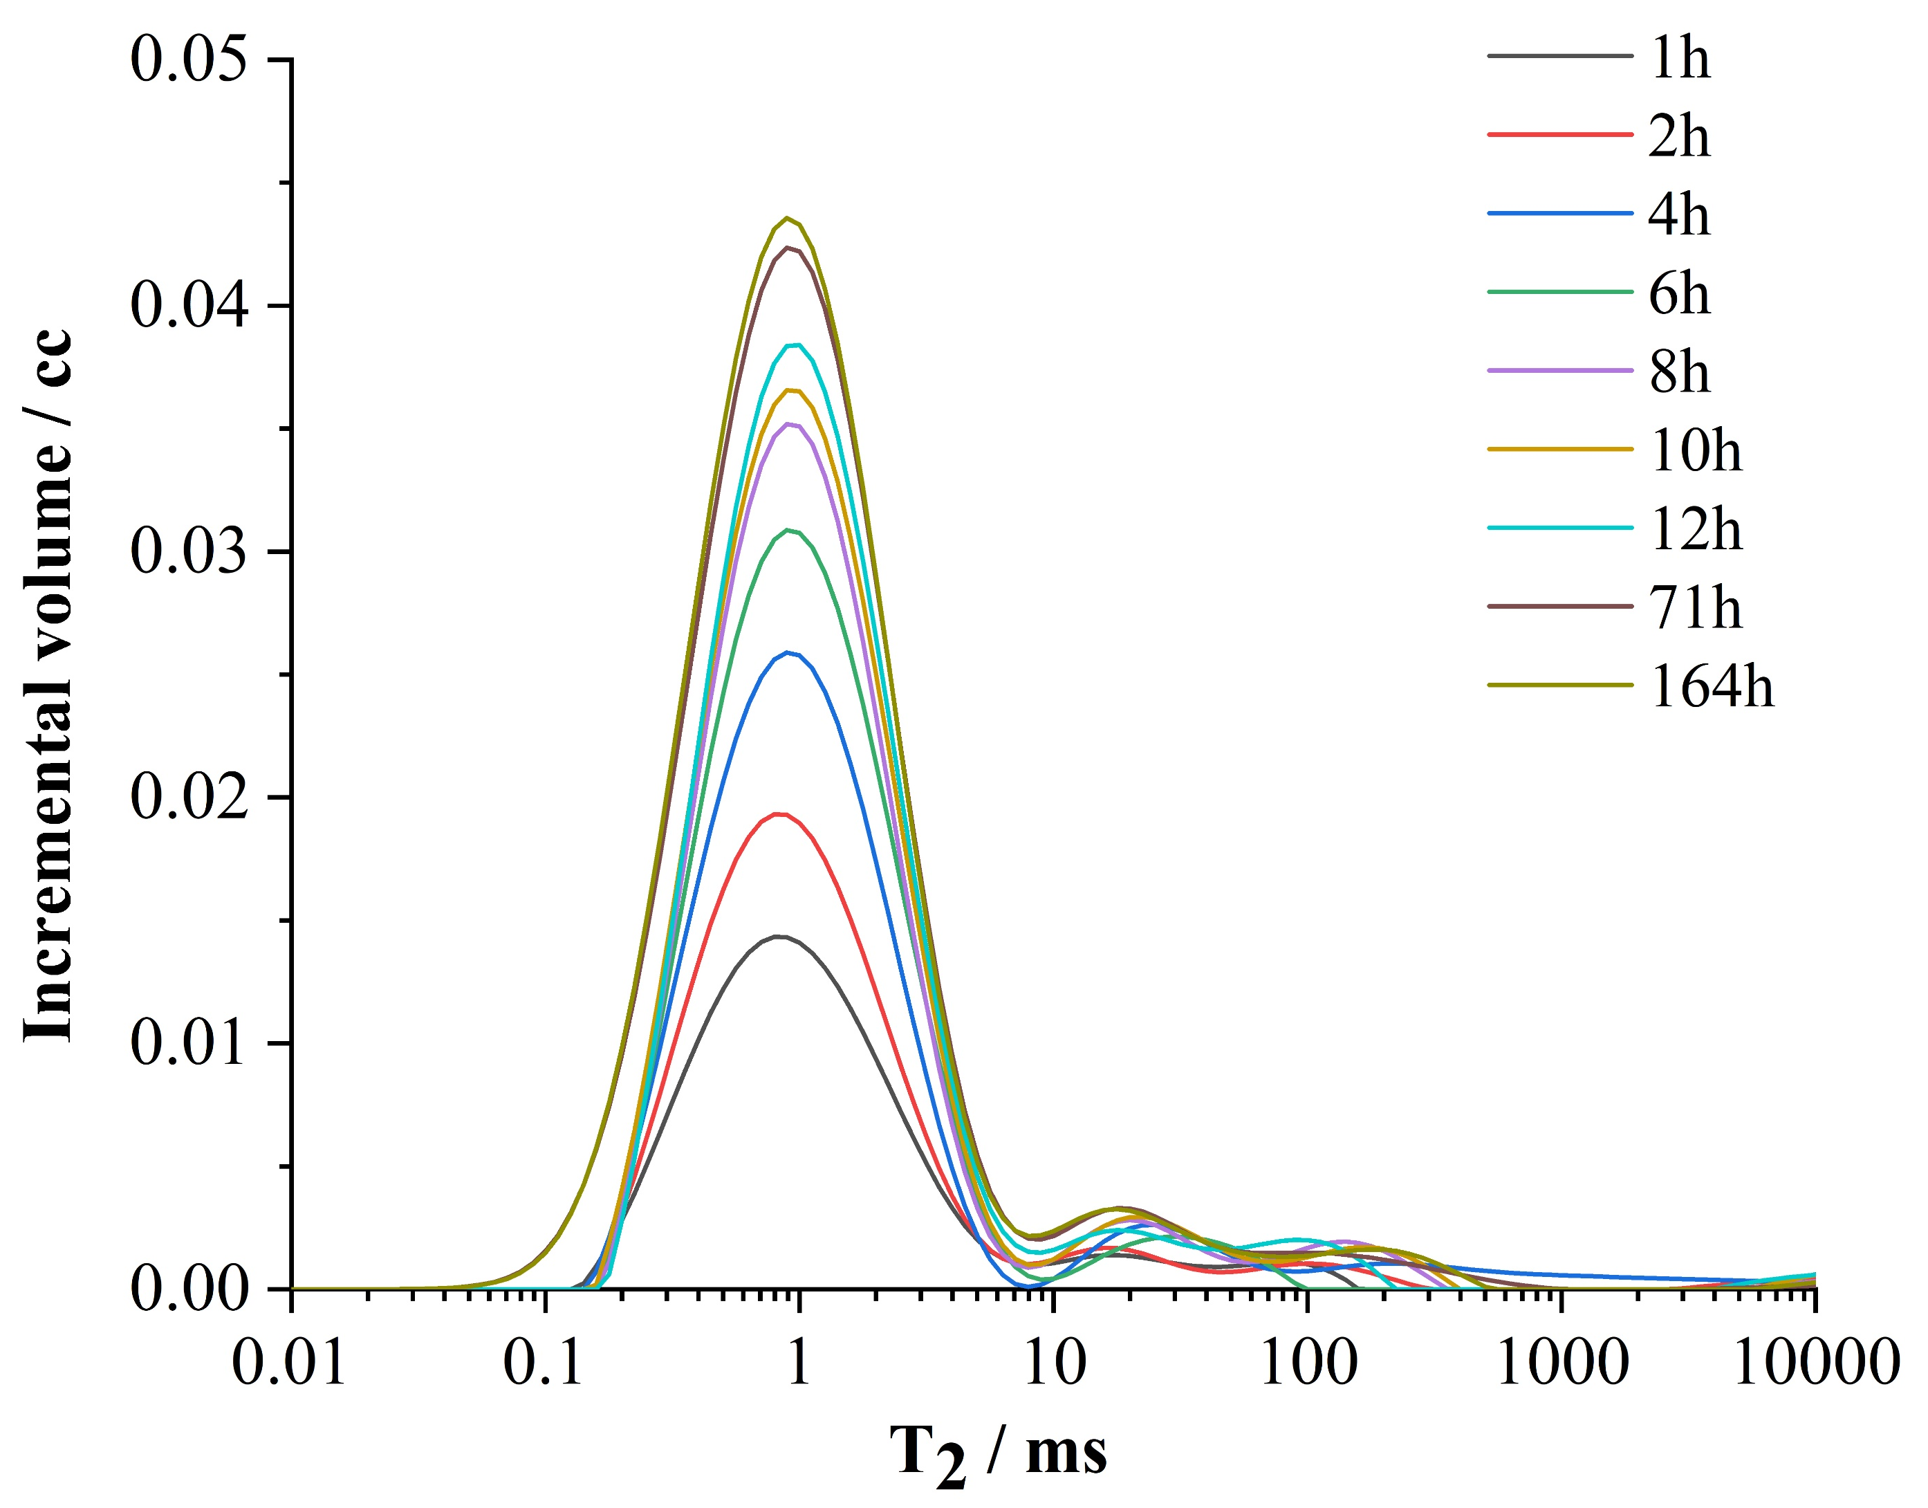
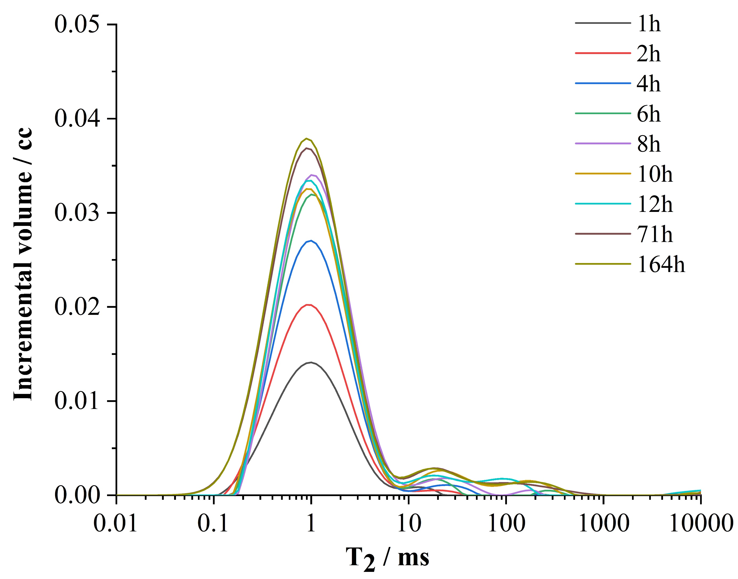
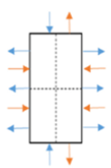
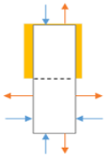
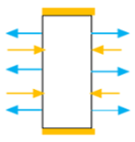
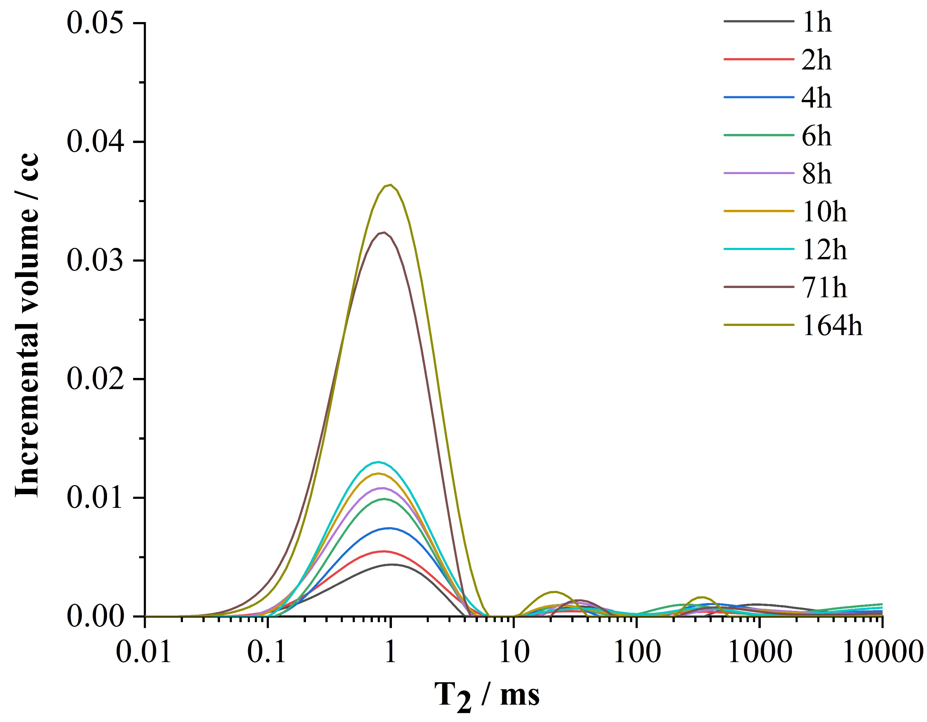
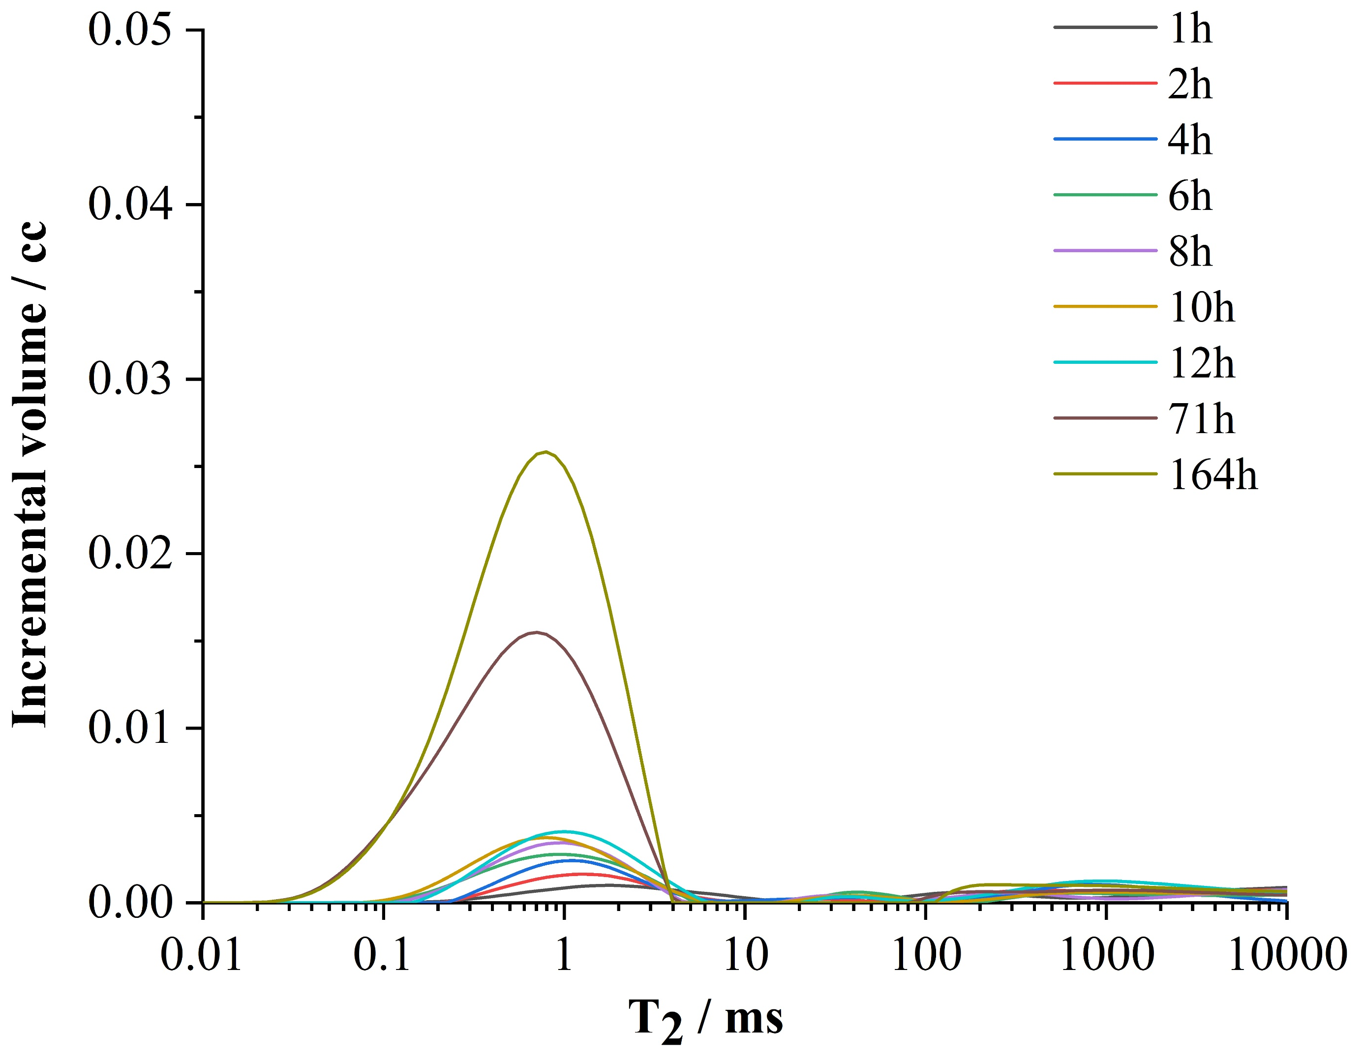


Results: NMR T₂ distributions
Categories
Ⅰ
ASO
HSO
TEC
Categories
Ⅱ
TSO
OSO
T₂ curves of five boundaries
show different imbibition
dynamics.
Notes:
According to changes of T2 curves， five imbibition cases can be divided into two categories：Ⅰ (ASO, HSO,TEC ) ,which illustrates faster imbibition rates, and and Ⅱ (TSO,OSO )， which illustrates slower imbibition.

Slide 5
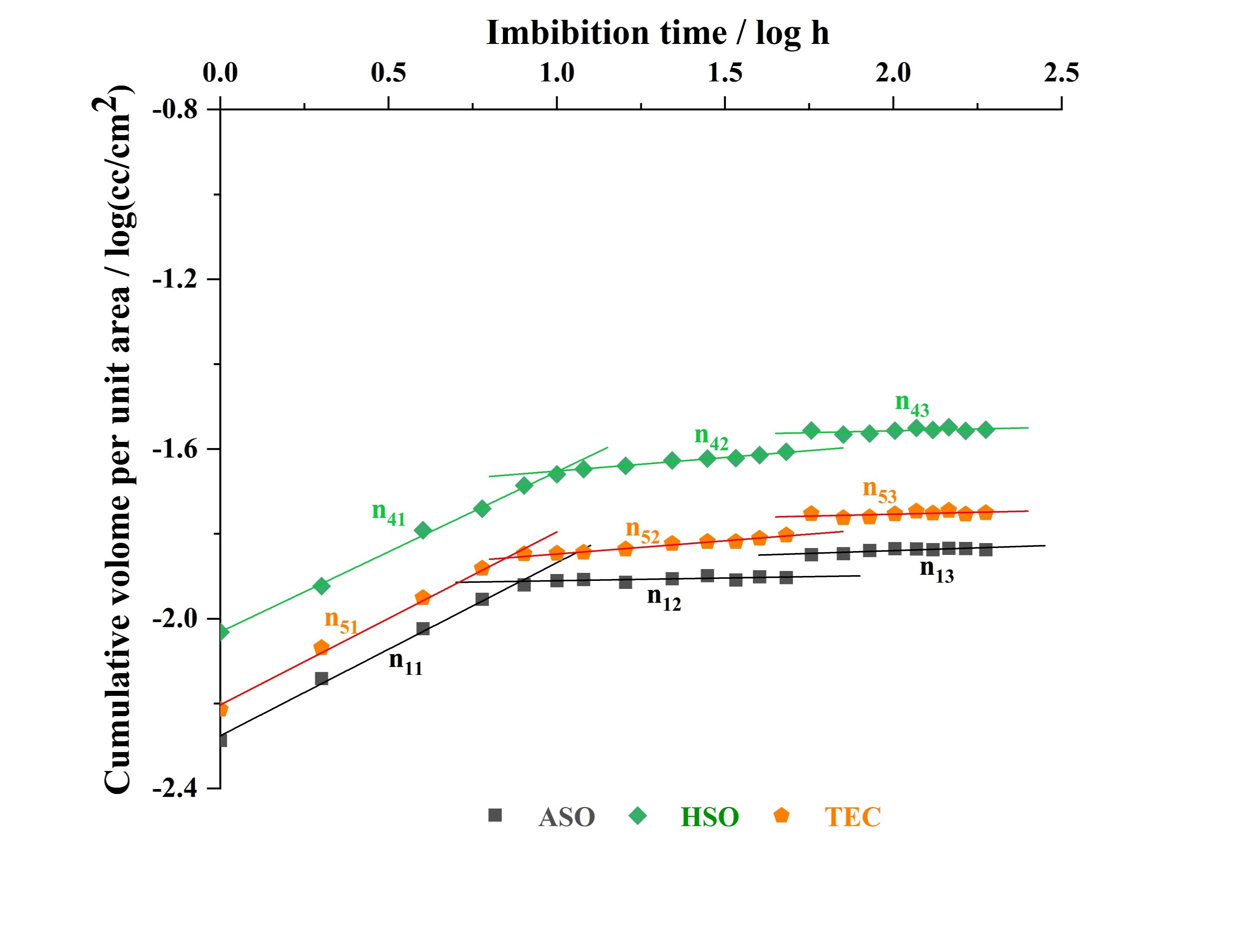
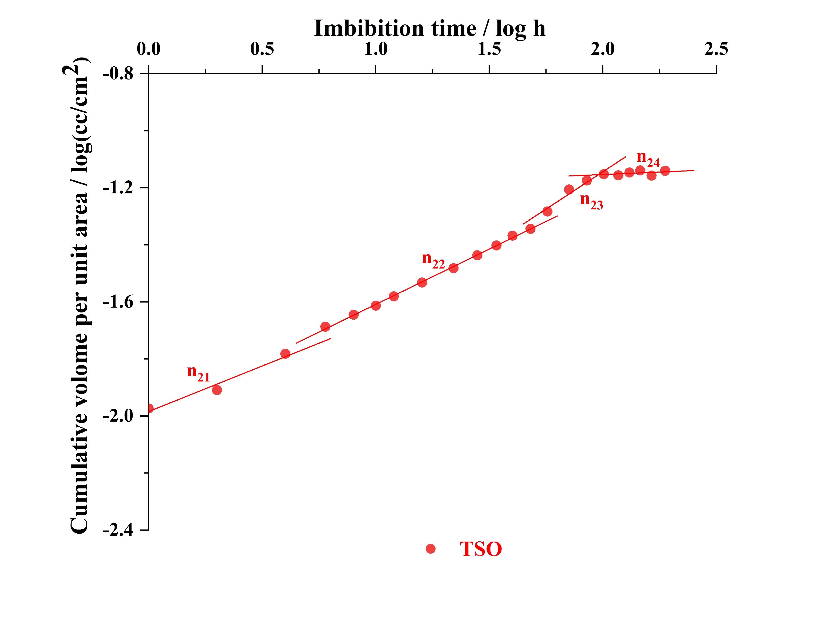
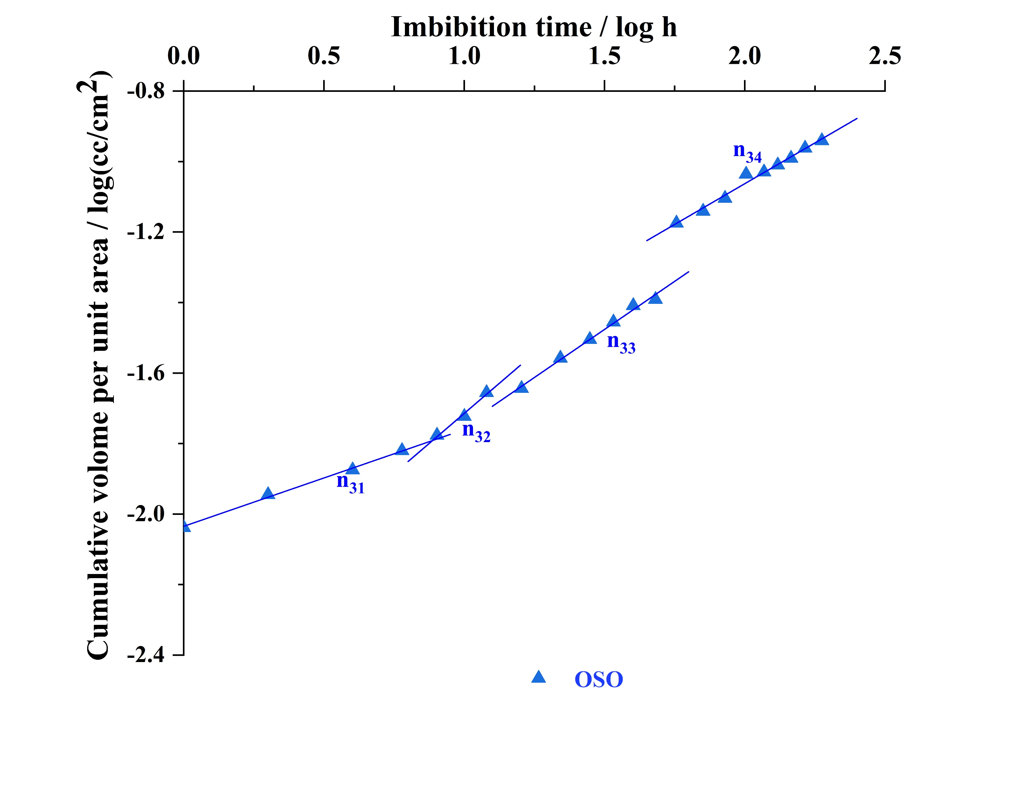


Results: double logarithmic imbibition curves
Imbibition dynamic analysis——piecewise linear fitting.
Zolfaghari imbibition model
—
—
t
Imbibition time, h,
$$V_{imb}$$
Imbibition water volume, cm³,
—
—
$$A_{c}$$
Imbibition area, cm², A
$$\frac{V_{imb}}{A_{c}}=A t^{n}$$
$$\lg{\frac{V_{imb}}{A_{c}}}=lgA+nlgt$$
Imbibition rate, cm/h^{n},
n
—
Imbibition or diffusion index,
Notes:
Traditional imbibition models such as Lucas-Washburn model and Handy model are not suitable for imbibition dynamic analysis of unconventional tight rocks.
In our study, we use the double logarithmic imbibition curves combined with the piecewise linear fitting method to compare the five imbibition dynamics.
It should be noted that different imbibition stages and diffusion stages are divided in each imbibition curve.
Meanwhile, the fit slope n is the imbibition index or diffusion index, which is an importance parameter for imbibition dynamic analysis.
Based on the comparisons of imbibition/ diffusion indexes corresponding to five imbibition curves, we can know that ASO、HSO and TEC have similar imbibition dynamics，and these imbibition curves can be divided into one imbibition stages and two diffusion stages：imbibition stage (ni1), diffusion stage 2 (ni2), and diffusion stage 3 (ni3).
While for TSO, it can be divided into：imbibition stage 1 (ni1), imbibition stage 2 (ni2), imbibition stage 3 (ni3), and diffusion stage 4 (ni4).
For OSO, it can be divided：imbibition stage 1 (ni1), imbibition stage 2 (ni2), imbibition stage 3 (ni3), and imbibition stage 4 (ni4).

Slide 6
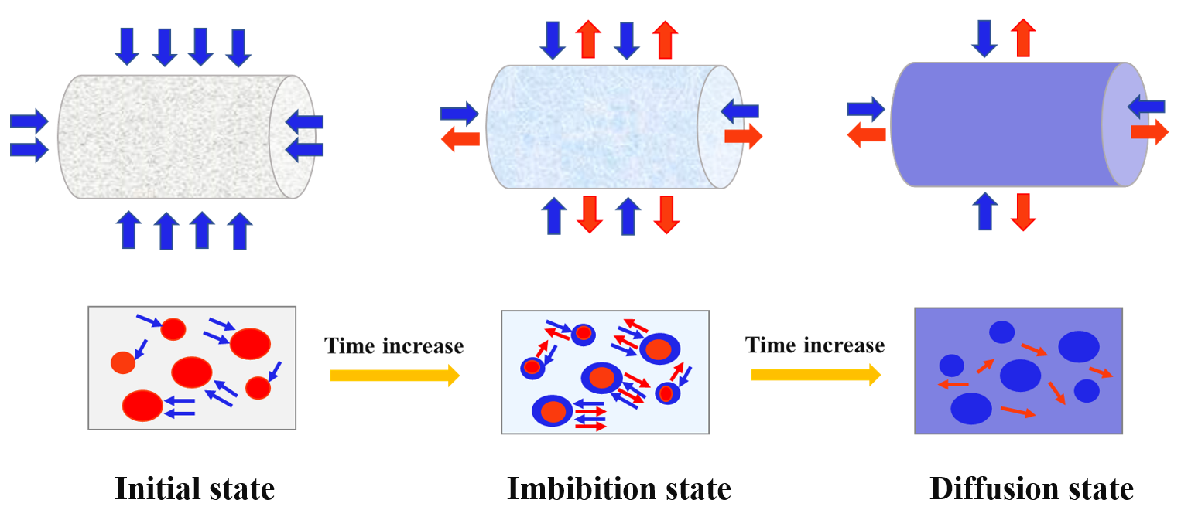
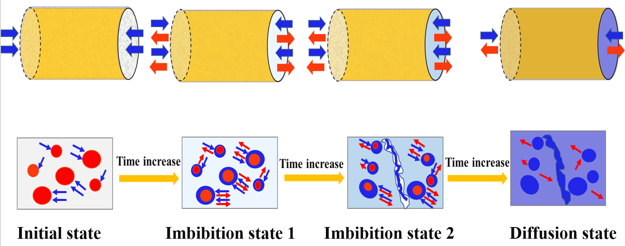
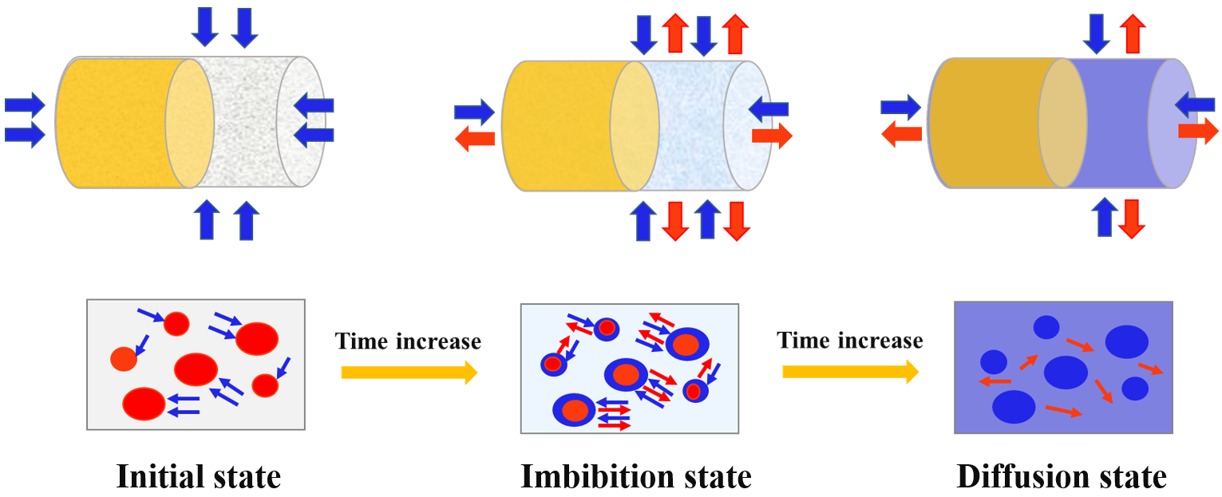
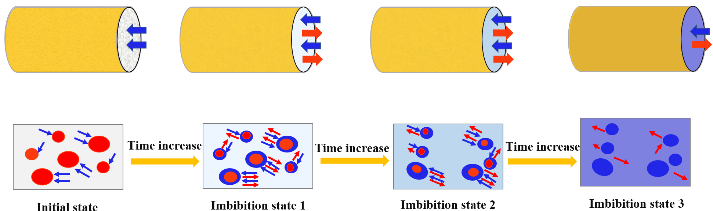
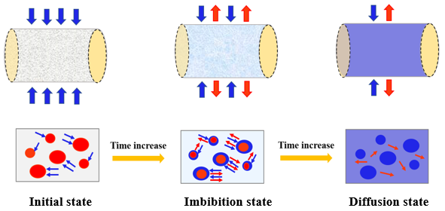
Results: imbibition patterns of five boundaries
Conclusions
The shale imbibition dynamics of five boundary conditions has been investigated and compared using NMR technology;
Our study provides implications for optimizing fracturing design and determining shut-in time in shale gas production.
liuyongcugb@gmail.com
ASO
TSO
HSO
OSO
TEC
Notes:
Finally, schematic diagrams of imbibition patterns for five imbibition cases are established to illustrate the imbibition processes. These five imbibitions can also be divided into two categories as T2 curves.
On one hand，XXXX On the other handXXXX

Slide 7


Thanks for listening!

