Slide 1

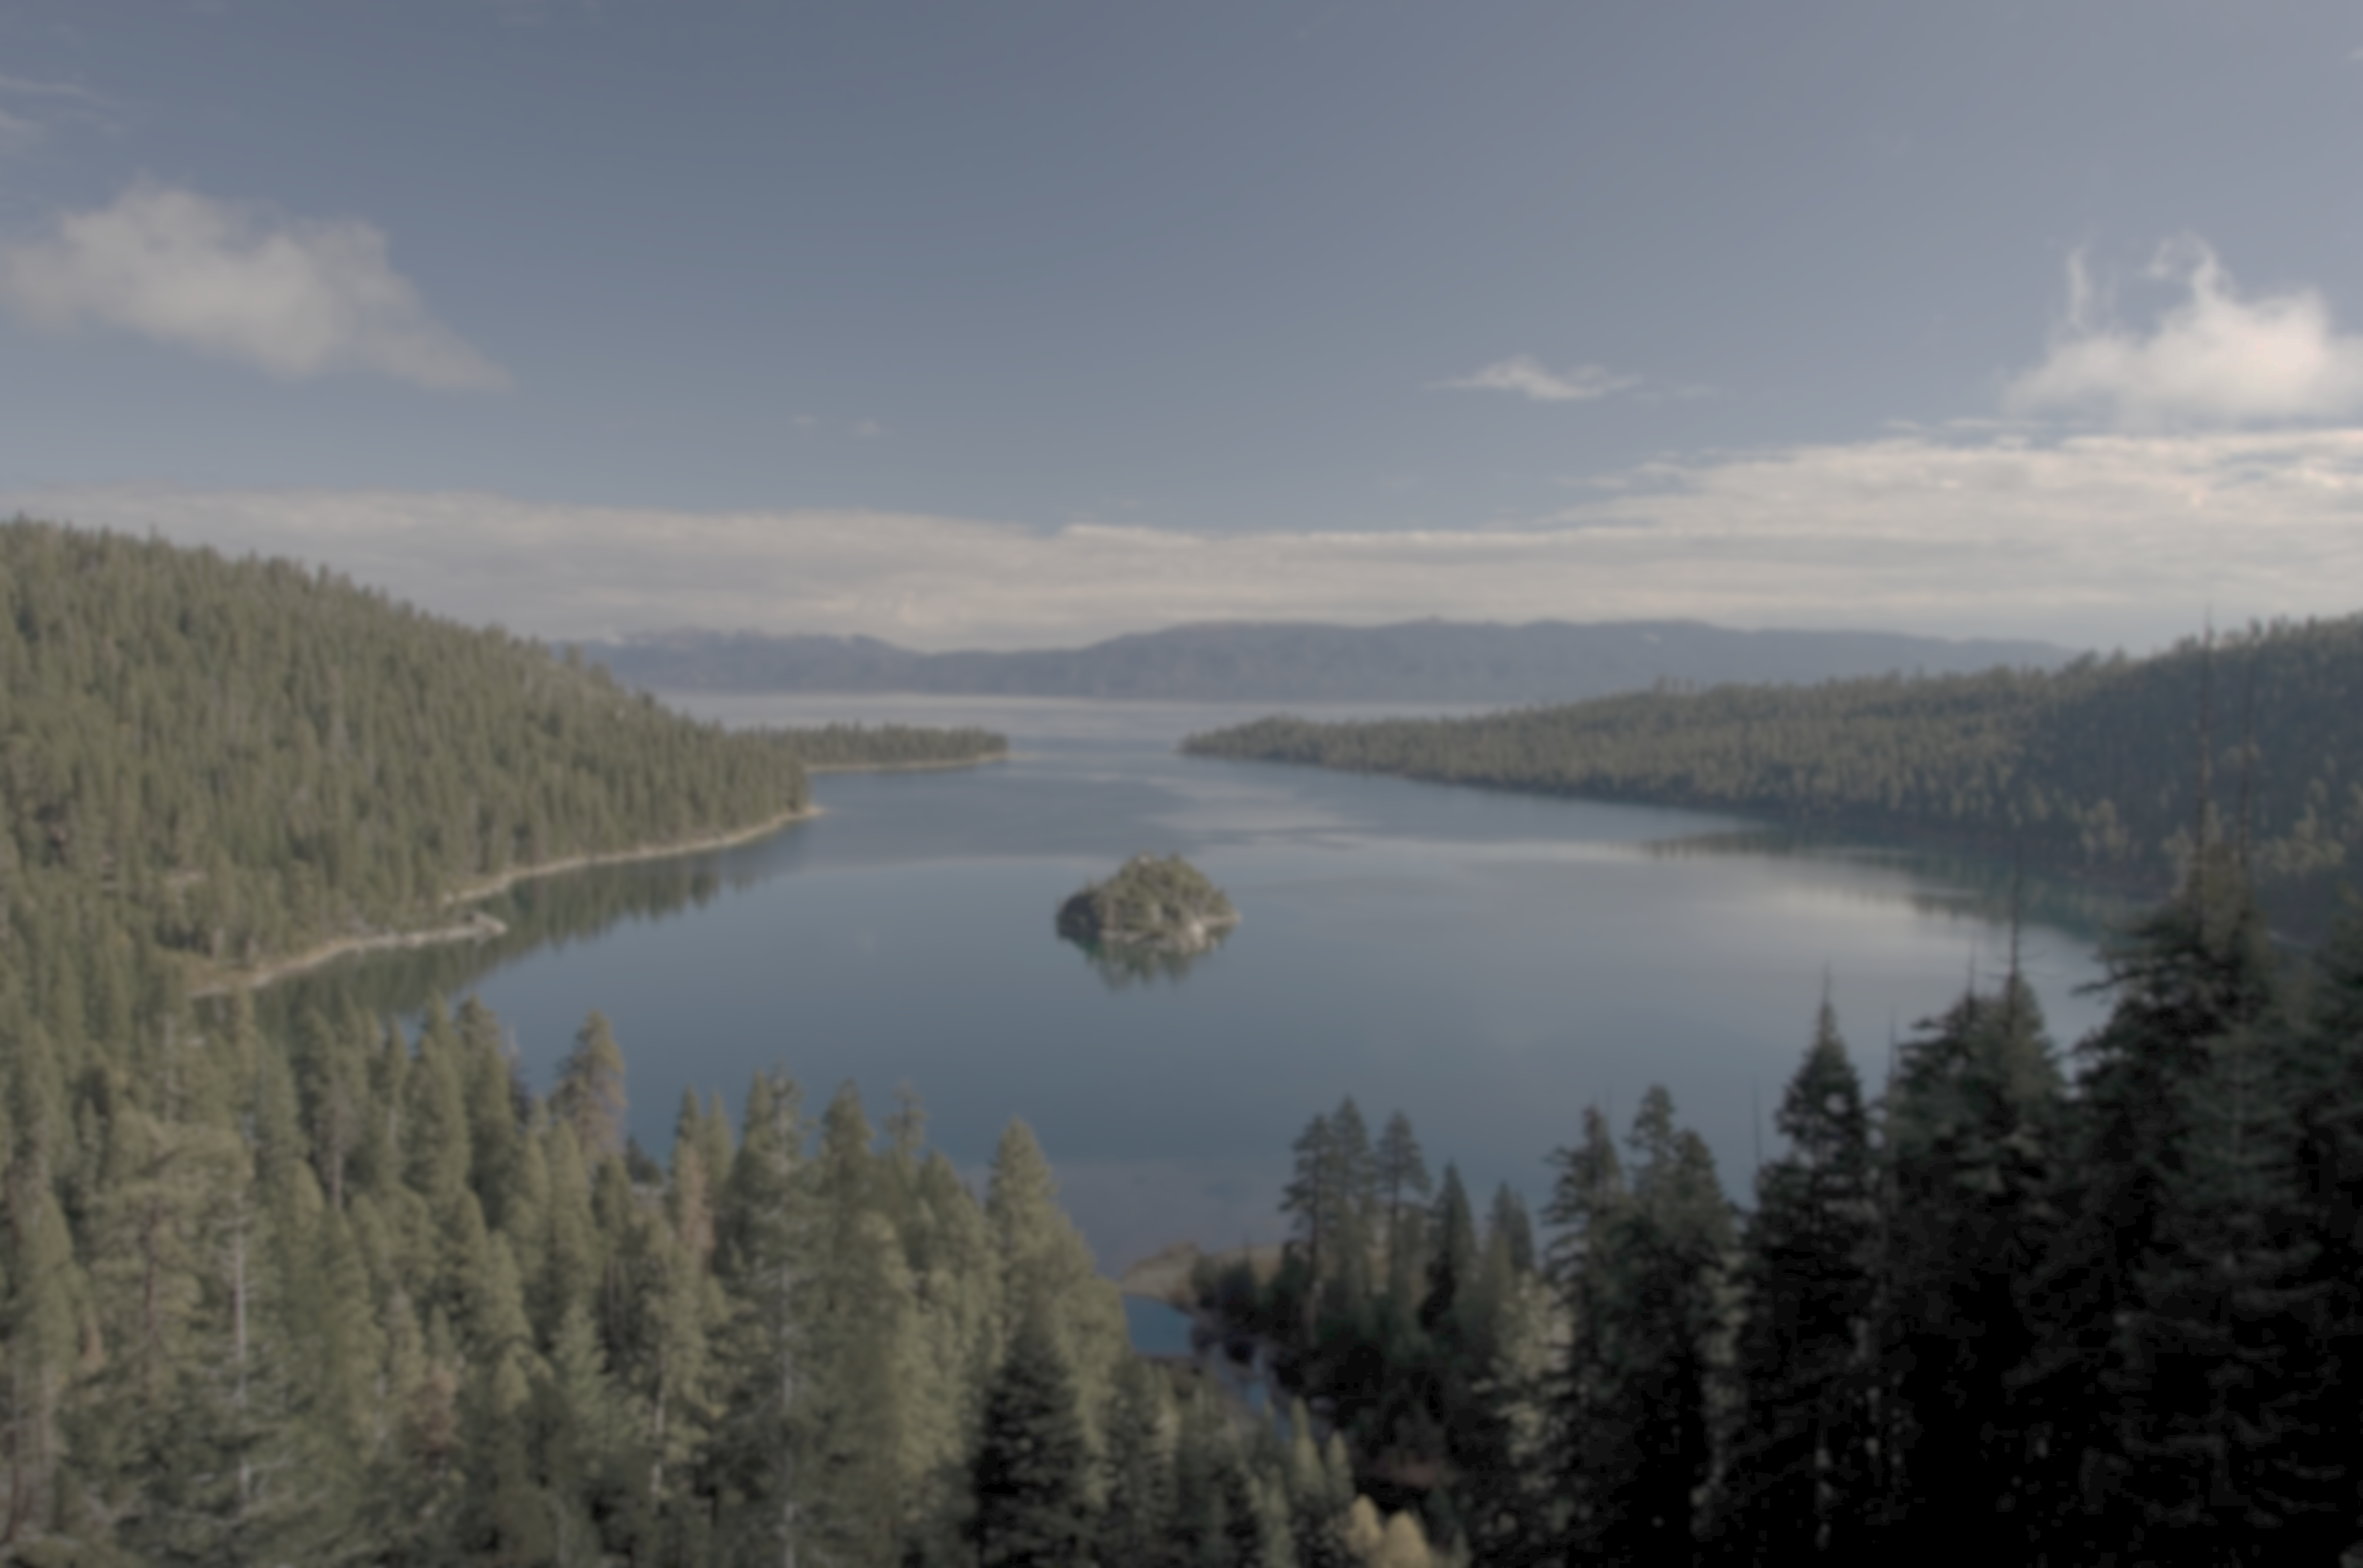






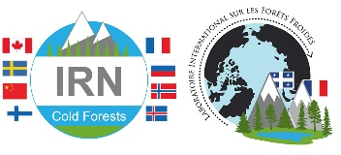


Global changes, fire and spruce-forest dynamics in
Québec-Labrador during the Holocene.
Jonathan LESVEN
Milva DRUGUET DAYRAS, Laurent MILLET, Adam ALI, Yves BERGERON,
André ARSENAULT, François GILLET, Damien RIUS
Supervised by:
François GILLET & Damien RIUS (Chrono-Environnement, France)
Yves BERGERON (UQAT, Canada)
Andre ARSENAULT (Natural Resources Canada)
May 25th, 2022

Slide 2
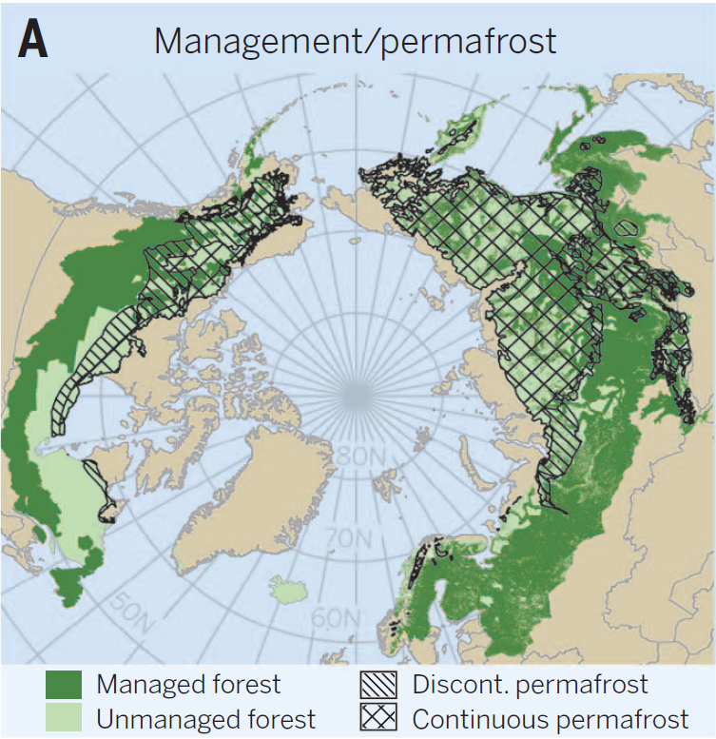




Context
Boreal forests
High latitudes of the Northern Hemisphere
30% of global forested area
Many associated ecosystem goods and services
20% of the global forest carbon sink
Gauthier et al., (2015) Science
1

Slide 3
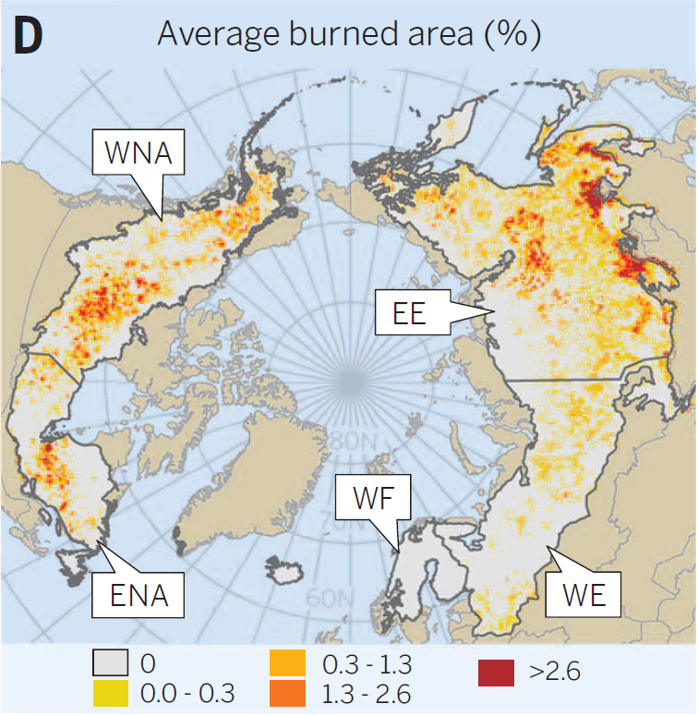

Context
Boreal forests
High latitudes of the Northern Hemisphere
30% of global forested area
Many associated ecosystem goods and services
20% of the global forest carbon sink
Functioning and structure related to disturbance regimes (insects, fires)
Gauthier et al., (2015) Science
2

Slide 4
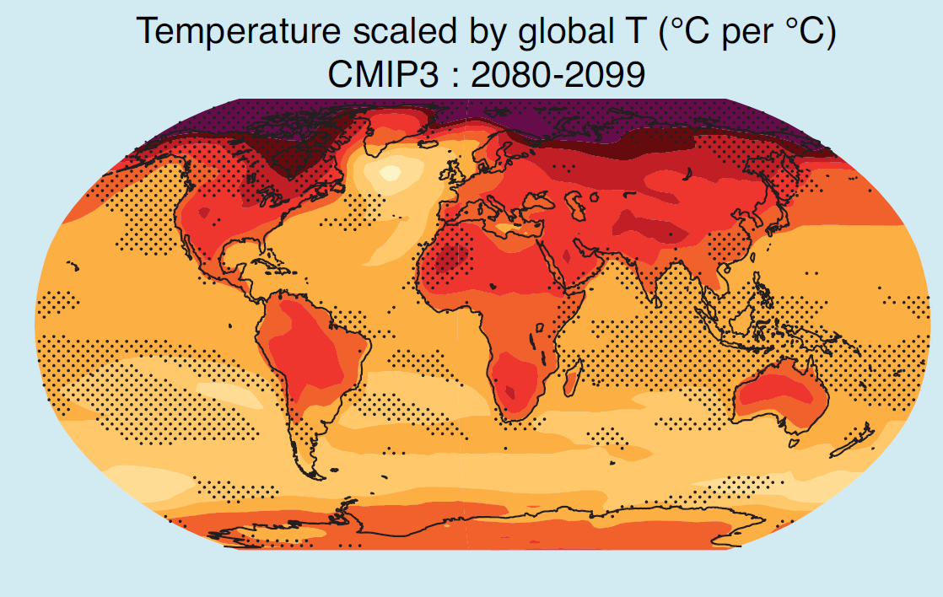
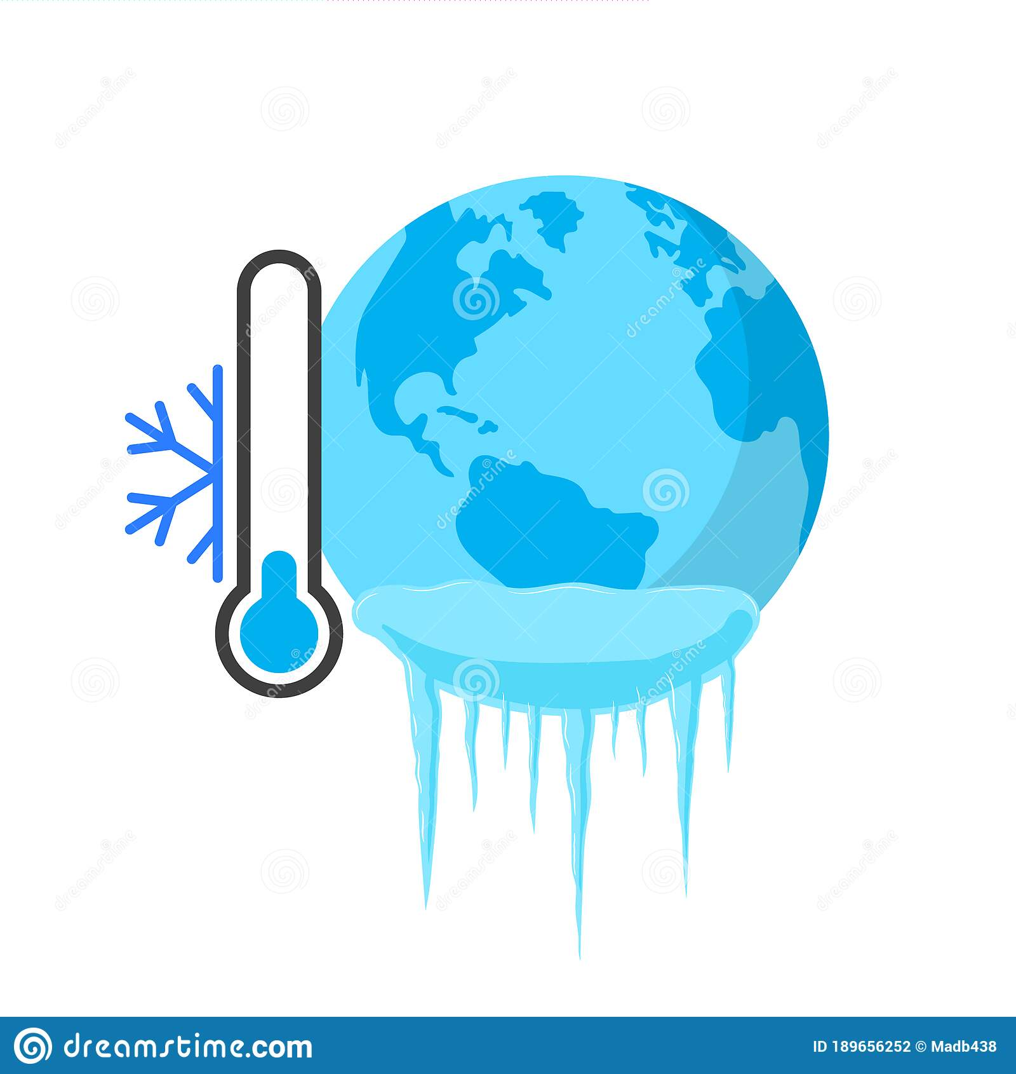


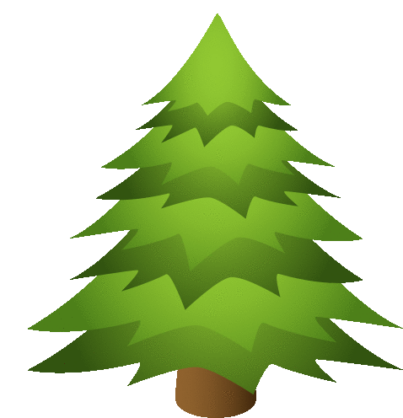
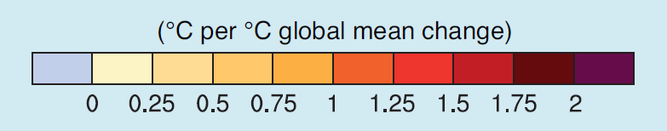
Context
Aim of the study
Temperature increase predictions for 2100:
Global level: 1.5 to 4°C
Boreal biome: 4 to 11°C
Consequences:
Increase in fire frequency & size and length of the fire season
Carbon sink → Carbon source
Current prediction models:
Short time periods
Few fire-climate-vegetation interactions
Long-term studies needed
Eastern Québec and Labrador poorly studied
IPCC (2015)
Modelisation of temperature increase between 2080 and 2099 (°C per °C at the global level)
3

Slide 5
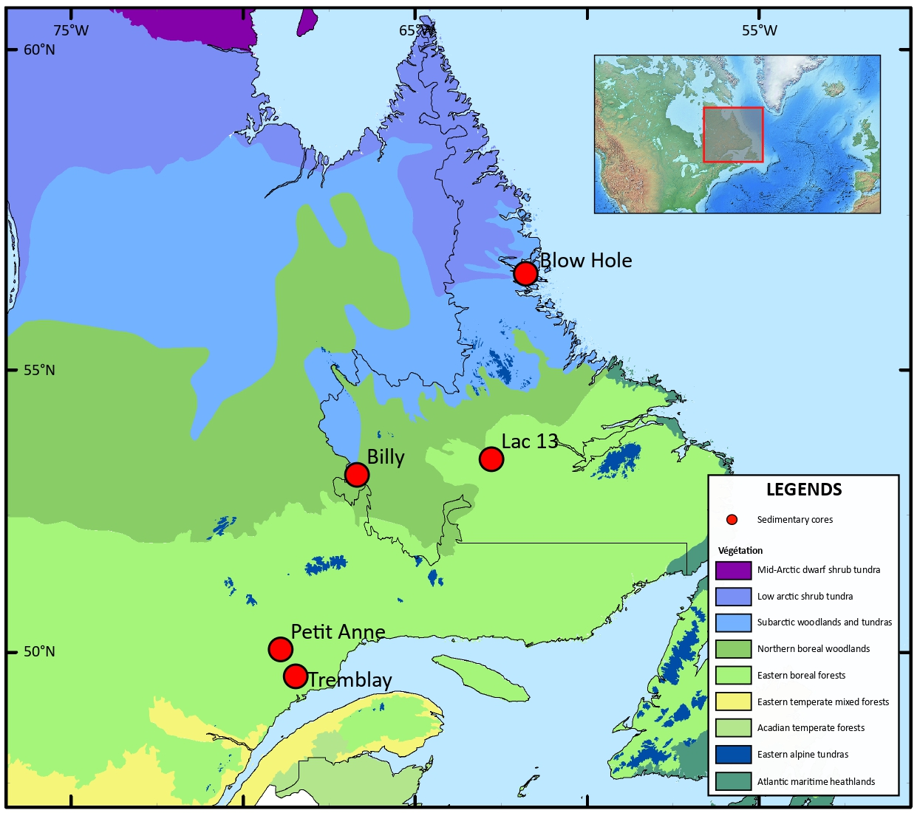





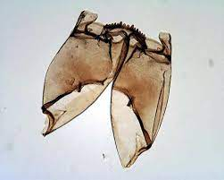
Context
Aim of the study
Material & methods
Dual approach:
Temporal approach:
Study of the Holocene
→ Holocene climatic optimum
→ Neoglacial period
→ Medieval warm period
→ Little ice age
Spatial approach:
North-South transect of 5 lacustrine sediment cores → Wide temperature and vegetation gradient
→ Wide range of potential feedback processes
Methods :
Fire regimes: macrocharcoals
Vegetation dynamics: pollen grains
Climatic reconstructions: chironomid assemblages
4

Slide 6
Context
Aim of the study
Material & methods
Dual approach:
Temporal approach:
Study of the Holocene
→ Holocene climatic optimum
→ Neoglacial period
→ Medieval warm period
→ Little ice age
Spatial approach:
North-South transect of 5 lacustrine sediment cores → Wide temperature and vegetation gradient
→ Wide range of potential feedback processes
Methods :
Fire regimes: macrocharcoals
Vegetation dynamics: pollen grains
Climatic reconstructions: chironomid assemblages
4

Slide 7
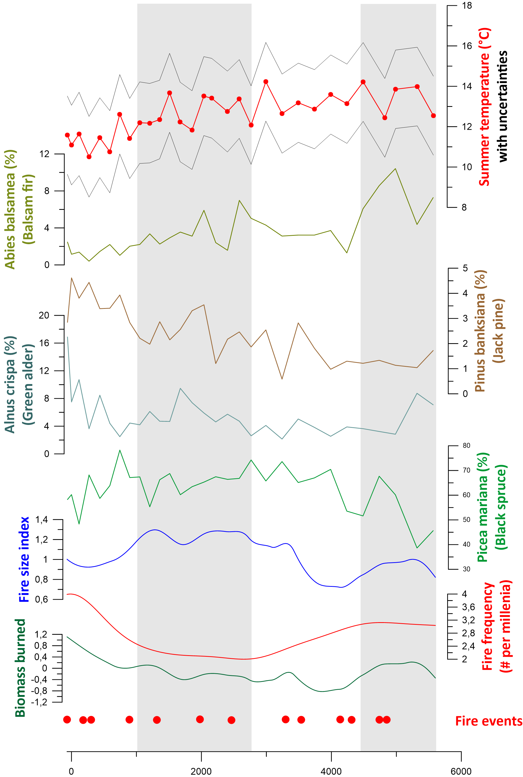
Context
Aim of the study
Material & methods
Discussion
Billy Lake
5

Slide 8
Context
Aim of the study
Material & methods
Discussion
Billy Lake
Summer temperatures
with uncertainties
Percentages of main pollen taxa
Fire parameters
5

Slide 9
Context
Aim of the study
Material & methods
Discussion
Billy Lake
6000 - 4500 years before present :
High summer temperatures
High fire frequency
Increase of black spruce
5

Slide 10
Context
Aim of the study
Material & methods
Discussion
Billy Lake
6000 - 4500 years before present :
High summer temperatures
High fire frequency
Increase of black spruce
4500 - 2500 years before present :
Decrease of summer temperatures
Decrease of fire frequency, increase of fire size
Increase of black spruce
5

Slide 11
Context
Aim of the study
Material & methods
Discussion
Billy Lake
6000 - 4500 years before present :
High summer temperatures
High fire frequency
Increase of black spruce
4500 - 2500 years before present :
Decrease of summer temperatures
Decrease of fire frequency, increase of fire size
Increase of black spruce
2500 - 900 years before present :
→ 2300 year : large fire event, associated with the disappearance of balsam fir
Decrease of black spruce !
5

Slide 12
Context
Aim of the study
Material & methods
Discussion
Billy Lake
6000 - 4500 years before present :
High summer temperatures
High fire frequency
Increase of black spruce
4500 - 2500 years before present :
Decrease of summer temperatures
Decrease of fire frequency, increase of fire size
Increase of black spruce
2500 - 900 years before present :
→ 2300 year : large fire event, associated with the disappearance of balsam fir
Decrease of black spruce !
900 - 0 years before present :
Decrease of black spruce
Increase of pioneer taxa
5

Slide 13
Context
Aim of the study
Material & methods
Discussion
Billy Lake
2 main phases :
From 6000 to 2500 years before present :
Black spruce regenerates and maintains itself despite fires.
5

Slide 14
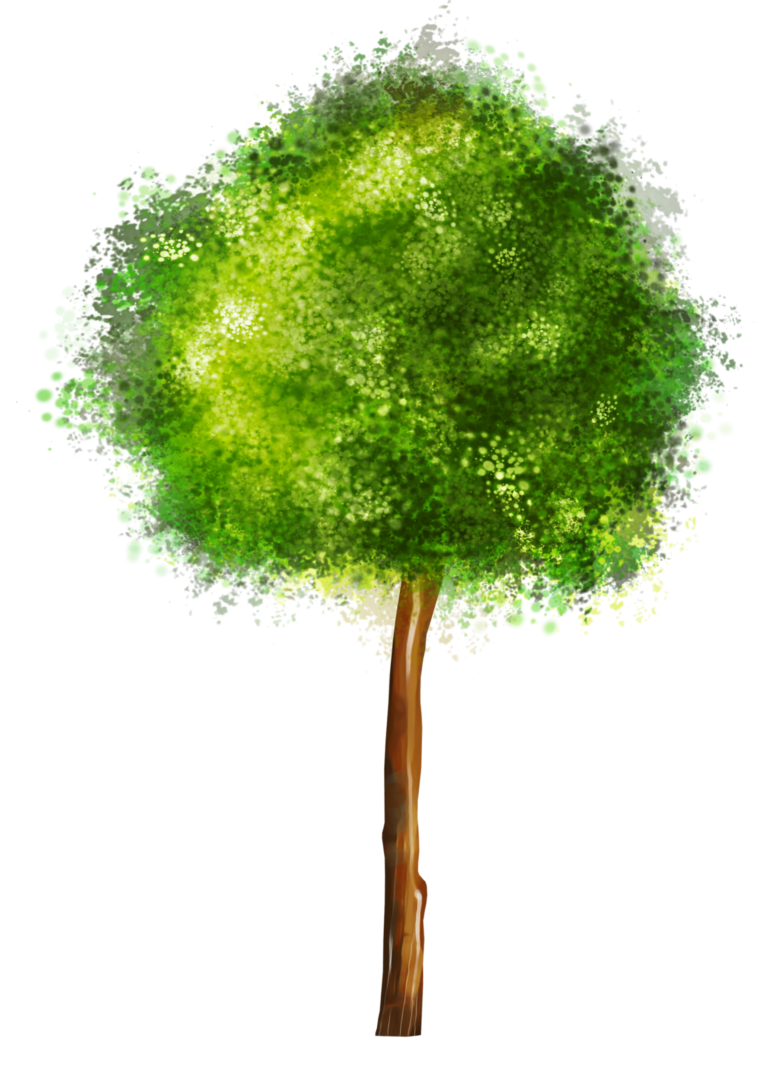
Context
Aim of the study
Material & methods
Discussion
Billy Lake
2 main phases :
From 6000 to 2500 years before present :
Black spruce regenerates and maintains itself despite fires.
From 2500 years to today :
Opening of the environment after fires, low decline of black spruce, increase of pioneers, possibly caused by a change in fire dynamics.
5

Slide 15
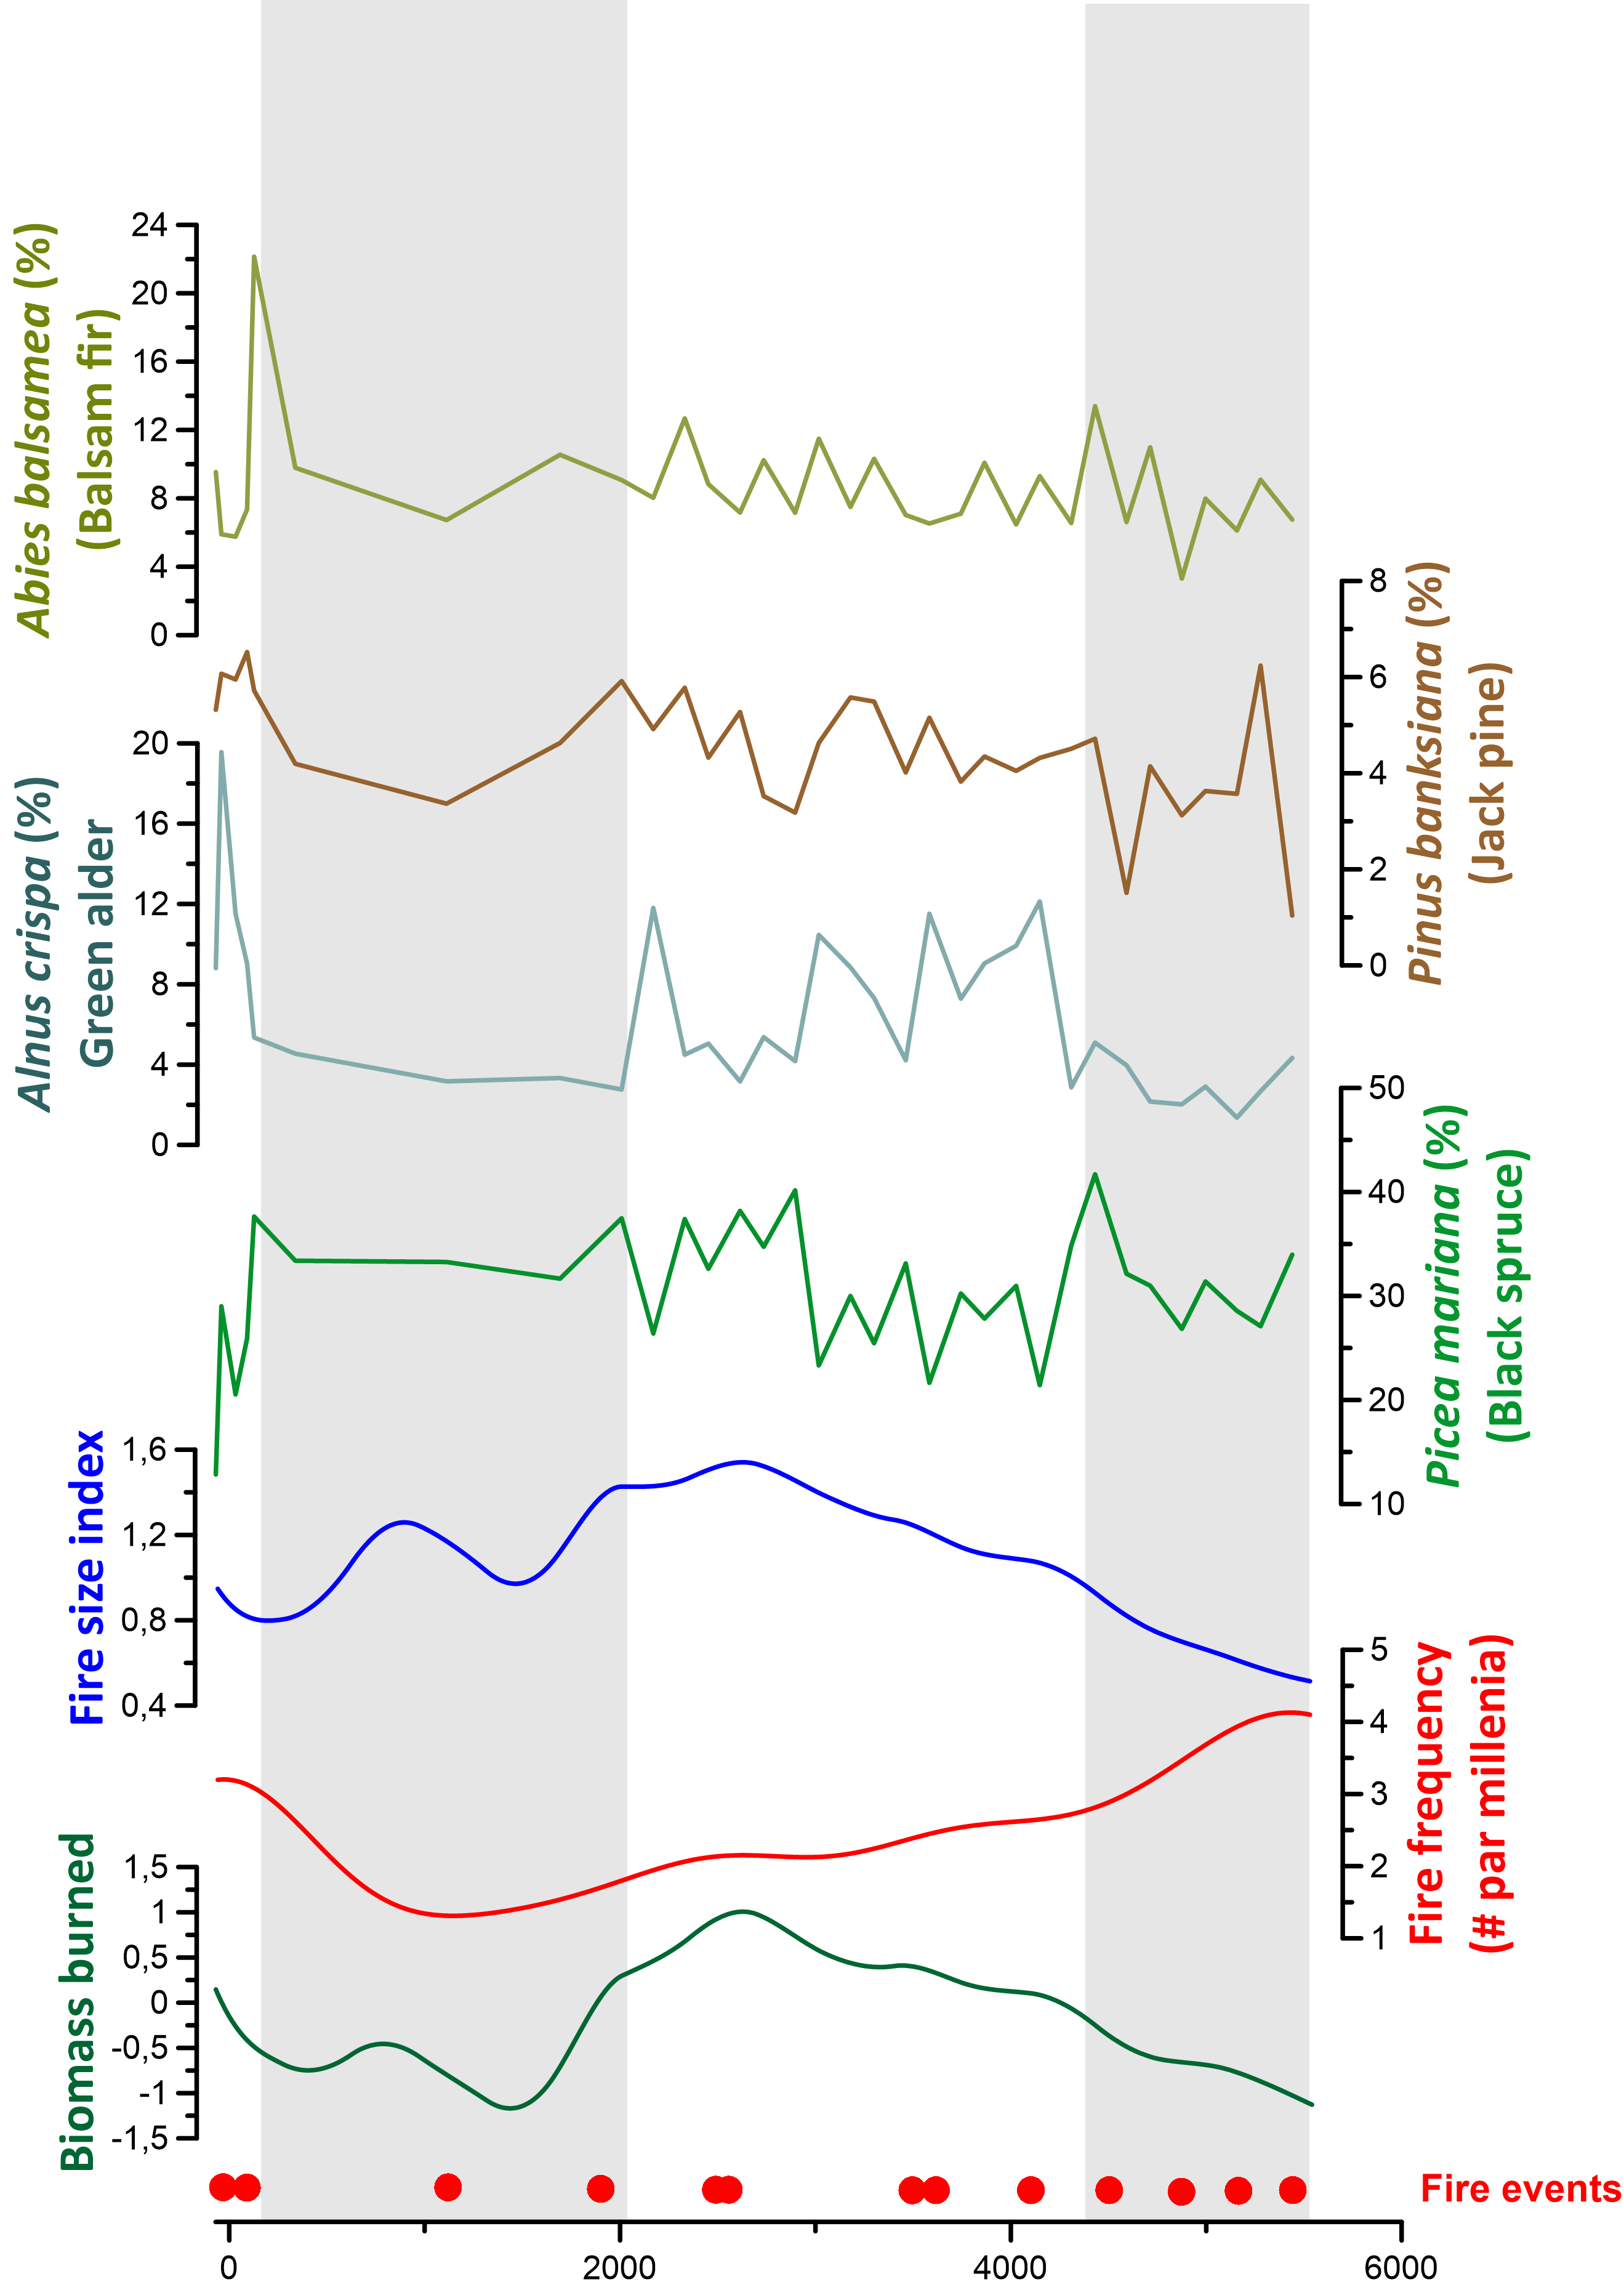
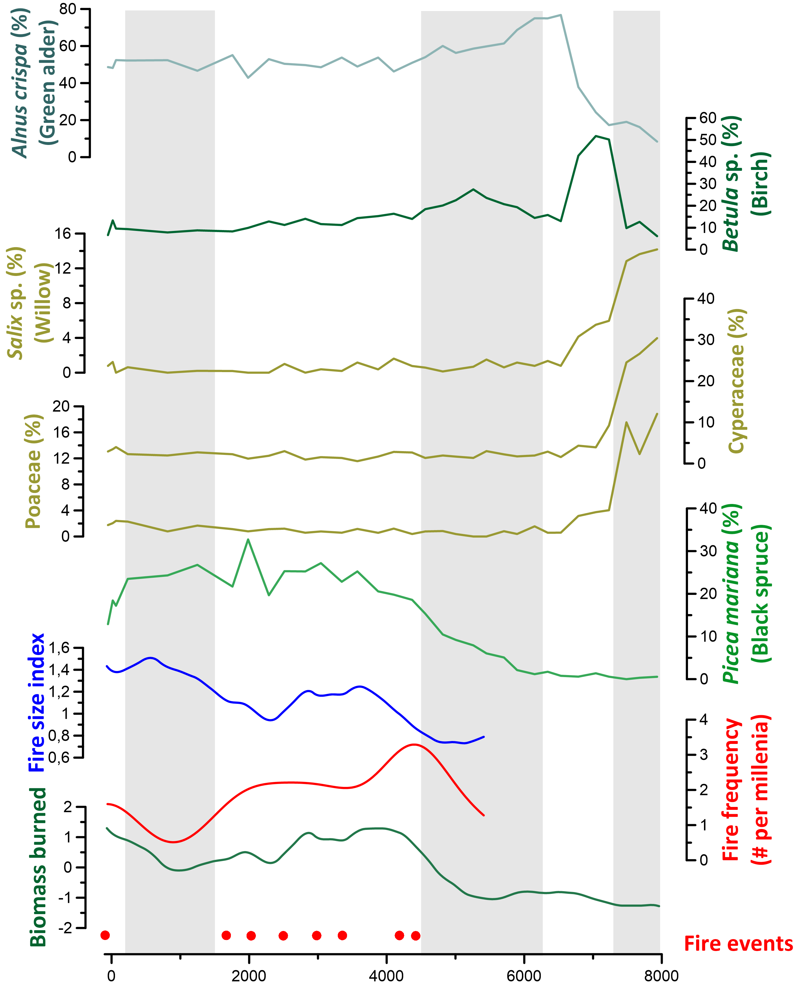
Context
Aim of the study
Material & methods
Discussion
BILLY LAKE
TREMBLAY LAKE
BLOW HOLE LAKE
6

Slide 16
Context
Aim of the study
Material & methods
Discussion
BILLY LAKE
TREMBLAY LAKE
BLOW HOLE LAKE
6

Slide 17
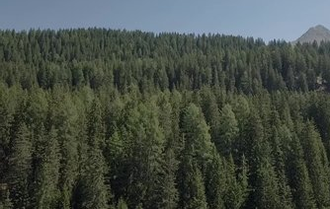
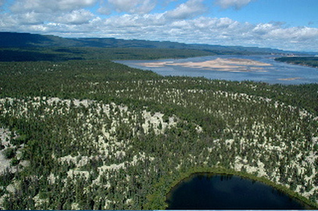
Context
Aim of the study
Material & methods
Discussion
Perspectives
What future for boreal forests of Canada ?
Closed canopy
(spruce-moss forest)
Open canopy
(lichen woodlands)
High CO₂ sequestration
High economic value
Reduced CO₂ sequestration
Low economic value
7

Slide 18
Thank you for your attention!
Do you have any questions?

