Slide 1




A conceptual model for the initiation of flank creep at Pacaya Volcano, Guatemala
Judit Gonzalez Santana, Christelle Wauthier, Michelle Burns
EGU22-5239
Mackenney Cone
N
Cerro Grande
Cerro Chiquito
1200 m
Collapse scarp
2010 lava flow
Contact:
jmg6885@psu.edu
@Jmglez_95
palasantour.com
80NSSC20K1632
80NSSC20K0490
Notes:
I will be talking about present-day instability on Pacaya’s SW flank and how it relates to different styles of volcanic unrest.
Pacaya is an active, basaltic stratovolcano in Guatemala with evidence for a past collapse of its SW flank. Recently, magmatism was identified as a driver of flank instability at Pacaya, which showed transient instability during a large eruption in 2010 and where another large eruption in 2014 accelerated the slower southwest flank creep identified during a lower activity interval from 2011 to 2013.

Slide 2
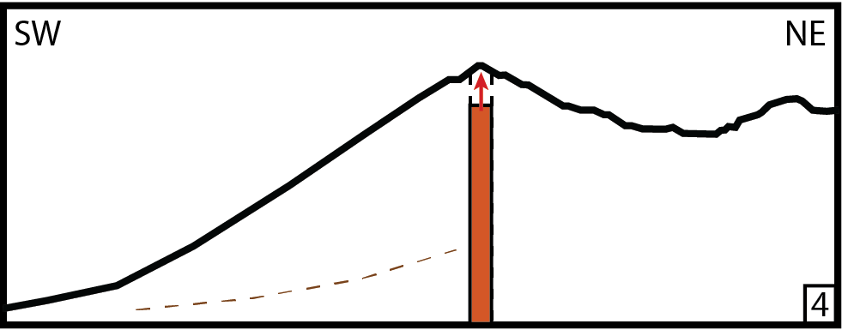
How does flank creep behavior relate to eruptive activity at Pacaya?
?
?
Radar satellite geodesy
(InSAR) time-series
1. Activity Reports
2. Ash advisories
3. Thermal anomalies
4. Lava flow maps
?
Notes:
Given the evidence for past flank collapse at Pacaya, it is essential to evaluate the response of present-day flank creep to changes in volcanic behavior, to better understand the conditions under which another collapse might happen.
To capture the evolution of flank instability we produced InSAR time-series with 7 radar satellite datasets spanning 2007-end of 2020; and to describe concurrent volcanic activity changes, we compiled volcanic activity reports, ash advisories and produced thermal anomaly timeseries and lava flow maps.

Slide 3
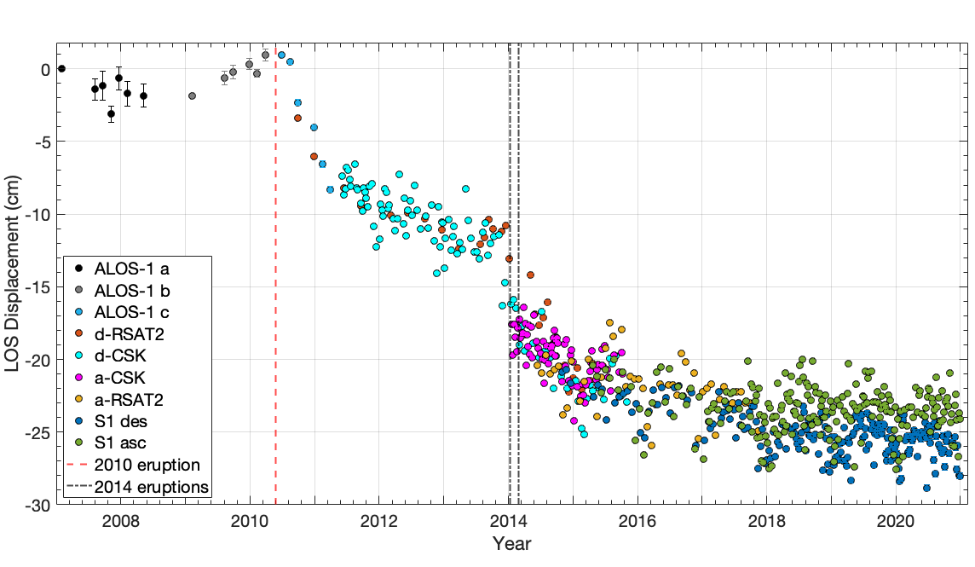
Time-series reveals repeated occurrence of faster deformation after major eruptions, followed by years of slower creep
Gonzalez-Santana et al. (in review, Bull Volc)
Notes:
Here are the time-series results for a 10x10 group of pixels on the SW flank of Pacaya (red square). The vertical dashed line shows the timing of the 2010 eruption and the vertical dashed black lines show the timing of the 2014 eruptions, during which we know transient flank slip occurred. A negative LOS displacement corresponds to the ground moving away from the satellite.

Slide 4
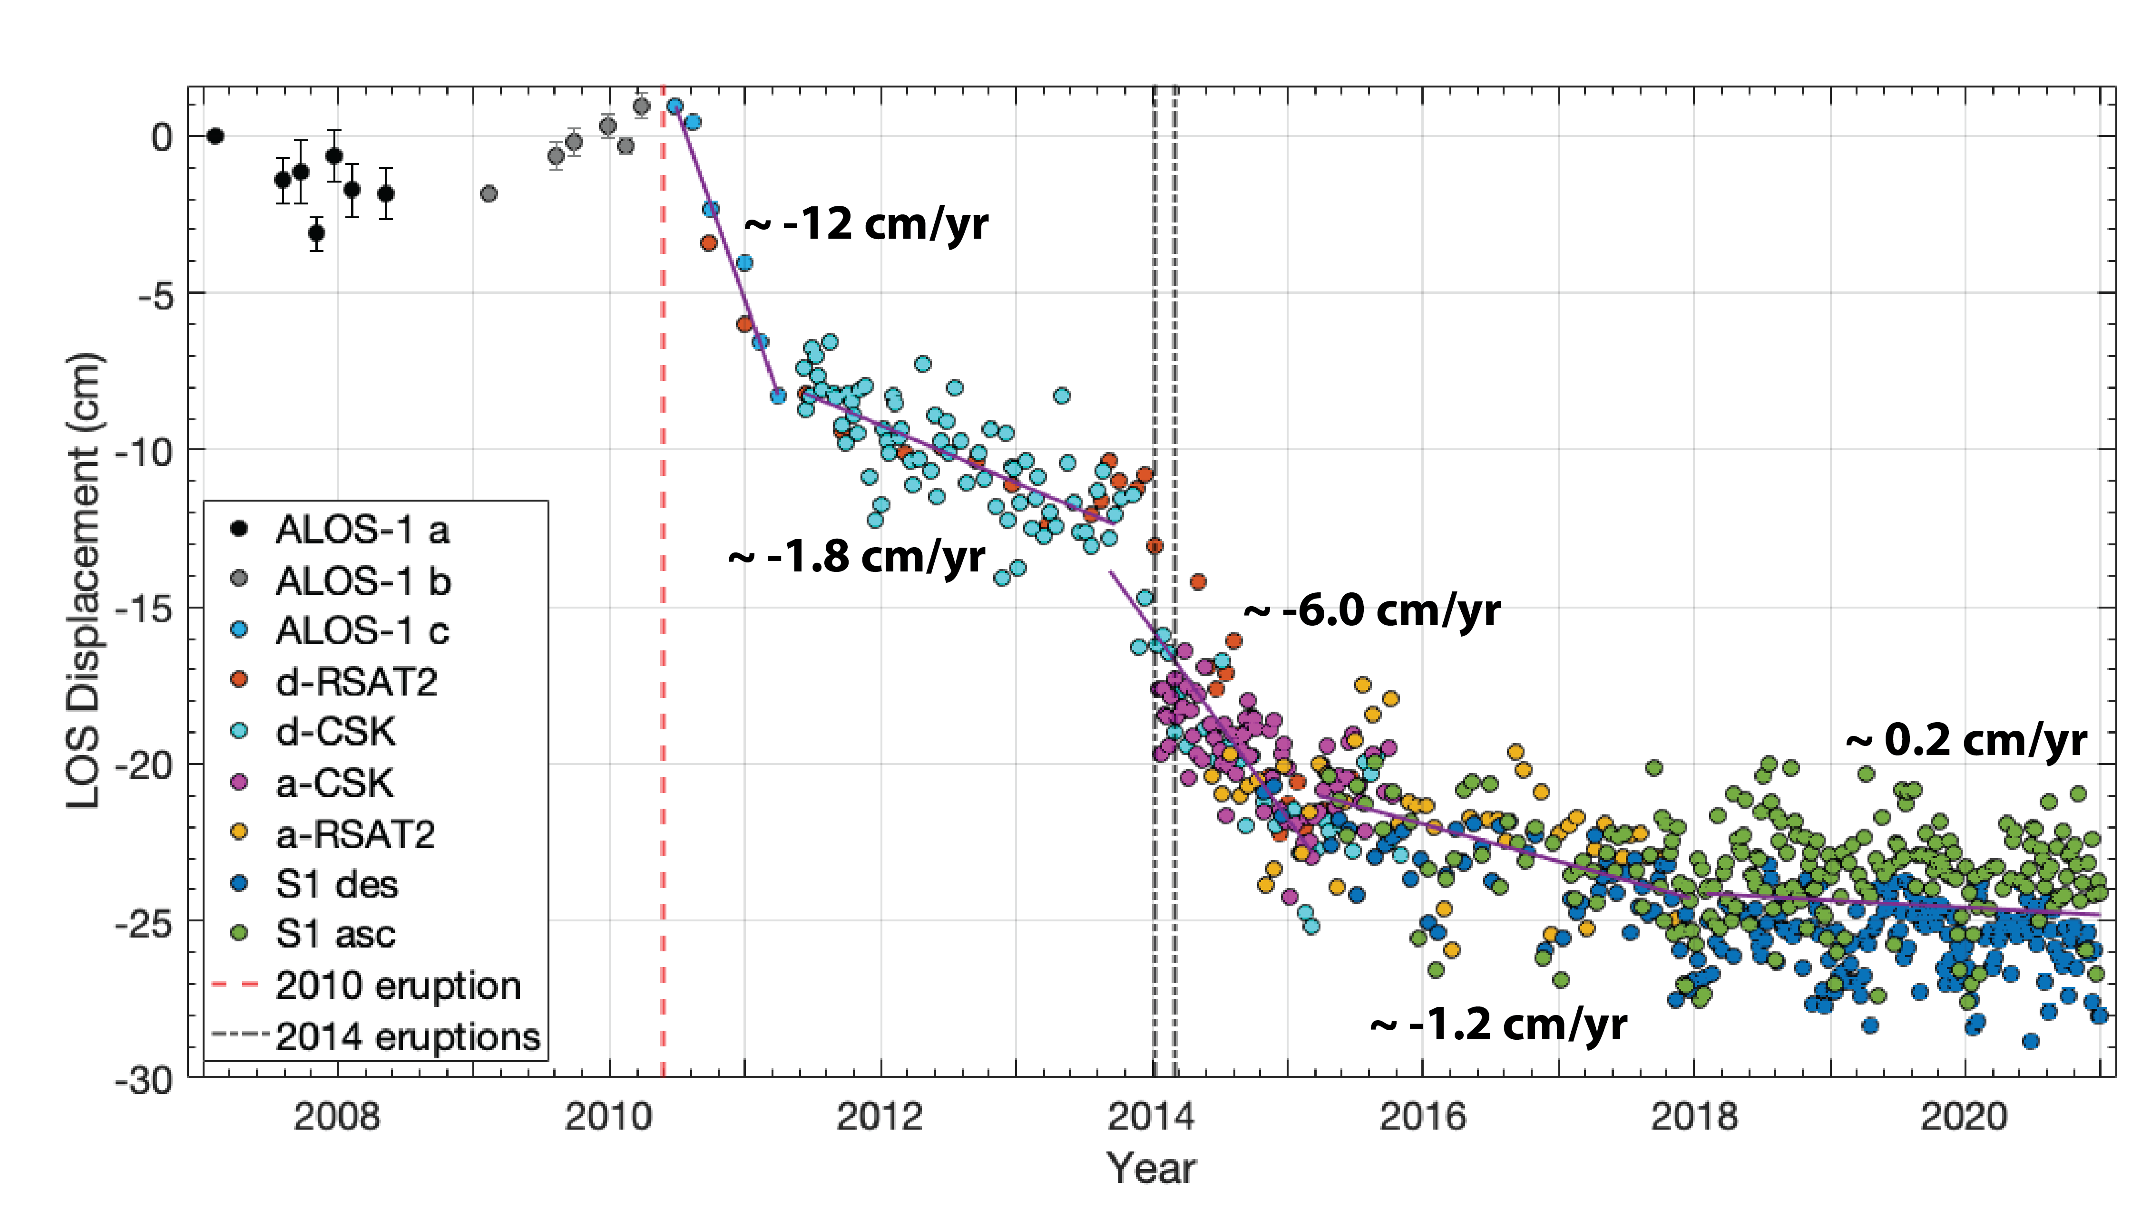
Time-series reveals repeated occurrence of faster deformation after major eruptions, followed by years of slower creep
2014
transient
instability
2010
transient
instability
Gonzalez-Santana et al. (in review, Bull Volc)
Notes:
Our time-series reveals a pattern of repeated occurrence of faster flank creep initiating after major eruptions and transient flank motion events, as seen in 2010 and 2014, and lasting on the order of a few months

Slide 5
Time-series reveals repeated occurrence of faster deformation after major eruptions, followed by years of slower creep
2015-2018
slower creep
2011-2013
slower creep
Gonzalez-Santana et al. (in review, Bull Volc)
Notes:
followed by several years periods of slower flank creep with no major eruptions. These took place between 2011 and 2013, and from 2015 to 2018.

Slide 6
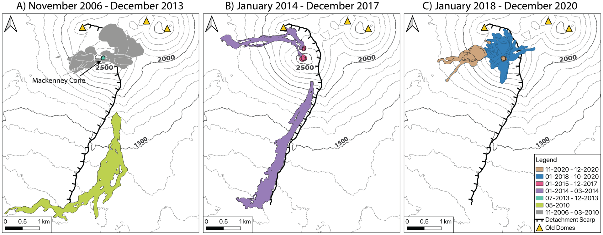
Lava flow maps show longest recent flows sourced from NNW-SSE oriented vents
Gonzalez-Santana et al. (in review, Bull Volc)
Notes:
For the purpose of time I will only be showing the lava flow maps here as a descriptor of volcanic unrest evolution from 2007-2020. We find that lava flows before the 2010 eruption (in grey) started mostly from the main crater. May 2010, coincident with the first of the 2 transient instability events, was the first instance since 1961 where a vent opened outside the collapse scarp, producing a lava flow greater than 5 km in length, that is shown in green. After this, when the flank was having its 2011-2013 slower creep interval, we see mostly crater incandescence in 2013.

Slide 7
Lava flow maps show longest recent flows sourced from NNW-SSE oriented vents
Gonzalez-Santana et al. (in review, Bull Volc)
Notes:
The 2014 eruptions, associated with acceleration of the flank deformation signal, had 2.5 and 4.8 km long lava flows from vents in a NNW-SSE orientation, with the SSE vent also > 600m away from the main cone, an in an alignment with the 2010 vents. These are shown in purple. Variable amounts of crater incandescence were recorded from 2015-2017, the second period of slower flank creep

Slide 8
Lava flow maps show longest recent flows sourced from NNW-SSE oriented vents
Gonzalez-Santana et al. (in review, Bull Volc)
Notes:
and from 2018 to October 2020, when flank deformation appears to flatten out, lava flowed in variable directions from vents near the summit crater, with lengths <1 km, as shown in blue.

Slide 9
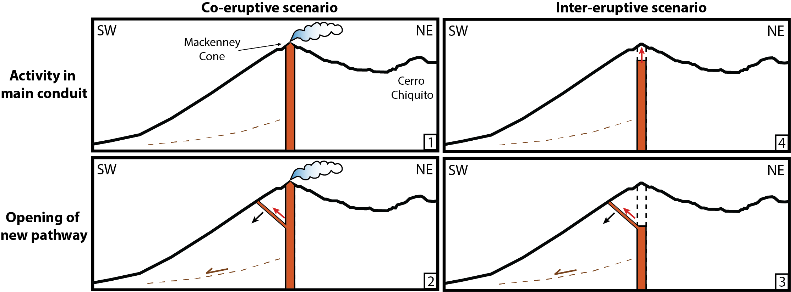
Possible scenarios of volcanic activity and flank creep interactions at Pacaya
2007-2009
2018-2020
Gonzalez-Santana et al. (in review, Bull Volc)
Notes:
Comparing the timing of changes in flank deformation behavior with our descriptions of volcanic activity suggests there are four different scenarios of volcanic activity and flank creep interactions at Pacaya
In the first scenario, we have volcanic activity in an open conduit, implied by persistent fumarolic activity and incandescence in the crater, as in 2007-2009 and 2018-2020, that is associated with negligible flank motion

Slide 10
Possible scenarios of volcanic activity and flank creep interactions at Pacaya
2007-2009
2018-2020
May 2010
Gonzalez-Santana et al. (in review, Bull Volc)
Notes:
In the second scenario we have the opening of new magma pathways beyond the summit crater during an on-going eruptions, as in May 2010, that is associated with transient flank instability

Slide 11
Possible scenarios of volcanic activity and flank creep interactions at Pacaya
2007-2009
2018-2020
May 2010
2014
Gonzalez-Santana et al. (in review, Bull Volc)
Notes:
In the third scenario, we get opening of new magma pathways beyond the summit but after a periods of low volcanic activity, as in early 2014, that also results in transient flank instability

Slide 12
Possible scenarios of volcanic activity and flank creep interactions at Pacaya
2007-2009
2018-2020
2017-2018
May 2010
2014
Gonzalez-Santana et al. (in review, Bull Volc)
Notes:
And finally, we have the start of new periods of heightened activity from the main conduit, as in 2017 or 2018, that is associated with negligible flank instability

Slide 13
Subtle differences between scenarios -> challenge forecasting flank instability related hazards
2007-2009
2018-2020
2017-2018
May 2010
2014
Gonzalez-Santana et al. (in review, Bull Volc)
Notes:
Scenarios 1 and 2 apply to co-eruptive conditions, whereas 3 and 4 relate to inter-eruptive conditions. The subtle differences between these scenarios highlight the challenges in forecasting flank instability related hazards at Pacaya. For example, scenario 2 illustrates the secondary hazard from opening of a new vent during an apparently steady-state eruption. Identifying the transition from scenario 1 to scenario 2, as in May 2010, requires close monitoring of evolving eruptive activity. Similarly, whenever unrest is detected at a volcano, it is challenging to recognize whether this might result in scenario 3 or 4. The study of past vent locations and their association to each of the 4 scenarios can assist in forecasting the scenario new activity is most likely to cause.
Overall, based on our observations, it appears that opening of new aligned vents outside the Mackenney cone forewarn an increased likelihood of renewed or accelerating flank creep

Slide 14
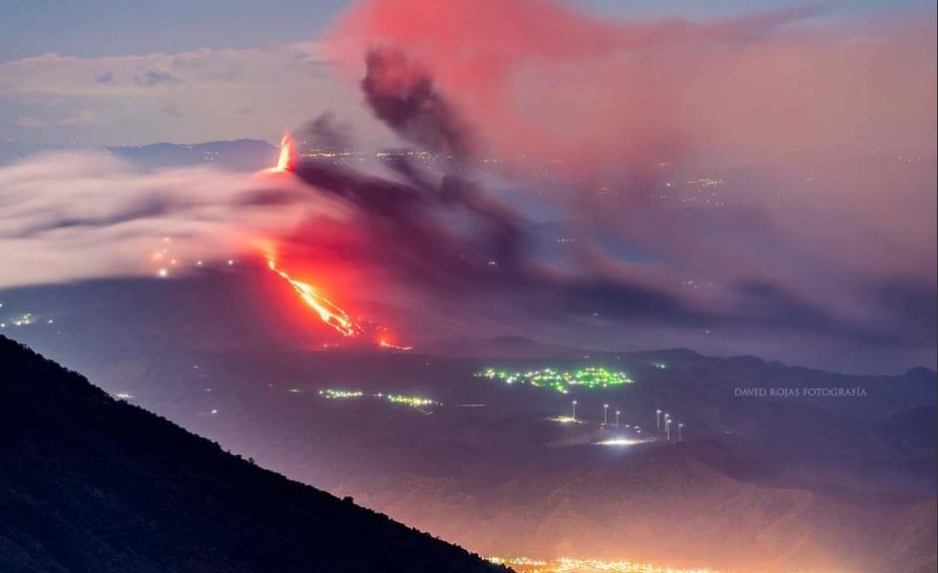
Questions?
Contact:
jmg6885@psu.edu
@Jmglez_95
David Rojas
Pacaya eruption – 1 April 2021

