Slide 1

A visual approach for water quality monitoring within the CrowdWater project
Sara Blanco Ramírez¹, Ilja van Meerveld¹, Jan Seibert^{1,2}, Mirjam Scheller¹,
and Franziska Schwarzenbach¹
¹ Department of Geography, University of Zurich, Zurich, Switzerland (sara.blanco@geo.uzh.ch)
² Department of Aquatic Sciences and Assessment, Swedish University of Agricultural Sciences,
Uppsala, Sweden

Slide 2
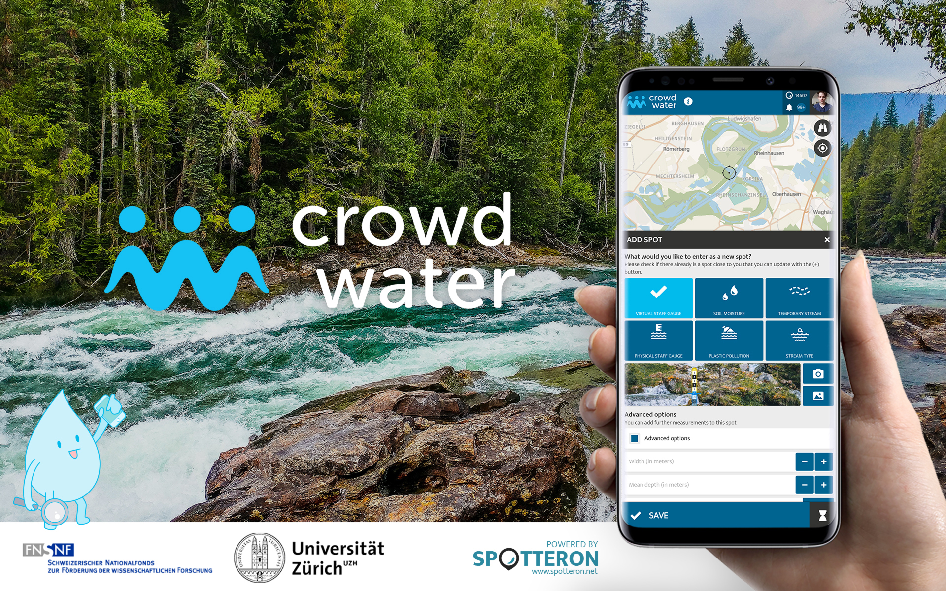

Slide 3
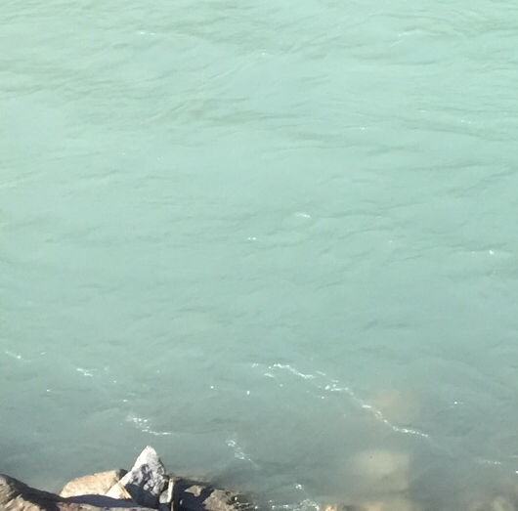
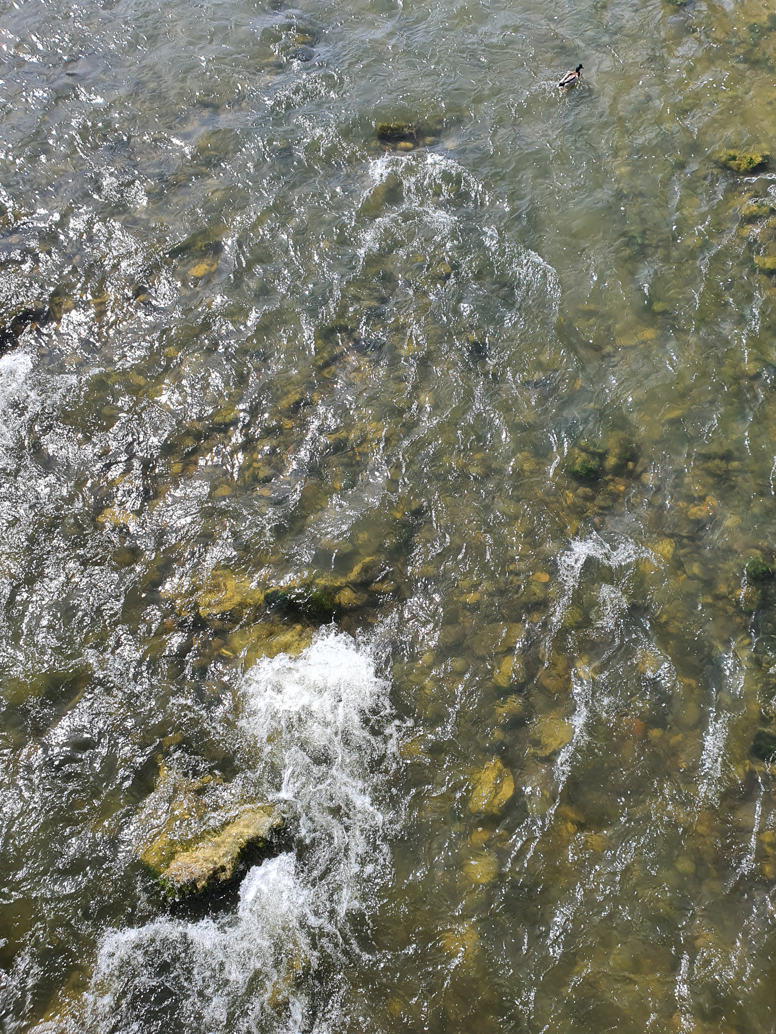
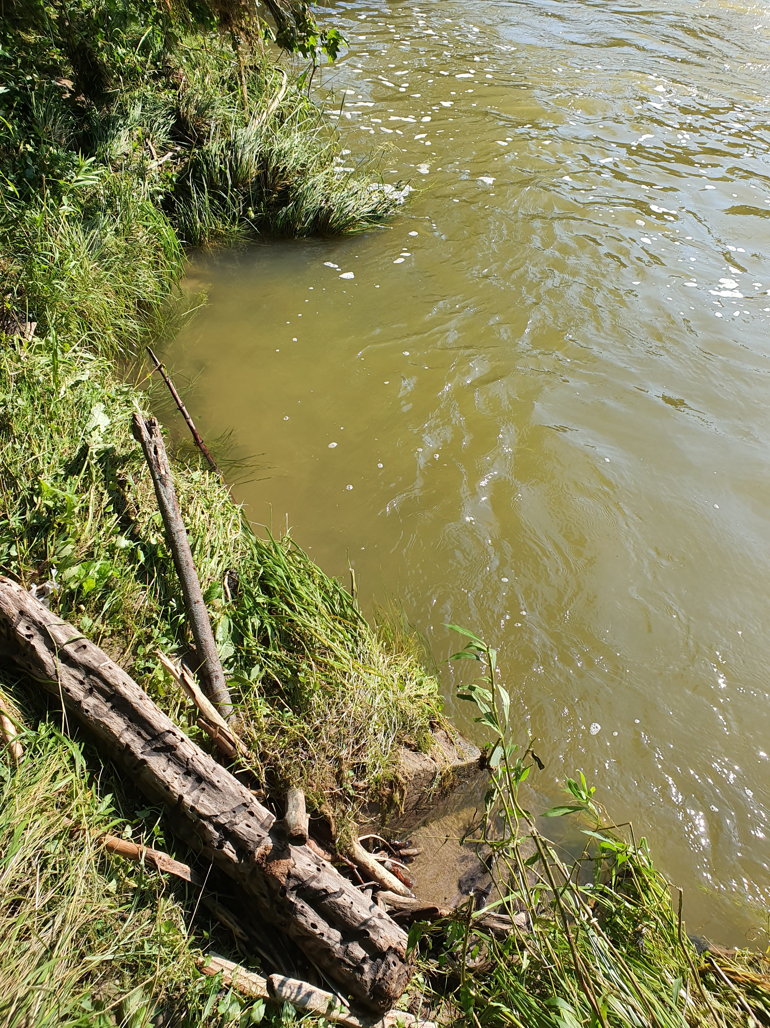
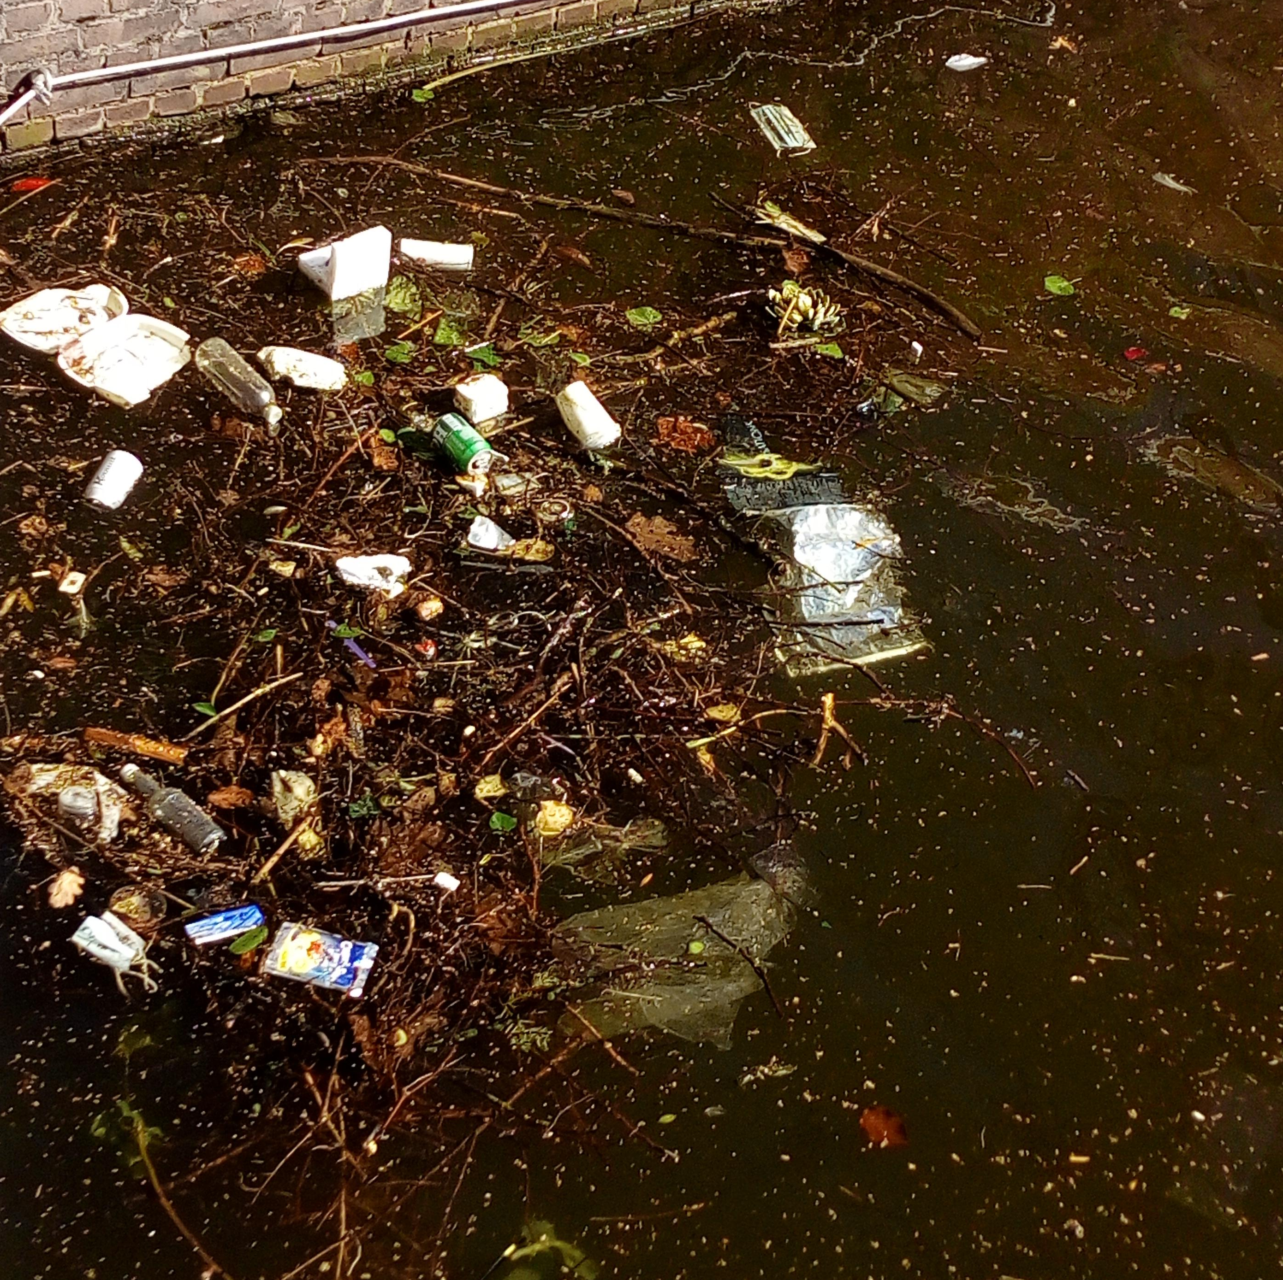
Visual water quality observations
While we can not observe all water quality components, it is possible to quickly obtain some information on stream health.
We use this information for everyday decisions
e.g., whether to swim in the water or not.

Slide 4



A visual approach for water quality monitoring
Water Quality Survey
Date: _____________ Time: _____________
CrowdWater
CrowdWater is a citizen science project in water science that uses a mobile phone application to collect information about rivers.
The CrowdWater app does not have a water quality category yet, and that is why I seek to develop a visual approach to collect information about river’s water quality in the app.
Your answers to the questions in this survey will help me define this visual approach for water quality observations.
Please answer the following questions individually for the river in front of you. There are no right or wrong answers!
What are the possibilities and uncertainties of a visual water quality approach?

Slide 5
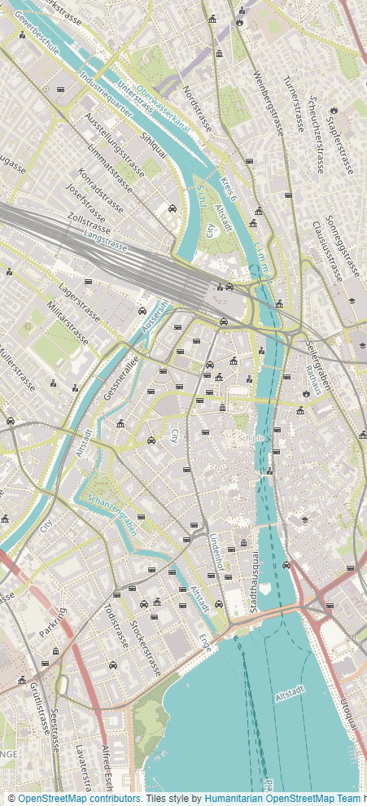
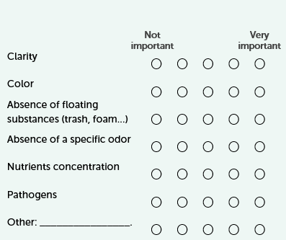

A visual approach for water quality monitoring
Water quality surveys
Water Quality Survey
How important are the following water quality indicators in rivers for you?
Sihl river in Zurich
3 different dates
75 participants

Slide 6
How important are these water quality indicators to you?
Not important
Very important
66%
66%
66%
36%
37%
32%
45%
47%
51%
76%
74%
75%
18%
17%
42%
27%
27%
32%

Slide 7
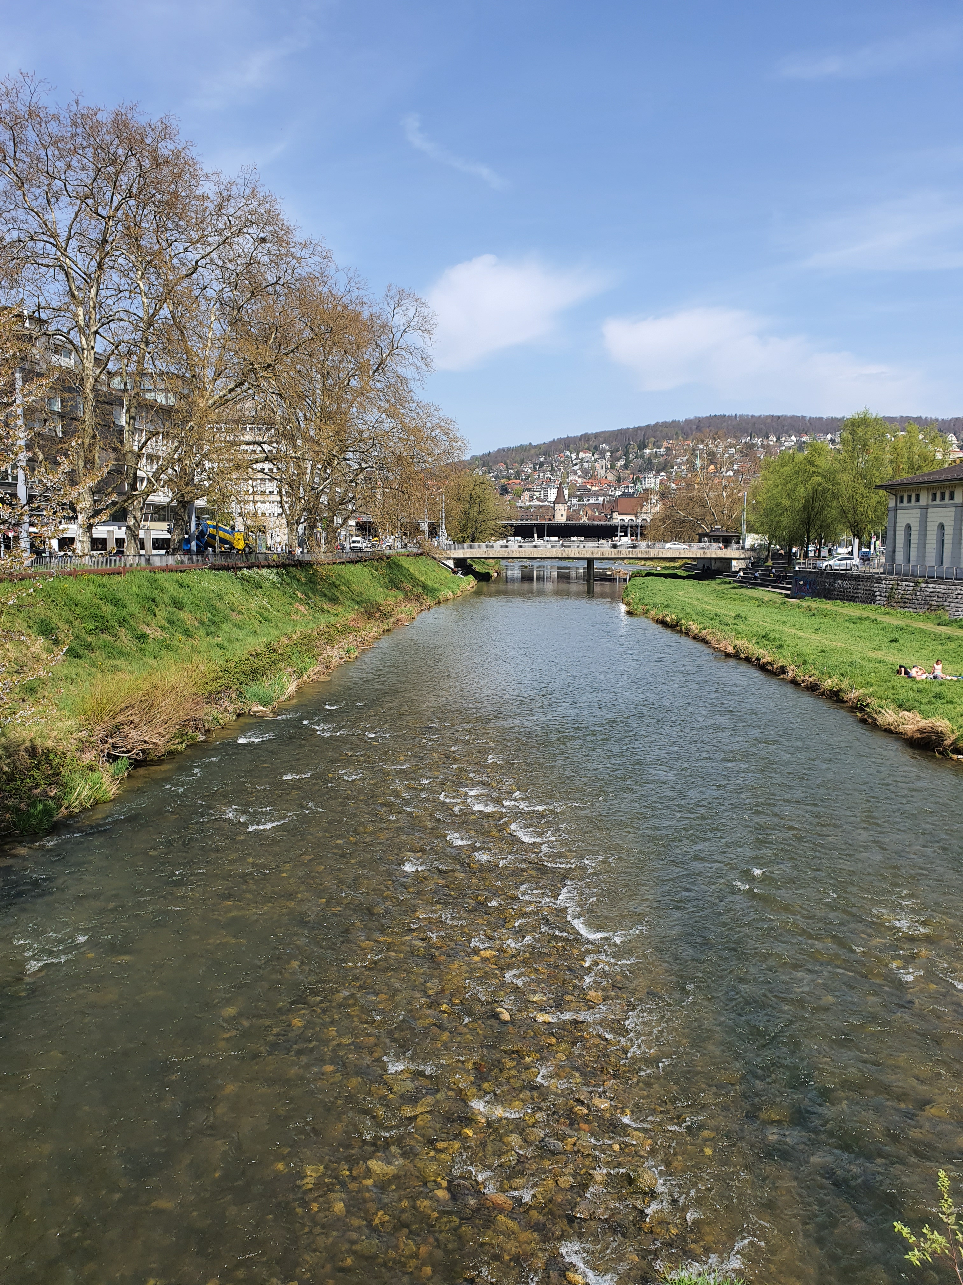
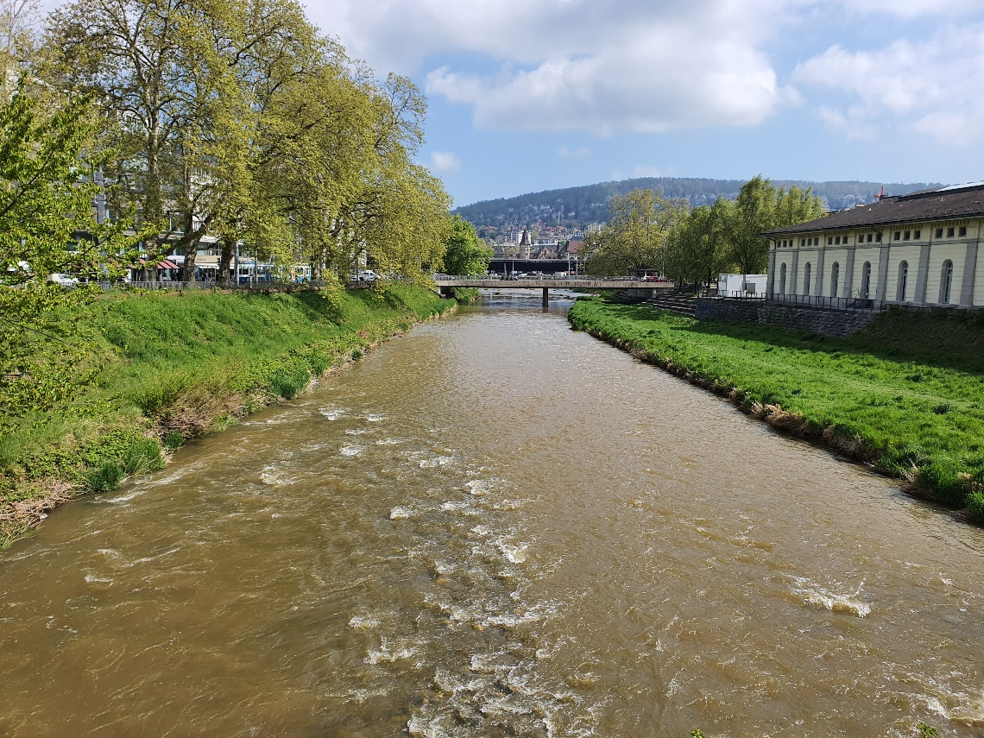
How do you rate the quality of the water in this river?

Slide 8
What is the color of the water?
CLEAR
BROWN

Slide 9
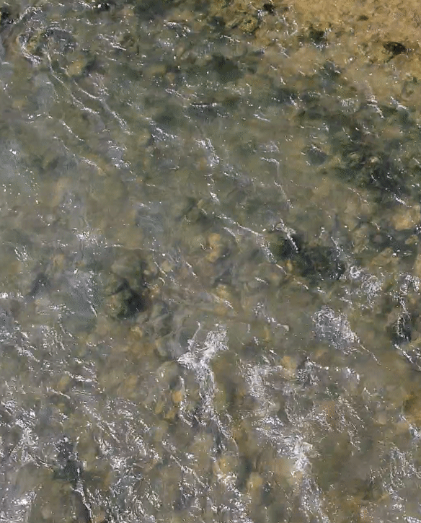
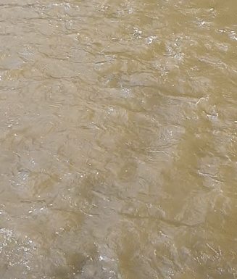
How clear is the water?
CLEAR
SLIGHTLY
MURKY

Slide 10
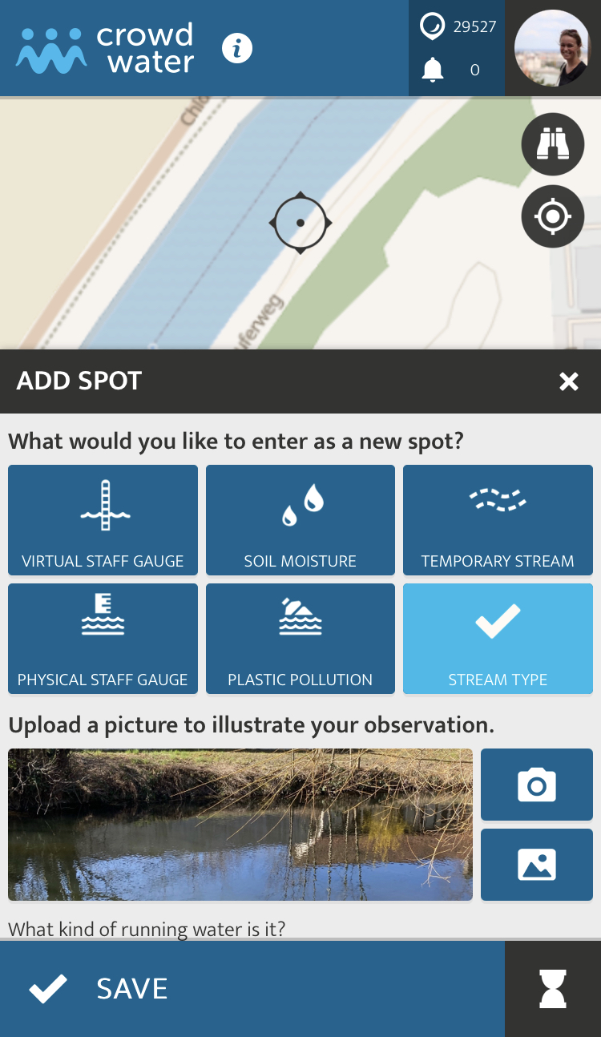
A visual approach for water quality monitoring
Take home messages
Some uncertainties but many observations agree
Possible to observe changes over time
You can already contribute to water quality observations using the stream type category in the CrowdWater app

Slide 11

Thank you for your attention!
sara.blanco@geo.uzh.ch
www.crowdwater.ch

