Slide 1
Imaging water transport across the soil-snow interface using neutron transmission radiography
Michael Lombardo¹, Peter Lehmann², Anders Kastner³, Amelie Fees¹, Alec van Herwijnen¹, Jürg Schweizer¹
1. WSL Institute for Snow and Avalanche Research SLF, Davos, Switzerland
2. Physics of Soils and Terrestrial Ecosystems, ETH Zürich, Zürich, Switzerland
3. Laboratory for Neutron Scattering and Imaging, Paul Scherrer Institute, Villigen, Switzerland

Slide 2
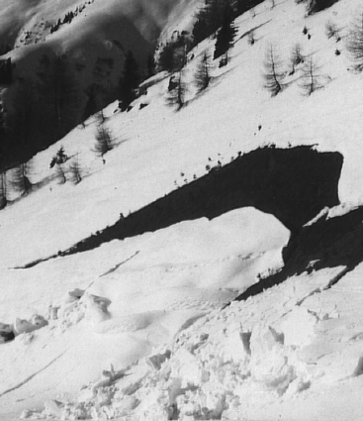
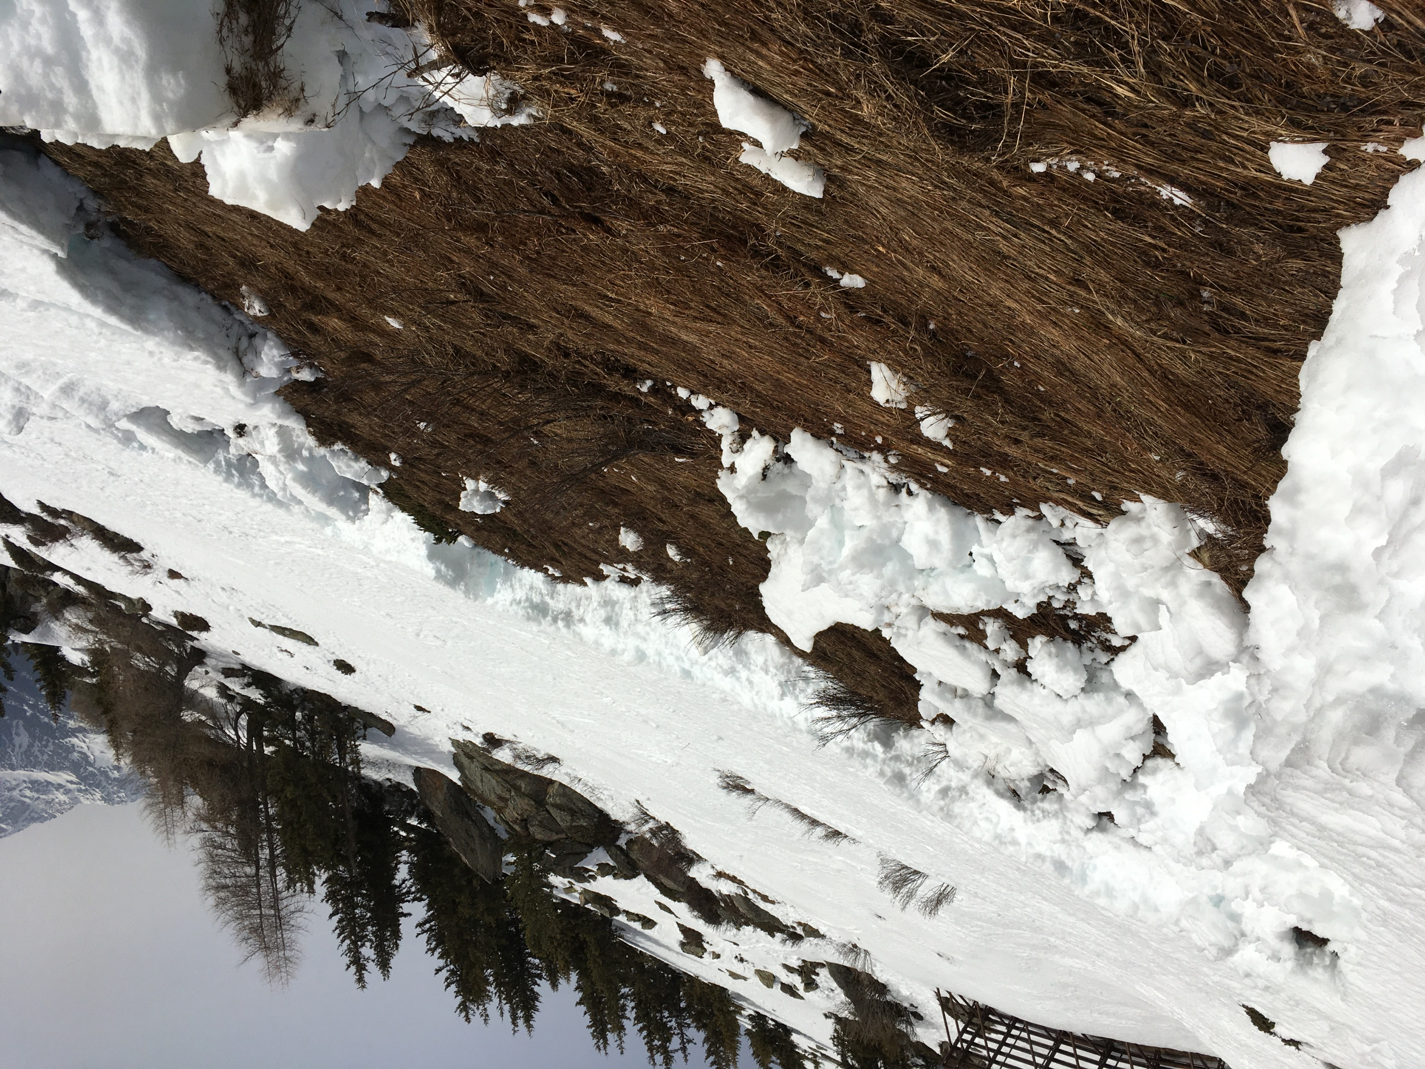
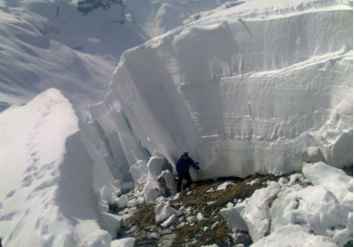
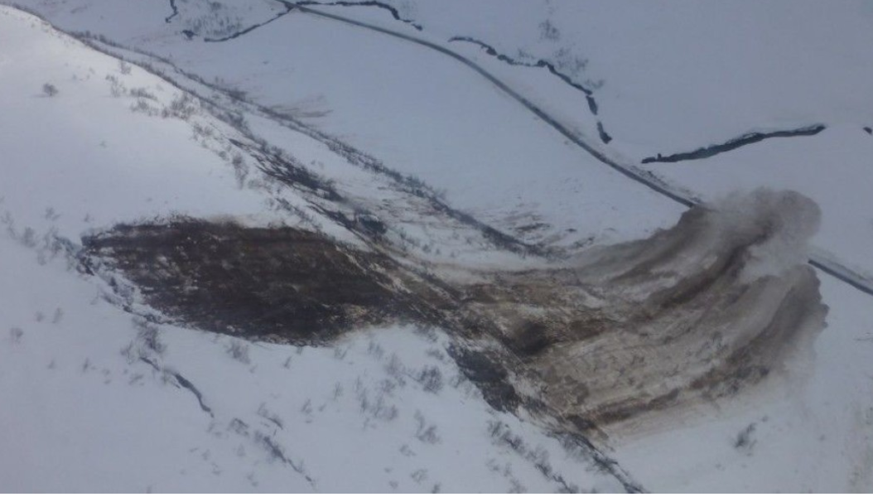
Background
Photo: P. Höller
Photo: A. Fees
Photo: S. Bürgler
Know that interfacial water is important
How is it generated?
Under what conditions is it generated?
How much is needed?
Photo: NRPA

Slide 3

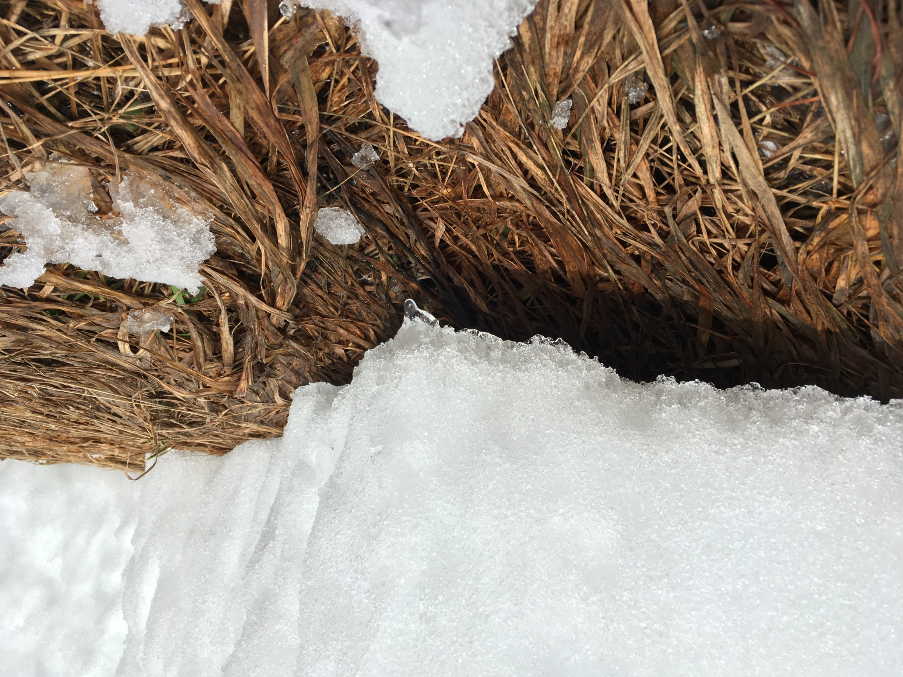



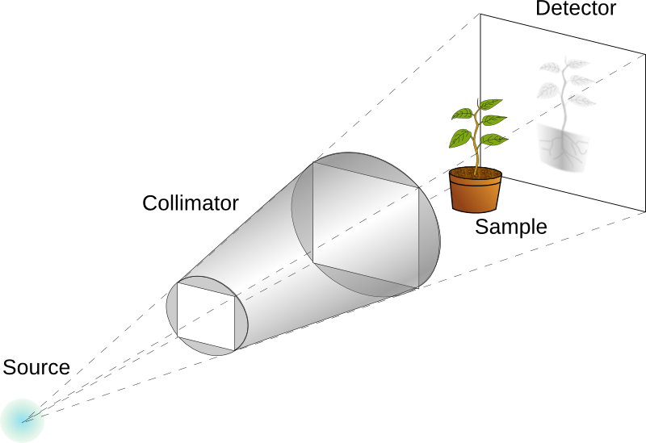
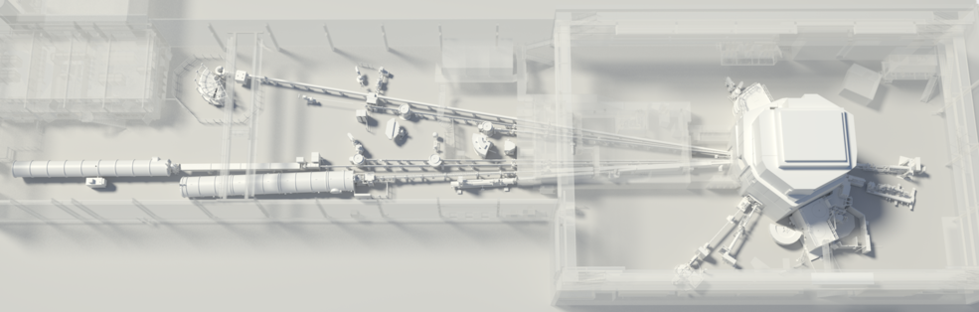
Methods
Field
Lab
Snow
Snow
Vegetation
Gravel
Soil
Sand
H₂O
14 cm x 10 cm x 2 cm
Spallation Neutron Source
(protons → target → neutrons)
Diagram: PSI
NEUTRA
Diagram: PSI

Slide 4
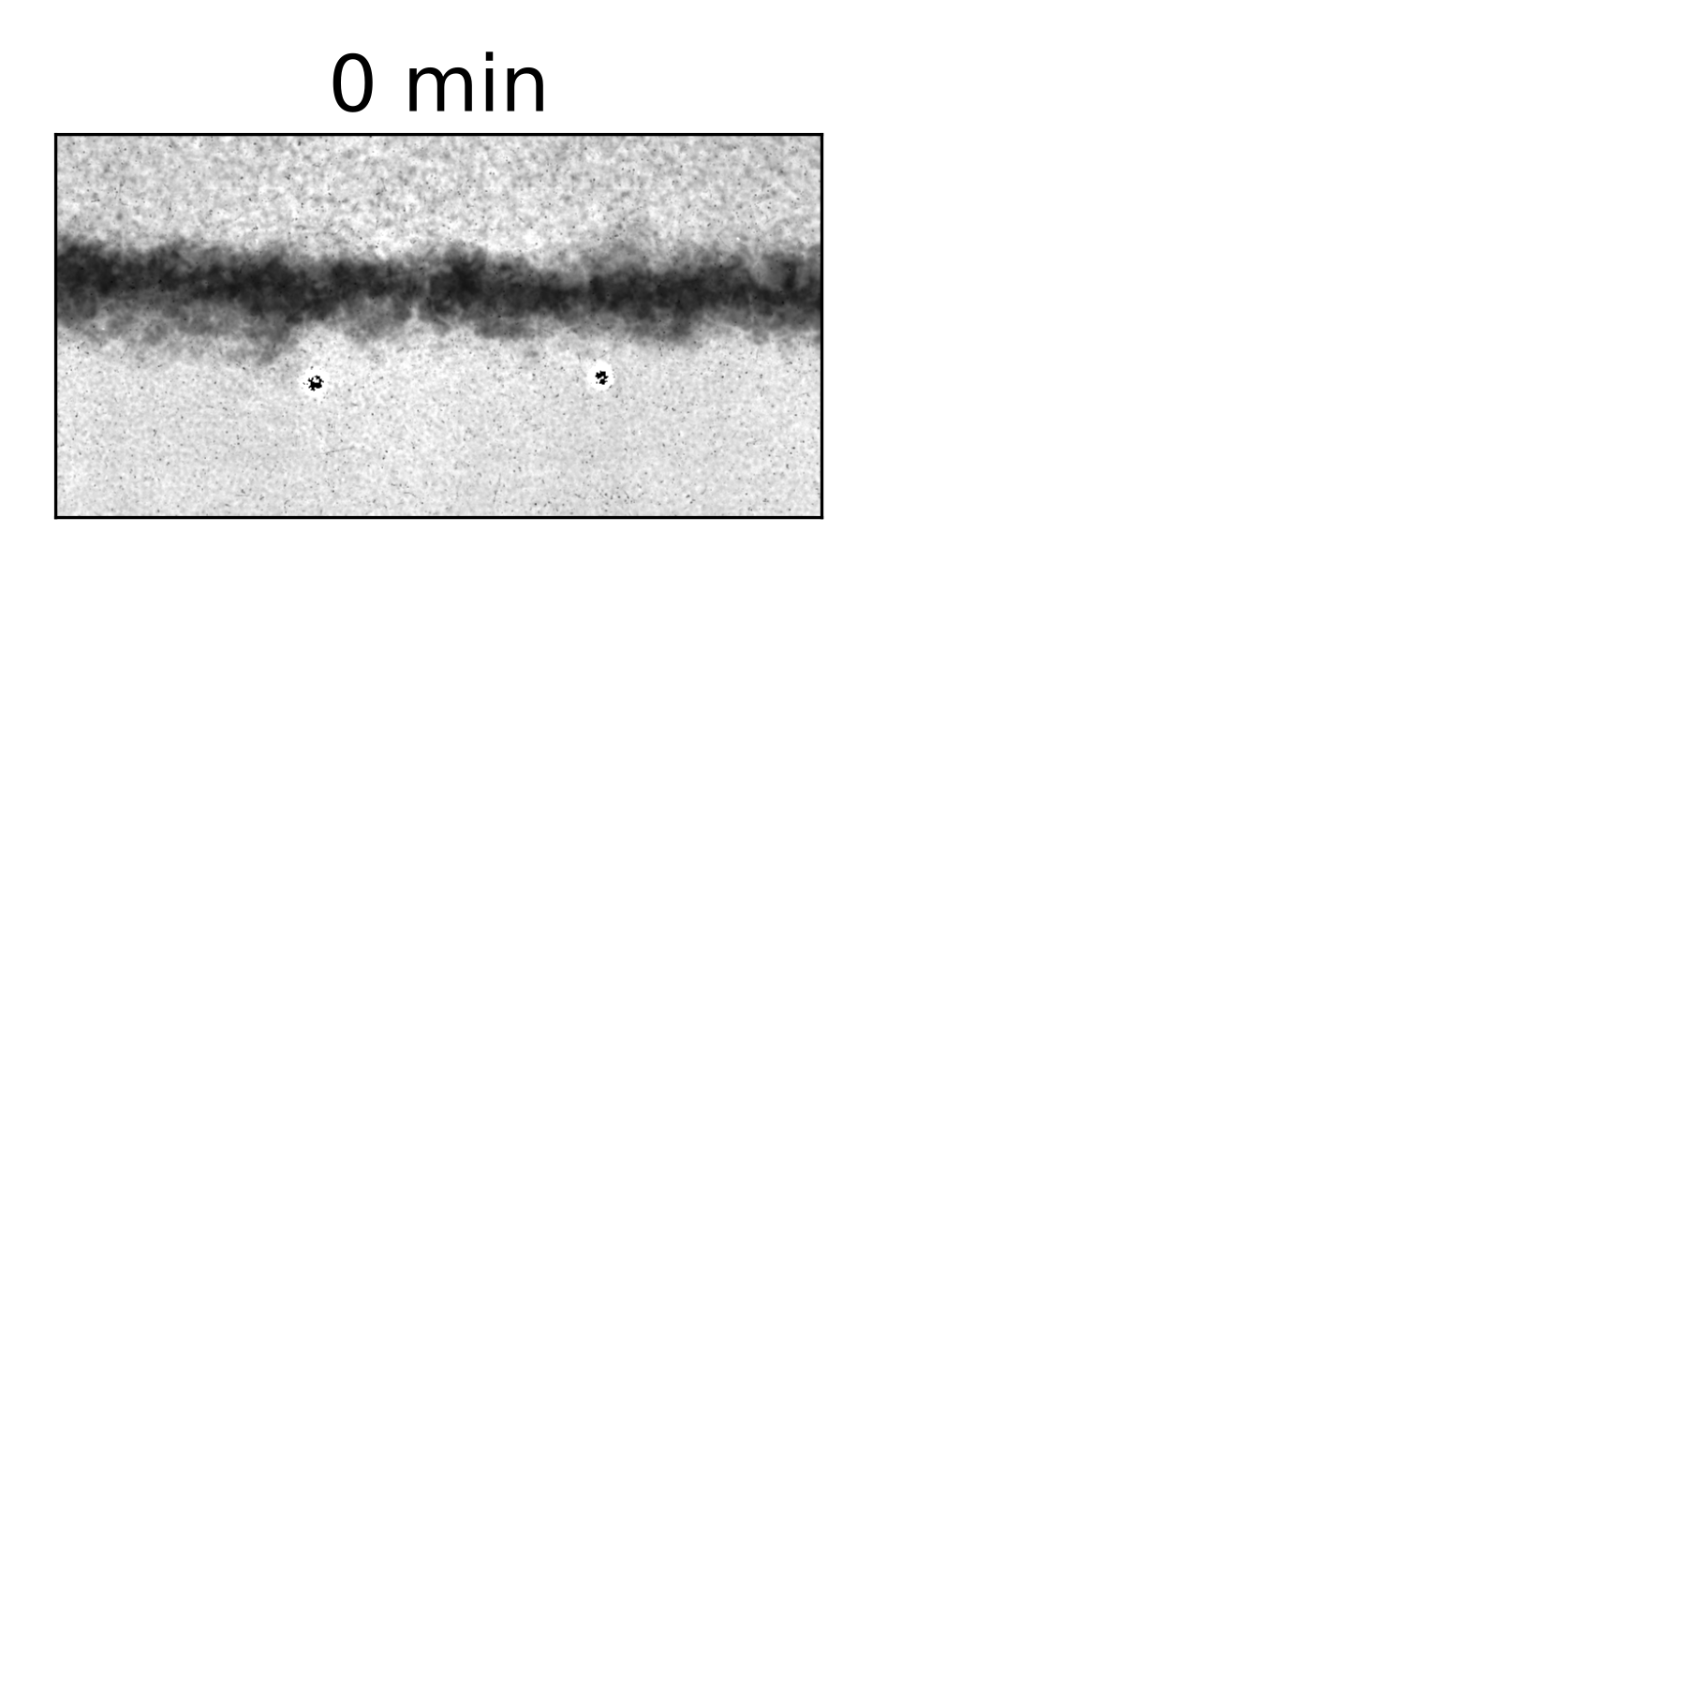
Results
white = more water
black = less water
snow
gravel
sand
25 mm

Slide 5
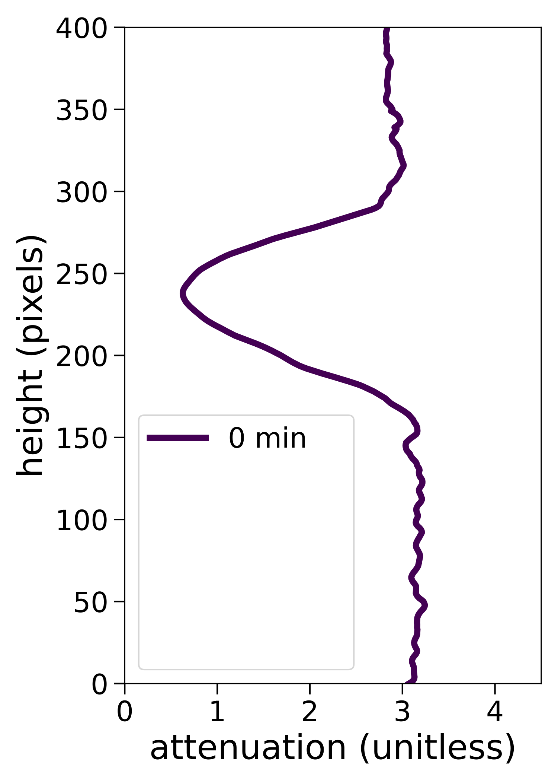
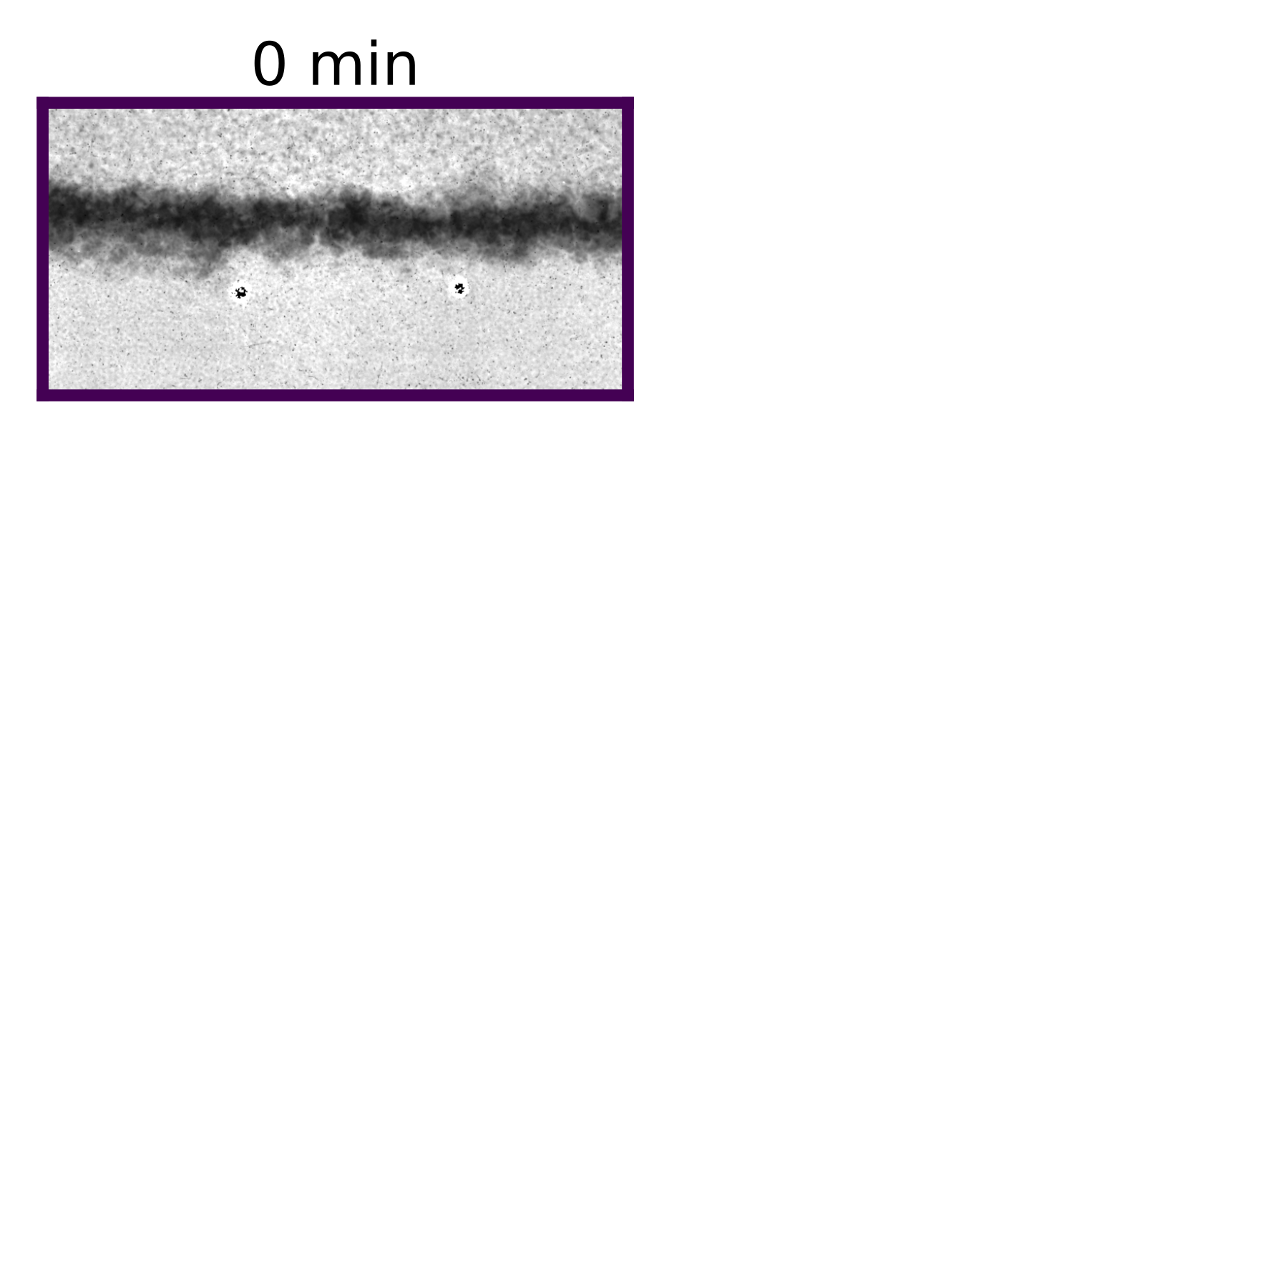
Results
white = more water
black = less water
snow
gravel
sand
25 mm
water content

Slide 6
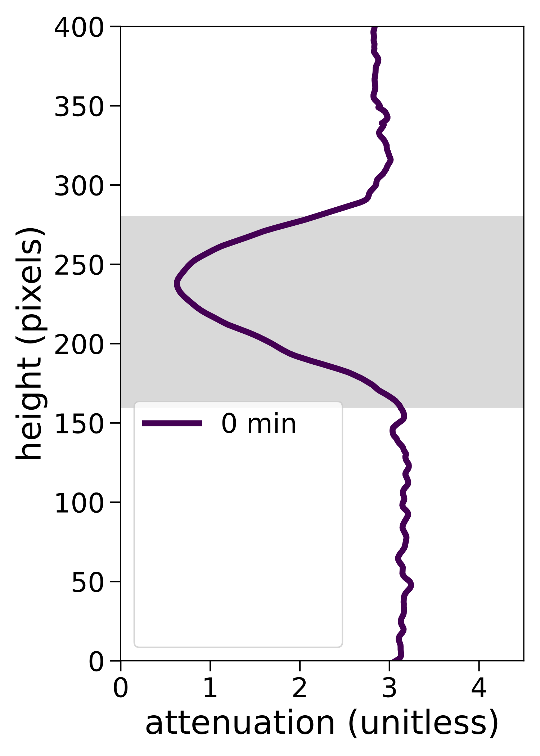
Results
white = more water
black = less water
snow
snow
gravel
sand
gravel
sand
25 mm
water content

Slide 7
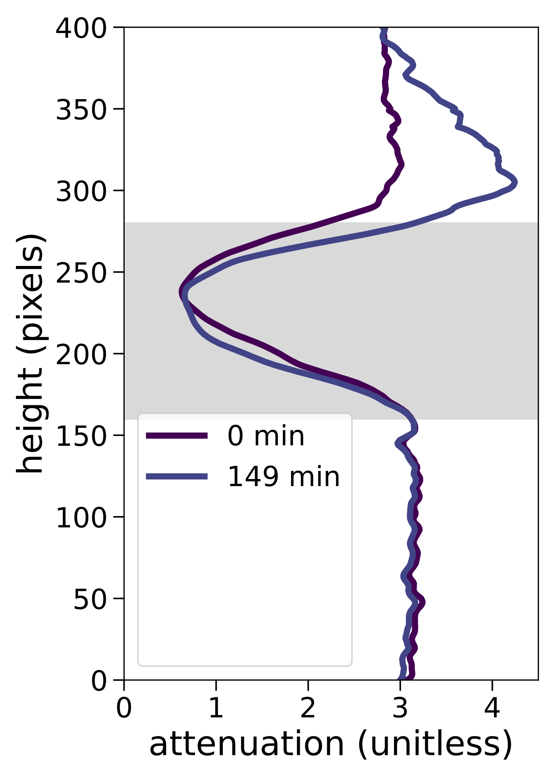
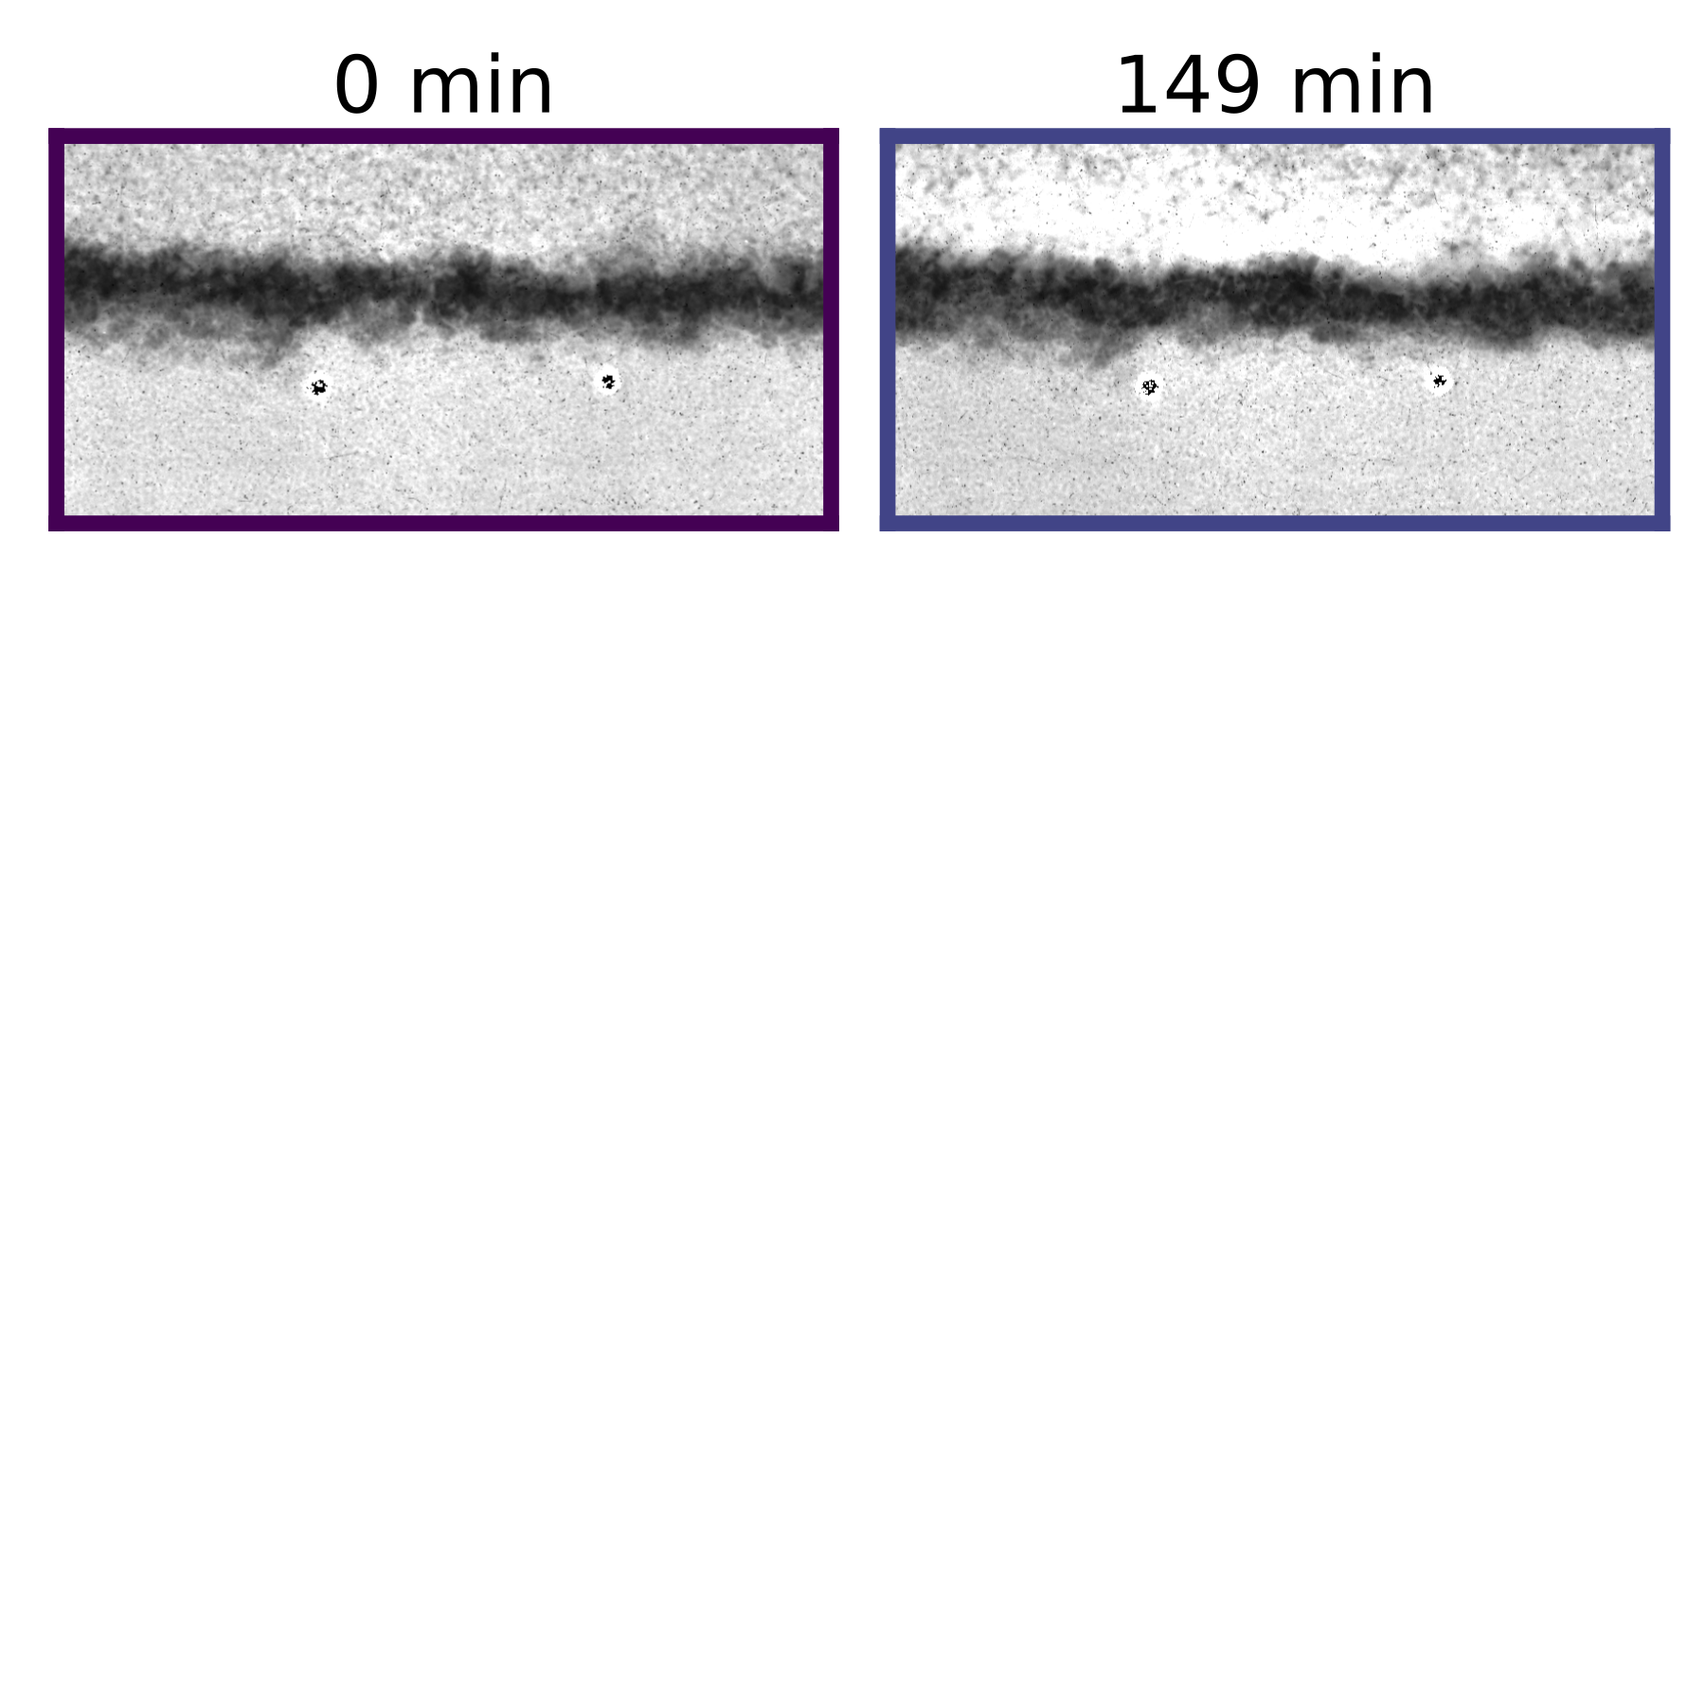
Results
white = more water
black = less water
snow
snow
gravel
sand
gravel
sand
25 mm
water content

Slide 8
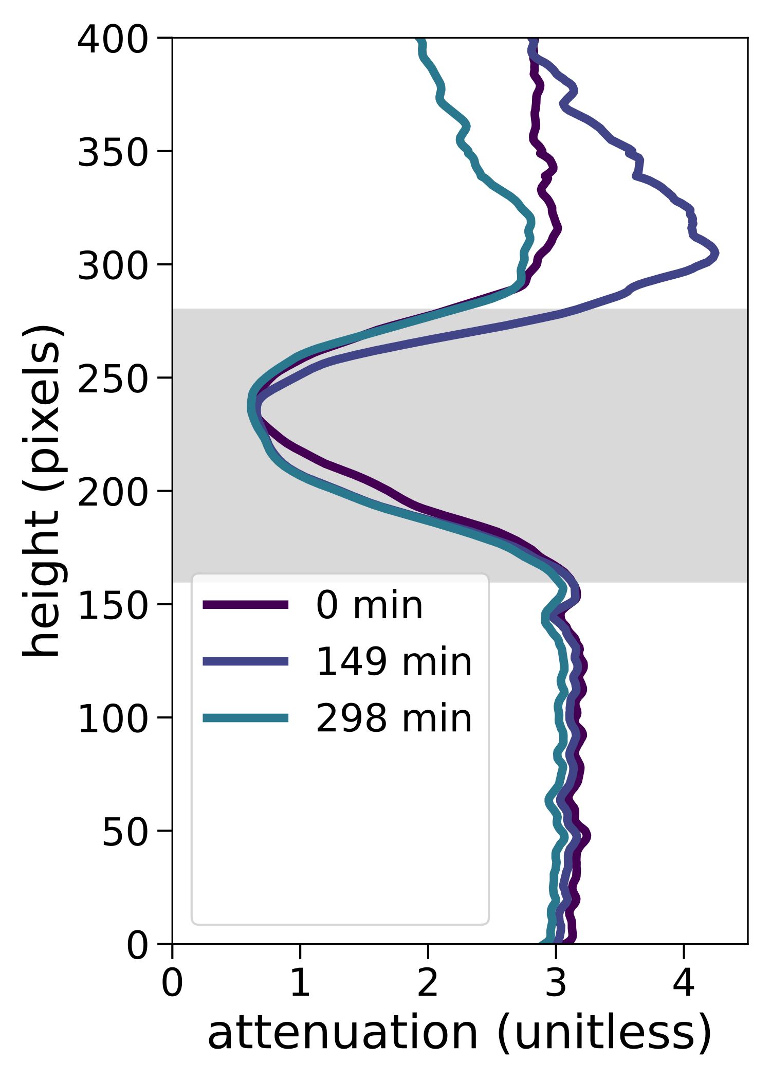
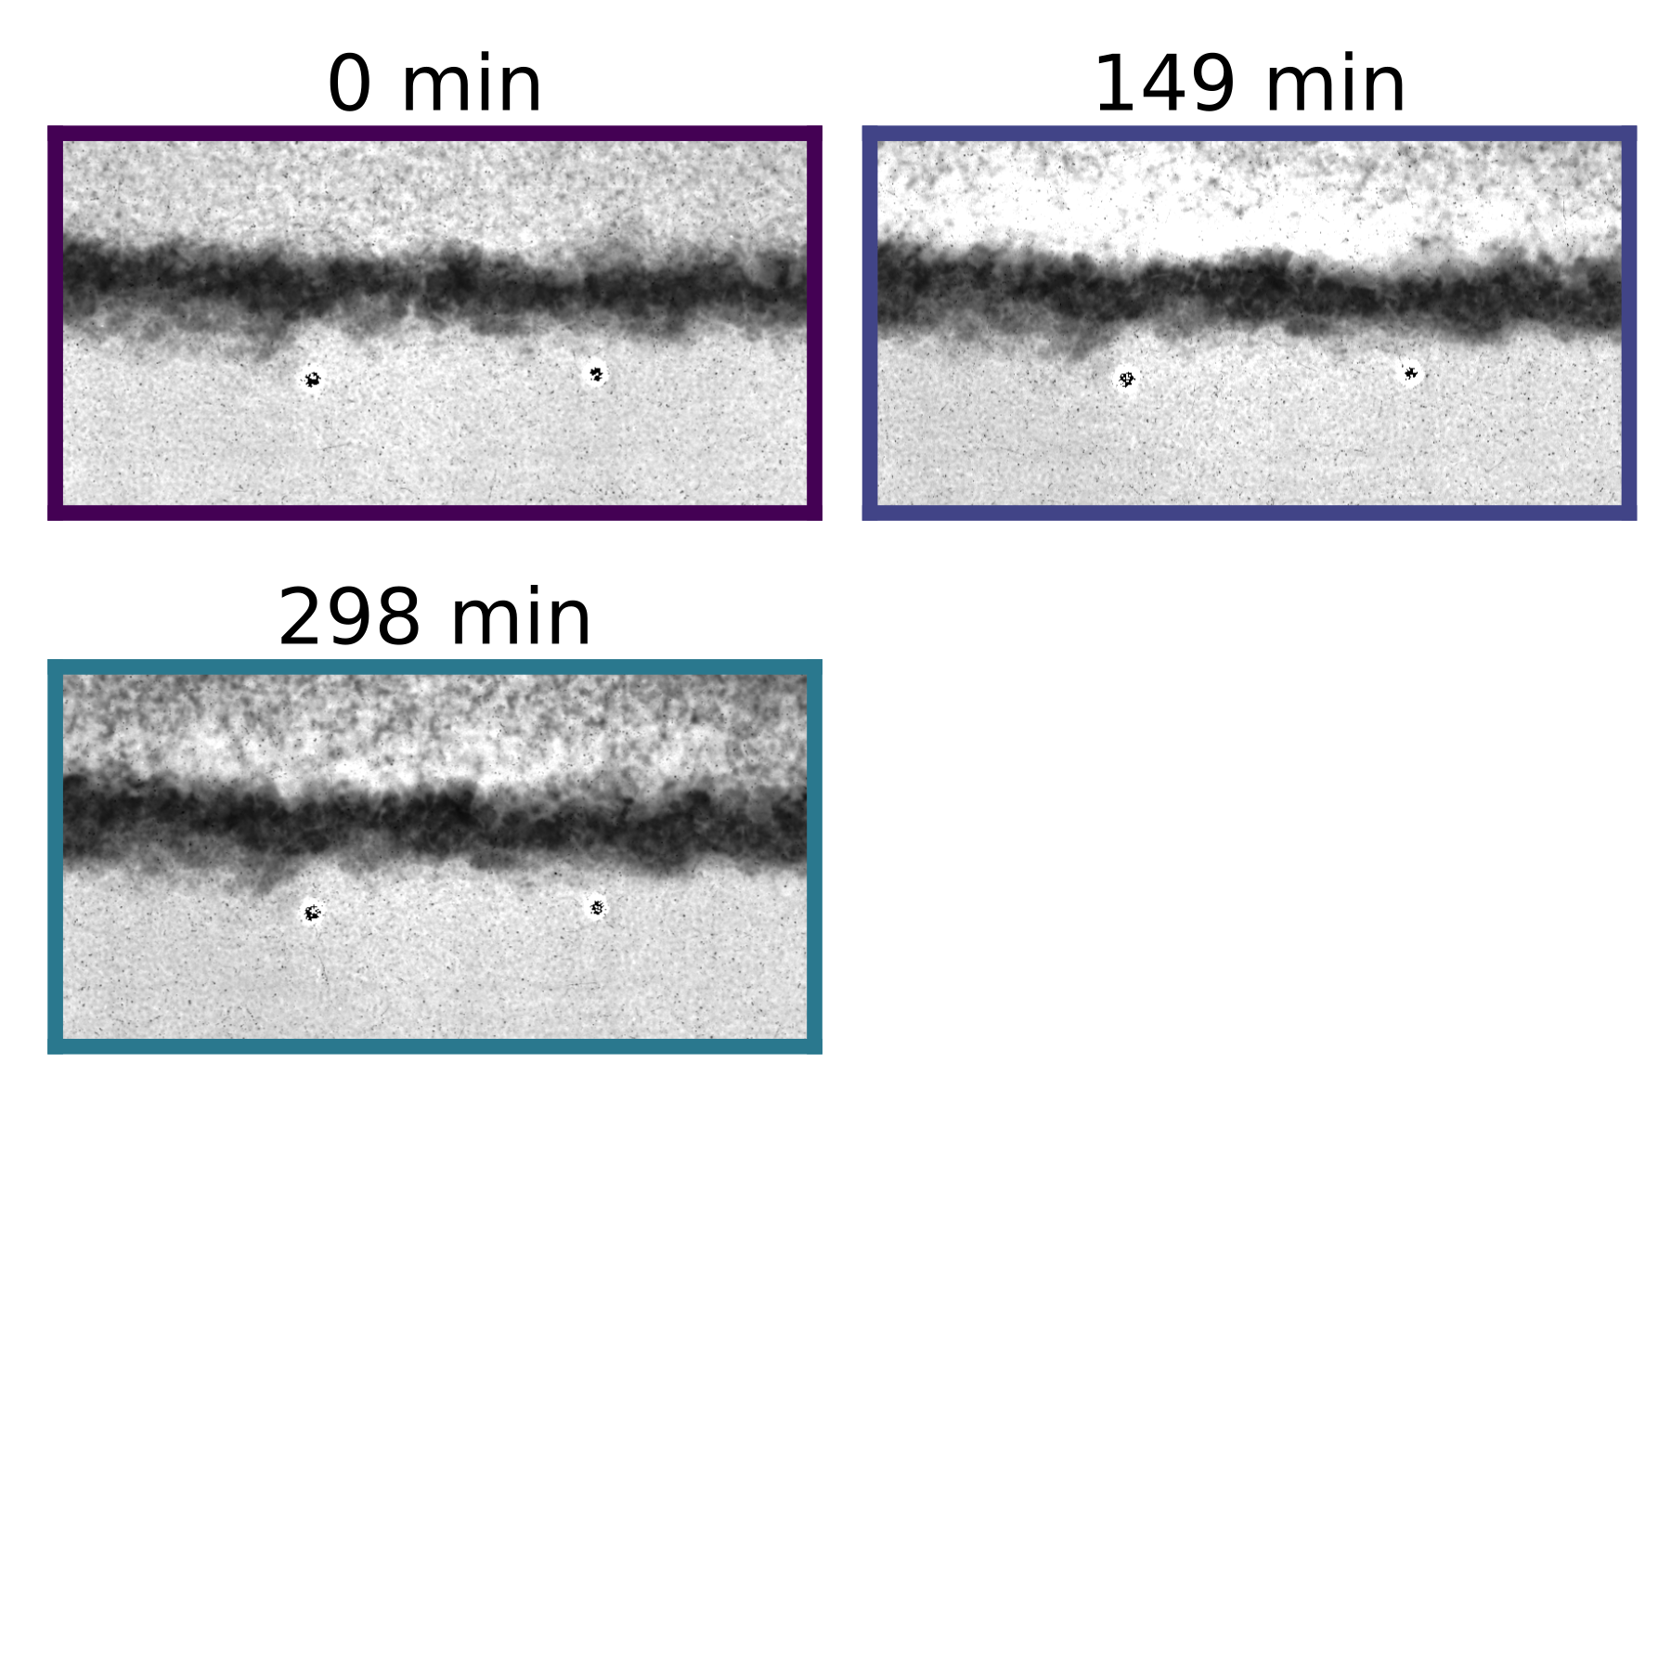
Results
white = more water
black = less water
snow
snow
gravel
sand
gravel
sand
25 mm
water content

Slide 9
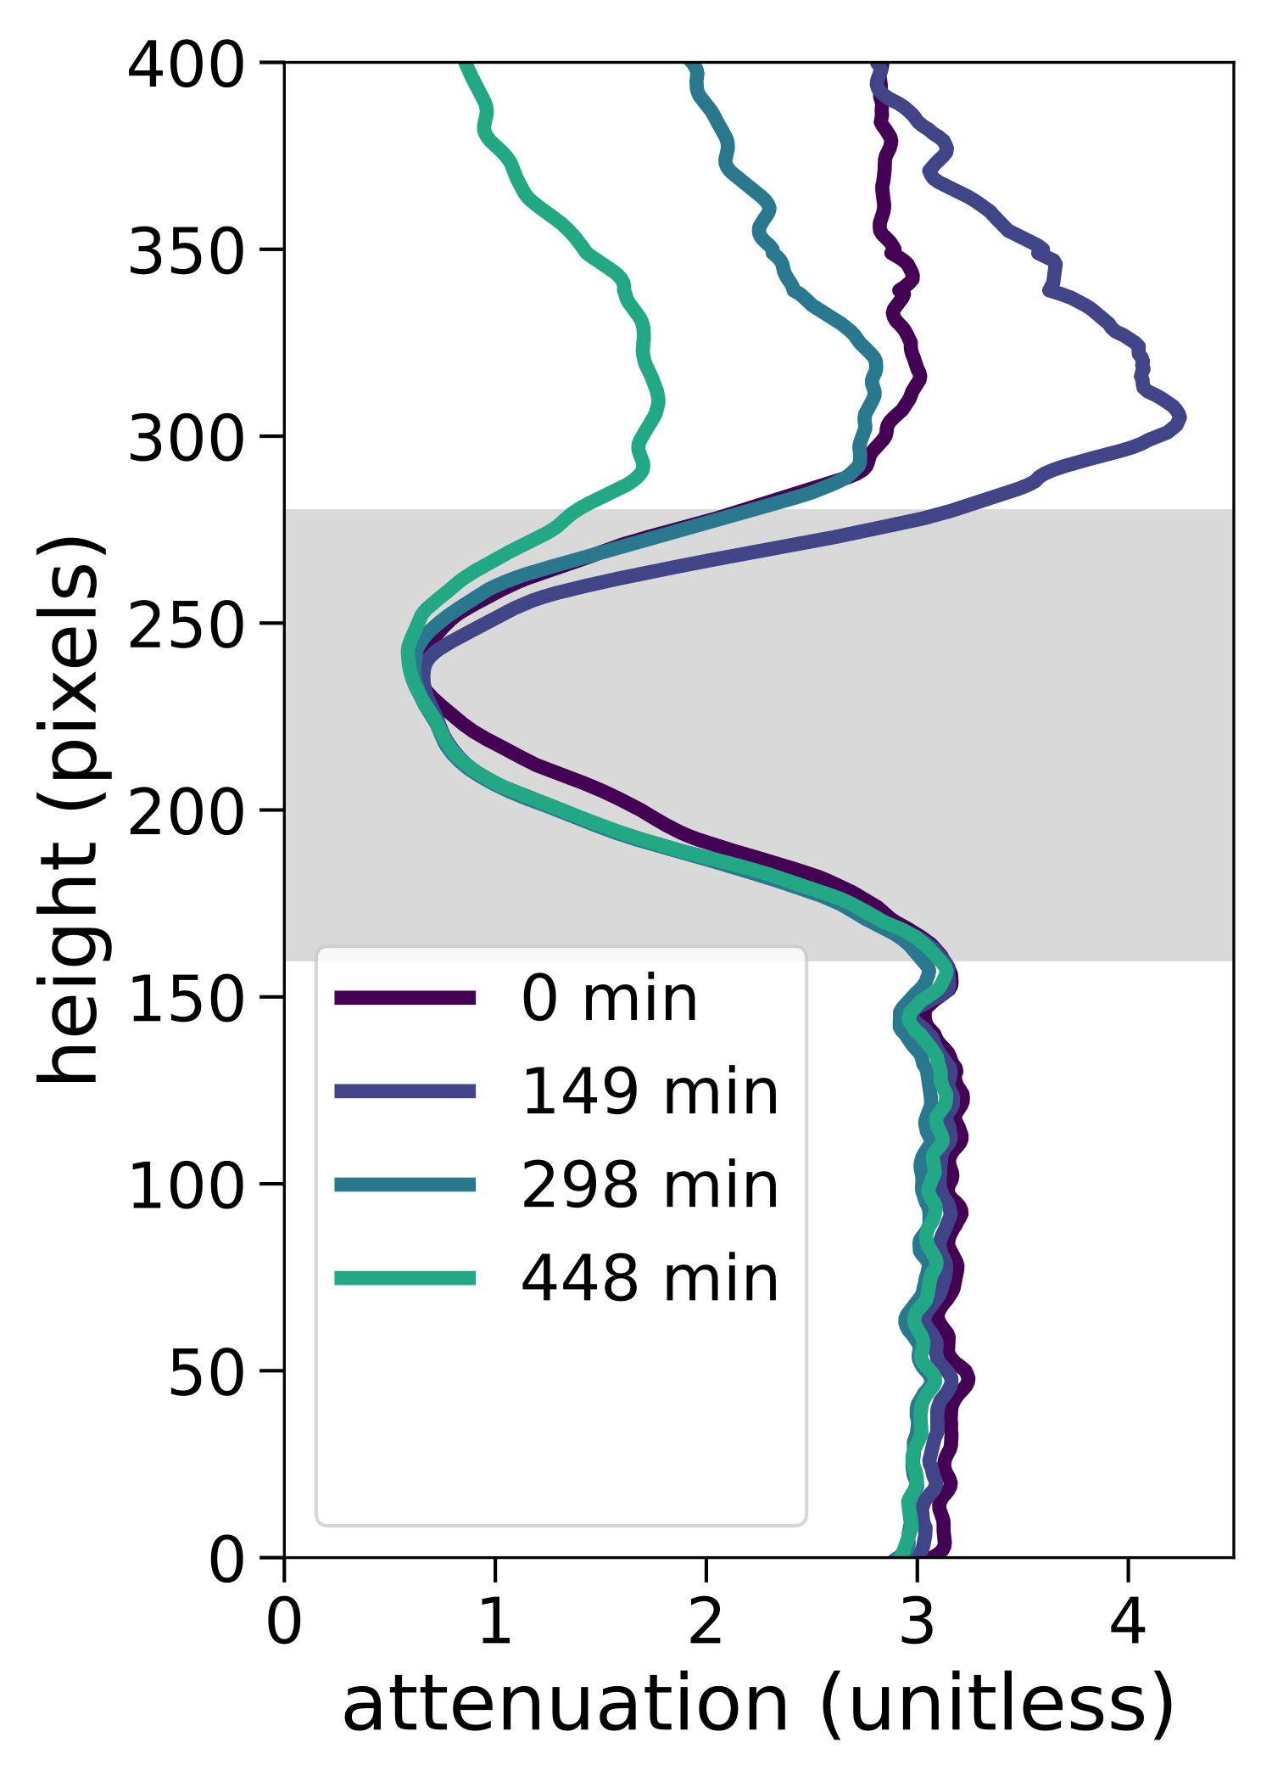
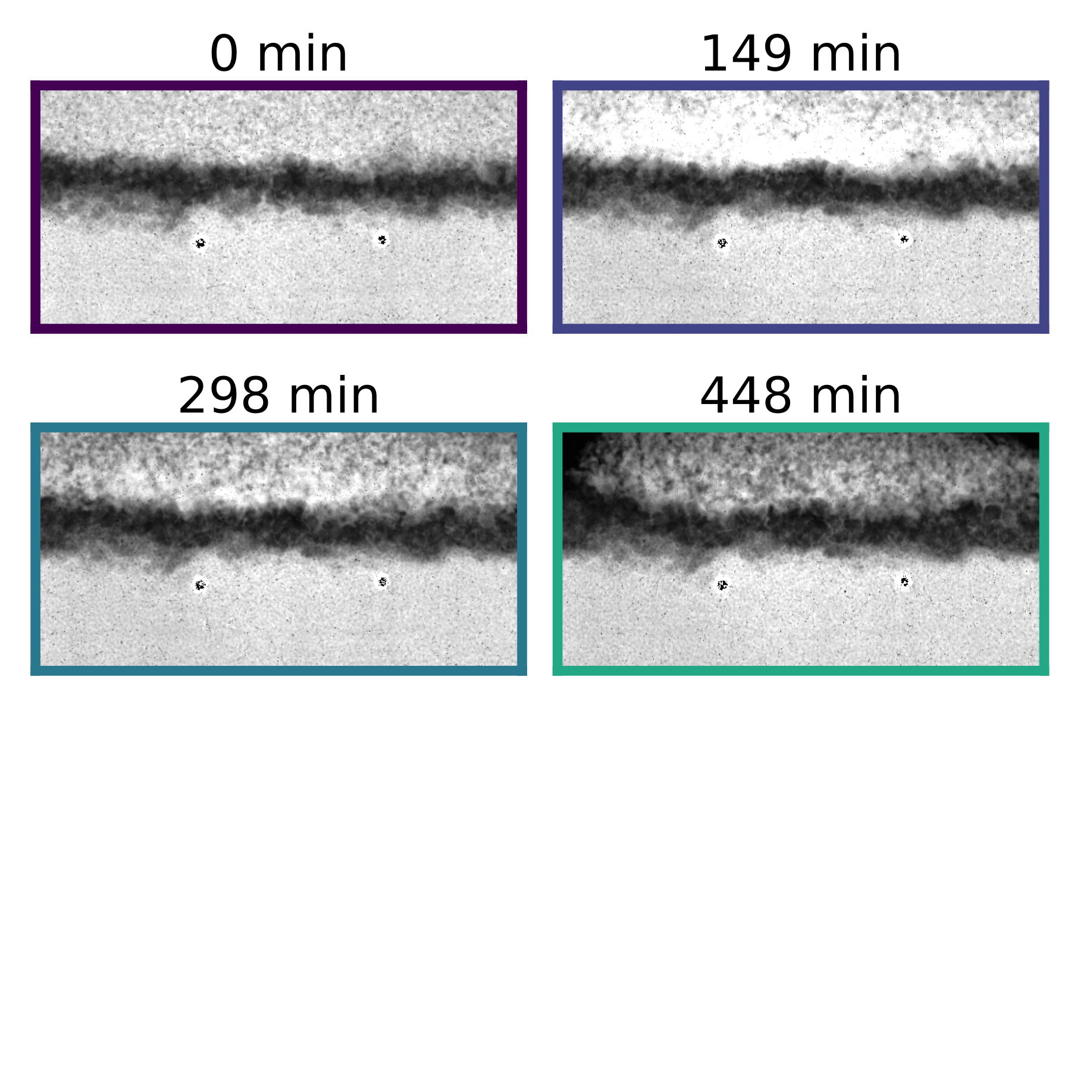
Results
white = more water
black = less water
snow/air
snow
gravel
sand
gravel
sand
25 mm
water content

Slide 10
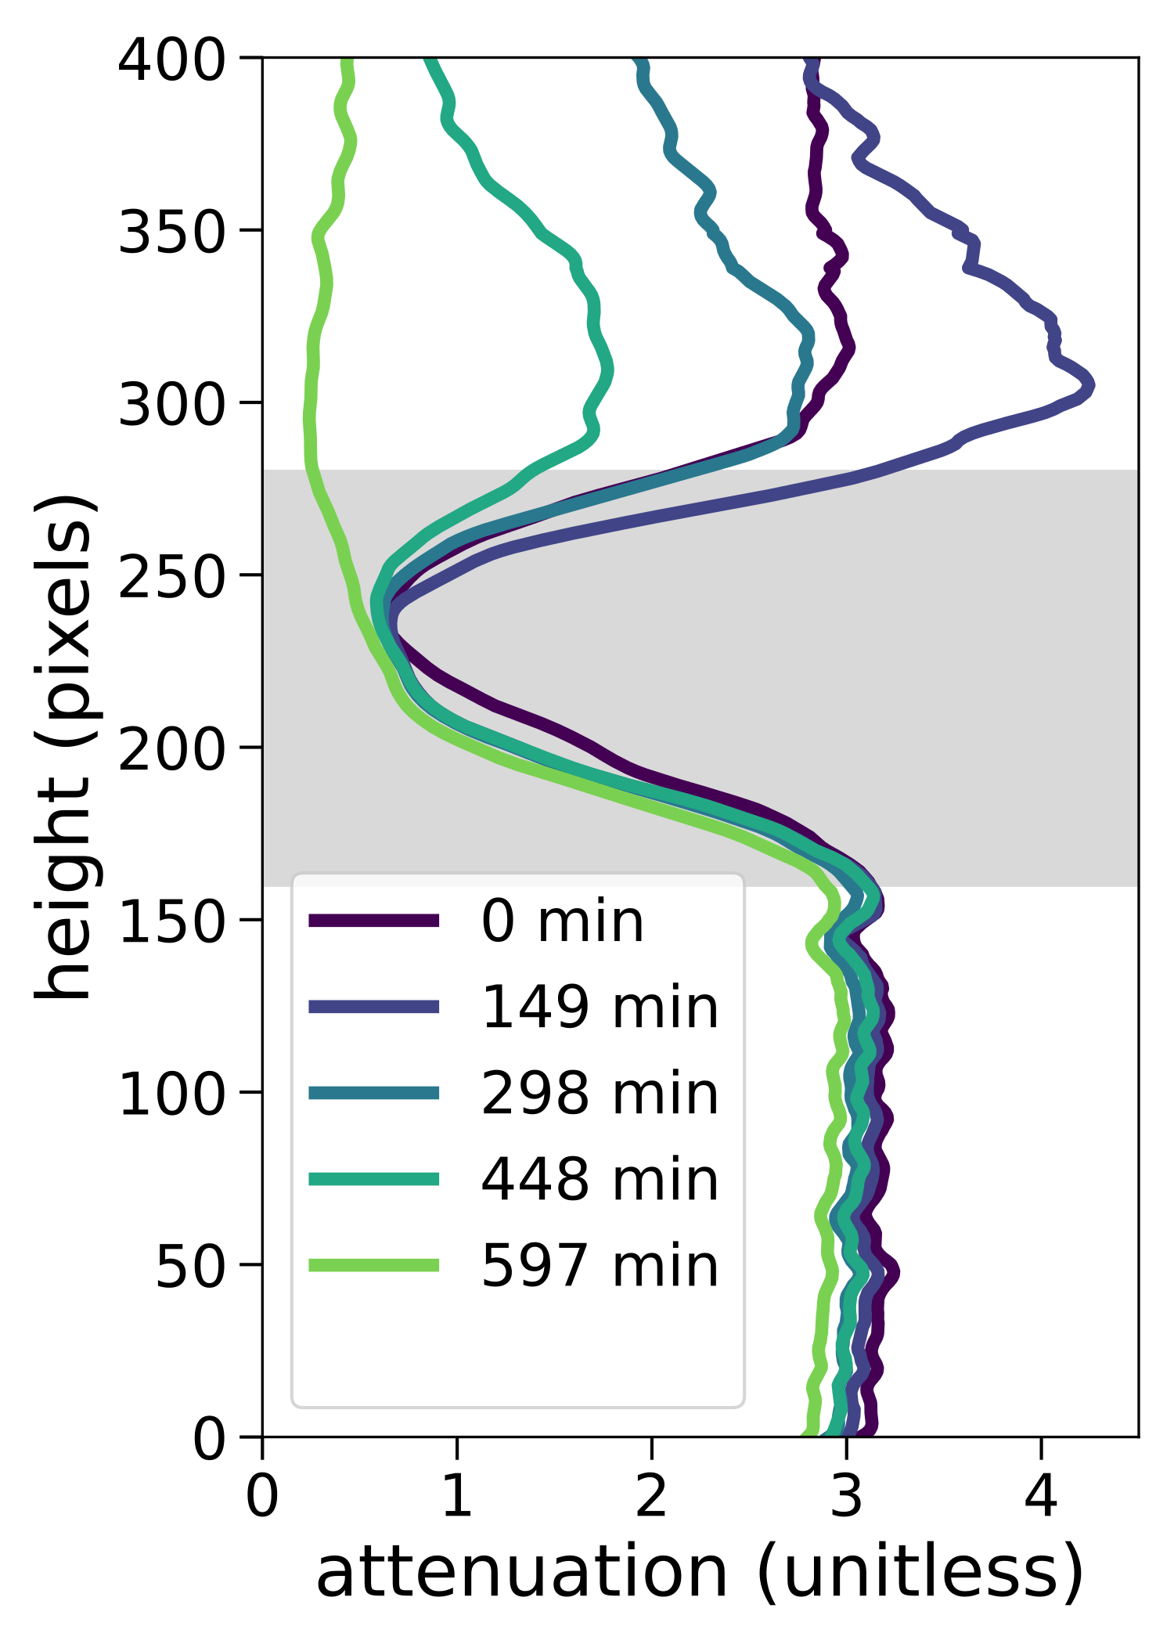
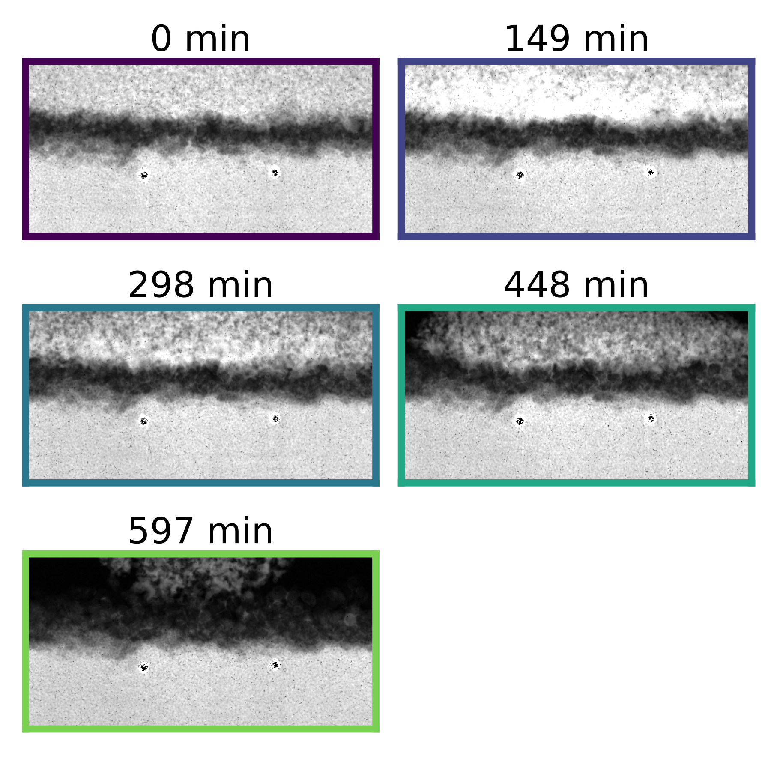
Results
white = more water
black = less water
snow/air
snow
gravel
sand
gravel
sand
25 mm
water content

Slide 11
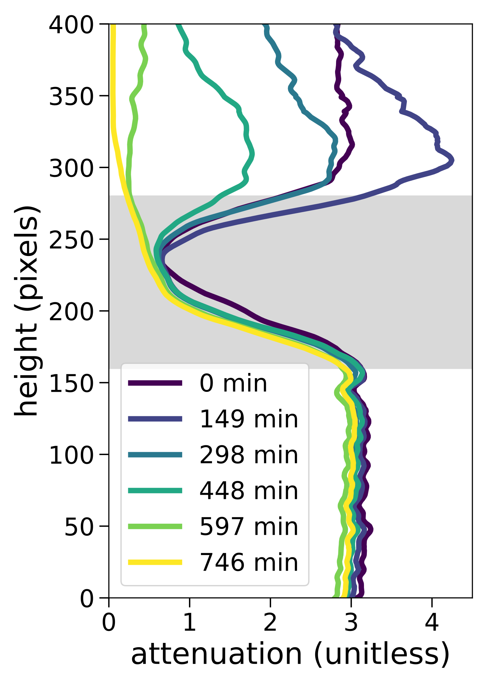
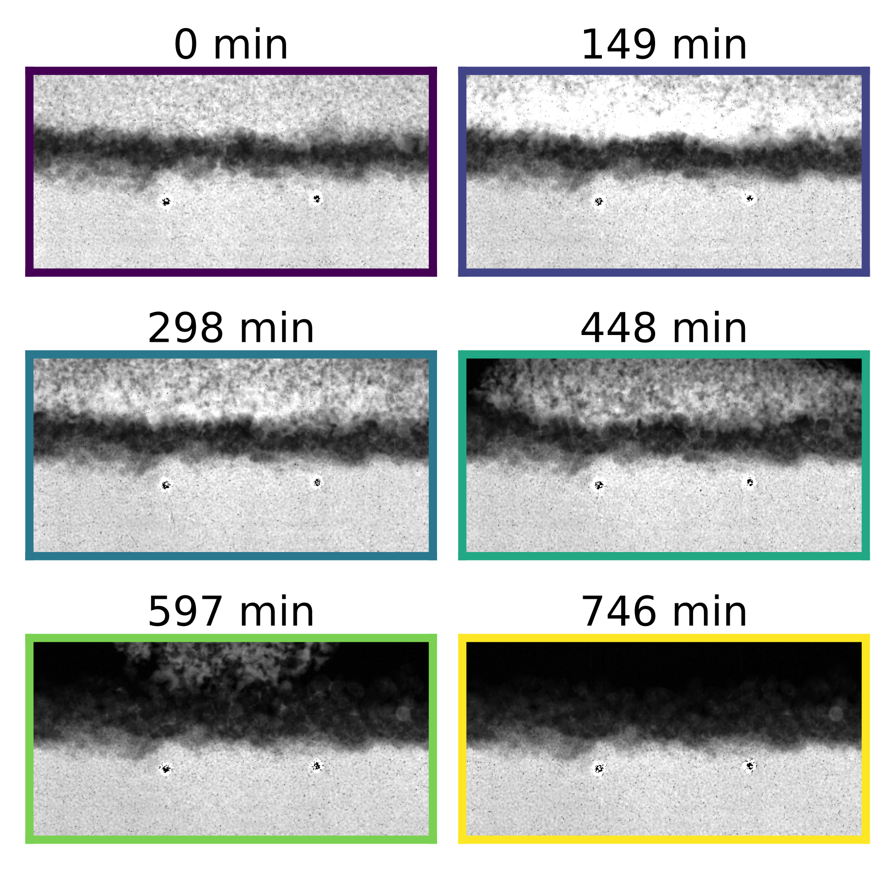
Results
white = more water
black = less water
air
snow
gravel
sand
gravel
sand
air
gravel
sand
25 mm
water content

Slide 12
Conclusions and Future Work
Neutron transmission radiography can be used to measure liquid water content changes across the soil-snow interface
Capillary barriers can cause accumulation of interfacial water
Future experiments to test effects of:
interface
melting rates
snow and soil properties

