Slide 1

European soil observatory (EUSO) structure and perspectives
Vienna | Austria & Online 23 – 27 May 2022
Wed, 25 May, 13:56–14:02 Room D3
European Geosciences Union General Assembly 2022
Calogero Schillaci, Anna Muntwyler, Anne Marechal, Alberto Orgiazzi, Arwyn Jones, Constantin Ciupagea, Daniele Belitrandi, Daniela De Medici, Daniele De Rosa, Diana Vieira, Francis Matthews, Juan Martin-Jimenez, Julia Koeninger, Leonidas Liakos, Luca Montanarella, Maeva Labouyrie, Marc van Liedekerke, Panos Panagos, Simone Scarpa, and Piotr Wojda
European Commission Joint Research Centre, Via E. Fermi 2749 Ispra, Italy
Notes:
The European Soil Observatory (EUSO) was launched in December 2020 to generate and disseminate policy-relevant and harmonized EU–wide soil data and indicators in support of the soil perspectives of the EU Green Deal, in particular the new Soil Strategy and the Mission on Soil Health and Food.
Among the activities of the Observatory, paramount importance is placed on the development of an EU-wide soil monitoring system, to assess progress towards soil-related targets, to support research & innovation and provide a European Soil Forum dedicated to a broad user base (citizens, farmers, land planners, scientists). These features will be an important step in providing access to a huge range of soil-related data through dedicated data-streams, from biodiversity to heavy metal concentrations.

Slide 2
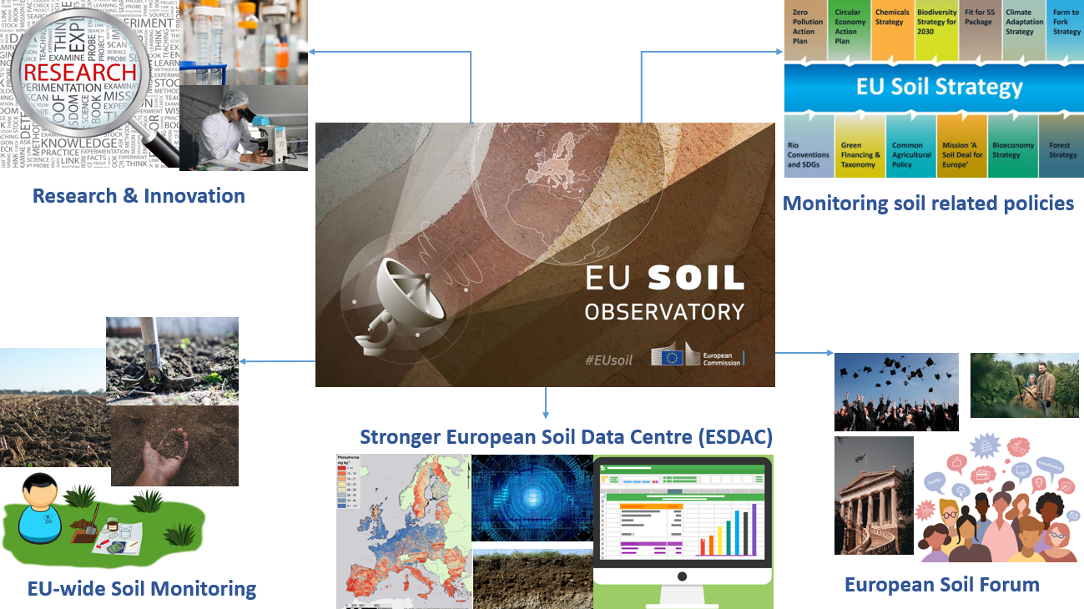
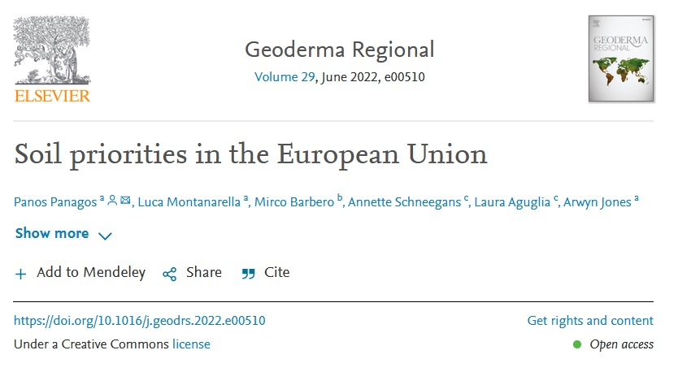
Vision
Should become the principal provider of reference data and knowledge at EU-level for all matters relating to soil.
Soil priorities in the European Union
Panos Panagos et al., 2022 Geoderma Regional Volume 29, June 2022, e00510
Notes:
The EUSO will establish a comprehensive dashboard containing indicators that present data on soil-related issues within and, in some cases, outside of the EU. Examples of indicators i include soil erosion, soil carbon, pollutants and soil nutrients (phosphorus, nitrogen, potassium) with relevance to the new EU Soil Strategy, the Common Agricultural Policy (CAP), Zero Pollution Action Plan and Sustainable Development Goals (SDGs).

Slide 3
Mission of the EUSO
To provide a dynamic and inclusive platform that supports EU soil-related policymaking.
To provide the relevant Commission Services, together with the broader soil user community, with the knowledge and data flows needed to safeguard and restore soils.
To support, and benefit from, EU Research & Innovation on soils while raising societal awareness of the value and importance of soils to the lives of citizens.
closely collaborate with relevant EU Agencies (e.g. EEA, EFSA, ECA) and Horizon Europe’s Soil Mission.
….to support EU policies by ensuring that the Commission is able to fully capitalise on the information made available through integrated data flows by transitioning from simply monitoring to understanding.
Notes:
The EUSO will support the implementation of all soil related objectives of the European Green Deal.

Slide 4
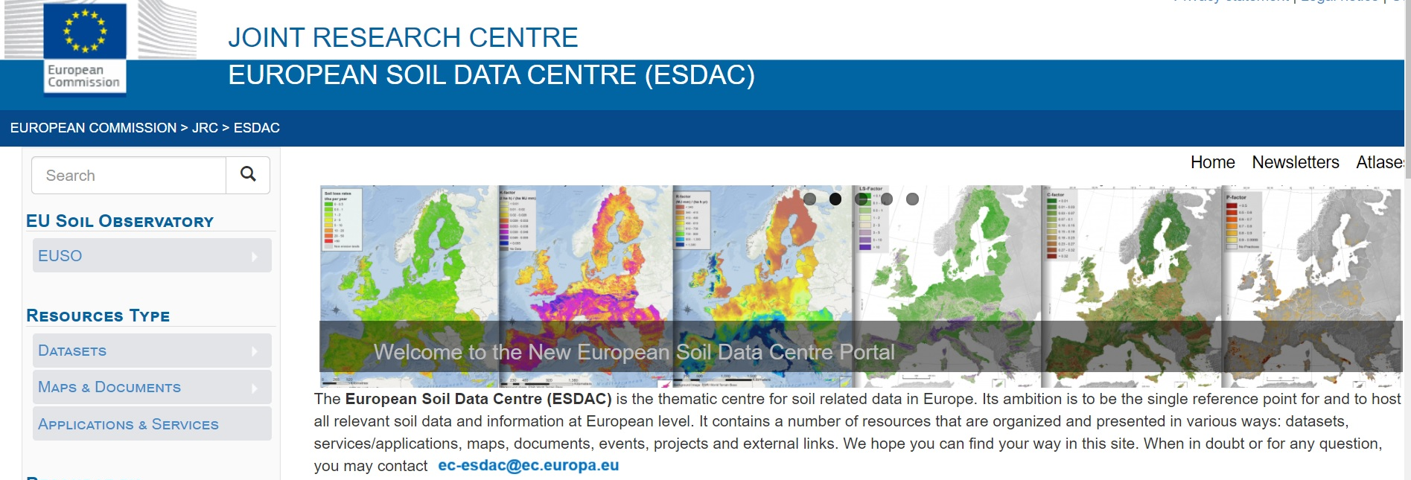
EUSO...building on ESDAC:
a one-stop hub for soil data at EU-scale with a long-term commitment by JRC (since 2006),
it is providing EU and European-wide datasets, and associated documentation
permanent and timely active helpdesk, continuous updates and news (Newsletters)
wide audience; mailing lists (for ESDAC and EUSO) most visited website in JRC
Data are FAIR (findable: try Google “European soil data etc”!)

Slide 5
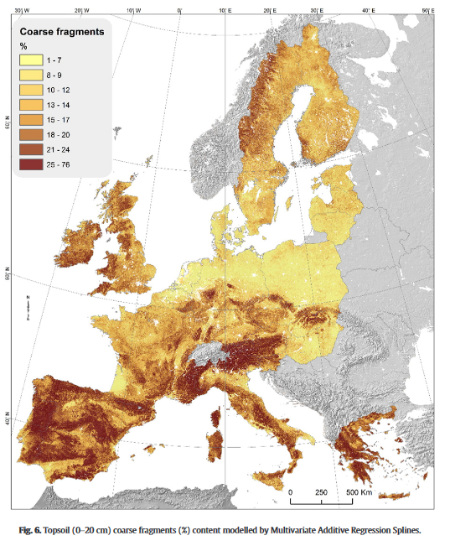
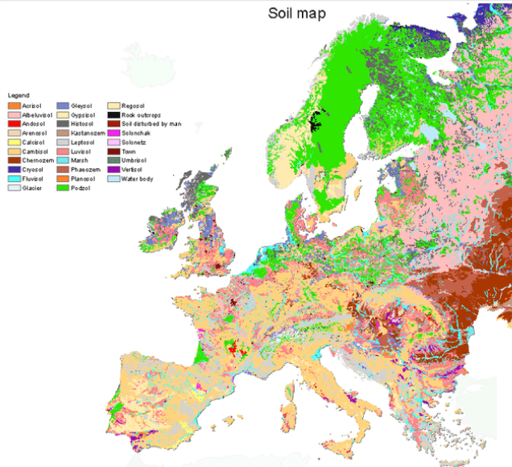
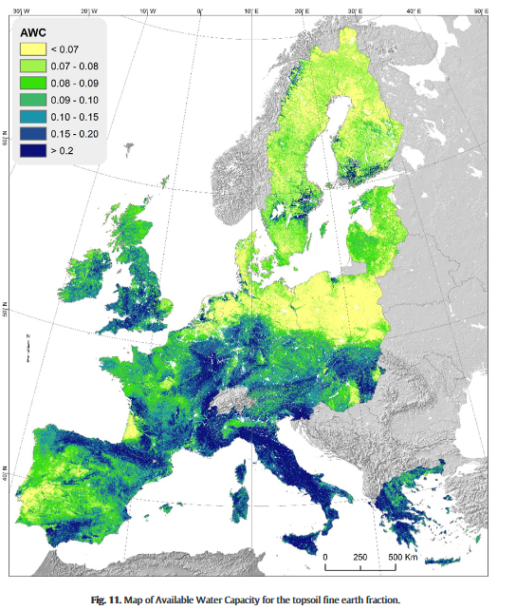
ESDAC datasets
On the basis of the 2009 LUCAS soil data,
maps have been created using advanced geospatial techniques;
Topsoil physical properties - 500m raster
Clay, Sand, Silt (%)
Coarse Fragments (%)
Bulk Density (T m-3)
Available Water Capacity
European Soil Database
Available since 2000
Scale 1:1,000,000
Vector and rasterized (1km; interpretation)
Many properties
For continental or regional use
https://esdac.jrc.ec.europa.eu/resource-type/datasets
Notes:
ESDAC at this moment hosts many datasets, categorized broadly as:
The European Soil Database (2004) and derived data; (ESBN)
LUCAS soil data for 2009/2012 and 2015 (soon also 2018) (Eurostat)
In-house modelling data at EU-scale (soil properties, threats, functions);
along with peer-reviewed JRC publications and EU reports

Slide 6


Organization of the EUSO
Steering Committee
The Steering Committee will be composed of representatives of the main Commission Services with relevant to soil policy.
Secretariat
The JRC provides the Secretariat of the Observatory. The Secretariat will: assure the daily operation of the EUSO and European Soil Data Centre (ESDAC), organise the regular meetings of the Steering Committee (including updating the Terms of Reference), prepare an annual work programme, develop communication material (newsletters, bulletin, etc.).
Technical Working Groups
To support the implementation and operation of the EUSO, four Technical Working Groups were established in 2021. Each working group is chaired by the JRC together with (up to) two co-chairs, representing the respective policy driver from the Steering Committee and a recognised expert in the field.
EUSO Stakeholder Forum
The EUSO Stakeholder Forum provides a mechanism for the EUSO to engage with the broad user community, to report developments and to collect feedback on the operation of the Observatory. The first EUSO Stakeholder Forum took place on 19-21 October 2021.
Notes:
Technical Working Groups are composed of Stakeholders with a recognised background in the specific domain.The duration and scope of Technical Working Groups mirror the specific needs of the EUSO.
Stakeholders included relevant European Commission services and agencies, together with international organisations, Member State representatives (ranging from policymakers to the research community), farming associations, industry representatives, NGOs and interested citizens.
Members of the Forum can contribute to Technical Working Groups and provide feedback to public consultation requests.
The Stakeholder Forum is workshop/conference style event that aims to meet once every year, preferably in a hybrid format. The structure of the Stakeholder Forum should reflect the Implementation Plan and Annual Work Programme of the EUSO and the challenges facing the various strategies of the Green Deal (e.g. the Soil, Biodiversity and Farm2Fork strategies, Zero Pollution Action Plan) and Horizon Europe’s Mission on Soil Health and Food. Participants are encouraged to engage in discussions and invited to contribute to the Technical Working Groups (as described above).
In line with their cycles, a dedicated session of the Stakeholder Forum will be held in conjunction with the World Congress of Soil Science and the European Conference of Soil Science (EUROSOIL).
The Stakeholder Forum should be the main public interface to the Technical Working Groups, who will report on progress.
The Stakeholder Forum should be the principle launch platform for Technical Working Groups.

Slide 7


Slide 8
EUSO
Data
Erosion
Biodiversity
Citizen Engagement
Monitoring
Pollution
5 working groups were launched during the
first stakeholder meeting in October 2021
Soil Monitoring
(Arwyn Jones, Anne Marechal, JRC)
Soil biodiversity
(Luca Montanarella, Alberto Orgiazzi JRC)
Soil data sharing
(Marc van Liedekerke, Calogero Schillaci JRC)
Soil erosion
(Panos Panagos, Diana Vieira, JRC)
Soil pollution
(Piotr Wojda, Diana Vieira, JRC)
Notes:
The event was great debate where five working groups were launched addressing key aspects in the implementation or the underpinning knowledge base of the EUSO.

Slide 9

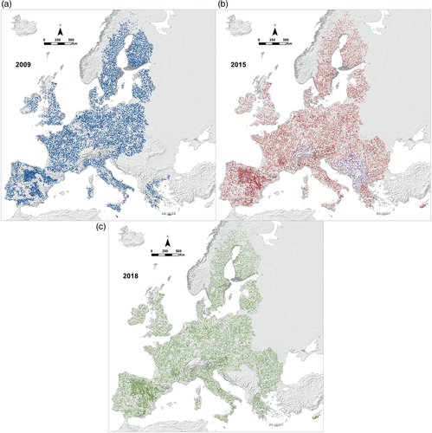
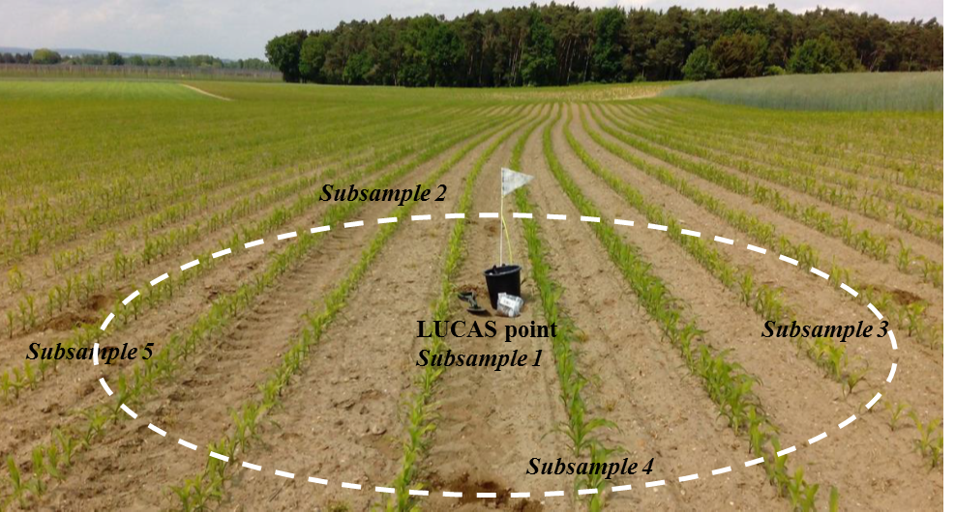
Soil Monitoring
(Arwyn Jones, Anne Marechal, JRC – Antonio Bispo, INRAE, Rainer Baritz, EEA)
Objective: Support the development of an integrated and harmonised soil monitoring system for the EU to track progress towards the vision of the EU Soil Strategy for healthy soils by 2050.
Building on LUCAS Soil Module and monitoring programmes in Member States (and eventually Accession Countries)
Addressing a range of current and emerging policy questions
Diverse data streams to support soi health dashboard and underpinning indicator framework
Notes:
The event was great debate where five working groups were launched addressing key aspects in the implementation or the underpinning knowledge base of the EUSO.

Slide 10
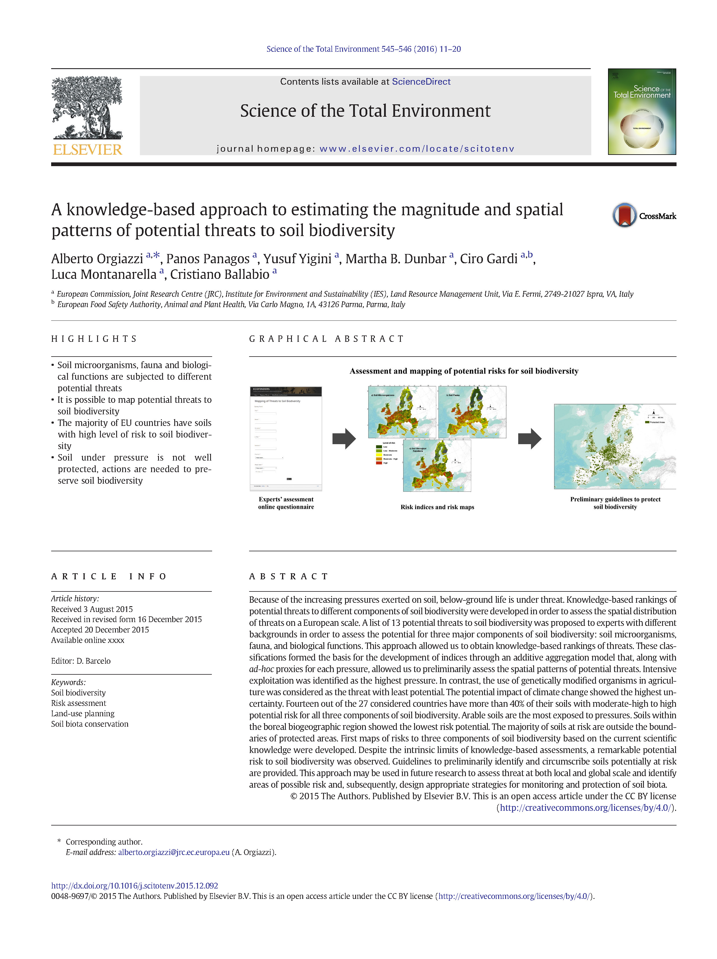
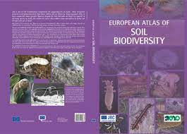
Soil biodiversity
(Luca Montanarella, Alberto Orgiazzi JRC)
The main aim of the EUSO soil biodiversity technical working group is to better integrate soil biodiversity into European policies (environmental, agricultural and others). In this context, it will be relevant to figure out what is exactly needed from the policy side. Strengths is a long-term commitment by JRC (since 2018) on developing a monitoring scheme for soil biodiversity at European scale as part of LUCAS Soil Survey.
Furthermore, LUCAS Soil biodiversity survey is an open-access initiative sharing both methodologies (sampling and processing) and data. Opportunities are offered by the possibility to integrate small- and large-scale monitoring plans. Challenges are represented by the need for standard methodologies.
Notes:
The event was great debate where five working groups were launched addressing key aspects in the implementation or the underpinning knowledge base of the EUSO.

Slide 11
Soil data sharing
(Marc van Liedekerke, Calogero Schillaci JRC)
Establishment of
EUSO data integration working group
Chair: JRC, Marc Van Liedekerke
EUSO Working group: five informal and voluntary; in consecutive stages, a more formal approach could be envisaged (e.g. when establishing an ‘official’ soil monitoring system in EU)
EU-Projects: create an exhaustive list of EU soil related projects (Christine le Bas)
Follow EU Soil Monitoring and EU Indicators activities
EJP-Soil: screen the EU-wide soil datasets proposed by EJP-Soil for future inclusion in EUSO.
Data from Literature: Review of literature to identify EU-wide soil related datasets; description, contacts, digital availability for the public
Hub: definition of a possible web based interface from which, through browsing and for each EU country, the user can link to digital soil resources in that country. Envisaged are soil properties / threats / functions. (Fenny)
Notes:
The event was great debate where five working groups were launched addressing key aspects in the implementation or the underpinning knowledge base of the EUSO.

Slide 12
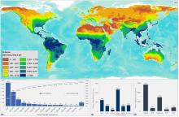
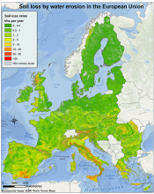
Soil erosion
(Panos Panagos, Diana Vieira, JRC, Pasquale Borrelli Univerisity of Rome)
Long term objective: Develop an object oriented (bottom-up) approach for estimating soil erosion and erosion-related soil health indicators at farm scale. Integrate soil erosion with emerging issues such as soil contamination, carbon loss and food security.
https://esdac.jrc.ec.europa.eu/content/global-rainfall-erosivity
https://esdac.jrc.ec.europa.eu/content/soil-erosion-water-rusle2015
Notes:
The event was great debate where five working groups were launched addressing key aspects in the implementation or the underpinning knowledge base of the EUSO.

Slide 13
Soil erosion
(Panos Panagos, Diana Vieira, JRC, Pasquale Borrelli Univerisity of Rome)
Short term action: 3-day workshop 20-22 June in emerging challenges of soil erosion
a) large scale modelling
b) land management at parcel level
c) climate change and future losses
d) integration with nutrient losses
e) erosion impact on carbon balance
f) sediments distribution
g) landslides
h) climate change
https://esdac.jrc.ec.europa.eu/public_path/EUSO/2022%20June%20Workshop.pdf
Notes:
The event was great debate where five working groups were launched addressing key aspects in the implementation or the underpinning knowledge base of the EUSO.

Slide 14
Soil pollution
(Piotr Wojda, Diana Vieira, Arwyn Jones, JRC)
The objectives of the Technical Working Group on Soil Pollution
To provide continuous support to the Clean Soil Outlook Report: 2022, 2024, ...
To analyse synergies and trade-offs between EU policies having impact on soil,
To help to translate ‘early warnings’ into recommendations on pollutants of increasing concern based on the latest research: watchlist, (e.g. ultrafine particles, emerging contaminants, pesticides, metals, ...),
To analyse data and environmental landscape following the R-DPSIR approach,
To provide projections, foresights considerations,
To identify the monitoring, knowledge and policy gaps, proposing how to close them.
Notes:
The event was great debate where five working groups were launched addressing key aspects in the implementation or the underpinning knowledge base of the EUSO.

Slide 15
Dashboard
The EUSO will establish a comprehensive dashboard containing indicators that present data on soil-related issues within and, in some cases, outside of the EU.
Examples of indicators i include soil erosion, soil carbon, pollutants and soil nutrients (phosphorus, nitrogen, potassium) with relevance to the new EU Soil Strategy, the Common Agricultural Policy (CAP), Zero Pollution Action Plan and Sustainable Development Goals (SDGs).

Slide 16
Indicators Stats
Indicators will be fed through models and operational soil monitoring systems ensuring seamless and harmonised data flows, where the LUCAS Soil programme will be fully integrated with national soil monitoring systems.
In addition to supporting the development of oil health indicators, an integrated monitoring system should also support the assessment of soil-related ecosystem services. .

Slide 17
Operational policy support
For the policy makers and other stakeholders will be a key issue for the development of accurate soil properties assessment and specific soil management strategies and tailored suggestion to member states targeted to their farming systems.

Slide 18
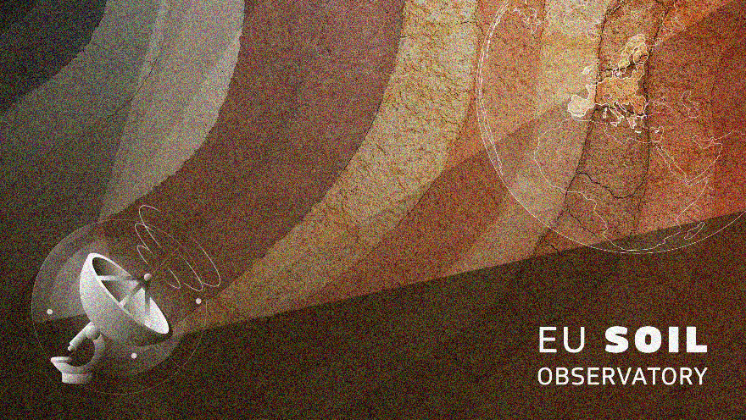
NEXT EVENT 2022
---> 3-day workshop 20-22 June in emerging challenges of soil erosion
https://esdac.jrc.ec.europa.eu/public_path/EUSO/2022%20June%20Workshop.pdf
--->October 2st Stakeholder forum event at the JRC
Date will be announced soon
More events https://esdac.jrc.ec.europa.eu/event/FutureEvents

Slide 19

Thank you
More information on https://esdac.jrc.ec.europa.eu/ ​
​
European Soil Observatory - EUSO​
European Soil Data Centre - ESDAC
How to cite: Schillaci, C., Muntwyler, A., Marechal, A., Orgiazzi, A., Jones, A., Ciupagea, C., Belitrandi, D., De Medici, D., De Rosa, D., Vieira, D., Matthews, F., Martin-Jimenez, J., Koeninger, J., Liakos, L., Montanarella, L., Labouyrie, M., van Liedekerke, M., Panagos, P., Scarpa, S., and Wojda, P.: European soil observatory (EUSO) structure and perspectives , EGU General Assembly 2022, Vienna, Austria, 23–27 May 2022, EGU22-5248, https://doi.org/10.5194/egusphere-egu22-5248, 2022.
© European Union 2022
Unless otherwise noted the reuse of this presentation is authorised under the CC BY 4.0 license. For any use or reproduction of elements that are not owned by the EU, permission may need to be sought directly from the respective right holders.

