Slide 1
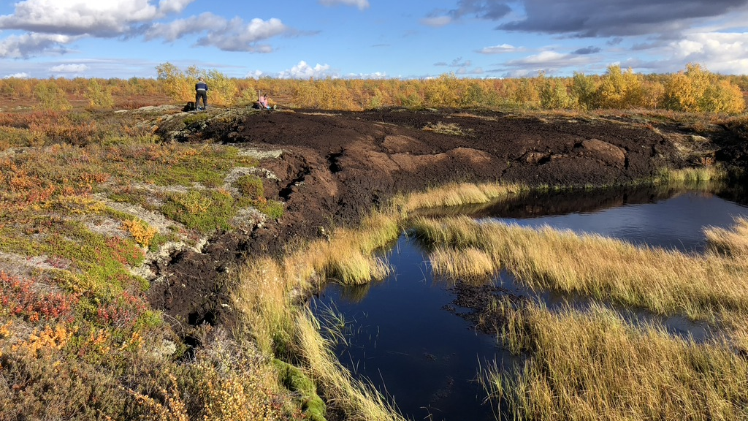



The long-term biogeochemical fate of carbon in Subarctic thawing peat plateaus
Sigrid Trier Kjær^{1,2,3}, Nora Nedkvitne², Sebastian Westermann³, and Peter Dörsch²
¹ETH Zürich, ²Norwegian University of Life Sciences, ³University of Oslo

Slide 2
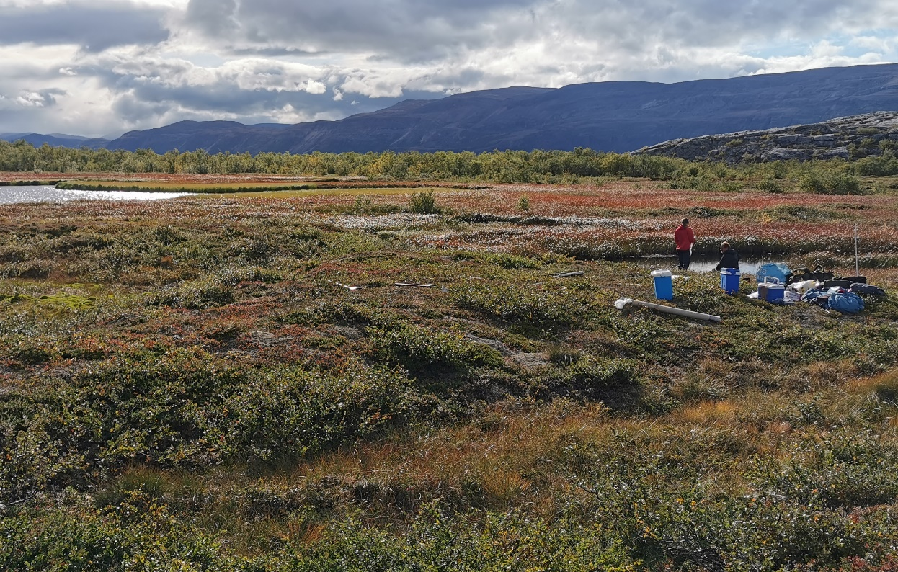
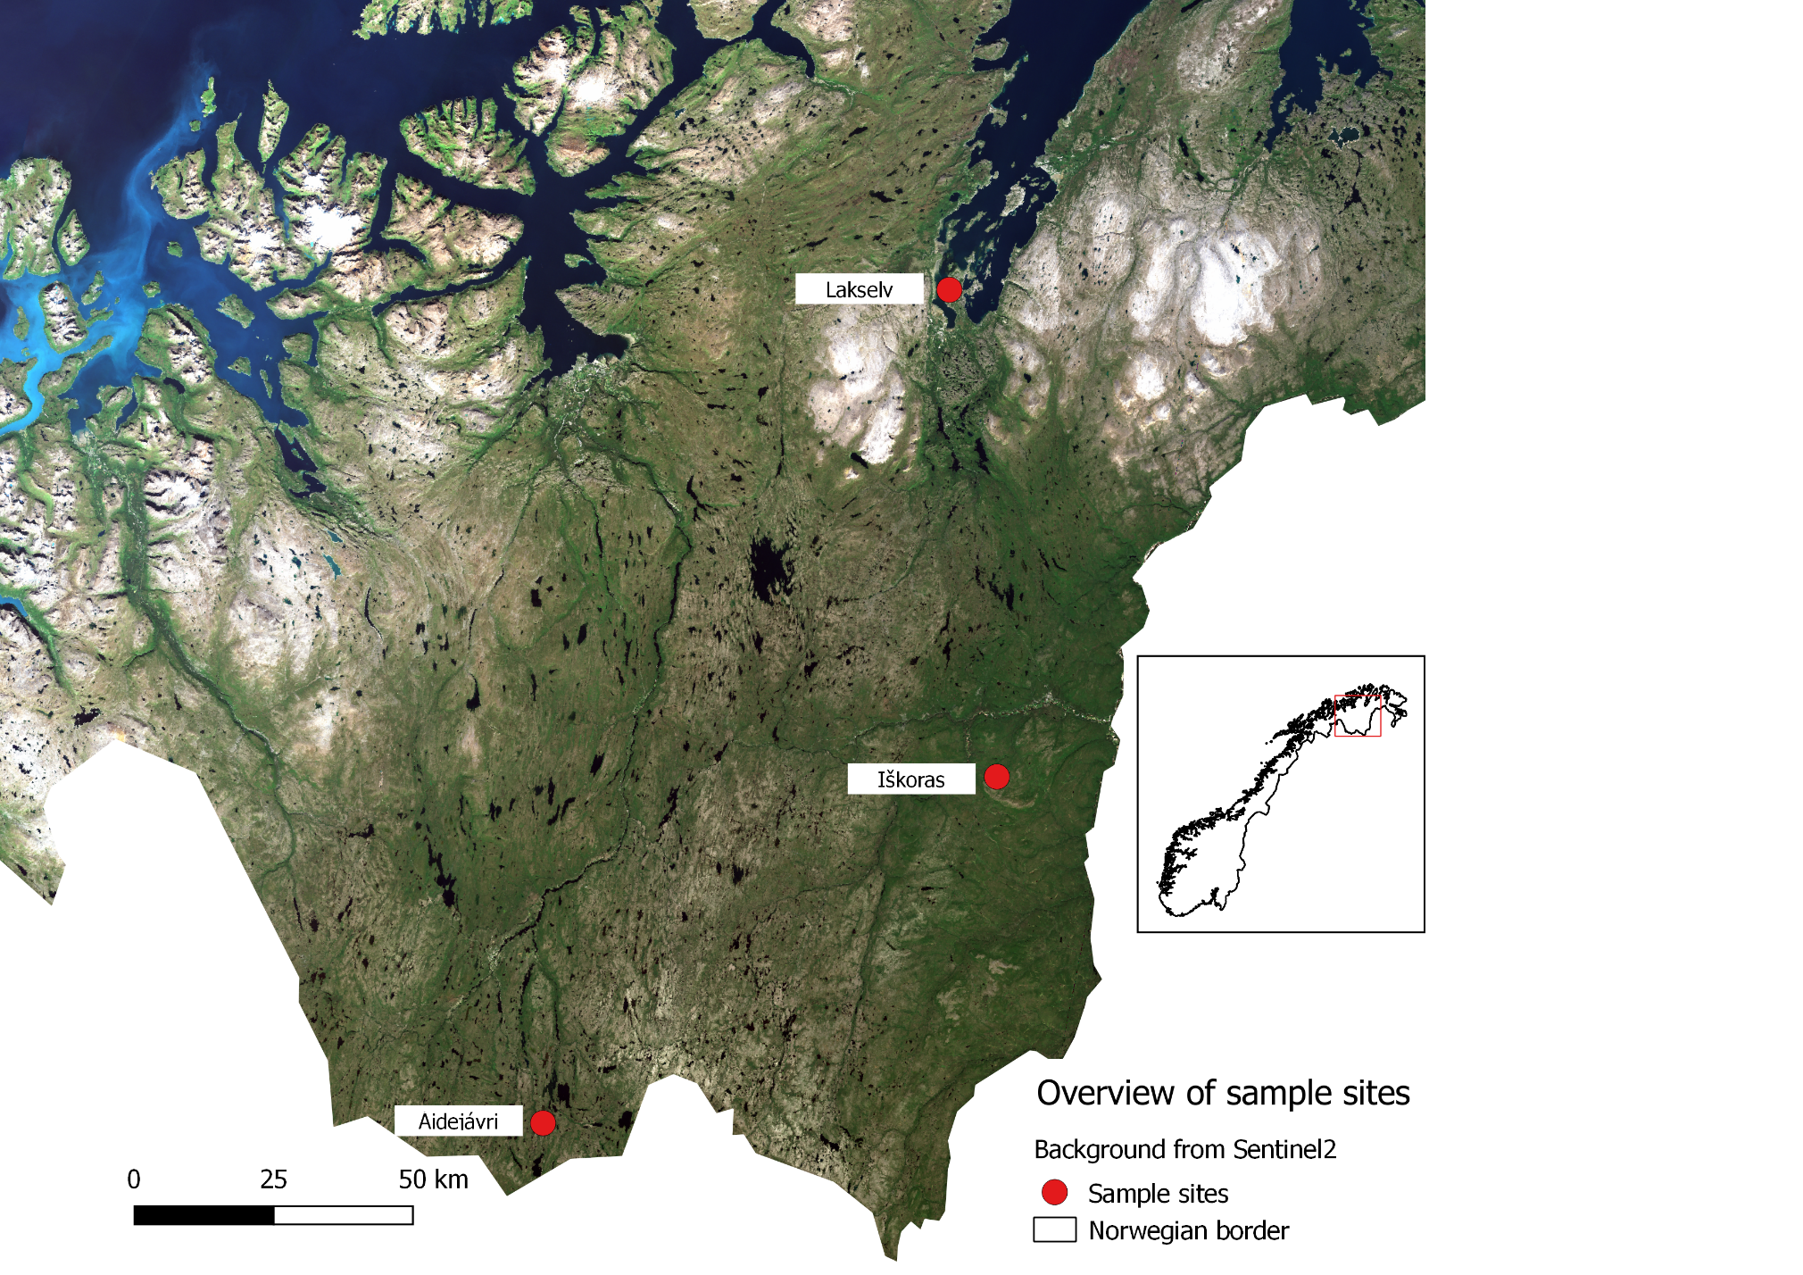
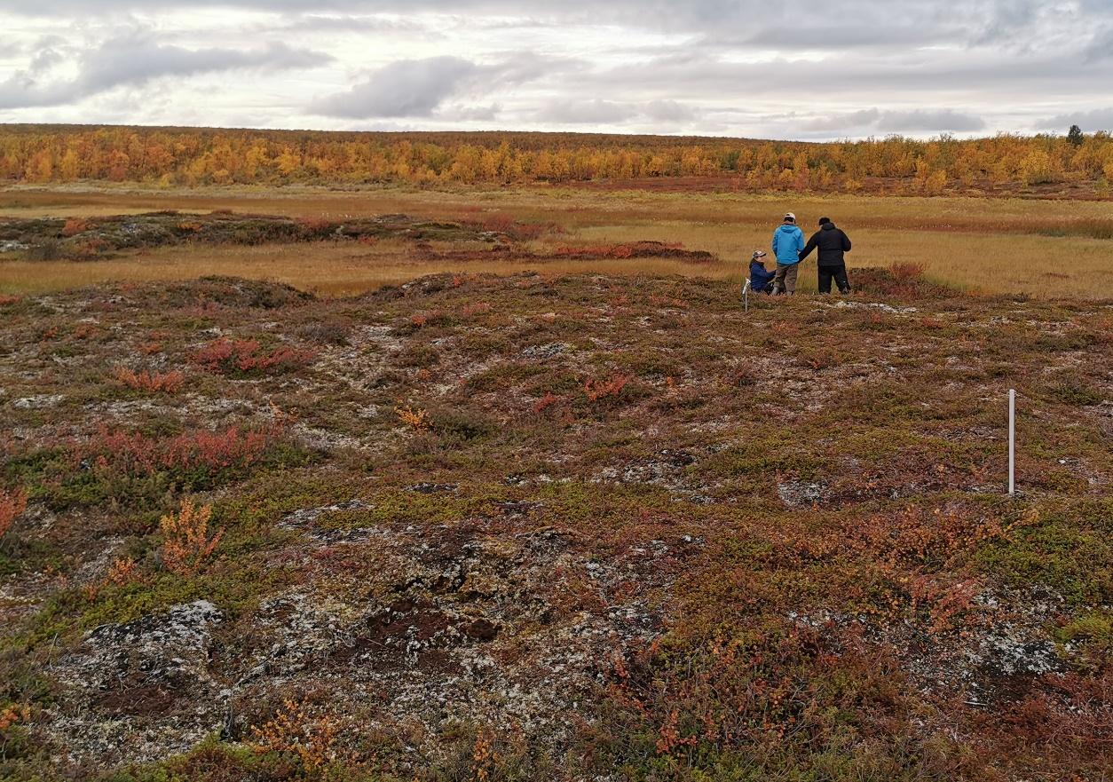
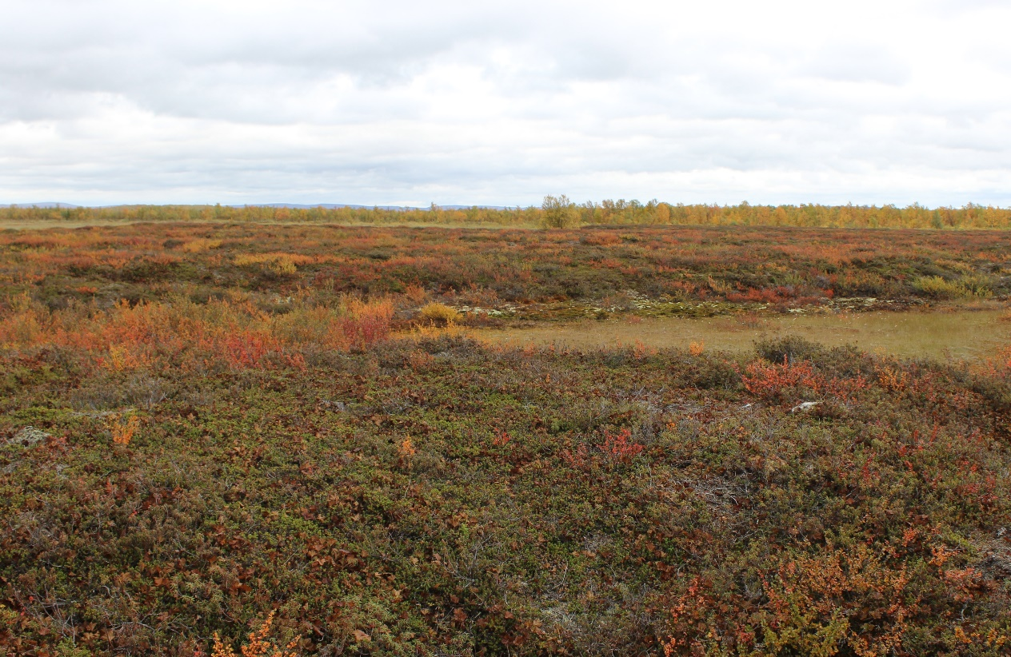
Finnmark, Norway
Peat: 6150* PF: 150*
Peat: 9200* PF: 800*
*cal. yr BP
Notes:
well-documented chronosequence of permafrost
Peat plateaus covers approximately 110 km² of the area in Finnmark
Permafrost underlays between 15 and 22 % of the terrestrial surface of the Northern hemisphere
Permafrost peatlands store about one third of all C in permafrost affected soils
Extent of peat plateaus in northern Norway decreased by 33-71 % from 1950s to 2010s
Limited information on C degradation in permafrost peatlands and GHG release

Slide 3
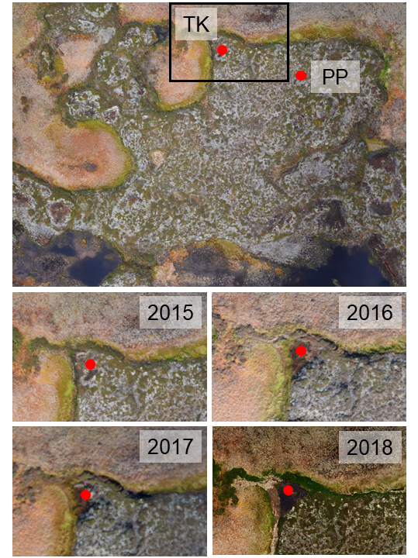
Permafrost Peat Plateaus (PP) to Thermokarst (TK) Peat
Discontinuous permafrost in “warm” climate
Permafrost thaw → either collapse or gradually
Example of gradual thaw (Iškoras) →
How does the transition from permafrost to thermokarst affect carbon degradation?
Compare controlled thaw of permafrost peat with thermokarst sediment

Slide 4
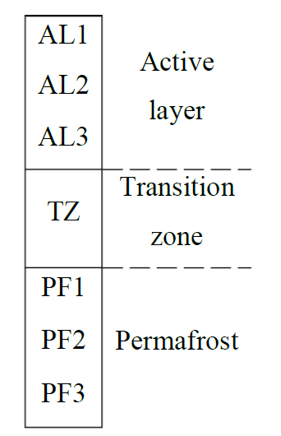
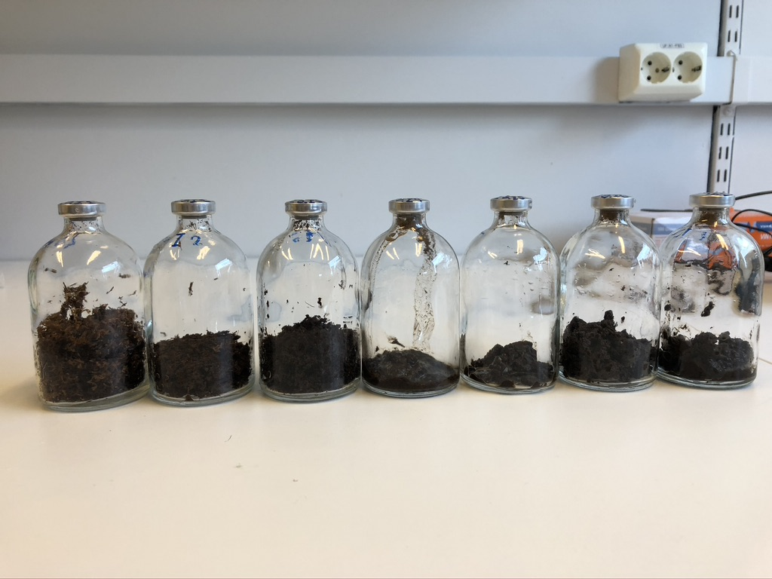
Thawed Permafrost Depth Profiles: Controlled Thawing, Oxic/Anoxic
Active layer
(AL)
Transition zone
(TZ)
Permafrost
(PF)
AL1
AL2
AL3
TZ
PF1
PF2
PF3

Slide 5
Anoxic CH₄ Release
Highest release in permafrost affected layers
Smaller production in beginning
CH₄ production needs time to get started
NB: missing after 350 days
Notes:
Peat from Iskoras and Aidejavri – natural long term experiment

Slide 6
Anoxic CH₄ Release
First 96 days
All 350 days

Slide 7
Oxic
µmol C g dw⁻¹ 350 days⁻¹
Anoxic
Much less CH₄-C compared to DOC and CO₂-C
After 350 days, most at Lakselv (PF2) = 1.6 µmol CH₄-C g dw⁻¹
Incubated thermokarst sediment shows a different trend
Larger CH₄-C release in top of core after 96 days = 14 µmol CH₄-C g dw⁻¹

Slide 8
Conclusions
Long anoxic incubation time is needed to see CH₄ production
CH₄-C contributes less to the carbon release than DOC and CO₂-C after controlled thaw
CH₄-C contributes more to the carbon release in thermokarst sediment

Slide 9
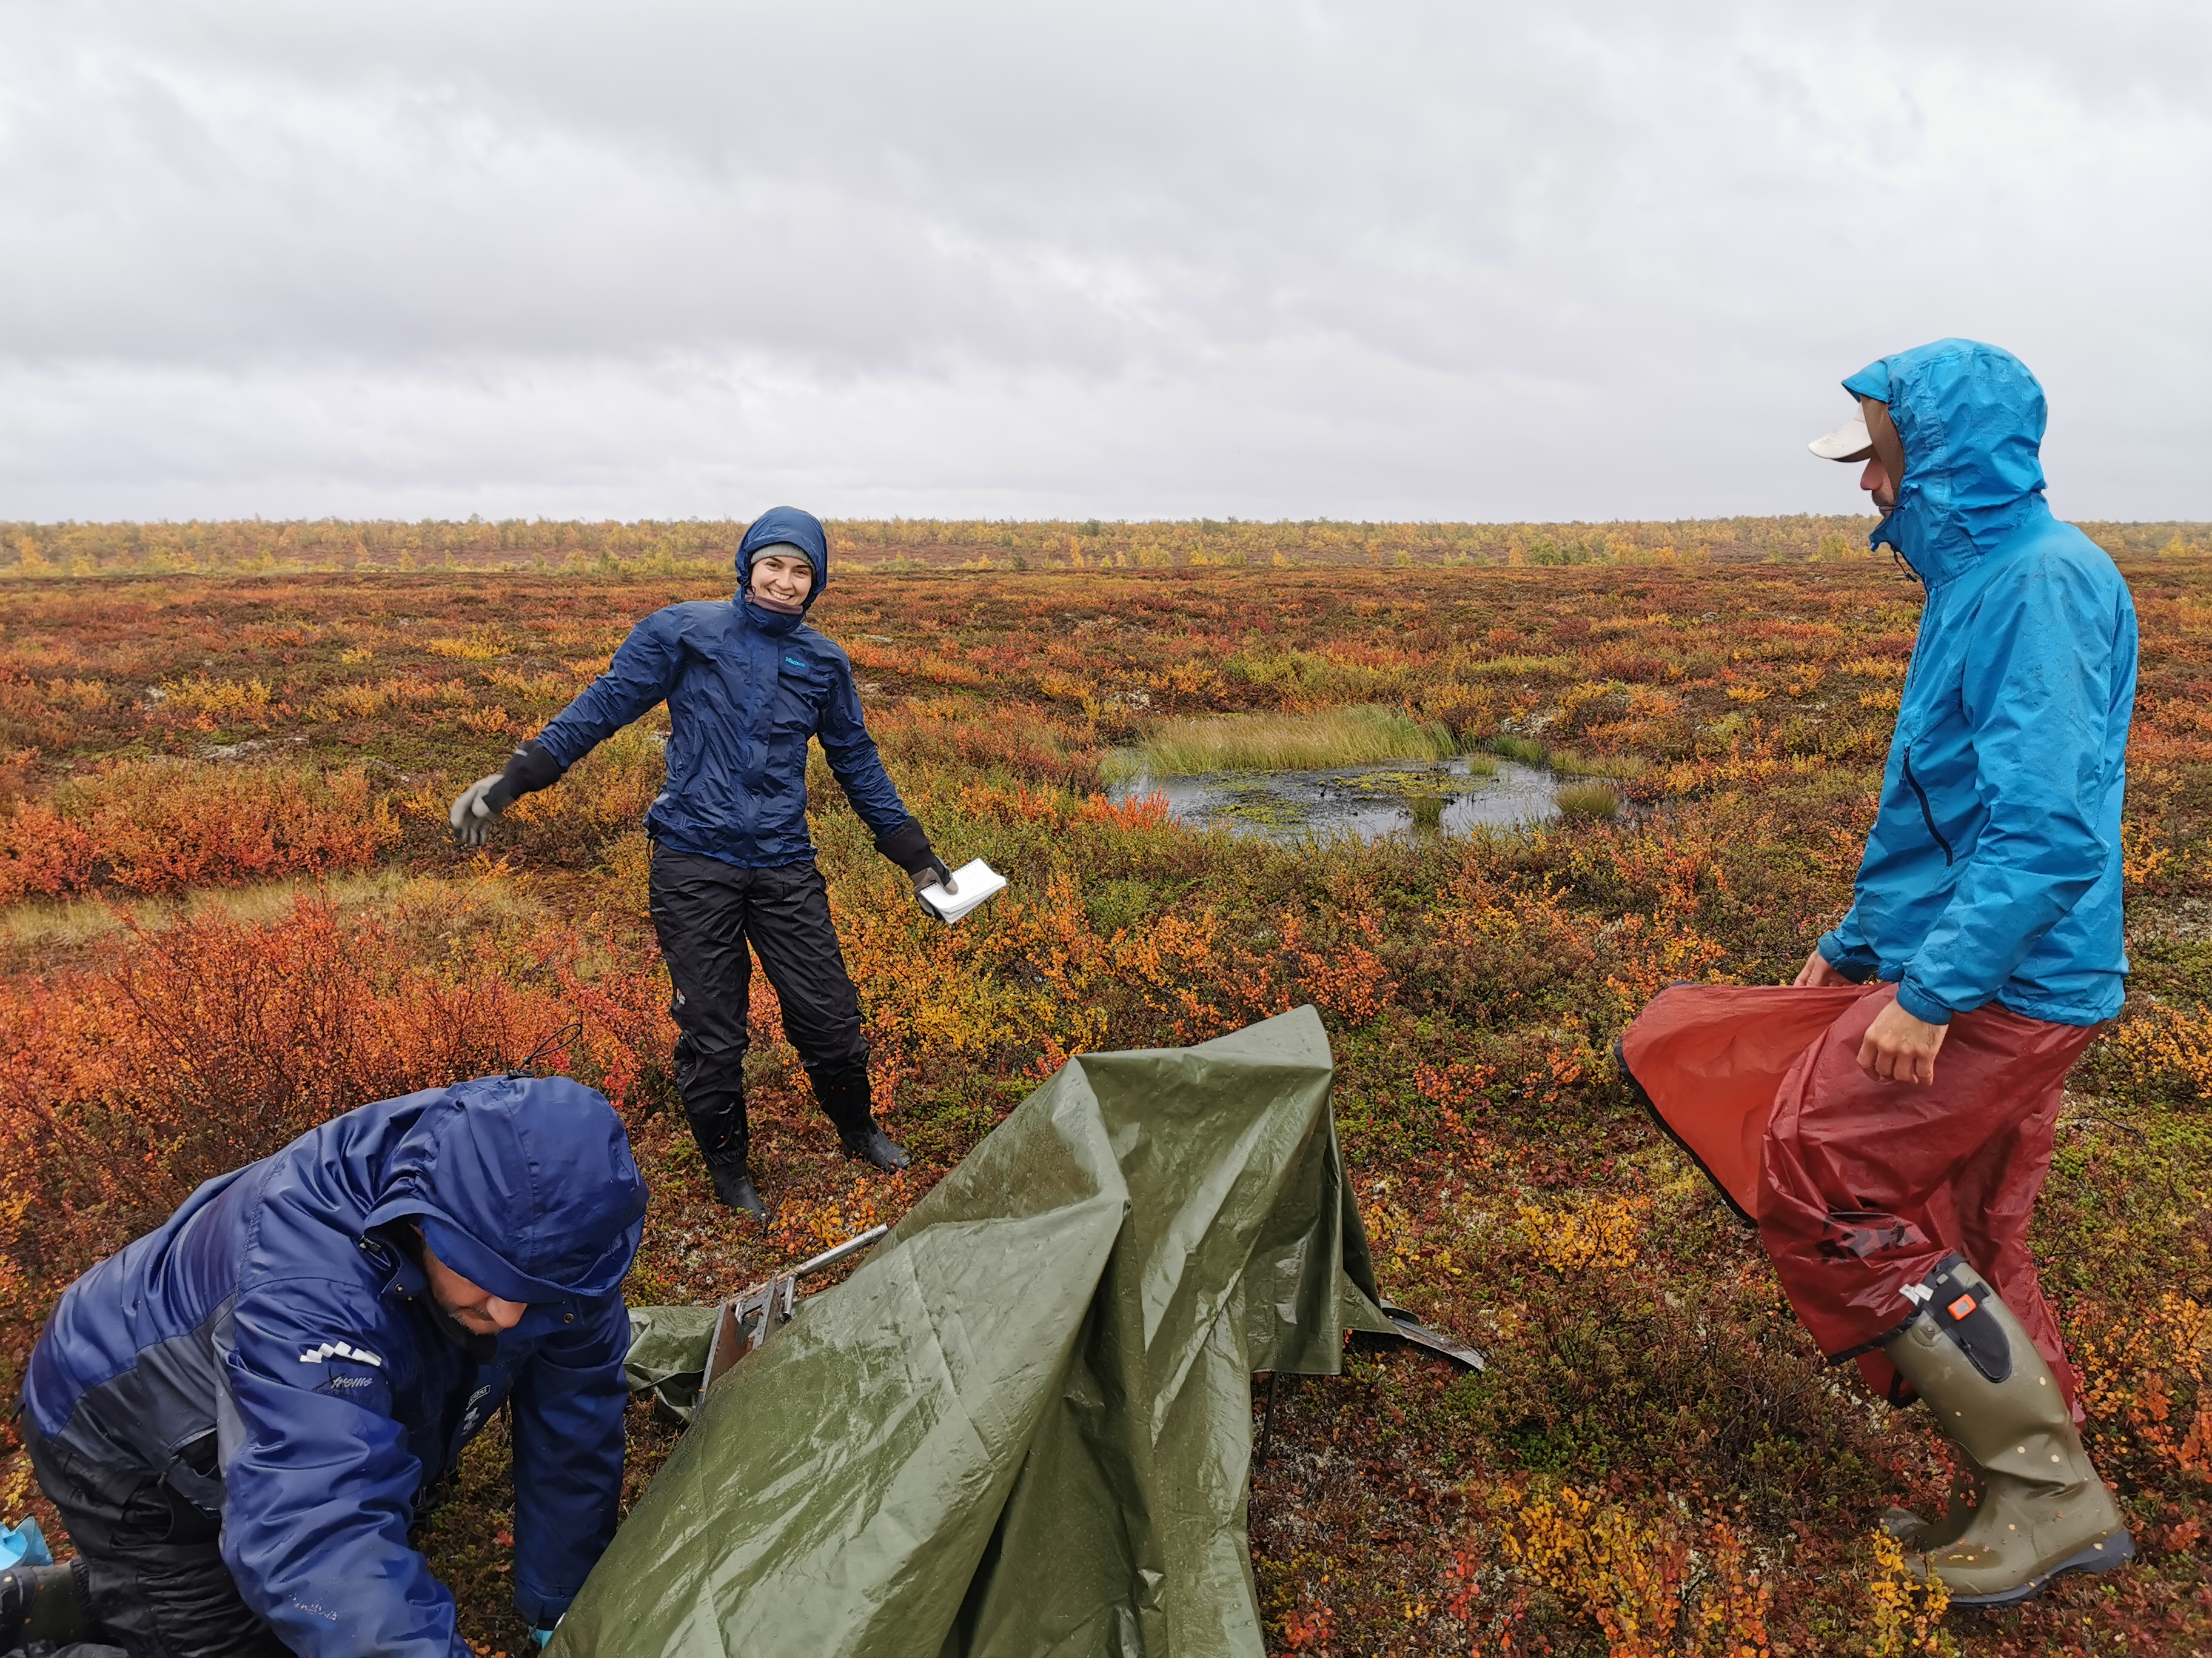
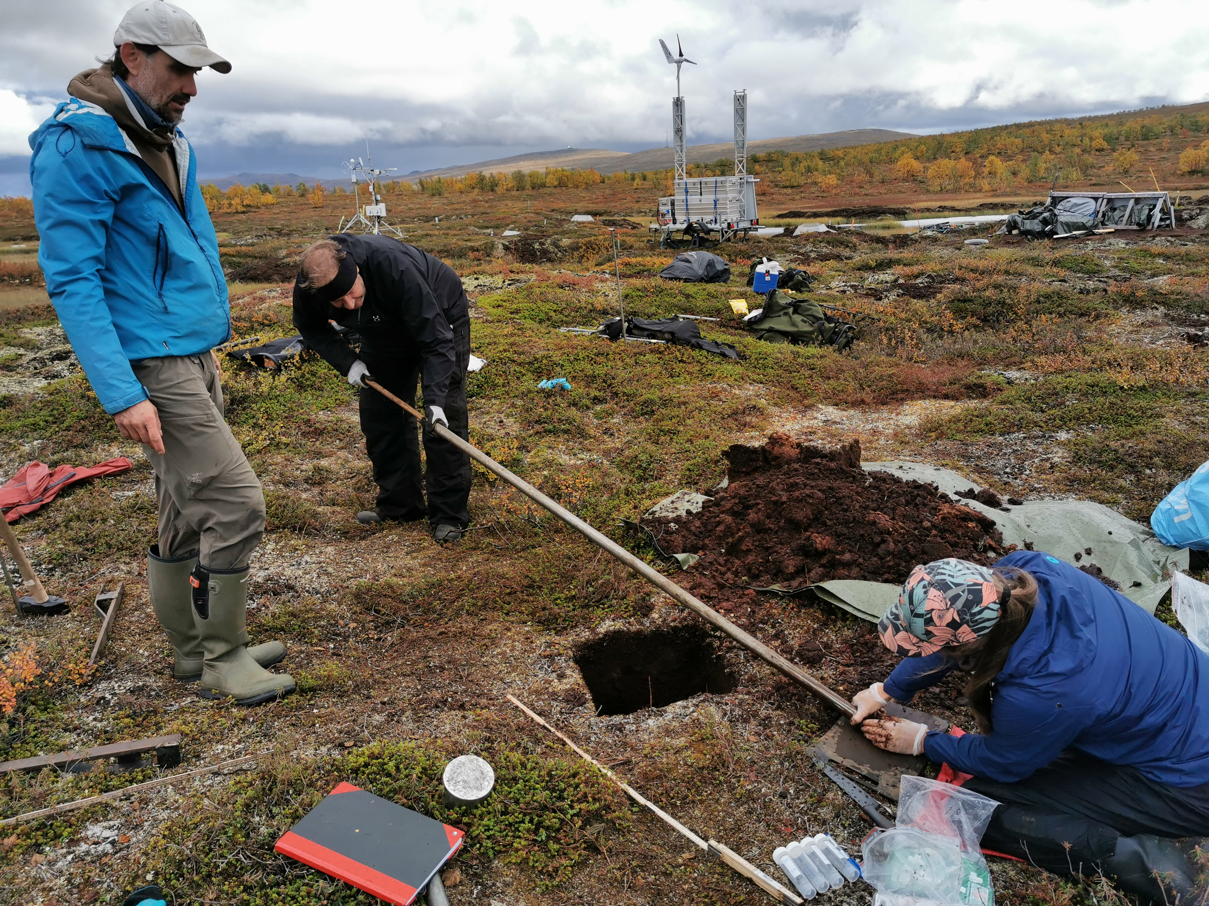
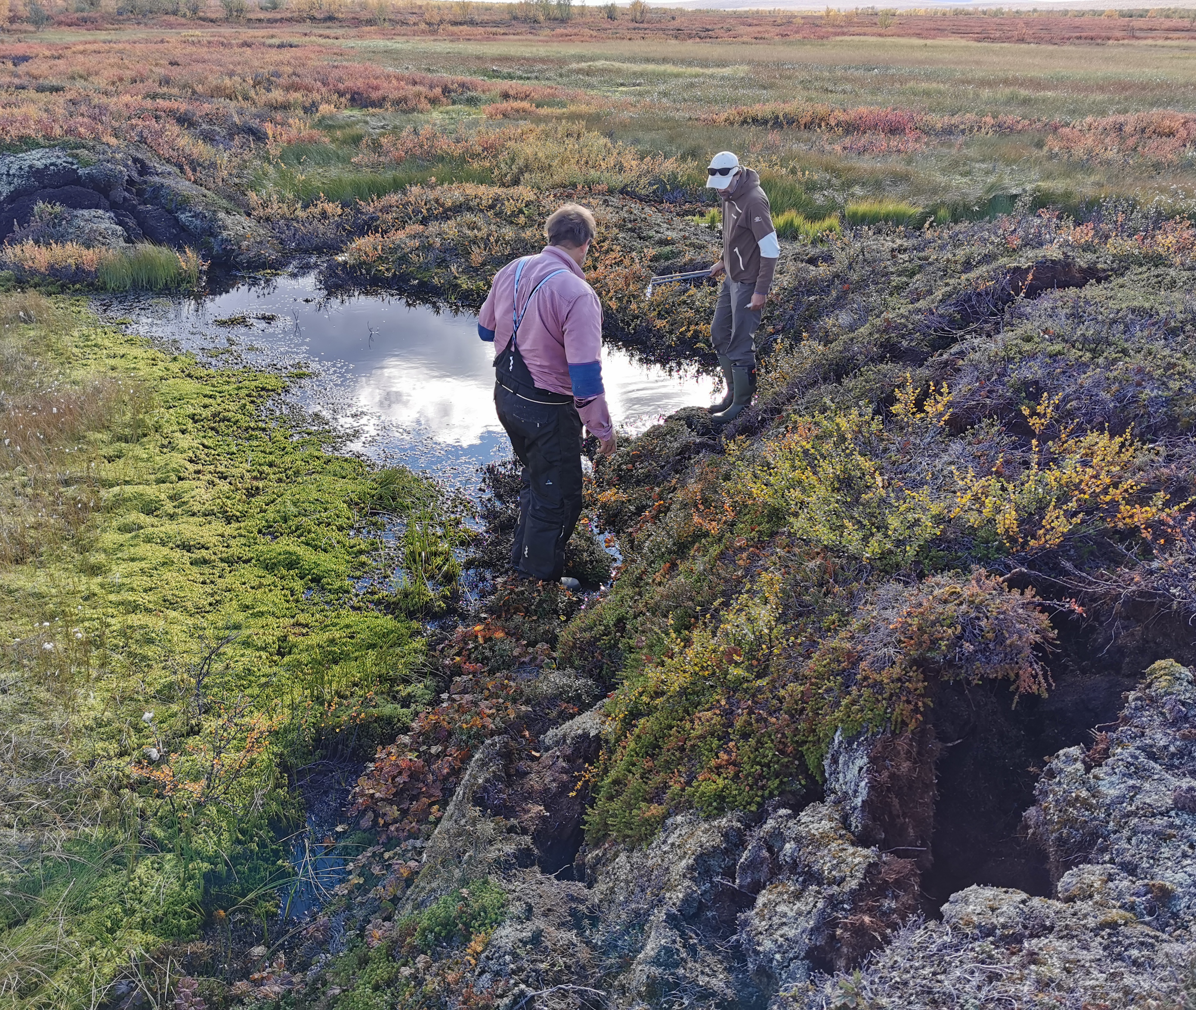
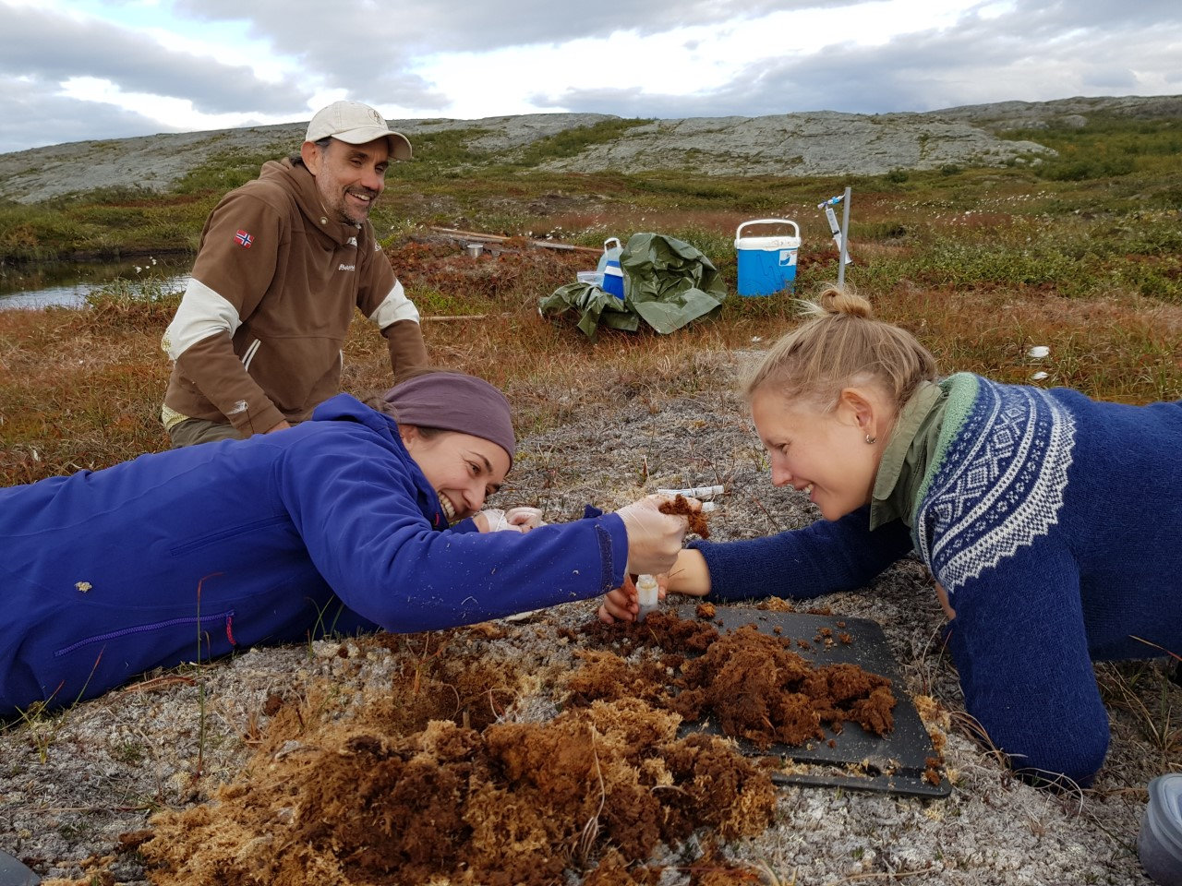
Thank you for your attention!

