Slide 1



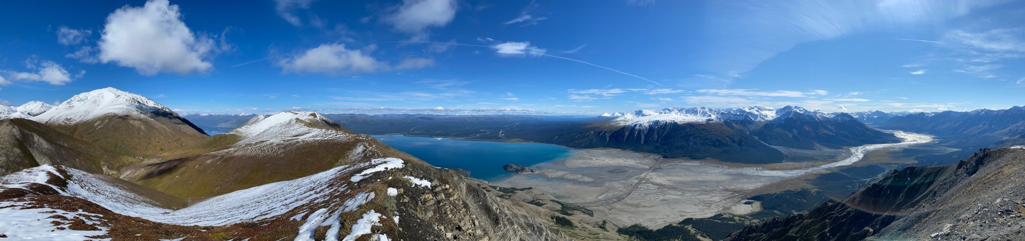
Impacts of mineral dust on soils and vegetation at Lù’àn Mân (Kluane Lake), Yukon Territory
Sophie Pouillé, University of Montreal, Geography, Montreal, Canada
Julie Talbot, University of Montreal, Geography
James S. King, University of Montreal, Geography
AS3.10 – Aeolian dust: initiator, player and recorder of environmental change
May 23, 2022
©Sophie Pouillé

Slide 2
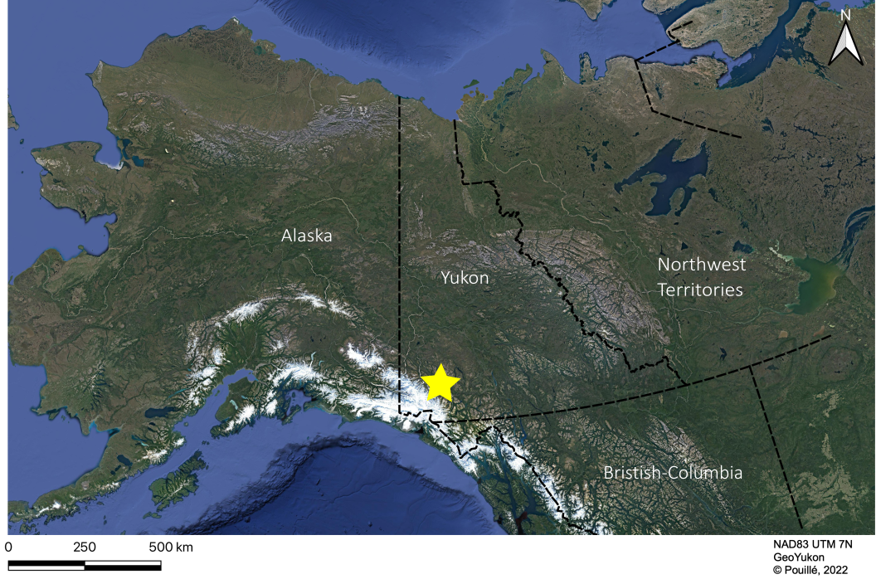
GLACIER RETREAT, DUST STORMS AND TRACE ELEMENTS
Glaciers of Canada’s high latitudes have, and will continue to experience substantial retreat (Bullard et al. 2016)
Glacier retreat can lead to massive dust storms as the sediments are newly exposed (Shugar et al. 2017)
The deposited dust may be rich in trace elements (TE) like arsenic (As) (Bachelder et al. 2020)
Lù’àn Mân (Kluane Lake) is the study site in Yukon territory.

Slide 3
OUR OBJECTIVES AND HYPOTHESES
1: Determine the impacts of dust deposition on TE concentrations in lichens and soils
2: Determine if TE concentrations in lichens correlate to that of soil

Slide 4
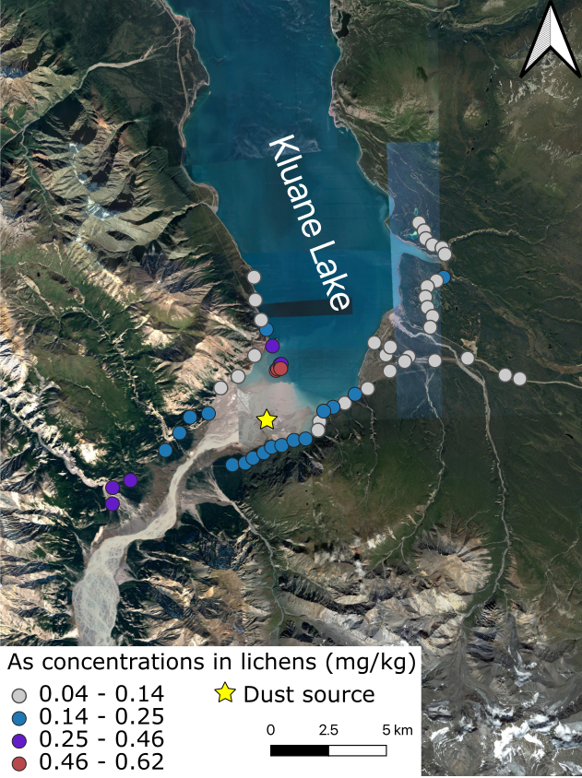
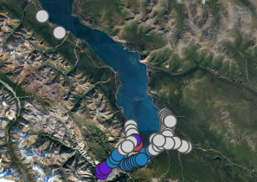
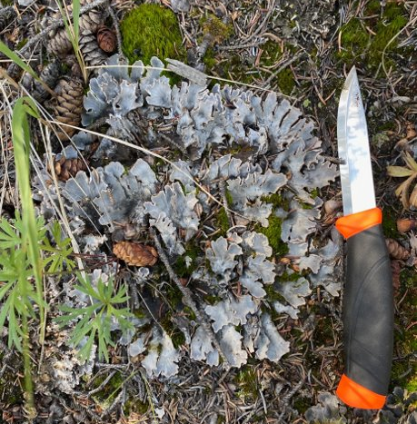
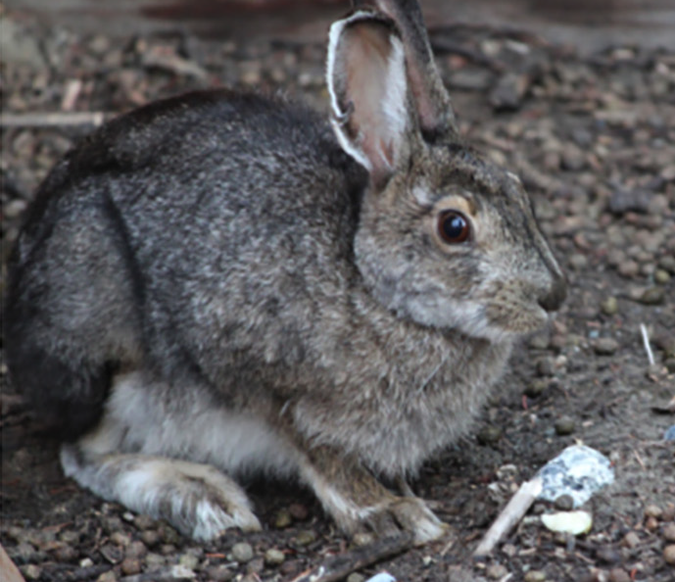
ARSENIC CONCENTRATIONS IN LICHENS
We sampled lichen Peltigera canina and two soil profiles (0-2 cm and 2-10 cm) at 60 sites
Sites closer to the delta have higher As concentrations compared to sites 5, 10 and 20 km away.
Peltigera canina
Lepus americanus
©Sophie Pouillé
© Lavergne et al. 2020
© Sophie Pouillé

Slide 5
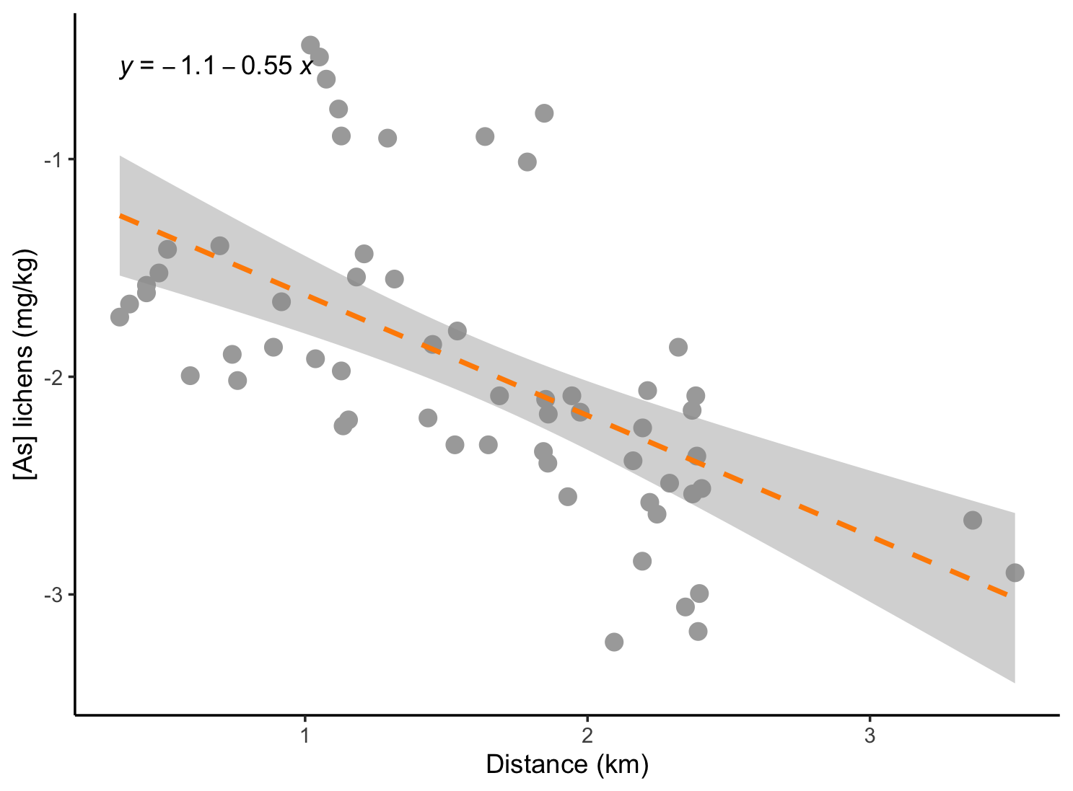
SIGNIFICANT RELATIONSHIP BETWEEN [As] AND DISTANCE (Obj.1)
As concentrations in lichens were significantly and negatively correlated with distance from the delta.
R² = 0.36
p-value<0.001

Slide 6
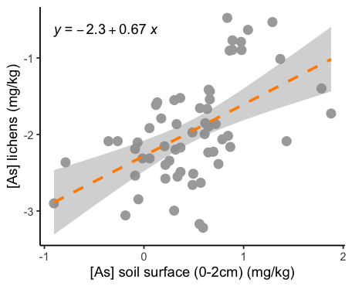
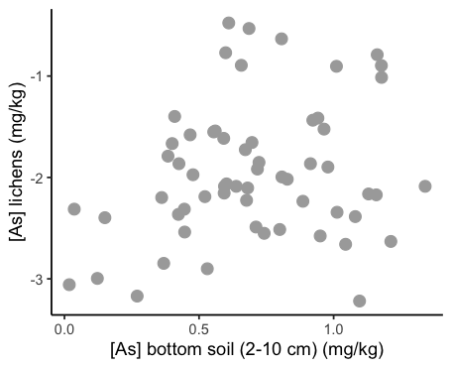
SIGNIFICANT RELATIONSHIP WITH ARSENIC AND SOIL SURFACE (Obj. 2)
Soil surface
Bottom soil
R² = 0.04
p-value >0.05
R² = 0.27
p-value<0.001
It confirms that As in lichens is most likely linked to deposited dust. Otherwise it would be correlated with the bottom soil, that represents the geochemical background.

Slide 7
TO CONCLUDE
The smaller the distance, the higher As concentrations in lichens (Obj. 1)
There is a positive and significant relationship between As in lichens and soil surface (Obj. 2)
The relationship between As in lichens and bottom soils is not existing (Obj. 2)
Human context: First Nations communities use much of the landscape as food sources.

Slide 8
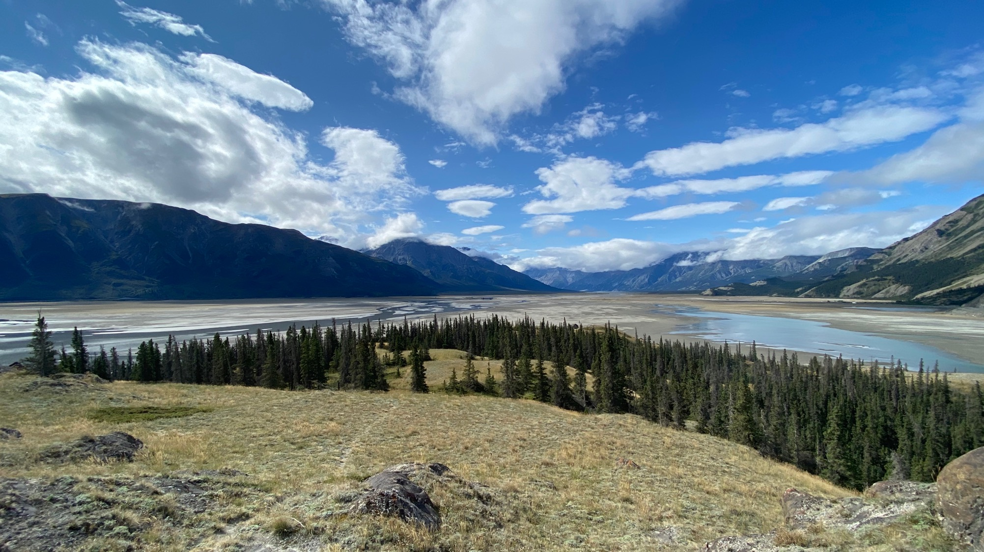







Acknowledgements
Thank you!
Session : AS3.10 – Aeolian dust: initiatior, player and recorder of environmental change
Day/Time : Hybrid: Monday, 23 May 2022, 14:18 CEST
Notes:
Thank you and I have a lot of people to acknowledge for the success of this resarch which includes permissions of first nations of the valley, and my funding sources.

