Slide 1







Electromagnetic anomalies detection over seismic regions during an earthquake
D. Recchiuti^{1,2*}, G. D’Angelo¹, E. Papini¹, P. Diego¹, A. Cicone^{3,1}, A. Parmentier¹, P. Ubertini¹, R. Battiston², and M. Piersanti^{3,1}
¹National Institute of Astrophysics – IAPS, Rome, Italy
²University of Trento, Physics Department, Trento, Italy
³University of L’Aquila, L’Aquila, Italy

Slide 2
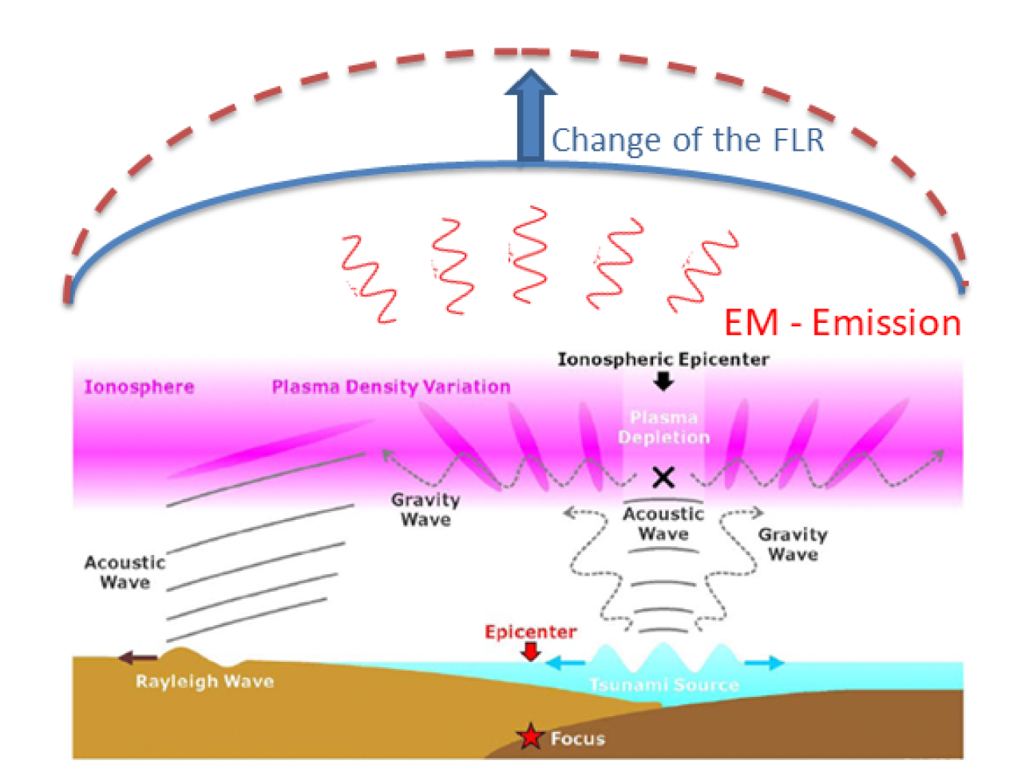
The MILC model (Piersanti et al. 2020)
The earthquake generates an AGW, propagating through the atmosphere;
The AGW interacts with the ionosphere generating local instability in the plasma distribution through a pressure gradient which results in plasma and/or EM wave injection;
TID + EM propagating through the ionosphere interacts with the local magnetospheric field and causes a FL eigen-frequency change.
TID + EM
The work focuses on the development of this part of the model:
Ionospheric background determination
An accurate procedure for identification of ionospheric anomalies is necessary for a better understanding of the physics behind the lithosphere-atmosphere-ionosphere coupling.

Slide 3
Background determination
We’re looking for electromagnetic signals exceeding a statistical meaningful threshold over a background
The background spectra aim to indicate the ionospheric conditions typically observed over the geographical point we’re interested in. Through the comparison between observations around the earthquake’s onset and the background spectra, an anomalous signal can be interpreted in the correct way and eventually be correlated with the seismic activity.
Following the approach of:
We started by the definition of the statistical distribution of the ionospheric EM waves energy in absence of external forcing.
Bertello et al.
2018
Piersanti et al.
2020

Slide 4
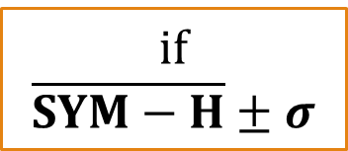
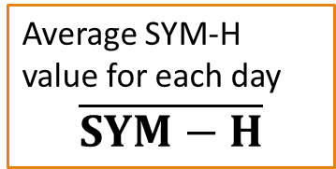
External forcing
Geomagnetic indices are proxies of geomagnetic disturbances observed on the ground
SYM-H
OMNI dataset
1 min resolution
Average SYM-H value for each day
$$\overline{SYM−H}$$
(-10 nT, 10 nT]
QUIET
if
$$\overline{SYM−H}±σ$$
DISTURBED
(-40 nT, -10 nT]
otherwise
STORM

Slide 5

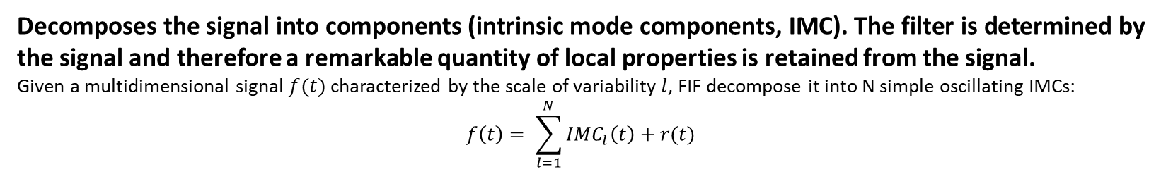
Background computation – Methods (1)
Fast Iterative Filtering (FIF)*
Decomposes the signal into components (intrinsic mode components, IMC). The filter is determined by the signal and therefore a remarkable quantity of local properties is retained from the signal.
Given a multidimensional signal $f(t)$ characterized by the scale of variability $l$, FIF decompose it into N simple oscillating IMCs:
$$f\left(t\right)= \sum_{l=1}^{N}{IMC_{l}\left(t\right)+r(t)}$$
Multiscale statistical analysis
Considering the statistics of the $IMC_{l}(t)$ to discern real signals from fluctuations having instrumental origins.
$$ε_{rel}\left(l\right)= \frac{\int_{l}{{\left|IMC_{l}\left(t\right)\right|}^{2}ⅆt}}{\int_{l}{{\left|f\left(t\right)\right|}^{2}ⅆt}}$$
*Cicone, A., Zhou, H. Numerical analysis for iterative filtering with new efficient implementations based on FFT. Numer. Math. 147, 1–28 (2021).

Slide 6
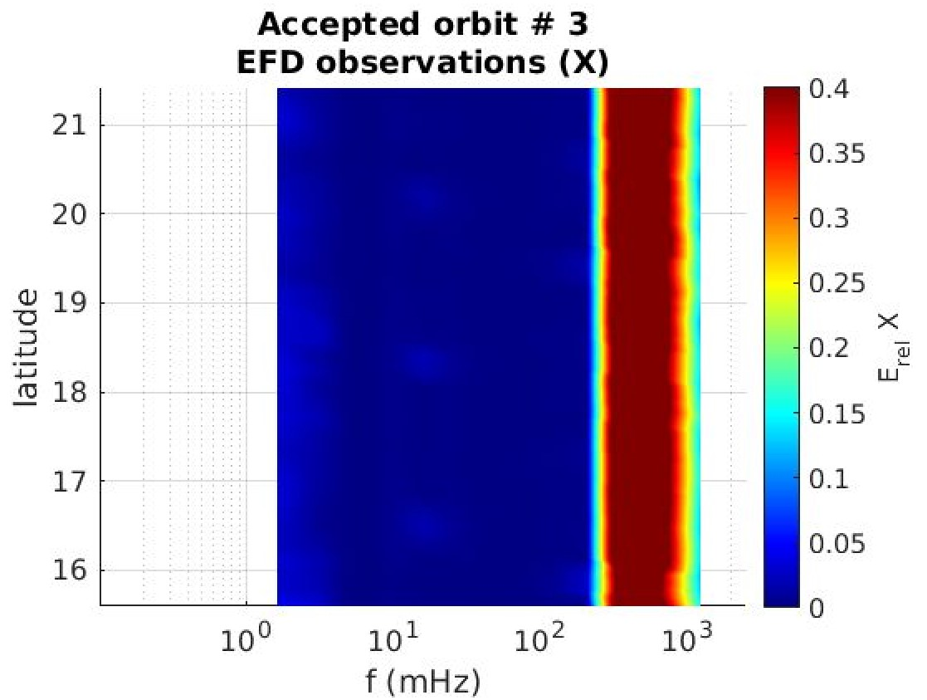
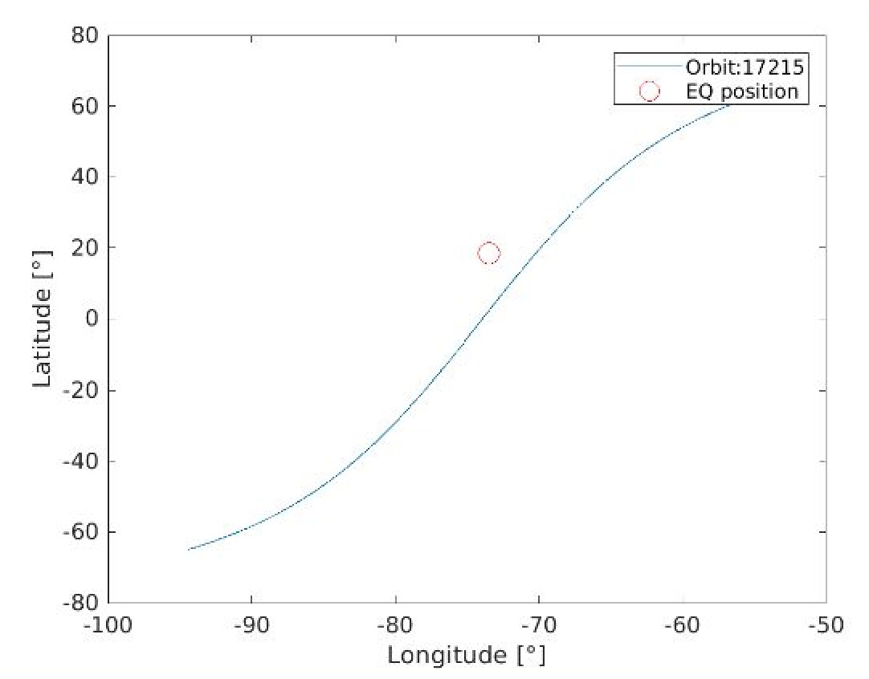
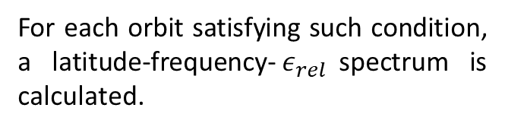
Background computation – Methods (2)
All the orbits flying over a 6°×6° latitude-longitude cell centered on the Earthquake Epicenter (EE) are considered for the multiscale analysis.
For each orbit satisfying such condition, a latitude-frequency-$ε_{rel}$spectrum is calculated.

Slide 7
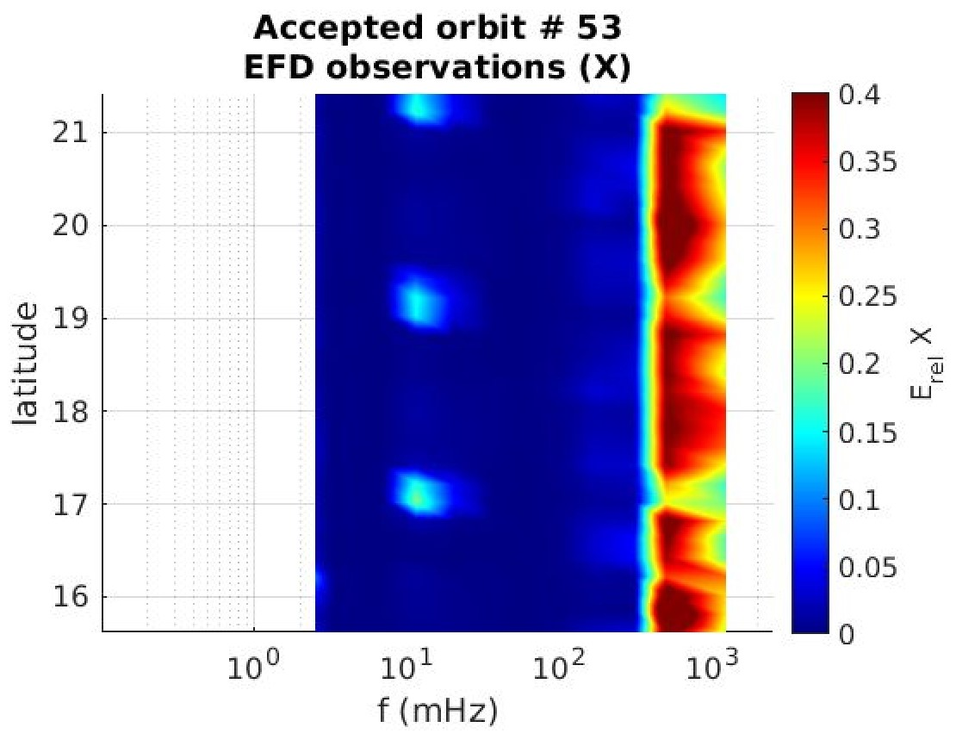
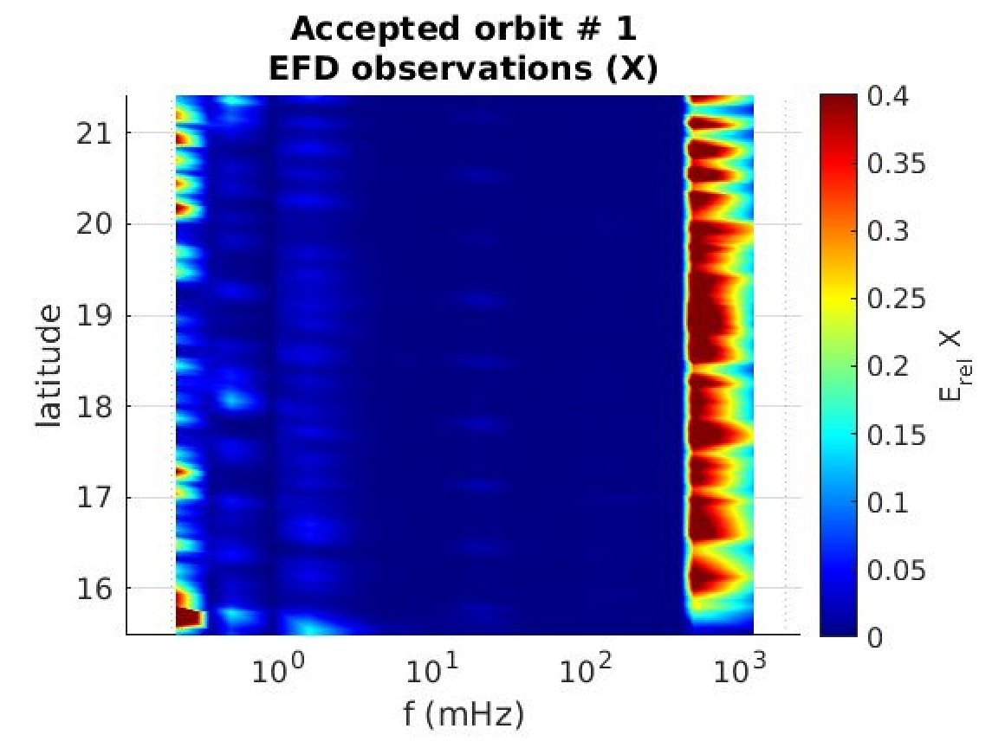
Background computation – Methods (3)
Every orbit has different sampling from each other, so the correspondent spectra are generated over different grids.
f(Hz)
f(Hz)

Slide 8
Background computation – Methods (4)
Constructing a grid on which remap the whole dataset
Latitudes
Linear spacing from $φ_{EE}−3°$ to $φ_{EE}+3°$ with 0.1° spacing
Linear spacing from 𝜙_𝐸𝐸−3° to 𝜙_𝐸𝐸+3° with 0.1° spacing
Frequencies
Frequency values span from 0.1 mHz to 2.5 kHz $⇒$ Logarithmic spacing
Frequency values span from 0.1 mHz to 2.5 kHz ⇒ Logarithmic spacing
Number of frequencies on the grid is chosen as the average of the number of frequencies for each orbit. In this way, on average, there will be a frequency value for each grid point.
60 x 17 (latitudes x frequencies) final grid
$ε_{rel}$ interpolated on every grid point

Slide 9
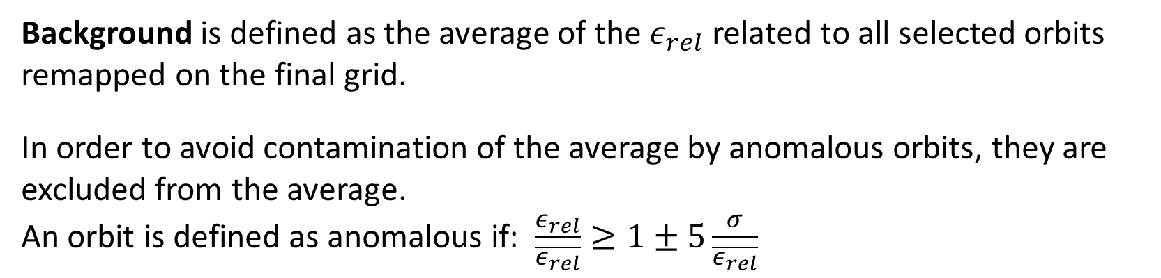
Background computation – Methods (5)
Background is defined as the average of the $ε_{rel}$ related to all selected orbits remapped on the final grid.
In order to avoid contamination of the average by anomalous orbits, they are excluded from the average.
An orbit is defined as anomalous if: $\frac{ε_{rel}}{\overline{ε_{rel}}}≥1±5\frac{σ}{\overline{ε_{rel}}}$
Once the background spectra are defined, any signal distinguishable from them is worthy of consideration as a possible signal correlated to seismic activity

Slide 10
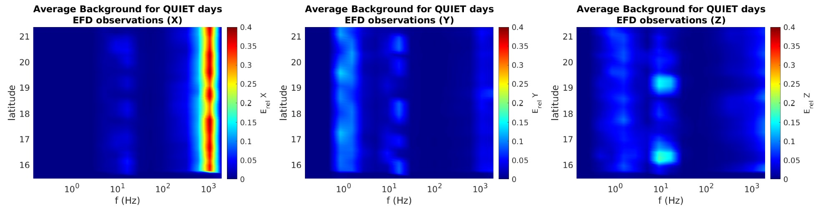
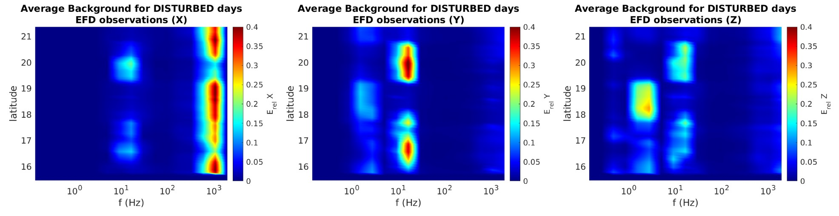
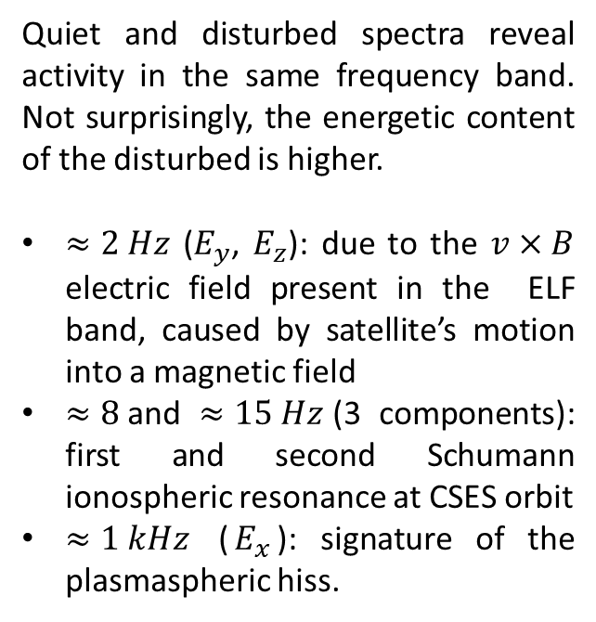
Case event 1: August 14, 2021 Haiti
BACKGROUND SPECTRA - EFD
$⋄$Magnitude: $7.2 M_{W}$ $⋄$ Latitude: $18.417°N$ $⋄$ Longitude: 73.480°W
Quiet and disturbed spectra reveal activity in the same frequency band. Not surprisingly, the energetic content of the disturbed is higher.
$≈2 Hz$ ($E_{y}$, $E_{z}$): due to the $v×B$ electric field present in the ELF band, caused by satellite’s motion into a magnetic field
$≈8$and $≈15 Hz$(3 components): first and second Schumann ionospheric resonance at CSES orbit
$≈1 kHz$ ($E_{x}$): signature of the plasmaspheric hiss.
Notes:
Il grafico restituisce la ridistribuzione dell’energia su varie bande, permette di studiare quando fenomeni si accendono o rimangono stazionari.

Slide 11
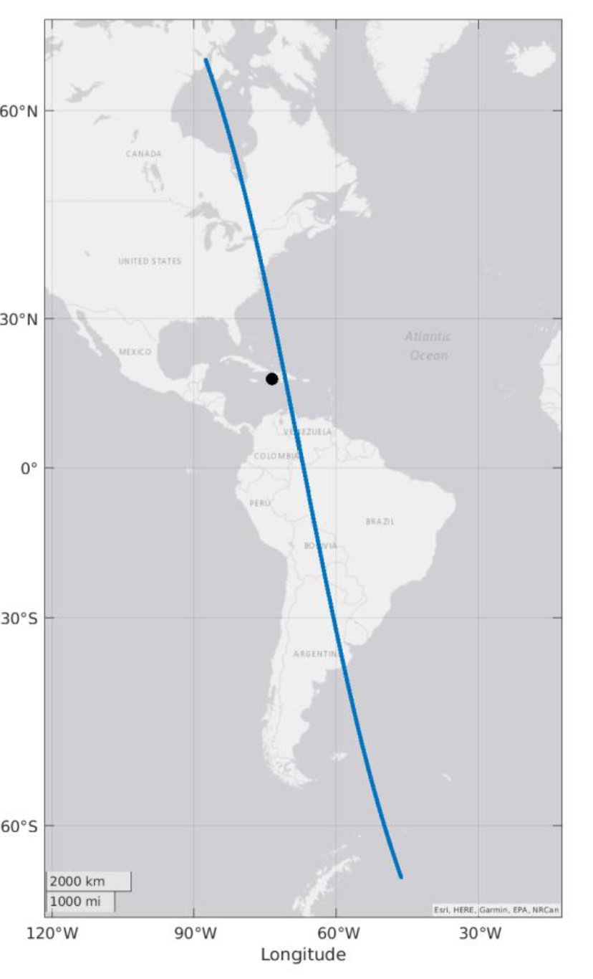
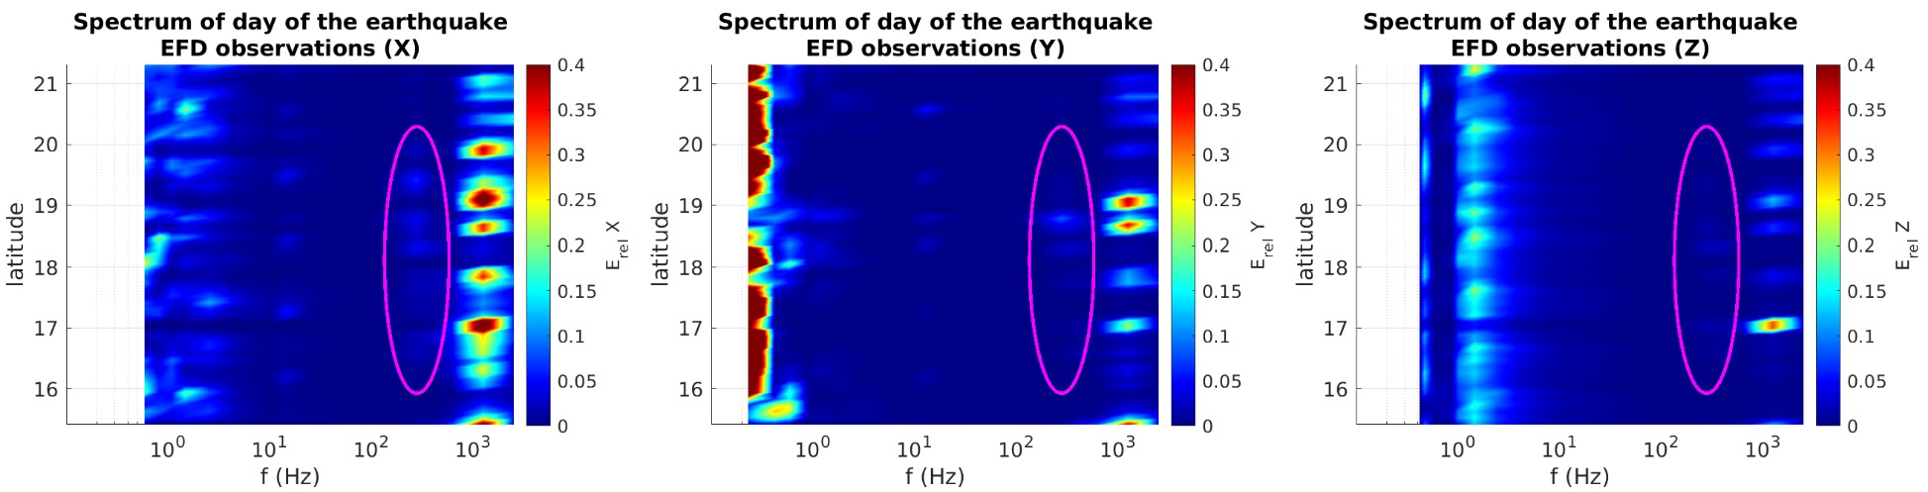
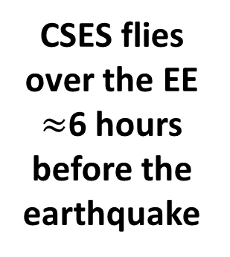
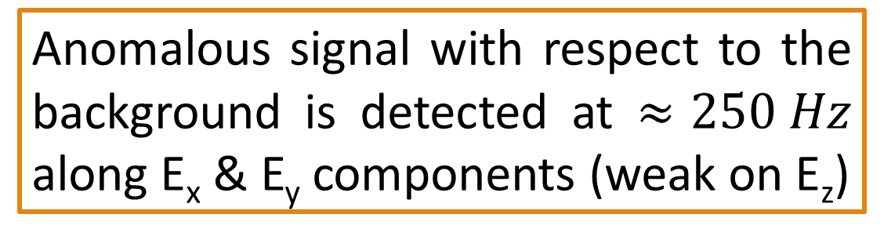
Case event 1: August 14, 2021 Haiti
OBSERVATIONS AROUND THE EARTHQUAKE EPICENTER (EE) - EFD
CSES flies over the EE $≈$6 hours before the earthquake
Anomalous signal with respect to the background is detected at $≈250 Hz$ along E_{x} & E_{y} components (weak on E_{z})

Slide 12
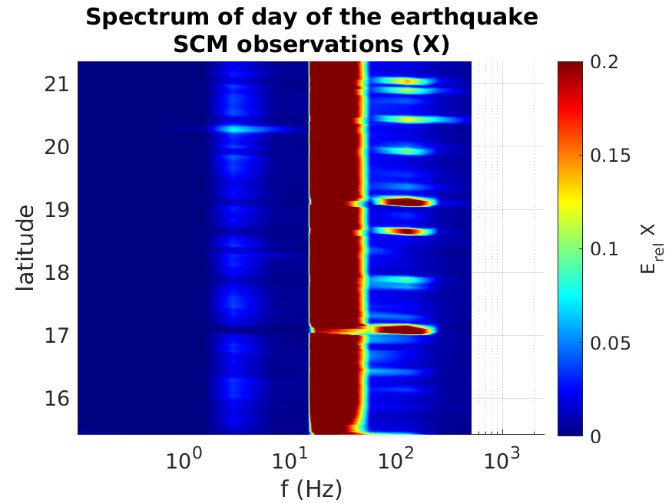
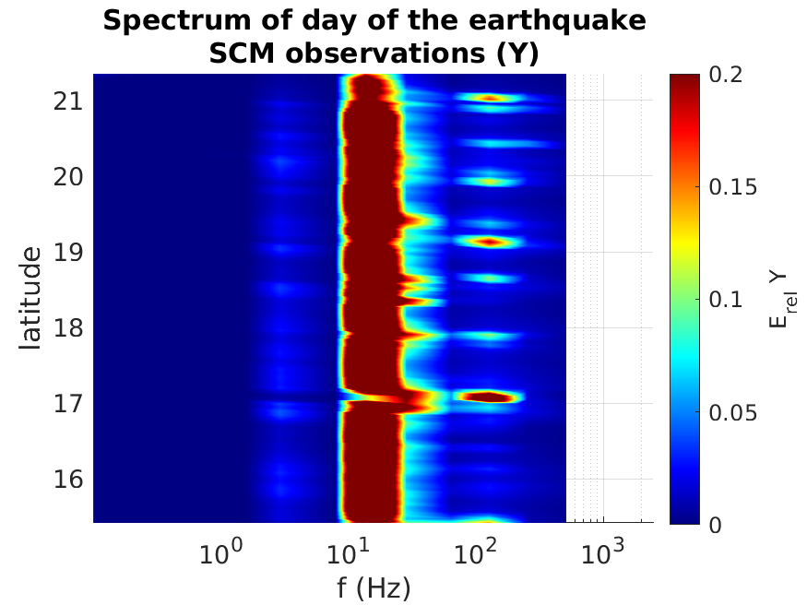
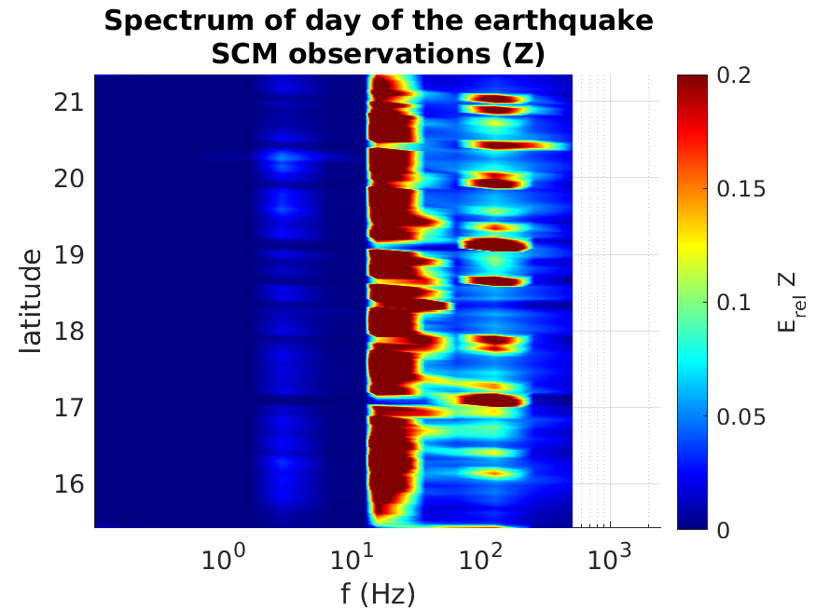


Case event 1: August 14, 2021 Haiti
OBSERVATIONS AROUND THE EARTHQUAKE EE - SCM
The anomalous signal is still present. This time it appears clearly on B_{z} and it’s weak along B_{x} & B_{y} components.
$$⇒$$
$\vec{E}⊥\vec{B}$
It’s an EM wave!
Notes:
La banda intorno a 20 Hz è la seconda risonanza di Schumann che si vede sempre bene su SCM

Slide 13
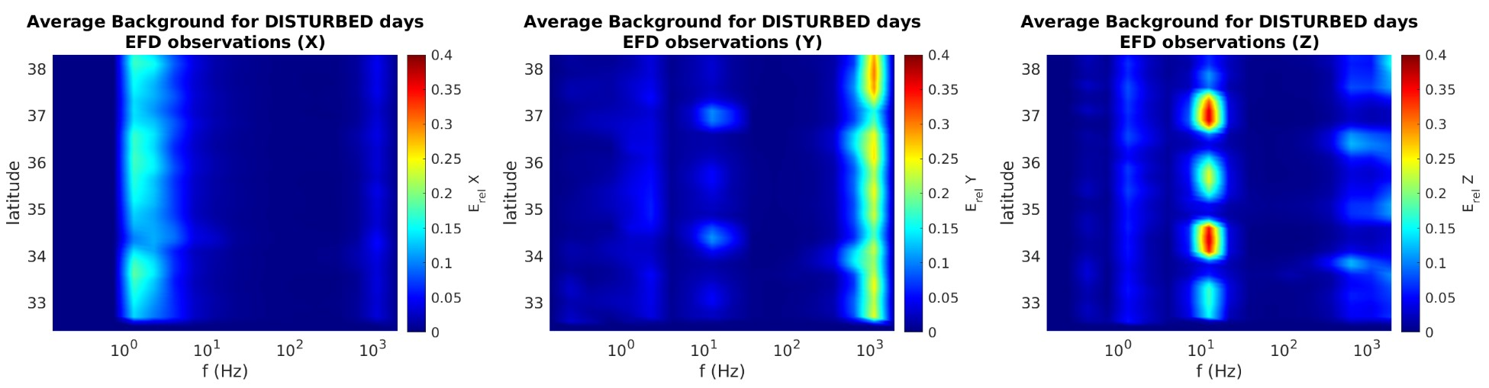
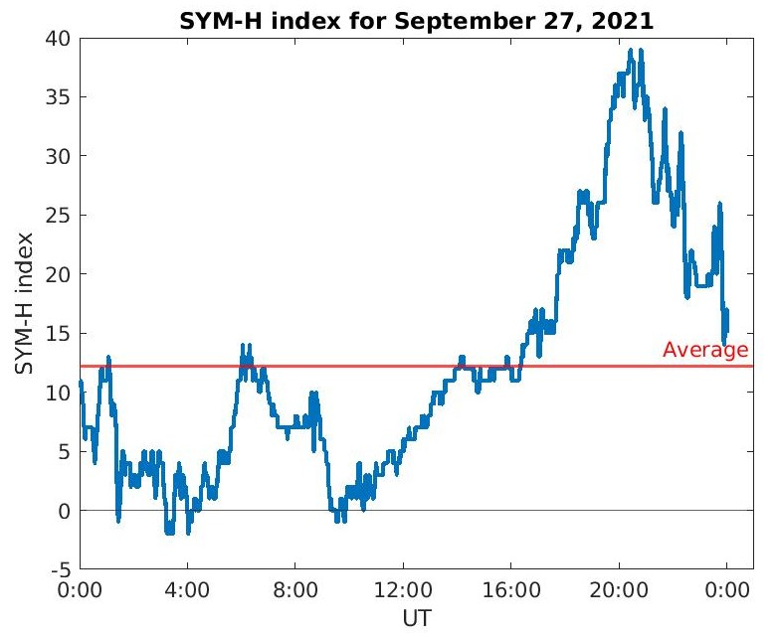
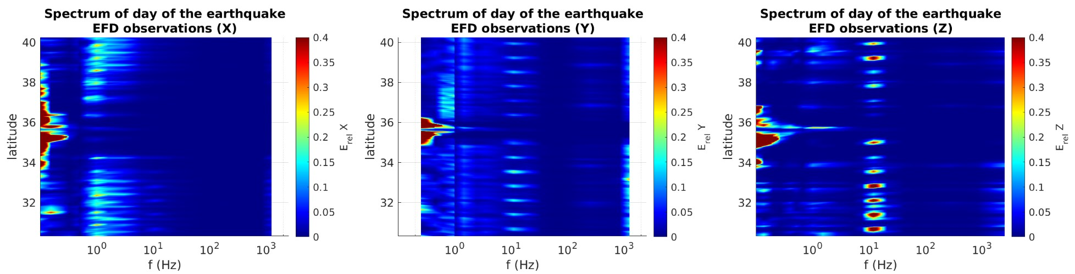
Case event 2: September 27, 2021 Crete
$⋄$Magnitude: $6.0 M_{W}$ $⋄$ Latitude: $35.252°N$ $⋄$ Longitude: 25.260°E
No evidence of signals emerging clearly from the background.
External forcing is dominant, in fact this day is categorized as STORM.

Slide 14
Conclusions
The algorithm presented here represents a very efficient technique to discriminate a signal detected from satellite observations from the background and external sources signals.
The background spectra obtained:
  includes only EM observation geographically close to the earthquake (avoiding possible local effects far from the region of interest that can contaminate the spectrum);
  exclude outliers due to possible extreme events occurred before the earthquake to be analyzed (the threshold equal to 5σ should exclude possible false positives and ensures an anomaly selection as strong as possible)
FIF technique represent at the moment the state of the art for non-linear and non-stationary signal analysis.

Slide 15
Conclusions
CASE EVENT 1 | CASE EVENT 2
Quiet or mildly disturbed geomagnetic conditions: Electromagnetic anomalies could be detected through a proper comparison with the background spectra. | Highly disturbed geomagnetic conditions: Background spectra regarding storm days weren't computed, since defining an average spectrum in such extreme situations would not represent a proper description of the ionospheric conditions.
The ≈ 250 Hz signals showing up both in the EFD and SCM spectra when CSES flew exactly over the EE for Haitian earthquake, doesn’t appear in the corresponding background and may represents an interesting anomalous signal. | A particular caution is required before correlating a signal to the seismic activity, because external forcing represent the principal disturbance of the ionospheric field.
References:
1. Bertello, I., Piersanti, M., Candidi, M., Diego, P., and Ubertini, P.: Electromagnetic field observations by the DEMETER satellite in connection with the 2009 L'Aquila earthquake, Ann. Geophys., 36, 1483–1493, https://doi.org/10.5194/angeo-36-1483-2018, 2018.
2. Piersanti, M.; Materassi, M.; Battiston, R.; Carbone, V.; Cicone, A.; D’Angelo, G.; Diego, P.; Ubertini, P. Magnetospheric–Ionospheric–Lithospheric Coupling Model. 1: Observations during the 5 August 2018 Bayan Earthquake. Remote Sens. 2020, 12, 3299. https://doi.org/10.3390/rs12203299.

Slide 16
Thank you!

Slide 17
Backup slides

Slide 18
Improvements with respects to previous works
Thresholds on the SYM-H index were redefined for a better inclusion of the geomagnetic situation: the external forcing is now automatically considered.
The background computation include 4 years of data (2018-2022). In addition, the algorithm allows the dynamic input of data. In such way every time the algorithm is launched, if new data are available, they are automatically added and they contribute to generate a background more and more robust.
The construction of a grid with a logarithmic scale for frequencies on which remap all the selected orbits allow a better comparison between them.
Automatization of the whole process: now it can be applied on every event. It only need significant computational time due to the large amount of data.

Slide 19
Future developments
Computation of the Poynting vector, indicating the wave’s propagation direction with respect to the satellite.
Analysis on more events.
Definition of the spatial distance from the epicenter of the earthquake and the temporal distance from the onset of the earthquake from which it is possible to identify EM anomalies.
Numerical simulation of electro-magnetic ionospheric field. This will allow a causality analysis. It will involve MHD equation with time-scale of 1-min (no turbulence).
Analysis on the VLF band (VLF anomalies could be linked to seismic precursor)
Notes:
Numerical and not analytical because the analytical was not solved yet

Slide 21
The anomalous signal: When & Where?
In order to establish the spatial and temporal persistence of the anomalous signal, we generated the ELF spectra for all the orbits of 13, 14, and 15 of August.
This time we analyzed the whole orbit and not only the part crossing the cell over the EE.

Slide 22
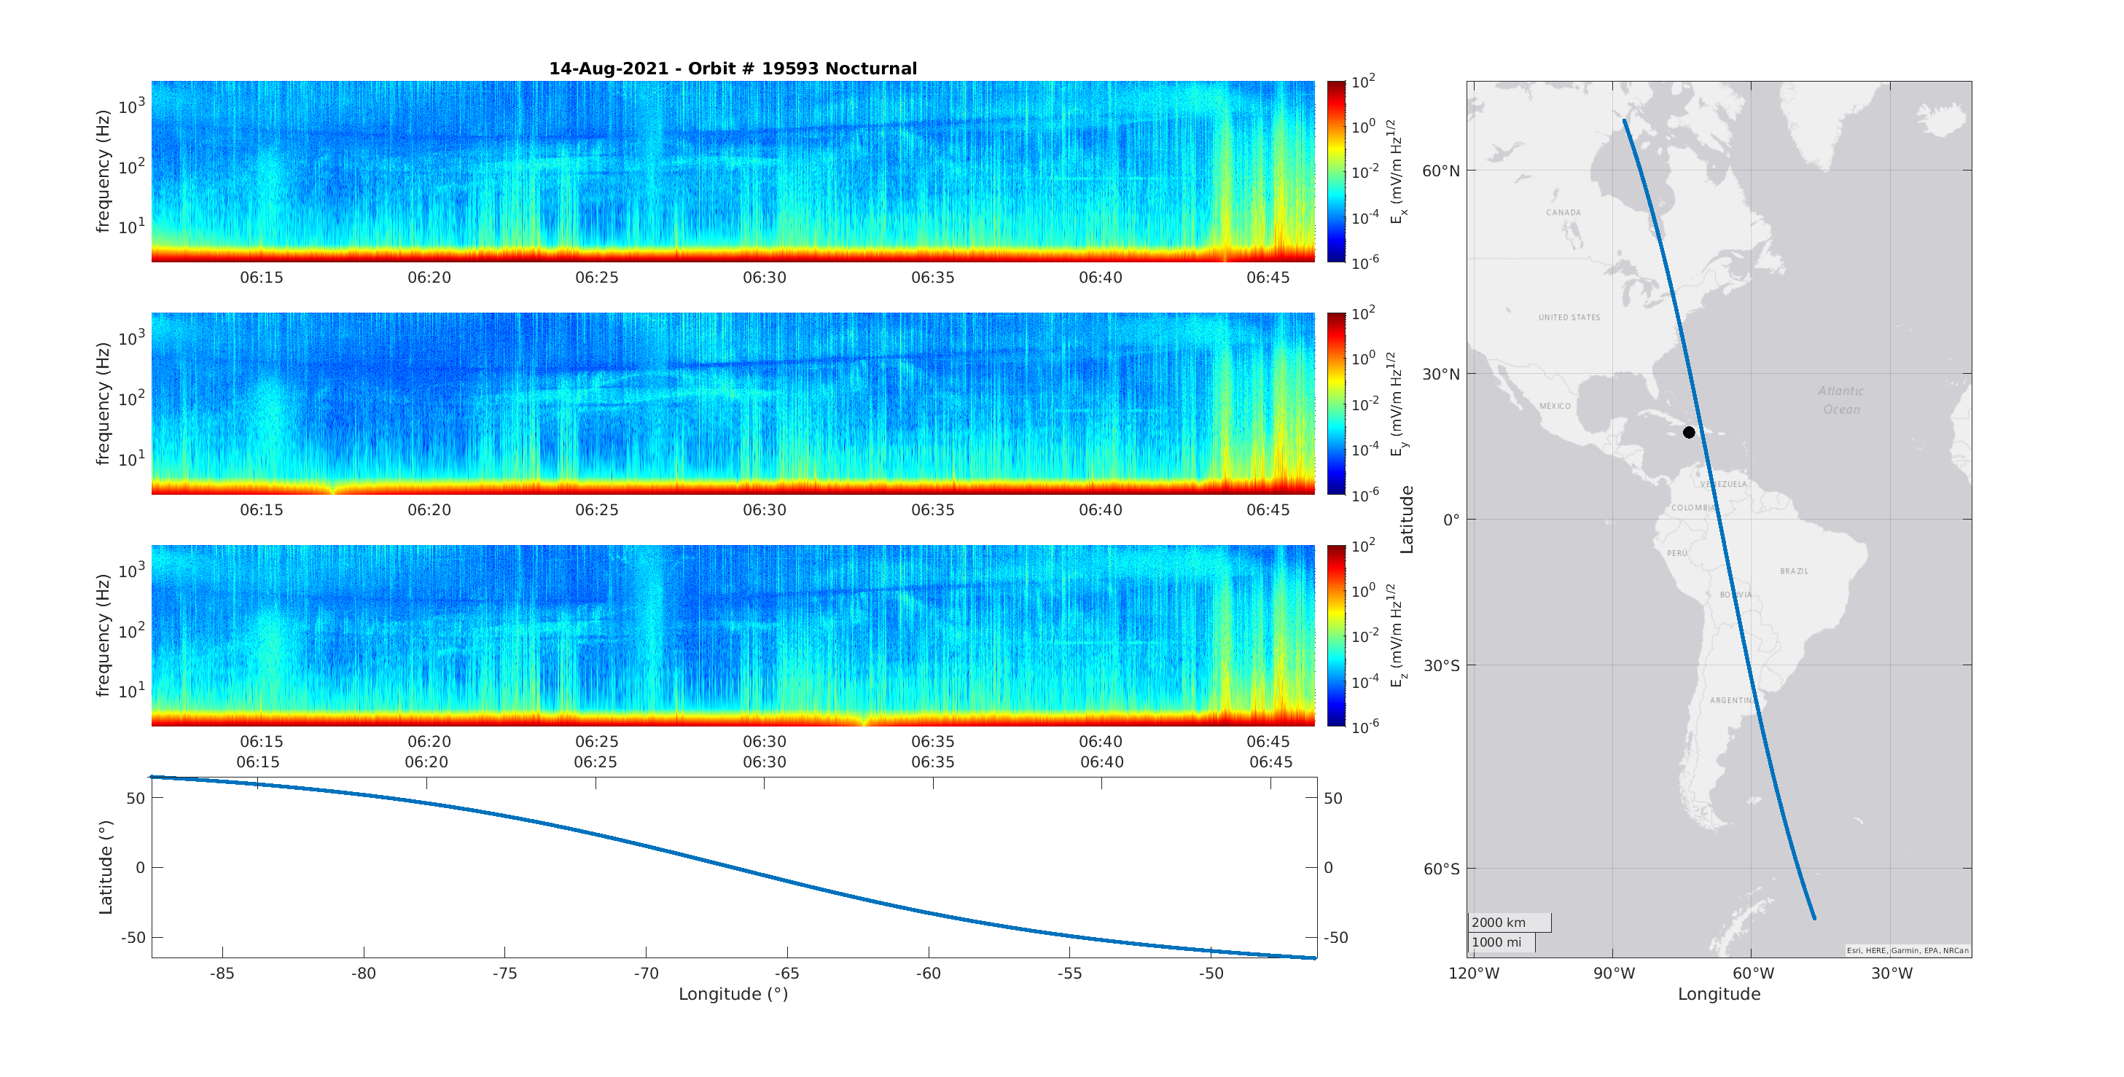
The anomalous signal: When & Where?
The signal seems to appear only over the earthquake!

Slide 23
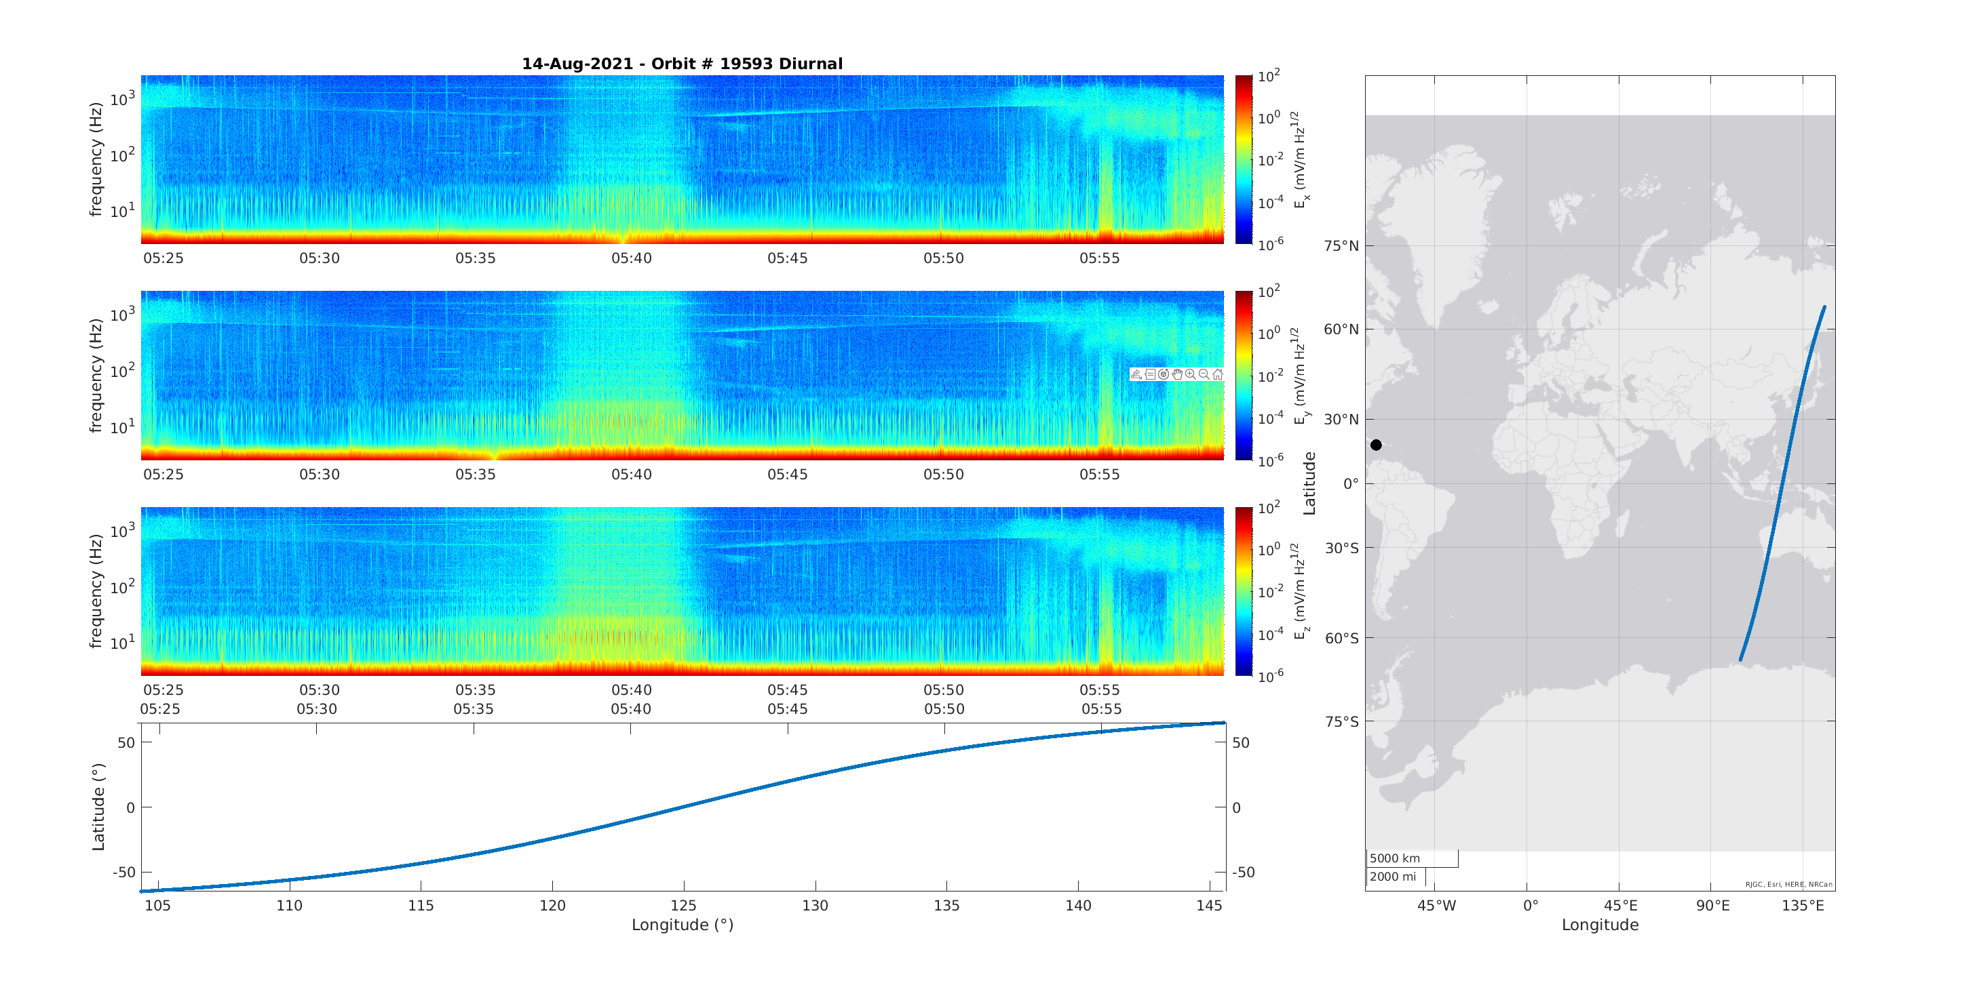
The anomalous signal: When & Where?
Previous orbit

Slide 24
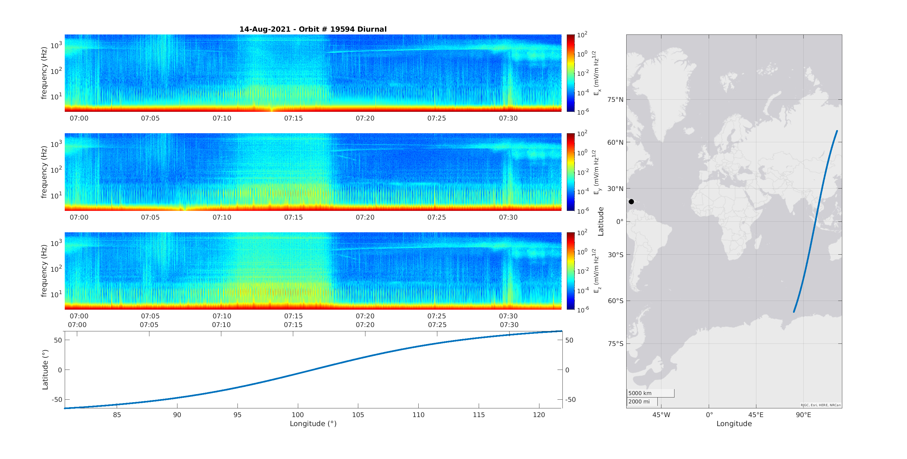
The anomalous signal: When & Where?
Subsequent orbit
The signal does not appear before and after!

Slide 25
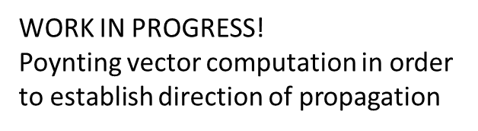
Poynting vector

