Slide 1
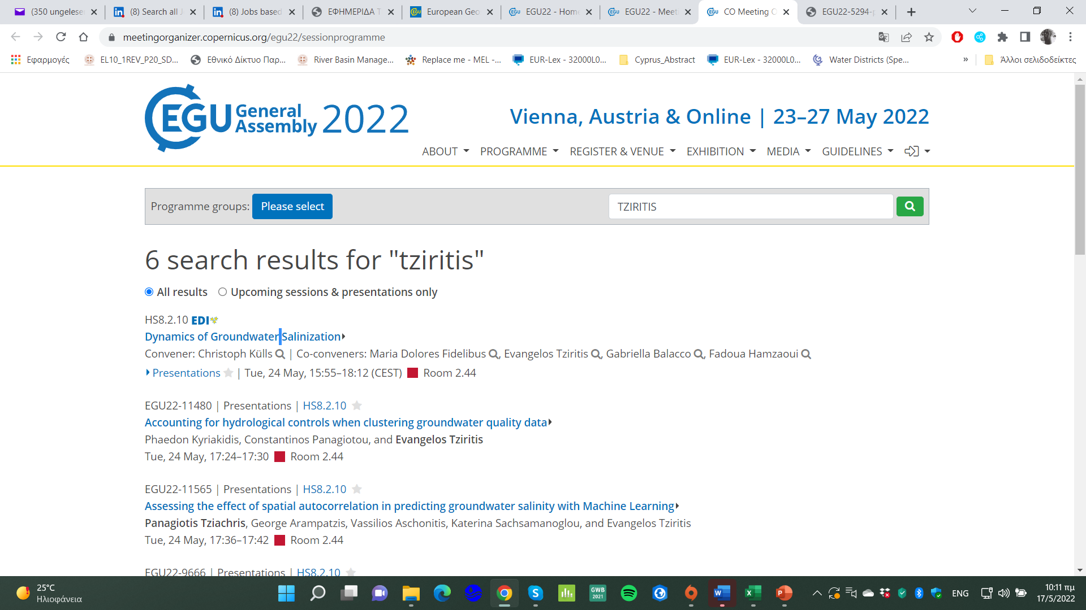

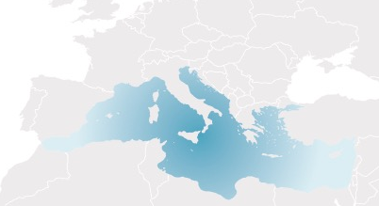



Title: SPATIOTEMPORAL ASSESSMENT OF MULTI-SOURCED GROUNDWATER SALINIZATION IN A COASTAL AQUIFER (RHODOPE, NORTHERN GREECE).
Authors: TZIRITIS, E. ¹, SACHSAMANOGLOU, E. ¹, ASCHONITIS, V. ¹, DALAMPAKIS, P. ¹, DOULGERIS, C. ¹, PANAGOPOULOS, A. ¹, PISINARAS, V. ¹, KINIGOPOULOU, V. ¹, VROUHAKIS, I. ¹
¹Hellenic Agricultural Organization "Demeter", Soil and Water Resources Institute, Greece
Notes:
1

Slide 2
Introduction
Get an insight into the complex groundwater system of Rhodope’s coastal aquifer
Evaluation of its hydrogeochemical characteristics
Assessment of the spatiotemporal variations of groundwater salinization and identification of the dynamics governing the phenomenon
Decipher the mechanism(s) of groundwater salinization and their evolution in time and space
Notes:
2

Slide 3
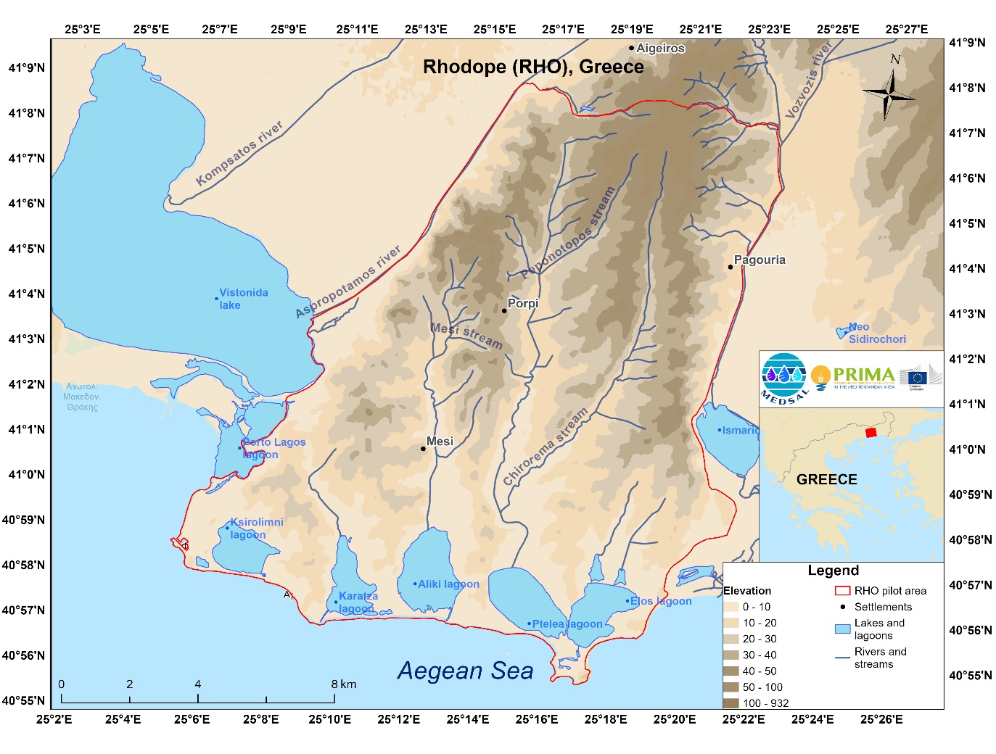
RHO Pilot site description
Located in Rhodope, NE Greece
Extends approximately to 165 km² and is predominately covered by agricultural land
Delineated by two rivers; the Aspropotamos River at the west and the Vozvozis River at the east
The surface water reservoirs are also composed of several coastal lagoonal complexes and two lakes, Vistonida and Ismarida Lakes
Two main aquifers; an upper semi-confined aquifer and a lower confined aquifer
Notes:
3

Slide 4
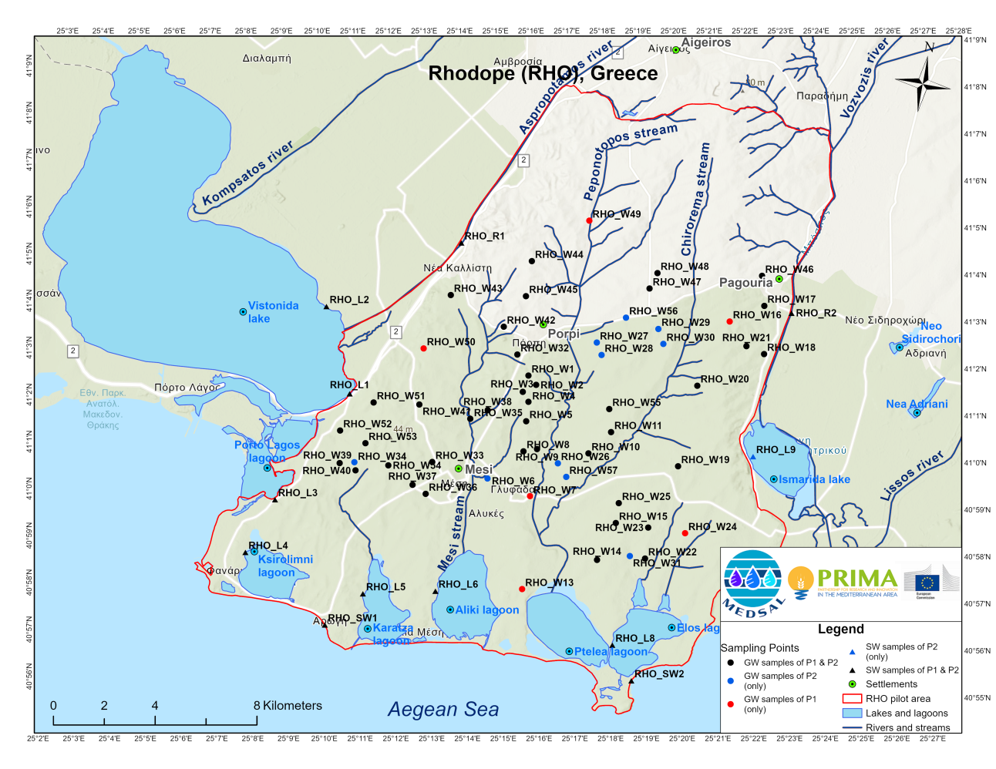
Methodology
2 sampling campaigns (P1 & P2), in June and August 2020, corresponding to the wet and dry hydrological period
96 groundwater (GW) and 25 surface water (SW) samples, collected from 70 sampling sites
P1: 46 for GW and 11 for SW
P2: 50 for GW and 12 for SW
Notes:
4

Slide 5
Methodology
The groundwater wells are mainly used for irrigation purposes
The SW samples were collected from different surface water systems, including rivers, lakes, lagoons, and seawater
The chemical analysis for the physicochemical parameters was conducted at the SWRI Lab
The values measured below the limit of detection (LOD) of the methods used (non-detects) were considered as “censored”. Values below LOD were replaced by a conventional value of 0.55 of LOD.
The dataset was evaluated for its normality (normal or log-normal distribution)
Johnson Transformation was applied to the data that were not normally distributed
11 parameters were included in the matrix used to apply the MVSA in the dataset of P1 and P2, namely EC, pH, Ca²⁺, Mg²⁺, Na⁺, Si, HCO₃⁻, NO₃⁻, Al, Li and Sr.
Notes:
5

Slide 6
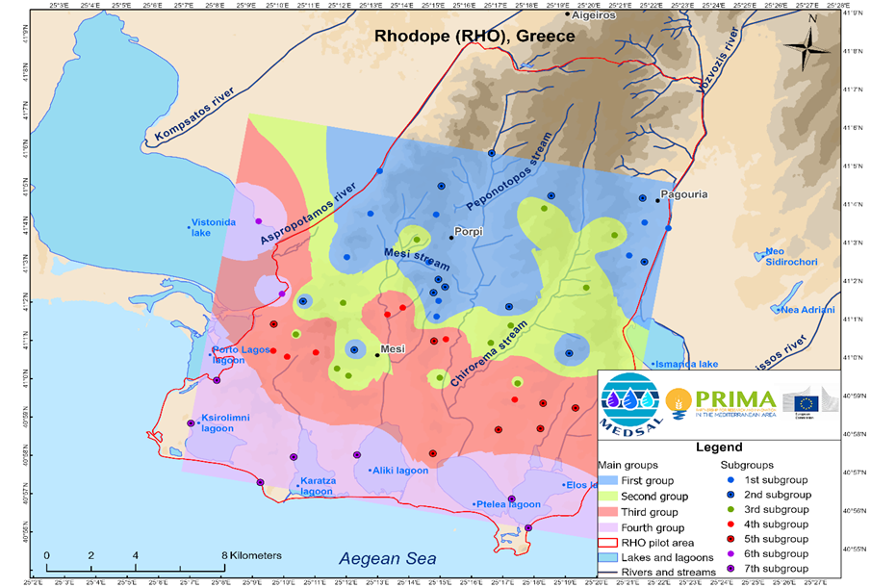
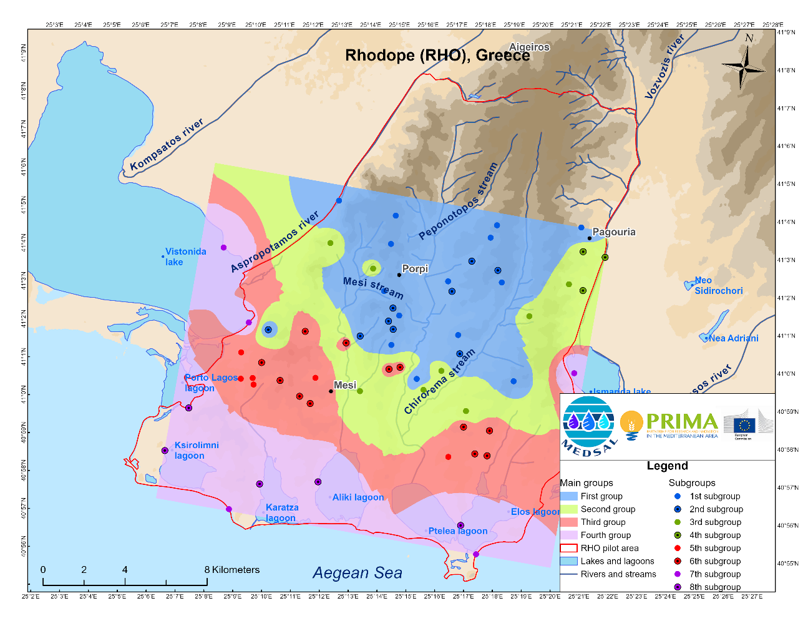
Q-mode hierarchical cluster analysis (HCA)
4 clusters were considered for both sampling campaigns, classifying water samples into four (4) diverse groups and seven (7) subgroups that denote different hydrogeochemical and salinization phases
P1
P2
Notes:
6

Slide 7
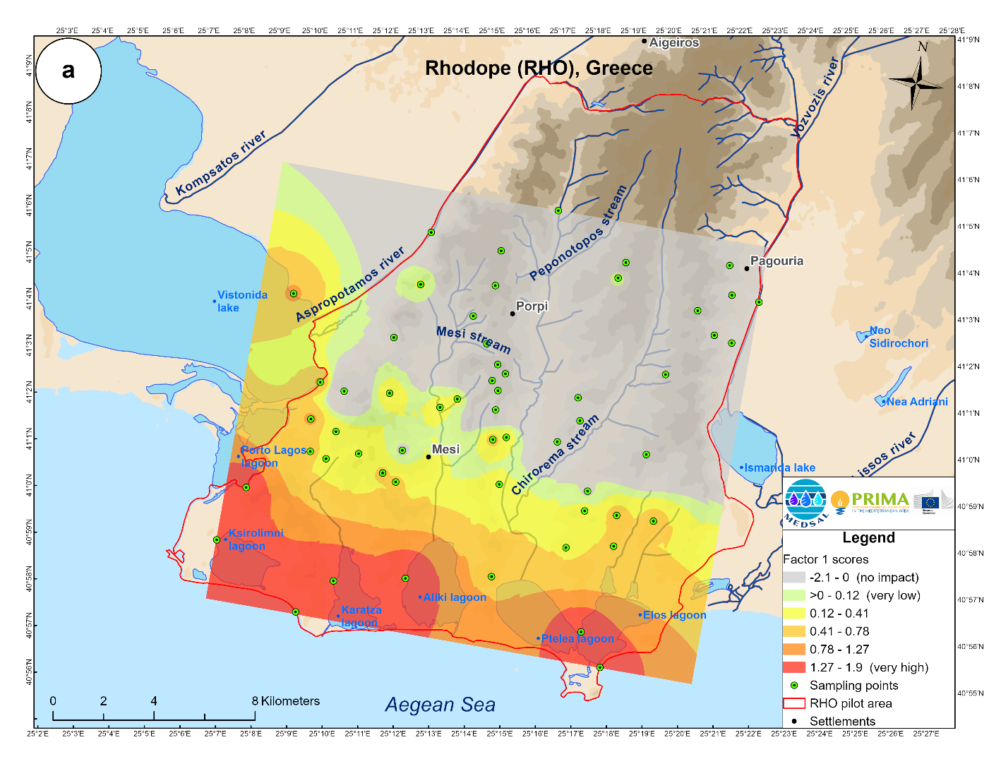
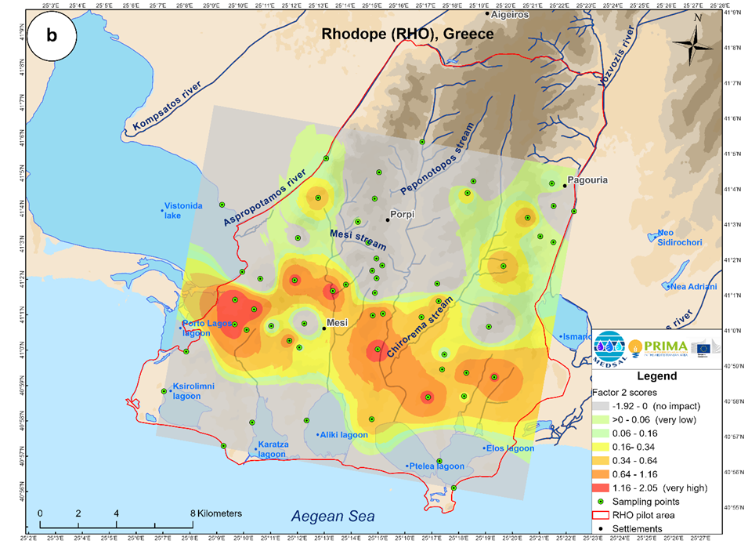
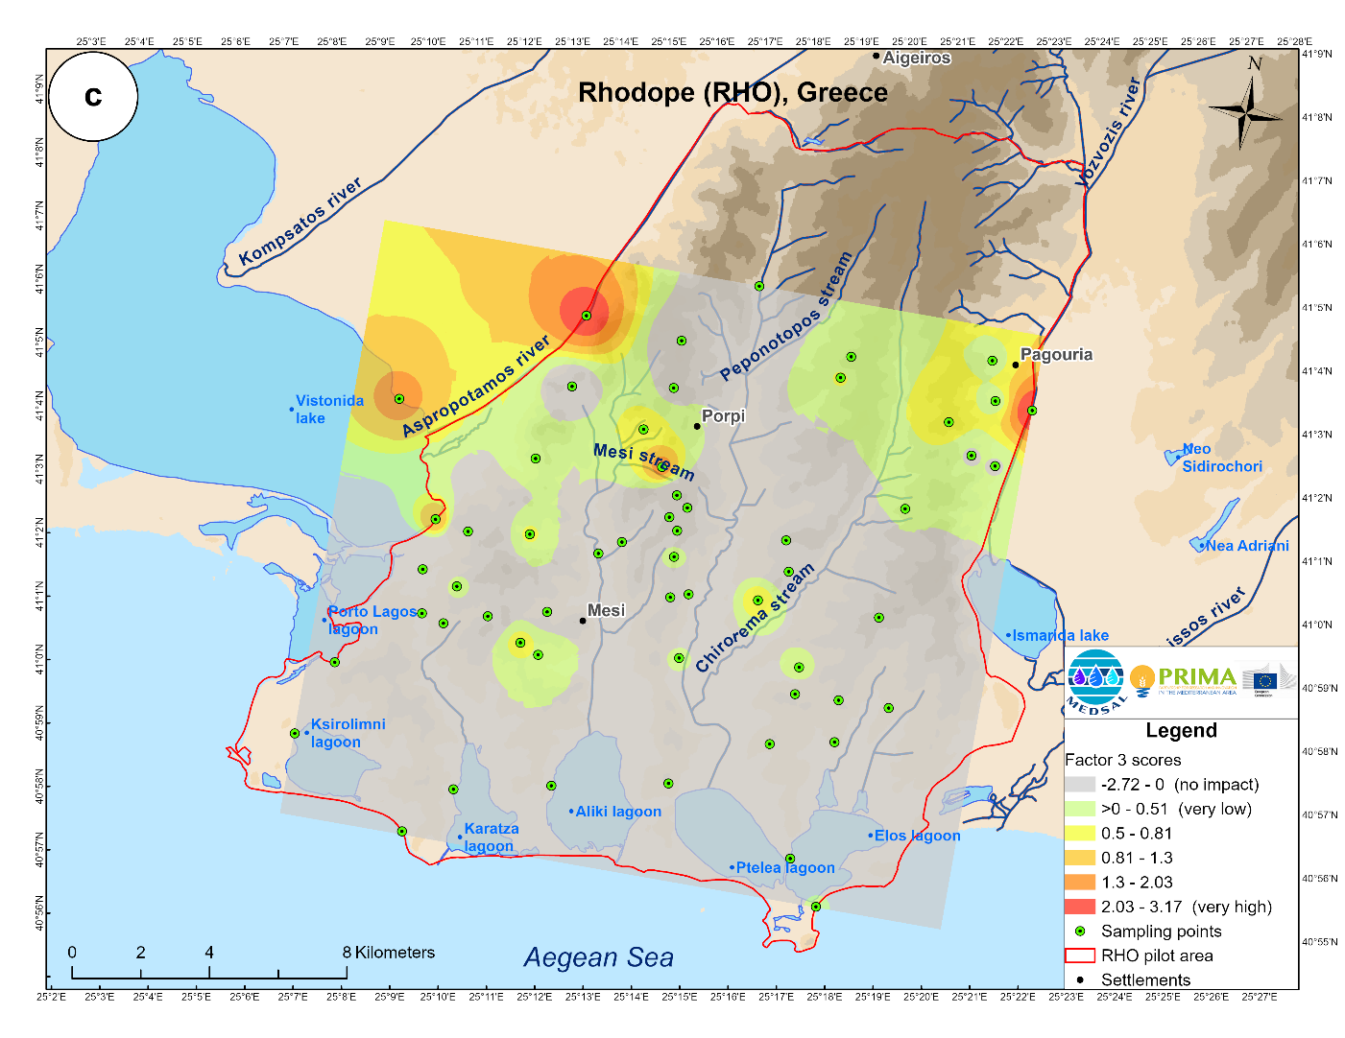
R-mode factor analysis (FA)
The outcomes outlined three main factors that supplemented the HCA for P1, that explain 69% of the total variance
P1
seawater intrusion
effect of the pH and Nitrates
weathering of surrounding geological formations and potential impact of the geothermal field
Notes:
7

Slide 8
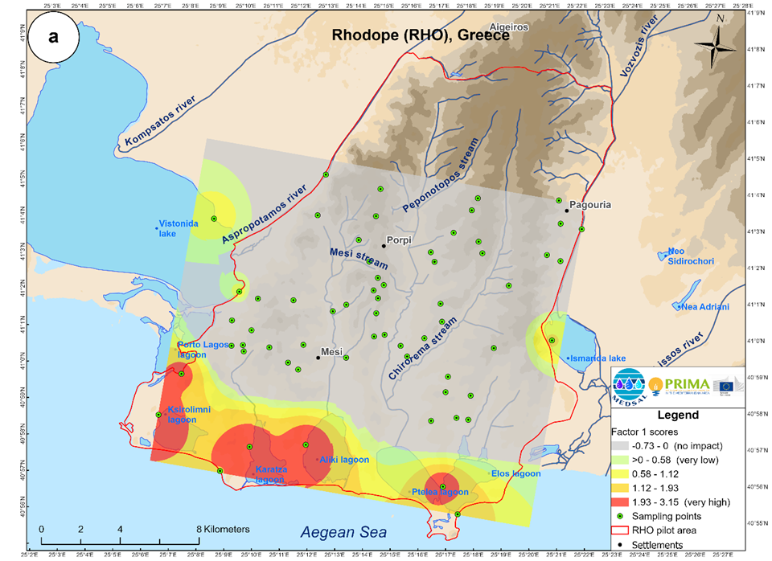
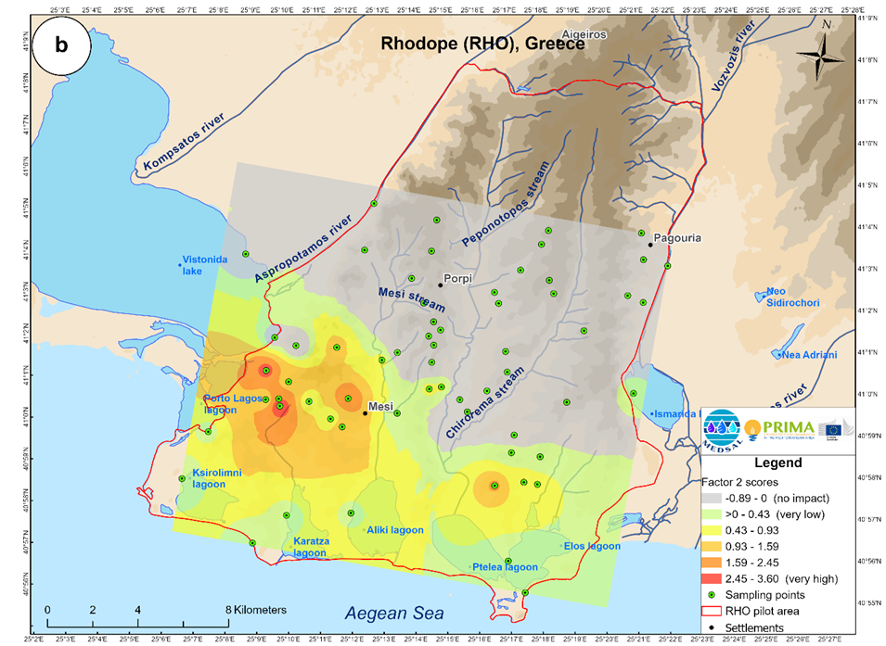
R-mode factor analysis (FA)
The outcomes outlined two main factors that supplemented the HCA for P2, that explain 68,6% of the total variance
P2
seawater intrusion
process of nitrogen enrichment
Notes:
8

Slide 9
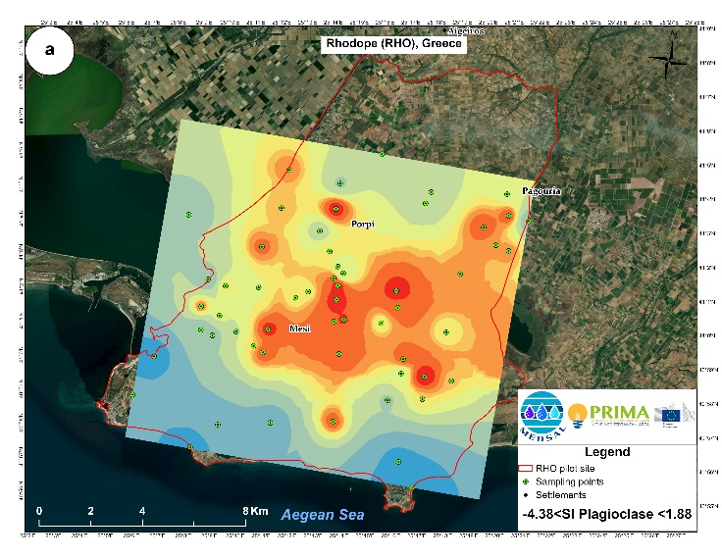
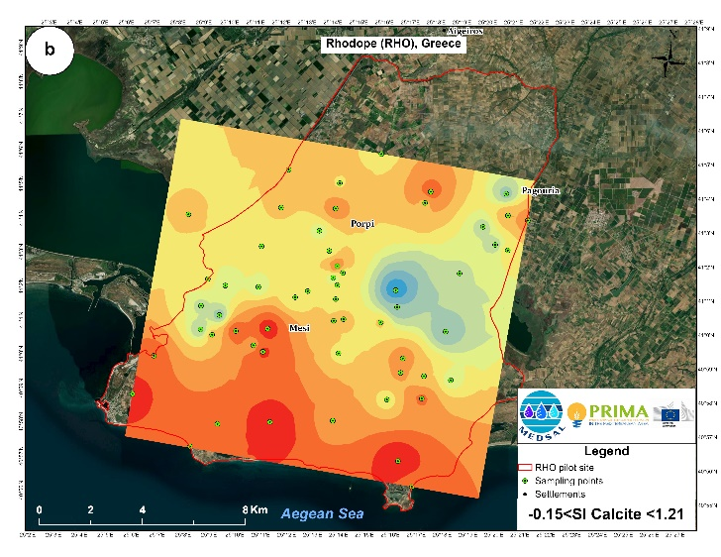
Saturation Indices
Ten minerals: calcite, dolomite, gypsum, halite, celestite, strontianite, plagioclase (albite), K-feldspar, Ca-montmorillonite (Ca-smectite) and kaolinite.
P1
Notes:
9

Slide 10
Hydrogeochemical modelling
The “virtual samples” of the HCA identified groups were used. The virtual samples are composed of the median values of all examined parameters for each group of the HCA
Additionally, the Saturation Indices (SIs) of the dominant mineralogical phases were calculated and processed to support the overall conceptualization.
The inverse hydrogeochemical modelling has been performed with PHREEQC ® software (Parkhurst and Appelo, 1999) using the thermodynamic database LLNL and includes 4 sequential steps (models), as listed below:
• Model 1: Mixing of seawater and Aspropotamos River to produce the solution of Vistonida Lake, considering evaporation as the dominant process
• Model 2: Vistonida Lake to Group III of the HCA with cation exchange
• Model 3: Group III to Group II with cation exchange
• Model 4: Mixing of Group II with recharge water (RE) to produce Group I
Results explained the mass-balance evolution of the aqueous solutions of the two periods
Notes:
10

Slide 11
Conclusions
The HCA was implemented for both sampling campaigns, P1 and P2, denoting four distinct hydrogeochemical groups.
According to the interpretation of the analytical results of P1 and P2, have a similar hydrogeochemical fingerprint
The FA was applied for both sampling campaigns. Three factors are identified for P1 and two for P2. The dominant factor is related to the cascading processes of salinization, and the secondary factors are related to anthropogenic contamination (N surplus due to agricultural activities) and the impact from the substrate (water-rock interaction).
The hydrogeochemical modelling confirmed the aforementioned processes.
Four sequential models were developed for both periods. The models considered the significant minerals according to the dominant geological formations and processes and performed an inverse modelling analysis.
The hydrogeological evolution differed between the wet (P1) and the dry (P2) periods. In the wet period, the upper aquifer layer (semi-confined aquifer) is mainly exploited with a smaller contribution of the deeper (confined) one. The upper aquifer is depleted progressively and close to the end of the irrigation period (P2). larger volumes from the deeper aquifer are abstracted, improving groundwaters' qualitative characteristics (reduction of electrical conductivity and nitrates).
Notes:
11

Slide 12
Thank you for your Attention
Acknowledgement
This research was supported by the MEDSAL Project © (www.medsal.net), which is part of the PRIMA Programme, supported by the European Union’s Horizon 2020 Research and Innovation Programme and funded by the Greek national funding agency - GSRT (grant number 2018-7).
Notes:
12

