Slide 1


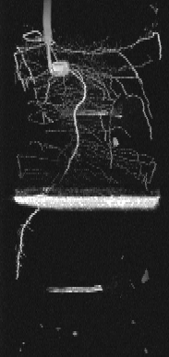
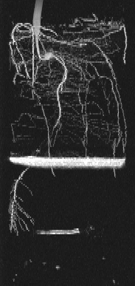
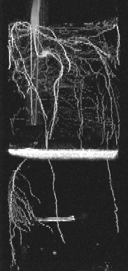
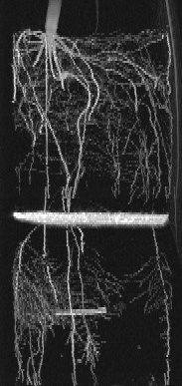

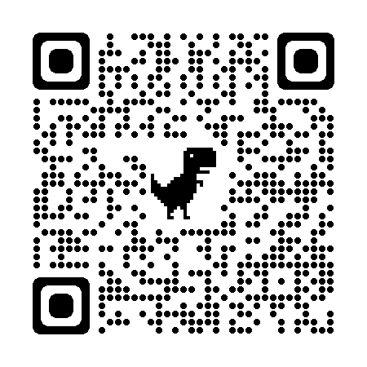
Dynamics and reversibility of global hydropatterning in a split-root experiment
Samuele Ceolin¹ ECS, Stanislaus Schymanski¹, Dagmar van Dusschoten², Robert Koller², Daniel Pflugfelder², Julian Klaus³
¹ERIN department, Luxembourg Institute of Science and Technology (LIST), Sanem (LU)
²Institute of Bio- and Geosciences, IBG-2: Plant Sciences, Forschungszentrum Jülich GmbH, Jülich (DE)
³University of Bonn (DE)
Supported by the Luxembourg National Research Fund (FNR), AFR PhD/19/SR/13577787
Supported by European Plant Phenotyping Network (EPPN), project ID: 488
Notes:
<number>

Slide 2


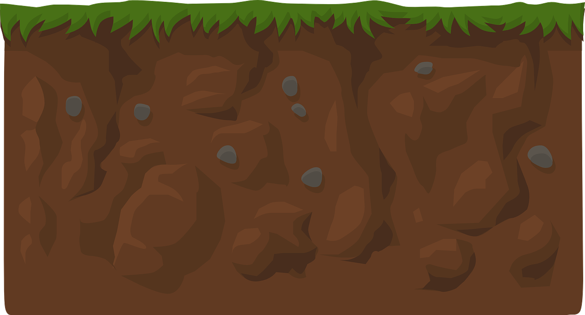
MOTIVATION
Hydropatterning: asymmetrical lateral root formation at the radial level

Slide 3
MOTIVATION
Hydropatterning: asymmetrical lateral root formation at the radial level
Dynamics of global hydroppatterning observed at the seasonal level in plant communities
Global hydropatterning: root formation and elongation at every direction

Slide 4
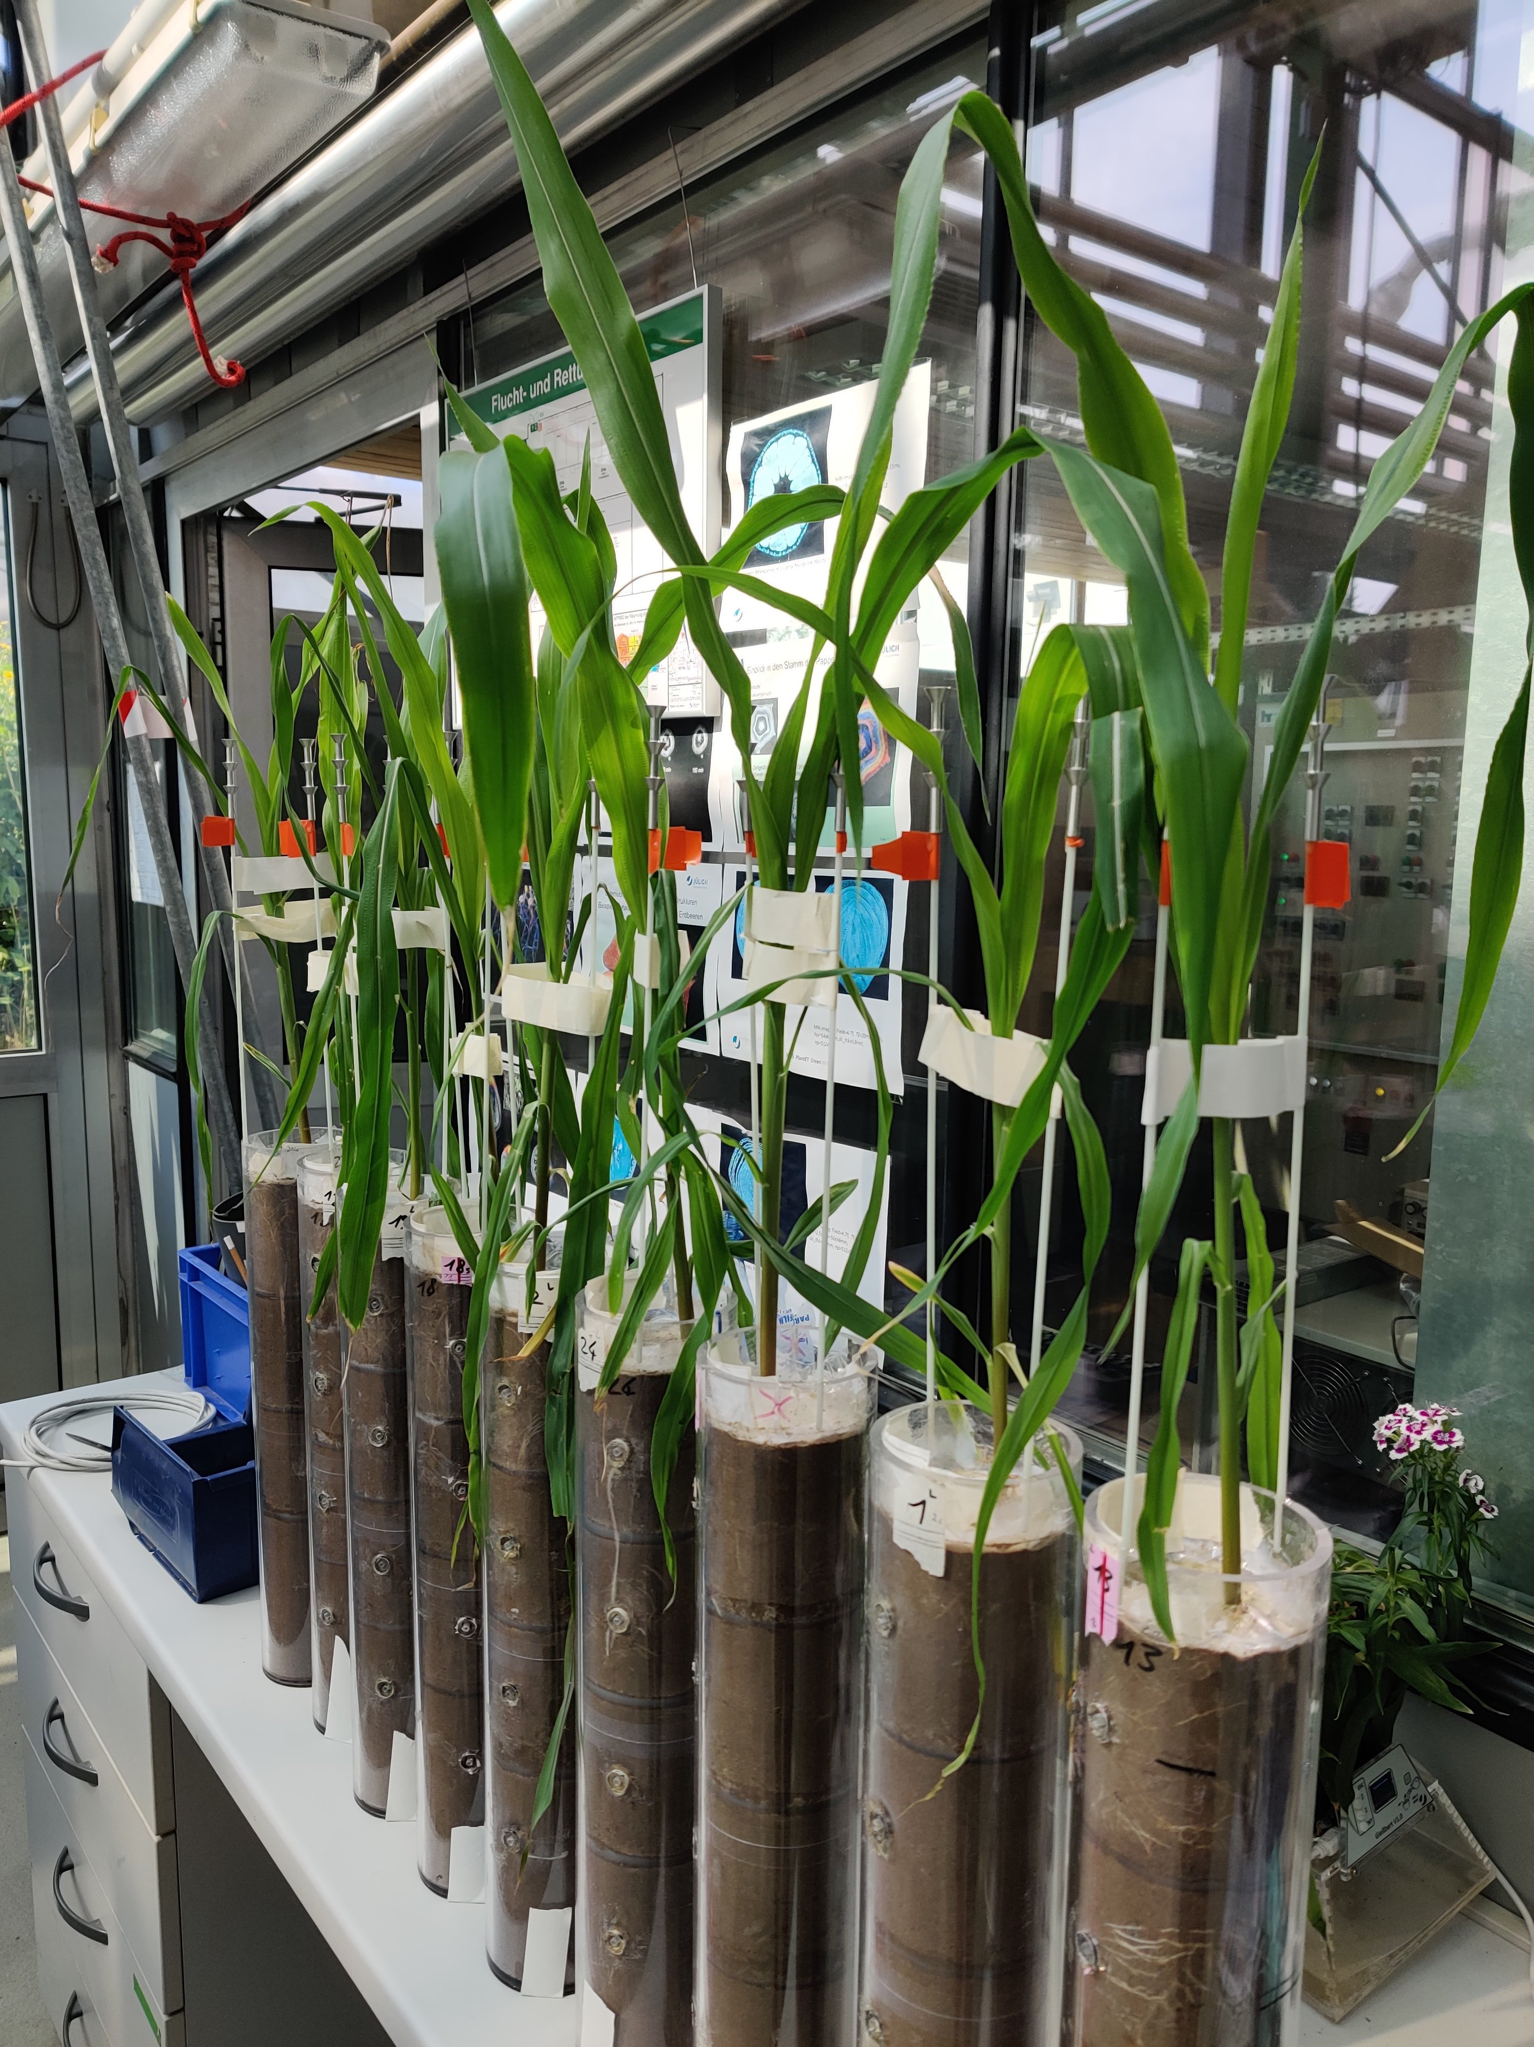

MATERIALS AND METHODS
Vaseline barrier
Rhizon for water injections

Slide 5
MATERIALS AND METHODS
Treatment 1
Treatment 2
Pulse
1
Pulse
1

Slide 6
MATERIALS AND METHODS
Treatment 1
Treatment 2
Pulse
Pulse
2
1
Pulse
Pulse
1
2

Slide 7
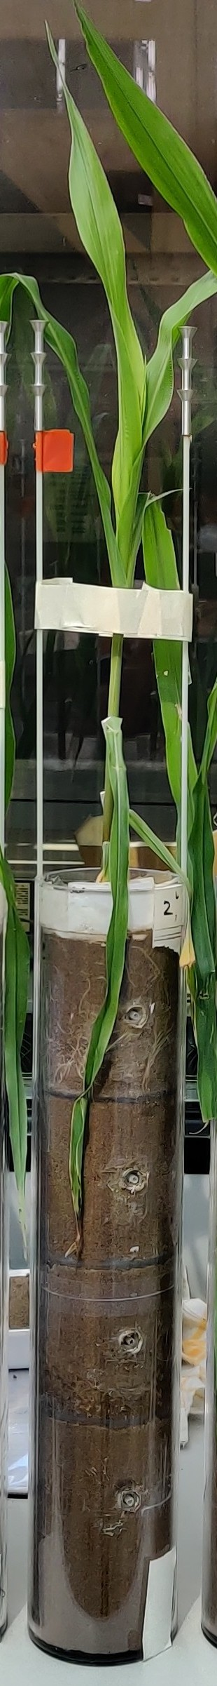
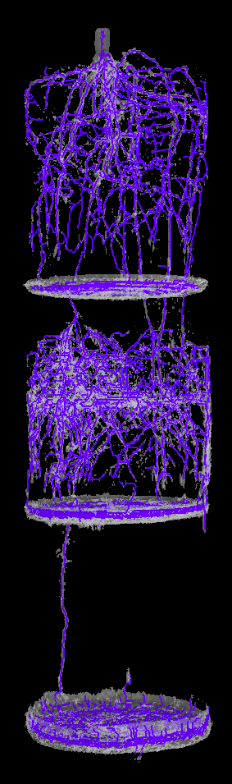
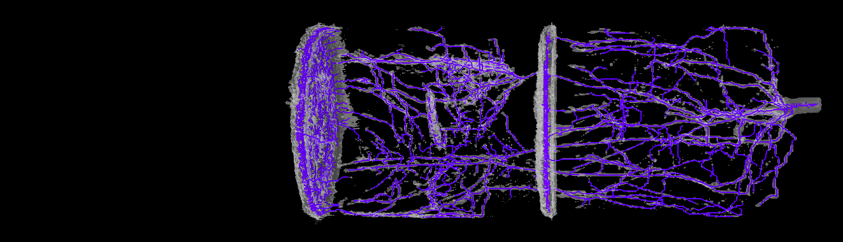
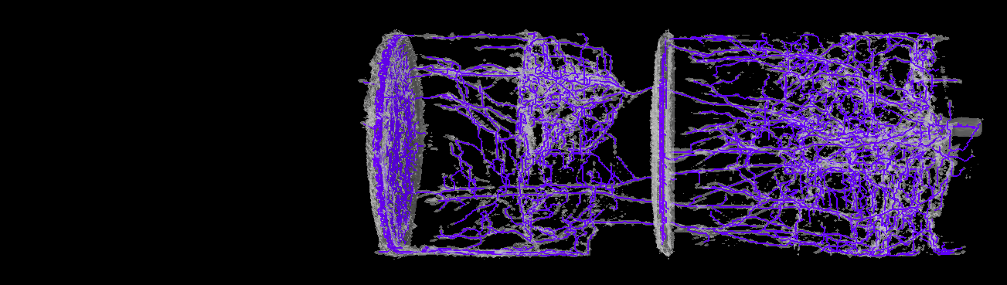
RESULTS
Pre-treatment (PT)
After pulse 1 (P1)
After pulse 2 (P2)
Treatment 2
Pulse 1
Pulse 2

Slide 8
RESULTS

Slide 9
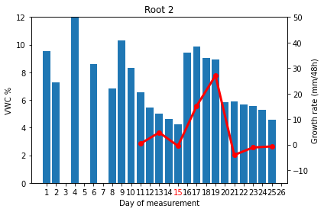
RESULTS
Layer receiving pulse 1:
Growth rate evolution layer 1 (single root)
Pulse 1
20
PT
Pulse 1
P1
P2
Pulse 2
Growth rate after pulse 1 significantly higher compared to before (p=8E-6; data from 10 plants)
PT
P1
P2

Slide 10
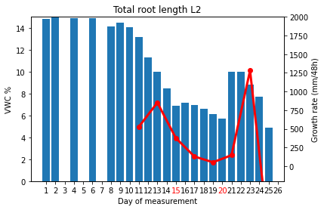
RESULTS
Layer receiving pulse 2:
Growth rate evolution layer 2 (entire layer)
Pulse 2
PT
Pulse 1
P1
P2
Pulse 2
Growth rate after pulse 2 significantly higher compared to before (p=5E-6; data from 10 plants)
PT
P1
P2

Slide 11
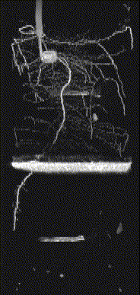
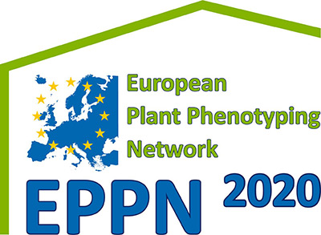



CONCLUSIONS
1
2
3
Fast occurrence of global hydropatterning (48 h)
Response independent of location and timing of pulse injection
Preliminary indication of reversibility of phenomenon
Contact information
For more info, please contact me at
samuele.ceolin@list.lu

