Slide 1
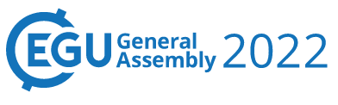

Activity concentration of radionuclides of natural and anthropogenic-transformed soils in Rostov region
Denis Kozyrev
Sergey Gorbov
Elena Buraeva
Nadezhda Salnik
Vienna, Austria, 23–27 May 2022

Slide 2
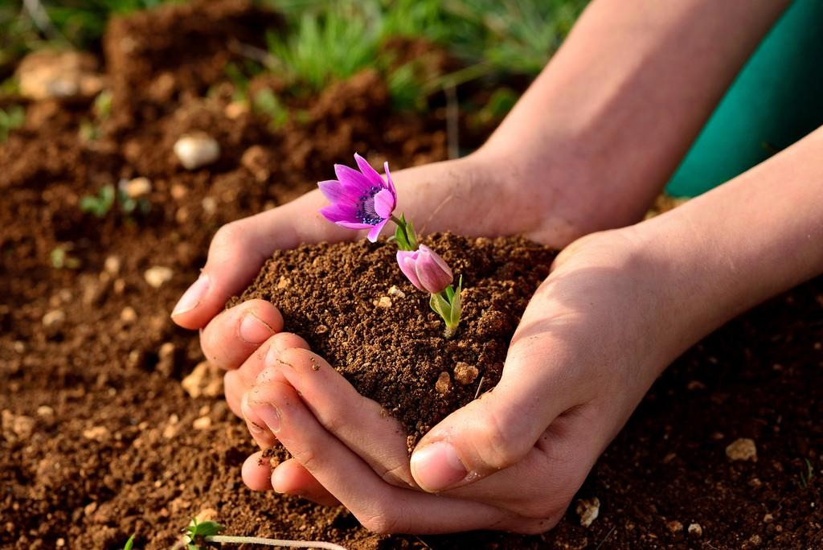
The soil is life
Topsoil is a filter that can absorb all wastes of production and anthropogenic activities. During the last 35 years, following several large industrial disasters and artificial radionuclides entering ecosystems, the ways of their migration and impact on living and biosphere systems are attracting close attention. As a result, the determination of both artificial and natural radionuclides in the soil seems relevant and is part of the radiation monitoring of the soil cover in Russia and the world. The purpose of the work was to carry out ecological monitoring of park-recreational, residential areas, as well as specially protected natural areas of the South of European Russia.

Slide 3
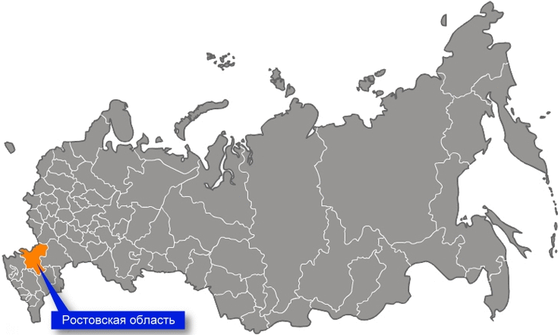
Geography of research
Rostov region

Slide 4
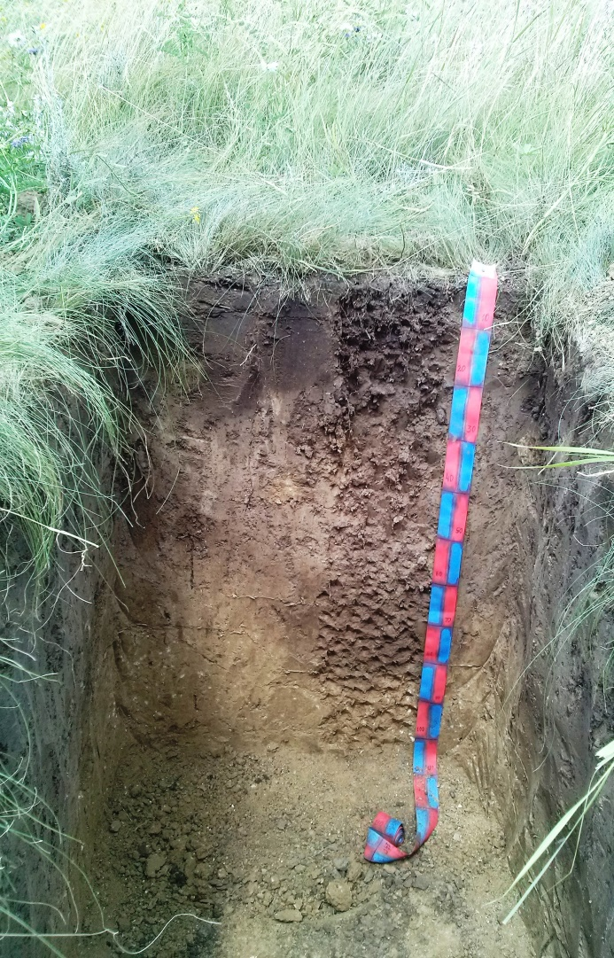
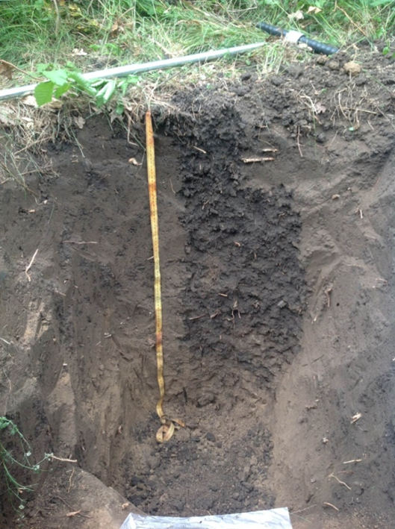
Object of research
Chernozem of specially protected natural areas
Chernozem of park-recreational areas
Chernozem of residential areas areas

Slide 5
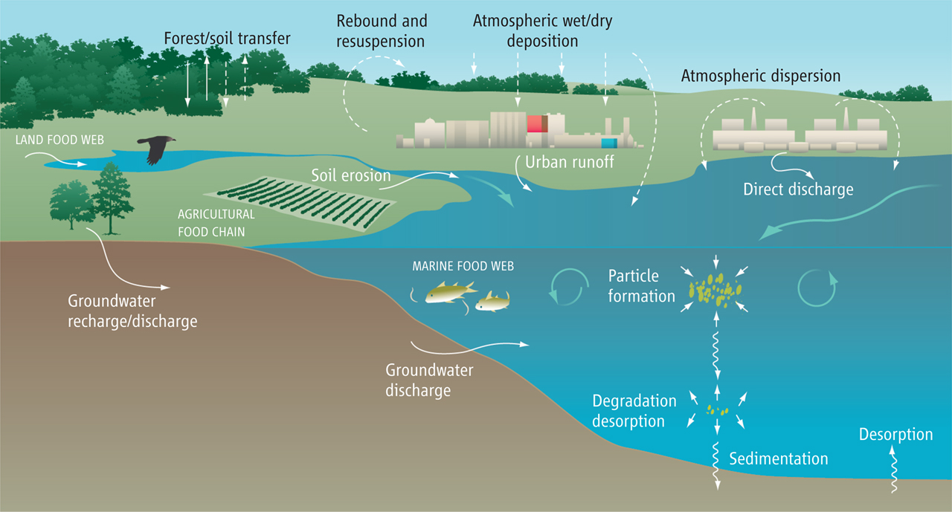
Object of research
Native:
K⁴⁰
Т_{1/2} 1,248*10⁹ years
Artificial:
Cs¹³⁷
Т_{1/2} 30,16 years
Th²³²
Т_{1/2} 1,405*10¹⁰ years
Ra²²⁶
Т_{1/2} 1600 years

Slide 6
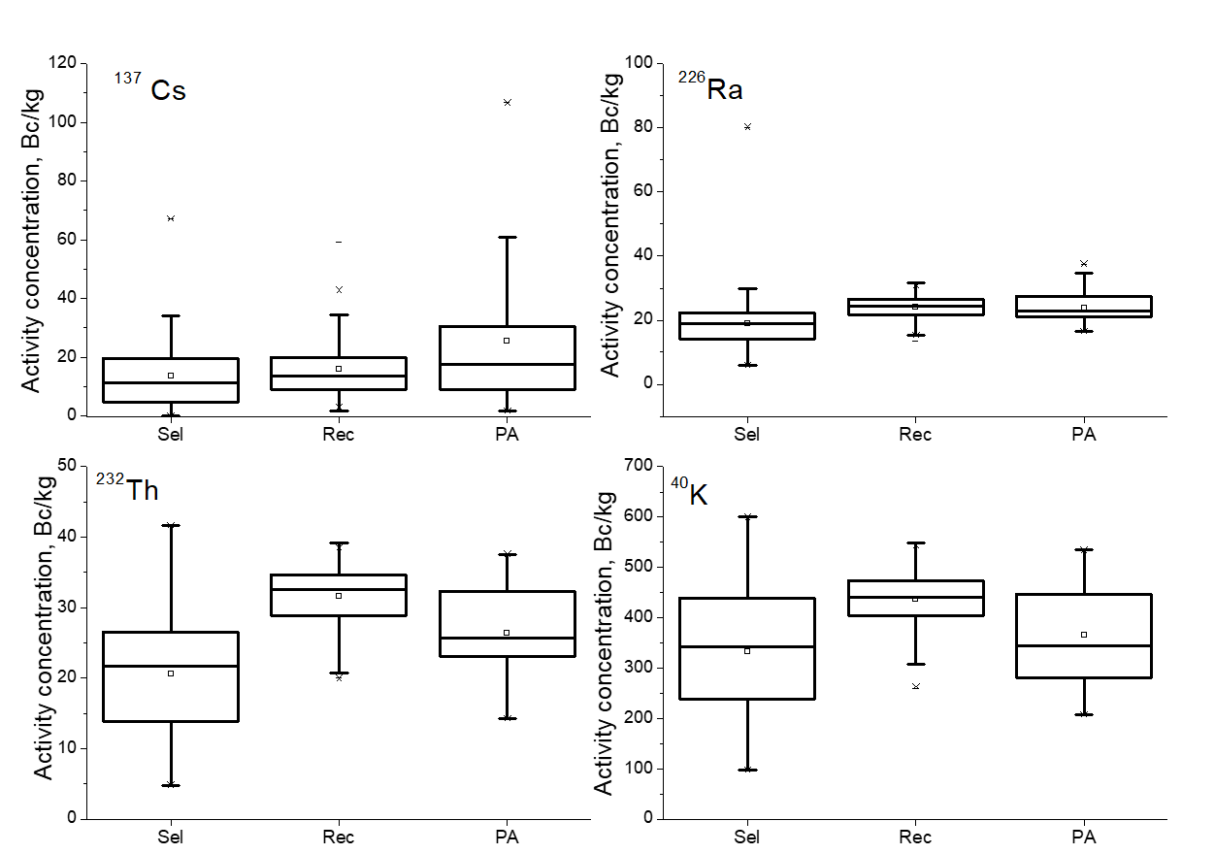
Results and discussion
Fig. 3. Distribution of ¹³⁷Cs in soils of residential (Sel) and recreational (Rec) areas of Rostov-on-Don and in soils of protected areas (PA) of Rostov region

Slide 7
Results and discussion
Fig. 3. Distribution of native radionuclide in soils of residential (Sel) and recreational (Rec) areas of Rostov-on-Don and in soils of protected areas (PA) of Rostov region

