Slide 1


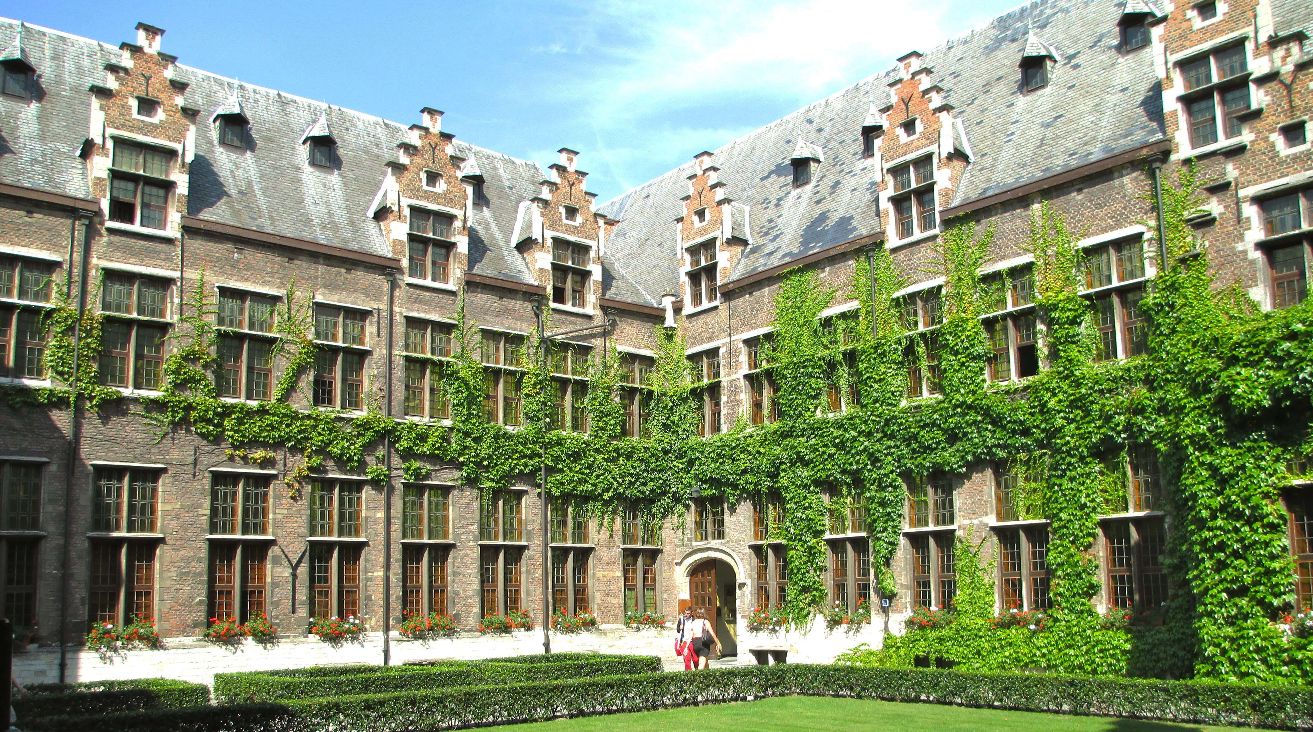

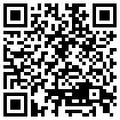
DEVELOPING A DECISION-MAKING TOOL FOR
EVALUATING THE COMPATIBILITY OF
NATURE-BASED SOLUTIONS TO THE BUILT HERITAGE
Eda Kale, Marie De Groeve and Tim De Kock
University of Antwerp / Faculty of Design Sciences / ARCHES

Slide 3
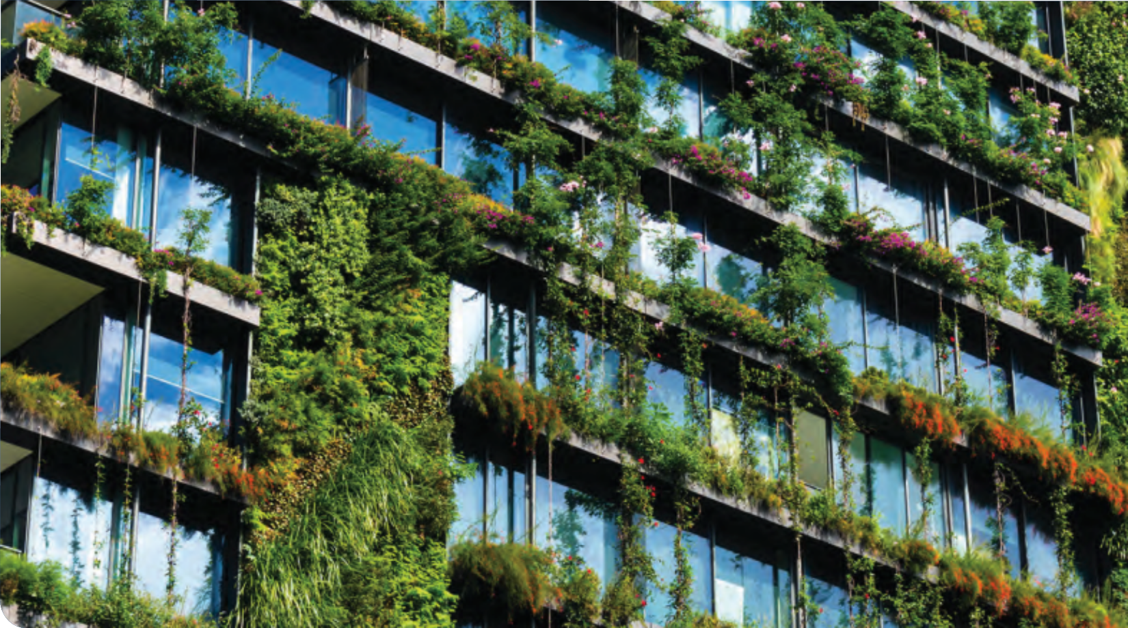
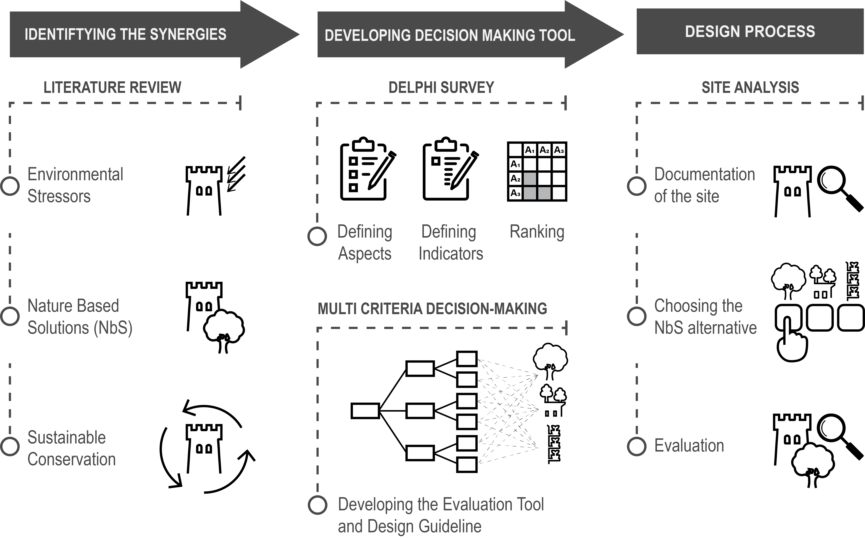
1- IDENTIFYING THE SYNERGIES

Slide 4

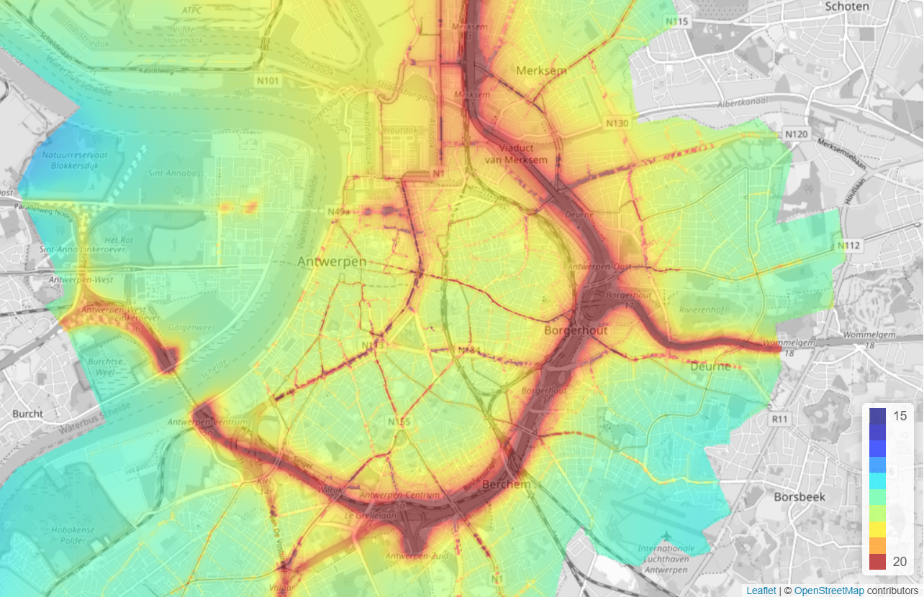
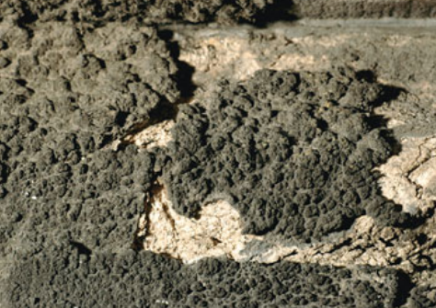
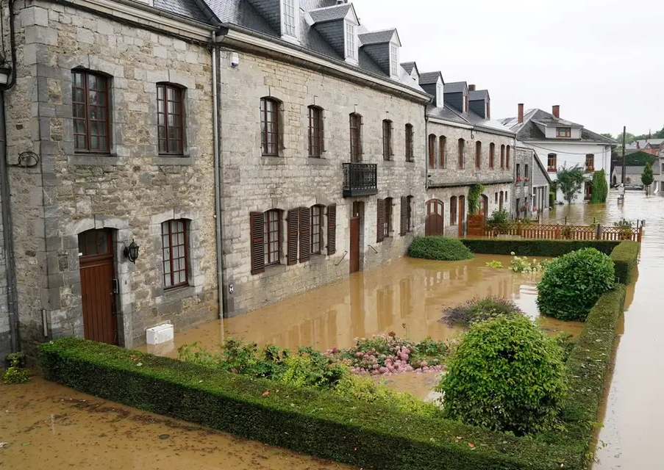
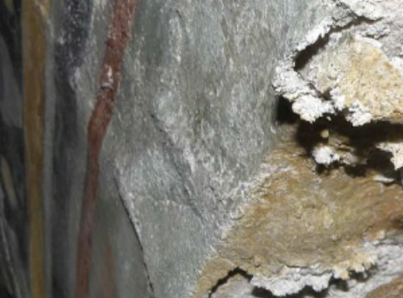
Environmental
Stressors
Air Pollution – PM 2.5 level in Antwerp (2012)
Crust Formation on stone surface
Floods – Belgium (July 15, 2021)
Salt Crystallization on stone surface

Slide 5
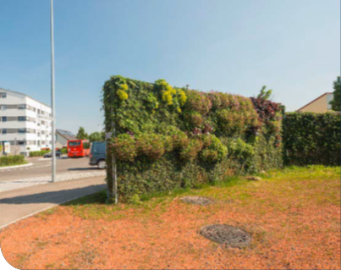
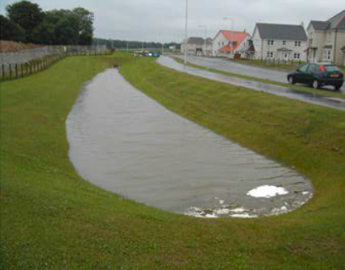
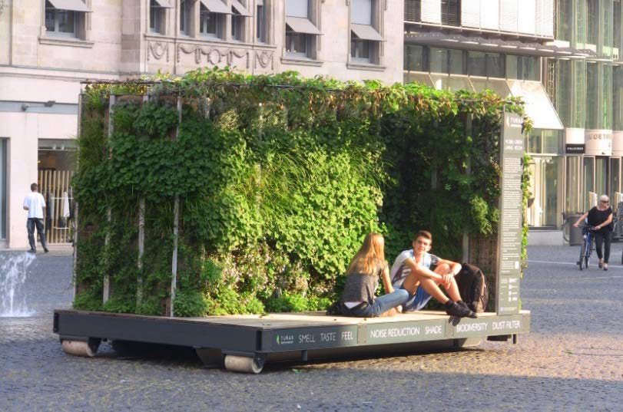
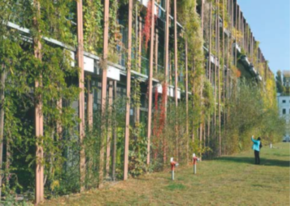
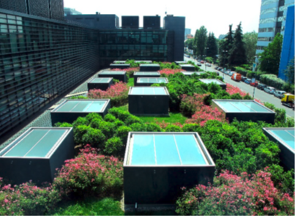
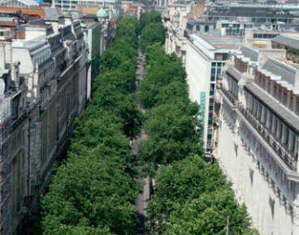
Nature Based Solutions
Free-standing Living Wall
Detention Pond
Mobile Vertical Greening
GREEN INFRASTRUCTURES
GREEN WALLS
GREEN ROOFS
STREET TREES

Slide 6
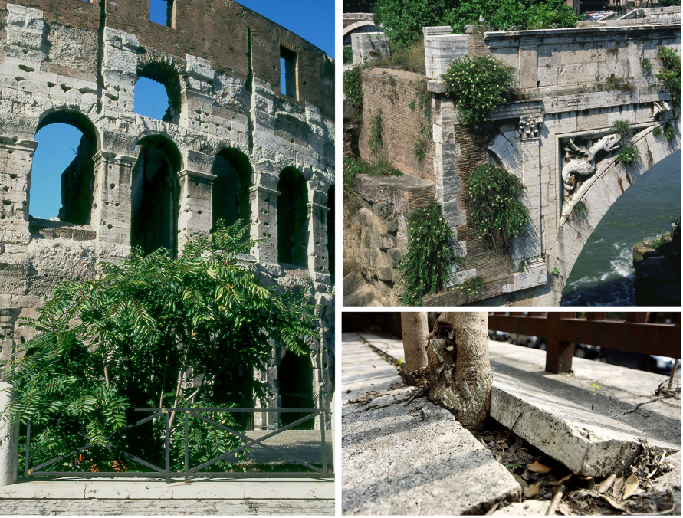
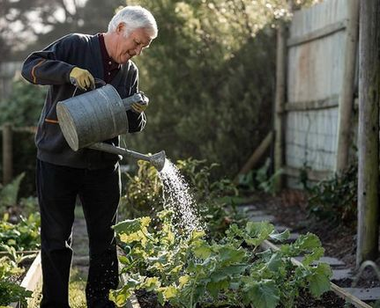

BENEFITS OF NbS
Health Impacts
Bio-diversity
Sustainable water
Urban agriculture
Acoustic
Jobs and Investment
Social cohesion
Urban heat island (UHI) mitigation
Carbon sequestration
Air quality
Nature Based Solutions
Authenticity
Maintenance
Coombes, M. A., & Viles, H. A. , 2021
Structural integrity
Approval of political will

Slide 7
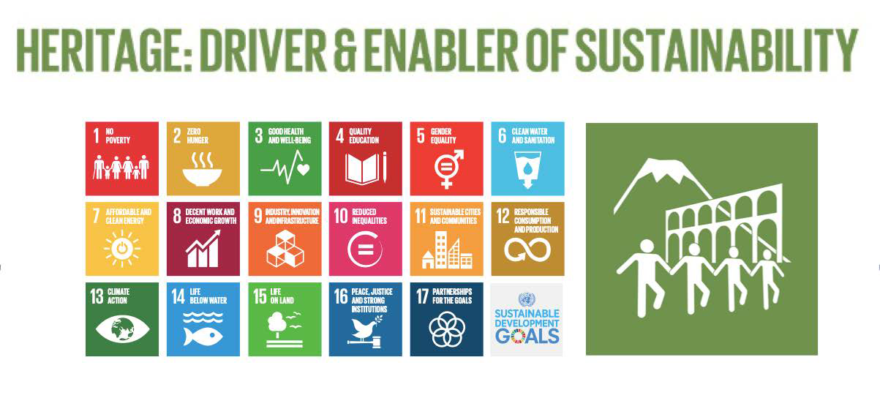

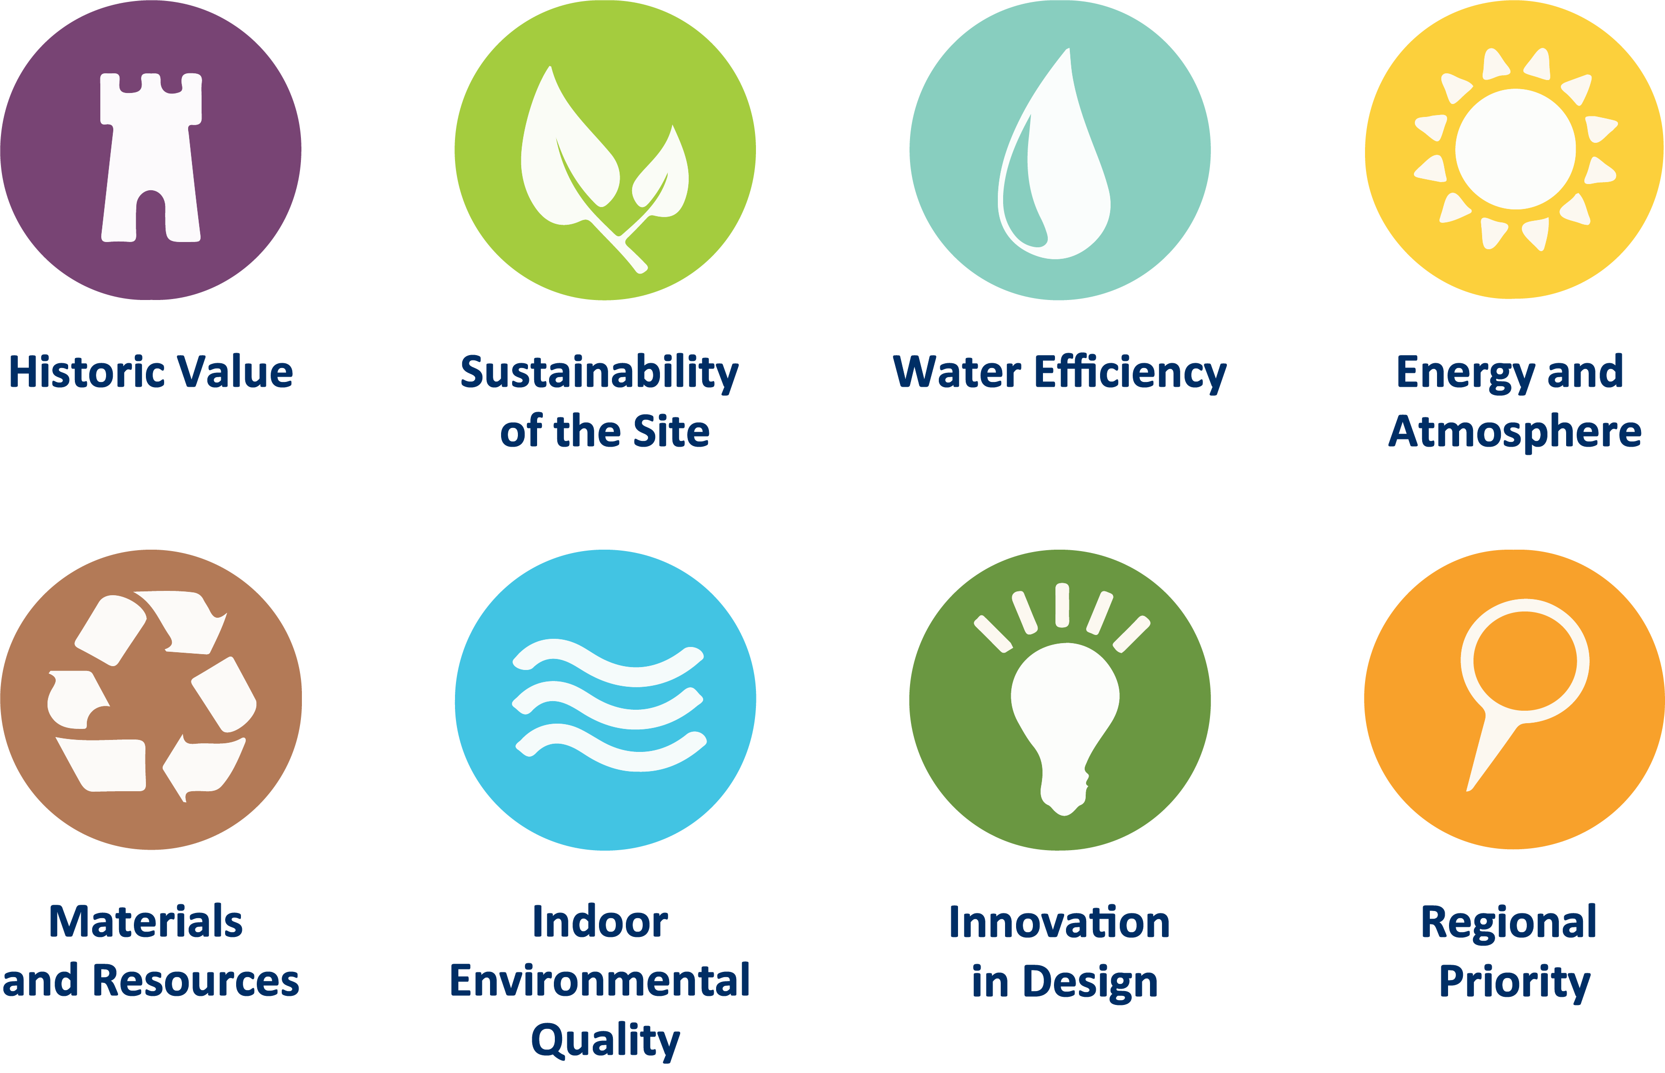
Sustainable Conservation

Slide 8
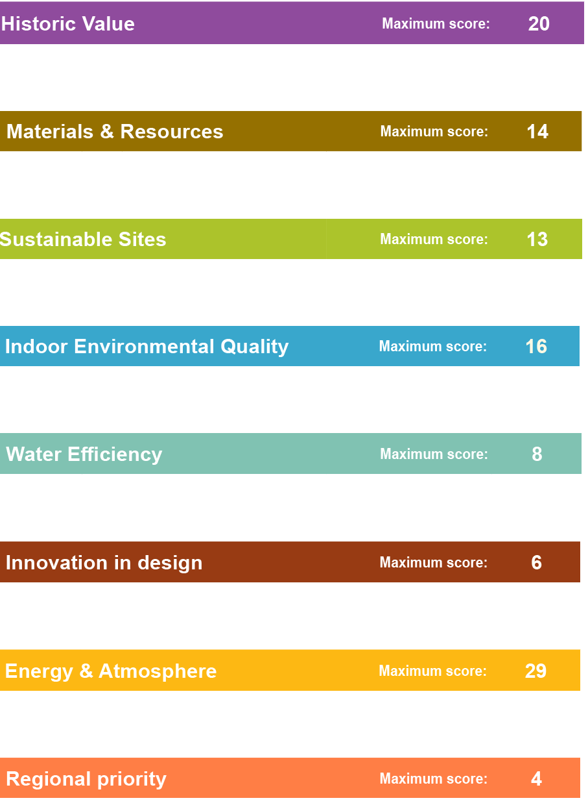
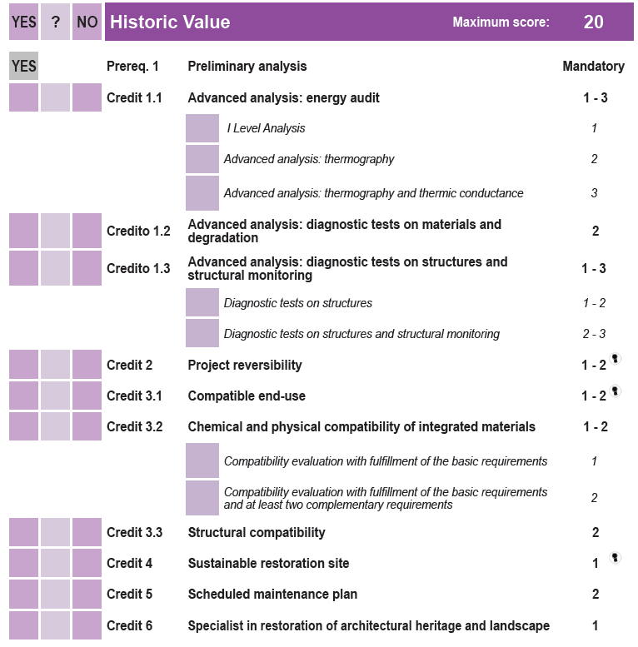
GBC Historic Building Check List as an example
Sustainable Conservation

Slide 9
2- DEVELOPING DECISION MAKING TOOL

Slide 10
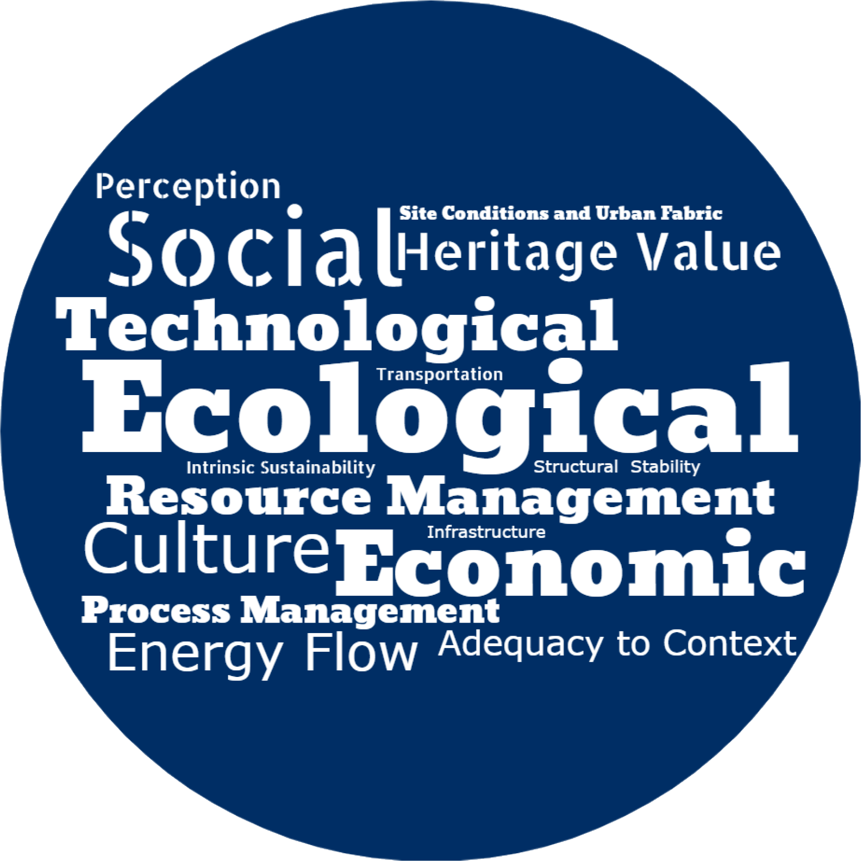





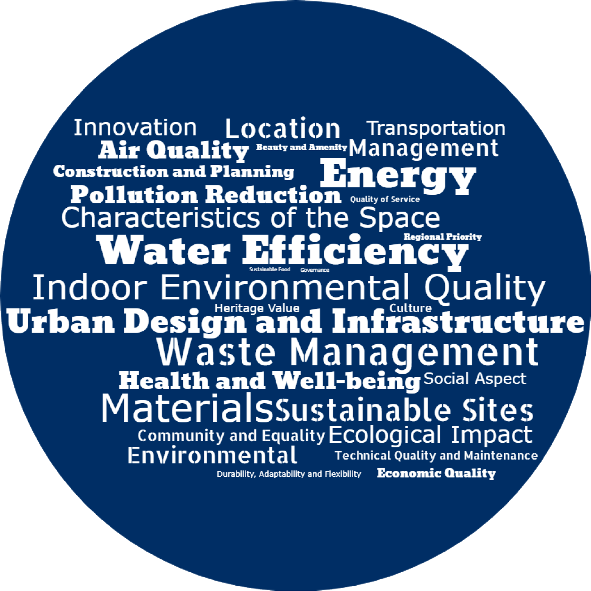




DELPHI
SURVEY
Main aspects to consider for sustainable conservation
CULTURAL HERITAGE
ENVIRONMENTAL
Described in 42 relevant records in the LITERATURE
ECONOMICAL
Defining
the Aspects
SOCIAL
TECHNOLOGICAL
AND TECHNICAL
URBAN MORPHOLOGY
AND INFRASTRUCTURAL
Described in 14 relevant records of the GREEN RATING TOOLS
LEGISLATIVE AND
GOVERNMENTAL
PROCESS MANAGEMENT

Slide 11
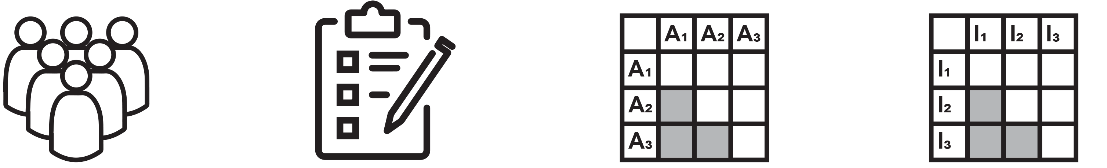
DELPHI
SURVEY
Defining the Indicators and Ranking
Expert Selection
1st Round
2nd Round
3rd Round
Sustainable Architecture
Heritage Conservation /Preservation
Open-ended questions to define the compatibility indicators
Pairwise comparison of the aspects
Pairwise comparison of the indicators

Slide 12
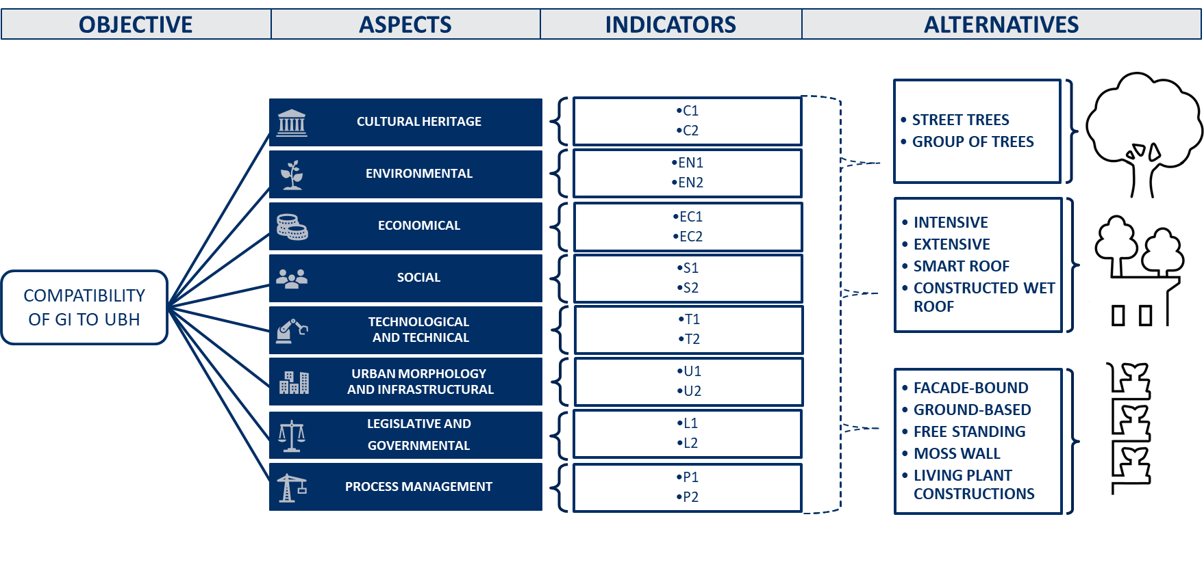

MULTI
CRITERIA DECISION MAKING
Developing the Evaluation Tool and Design Guideline

Slide 13
3- DESIGN PROCESS

Slide 14
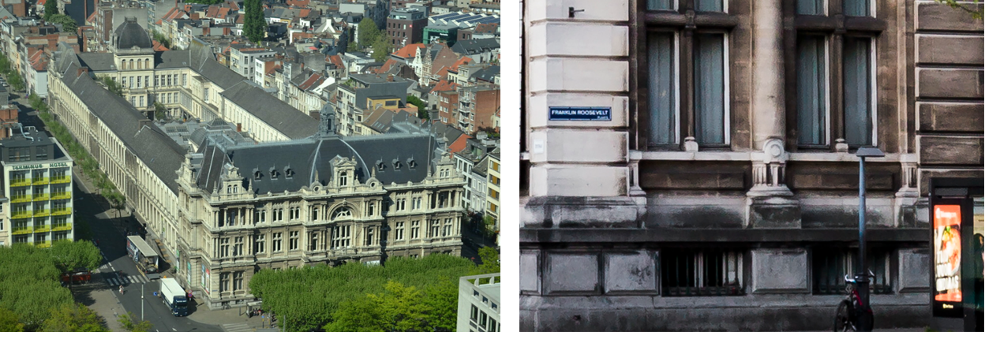

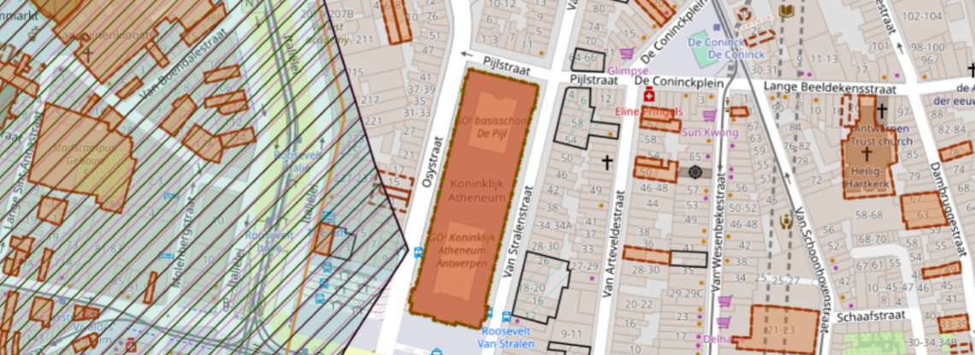
DESIGN PROCESS
Royal Athenaeum Antwerp
VERTICAL
GREEN
GREEN
ROOF
STREET
TREES
Documentation Of The Site

Slide 15
DESIGN PROCESS
Documentation Of The Site

Slide 16
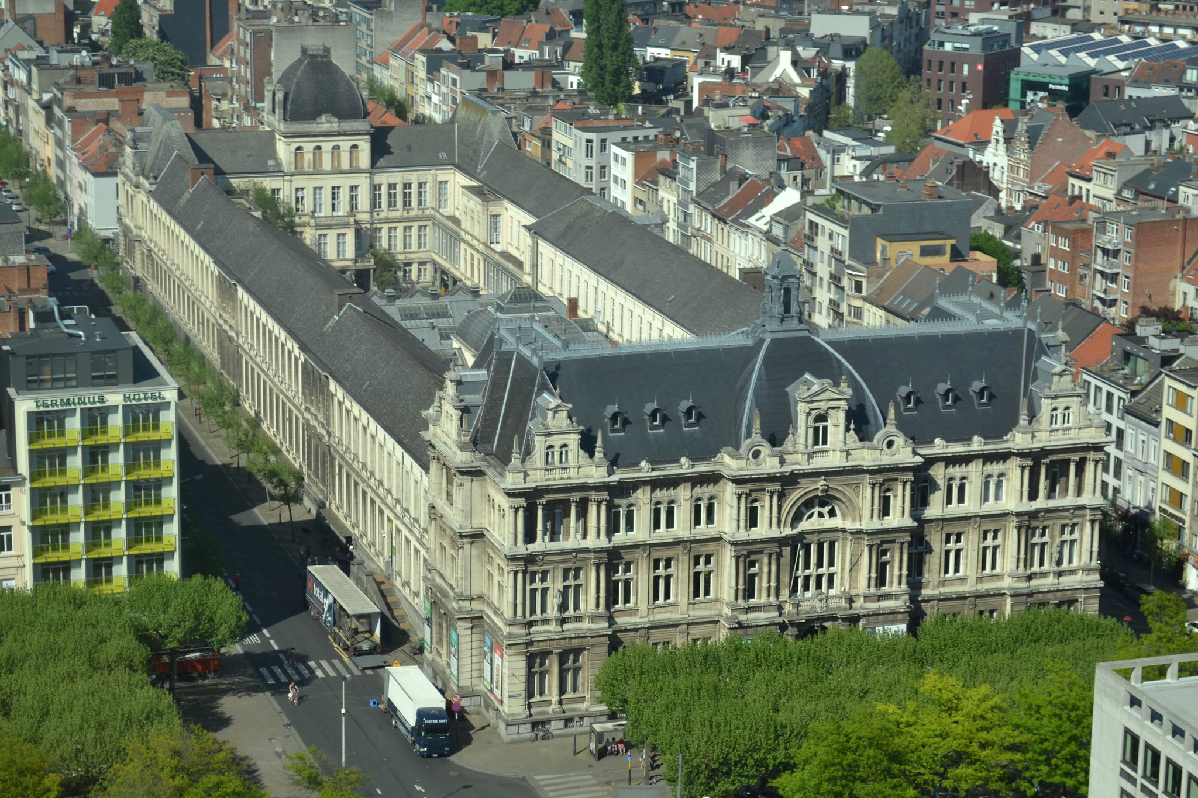
DESIGN PROCESS
Royal Athenaeum Antwerp
Site Analysis

Slide 17
DESIGN PROCESS
Documentation Of The Site

Slide 18
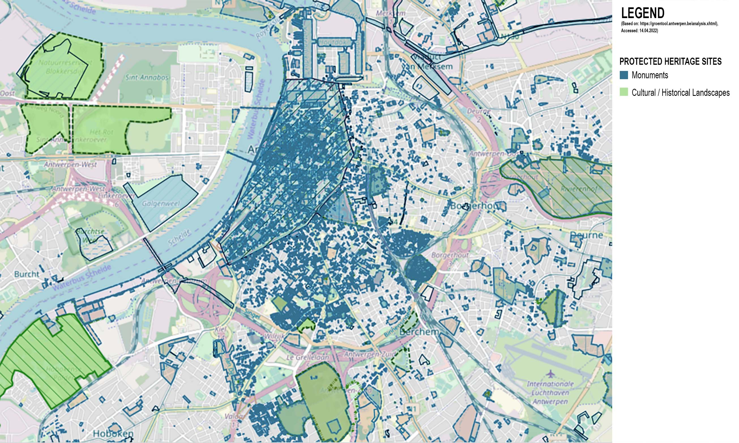
DESIGN PROCESS
Heritage Status
Royal Atheneum
VERTICAL
GREEN
GREEN
ROOF
STREET
TREES
Documentation Of The Site
Generated based on Flanders Heritage Geoportal data: https://geo.onroerenderfgoed.be/#zoom=13&lat=6659561.934962054&lon=493137.7337067785 , Accessed: 14.04.2022

Slide 19
DESIGN PROCESS
Documentation Of The Site

Slide 20
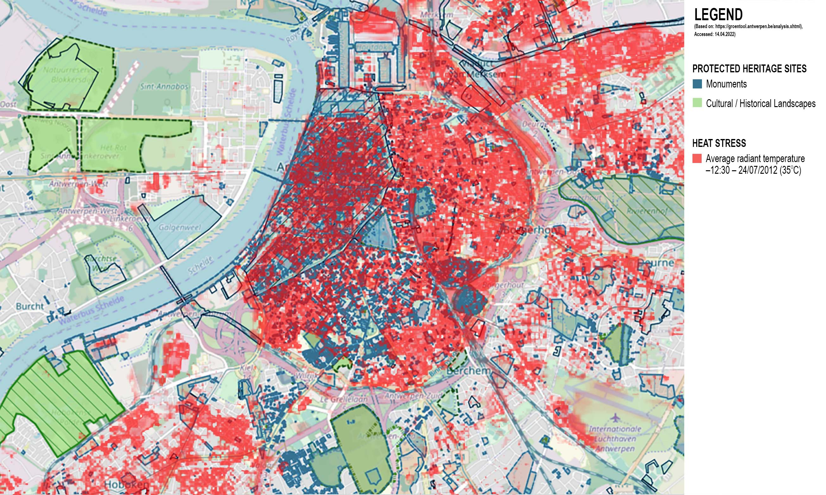
DESIGN PROCESS
Environmental Stressors: HEAT STRESS
Royal Atheneum
VERTICAL
GREEN
GREEN
ROOF
STREET
TREES
Documentation Of The Site
Generated based on Groen tool data:
https://groentool.antwerpen.be/analysis.xhtm Accessed: 14.04.2022

Slide 21
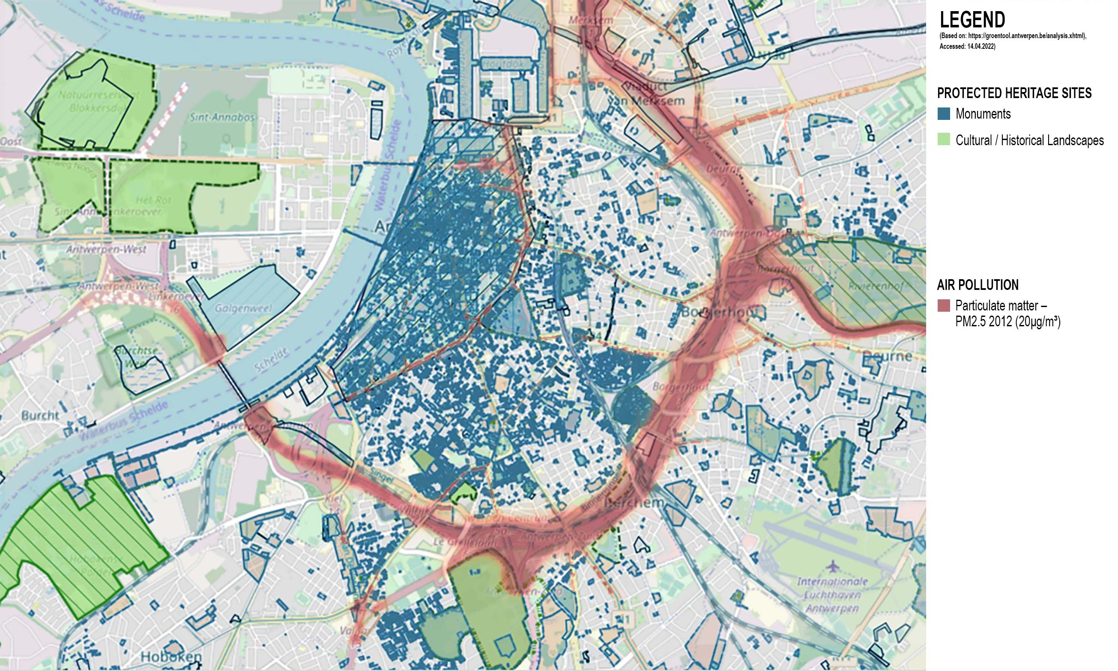
DESIGN PROCESS
Environmental Stressors: AIR POLLUTION
Royal Atheneum
VERTICAL
GREEN
GREEN
ROOF
STREET
TREES
Documentation Of The Site
Generated based on Groen tool data:
https://groentool.antwerpen.be/analysis.xhtm Accessed: 14.04.2022

Slide 22
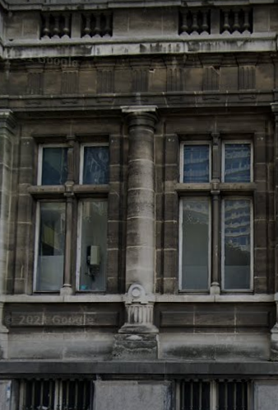
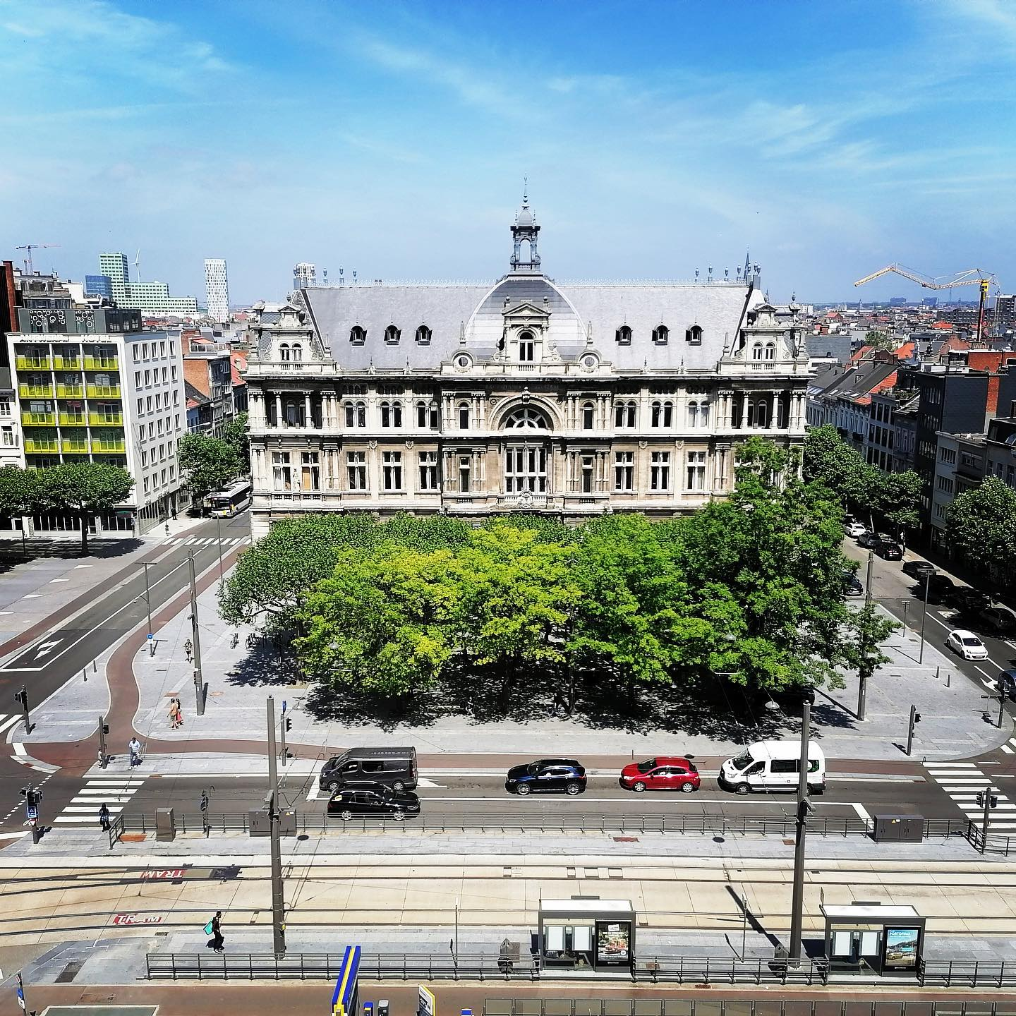
DESIGN PROCESS
Environmental Stressors: IMPACT ON BUILDING
VERTICAL
GREEN
GREEN
ROOF
STREET
TREES
Documentation Of The Site

Slide 23
DESIGN PROCESS
Choosing the NBS alternative

Slide 24
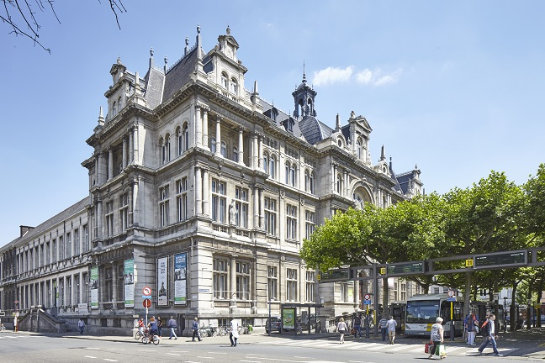
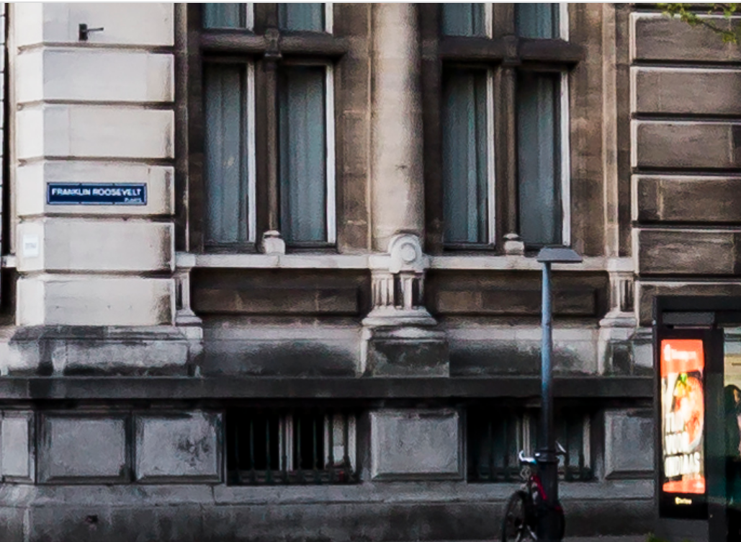
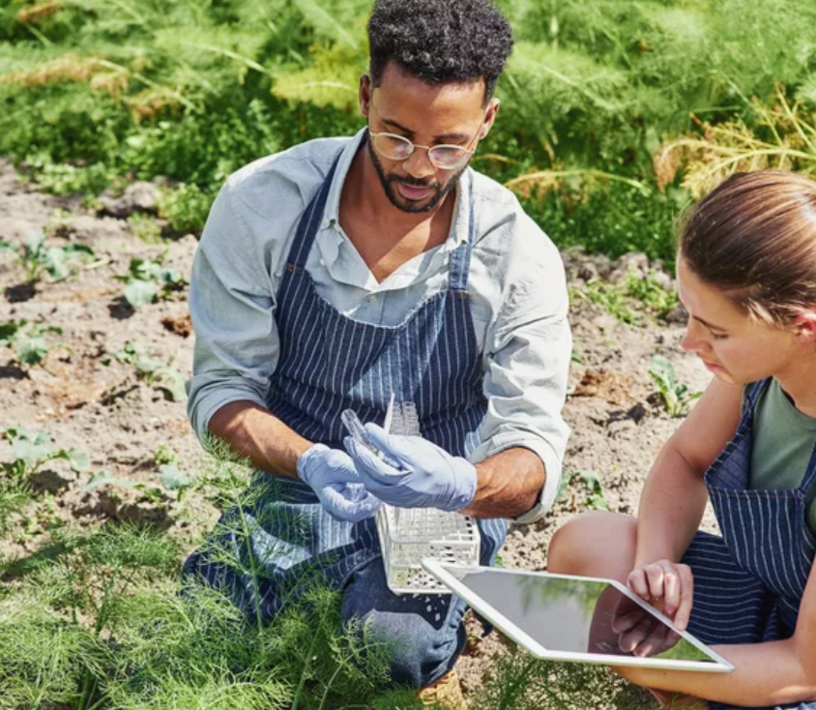
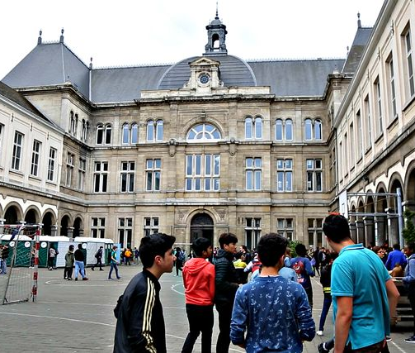
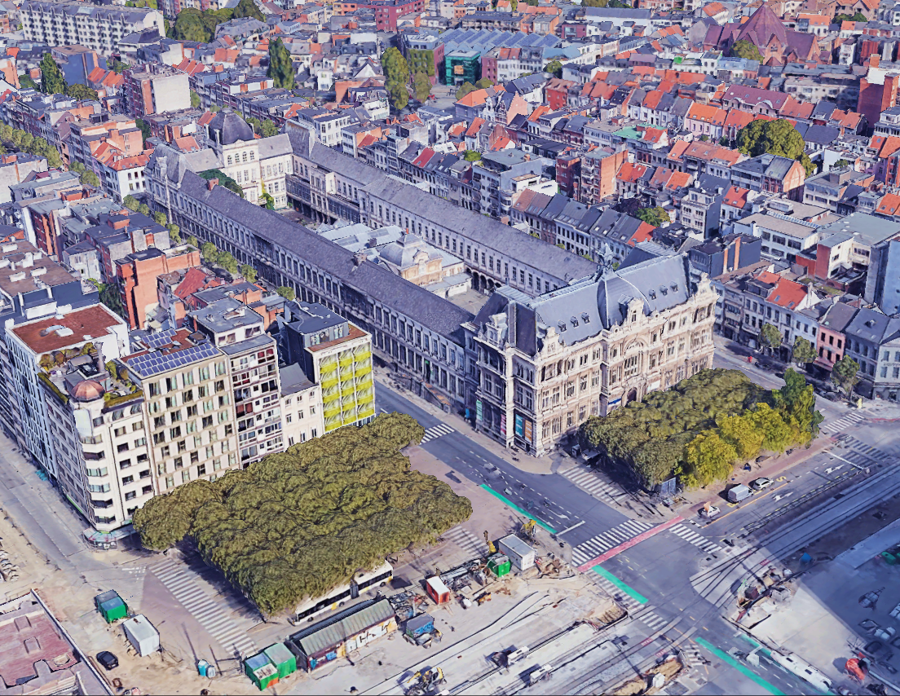

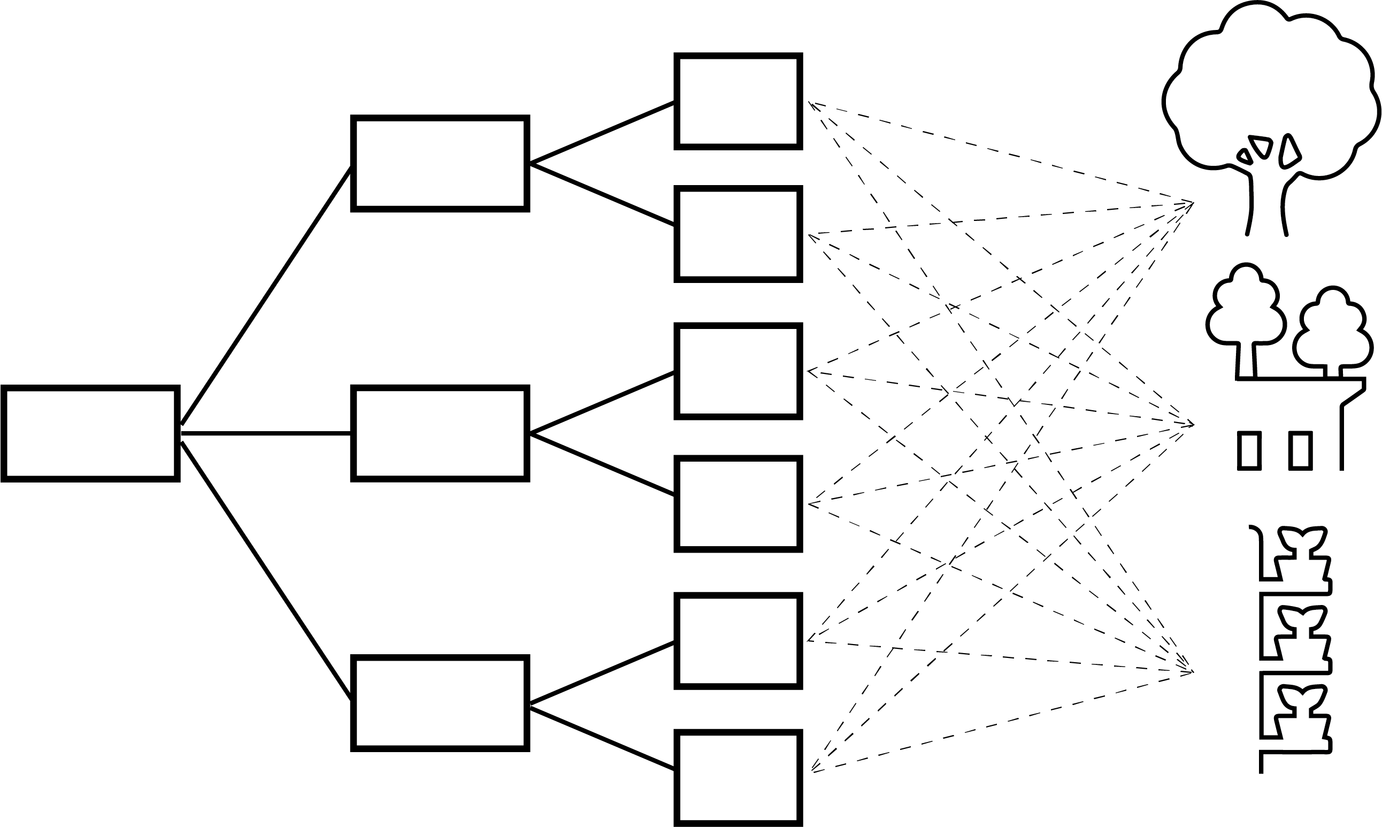
DESIGN PROCESS
CULTURAL HERITAGE
ENVIRONMENTAL
ECONOMIC
SOCIAL
Evaluation
TECHNOLOGICAL AND TECHNICAL
URBAN MORPHOLOGY AND INFRASTRUCTURAL
LEGISLATIVE AND GOVERNMENTAL
PROCESS MANAGEMENT

Slide 25
REFERENCES
BIBLIOGRAPHY:
Ashurst, J.,Ashurst, N., 1988, "Practical Building Conservation English Heritage Technical Handbook, Volume 1: Stone Masonry",Vol. 1, Gower Publishing Ltd ., Hampshire
Celesti-Grapow, Land Ricotta, C., 2021 "Plant invasion as an emerging challenge for the conservation of heritage sites: the spread of ornamental trees on ancient monuments in Rome, ltaly "Biological Invasions, 23(4),1191-1206
Coombes, M. A., Viles, H. A. (2021) Integrating nature-based solutions and the conservation of urban built heritage: Challenges, opportunities, and prospects. Urban Forestry and Urban Greening (Vol. 63). Elsevier GmbH. https://doi.org/10.1016/j.ufug.2021.127192
Heron, S. F., Day, J. C., Zijlstra, R., Engels, B., Weber, A., Marencic, H., & Busch, J. A. (2020). Workshop report: Climate Risk Assessment for Wadden Sea World Heritage property Application of the Climate Vulnerability Index-Outstanding Universal Value (OUV) Vulnerability Workshop report: Climate Risk Assessment for Wadden Sea World Heritage property-Phase 1 iii. www.waddensea-worldheritage.org/resources/2020-cvi-report
Labadi, S., Giliberto, F., Rosetti, I., Shetabi, L., & Yildirim, E. (2021). HERITAGE AND THE SUSTAINABLE DEVELOPMENT GOALS: POLICY GUIDANCE FOR HERITAGE AND DEVELOPMENT ACTORS Prepared by the Sustainable Development Goals Working Group-Priority Action 1 Task Team: Sophia Labadi (Task Team Coordinator). www.icomos.org
Sesana, E., Gagnon, A. S., Ciantelli, C., Cassar, J., & Hughes, J. J. (2021). Climate change impacts on cultural heritage: A literature review. WIREs Climate Change, 12(4). https://doi.org/10.1002/wcc.710
UNA Lab. (2019). Nature Based Solutions-Technical Handbook Part II NBS Technical Handbook-Part II. https://unalab.eu/en/documents/unalab-technical-handbook-nature-based-solutions
GIS DATA:
Functioneel Groen - Gebiedsanalyse. (2012). Groentool.Antwerpen.be. Retrieved January 15, 2022, from https://groentool.antwerpen.be/analysis.xhtml
Geoportaal | Onroerend Erfgoed. (2013). geo.onroerenderfgoed.be. Retrieved January 15, 2022, from https://geo.onroerenderfgoed.be/#zoom=14&lat=6659453.959363192&lon=491331.78691932757
VERTICAL
GREEN
GREEN
ROOF
STREET
TREES

Slide 26

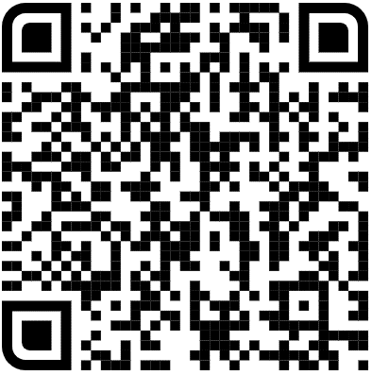
Are you an expert in heritage sciences or sustainable architecture?
“Would you like to participate in my survey?”
https://uantwerpen.eu.qualtrics.com/jfe/form/SV_eLfTHMqeR3ILROe
It’s completely voluntary. If you like to participate, please leave your contact details on the platform ☺

Slide 27
Any questions or suggestions?
Contact Us:
Eda Kale:
eda.kale@uantwerpen.be
Marie De Groeve:
marie.degroeve@uantwerpen.be
Tim De Kock:
tim.dekock@uantwerpen.be
Stadscampus
Blindestraat 9
2000 Antwerpen, BEL

Slide 28
THANK YOU VERY MUCH

