Slide 1





The Impact of Slope on Fire Spread in a Dynamic Global Vegetation Model
Luke Oberhagemann, Markus Drüke, Maik Billing, Werner von Bloh, Boris Sakschewski, Henning Rust, and Kirsten Thonicke

Slide 2
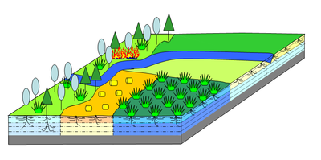
Fire-Enabled Dynamic Global Vegetation Models
Model processes including plant establishment, growth, and mortality on a global scale
Often coupled to a global fire model – we focus on LPJmL-SPITFIRE
  Wind-driven fire spread
  0.5° by 0.5° grid cells
Generally, these models do not include terrain effects on fire spread
1
Image source: pik-potsdam.de

Slide 3
How Important are Terrain Effects at the Grid Cell Level? – Satellite Data Analysis
  Fire data from the Global Fire Atlas assigned to a 0.5° by 0.5° grid
  What role does terrain complexity play?
    Comparison to median vector ruggedness measure within a grid cell
  What role does the slope play?
    Comparison to median slope squared within a grid cell
  Separation by main landcover type burned to reduce variation in fuel beds
2
Image source: Frank Cone via Pexels.com

Slide 4
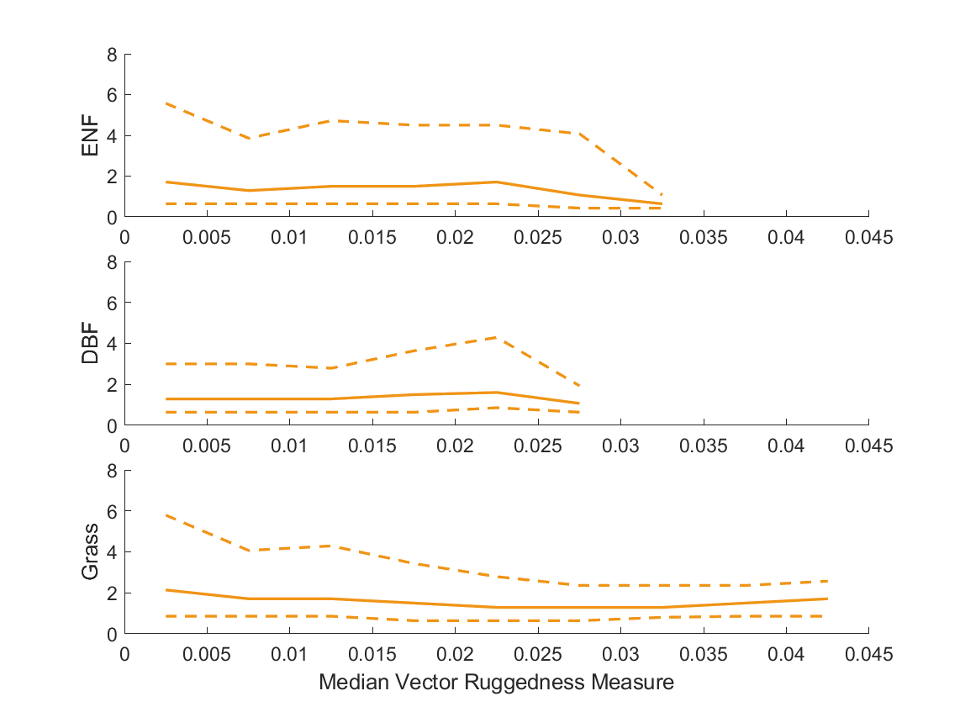
Terrain Ruggedness Acts as a Limit on Burnt Area
Binned data & calculated quartiles
Upper quartile burnt area decreases with vector ruggedness measure (GMTED2010 250m DEM)
Extent of the effect depends on vegetation type
Burnt Area Per Fire (km²)
3

Slide 5
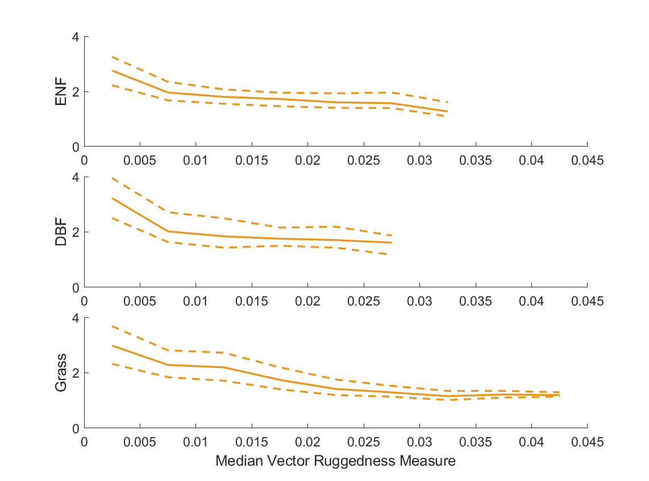
Terrain Ruggedness Limits Wind Speed Observed During Fires
Grid cell mean wind speed (ERA5) during fires decreases with increasing vector ruggedness measure
Therefore, predicted wind-driven fire spread decreases in many DGVM’s with increasing vector ruggedness measure
Mean Wind Speed (m/s)
4

Slide 6
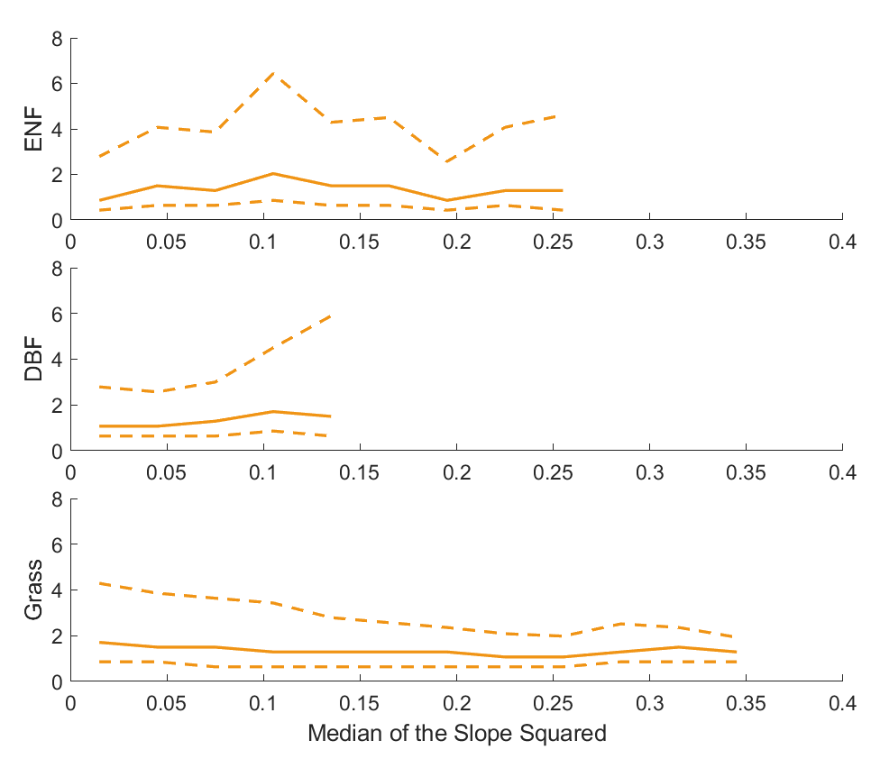
Slope-driven Increases in Fire Spread are Observable at the Grid Cell Scale
Only bottom quartile of wind speeds compared to control for wind speed differences
Burnt area increases with median slope squared until terrain ruggedness becomes excessively large
  Slope and vector ruggedness measure are correlated
Burnt Area Per Fire (km²)
5

Slide 7

Conclusions
Many DGVMs see this
High Wind Speeds
Lower Wind Speeds
Terrain boundaries
But not this
Slope-driven fire spread
Slope-driven fire spread increases burnt area per fire in a grid cell until limits due to terrain ruggedness are reached
The strength of these effects is dependent on the vegetation type burned
oberhagemann@uni-potsdam.de
6

