Slide 1
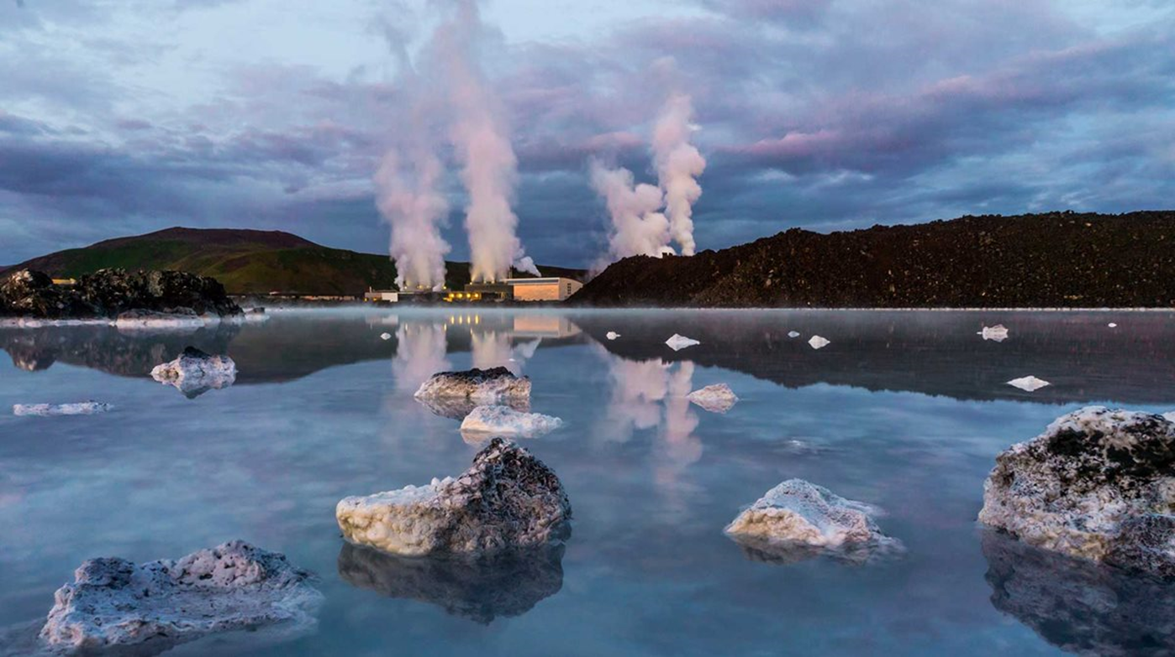



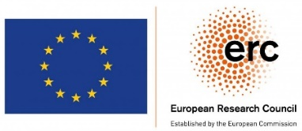
Thermal stressing is likely to reactivate distant faults in hot sedimentary aquifers
Iman Rahimzadeh Kivi, Estanislao Pujades, Jonny Rutqvist, Victor Vilarrasa
EGU General Assembly, Vienna, 23–27 May 2022

Slide 2
Hot Sedimentary Aquifers (HSA) are attractive sources of geothermal energy, but also prone to induced seismicity!
Poing
Unterhaching

Slide 3
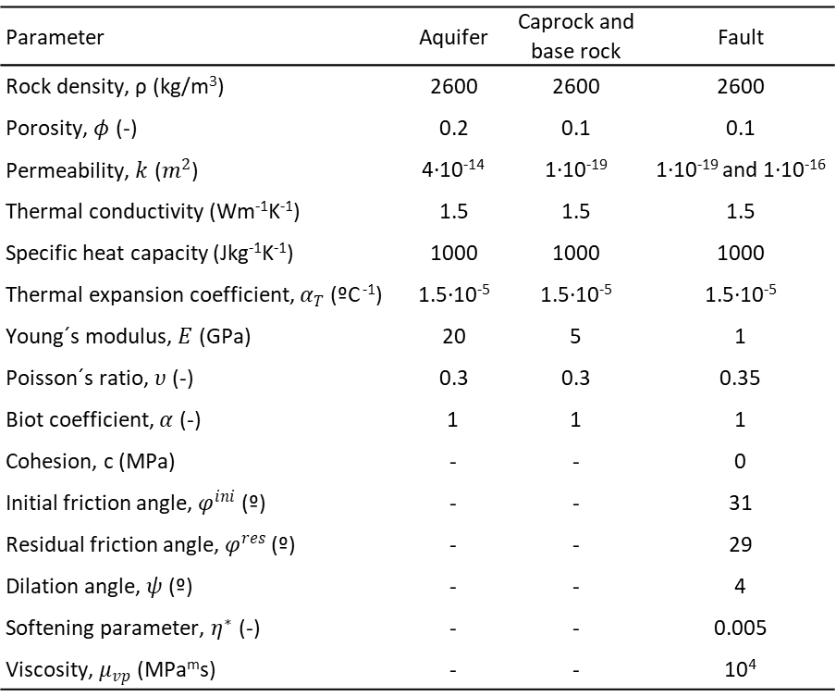
Faults can act as barrier or conduit to fluid flow!
Parameter | Aquifer | Caprock and base rock | Fault
Rock density, ρ (kg/m³) | 2600 | 2600 | 2600
Porosity, $φ$ (-) | 0.2 | 0.1 | 0.1
Permeability, $k$ ($m^{2}$) | 4‎·‎10⁻¹⁴ | 1‎·‎10⁻¹⁹ | 1‎·‎10⁻¹⁹ and 1‎·‎10⁻¹⁶
Thermal conductivity (Wm⁻¹K⁻¹) | 1.5 | 1.5 | 1.5
Specific heat capacity (Jkg⁻¹K⁻¹) | 1000 | 1000 | 1000
Thermal expansion coefficient, $α_{T}$ (ºC ⁻¹) | 1.5·‎10⁻⁵ | 1.5·‎10⁻⁵ | 1.5·‎10⁻⁵
Young´s modulus, $E$ (GPa) | 20 | 5 | 1
Poisson´s ratio, $υ$ (-) | 0.3 | 0.3 | 0.35
Biot coefficient, $α$ (-) | 1 | 1 | 1
Cohesion, c (MPa) | - | - | 0
Initial friction angle, $φ^{ini}$ (º) | - | - | 31
Residual friction angle, $φ^{res}$ (º) | - | - | 29
Dilation angle, $ψ$ (º) | - | - | 4
Softening parameter, $η^{∗}$ (-) | - | - | 0.005
Viscosity, $μ_{vp}$ (MPa^{m}s) | - | - | 10⁴
Rahimzadeh Kivi et al. (2022), Sci. Rep.
Visco-plastic model implemented in CODE_BRIGHT (Olivella et al., 1996)

Slide 4
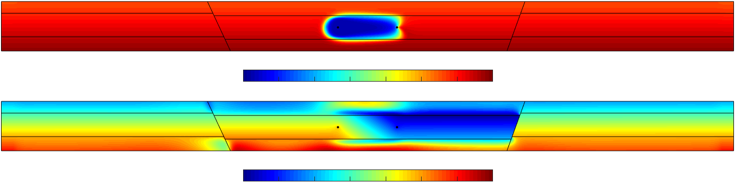
The compartmentalized aquifer formed by low-permeability faults, experience a global pore pressure decline
Injection
Production
t= 30 years
Temperature (°C)
45
55
65
75
85
95
105
115
c
d
Pressure (MPa)
23
24
25
26
27
28
29
30
Temperature decline after termal breakthrough

Slide 5
Cooling gives rise to non-isotropic stress reductions, transmitted much ahead of the cooling front
t= 30 years
Low-permeability fault

Slide 6
Cooling-induced stress reduction may reactivate distant faults

Slide 7

Deep geological characterization accounting for coupled THM processes is the key for safe and prolonged production of geothermal energy.

Slide 8
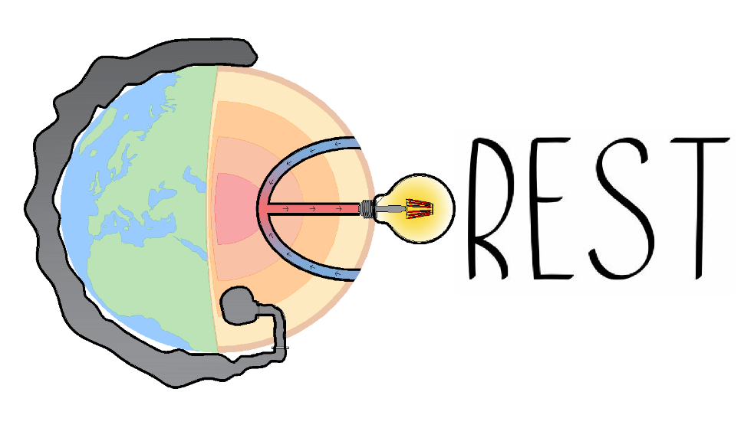


Thank you very much for your attention!
www.georest.eu
This project has received funding from the European Research Council (ERC) under the European Union’s Horizon 2020 research and innovation programme (grant agreement No 801809).
The work was also supported by the grant IJC2020-043809-I funded by MCIN/AEI/ 10.13039/501100011033
This presentation reflects only the author's view and the Agency and the Commission are not responsible for any use that may be made of the information it contains.

