Slide 1





Accuracy of remote sensing techniques in beach geomorphological surveys: a case study of Hvar island, Croatia
Marin Mićunović , Sanja Faivre & Mateo Gašparović
University of Zagreb, Faculty of Science, Department of Geography
University of Zagreb, Faculty of Geodesy
EGU22, 24.5.2022.
SEA LeveL

Slide 2
INTRODUCTION
Beaches → sedimentary forms, dyinamic coastal forms
Land-sea interractions
Beach monitoring
Sustainable management
Remote sensing

Slide 3
STUDY AREA
Island of Hvar
~250 beaches
3.8% total coastal length
Beach erosion

Slide 4
METHODS
Remote sensing
Fieldwork
GIS analysis

Slide 5
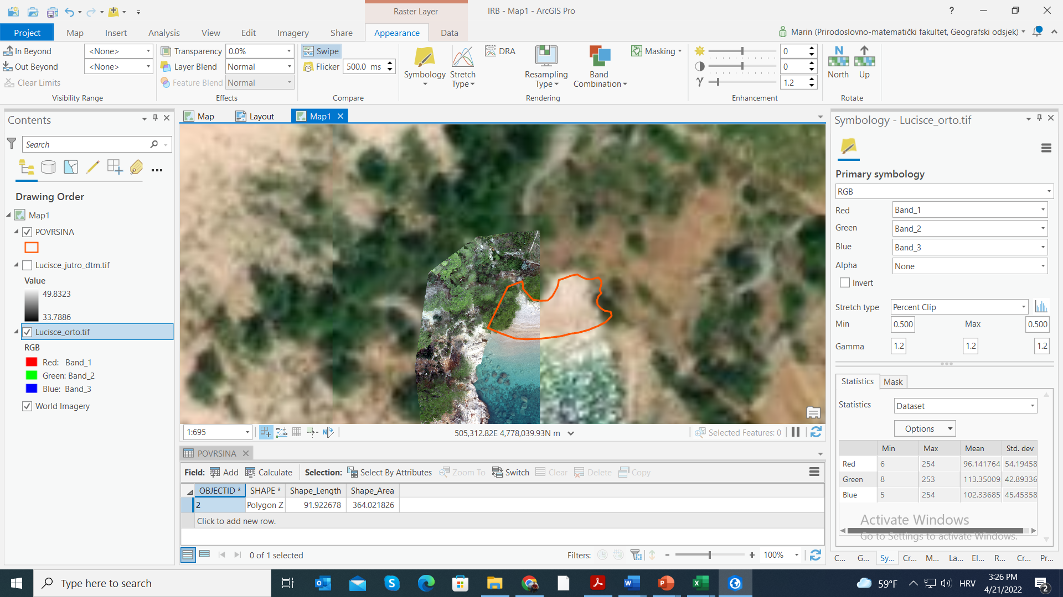
REMOTE SENSING
State Geodetic Administration – Geoportal (WMS –GIS software)
Google Earth Pro (Maxar Technologies)
Geoportal DOF
Satellite imagery

Slide 6
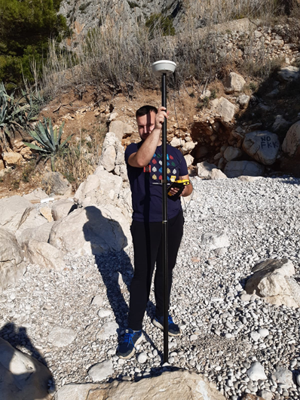
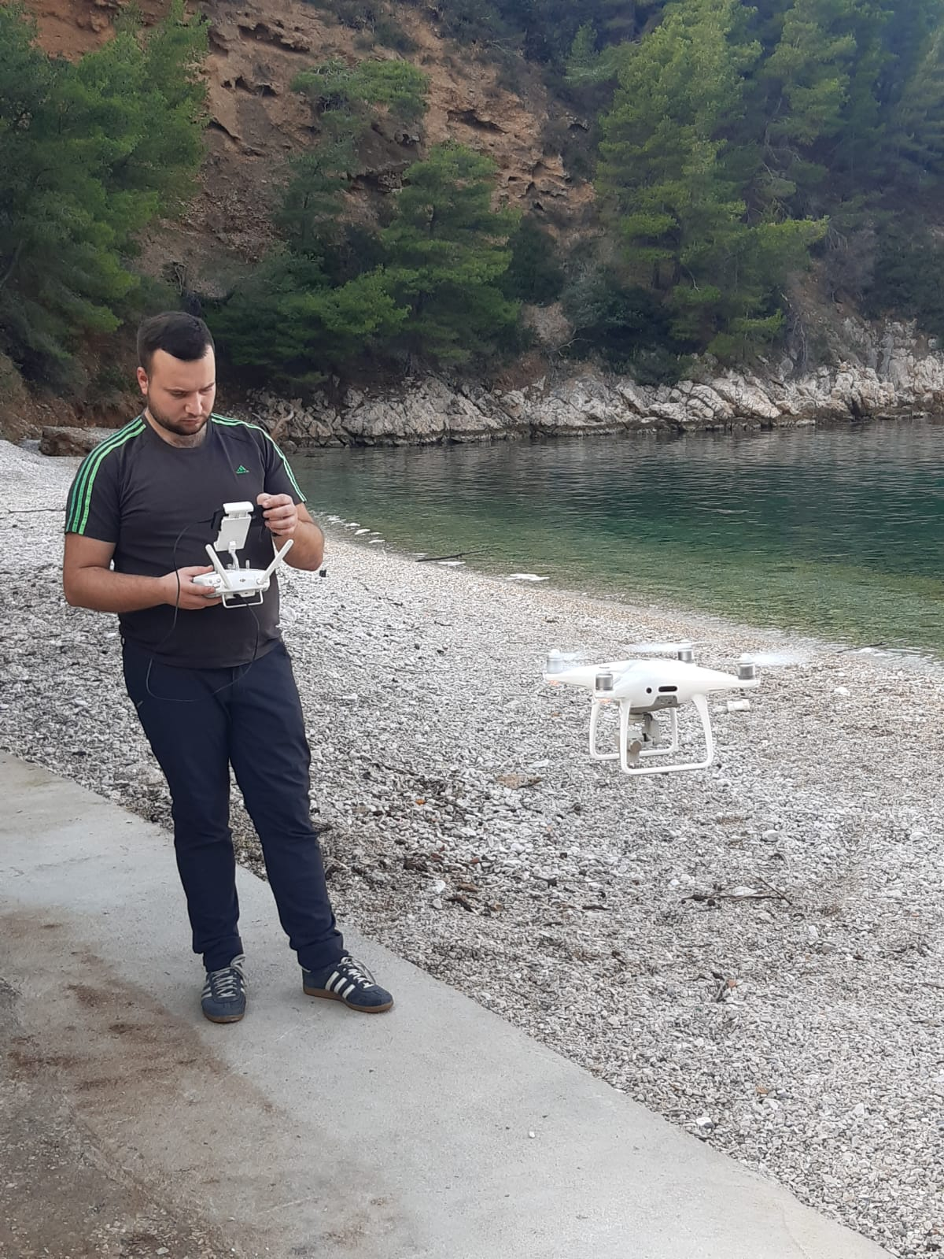
GCP – Trimble GNSS
UAV-DJI Phantom 4
Mapping
FIELDWORK

Slide 7
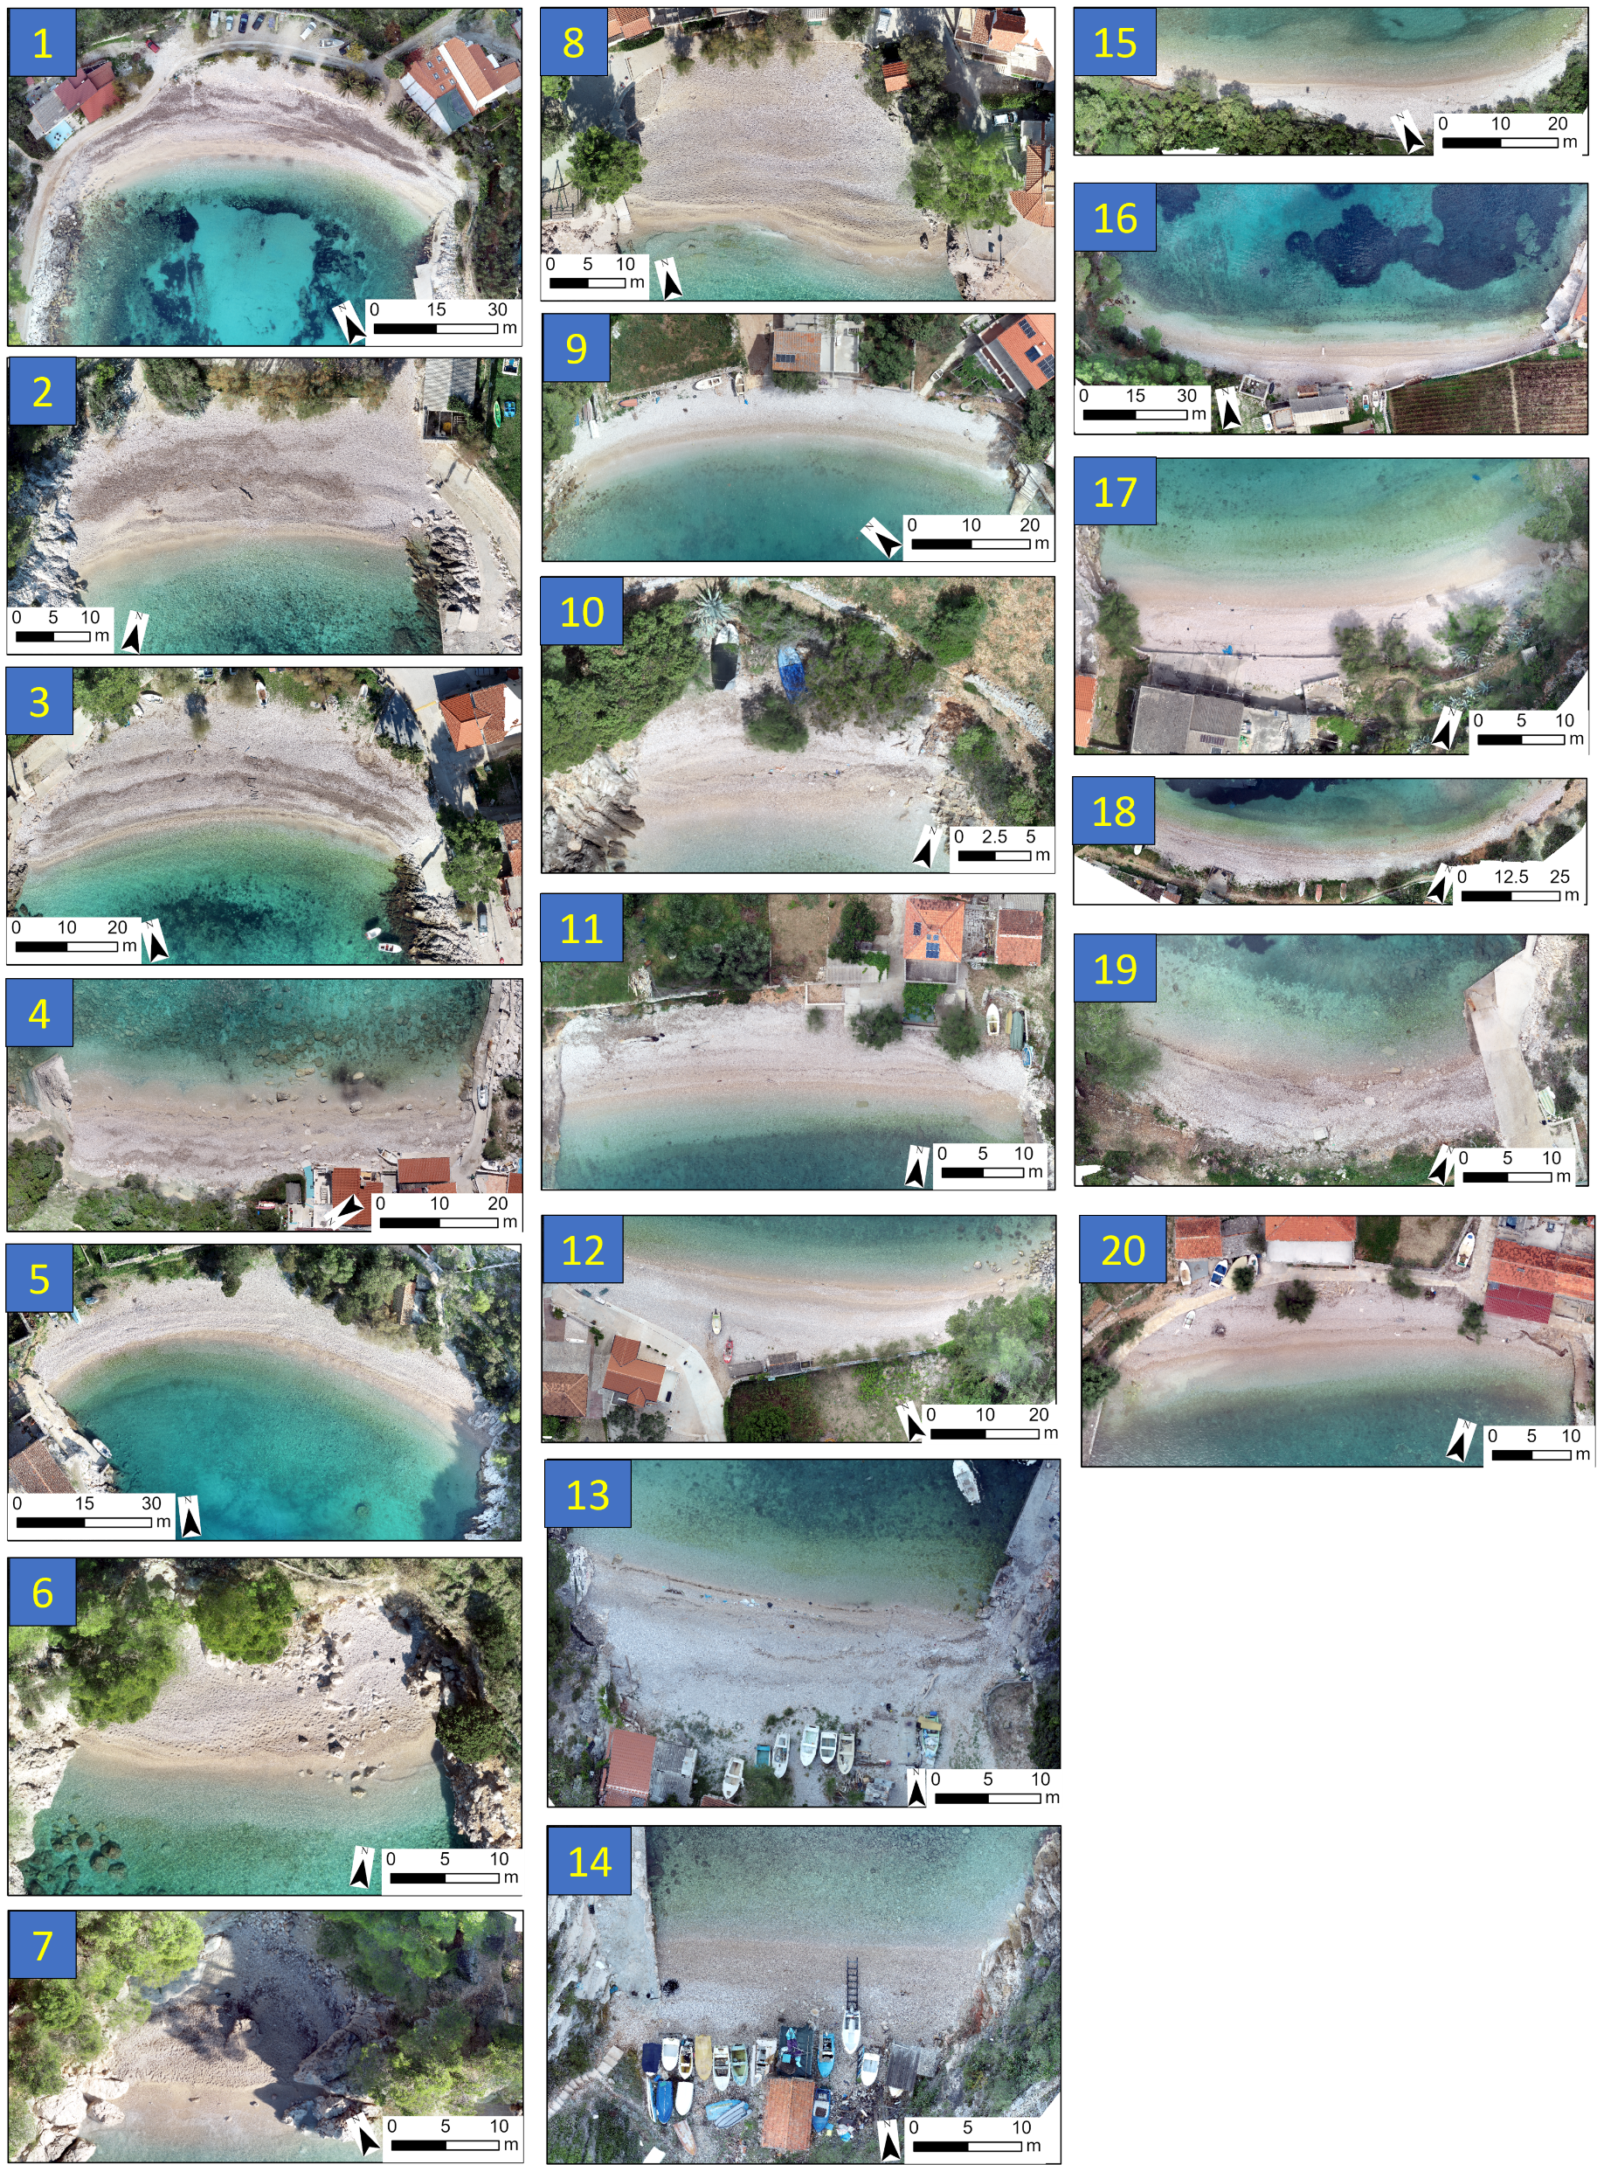

Slide 8
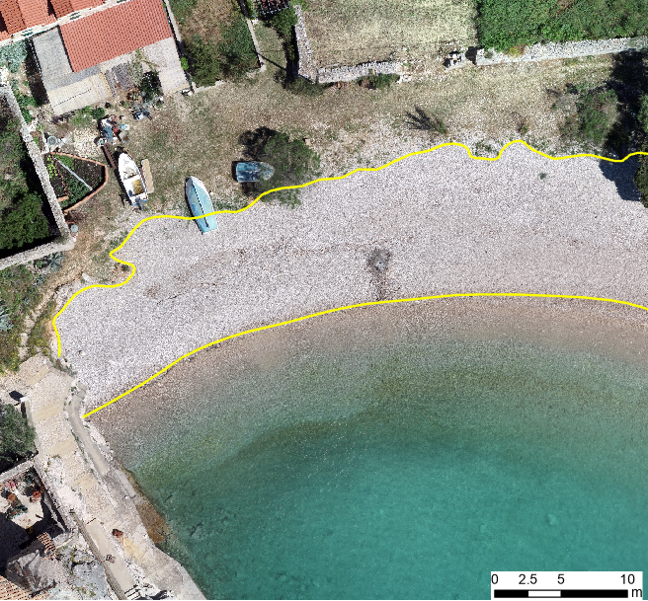
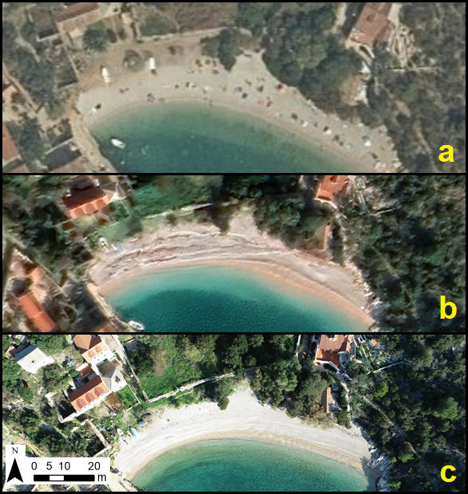
GIS ANALYSIS AND PHOTOGRAMMETRY
ArcGIS Pro software
Drone2Map and Agisoft
Beach area and length digitalisation

Slide 10
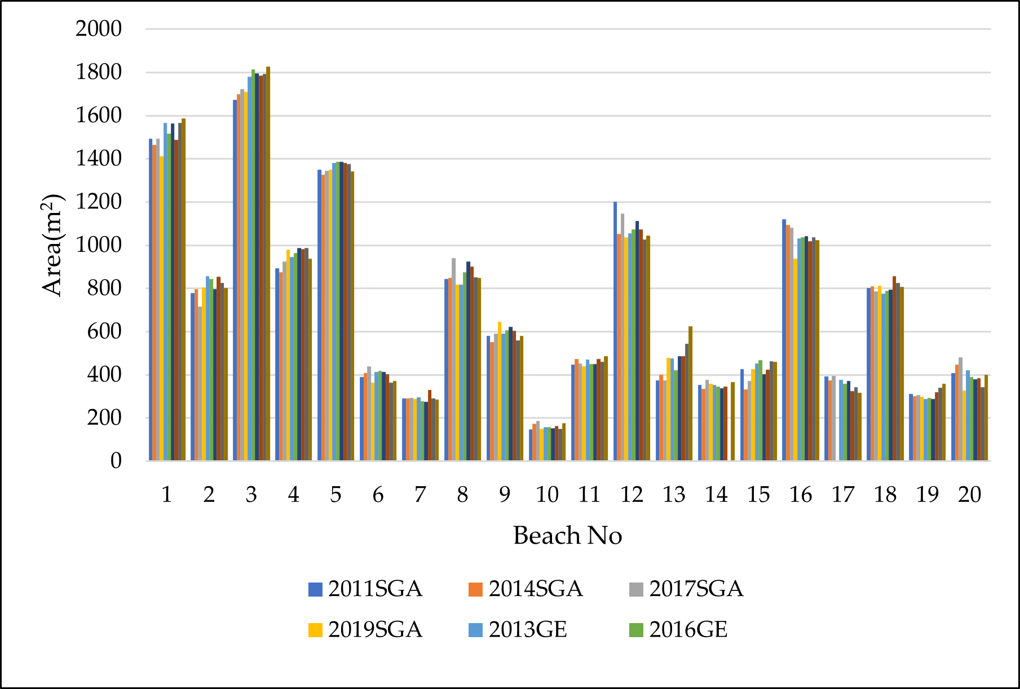
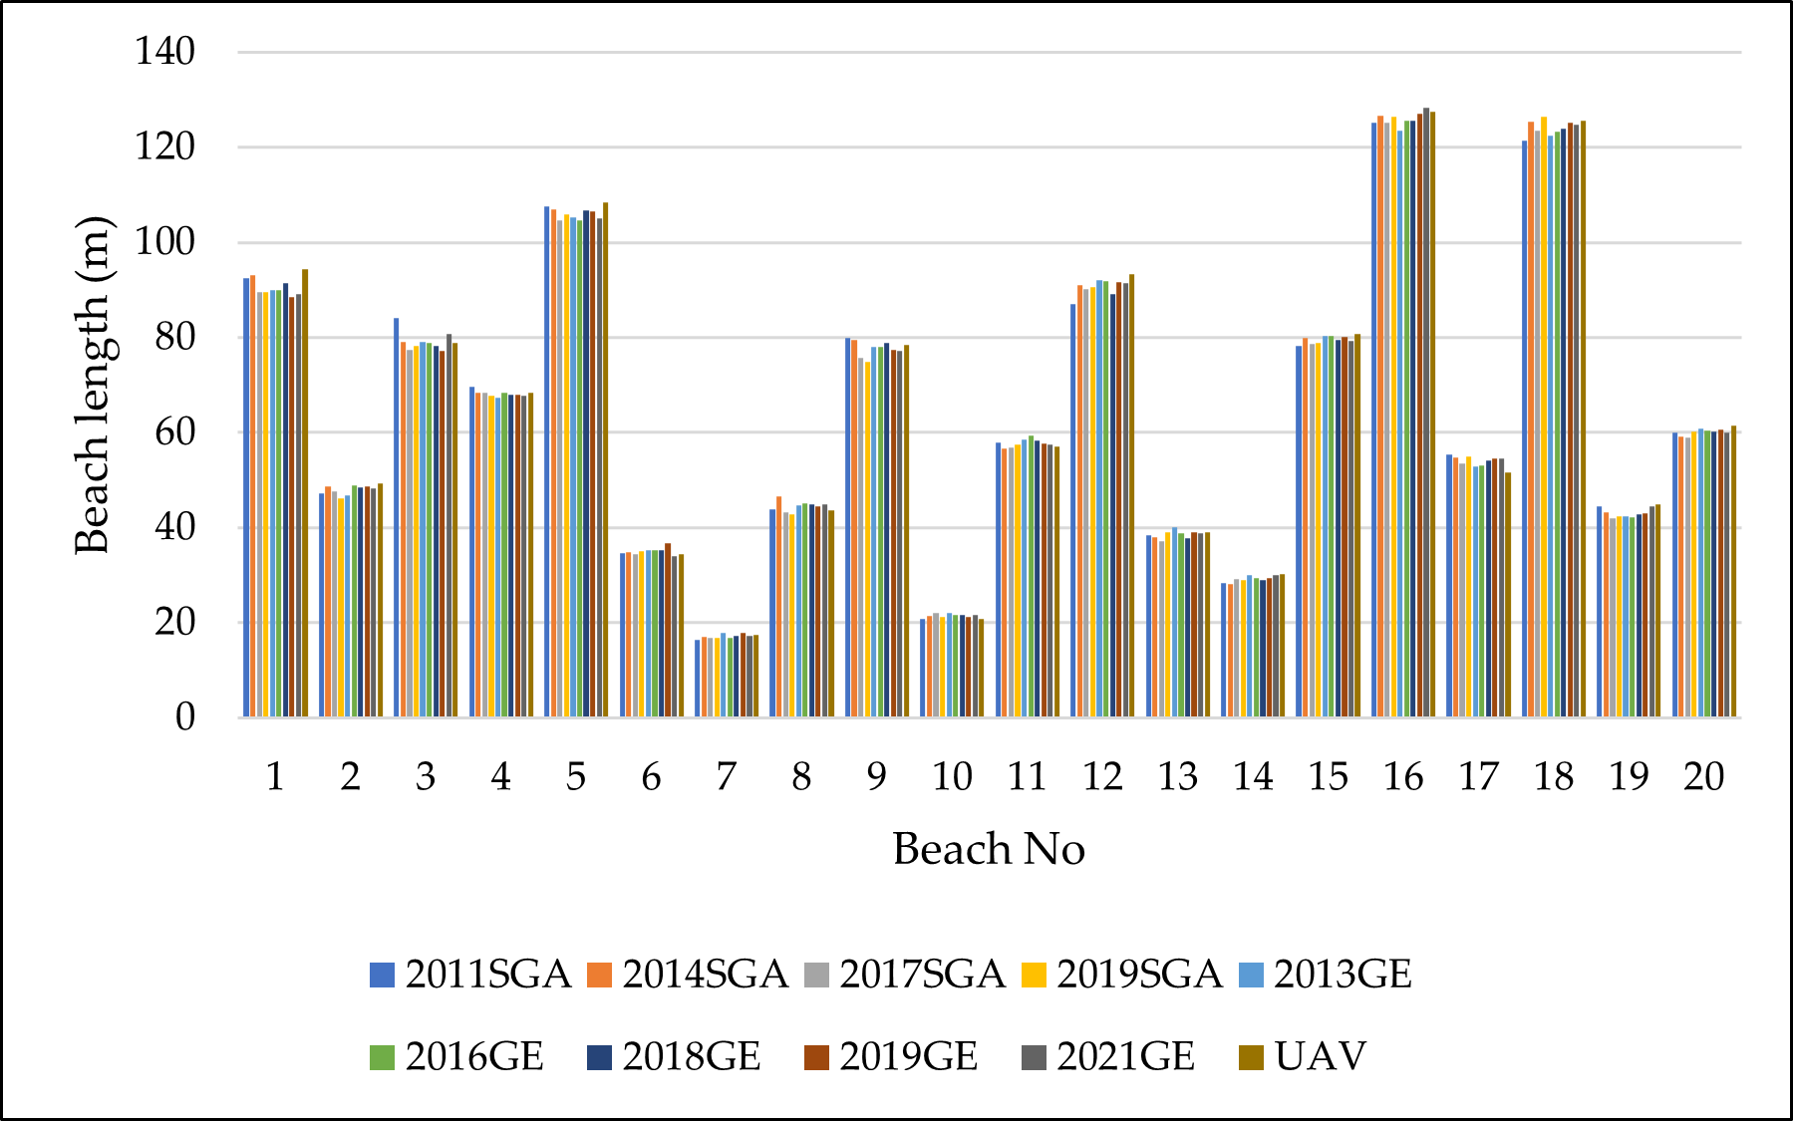
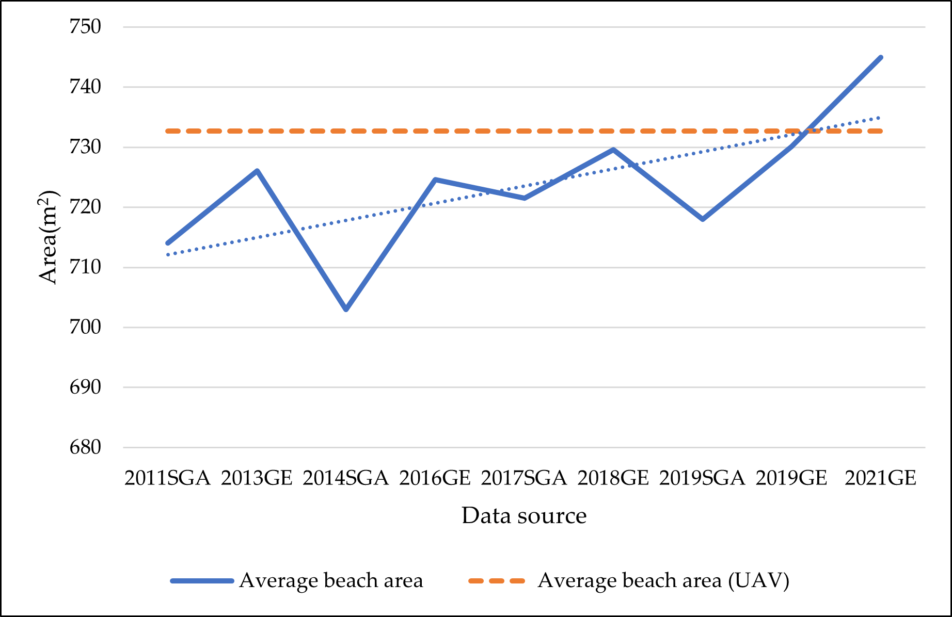
RESULTS
Beach area
Beach length

Slide 11
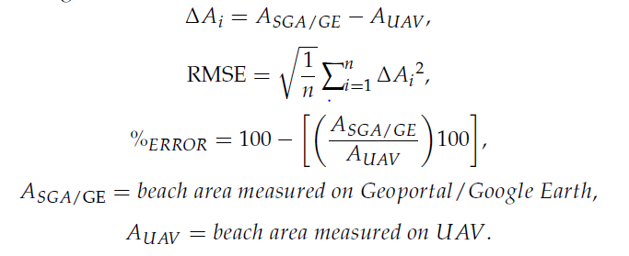
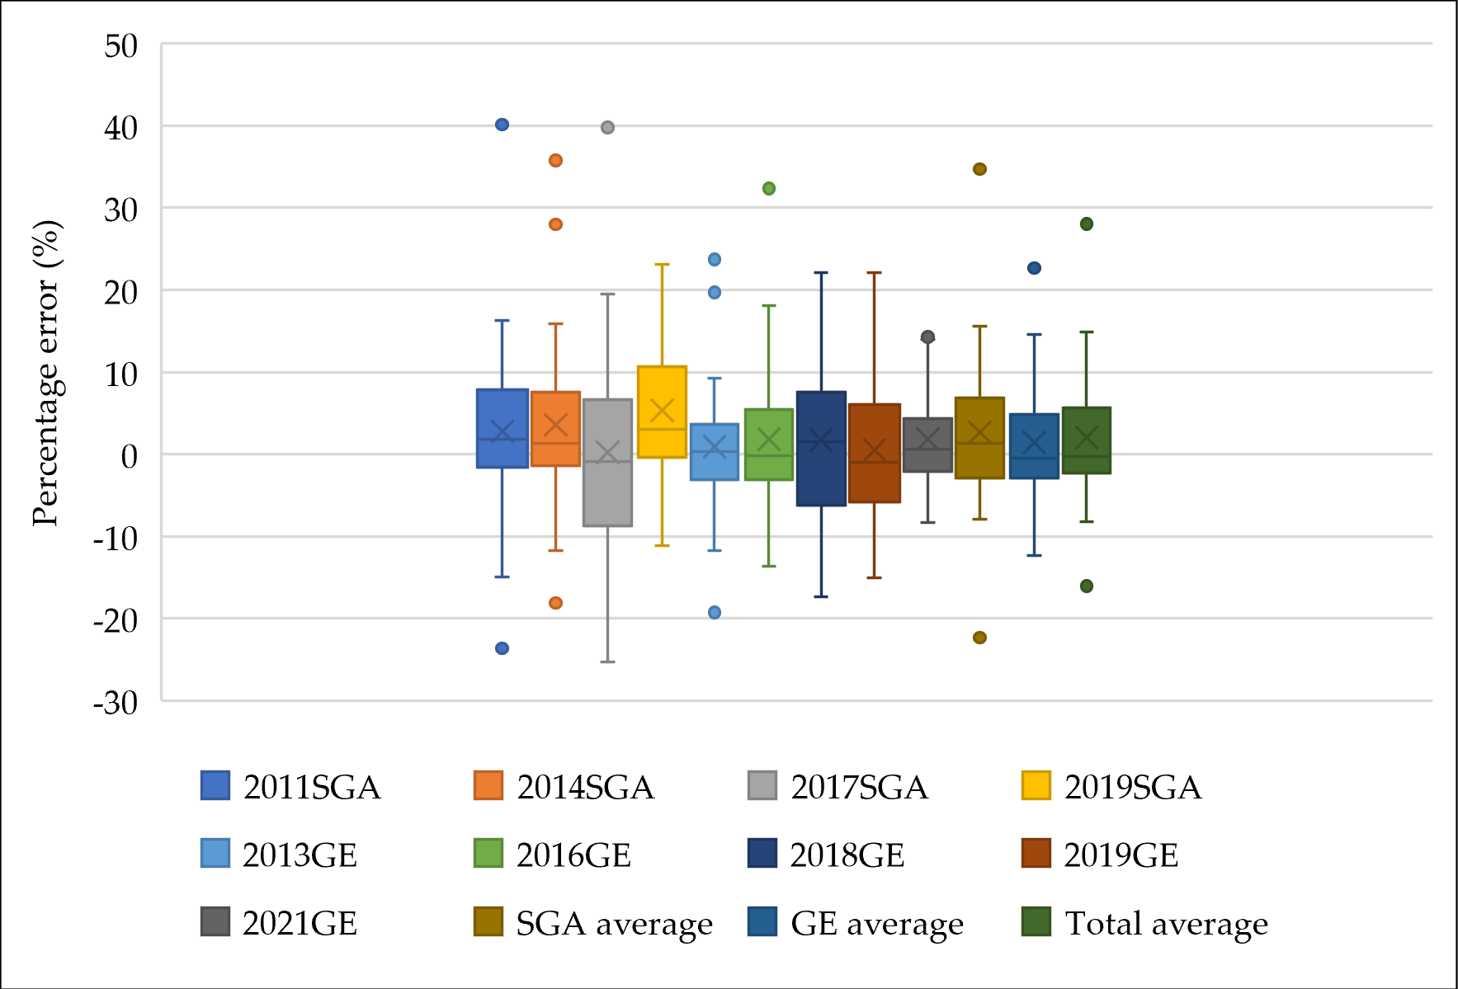
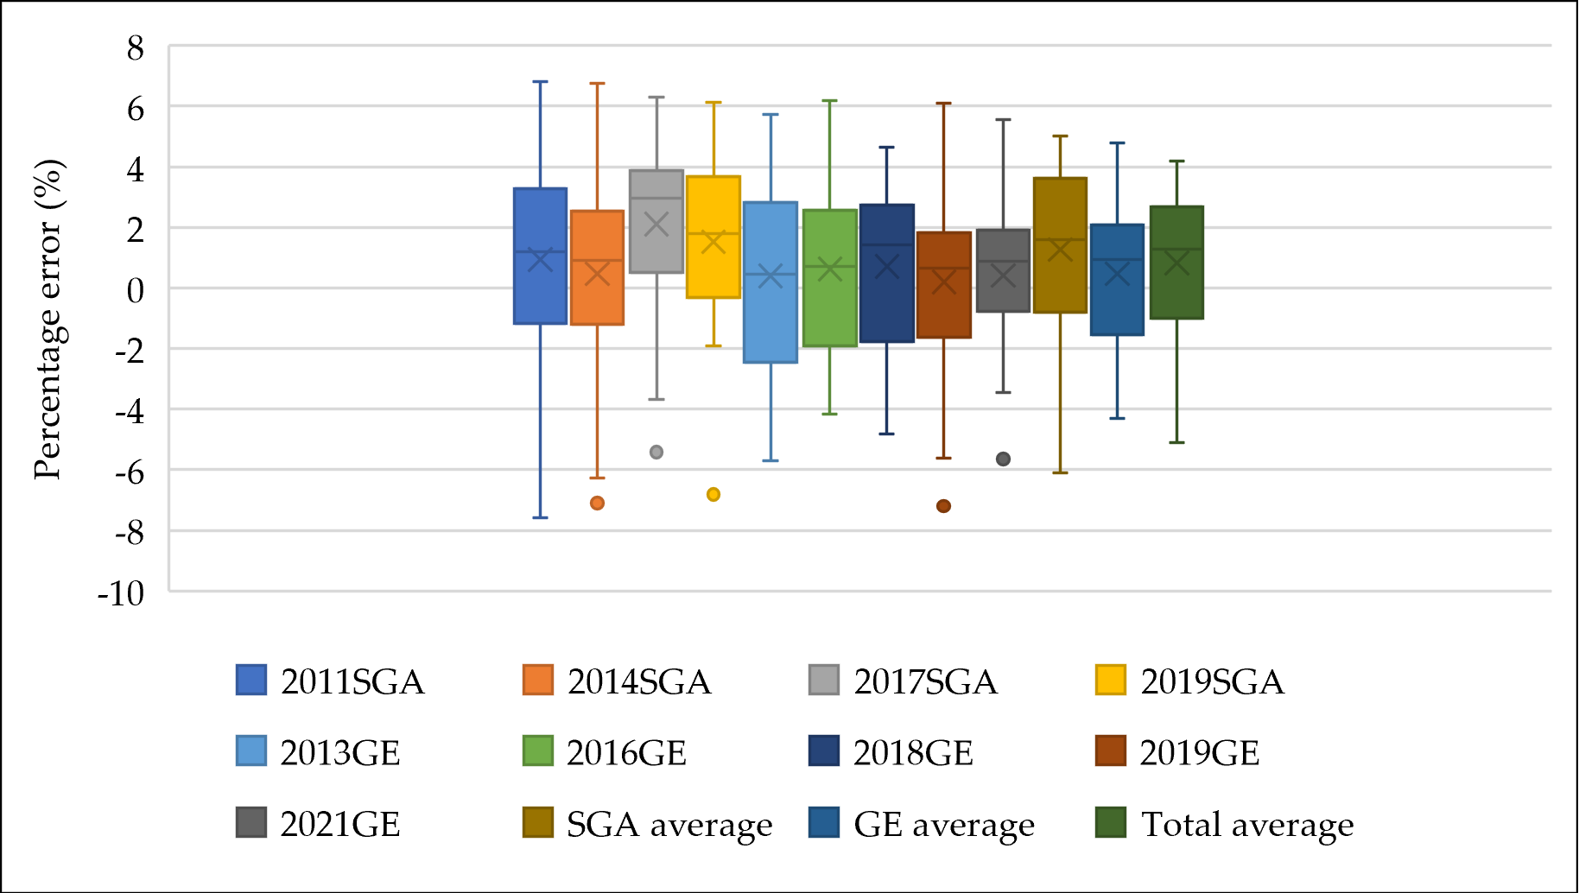
ANALYSIS
Error calculation
RMSE
%ERROR

Slide 12
RESULTS
SGA and GE sources →UAV → strong correlation (r2=>0.97)
1
Beach area: RMSE → 7.2% Percentage error → -2.3 to 5.6%
2
Beach length: RMSE→ 2.5 % Percentage error → -1 to 2.7%
3

Slide 13
CONCLUSION
Linear feature → more accurate than polygon based
Recent imagery → more accurate data
Different remote sensing sources → relatively accurate for beach geomorphological invstigations taking into account errors
Good base for futher monitoring and analyses
Coastal mangement

Slide 14
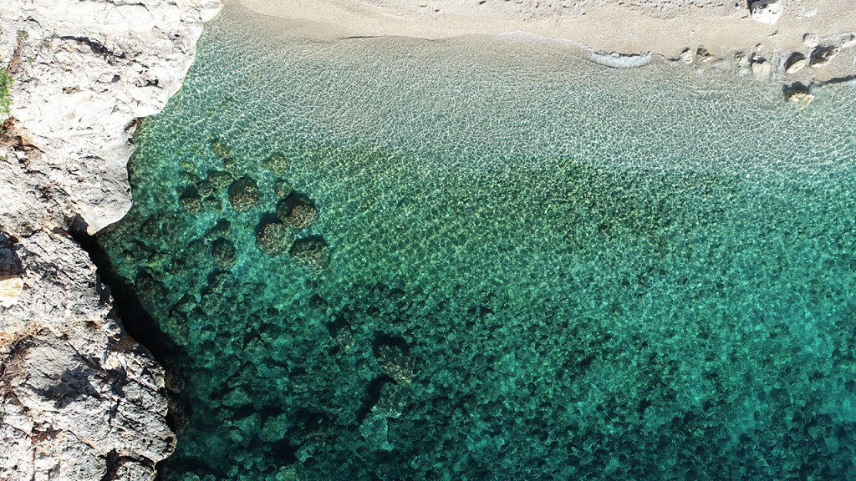
THANK YOU!
Mićunović, M.; Faivre, S.; Gašparović, M. Assessment of Remote Sensing Techniques Applicability for Beach Morphology Mapping: A Case Study of Hvar Island, Central Adriatic, Croatia. J. Mar. Sci. Eng. 2021, 9, 1407. https://doi.org/10.3390/jmse9121407

