Slide 1

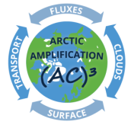
Ground-based retrievals of aerosol properties
using Emission FTIR and Raman-Lidar KARL measurements
Denghui Ji, Mathias Palm, Christoph Ritter*, Philipp Richter,
Matthias Buschmann,Xiaoyu Sun and Justus Notholt
Institute of Environmental Physics, University of Bremen, Bremen, Germany
*Alfred Wegener Institute, Helmholtz Centre for Polar and Marine Research, Potsdam, Germany
27.05.2022
denghui_ji@iup.physik.uni-bremen.de

Slide 2
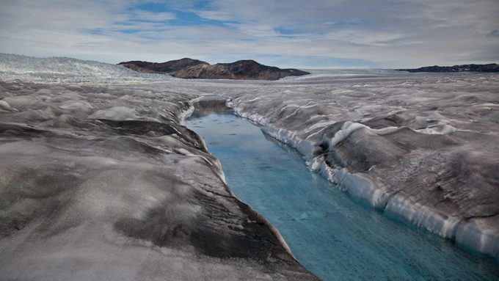
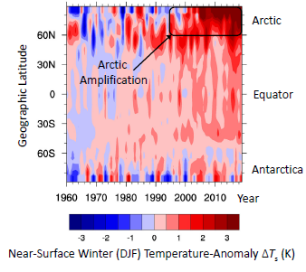
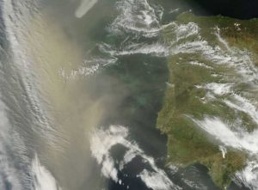
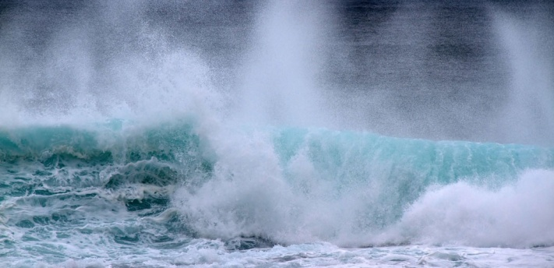
Aerosol in the Arctic
Black carbon
(Photo: ©Henrik Egede Lassen/Alpha Film, from the Snow, Water, Ice, and Permafrost in the Arctic report from the U.N. Arctic Monitoring and Assessment Programme.)
Dust in natural color seen from space traveling toward Greenland. NASA
Zonally averaged, near-surface air temperature anomaly, averaged over the boreal winter season (December, January, February). The anomaly is deined as the difference to the respective mean values for 1951– 1980. The abscissa represents time (year) and the ordinate shows the geographic latitude (degree). Figure (a) is adopted from Wendisch et al. (2017).
https://nyuad.nyu.edu/en/news/latest-news/science-and-technology/2018/october/dust-sahara-desert-arctic.html
Salty sea spray
https://source.colostate.edu/salty-sea-spray-affects-the-lifetimes-of-clouds-researcher-finds/
Notes:
Ny–Ålesund, located in the warmest part of the Arctic, exhibits distinct dynamic and radiative effects that are indicative for the transition from polar to maritime climate.

Slide 3
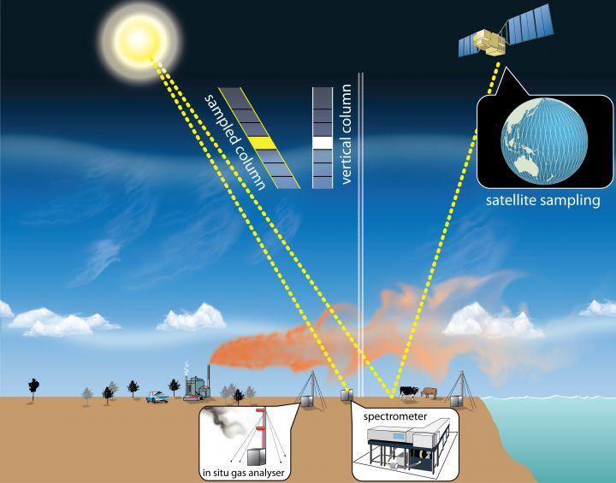
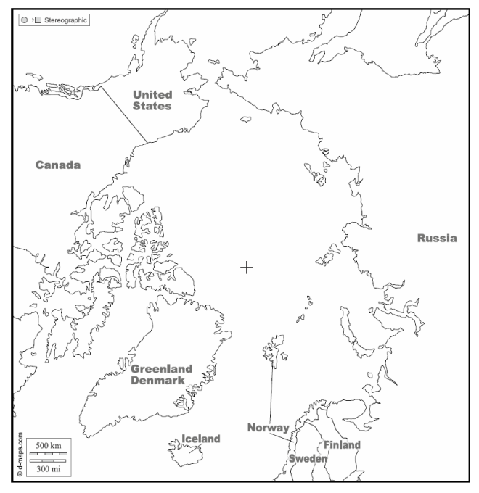
Emission FTIR spectrometry
From: https://niwa.co.nz/news/man-mission
https://dmaps.com/m/world/arctique/arctique10.pdf.
Barrow
Eureka
Ny-Ålesund
Instrument info:
Fourier Transform spectrometer NYAEM-FTS
Location: Ny-Ålesund (78.9N, 11.9E)
Time: 08.2019-present
Wave number range: 400 – 2500 cm⁻¹
(4 - 25μm)
Resolution: 0.03 cm⁻¹ (0.3 cm⁻¹)

Slide 4
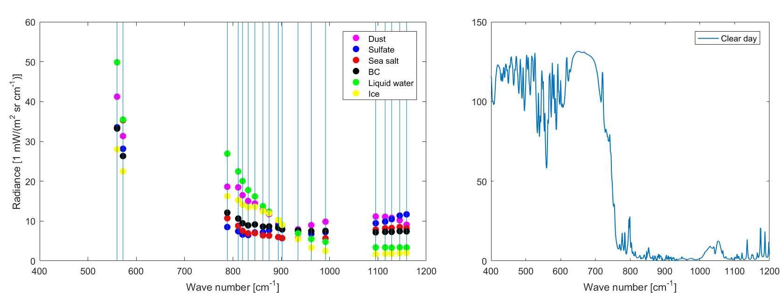
Whether different types of aerosols have their own emission spectrum characteristics?
(a)
(b)
The emission spectra of dust (pink), sulfate (blue), sea salt (red), BC (black), liquid water (green), and ice droplet (yellow), which is the difference between total emission radiance and clear emission radiance. The vertical lines mean the mid values of micro windows selected for retrieval (a). The emission spectra in clear day simulated from LBLDIS (b).

Slide 5
Retrieval Algorithm : Total Cloud Water retrieval (TCWret)
 | Atmospheric state | Forward model | Retrieval method
Version 1: (Richter et al., 2021) | ERA5 reanalysis data | LBLRTM + DISORT | Optimal estimation method
Version 2 (Ji et al., in prep)
 | Products
Version 1: | Cloud water optical depth; Total effective droplet radius; Condensed water path.
Version 2: | AOD of Salt salt, Sulfate, dust and BC.

Slide 6
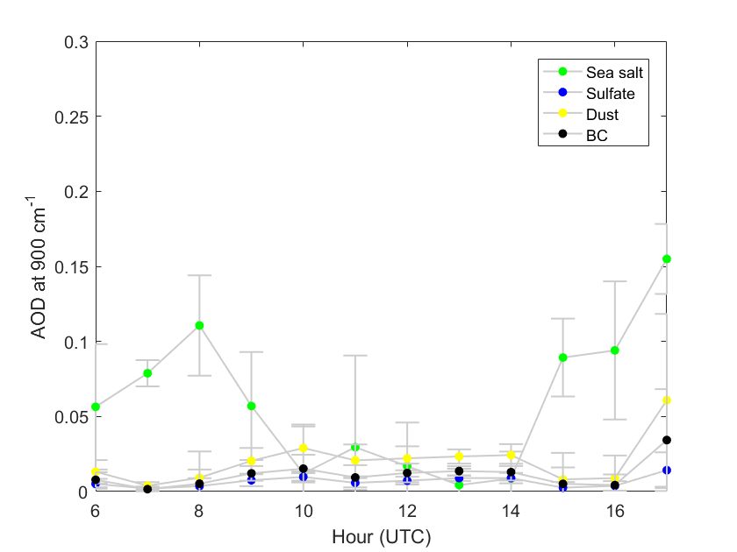
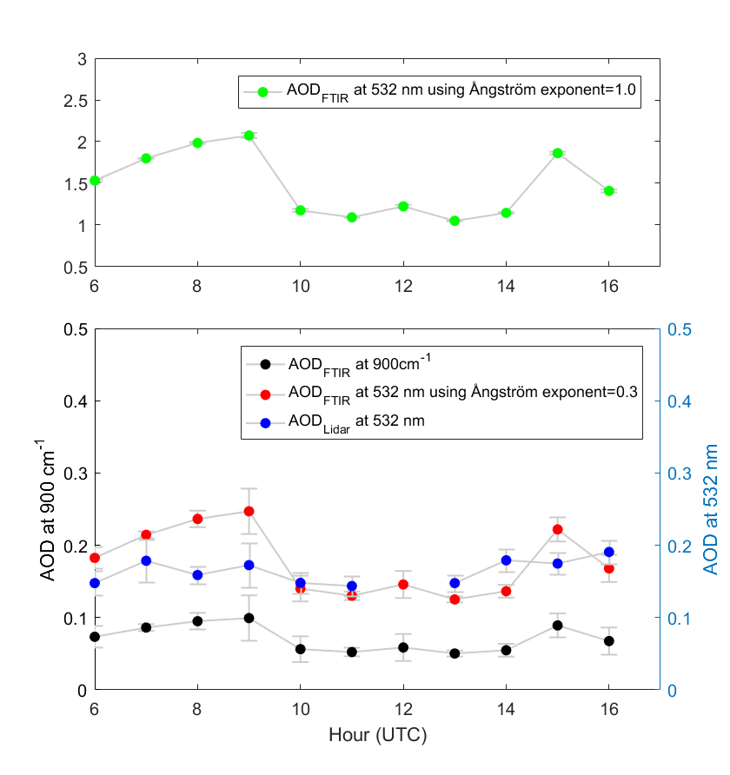
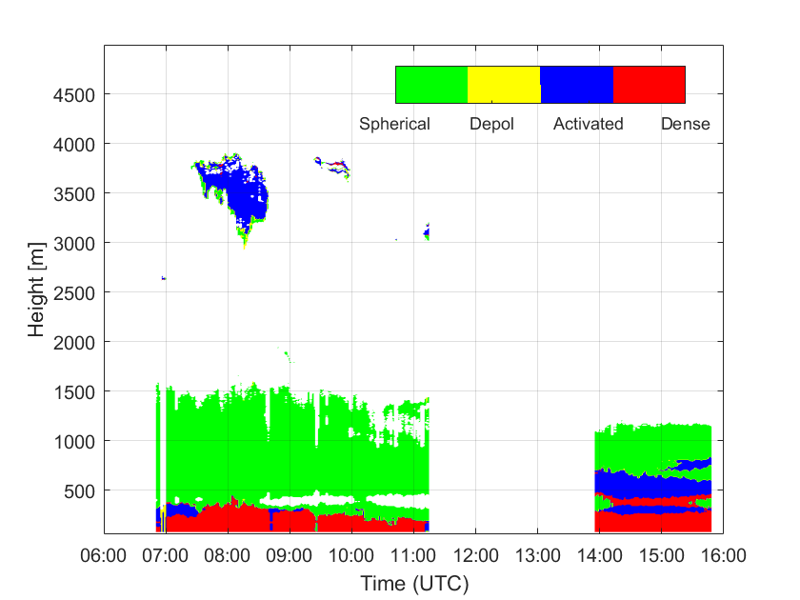
Case study 10.06.2020
Emission FTIR measurement
V.S. Lidar measurement

Slide 7
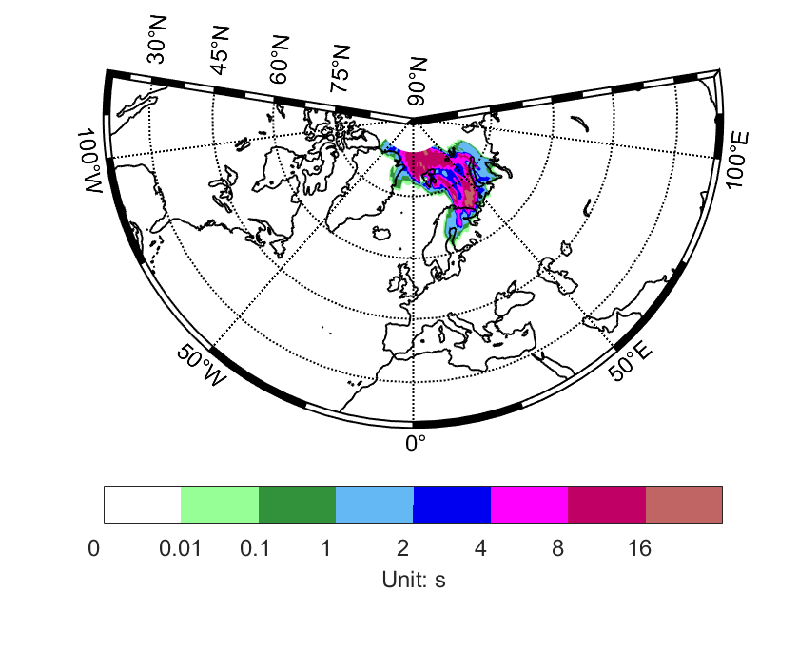
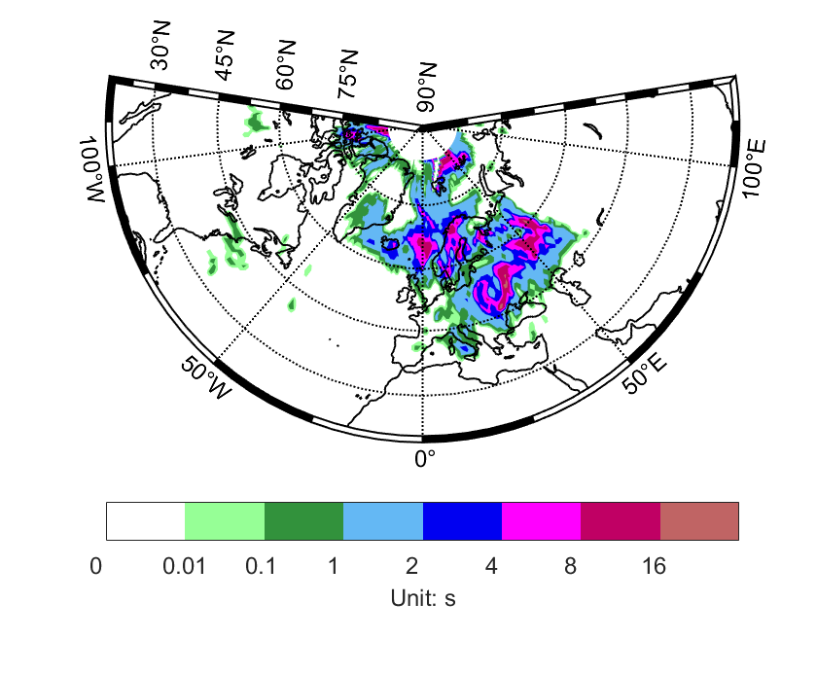
Case study 10.06.2020
FLEXPART Backward Footprint
Starting time: 10.06.2020, 14:00
3 days, 225m
8 days, 1225m
Sea salt : local emission
Dust, Sulfate and BC: remote area

Slide 8
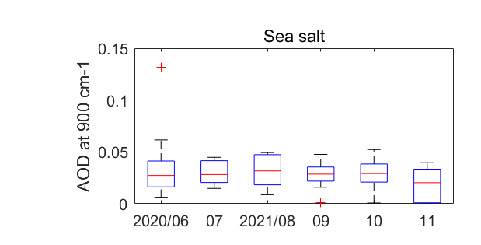
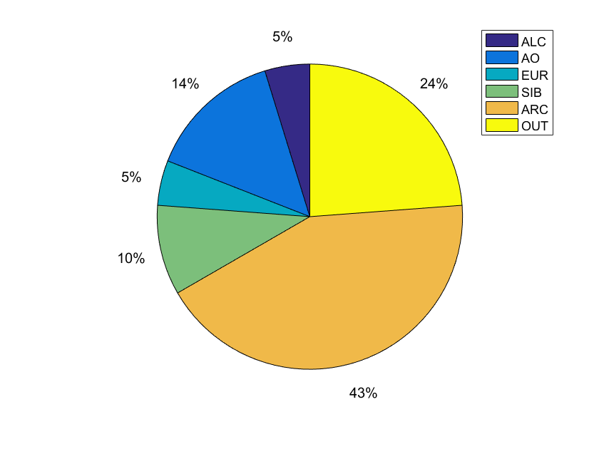
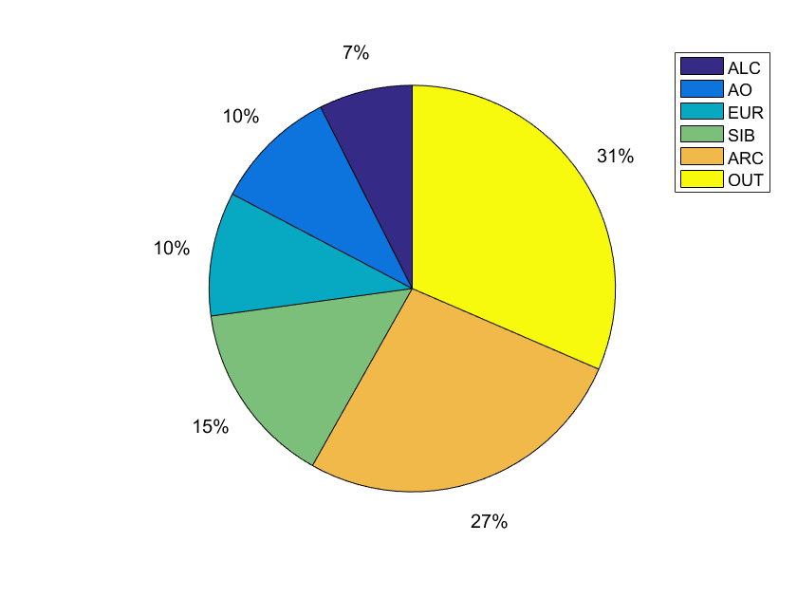
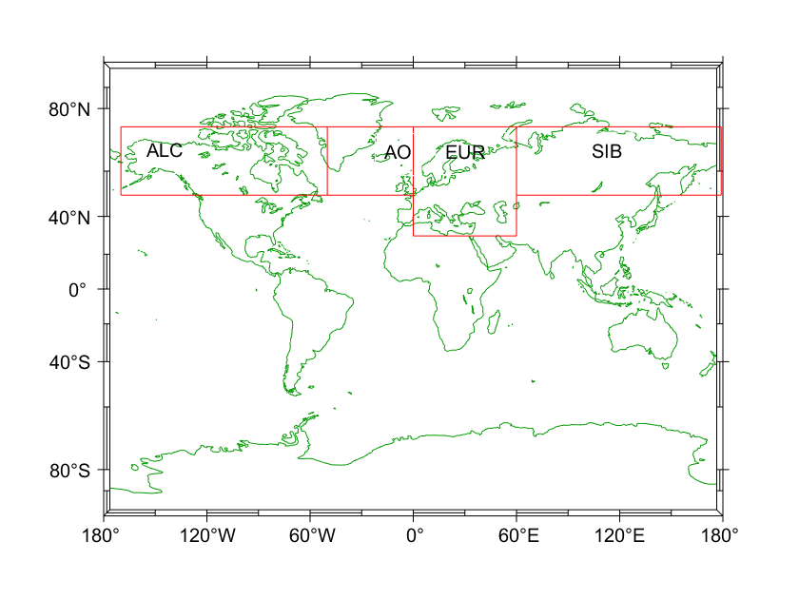
Long Time period observation
Sea salt in the Arctic is higher in summertime than autumn time.
Summertime: Local emission Autumn time: Transportation from remote area.
Summer
Autumn

Slide 9
Summary
A FTIR instrument for down-welling emission measurements and Raman-Lidar are operated in Ny-Ålesund. Combining the two observations, the aerosols can be observed more comprehensively.
Based on FTIR emission measurements, a retrieval algorithm for aerosol types and optical thickness is being developed.
Case studies of those retrievals are analyzed using measurements obtained on June 10th, 2020.
Future look
Long time measurements of emission FTIR data will be processed and compared with other aerosol datasets or GEOS-Chem aerosol simulation.

Slide 10
Questions, comments are welcomed.
Thank you!
denghui_ji@iup.physik.uni-bremen.de

