Slide 1


Mesoscale precipitation nowcasting
using 3D-space-time-separable
graph convolutional networks
Daniele Trappolini,
Luca Scofano, Phd Computer Science Sapienza University of Rome
Alessio Sampieri, Phd Computer Science Sapienza University of Rome
Frank Silvio Marzano, Prof. Electrical Engineering Sapienza University of Rome
Fabio Galasso, Prof. Computer Science Sapienza University of Rome
Francesco Messina, Leonardo
Saverio Di Fabio, CETEMPS L’Aquila University

Slide 2
OUTLINE
Precipitation nowcasting from weather radars
Available and current nowcasting models
  Moving MINST video database
  Benchmark radar TASRAD19 database
Proposed topology using STS-3DUNet GCN
  Intercomparison of categorical results
  Quantitative error results
Application to case over Central Italy
Conclusion and future developments
2

Slide 3
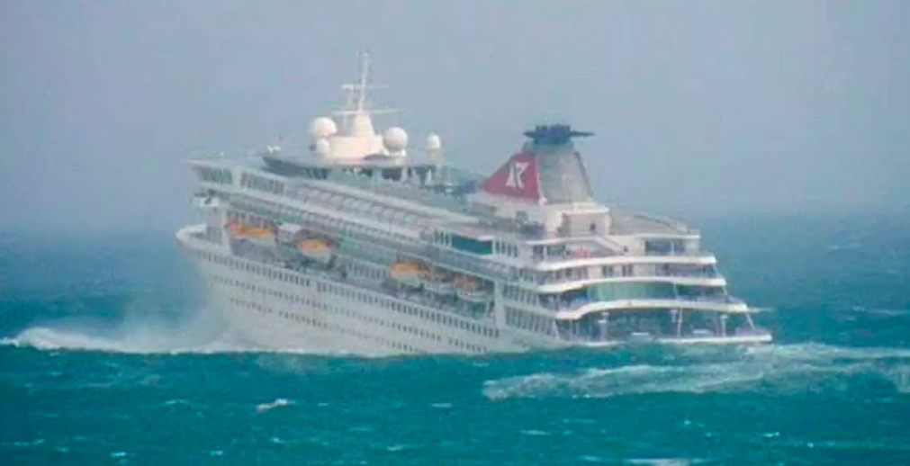
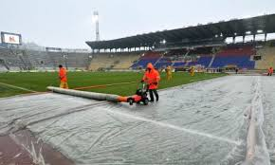
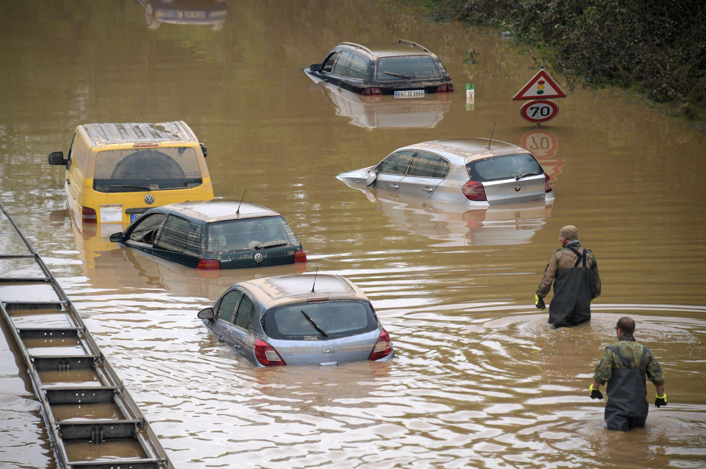

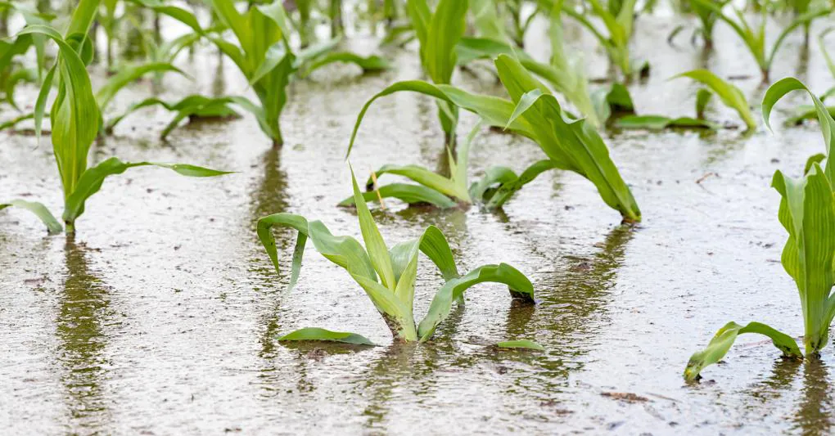
WHAT IS THE TASK ABOUT?
PRECIPITATION
RADAR-BASED NOWCASTING
(prediction at lead time less than 2 hours)
Data science perspective:
next frame video prediction
Trajectory forecasting
Pixel
forecasting
What are the applications?
1. Xingjian Shi et al. “Deep Learning for Precipitation Nowcasting: A Benchmark and A New Model”.
3

Slide 4
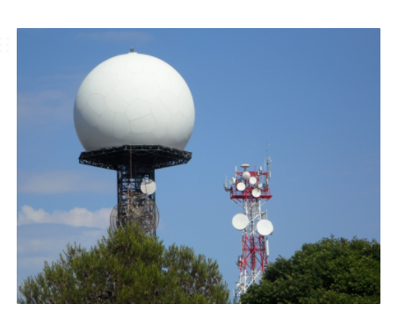
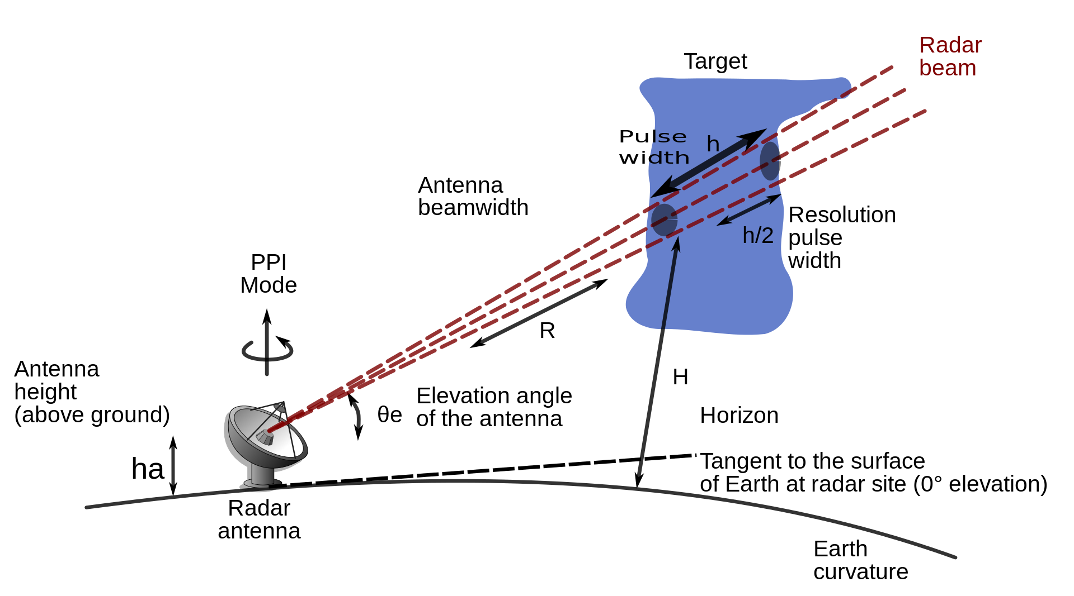
HOW PRECIPITATION DATA ARE CAPTURED?
CETEMPS Radar Mt. Midia (AQ)
TYPES OF REFLECTIVITY IMAGES:
Microwave system at C band (5.5 GHz)
Base Reflectivity (power return)
Composite Reflectivity (radar network)
TYPES OF RADAR REPRESENTATION:
Plan Position Indicator (PPI)
Constant Altitude Plan Position Indicator (CAPPI)
Vertical Maximum Intensity (VMI or MAX-Z)
4

Slide 5
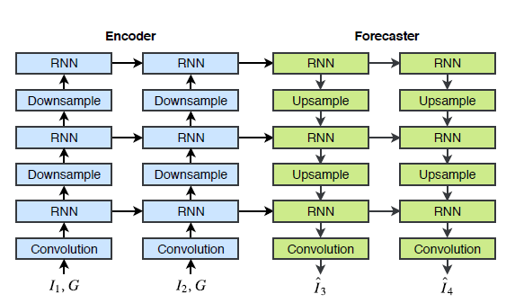
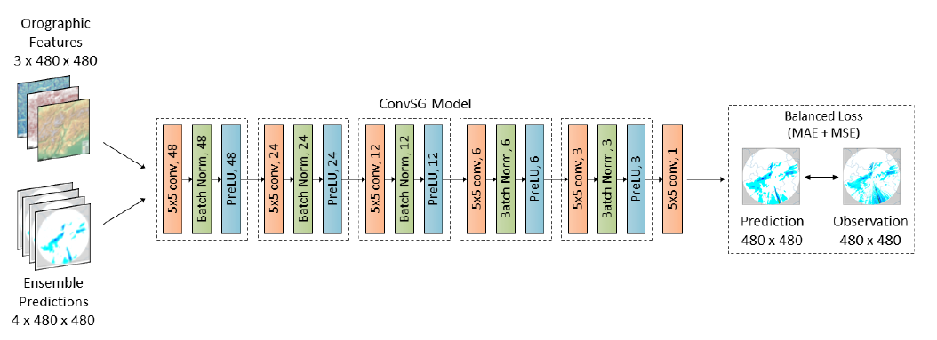
CURRENT NOWCASTING MODELS
TRADITIONAL APPROACH TO RADAR-BASED PRECIPITATION NOWCASTING:
DEEP LEARNING APPROACH:
Pattern-continuity temporal autocorrelation
SPROG (Spectral space-time decompostiion)
Traj GRU
Conv SG
Enhanced Conv SG
Trajectory GRU (Gated Recurrent Units)¹
Enhanced Conv SG (Convolutional Stacked Generalization)²
Xingjian Shi et al. “Deep Learning for Precipitation Nowcasting: A Benchmark and A New Model”.
Gabriele Franch et al. “TAASRAD19, a high-resolution weather radar reflectivity dataset for precipitation nowcasting”
5

Slide 6
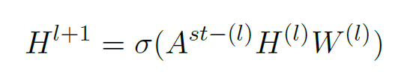
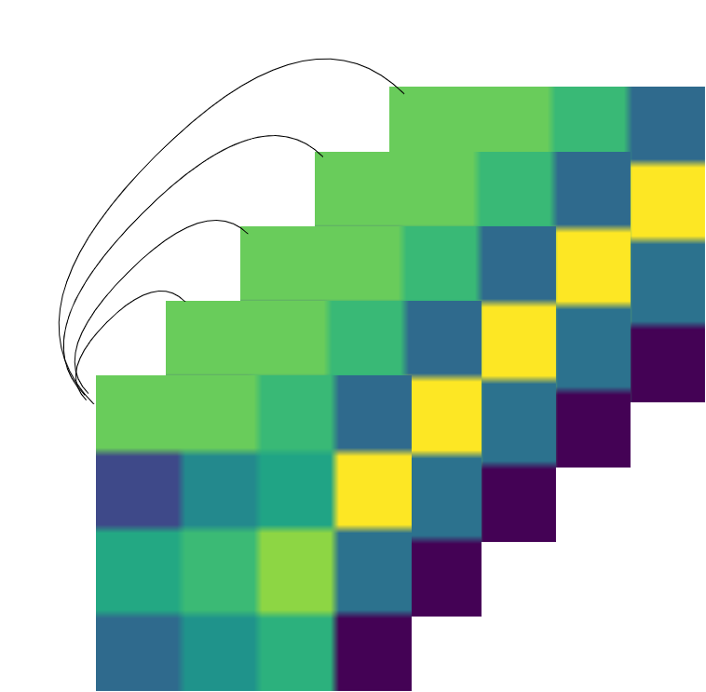
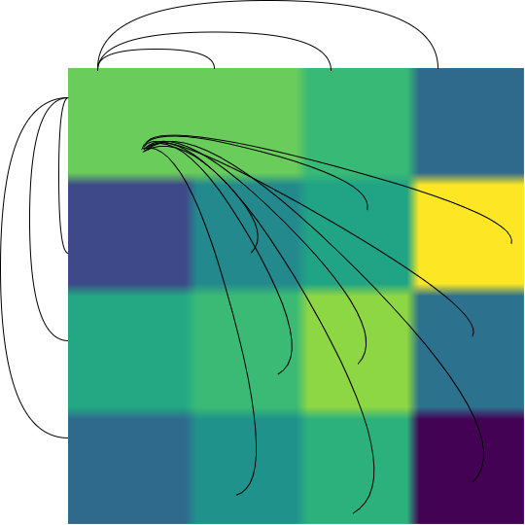
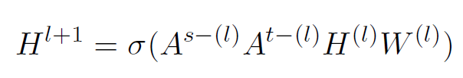
SPACE-TIME-SEPARABLE GRAPH CONVNET
Classical GCN layer
(1.1)
STS-GCN layer
(1.2)
A separable space-time graph convolutional layer l
Space-Time-Separable (STS) Graph-Convolutional-Network (GCN)
Temporal Convolutional Networks
Encode spatial pixel-pixel
Encode temporal pixel-pixel
Forecaster
3. Theodoros Sofianos et al. “Space-Time-Separable Graph Convolutional Network for Pose Forecasting”.
6

Slide 7
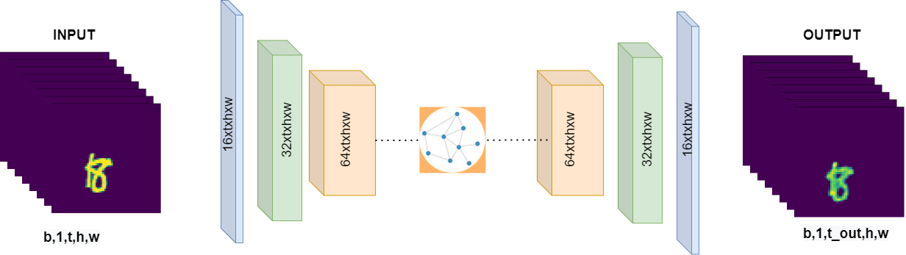


MOVING MNIST DATABASE
MNIST: Modified National Institute of Standards and Technology (database)
Introduced by Srivastava et al. in Unsupervised Learning of Video Representations using LSTMs
Naive model
The Moving MNIST dataset contains 10,000 video sequences, each consisting of 20 frames. In each video sequence, two digits move independently around the frame, which has a spatial resolution of 64×64 pixels. The digits frequently intersect with each other and bounce off the edges of the frame
Results
Ground truth frames from 11 to 20
Prediction frames from 11 to 20
Train (10 epoch)
7

Slide 8

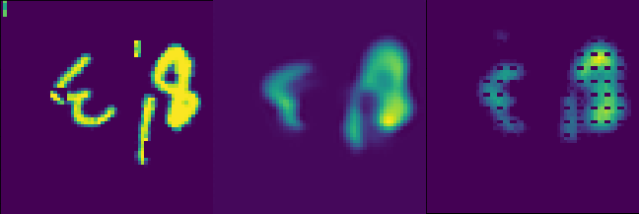
MOVING MNIST++ DATABASE
New motion pattern introduced respect to Moving Mnist.
We need a more complex model:
STS-UNet3D
Xingjian Shi et al. “Deep Learning for Precipitation Nowcasting: A Benchmark and A New Model”.
8

Slide 9
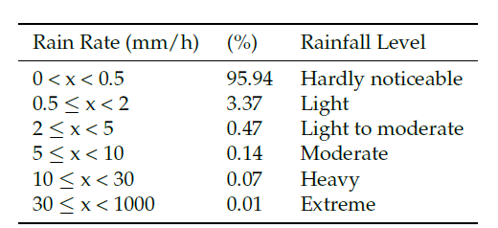
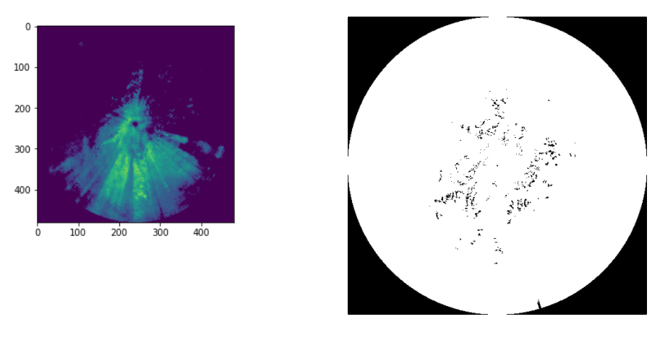
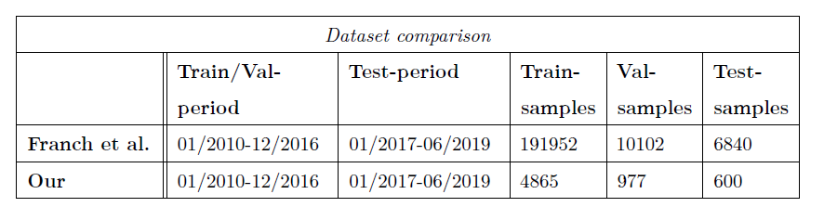
TAASRAD19 RADAR DATABASE
1
Unbalanced
2
Noise
3
Sampling
2. Gabriele Franch et al. “TAASRAD19, a high-resolution weather radar reflectivity dataset for precipitation nowcasting”.
9

Slide 10
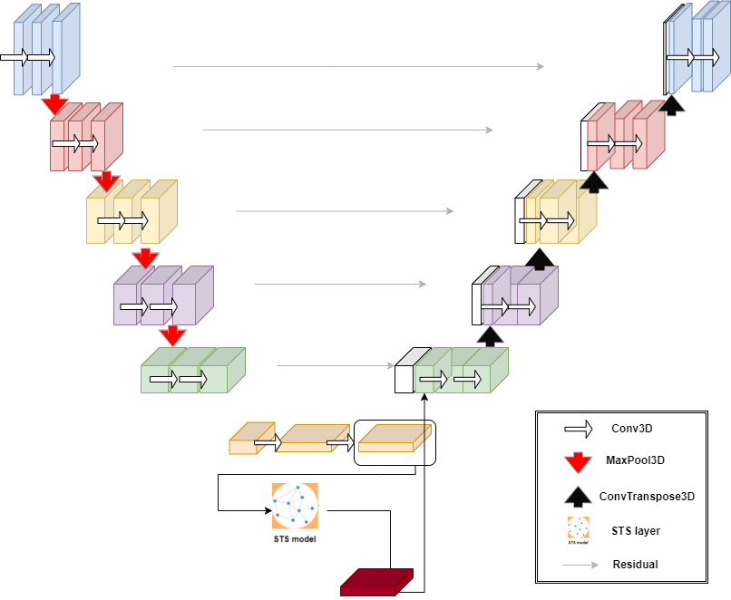
STS-UNet3D: A COMBINED TOPOLOGY
1. DOWN BLOCK
5. FINAL CONVOLUTION
2. STS-GCN
4. UP BLOCK
3. CONCATENATION
5. Özgün Çiçek et al. 3D U-Net: Learning Dense Volumetric Segmentation from Sparse Annotation. 2016.
3. Theodoros Sofianos et al. “Space-Time-Separable Graph Convolutional Network for Pose Forecasting”
10

Slide 11
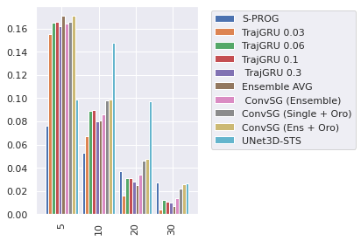
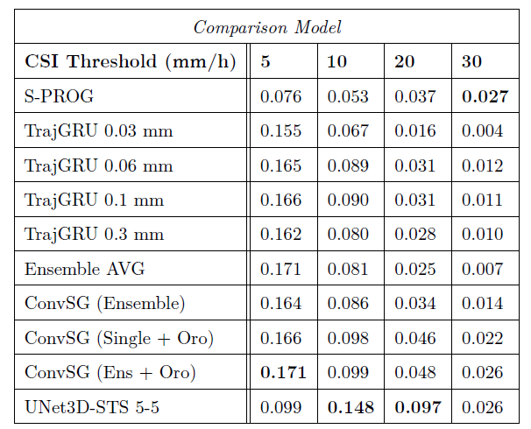
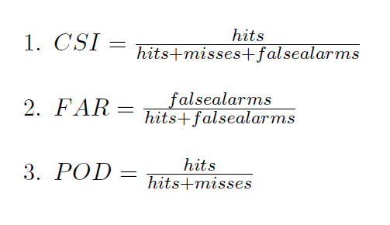
RESULTS INTERCOMPARISON (1/3)
HITS: truth = 1 and prediction = 1
MISSES: truth = 1 and prediction = 0
FALSE ALARMS: truth = 0 and prediction = 1
4. Gabriele Franch et al. “Precipitation Nowcasting with Orographic Enhanced Stacked Generalization: Improving Deep Learning Predictions on Extreme Events”.
11

Slide 12
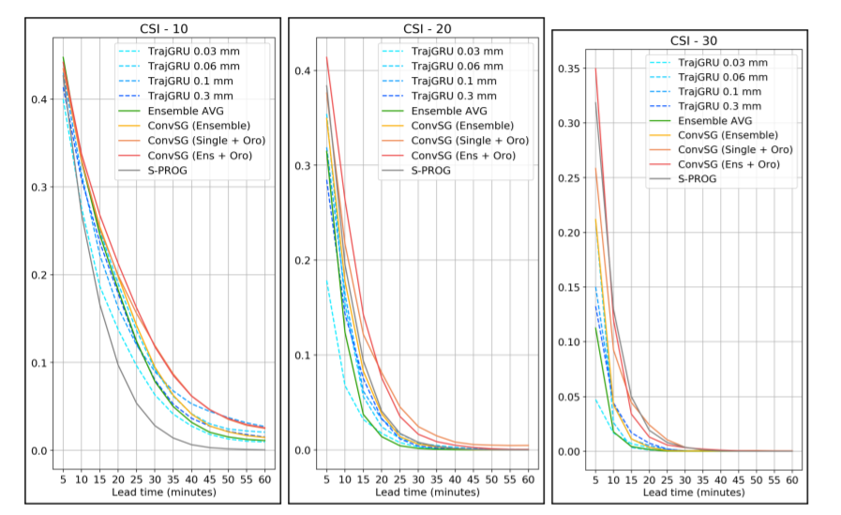
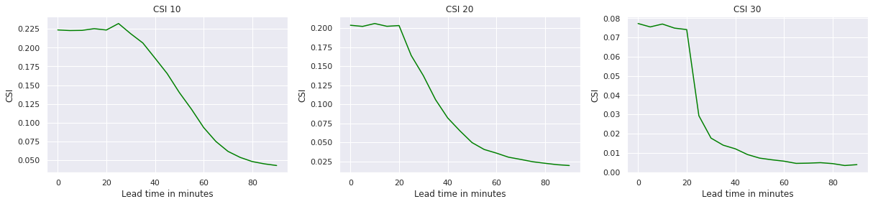
RESULTS INTERCOMPARISON (2/3)
Franch et al. Results (CSI)
STS-3DUNet
Results (CSI)
4. Gabriele Franch et al. “Precipitation Nowcasting with Orographic Enhanced Stacked Generalization: Improving Deep Learning Predictions on Extreme Events”.
12

Slide 13
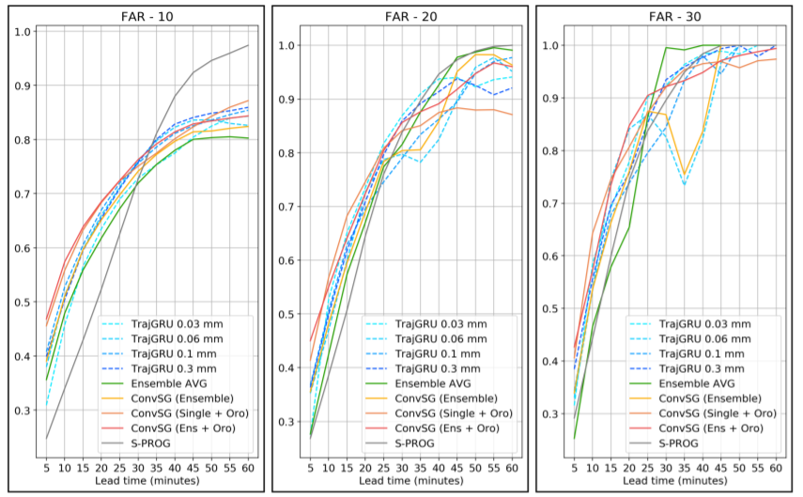
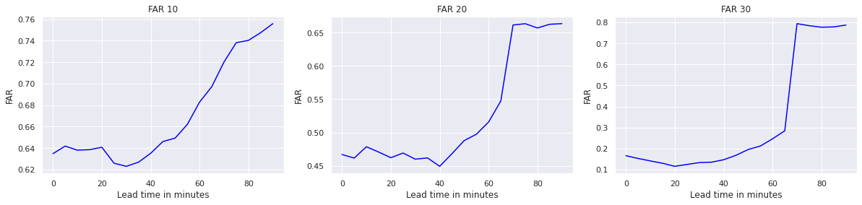
RESULTS INTERCOMPARISON (3/3)
Franch et al. Results (FAR)
STS-UNet3D
Results (FAR)
4. Gabriele Franch et al. “Precipitation Nowcasting with Orographic Enhanced Stacked Generalization: Improving Deep Learning Predictions on Extreme Events”.
13

Slide 14
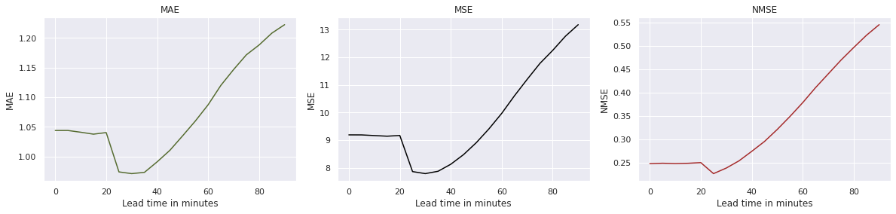
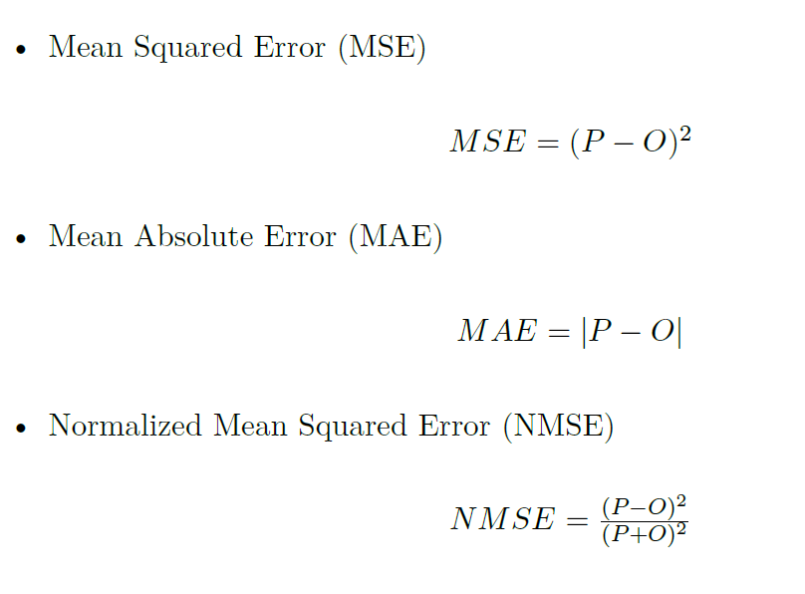
QUANTITATIVE ERROR RESULTS
14

Slide 15
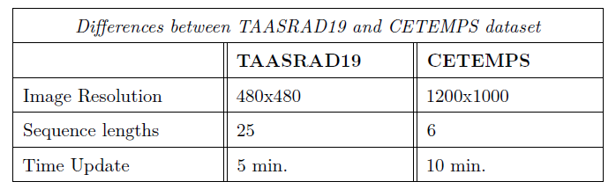
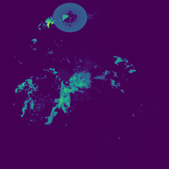
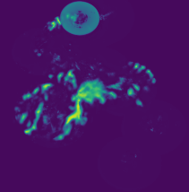
CASE STUDY: CENTRAL ITALY RADAR
Cetemps GT (frame n. 6)
Our Prediction (frame n. 6)
15

Slide 16
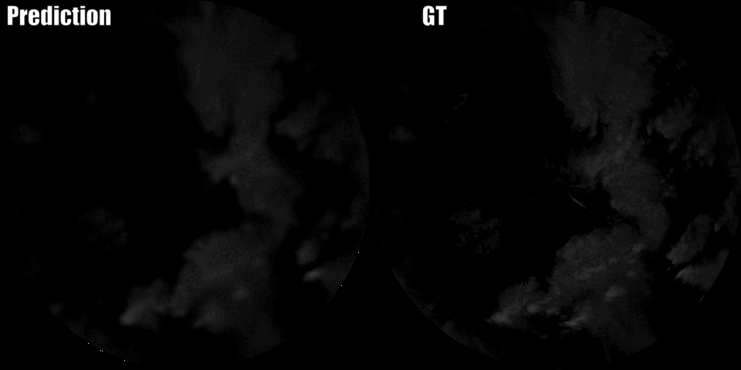
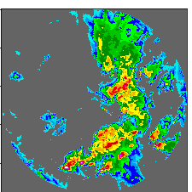
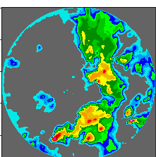
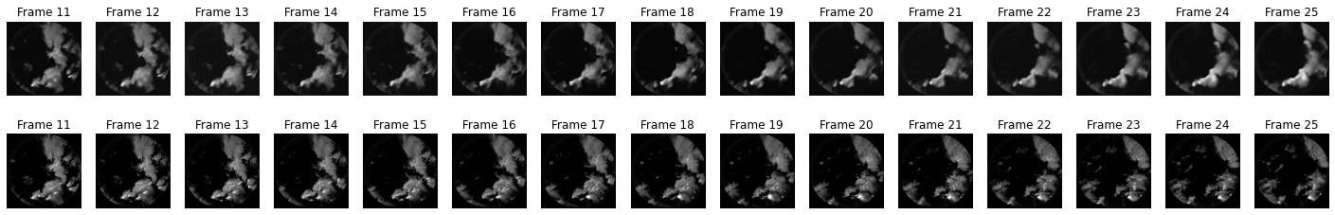
CASE STUDY STSUnet3D BEHAVIOR
GT FRAME 11
OUR PREDICTION FRAME 11
16

Slide 17
CONCLUSION AND FUTURE DEVELOPMENTS
Radar-based nowcasting of atmospheric precipitation
Analogy with next-frame video project
Proposed topology: combination of STS GCN with 3DUNet
Intercomparison with literature results
  CSI improvement for medium-high rainrates
  CSI slight worse results for very low and very high rainrates
Application to case study over Central Italy Mt. Midia radar imagery
STS-3DUNet improvement
A new architecture: SWIN TRANSFORMER
Noise mask
Data augmentation
Hyperparameters
Exploit the whole Dataset
Adapt Swin-UNet++ to a 3D structure and combine it with the STS-GCN in the bottleneck+
Hierarchical shifted window applied in combination with STS-GCN
6. Ze Liu et al. Video Swin Transformer. 2021.
7. Ze Liu et al. “Swin Transformer: Hierarchical Vision Transformer using Shifted Windows”
8. Pan Liu et al. “Swin-UNet++: A Nested Swin Transformer Architecture for Location Identification and Morphology Segmentation of Dimples on Fractured Surf.”
17

Slide 18




FOR KEEPING UP WITH OUR WORK
soon available on: GitHub https://github.com/dantrappolini/Weather_Nowcasting
work in progress for: Remote Sensing MDPI
https://www.mdpi.com/journal/remotesensing/instructions#submission
This project was made possible thanks to…
IN MEMORY OF FRANK SILVIO MARZANO
18

