Slide 1
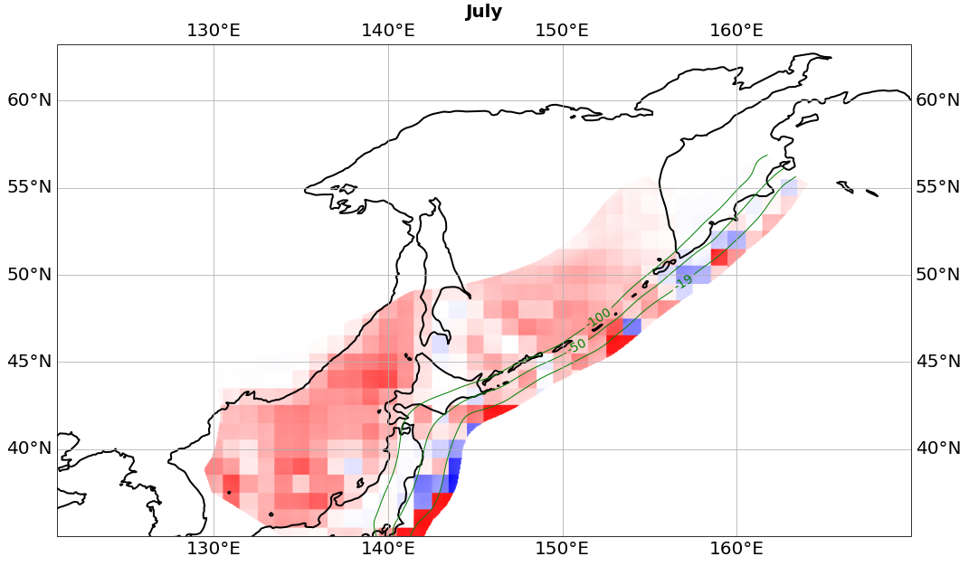







Non-tectonic-induced stress variations on active faults
Yiting Cai, Maxime Mouyen
Department of Space, Earth and Environment,
Chalmers University of Technology, Sweden
Yiting Cai, EGU, May 2022. Email: yiting.cai@chalmers.se

Slide 2
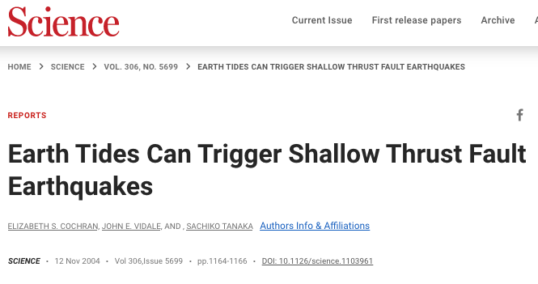
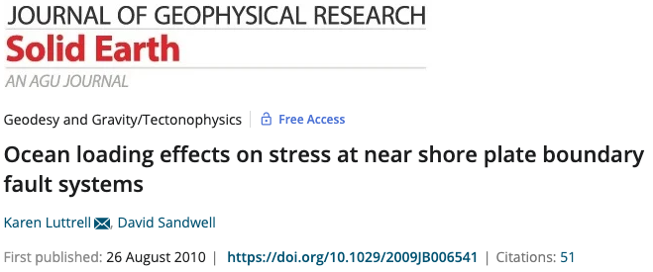
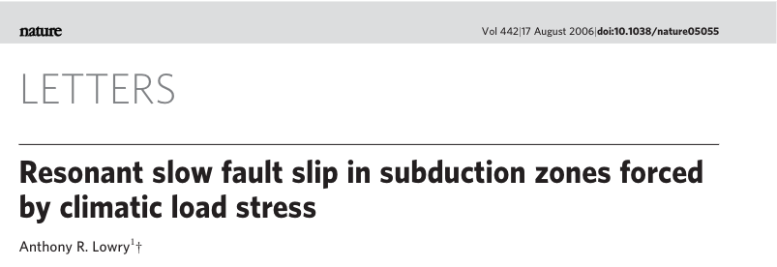
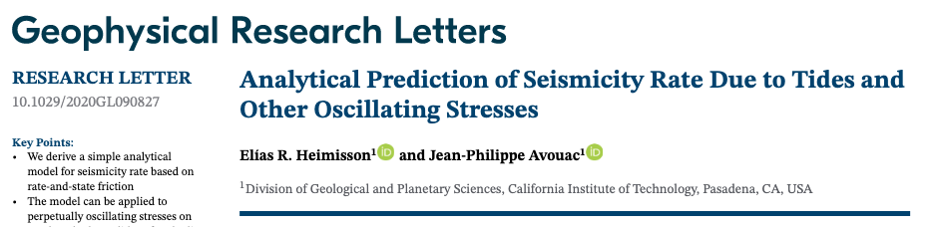
Can non-tectonic processes trigger earthquakes?
Yiting Cai, EGU, May 2022. Email: yiting.cai@chalmers.se
‹#›

Slide 3
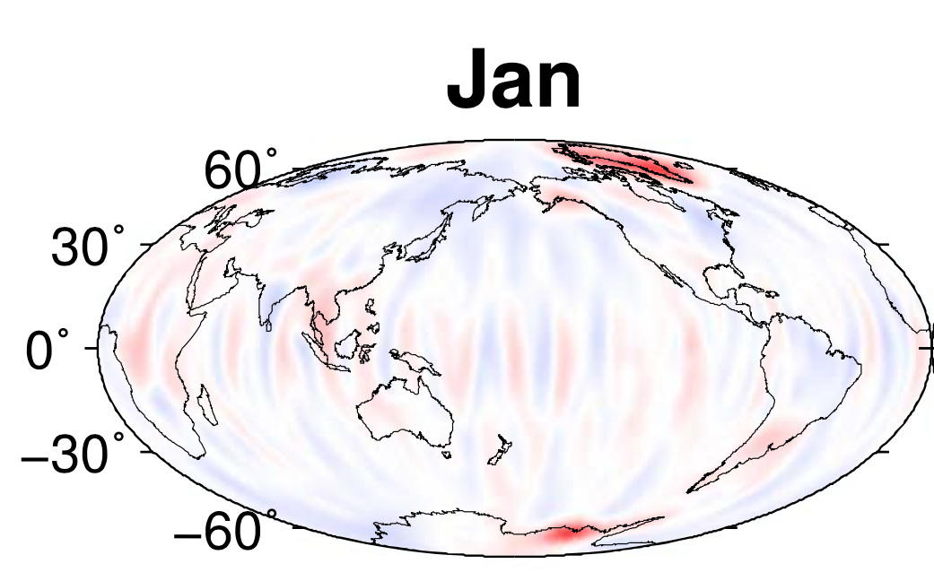
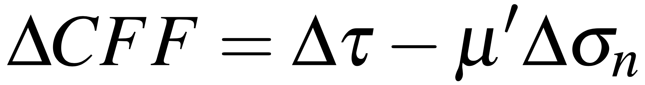
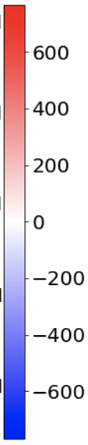
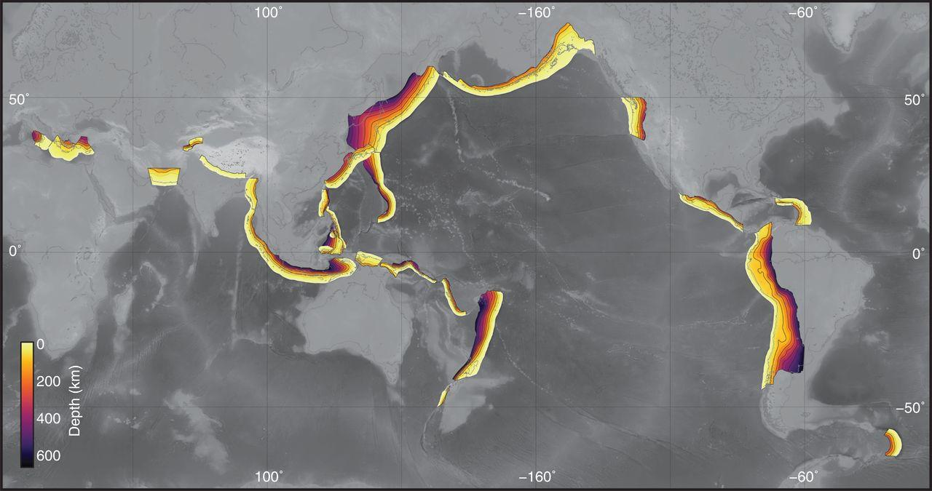
ΔCFF <- stress variations + fault parameters
  Hydrological loading
  Atmospheric pressure
  Non-tidal ocean loading
Coulomb failure function
Lu, Z., et al (2018). Journal of Geophysical Research: Solid Earth
+: loaded
Earthquakes
Slab2:
subduction zone model
-: unloaded
No earthquakes
Hayes, Gavin P., et al. (2018). Science
Case study: Kuril fault
Yiting Cai, EGU, May 2022. Email: yiting.cai@chalmers.se

Slide 4
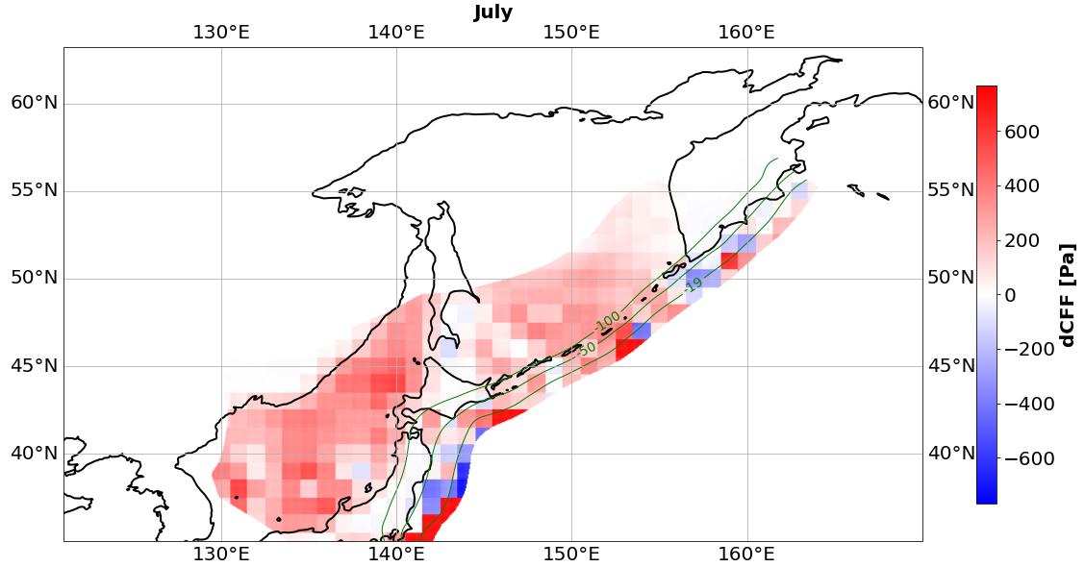
Non-tidal ocean loading, ΔCFF, Kuril, 2013
Spatial variations
Yiting Cai, EGU, May 2022. Email: yiting.cai@chalmers.se

Slide 5
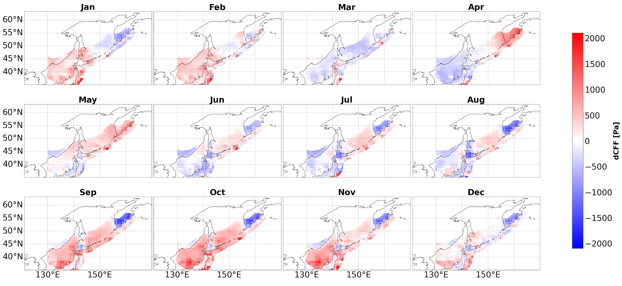
ΔCFF spatio-temporal variations, 2013
Loadings: hydro + air pressure + non-tidal ocean loadings
Yiting Cai, EGU, May 2022. Email: yiting.cai@chalmers.se

Slide 6
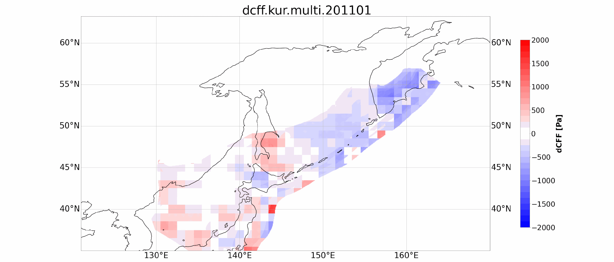
ΔCFF 2011-2016, multi-loading-induced
Yiting Cai, EGU, May 2022. Email: yiting.cai@chalmers.se

Slide 7
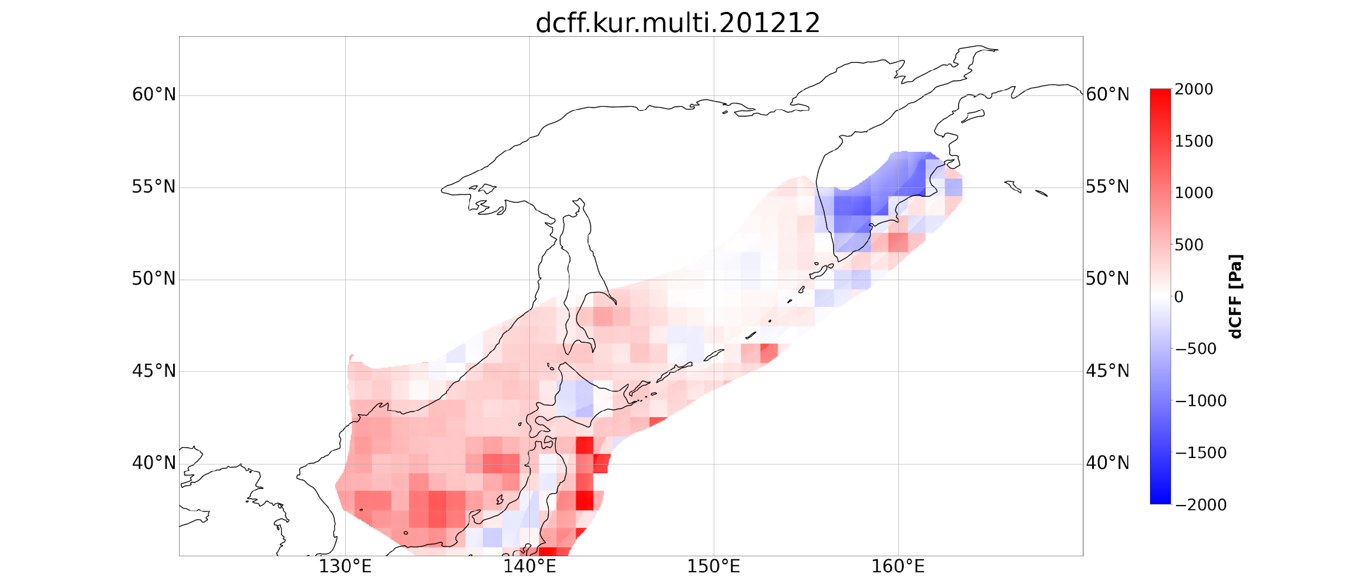
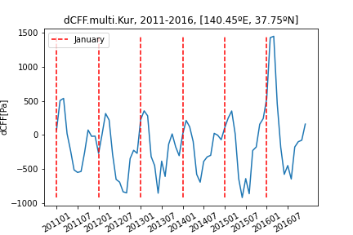
Conclusions &
Perspectives
Non-tectonic processes have a clear impact on the ΔCFF on active faults.
Stress variation induced by each non-tectonic process contributes to the total ΔCFF equivalently.
Comparison to the seismicity
More faults, e.g. Ryukyu
More stress sources, e.g. tides
Yiting Cai, EGU, May 2022. Email: yiting.cai@chalmers.se

Slide 8
Thank you!
Yiting Cai
EGU, May 2022
Email: yiting.cai@chalmers.se

