Slide 1
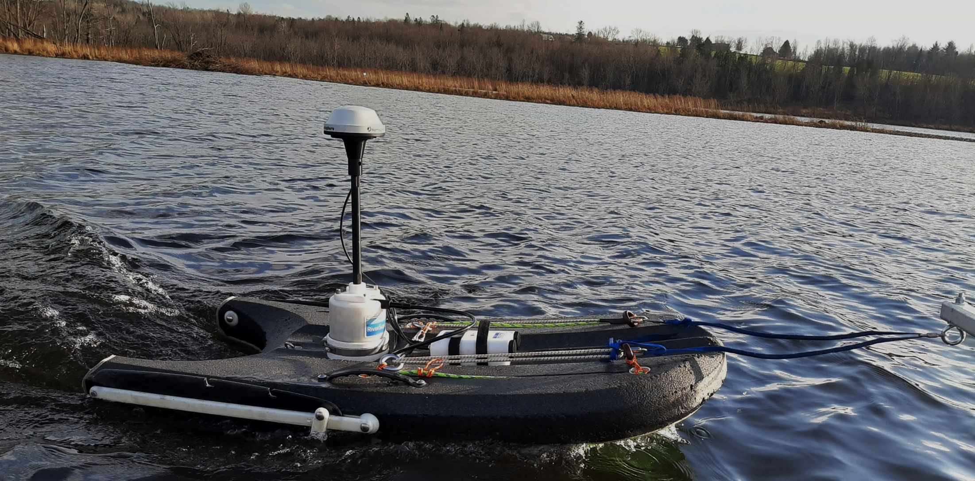



Quantifying the impact of bathymetry changes on flood events for the Trois-Lacs Basin
Sergio Redondo
Marie-Amélie Boucher
Jay Lacey
Jérémy Parent (MRC des Sources)
ADCP captor installed on a floating board at the Trois-Lacs.

Slide 2
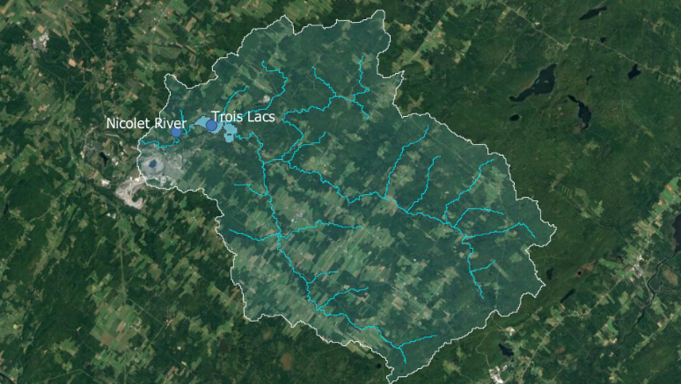
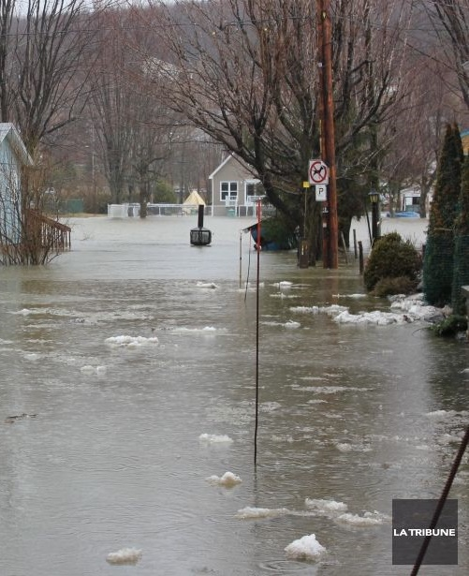
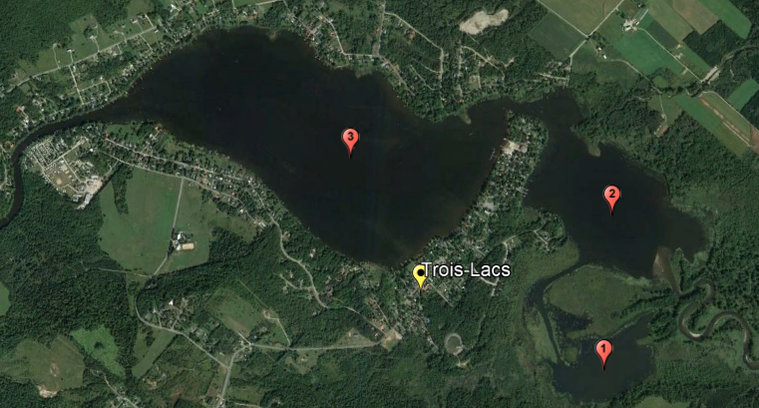
Context and problem
Flood in Trois-Lacs, Val-des-Sources, April 15, 2014
Yvan Provencher
Area exposed to spring floods.
Sediments accumulation problem in the lakes.
Dragging works after 2007 (Campeau et al., 2019).
Changes in bathymetry and bed elevation could lead to higher flood elevations.
Nicolet watershed area = 539 km²
Nicolet
Trois-Lacs surface area = 2.5 km²

Slide 3
Methodology: Hydrological model
Hydrotel distributed model (Fortin et al. 1996) pre-calibrated.
Complemented by Kriging on meteorological stations.
Validated for 2020-2021 with:
Downstream official hydrological station series.
Upstream flow measurements.

Slide 4
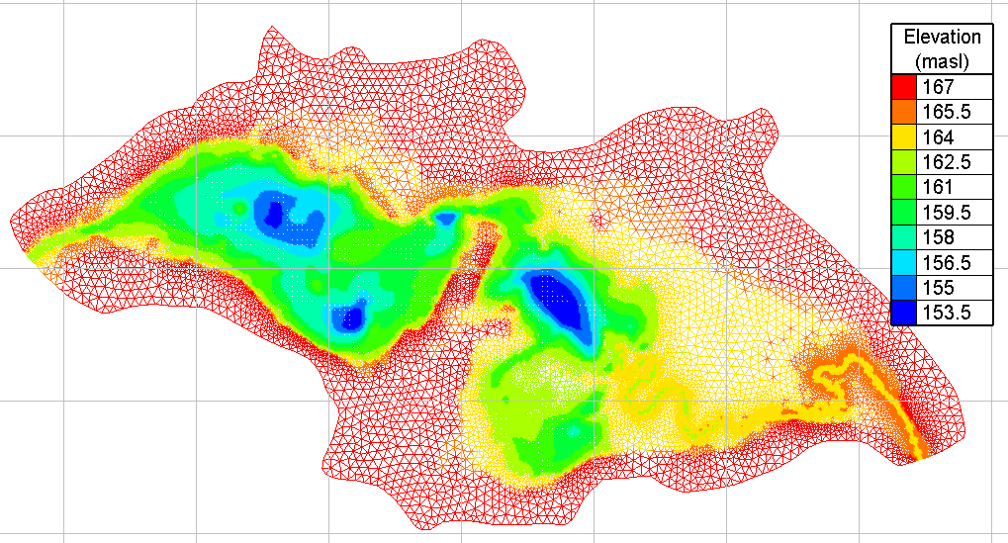
Methodology: Hydraulic model
7 bathymetry sets: 1974, 2004, 2019, 2020, 2021(3).
Telemac2D with BlueKenue for pre and post-processing (National Research Council Canada).
Initial condition: 5m³/s steady flow simulation.
Upstream boundary: Hydrograph.
Downstream boundary: State-discharge curve.

Slide 5
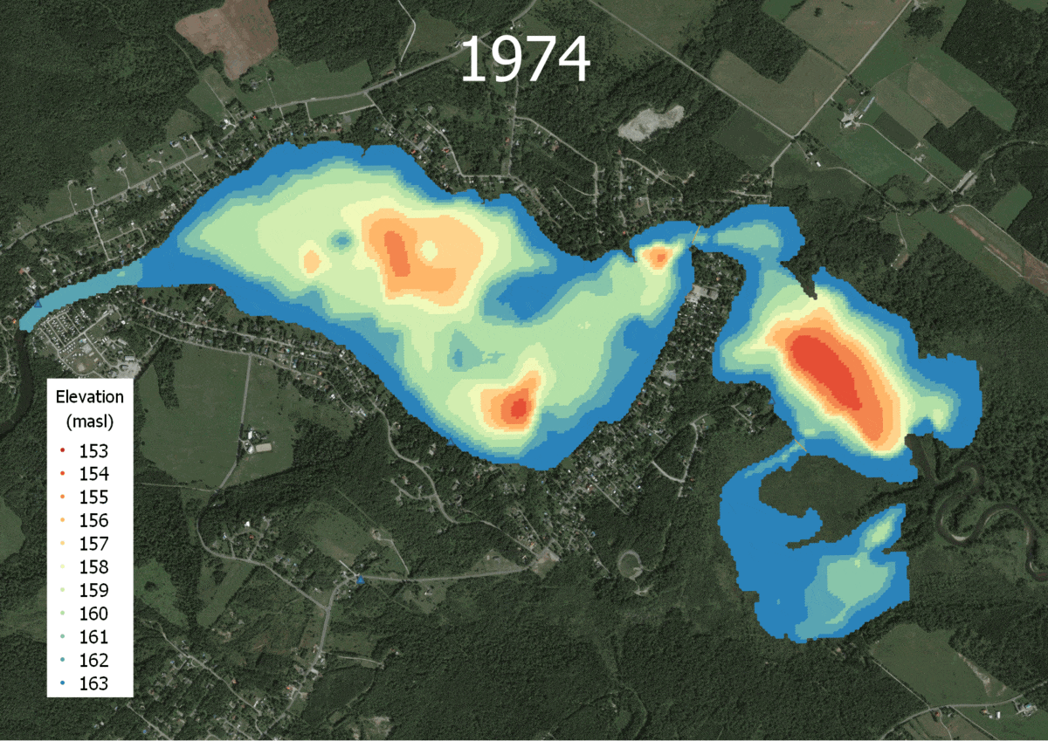
Results: Bathymetry comparison

Slide 6
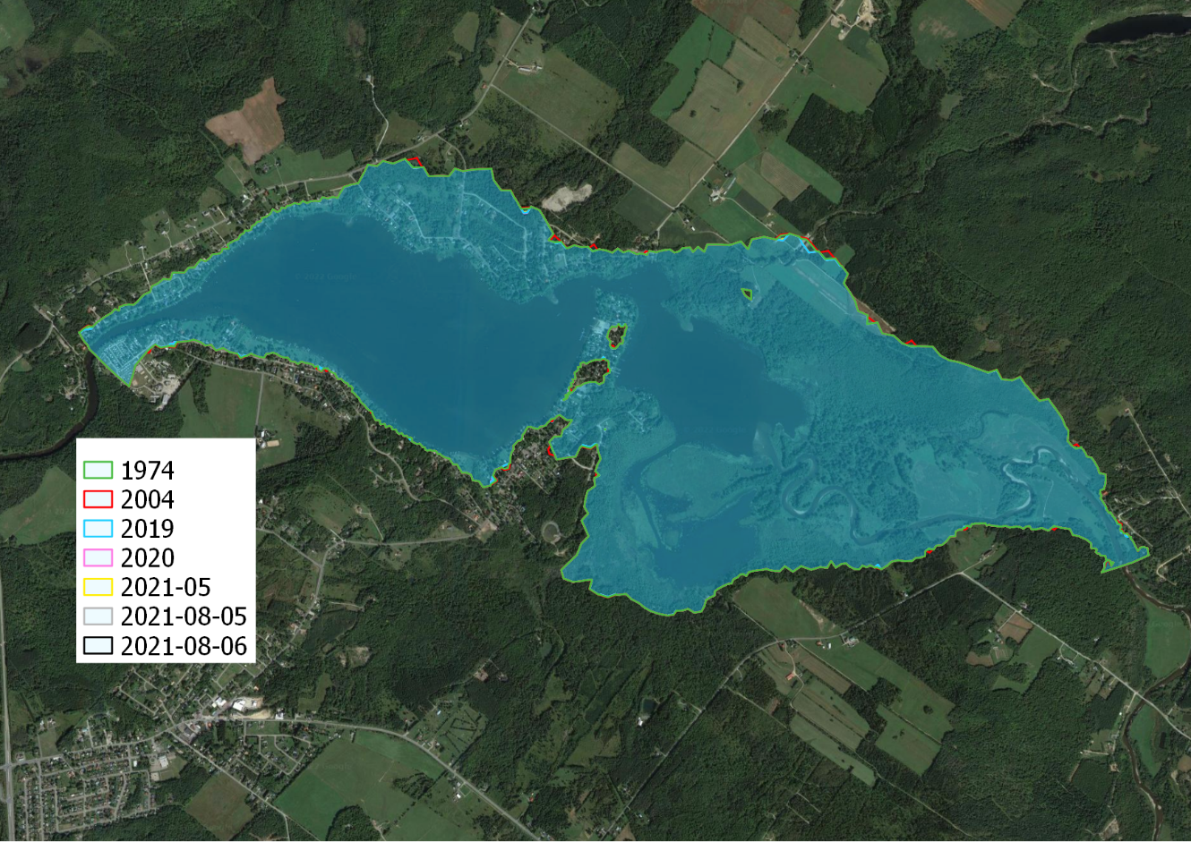
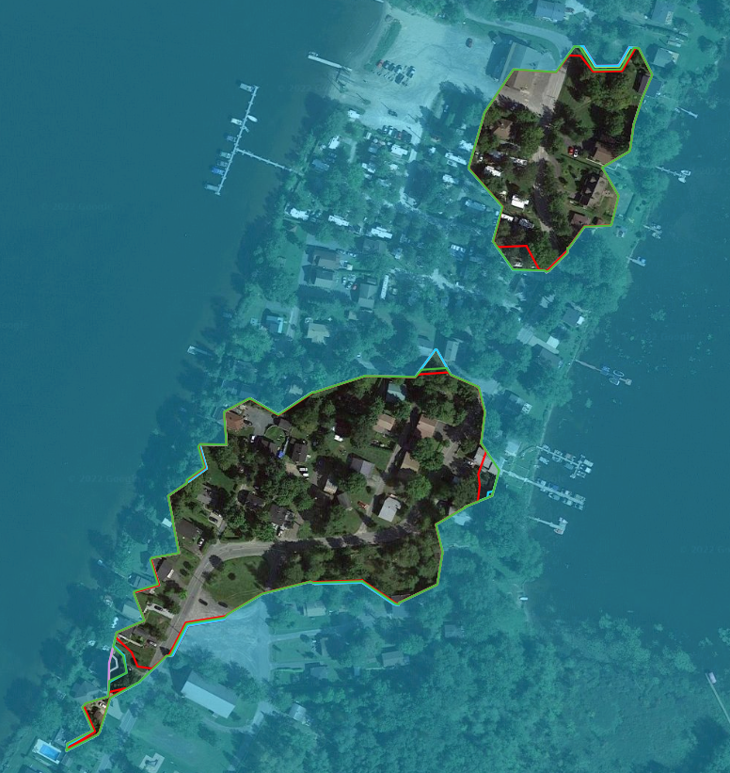
Results: Flood areas
Bathymetry | 1974 | 2004 | 2019 | 2020 | 2021-05 | 2021-08-05 | 2021-08-06
Extension (Ha) | 601.39 | 603.14 | 600.36 | 600.23 | 600.39 | 600.40 | 600.16
Max elevation (masl) | 167.51 | 167.56 | 167.48 | 167.47 | 167.48 | 167.48 | 167.47

Slide 7
ANALYSYS
The Trois-Lacs present important changes in bathymetry on the lakes that may be caused by sediment transport and shifting.
These bathymetry differences translate on proportional impacts on flood levels (centimeters) and extension (order of hectares) for the simulated conditions.

Slide 8
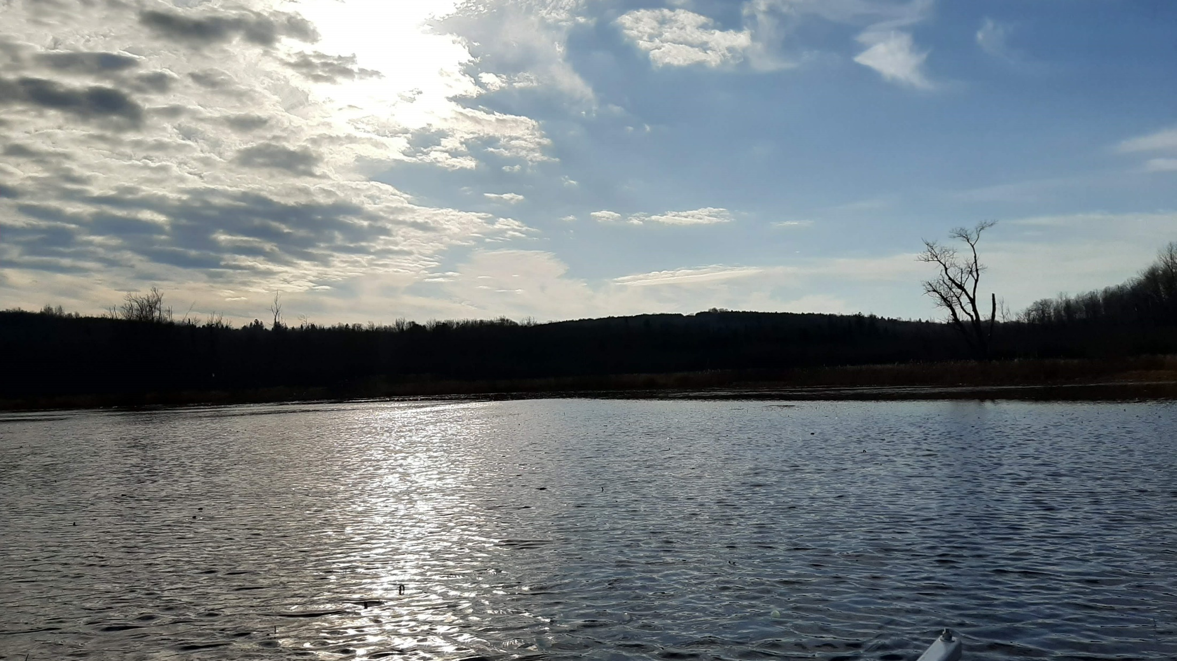
THANK YOU!
reds2401@usherbrooke.ca
Trois-Lacs, Val-des-Sources

