Slide 1
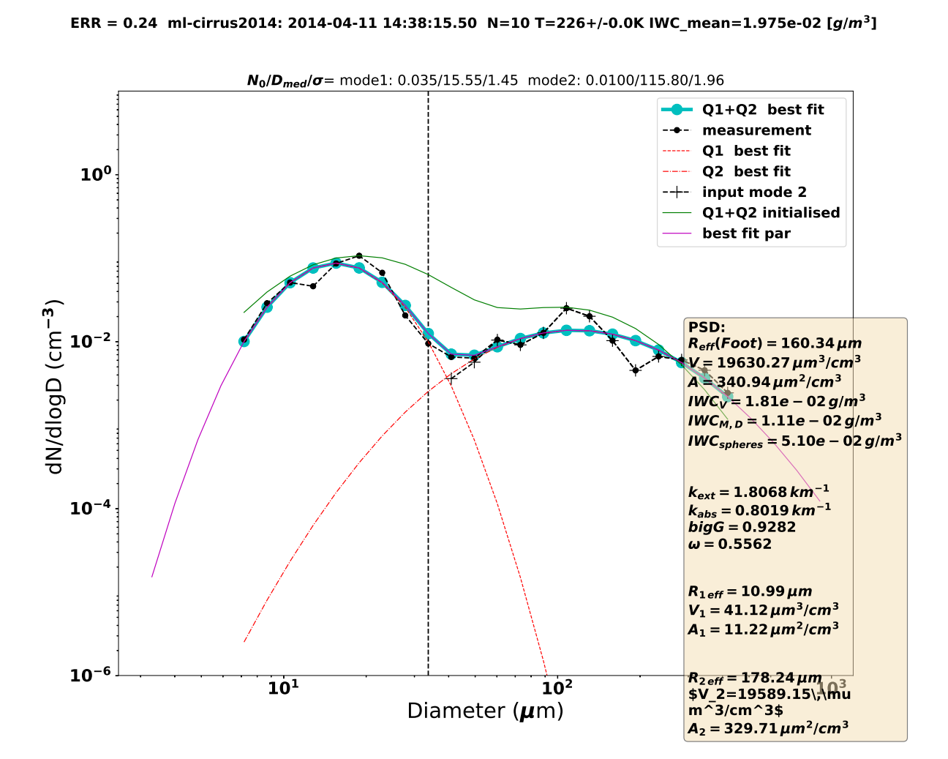
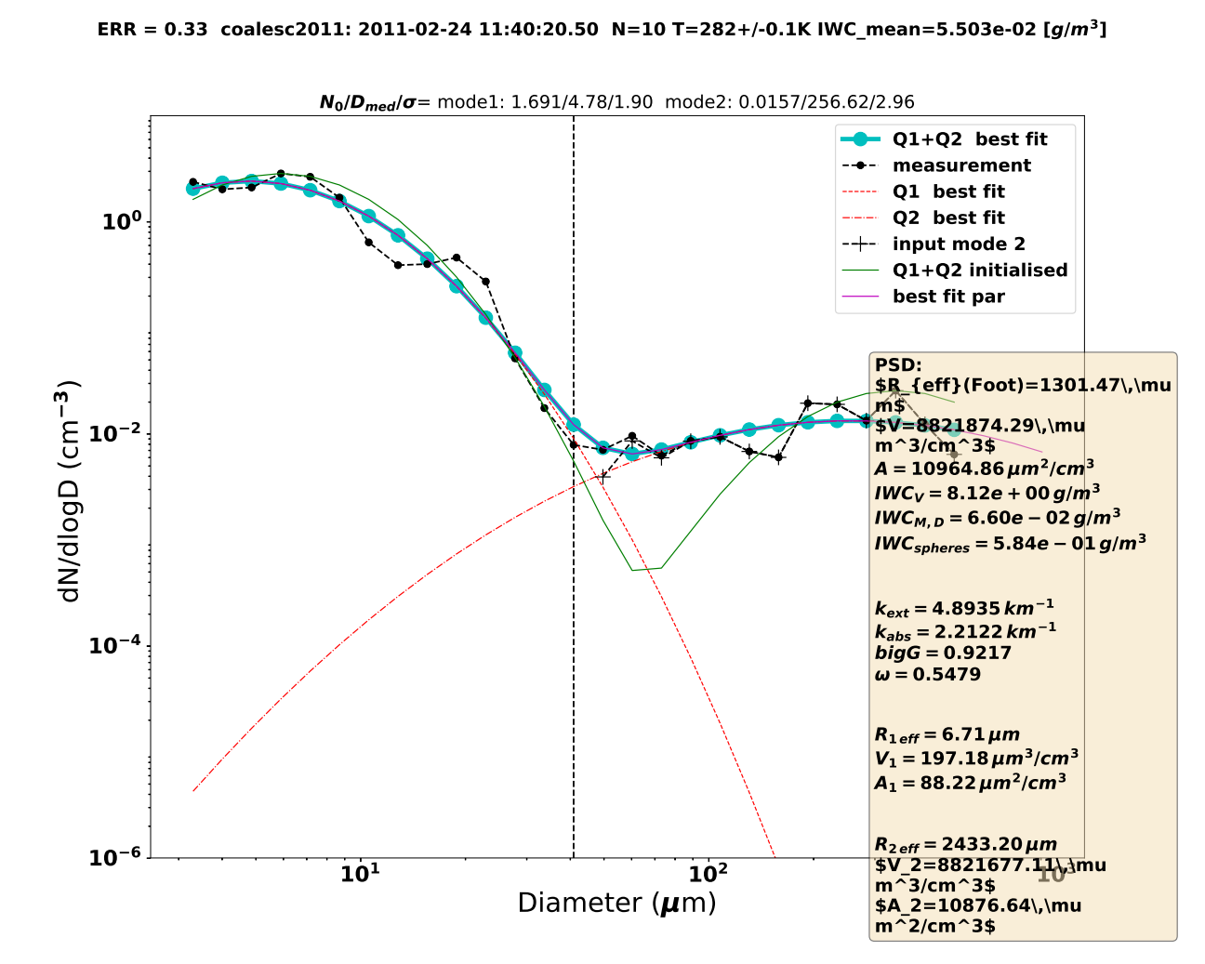
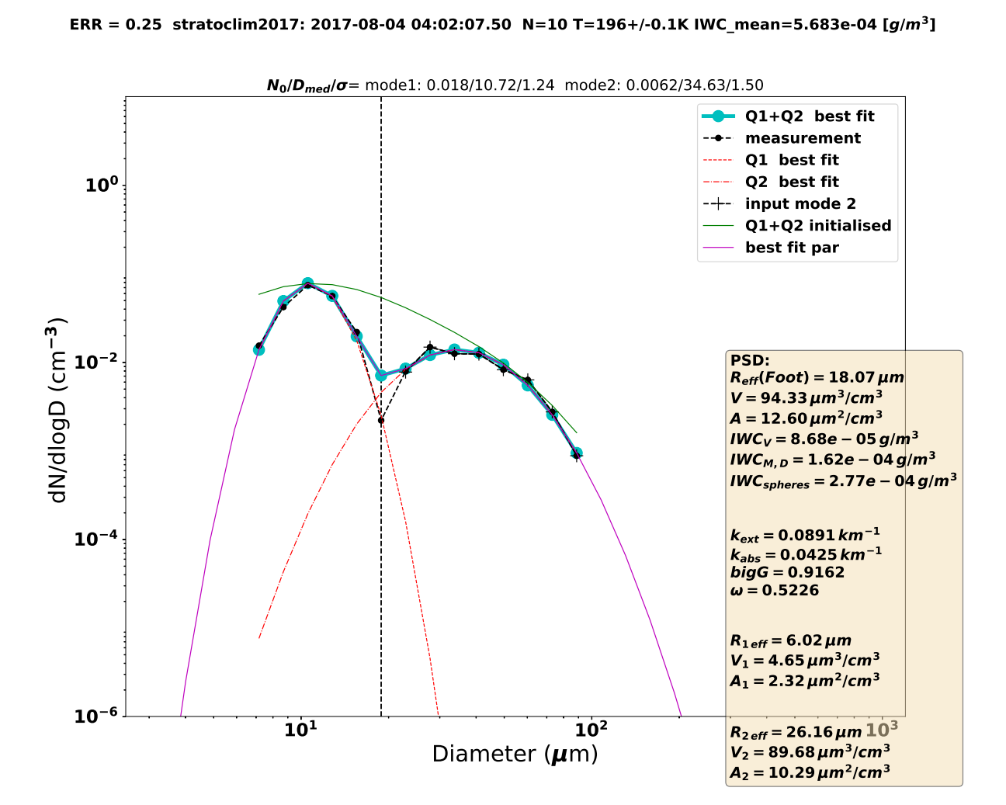
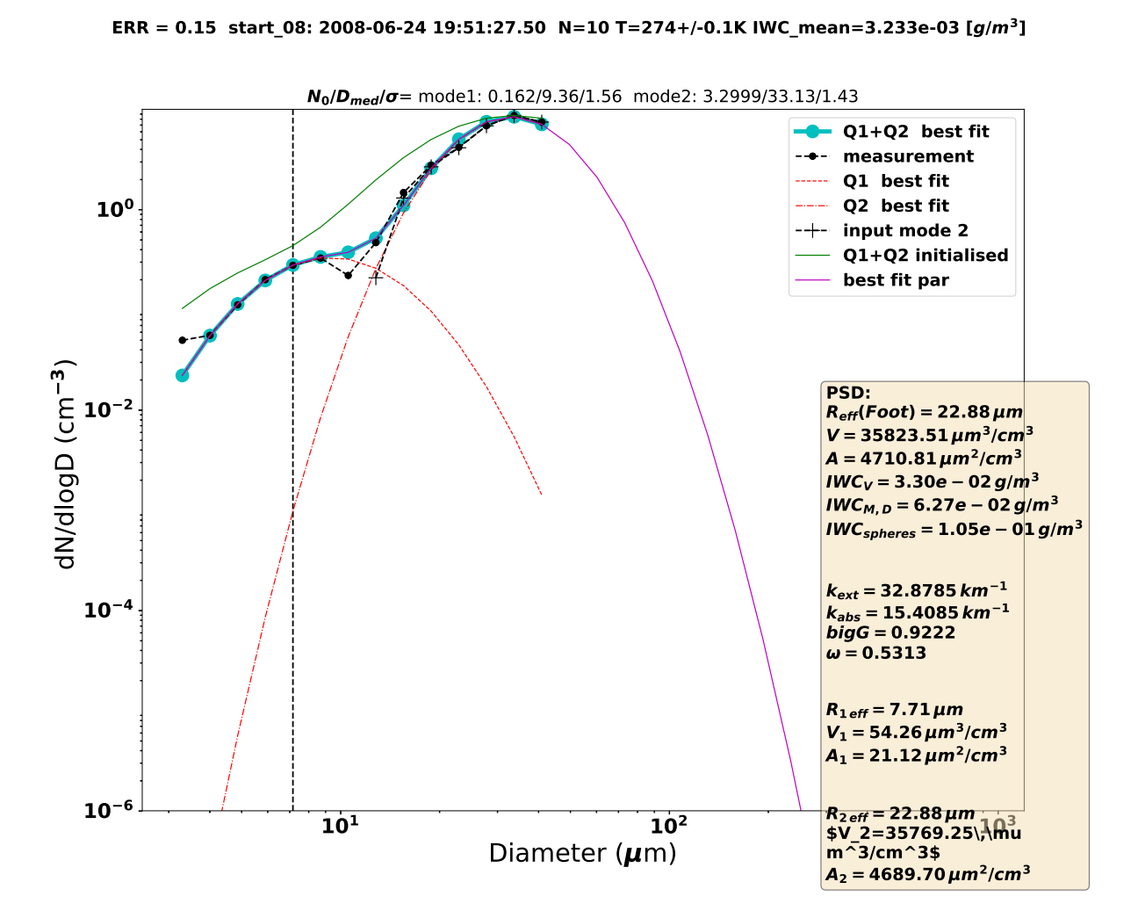
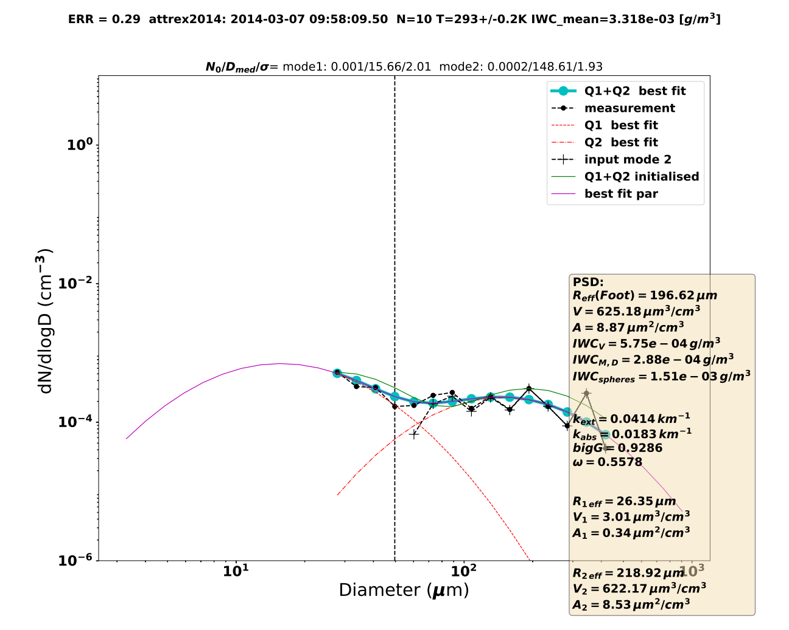
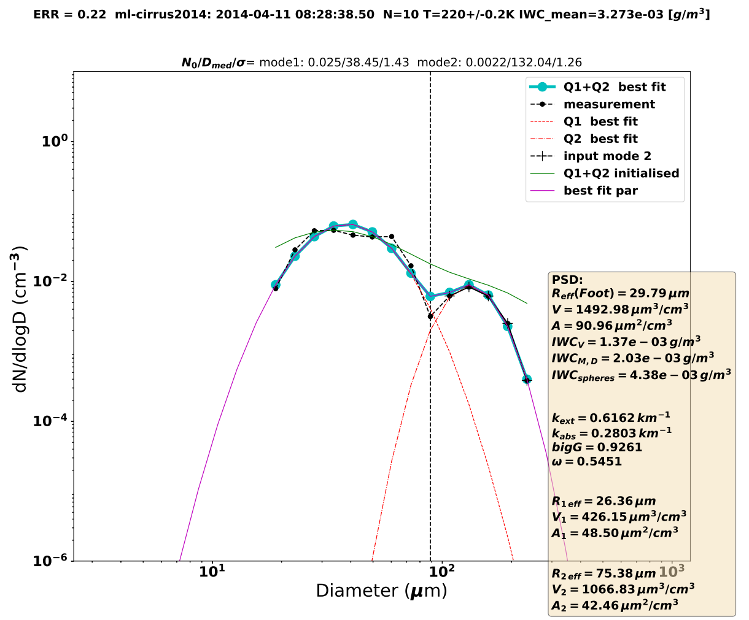
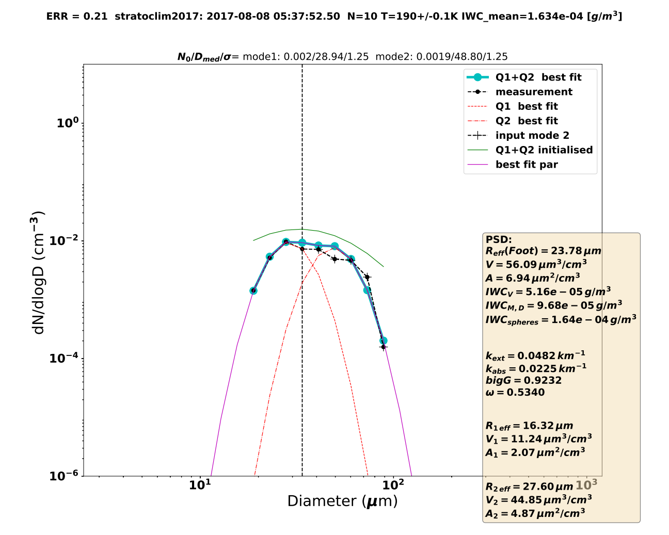
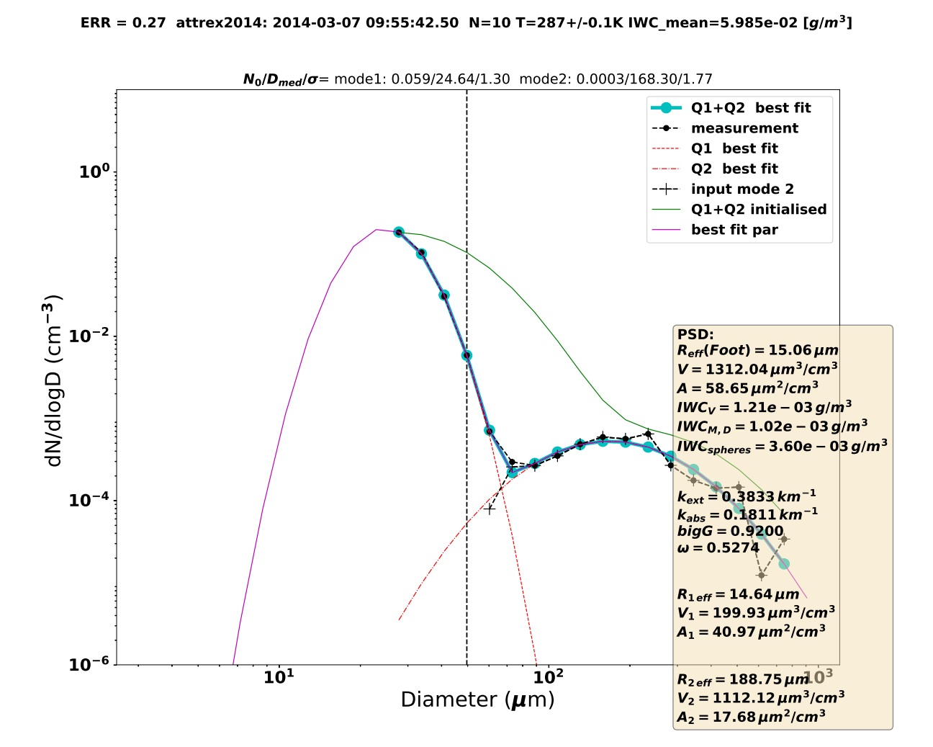
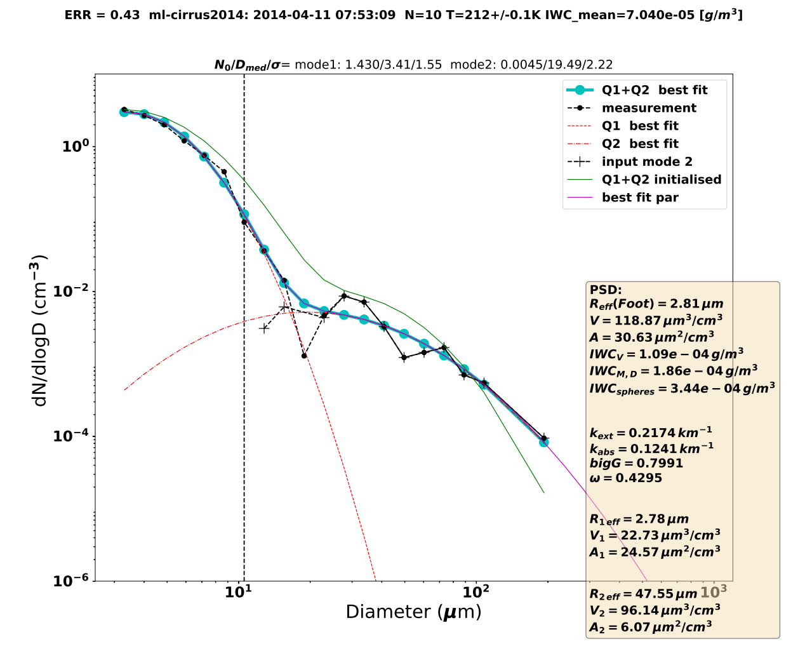
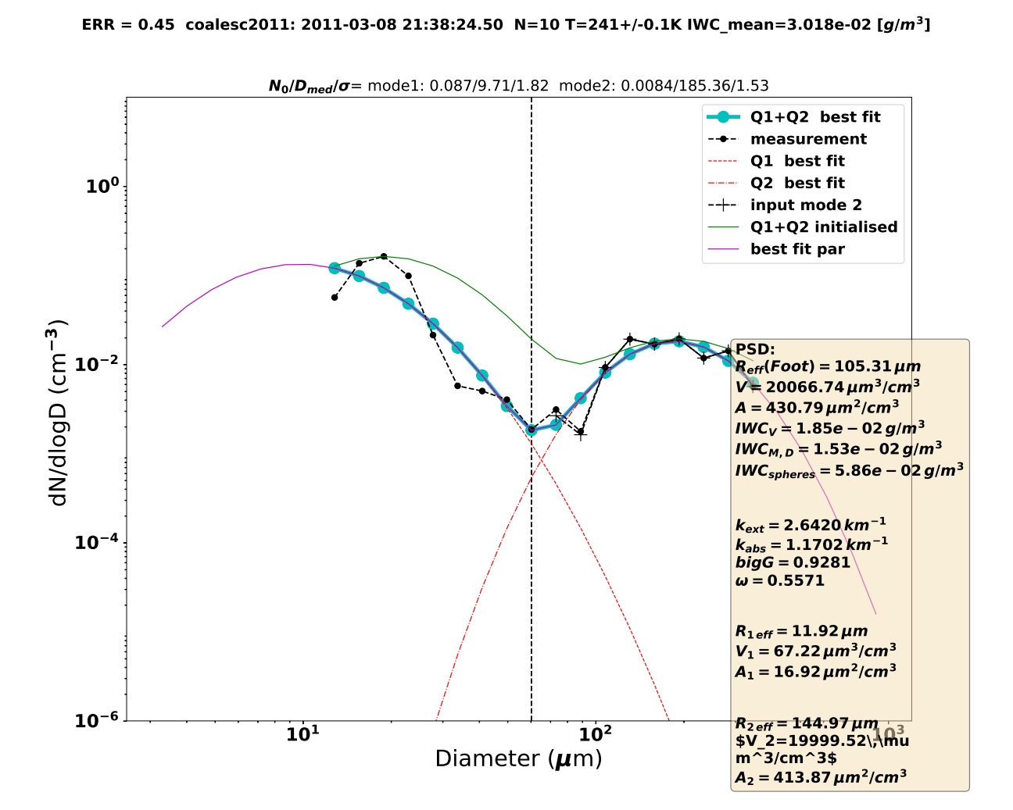
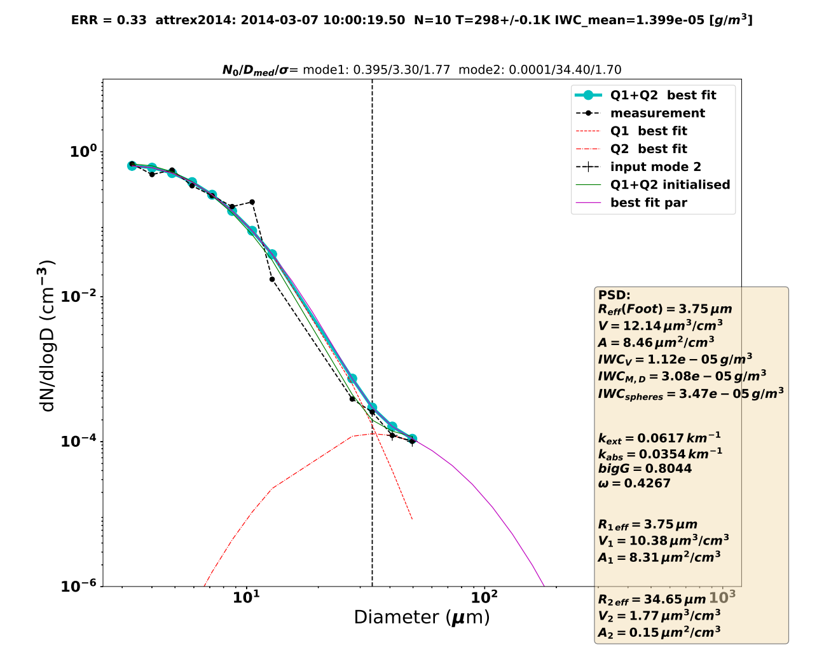
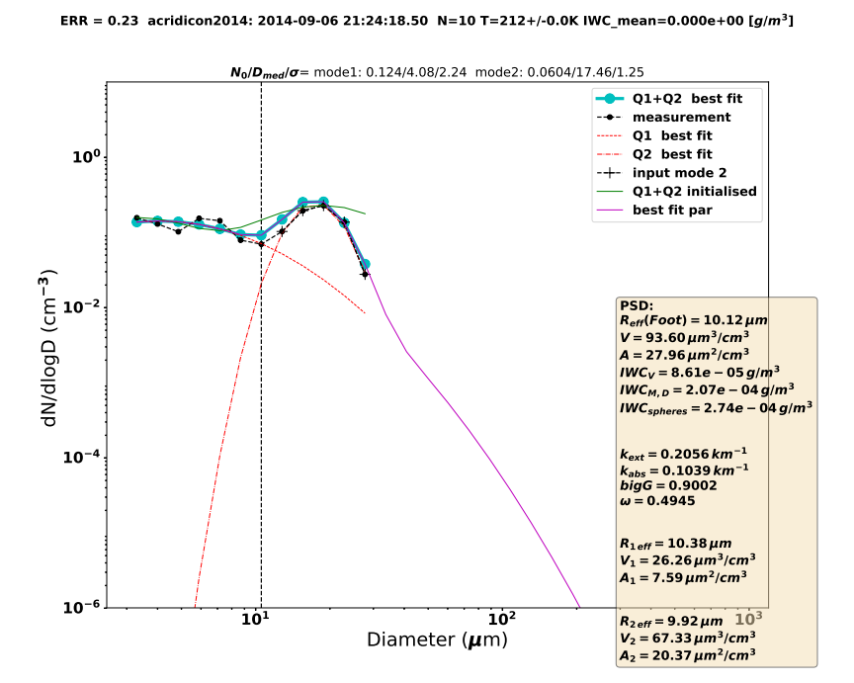
A database of microphysical and optical properties of thin to thick cirrus clouds derived from bimodal particle size distributions
Reinhold Spang¹, Nicole Spelten¹, and Martina Krämer^{1,2} AS-1.15
¹ Institute for Energy and Climate Research (IEK-7), Forschungszentrum Jülich GmbH, Germany EGU22-5382
² Institute for Physics of the Atmosphere (IPA), Johannes Gutenberg University Mainz, Germany
Extended Display Material Version

Slide 2
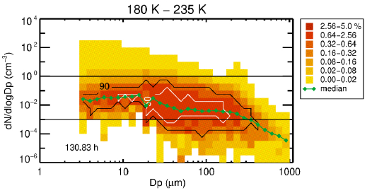
Motivation
JULIA
Why is bimodality of PSDs an issue ?
  different sedimentation velocities
  indicator for different formation mechanisms
  results in different particle shapes and scattering properties
  modifies radiative transport ⇒ effects retrieval results
  climate impact: e.g. via effective radius ⇔ warming/cooling
What do we like to present ?
  Results from the JULIA-DB with 8 out of 11 (s. Krämer et al. AS 1.15) campaigns, data are not affected by shattering, diameter down to 3 µm.
  Can we show or even better quantify the importance of the bimodality?
  Are there significant difference between tropical and mid-lat cirrus?

Slide 3
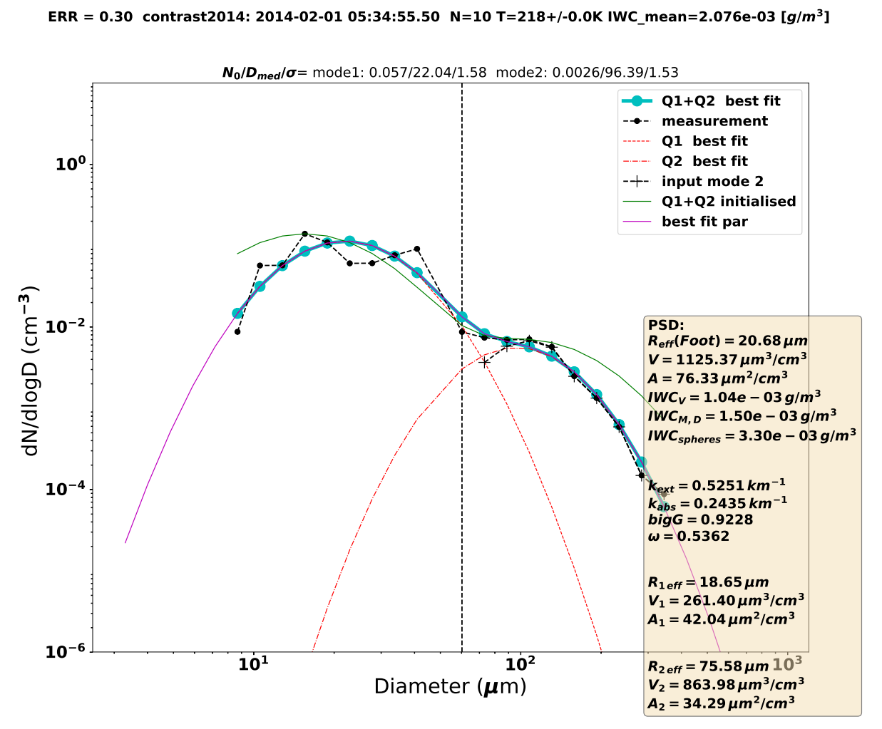
Methodology
… shift …
‘keep it simple’, but does it really fit?
Method of Jonasz & Fournier (1996) to fit multi-modal log-normal marine PSDs. Iteration process & minimizing error.
Python tools: LMFIT with Nelder&Mead optimization method
PyMieScatt library for Mie-scattering (Sumlin et al., JQSRT 2018)
How to check your fit:
For some - better say many - PSDs it is tricky to find a proper fit
Never believe your computer program fitting a PSDs, try visual inspection.
Define a cost function optimized with respect to ‘what you like to get’ (PSD, volume/IWC, area density, one, two, or even more modes - shift).
Which ‘PSD’ shall we fit? Temporal or IWC-T space mean?
J&F96:
fit ⇒

Slide 4
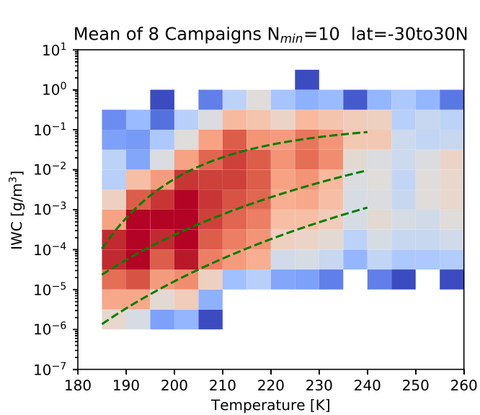
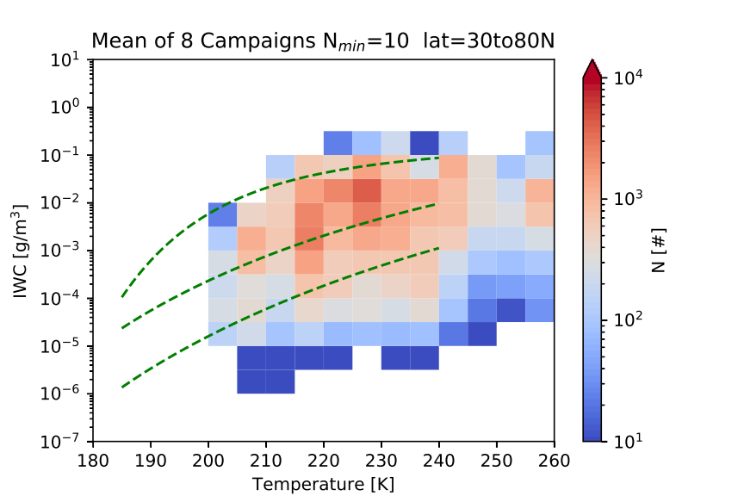
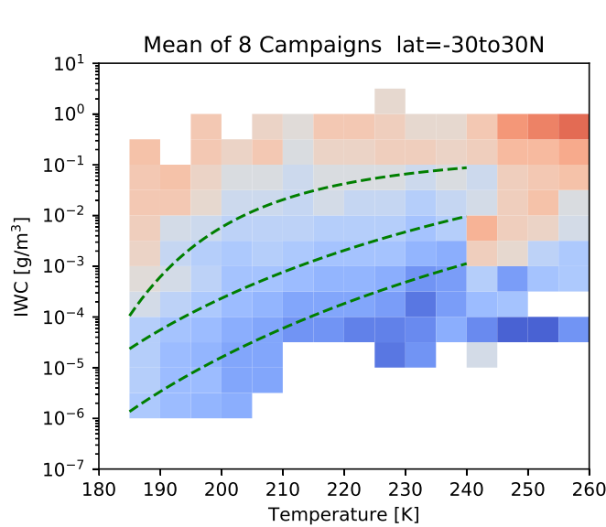
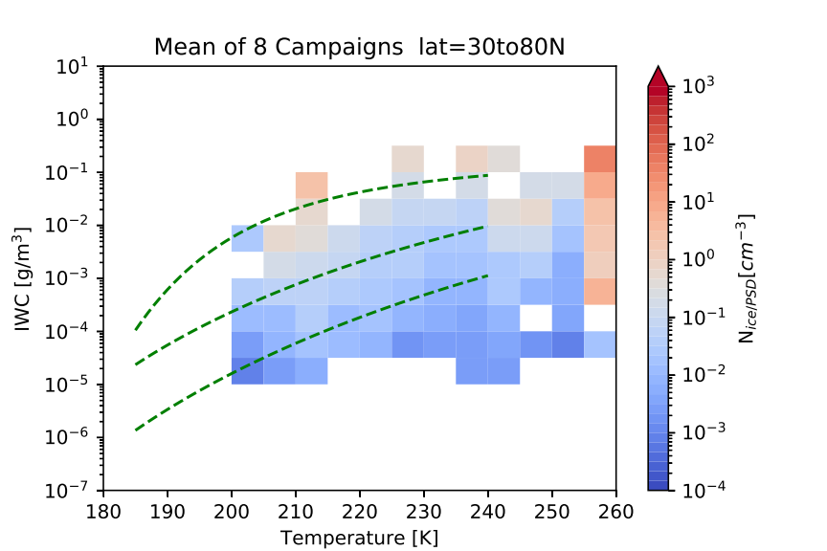
Mean PSD results
tropics mid-lat
Counts > 500,000 PSDs in total
Excellent coverage of parameter space:
  Extinction 10⁻³ to 10¹ km⁻¹ (@ 830 cm⁻¹)
  IWC – Temperature gird space (10⁻⁶ to 10 g/m³ and 185<T<235K)
  Up to >10000 PSDs per grid-box
  Green lines: Schiller et al. (2008) median IWC in situ measurements
# counts
# counts
Particle number density N
  Range: 10⁻⁴ to 1 (10) cm⁻³
  Weak temperature dependence
N [cm⁻³]
N [cm⁻³]

Slide 5
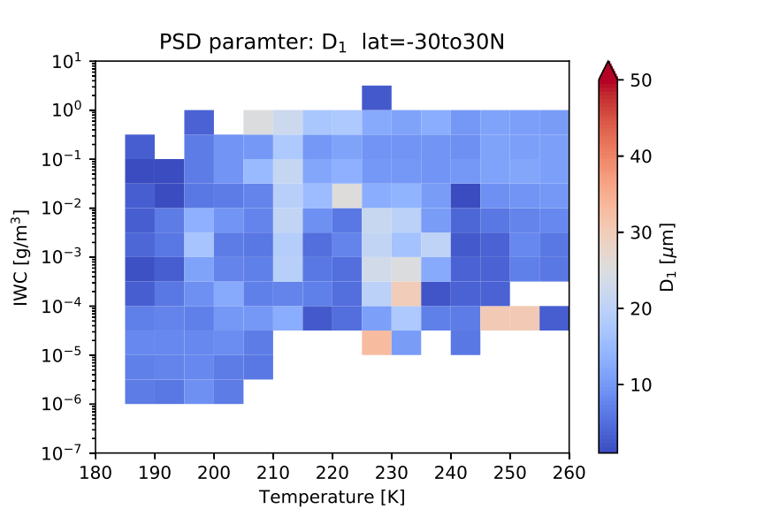
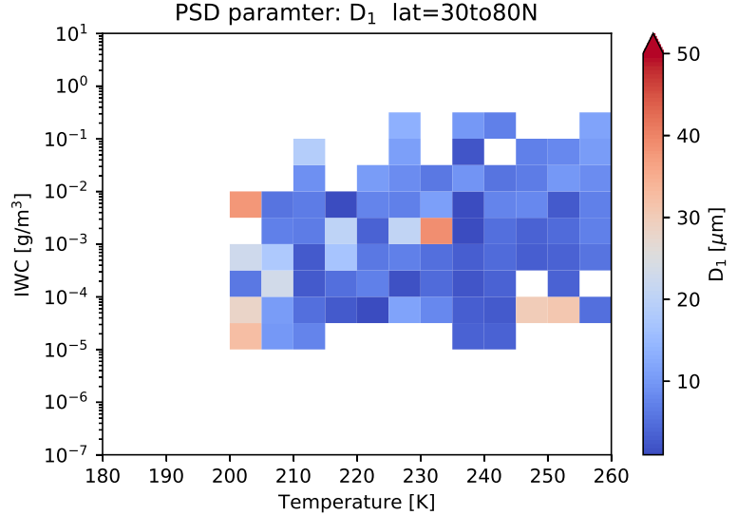
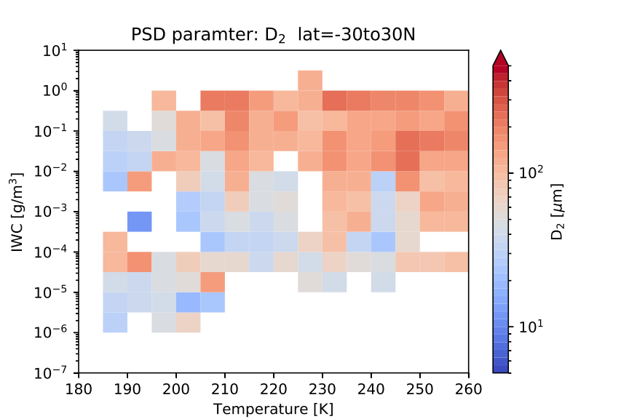
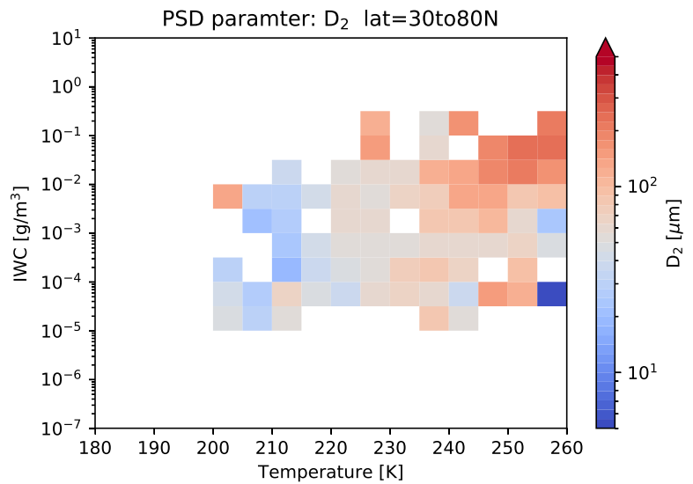
Bimodality:
tropics mid-lat
Comparison of Mode 1 and 2
D₁ shows:
  tendency for larger particles at low IWC and low T than for high IWC
  less variability in the tropics (less problems with the fitting)
D₂ indicates:
  gaps for mono-modal distributions
  similar size range for tropics and mid-lats
  Single 10s PSD analysis would be helpful (s. display material)
D₁ [µm]
D₁ [µm]
D₂ [µm]
D₂ [µm]

Slide 6
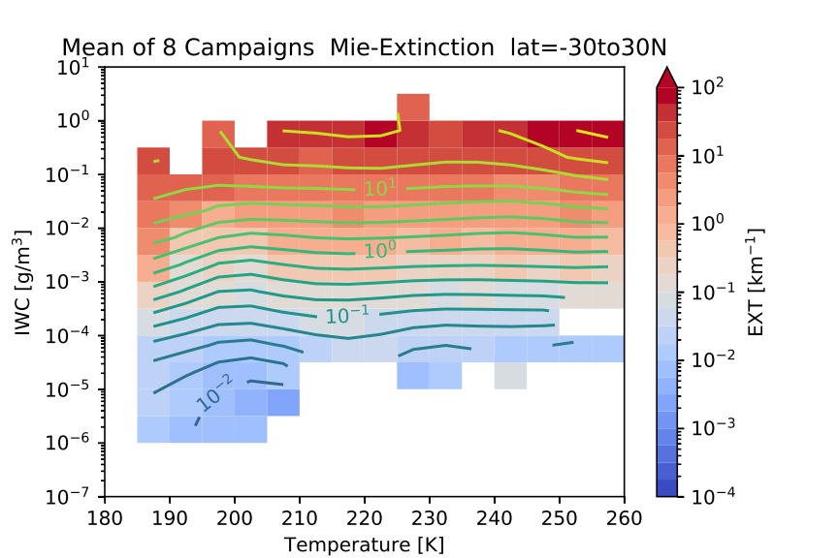
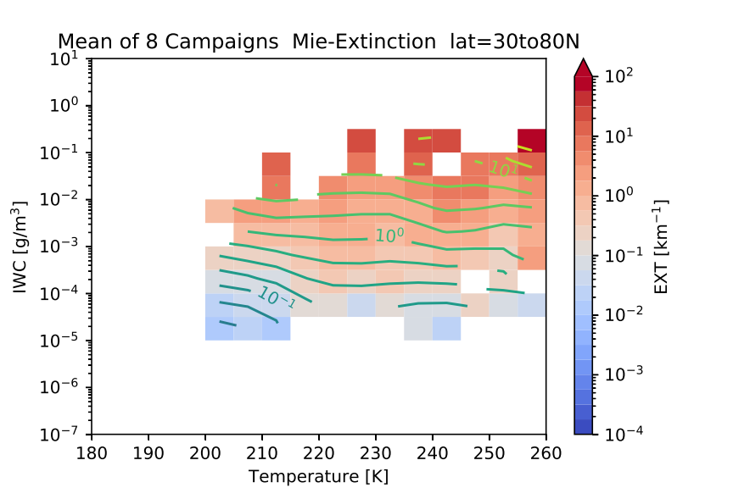
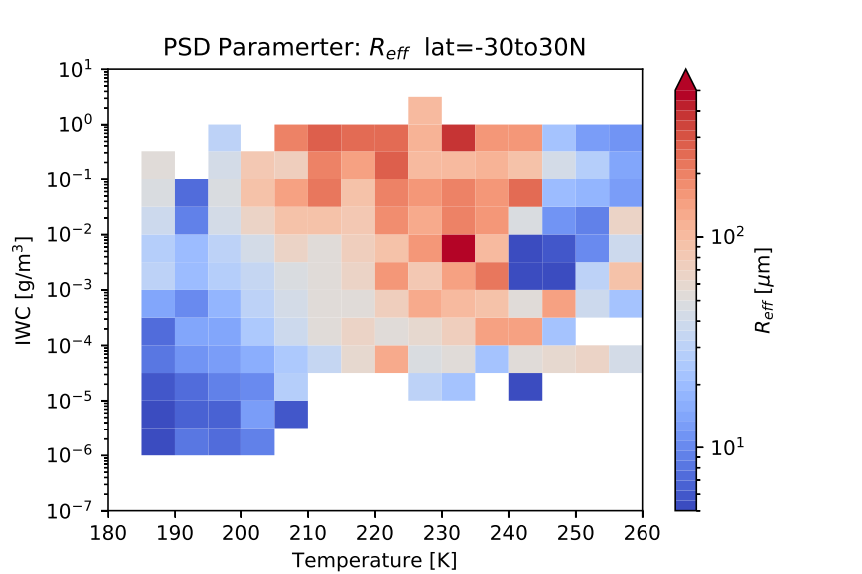
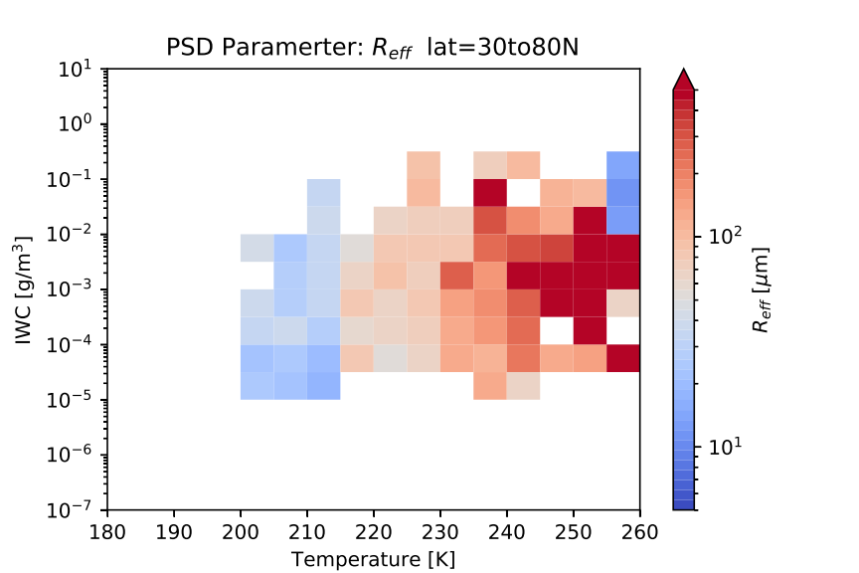
More mean PSD results
tropics mid-lat
So far habit mixtures for specific bulk properties are not considered.
Extinction
  smooth horizontal contours ⇒ small temperature dependency
  coldest (extremely low IWC) cirrus show lowest extinctions
  Optically ultra thin cirrus <10⁻³ km⁻¹
Effective Radius (R_{eff} = 3V/A)
  considering distribution width and more related to scattering processes
  For bimodality: following Foot et al. (1988) or Mitchell (2002)
  R_{eff} = f (T,IWC) is significant.
EXT [km⁻¹]
R_{eff} [km⁻¹]

Slide 7
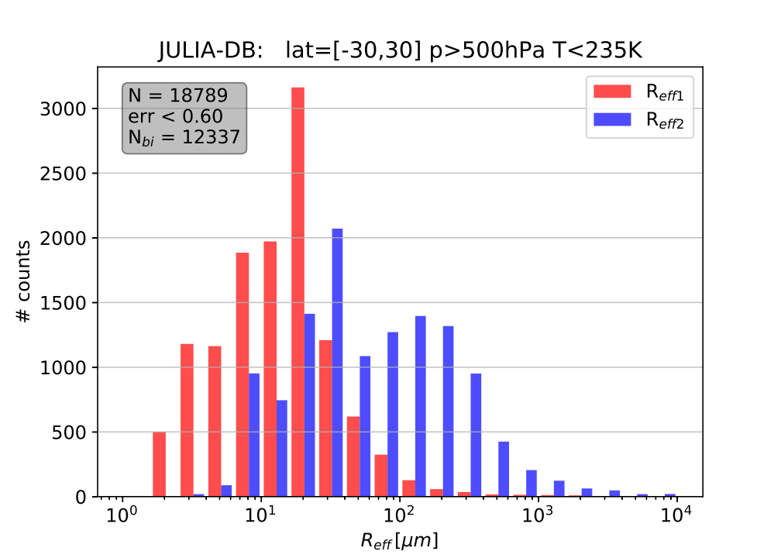
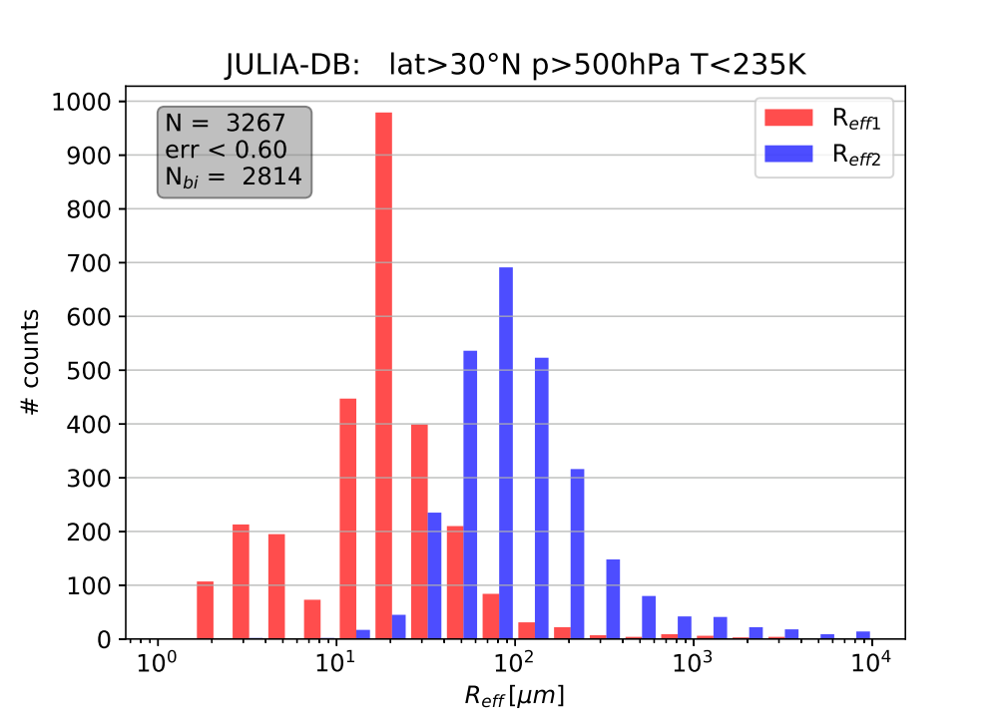
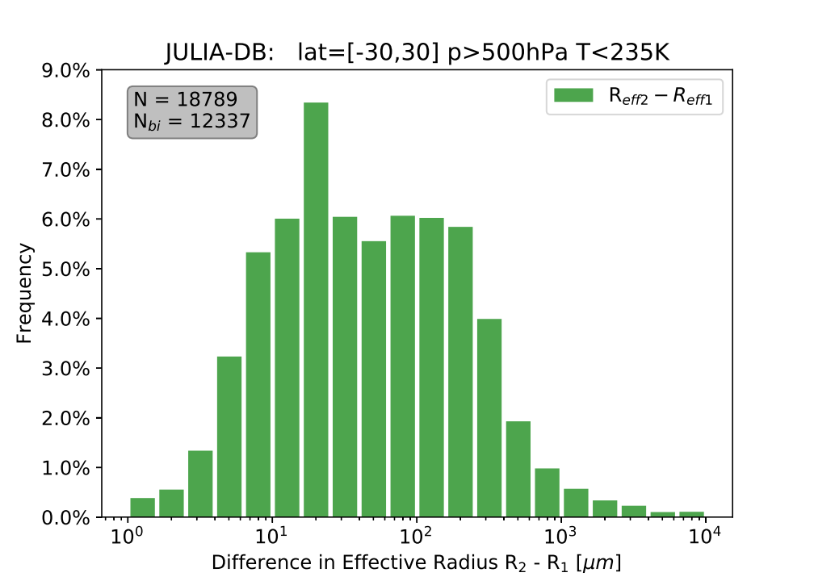
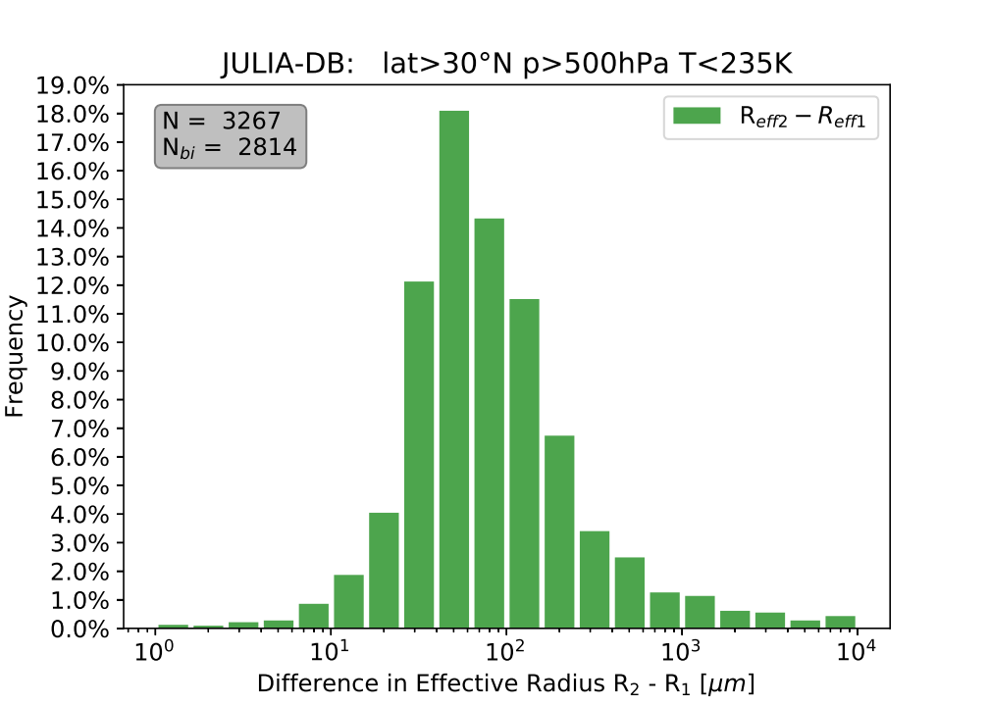
10s PSD mean statistics I
tropics mid-lat
Mean over maximum 20s and 10 PSDs for detection & consideration of the variability in the PSD shape
R_{eff}: for bimodality by following e.g. Foot et al. (1988) but here single R_{eff1/2} defined by log-normal distribution
  obviously different behavior between tropics and mid-lat
Effective radius difference
  @ mid-lat: dR ~ 100 µm
  @ tropics: dR_{S} < ~20 µm and dR_{L} > ~150 µm
  mode1 & 2 are closer for mid-latitudes
R_{eff}
R_{eff}
R_{eff2} – R_{eff1}
R_{eff2} – R_{eff1}

Slide 8
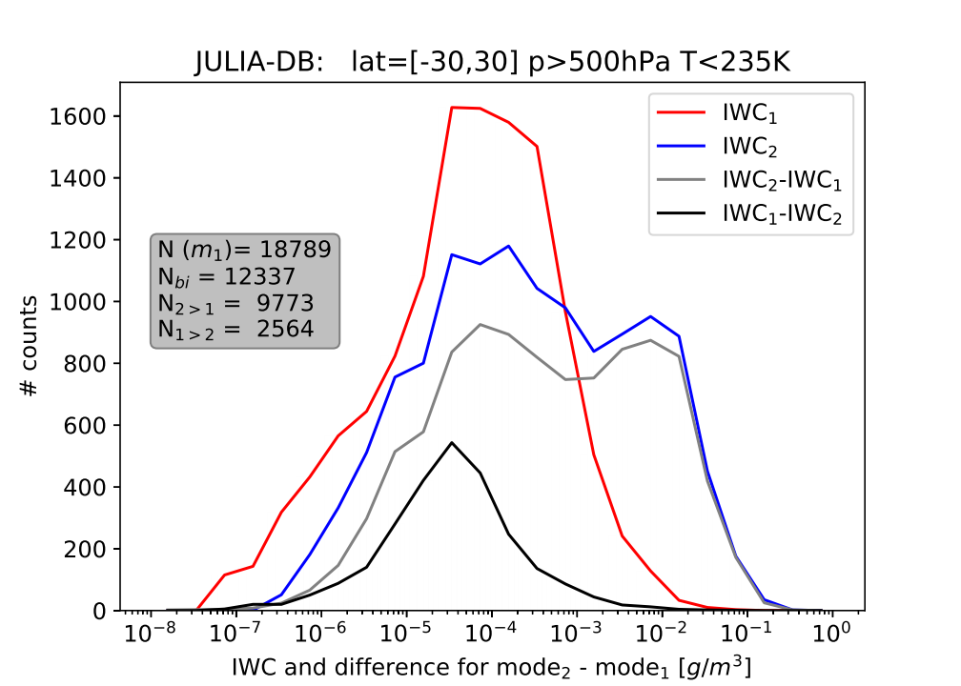
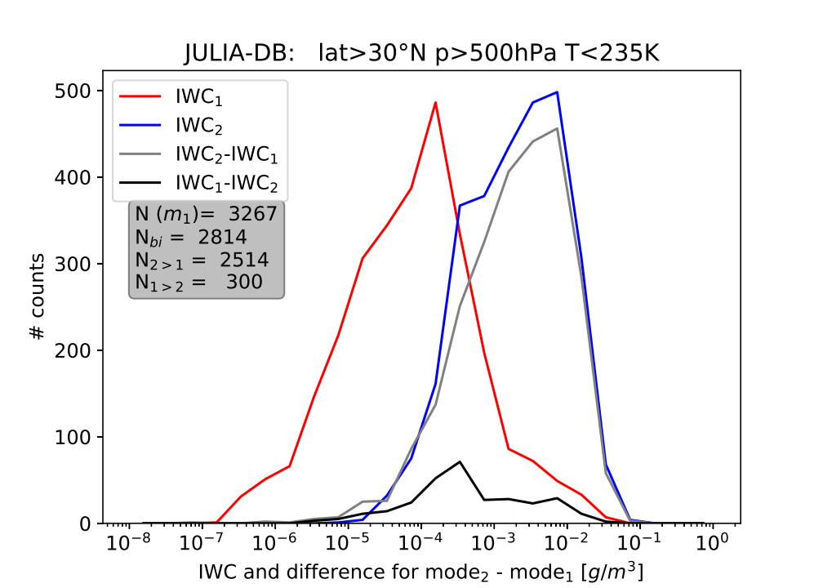
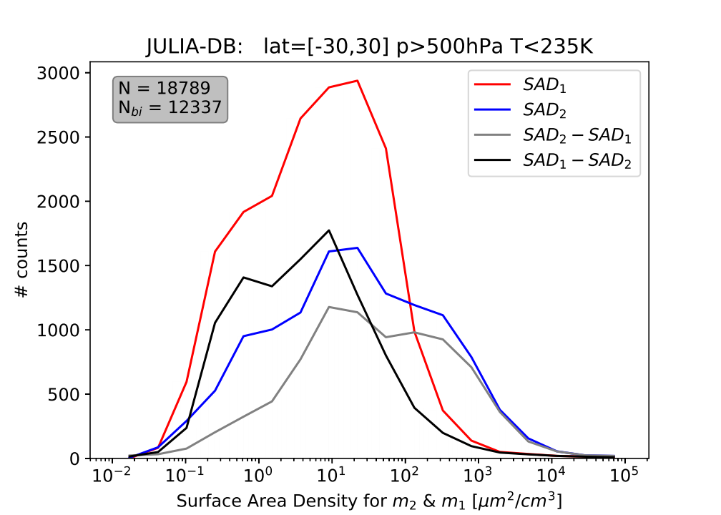
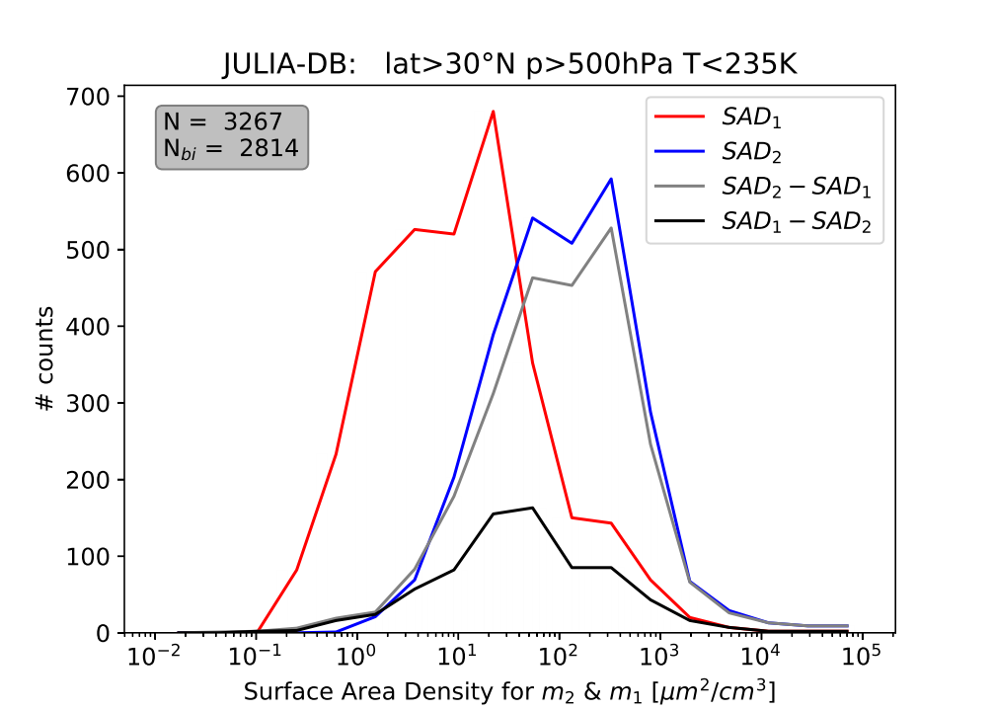
10s PSD mean statistics II
tropics mid-lat
IWC: obviously different behavior between tropics and mid-lat
  mode₁ can dominate mode₂ for 20% in the tropics and 9% at mid latitudes
  More narrow IWC range especially for mid-lat mode 2
Surface Area Density mode1/2
  Similar behavior like IWC, but in the tropics mode 1 appears with similar frequencies compared to mode 2
IWC
IWC
SAD
SAD

Slide 9
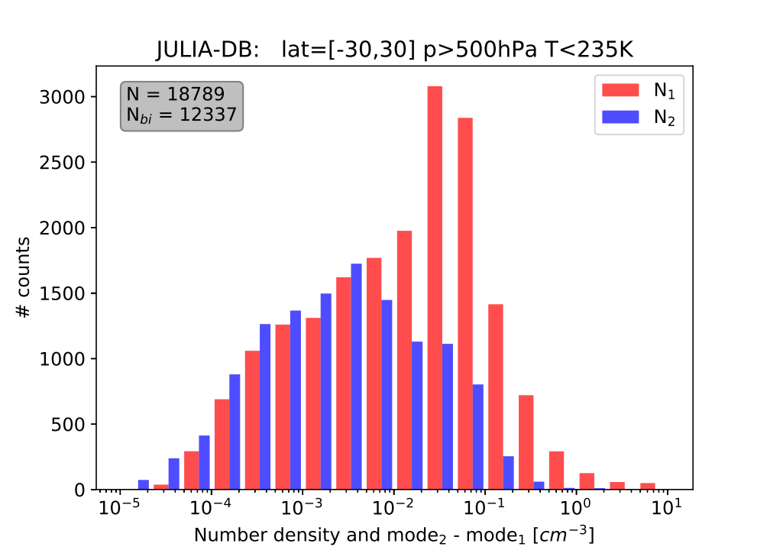
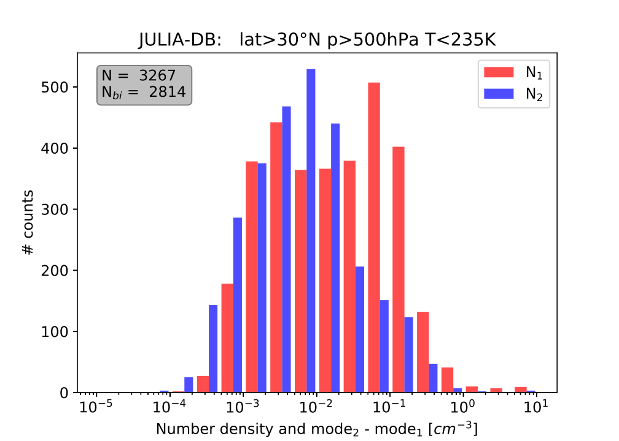
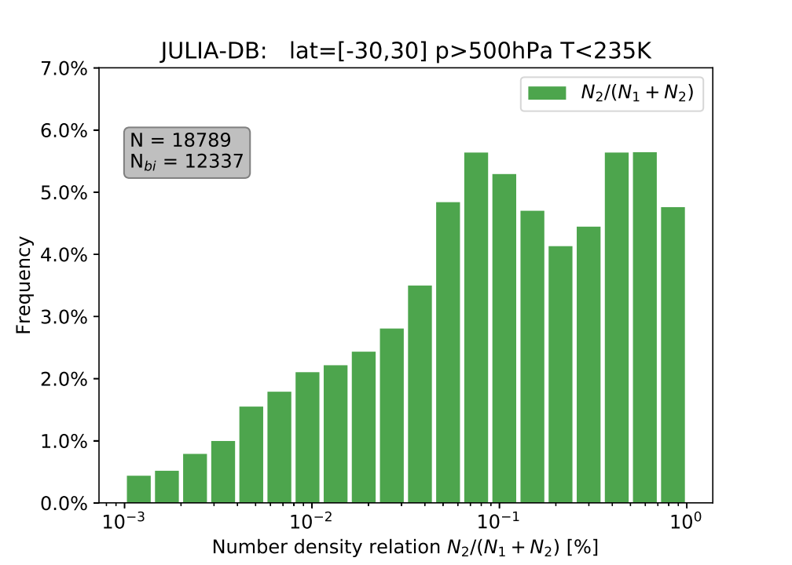
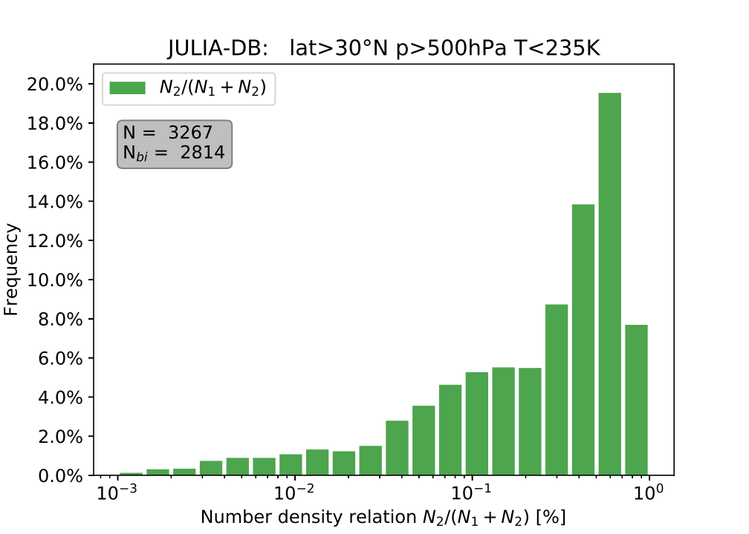
10s PSD mean statistics III
tropics mid-lat
Number density N:
  tropics: show smaller N’s, but mode 1&2 are very similar up to ~10⁻² cm⁻³. Large peak be mode 1 only PSDs.
  Mid-lat: similar but narrower distribution, but mode 2 can dominate in the 10⁻² cm⁻³ range
Number density partitioning:
  Mid-lat show again a significant different behavior to the tropics
  ‘bi-modal’ in the tropics
  Mid-lat: large fraction of PSDs is dominated by N₂
N [cm⁻³]
N [cm⁻³]
N2/(N1+N2)
N2/(N1+N2)

Slide 10
Summary & Outlook
Bimodality of cirrus PSDs is certainly an important issue:
  Mid-lats have the tendency to closer distance of D₁-D₂ and R_{eff1}-R_{eff2} than the tropics
  R_{eff} significant f (T/IWC) relation
  IWC: mode 1 can dominate mode 2 (20/10% trop/mid lat)
Next steps:
  make use of the complete database (but exclusion of contrails)
  make use of single PSD means (5-10s) under rather constant conditions ((T, p)=const)
  better representation of PSD variability for a IWP-T grid box
  computation of scattering properties DB of fitted PSDs (T, IWC)
  model application: PSDs parameterizations in the T-IWC space
D₁ [µm]
IWC mode1/2 PDF : tropics

