Slide 1





Hard-coupling of water and power system models increases the complementarity
of renewable energy sources
Rachel Koh¹, Jordan Kern², Stefano Galelli¹
[EGU22-5384]
(1)
(2)

Slide 2
Solar
Wind
Water management model
Available hydropower
> Dispatched
Power system model
Forced curtailment
Electricity “oversupply”
Grid congestion
Notes:
plot_hyd_solar_hr()

Slide 3





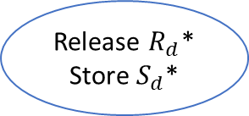
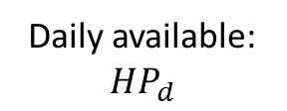
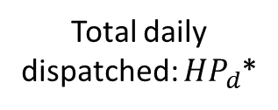

Solar, Wind, Load, Thermal plant properties
$$Q, S_{d−1}$$
Water management model
Power system model
Release $R_{d}$*
Store $S_{d}$*
Release $R_{d}$
Store $S_{d}$
oil
coal
hydropower
other renewables
Daily available: ${HP}_{d}$
Total daily dispatched: ${HP}_{d}$*
Re-operation model
Hydropower fully utilised?
implement
implement
☑ ${HP}_{d}$* = ${HP}_{d}$
☒ ${HP}_{d}$* < ${HP}_{d}$
Re-operate reservoir

Slide 4
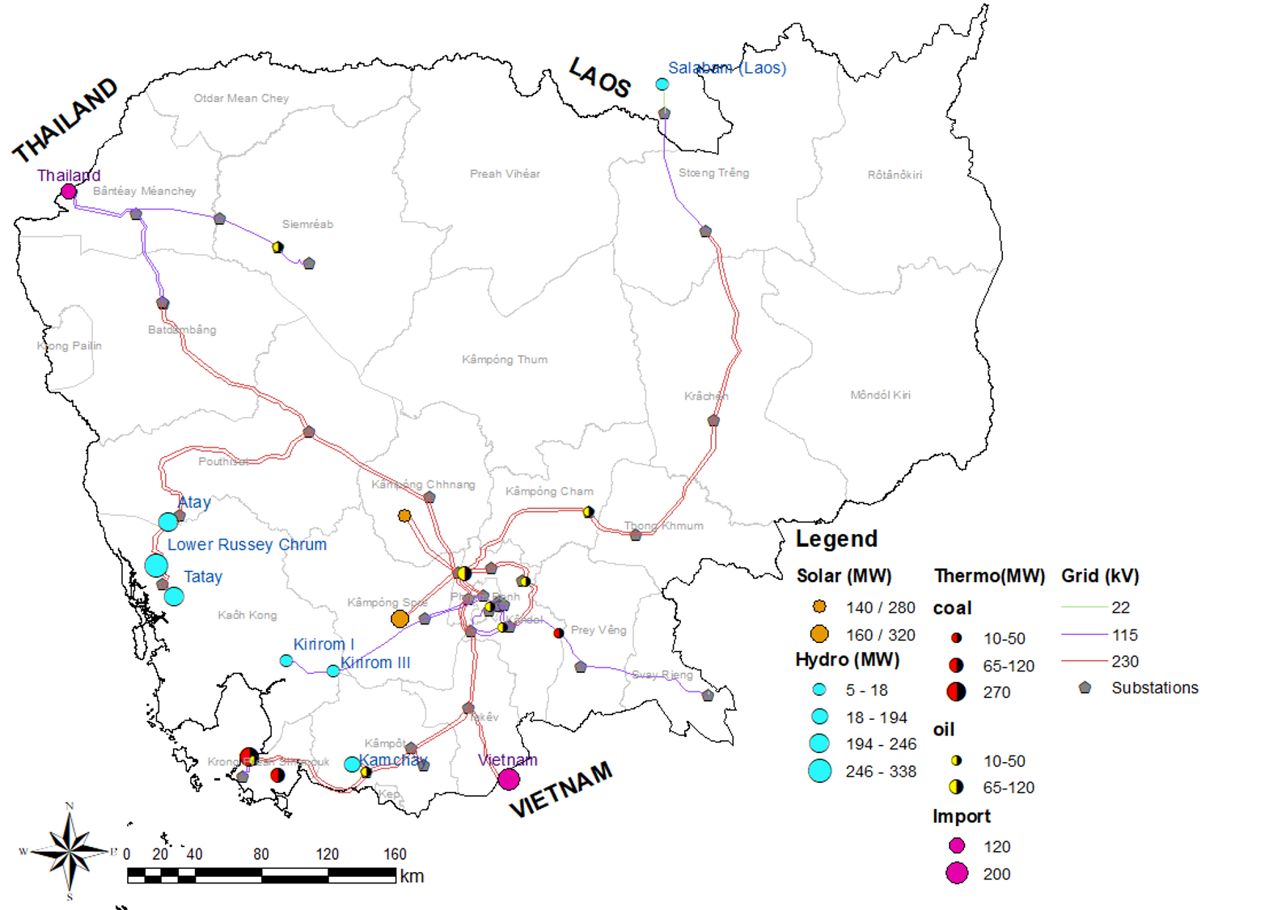
Notes:
plot_hyd_solar_hr()

Slide 5
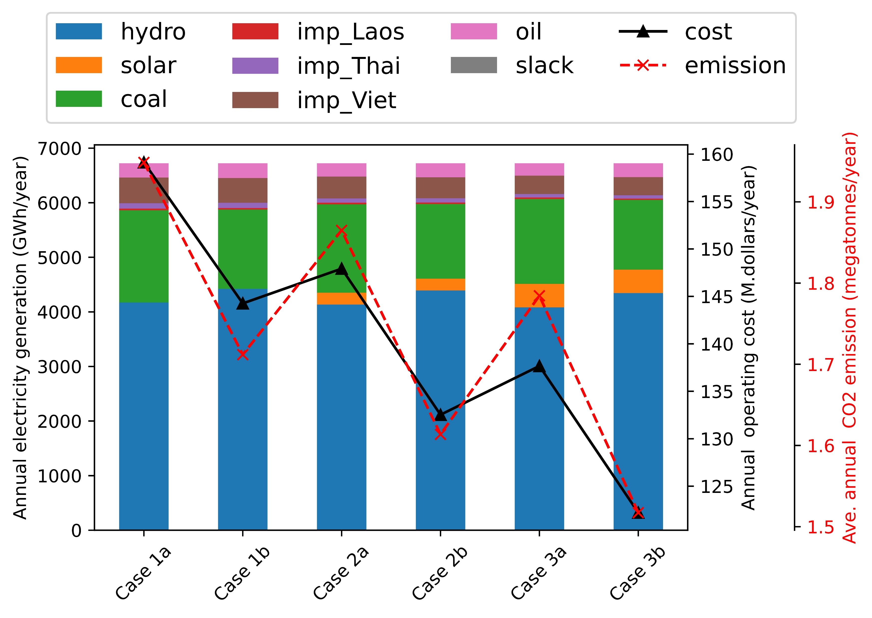
Solar | - | - | 300 MW |  | 600 MW
Feedback |  | ✓ |  | ✓ |  | ✓
Notes:
plot_hyd_solar_hr()

Slide 6
Conclusions
Operational flexibility
Lower operating costs
Lower CO₂ emissions
Test management and planning solutions

Slide 7
Thank you!
Contact us:
rachel_koh@mymail.sutd.edu.sg
https://people.sutd.edu.sg/~stefano_galelli/

