Slide 1
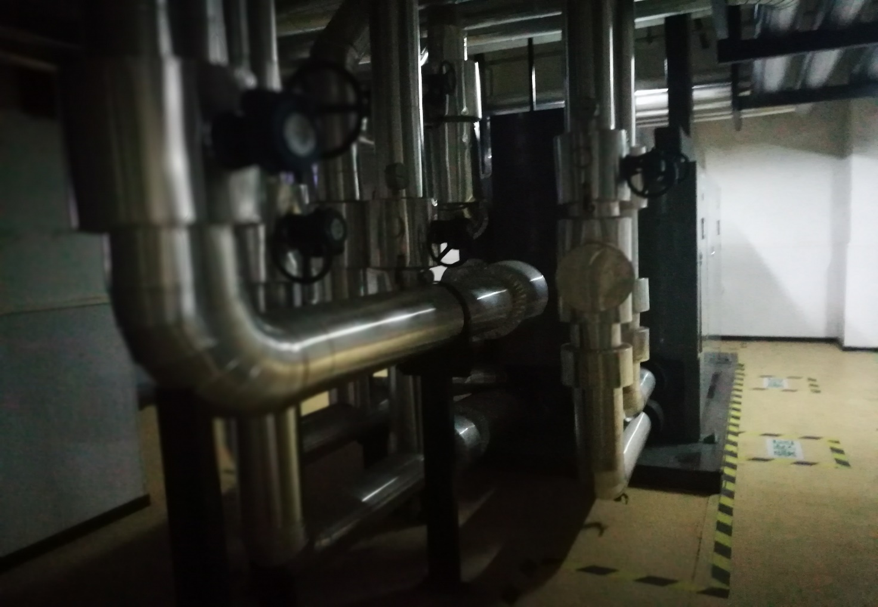
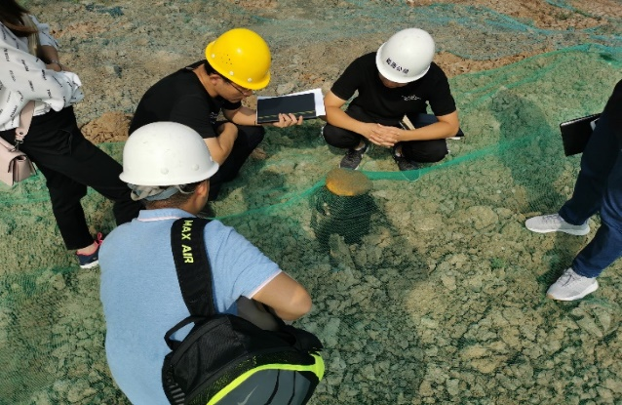

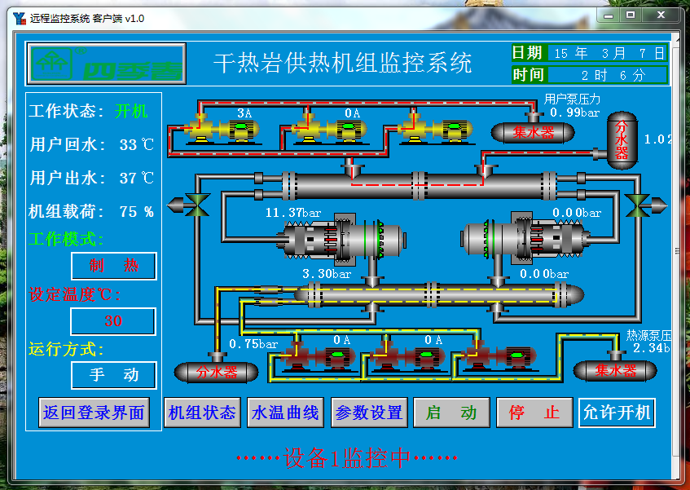




Life-span economic and environmental analysis of deep borehole heat exchanger coupled geothermal heat pump heating system with different drilling depths
Wanlong Cai, Fenghao Wang, Chaofan Chen, Zeyuan Wang, Jinghua Jiang, Olaf Kolditz, and Haibing Shao
23/05/2022

Slide 2
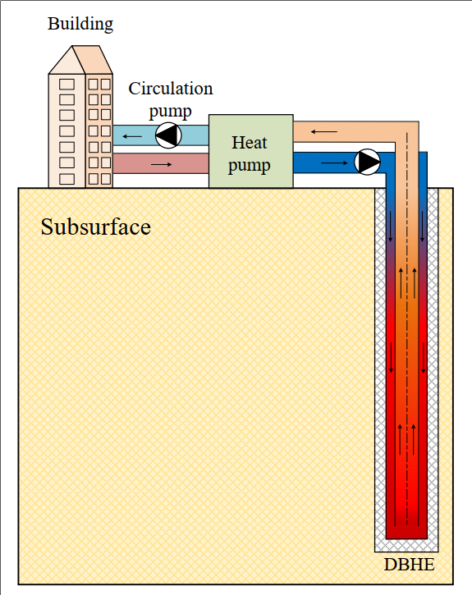


Deep Borehole Heat Exchanger Geothermal Heating System
Background：
Energy structure adjustment towards renewable energy
Severe air quality problem during heating season in northern China
Deep Borehole Heat Exchanger
Develop swiftly in recent years
Usually in coaxial type and more than 2000 m depth
Always coupled with heat pump to heat building
DBHE heating system
Scientific question:
How can we give a thorough life-span economic analysis framework to the DBHE heating system, which can be served as a reference for decision-makers?
Further, what is the typical payback period of the DBHE heating system?

Slide 3
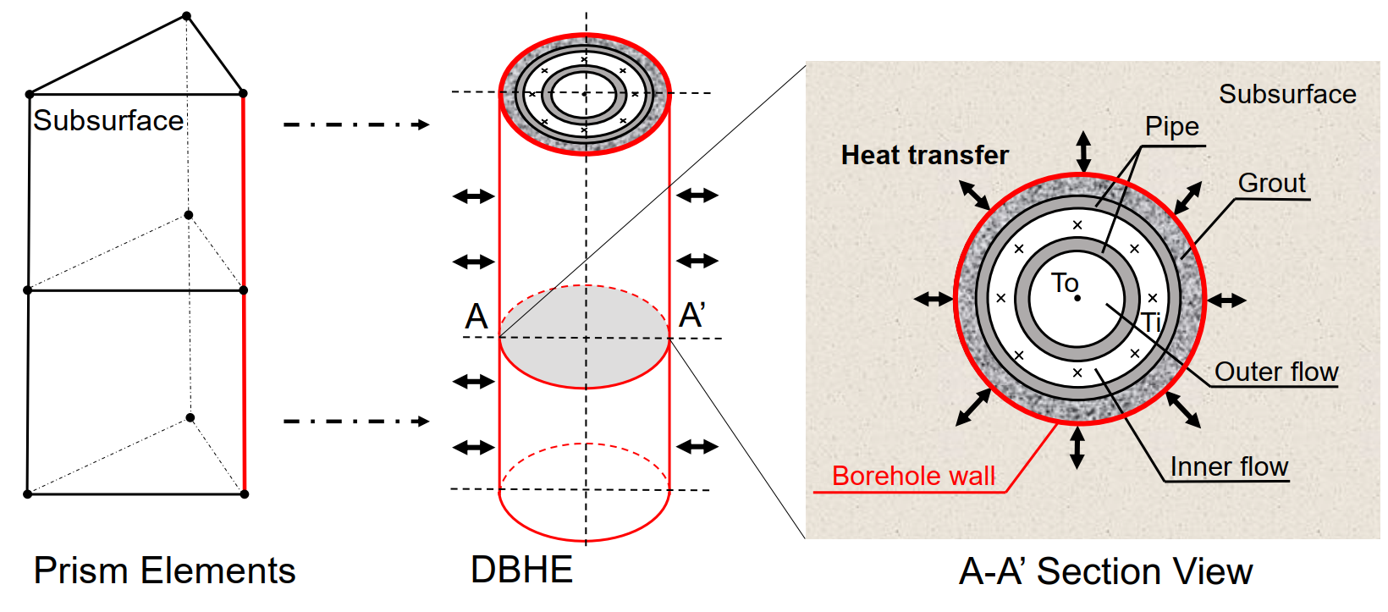
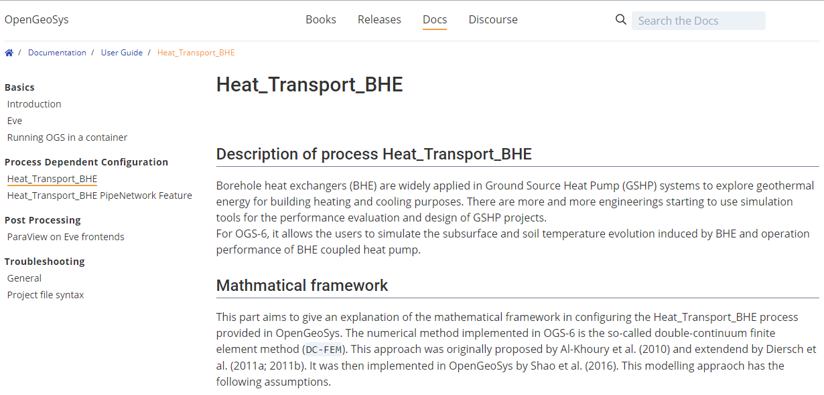
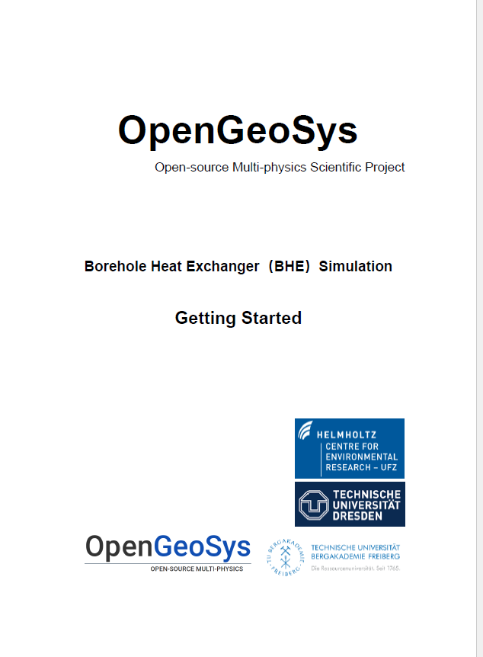
Methodology of Simulation
Dual-Continuum Finite Element Approach Proposed by Al-Khoury et al(2009) and Diersch et al (2013) and has been implemented in open-source OpenGeoSys software.
Process < Heat_Transport_BHE > in OpenGeoSys For OGS-6, it allows the users to simulate the subsurface and soil temperature evolution induced by BHE (1U, 2U, CXA, CXC) and operation performance of DBHE.
Tutorial for process < Heat_Transport_BHE >
Input parameters: < borehole >, < type >, < pipes >, < flow_and_temperature_control >, < grout > and < refrigerant >
https://www.opengeosys.org/docs/userguide/process-dependent-configuration/heat_transport_bhe

Slide 4
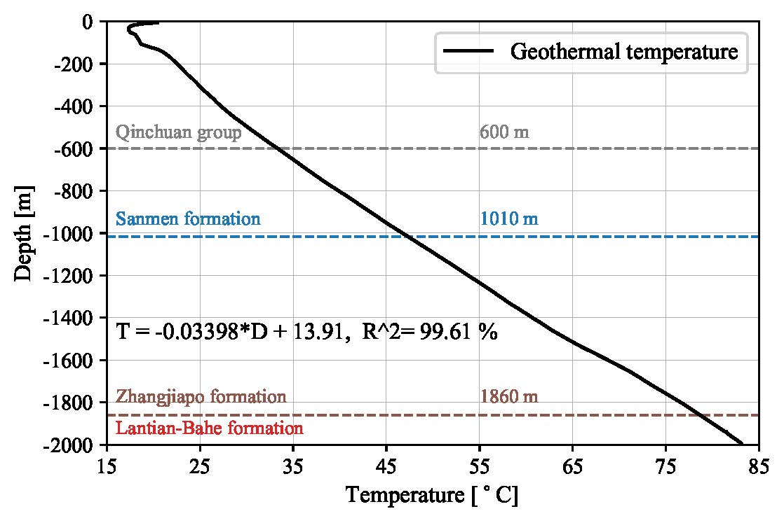
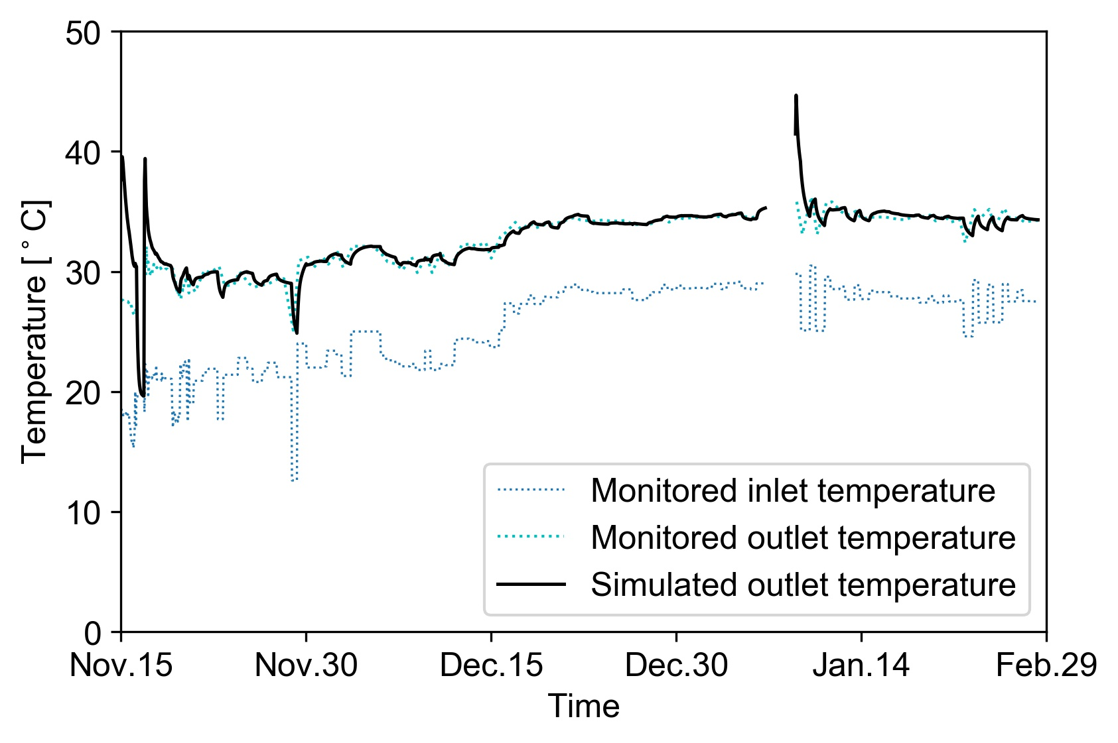
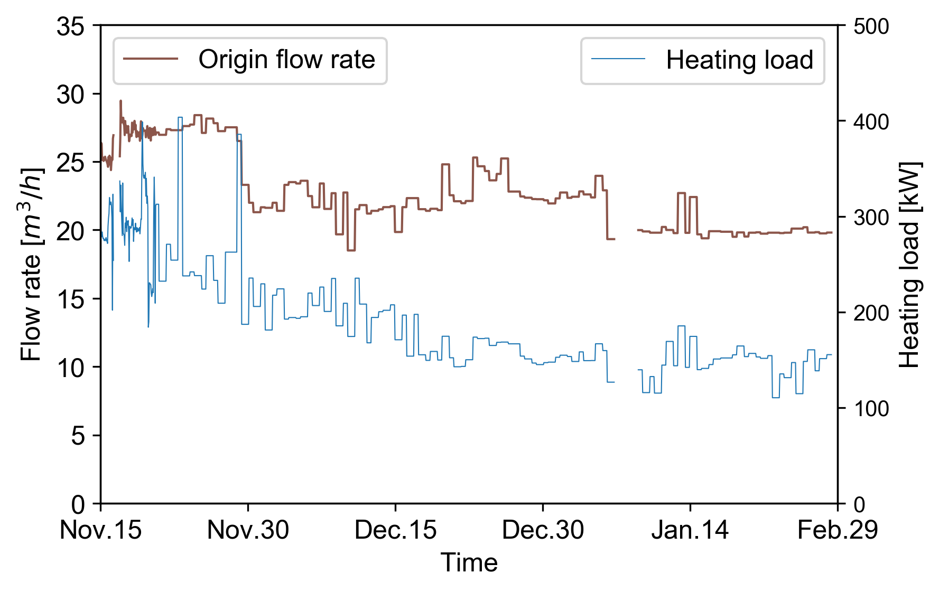
Model Validation against Monitoring Data from Pilot Project
Project information:
Heating Area: 8,000 m²
Single DBHE (2,500 m)
Monitoring data within 1,500 h
The in-situ geothermal gradient: 34.0 ℃/km
Monitored circulation temperature
Monitored flowrate and heating load
Simulation results fit well.
(Relative error < 5%)

Slide 5
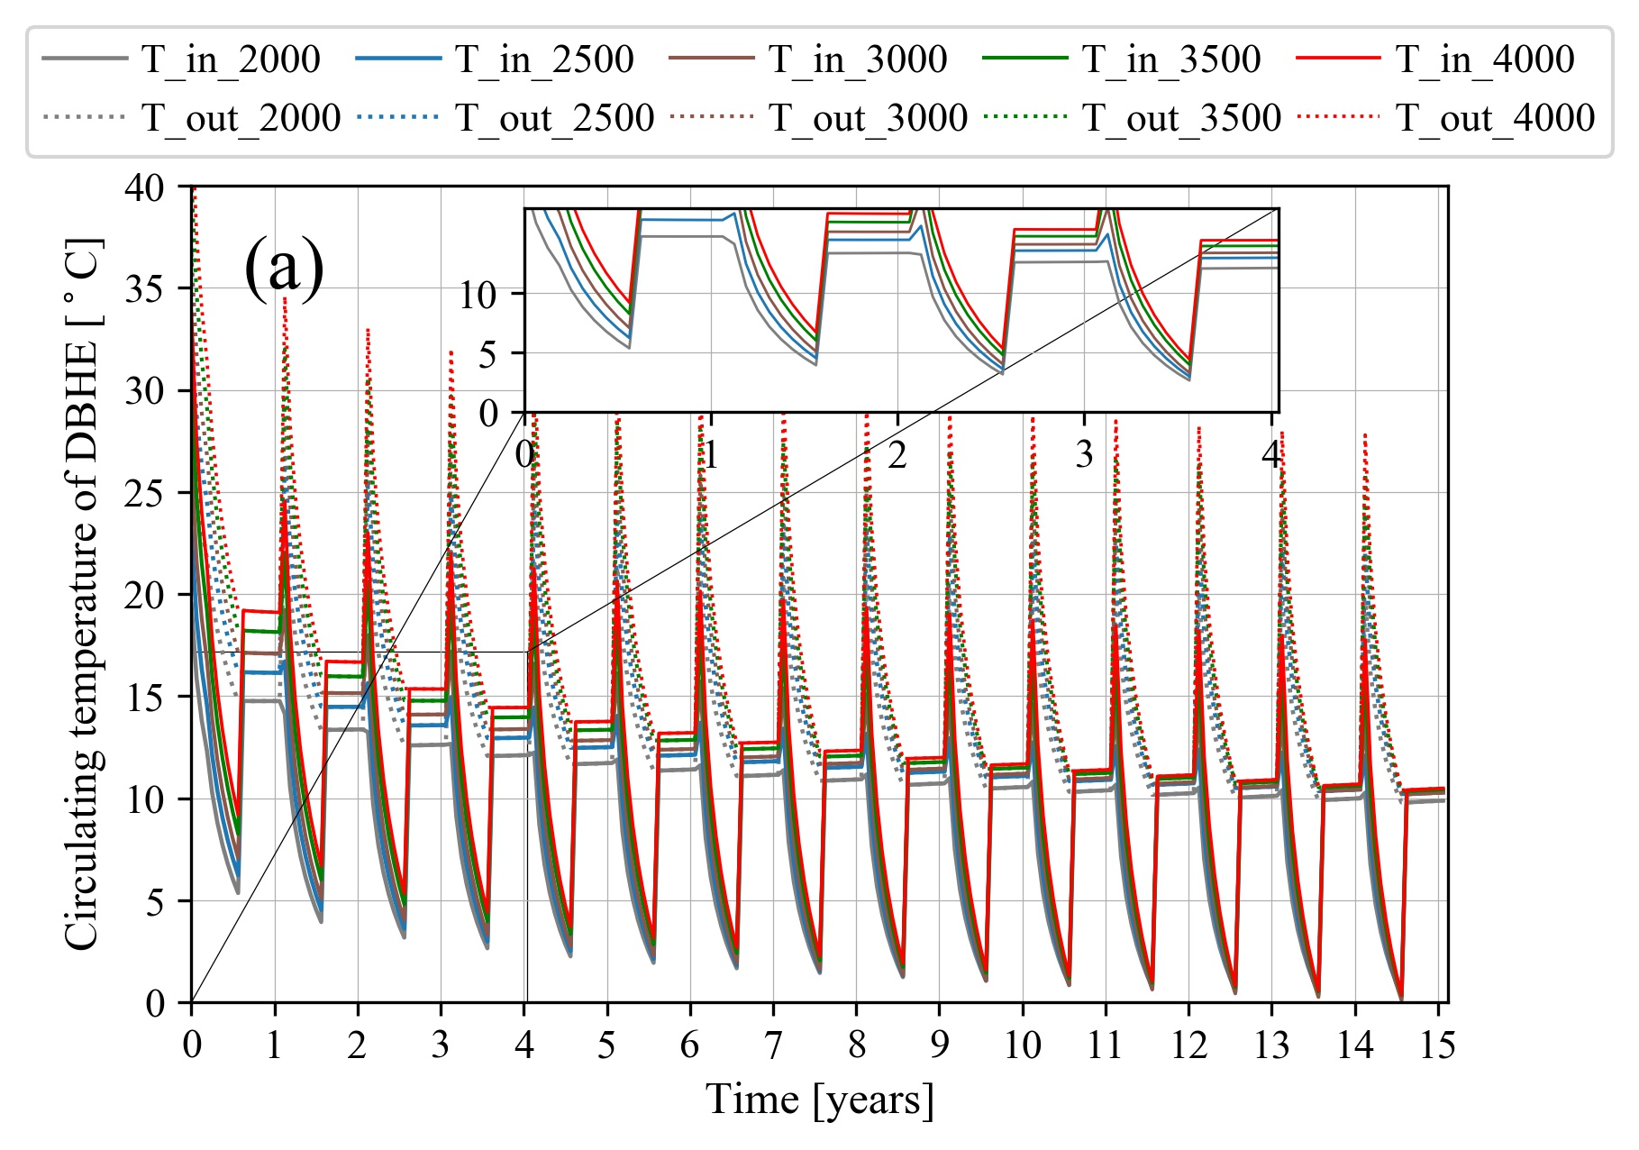
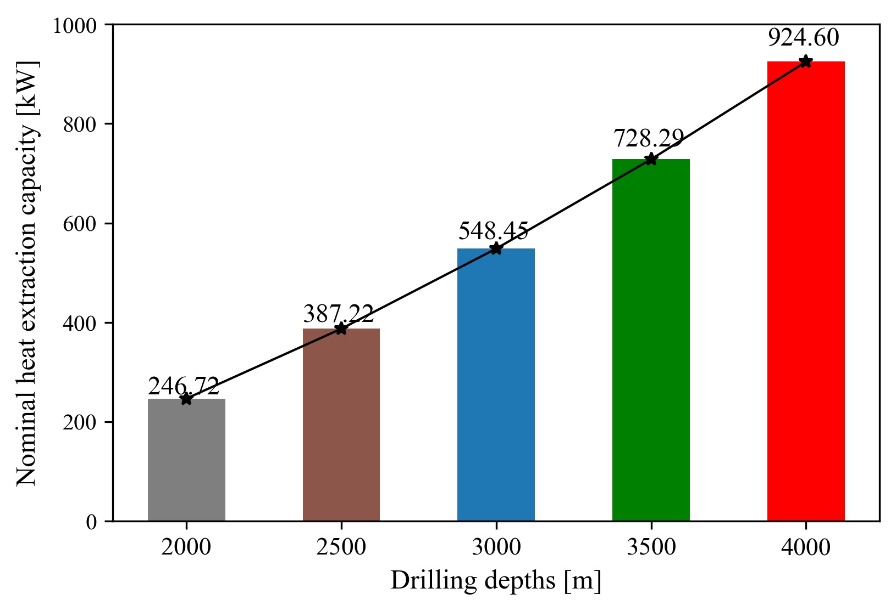
Long-term Performance Analysis of DBHE Coupled Heat Pump
Long-term heat extraction performance of DBHE
Long-term heat extraction capacity of DBHE
Circulation temperatures within DBHE tend to decrease during long-term operation.
With deeper depth, the heat extraction capacity will be higher.
Heat exchange rate per length elevates from 120 W/m (2000 m) to 230 W/m (4000 m).
Dynamic circulation T
Life-span economic analysis of DBHE system

Slide 6
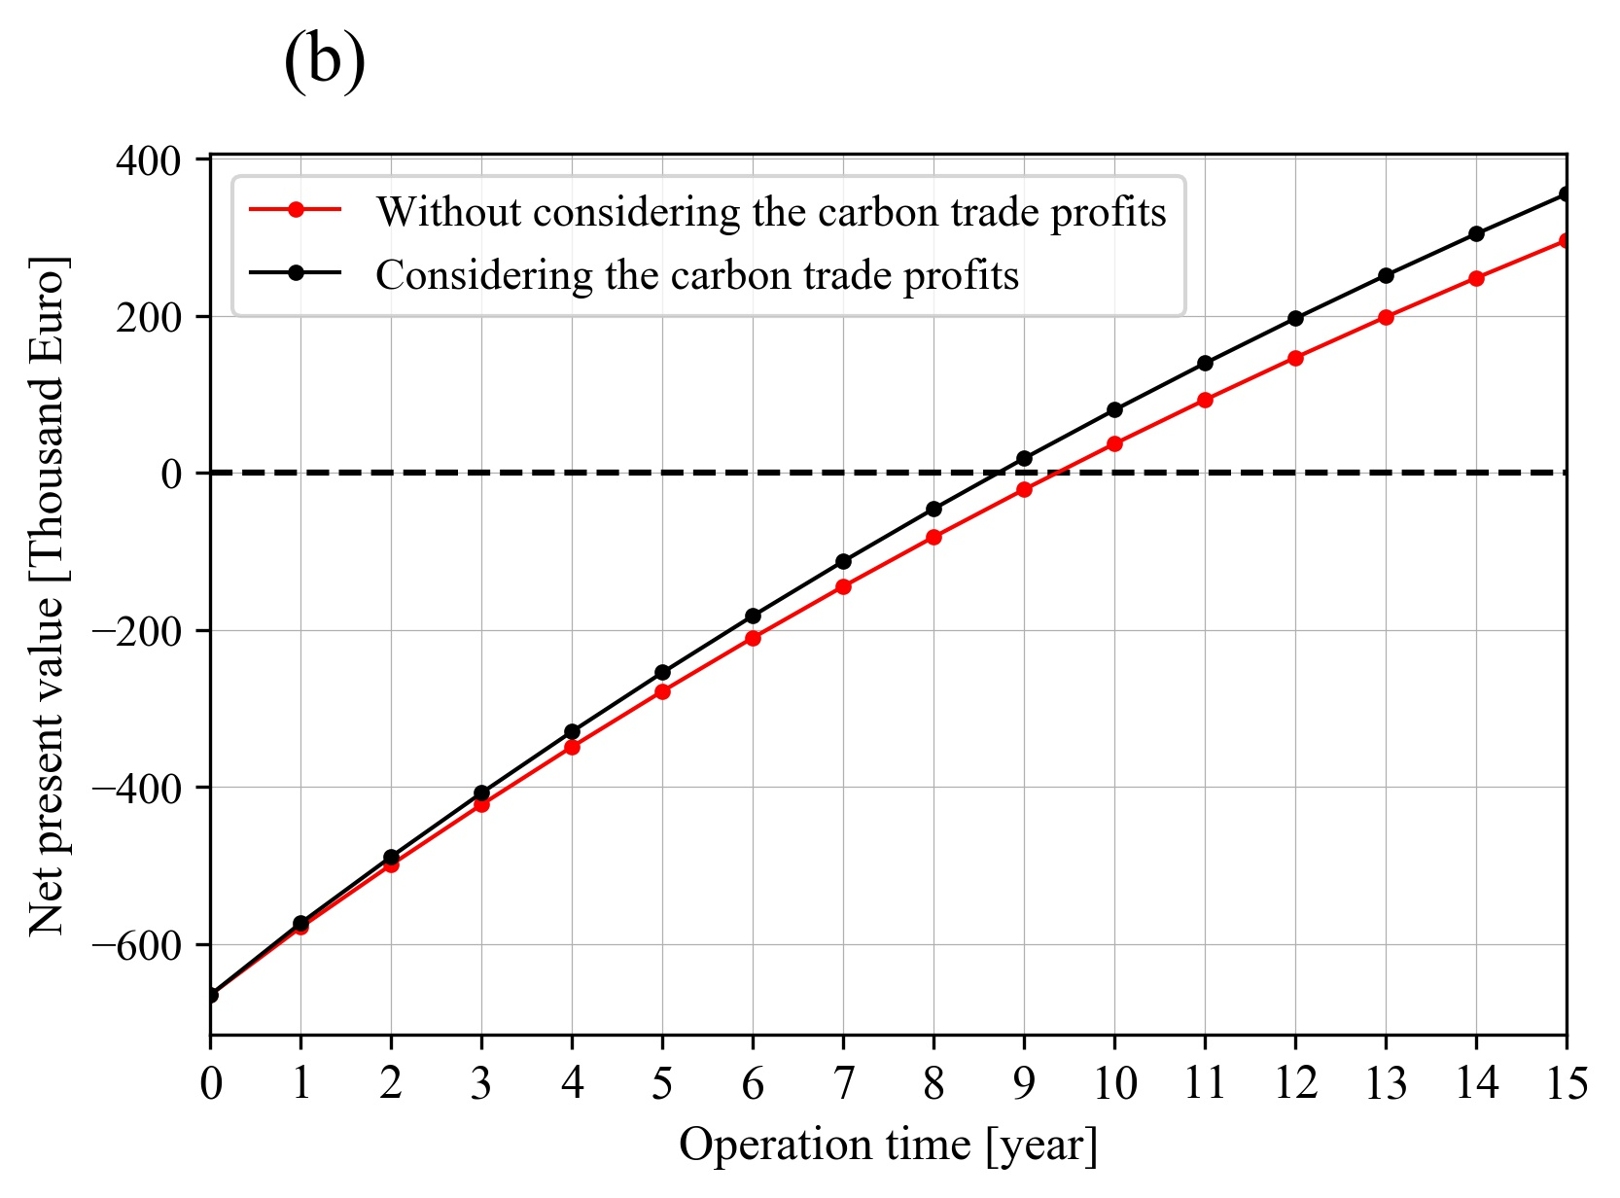



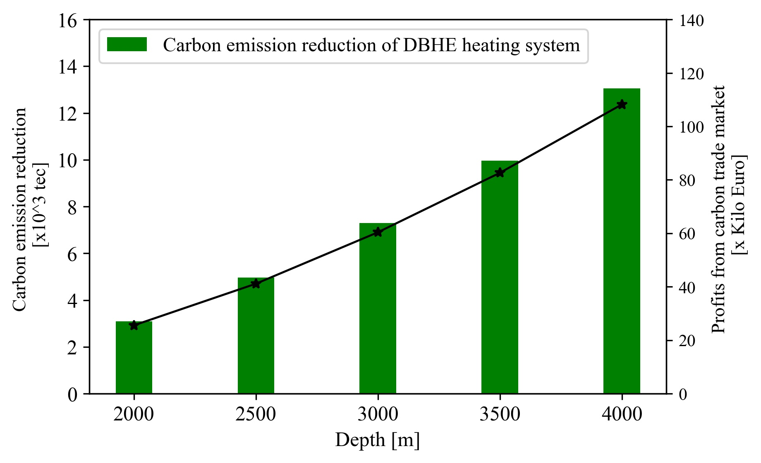
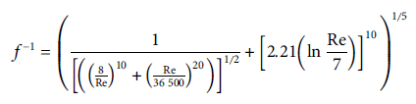
Life-span Economic and Environmental Analysis for DBHE heating system
Case study: DBHE heating system in northern China with 3000 m DBHE
Initial drilling cost (see Cai et al. FES 2022 )
Annual electricity cost of heat pump
Annual cost of circulation pump
Net present value
Carbon trade will bring ca. 1 year reduction of payback period of DBHE (9.5→8.5 year)
Carbon emission reduction
Carbon trade price is set as 58 RMB/tec (ca. 8.2€/tec) based on Chinese carbon market.

Slide 7
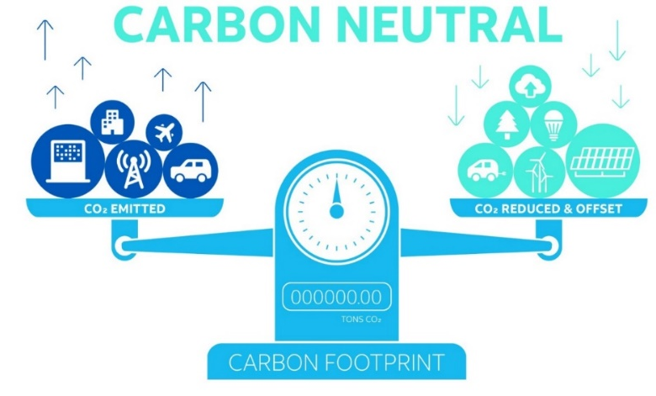
Bring Home Messages
Typical DBHE heating system (with the depth of 2000 to 4000 m) in northern China can provide heat extraction capacity of 300~1000 kW.
The carbon trade market will bring more financial benefits for the DBHE system and shorten the typical payback period from 9.5 to 8.5 year.

Slide 8
Thanks for your attention.
Email: cwl828@stu.xjtu.edu.cn
Wanlong Cai, Fenghao Wang, Chaofan Chen, Zeyuan Wang, Jinghua Jiang, Olaf Kolditz, and Haibing Shao
23/05/2022

