Slide 1


Learning from SHEAR: Innovations Research Outcomes on Forecasting and Early Warning

Slide 2
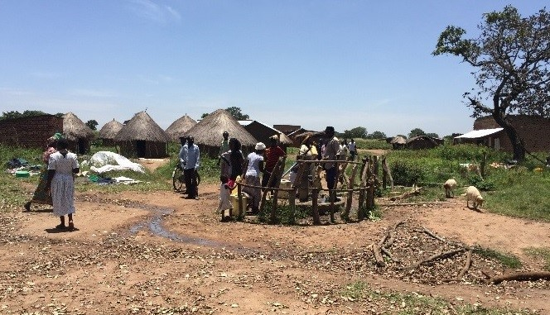
Science for Humanitarian Emergencies and Resilience
What is SHEAR?
Five-year programme
Jointly funded by DFID, NERC and ESRC
Interdisciplinary research and application
Improving understanding and monitoring of disaster risk
Notes:
Science for Humanitarian Emergencies and Resilience is an interdisciplinary, international research programme jointly funded for five years by the UK's Department for International Development, the Natural Environment Research Council and the Economic and Social Research Council.
It aims to support improved disaster resilience and humanitarian response by advancing monitoring, assessment and prediction of natural hazards and risks across Sub-Saharan Africa and South Asia.
The program comprises research and application components which aim to better understand the multifaceted and complex drivers of risk.
Research institutions, international non-governmental organisations and meteorological agencies are collaborating to deliver world-leading, interdisciplinary, end-to-end research with the goal of improving the characterisation and prediction of hazards.

Slide 3
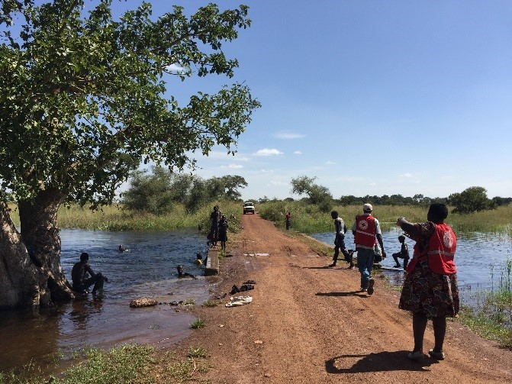
Aims and Objectives
Strengthening understanding of the underlying drivers of risk
Getting the right information, to the right people in the right ways
Notes:
The programme has two key scientific objectives:
Strengthening understanding of the underlying drivers of risk toward more integrated, multi-hazard risk monitoring and warning systems
Getting the right information, to the right people in the right ways – research to enhance the uptake and use of risk information in practice
For example, the current focus of work is on:
Improving risk assessment and prediction of drought and flooding across Sub-Saharan Africa
Enhancing multi-hazard risk assessment and monitoring across south Asia, with a focus on the interaction of ’cascading’ hazards such as landslides

Slide 4
Members of SHEAR
University of Aberdeen
University of Bath
University of Birmingham
University of Bristol
University of Cambridge
University of Dundee
University of Edinburgh
University of Geneva
University of Lancaster
University of Leeds
University of Liverpool
University of Newcastle
University of Oxford
University of Reading
University of Sussex
University of York
Wageningen University
World Food Programme
American Red Cross
Amrita University
British Geological Survey
Christian Aid
Climate Change Action
CNR
Dartmouth Flood Observatory
Deltares
Durham University
ECMWF
FloodTags
FutureWater
GEM
Geological Survey of Austria
Geological Survey of India
Global Facility for Disaster Reduction and Recovery
GNDR
Help Age International
IBIMET
ICPAC
IGAD
IIASA
iMMAP
Imperial College London
IRD
IWMI
Keystone Foundation
Kenya Red Cross
Kenya Met Office
King’s College London
KMD
KRCS
London School of Economics
Makerere University
National Centre for Atmospheric Science
NDMA
NIWA
NYU
ODI
Practical Action
Practical Action Consulting
Public Health England
Red Cross Climate Centre
Risk Management Solutions
SOHAM Nepal
Southampton
Stellenbosch University
Technical University of Mozambique
Tribhuvan University
UK Met Office
UNESCO
Universidade Técnica de Moçambique
University College London
Notes:
There are almost 70 research institutions, universities, meteorological agencies, INGOs and national NGOs working in the SHEAR programme in over 8 countries around the world, bringing together the expertise experience of a range of disciplines and practices to achieve the programme’s research and application goals.
The Consortium Coordination Team is comprised of the primary investigators of the four main research projects as well as the programme knowledge brokers.

Slide 5
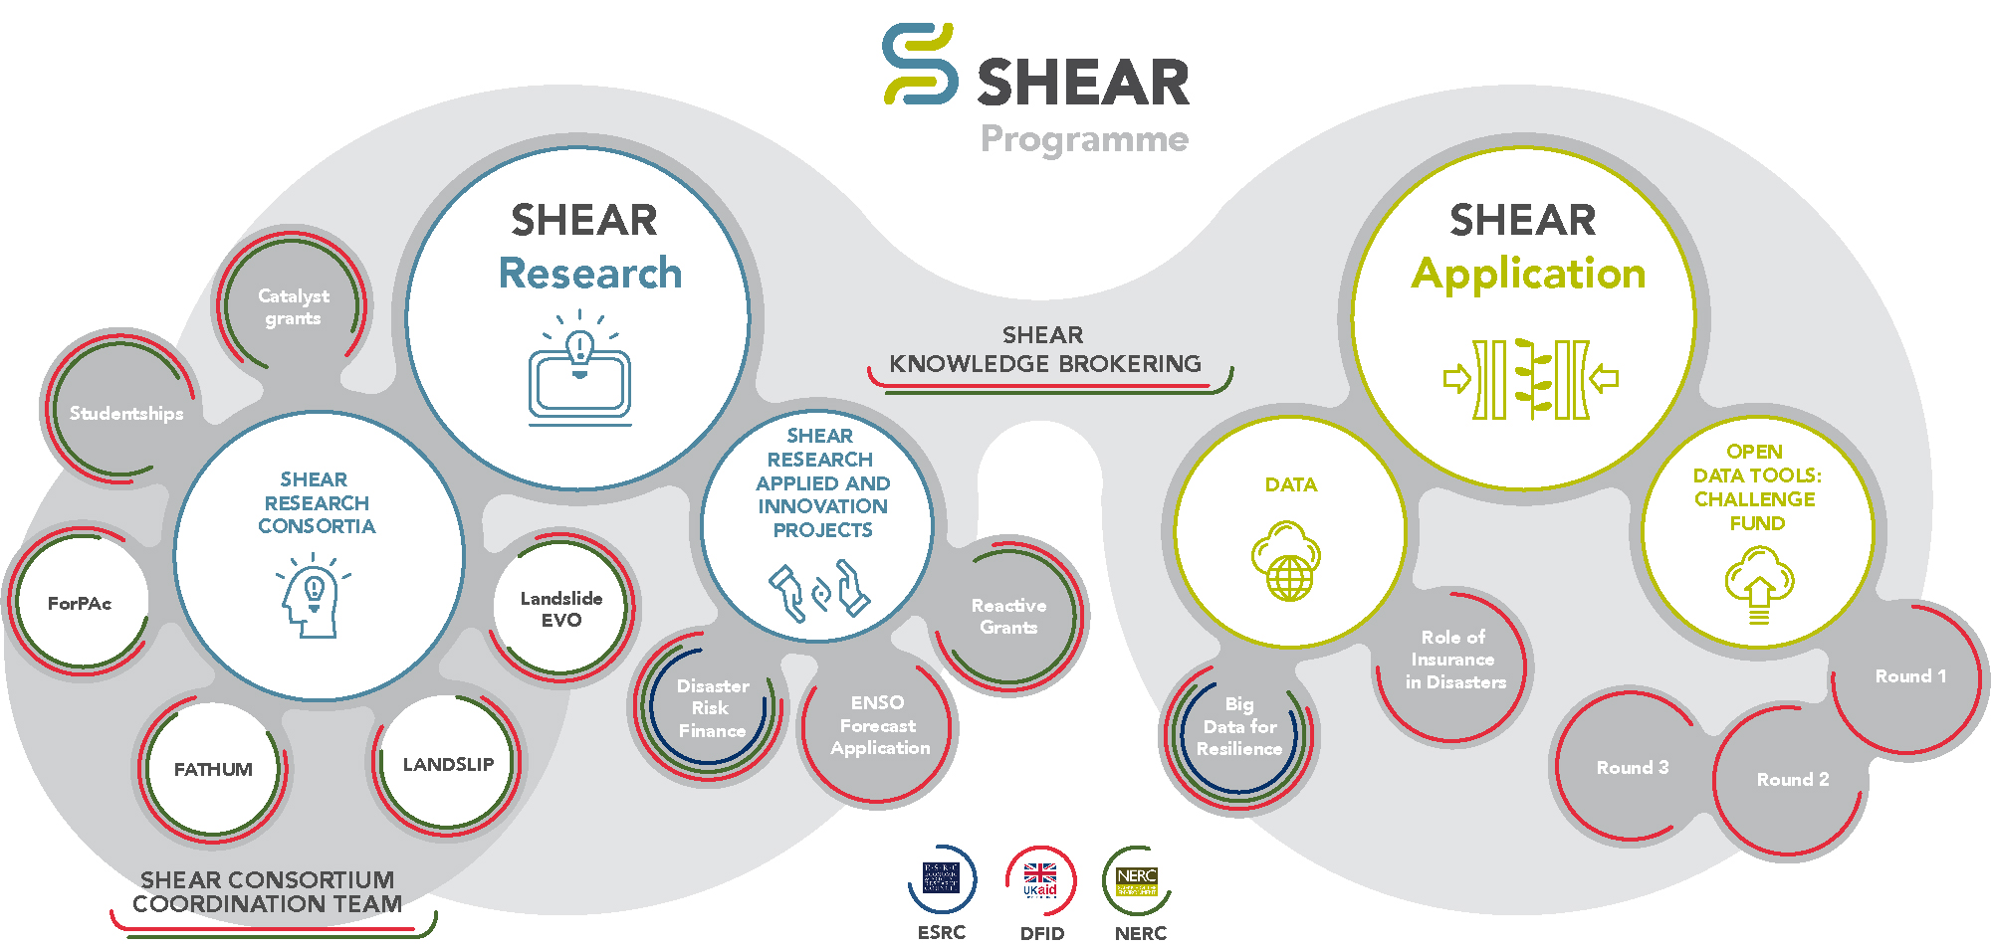
Programme Structure
Notes:
The SHEAR Programme is loosely divided into research and application focused projects. Over 90 projects are funded under the SHEAR programme by DFID, NERC and ESRC.

Slide 6
Overview
Improving forecasting science, data, and tools
Improving decision-making
Putting stakeholder needs at the centre
Interdisciplinary collaboration
Key resources
Notes:
Science for Humanitarian Emergencies and Resilience is an interdisciplinary, international research programme jointly funded for five years by the UK's Department for International Development, the Natural Environment Research Council and the Economic and Social Research Council.
It aims to support improved disaster resilience and humanitarian response by advancing monitoring, assessment and prediction of natural hazards and risks across Sub-Saharan Africa and South Asia.
The program comprises research and application components which aim to better understand the multifaceted and complex drivers of risk.
Research institutions, international non-governmental organisations and meteorological agencies are collaborating to deliver world-leading, interdisciplinary, end-to-end research with the goal of improving the characterisation and prediction of hazards.

Slide 7
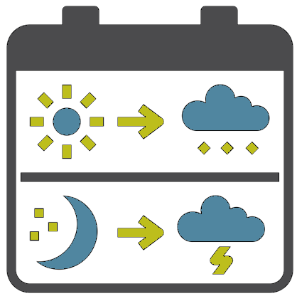
Improving forecasting science, data, and tools
Increasing lead time
Improving forecast skill and coverage
Incorporating impact information
Forecasts for Anticipatory Humanitarian Action (FATHUM):
Using global forecast products to improve local forecast information
Image by Kamin Gingaew

Slide 8
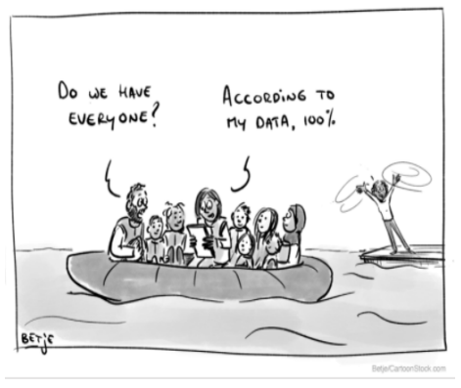
Improving forecasting science, data, and tools
Collecting and monitoring climate data for forecasting and early warning
Analysing historical climate data to better understand patterns and trends
Linking climate with impact data to inform decisions.
Mitigating Basis Risk:
Using smartphone imagery, citizen science data collection methods, and with satellite data to support localised crop modelling and loss assessment

Slide 9

Improving forecasting science, data, and tools
Putting science into practice
Gathering, processing, and communicating information
Thresholds, maps, and data collection to support disaster risk reduction
Landslide multi-hazard risk assessment, preparedness and early warning in South Asia (LANDSLIP):
Developing a statistical model to identify rainfall thresholds linked with landslide occurrences
Image by Hrbon

Slide 10

Improving decision making
Critical decisions about resources and actions
Complex data on hazard, exposure, and vulnerability needed for risk information
Improved anticipatory capacity and decision making enhances action
Towards Resilience:
Developing a model to identify priority areas for evacuation and guide targeted emergency response
Image by WebTechOps LLP

Slide 11

Putting stakeholder needs at the centre of research
Research needs to meet the needs of the people and institutions who will put it into practice
LANDSLIP:
Stakeholder mapping
Forecast-based Preparedness and Nowcasting Flood Impacts of Convective storms in the Sahel:
Participatory Impact Pathway Analysis
Image by Vectors Point, KP

Slide 12
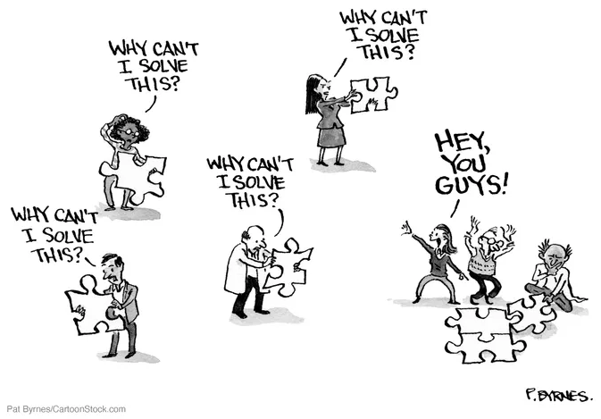
Interdisciplinary Collaboration
Bringing together the unique knowledge and skills of stakeholders
Including physical and social sciences, disaster risk management practice, and policymaking
SHEAR:
Building relationships, trust, understanding, and consensus

Slide 13
Improved forecasting helps people prepare for the weather and the seasons Improved data to better understand exposure, vulnerabilities and hazards Improved tools to enhance resilience Improved decision-making to act in anticipation of hazards
Key Resources: SHEAR Research Outcomes

Slide 14
Putting stakeholder needs at the centre of research Interdisciplinary collaboration Lessons for future funding
Key Resources: SHEAR Learning

Slide 15
info@shear.org.uk www.shear.org.uk @SHEAR_Programme
Thank You

