Slide 1
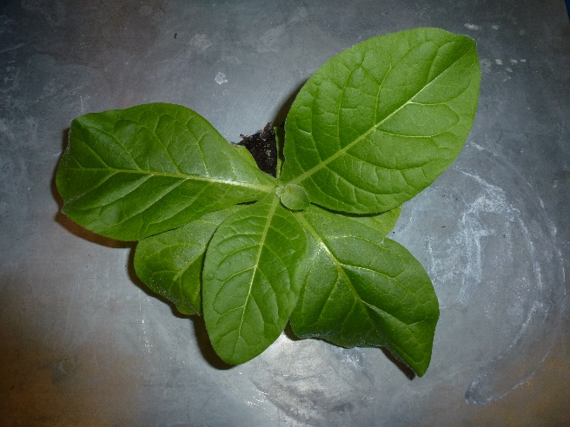


Hydrogen isotopes in assimilates and cellulose,
but not in n-alkanes, integrate plant metabolic signals
EGU 2022 Session - BG 2.1
'Application of Stable Isotopes in Biogeosciences'
by Dr. Marco M. Lehmann
WSL Birmensdorf, Birmensdorf, Zurich, Switzerland
*marco.lehmann@wsl.ch
SNSF Ambizione

Slide 2
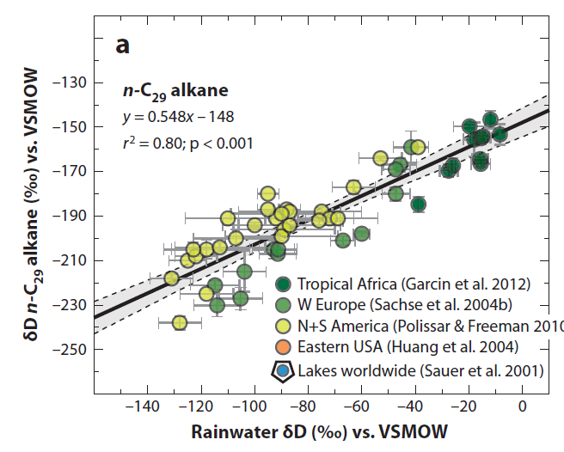
δ²H of n-alkanes as paleo-hydrological indicator
Sachse et al. 2012

Slide 3
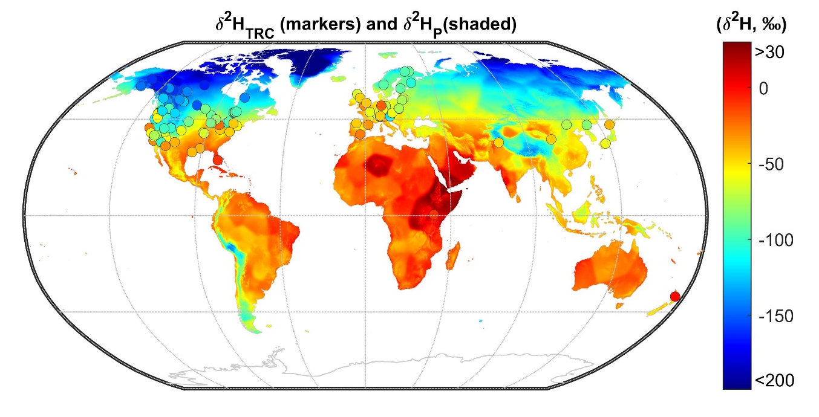
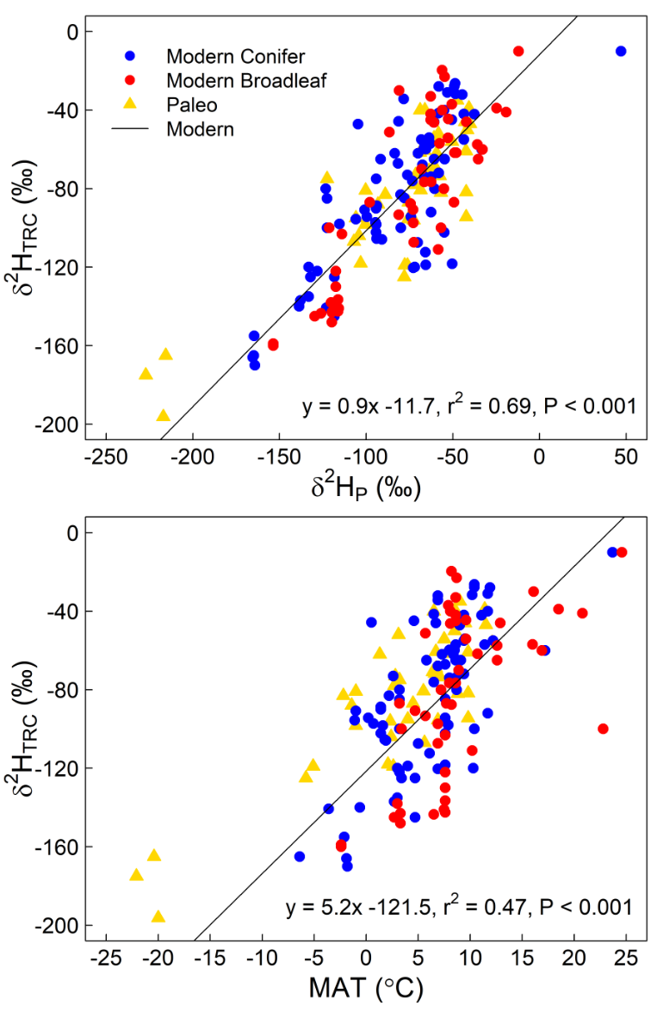
High climate sensitivity for δ²H of tree-ring cellulose at global scale
δ²H of tree-ring cellulose records δ²H of precipitation
and mean annual temperature on a global scale
Lehmann et al. 2022, Book chapter (n = ~50 studies)

Slide 4
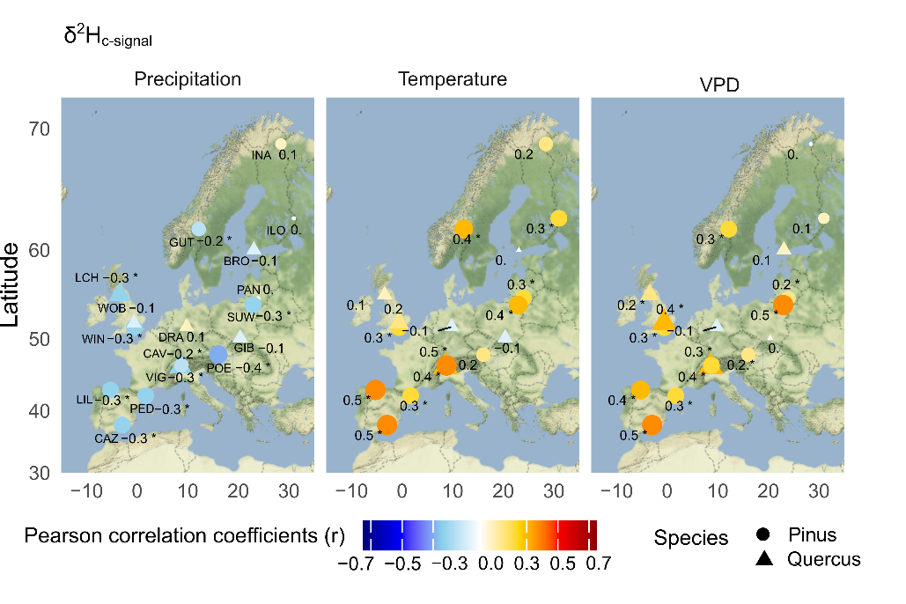

Low climate sensitivity for δ²H of tree-ring cellulose at temporal scale
Valentina Vitali
Vitali et al., 2022,
ISONET Tree-ring Network, 1900-2002, annual data, 17 European sites,
Pinus vs. Quercus
δ²H in tree-ring cellulose holds plant metabolic information

Slide 5
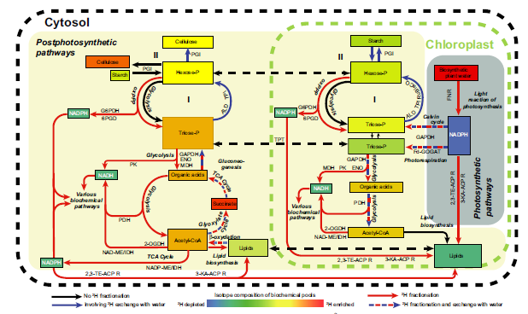
δ²H variation caused by changes in sugar/starch ratios?
Cormier et al., 2018
The sugar/starch ratio affects the likelihood of H-exchange with water
The higher the sugar pool compared to starch, the more ²H-enriched sugar become

Slide 6
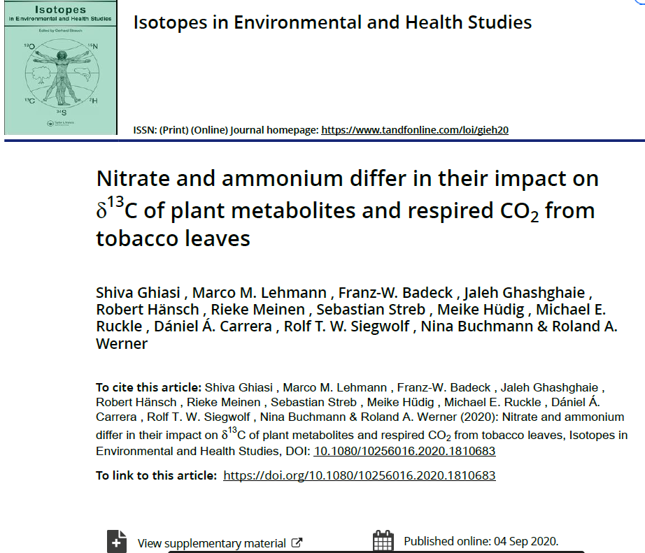
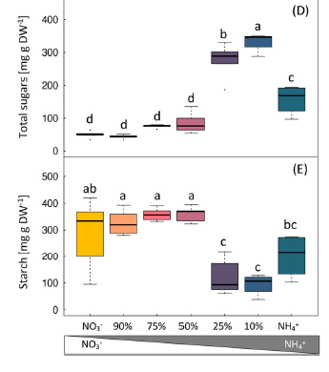
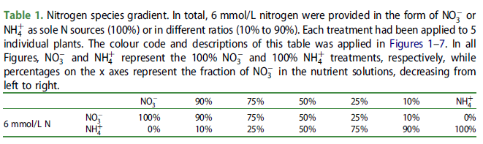
Model system 1: N nutrient gradient (N. sylvestris)
Ghiasi et al., 2020
Compound Concentrations, Gas-exchange, Enzyme activities, Isotopes (C, N), Biomass

Slide 7
Model System 1: δ²H variation along a N nutrition gradient

Slide 8
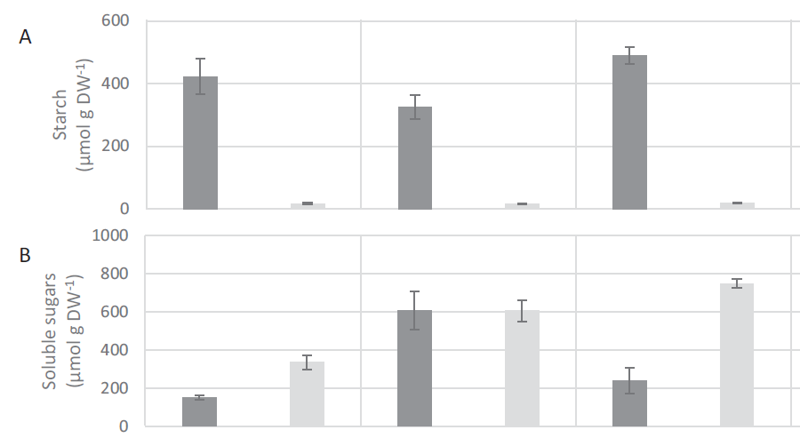
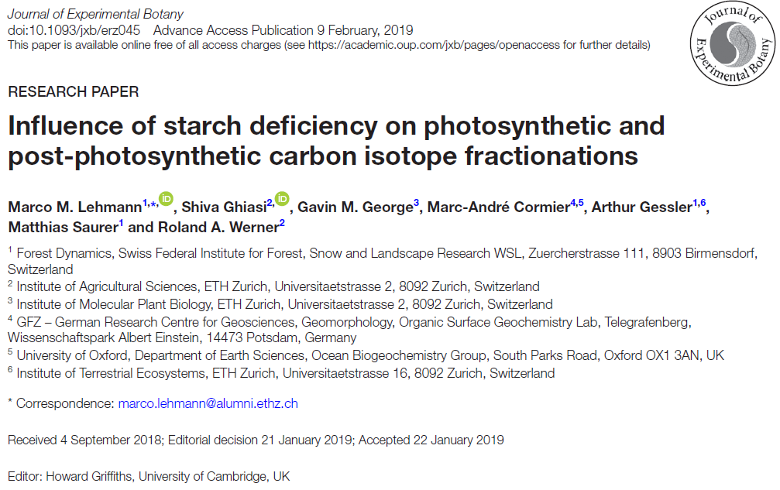
Model system 2: Starch deficient pgm mutant (N. sylvestris)
Wildtype
(WT)
pgm
Lehmann et al., 2019
Plant Mutants, Isotopes (C), Compound Concentration, Gas-exchange
pgm = phosphoglucomutase

Slide 9
Model System 2: δ²H of wildtype vs pgm mutants
Changes in sugar/starch ratios of leaves affect δ²H values of carbohydrates but not δ²H in n-alkanes

Slide 10
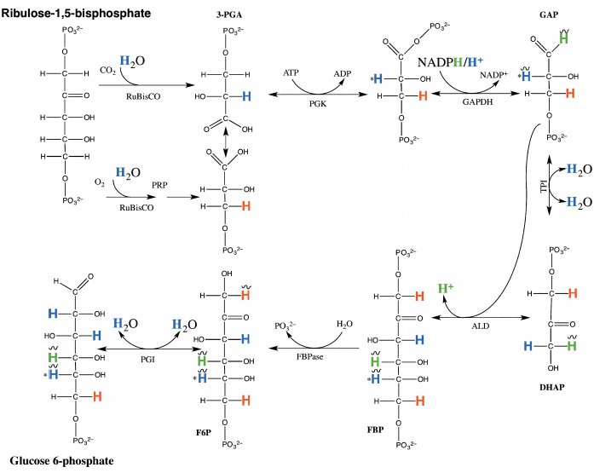
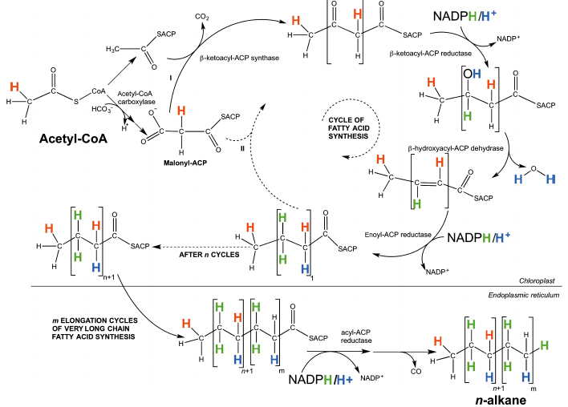
δ²H of carbohydrates vs. δ²H of n-alkanes
Cormier et al., 2018
Carbohydrates: ~15% from NADPH/H
n-alkanes: ~50% from NADPH/H
δ²H of n-alkanes suggest constant δ²H values of leaf NADPH/H pools
δ²H changes in carbohydrates likely induced by changes in metabolic fluxes

Slide 11
Summary and conclusions
Large ²H-fractionation in assimilates induced by changes in leaf sugar/starch ratio
²H-fractionation strongly dampened in cellulose compared to assimilates
n-alkanes not affected by leaf sugar/starch ratio
Large difference in δ²H of leaves vs. root carbohydrates
Leaf-level metabolism is a main driver of δ²H in carbohydrates
in autotrophic and heterotrophic tissues

Slide 12

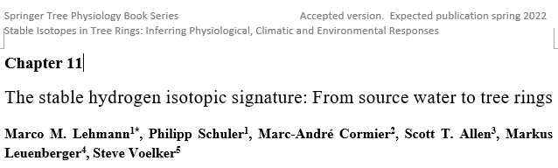
Do you want to know more?
Review of recent methods, knowledge, models and potential future δ²H applications
Published ~June 2022 – Open Access
by Dr. Marco M. Lehmann
WSL Birmensdorf, Birmensdorf, Zurich, Switzerland
*marco.lehmann@wsl.ch
SNSF Ambizione

Slide 13
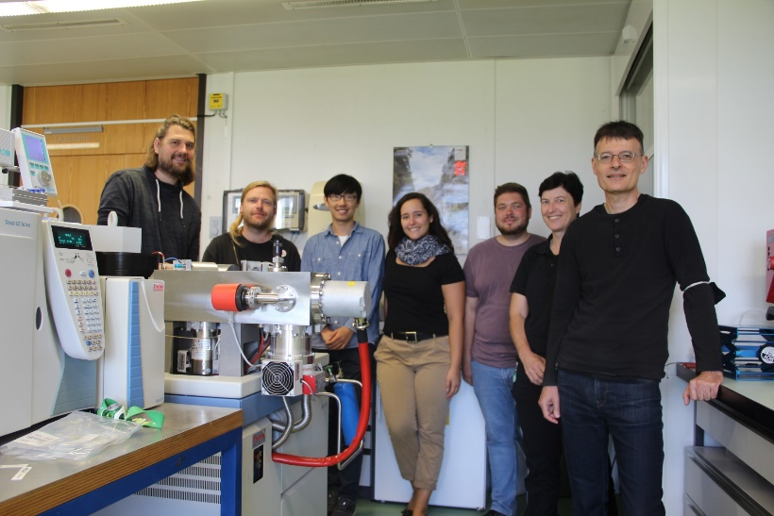
Acknowledgements
The Stable Isotope Research Team at WSL

Slide 14






Collaboration partners
Many others:
Scott Allen (US)
Steve Voelker (US)
Gregory Goldsmith (US)
Lucas Cernusak (AU)
Marc-André Cormier (UK)
Charlotte Grossiord
Leonie Schoenbeck
Philipp Schuler
Matthias Saurer
Valentina Vitali
Haoyu Diao
Claudia Guidi
Frank Hagedorn
Arthur Gessler
Kerstin Treydte
Rolf Siegwolf
Katja Rinne
Charlotte Angove
Nina Buchmann
Roland Werner
Ansgar Kahmen
Meisha Holloway-Philipps
Dan Nelson
Markus Leuenberger
Christoph Schwörer
Willy Tinner
Guido Wiesenberg

