Slide 1






Managing multi-layered geographic information to describe environmental monitoring and research sites using DEIMS-SDR
23 May 2022
Christoph Wohner*^{1, 2} https://orcid.org/0000-0002-0655-3699
Johannes Peterseil¹ https://orcid.org/0000-0003-0631-8231
*Corresponding author: christoph.wohner@umweltbundesamt.at ¹ Environment Agency Austria, Department for Ecosystem Research and Monitoring, Spittelauer Lände 5, A-1090 Vienna, Austria ² Paris-Lodron University of Salzburg, Schillerstraße 30, 5020 Salzburg, Austria

Slide 2


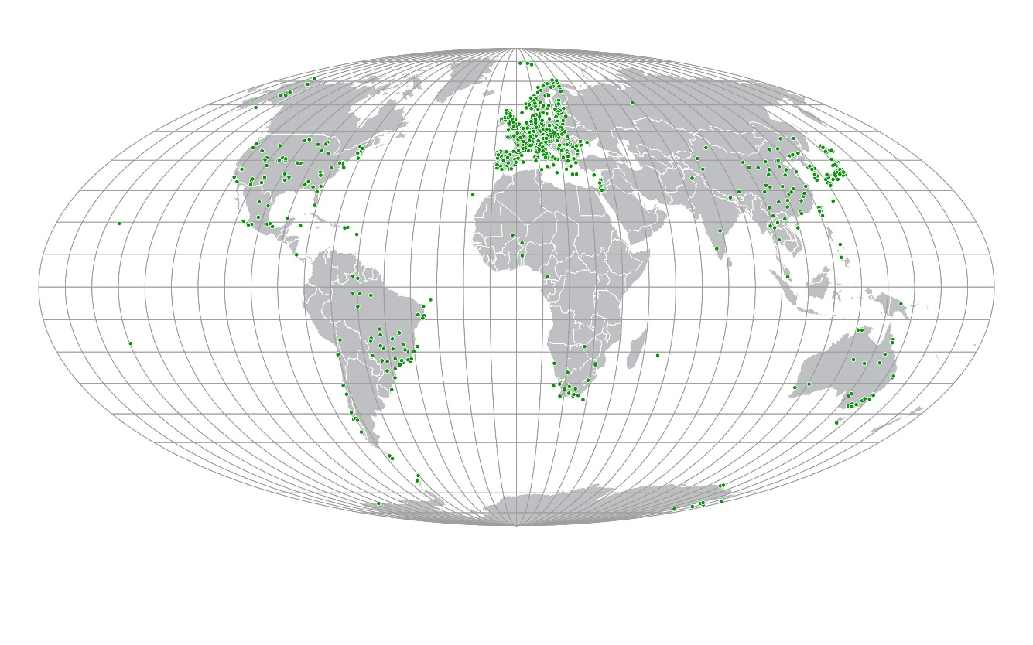
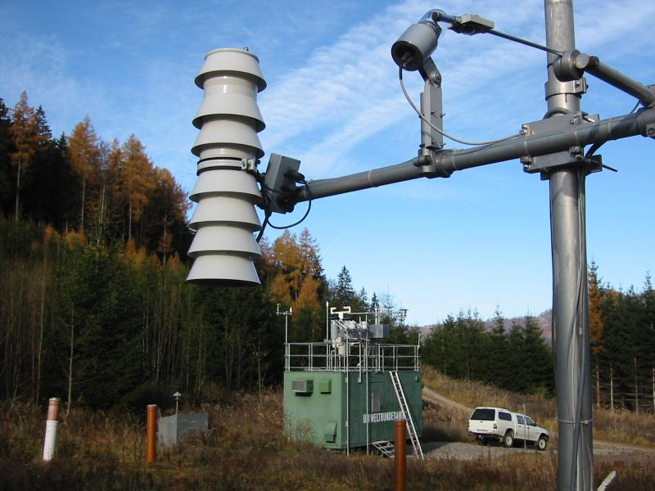
Introduction - DEIMS-SDR (deims.org)
A site and dataset registry
Allows to document environmental monitoring and research sites
Ca. 1200 sites* registered as of May 2022
Used in the research networks eLTER & ILTER and a number of EU projects such as e-shape
*
A site is defined as an in-situ observation or experimentation facility, delimited in space, but varying in size and complexity of the internal organisational and observational design, for the collection of data covering e.g. biogeophysical, biotic or socio-ecological characteristics and processes (Wohner et al., 2019)
LTER Zöbelboden, Austria
https://deims.org/8eda49e9-1f4e-4f3e-b58e-e0bb25dc32a6
EGU 2022 - 23 May, Vienna, AT

Slide 3
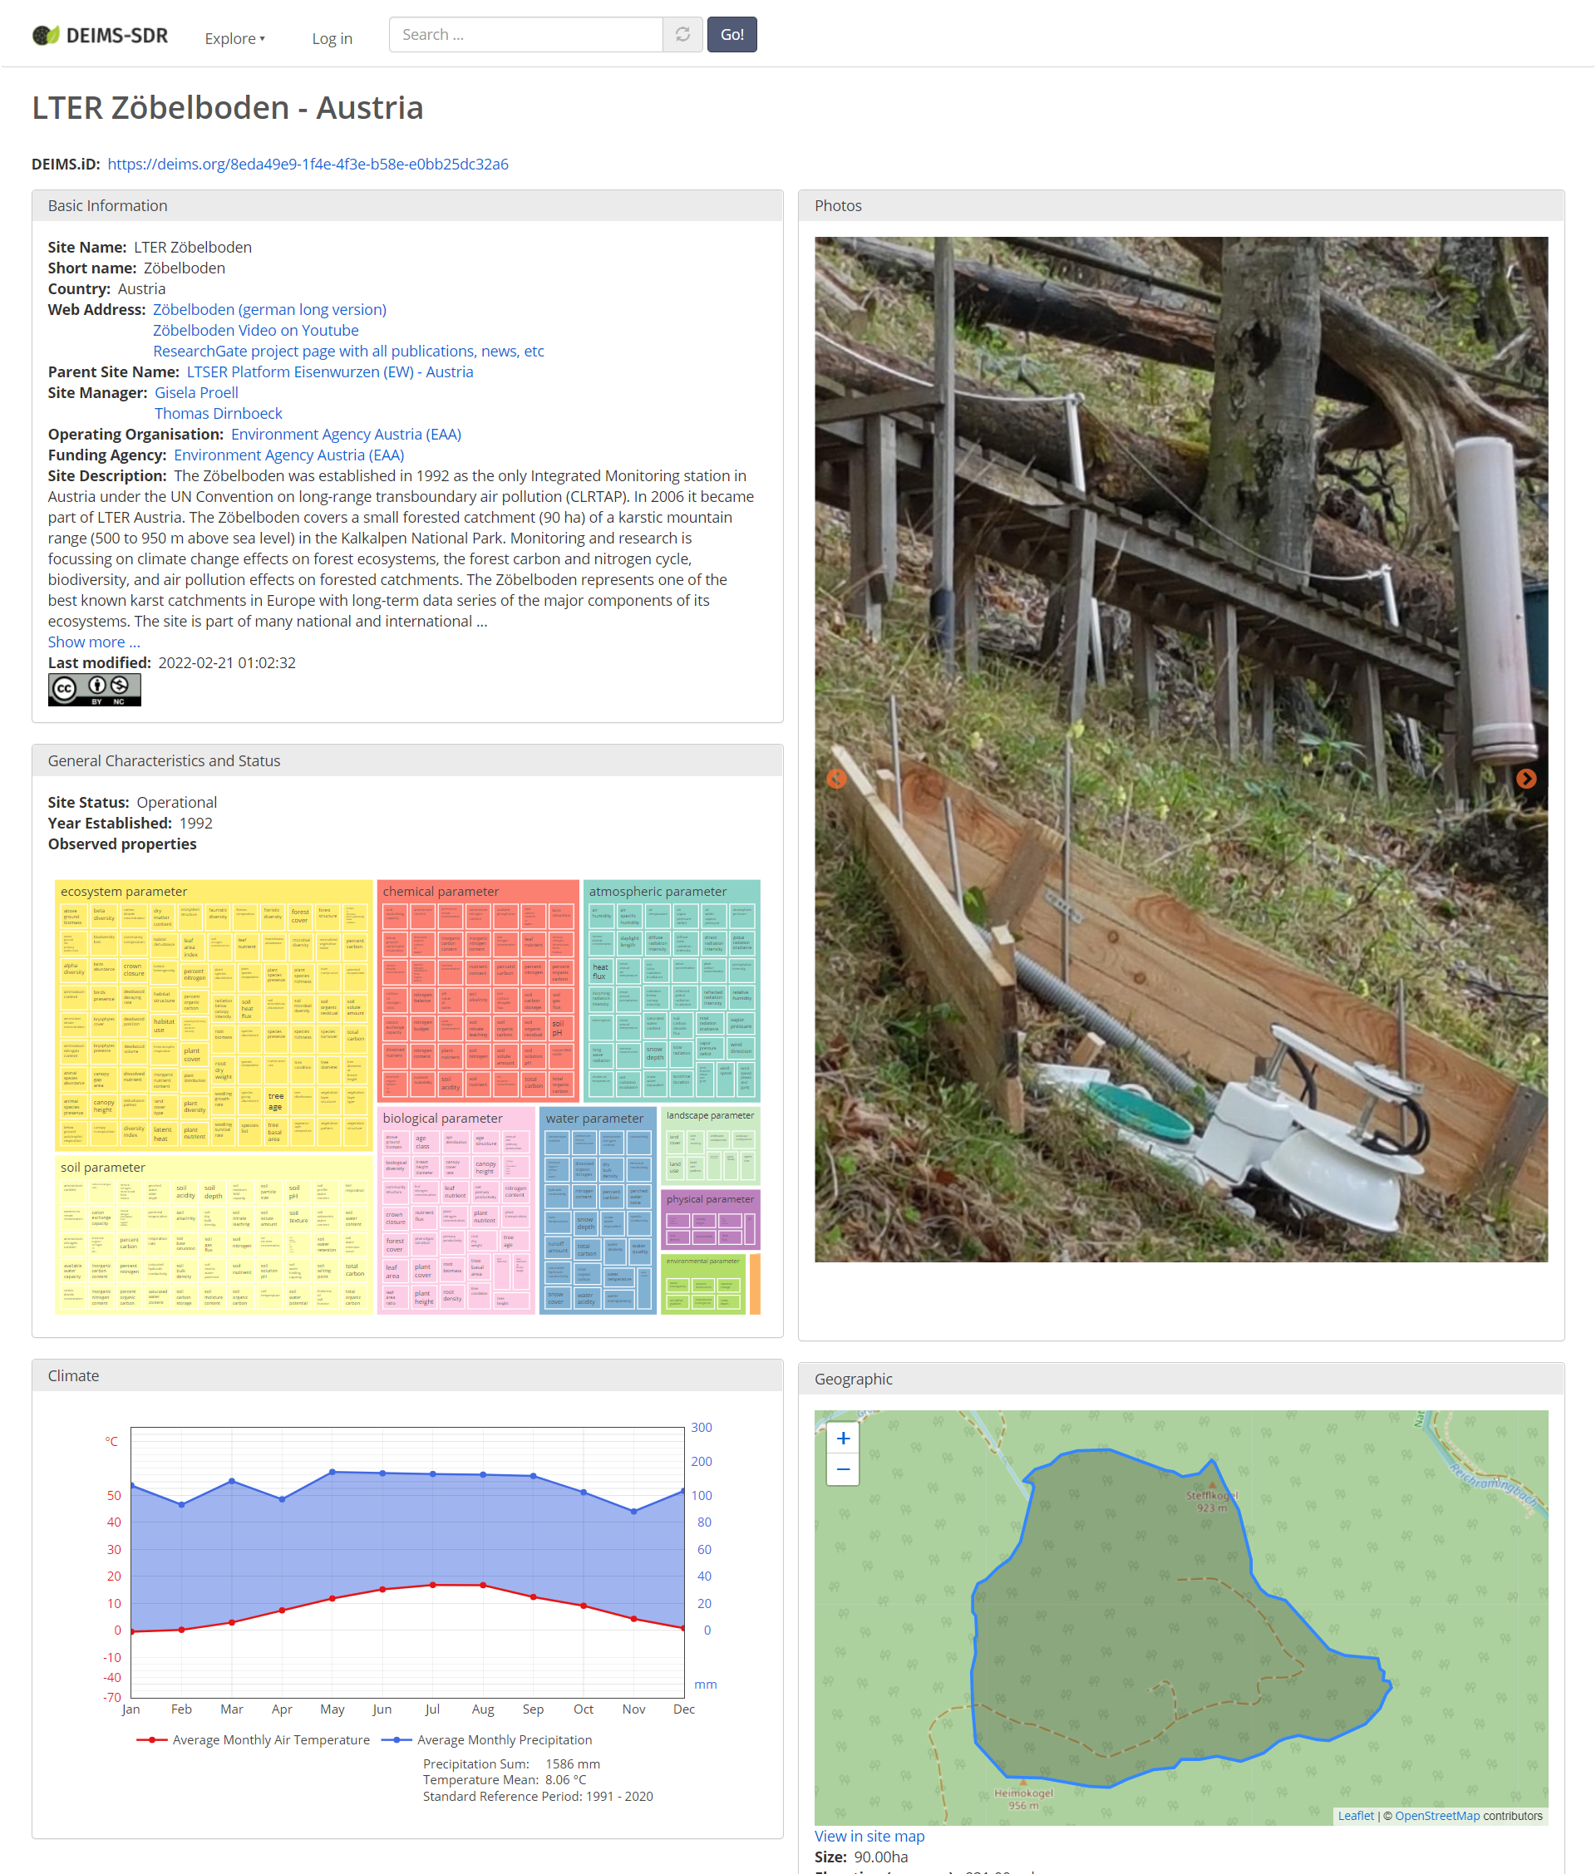
Introduction - DEIMS-SDR (deims.org)
Issues persistent identifiers for sites (DEIMS.ID)
Provides information about observed properties, geographic extent, contact details and environmental characteristics
All of that information is available through machine-readable endpoints
LTER Zöbelboden (https://deims.org/8eda49e9-1f4e-4f3e-b58e-e0bb25dc32a6)
EGU 2022 - 23 May, Vienna, AT

Slide 4

A site can consist of multiple layers of geographic information
Plot
Plot
Measurement
tower
Plot
Site extent
Airshed
Hydrological catchment area
EGU 2022 - 23 May, Vienna, AT

Slide 5
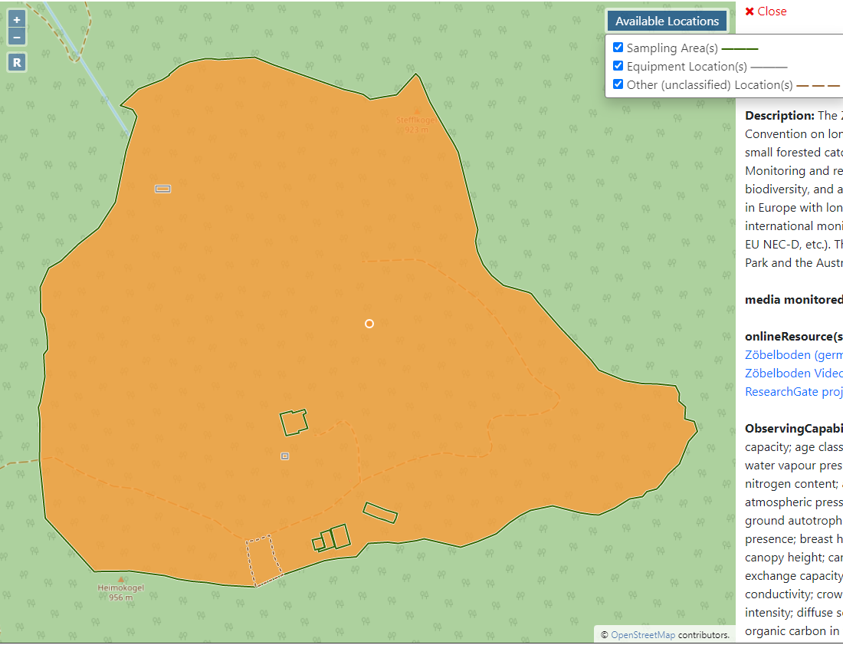
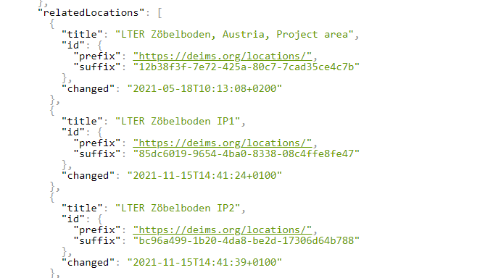
Solution: Multiple geographic layers
Adding “locations” to DEIMS and linking them to sites
Can be (multi)points, (multi)linestrings or (multi)polygons
Can be classified:
Equipment Location
Hydrological Catchment
Sampling Area
Socio-ecological Reference Area
Air Shed
Model Area
Remote Sensing Analysis Area
Can feature additional textual descriptions and images
Link is displayed both in human-readable and machine-readable form
Fig. Boundaries and locations of Zöbelboden
EGU 2022 - 23 May, Vienna, AT

Slide 6
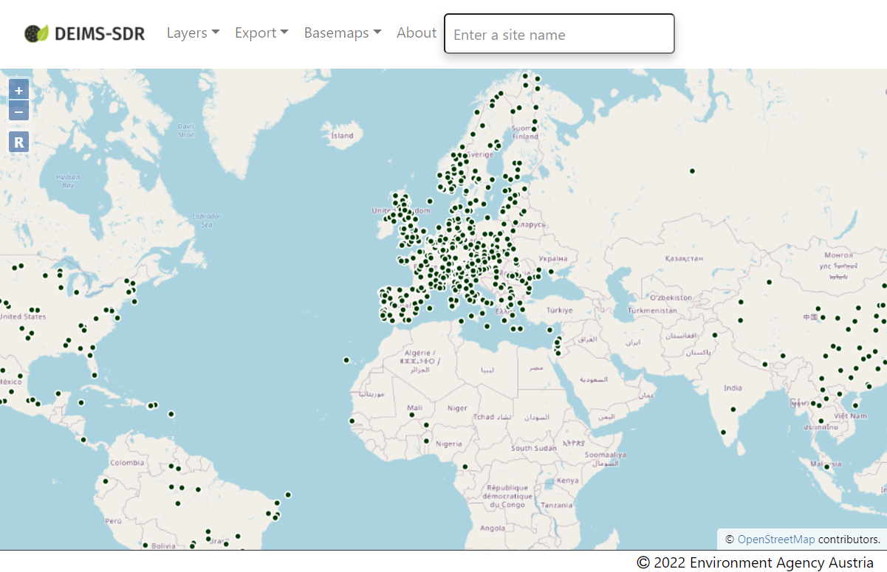
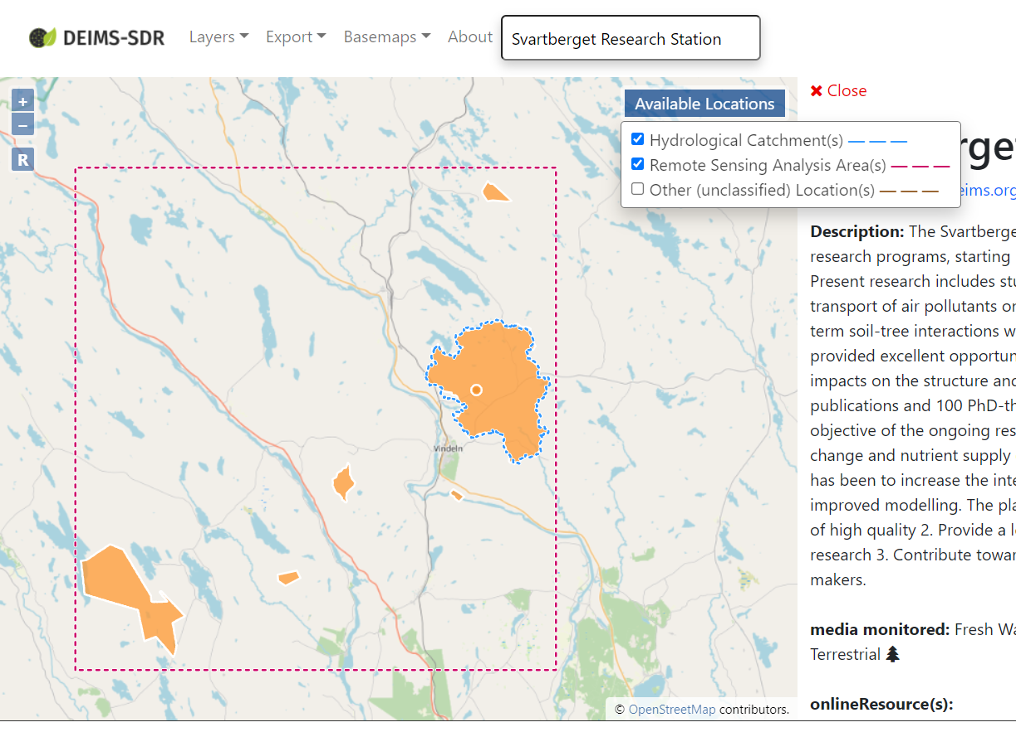
Sharing DEIMS data: Geodata services
Geodata of sites is provided through WFS and WMS services
Supported data export formats:
Shapefile
KML
GML
GeoJSON, …
Can be used as input data for scripts or in a desktop GIS
Fig. DEIMS Site Map (deims.org/map)
Fig. Site Map – Svartberget (e-shape site)
https://deims.org/c0705d0f-92c1-4964-a345-38c0be3113e1
EGU 2022 - 23 May, Vienna, AT

Slide 7
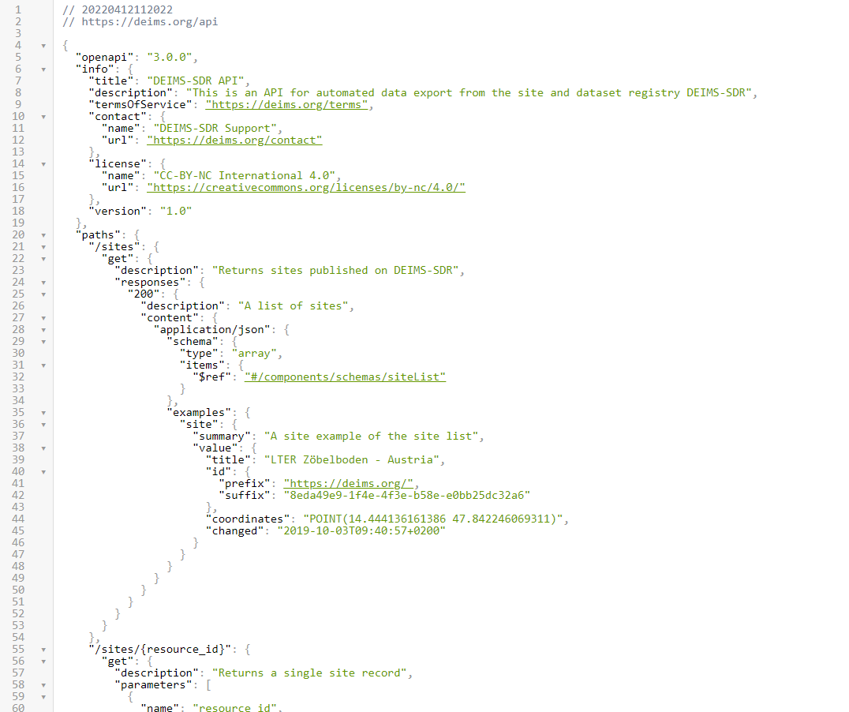
Sharing DEIMS data: REST-API https://deims.org/api
All data is also available through a REST-API
Following the Open API 3.0 specification
Can be used for scripts, etc.
More information:
https://deims.org/docs/export.html
Fig. Screenshot REST-API
EGU 2022 - 23 May, Vienna, AT

Slide 8
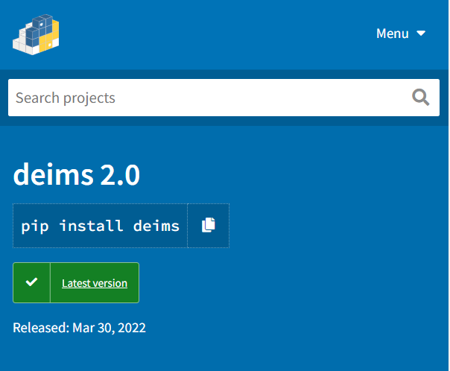
Sharing DEIMS data: The DEIMS-SDR Python package - deimsPy
We have published a dedicated Python package for data extraction from DEIMS-SDR
Basic functionality for getting site information out of DEIMS with simple functions to
Normalise site identifiers
Get list of sites
Based on networks/RIs
Based on spatial proximity
Get site details
Get site boundaries for single sites or lists of sites as shapefile
Example: find sites close to coordinates
import deims
# getSitesWithinRadius(lat, lon, distance_in_metres)
getSitesWithinRadius(47.84, 14.44, 30000)
[
['8eda49e9-1f4e-4f3e-b58e-e0bb25dc32a6', 398],
['49515dda-1198-4013-8f43-c33e107af081', 8310],
['d0a8da18-0881-4ebe-bccf-bc4cb4e25701', 19787]
]
getSiteById("8eda49e9-1f4e-4f3e-b58e-e0bb25dc32a6")
LTER Zöbelboden – Austria […]
deims.id
Distance to the coordinates in metres
https://pypi.org/project/deims/
EGU 2022 - 23 May, Vienna, AT

Slide 9
Questions?
Acknowledgements:
H2020 e-shape (GA number: 820852)
H2020 eLTER PLUS (GA number: 871128)
Contact
christoph.wohner@umweltbundesamt.at
EGU 2022 - 23 May, Vienna, AT

