Slide 1
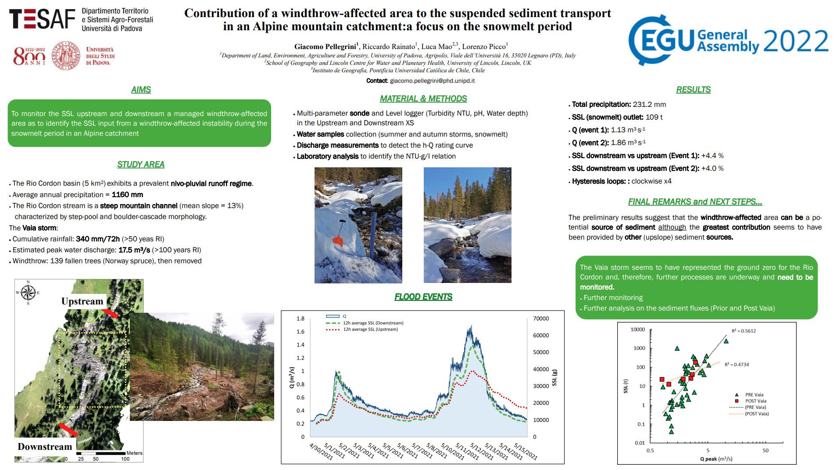



Slide 2
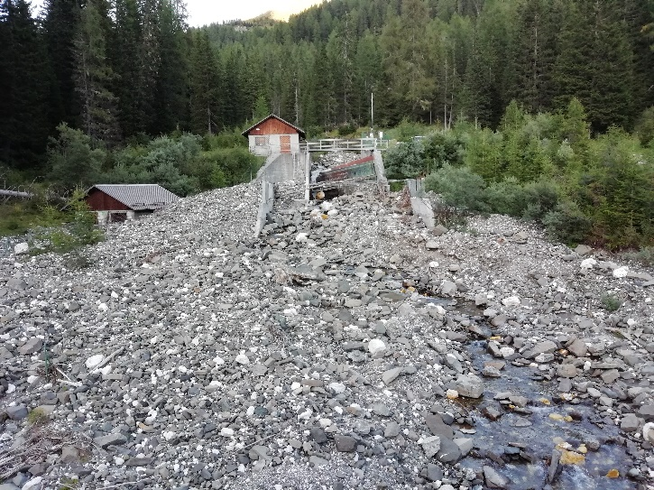

STUDY AREA
The Rio Cordon is a small dolomitic catchment (5km²) located in the Veneto Region (Belluno province).
The elevation ranges from 1815 to 2760 m a.s.l. with alpine climate: mean annual precipitation ~ 1160 mm and nivo-pluvial regime.
The Vaia storm (Rainato et al., 2021) (October 2018) affected the catchment at different spatial and temporal scales.
Cumulative rainfall: 340 mm/72h (> 50 years RI)
Estimated peak water discharge: 17.5 m³/s (>100 years RI)
Sonde

Slide 3
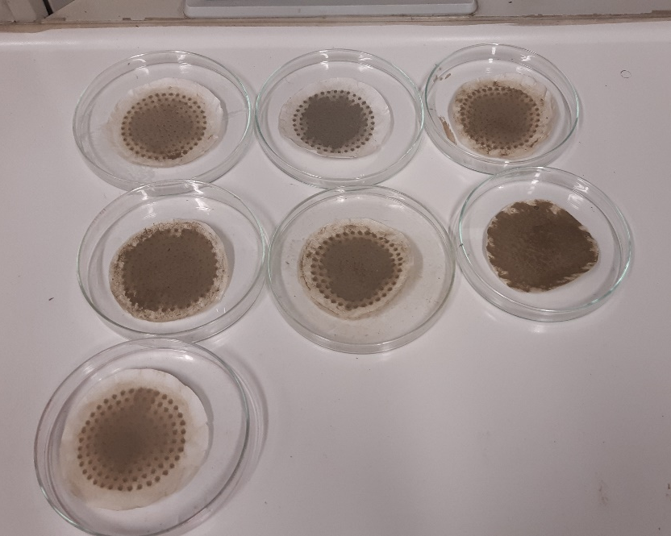
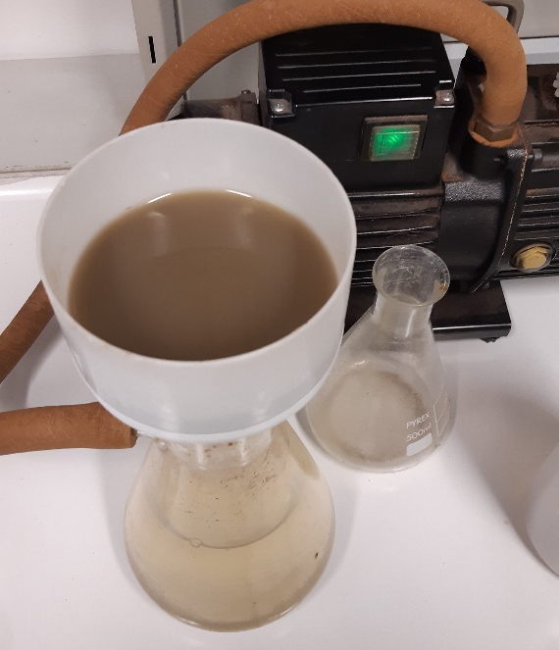
MATERIAL AND METHODS
(A)
(B)
Discharge rating curve of the (A) downstream monitoring site (R² = 0.89) and (B) empirical relation NTU-g/l (R² = 0.92) derived through field and laboratory analysis.
g l⁻¹
Pictures illustrating some of the laboratory analysis applied to derive the empirical relation NTU-g/l.

Slide 4
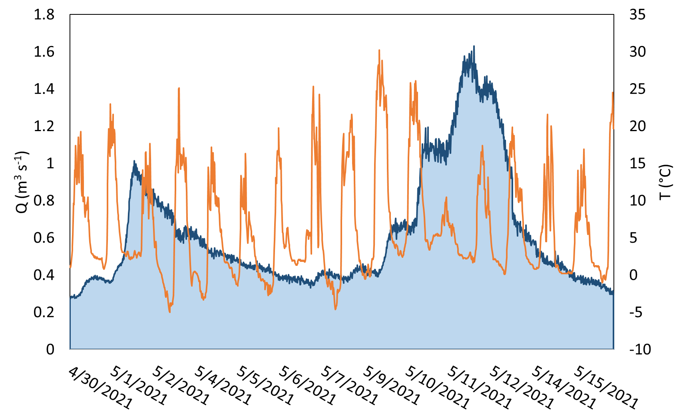
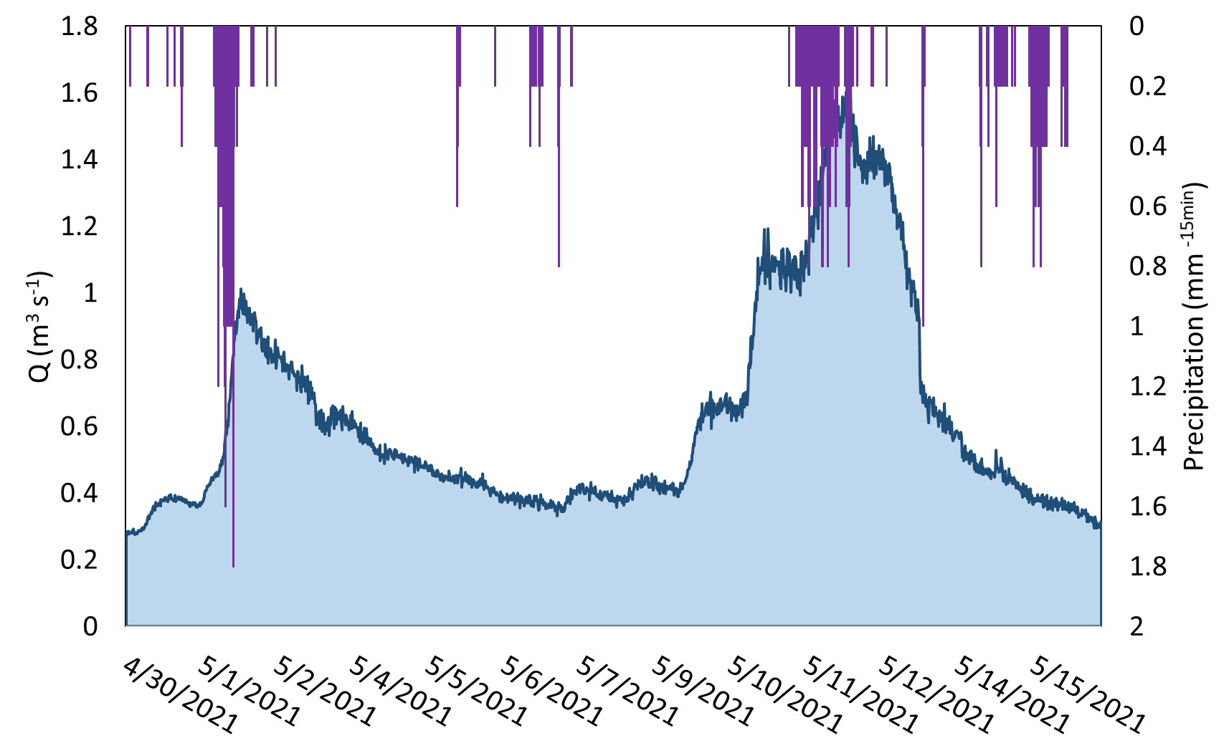
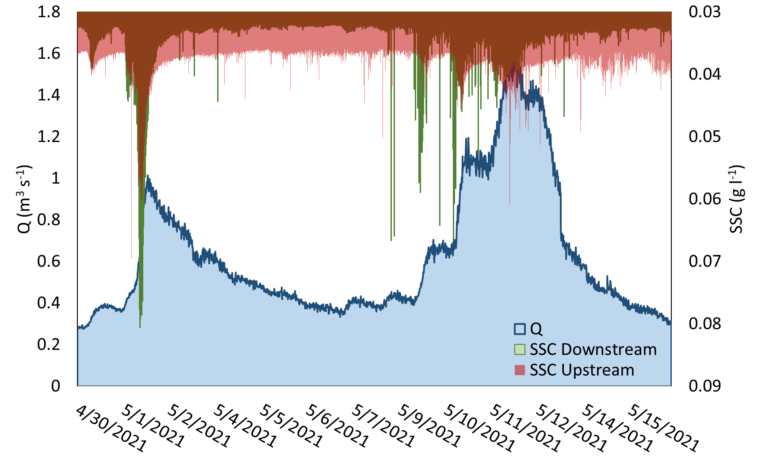

FLOOD EVENTS
Q
T°
Q
Precipitation

Slide 5
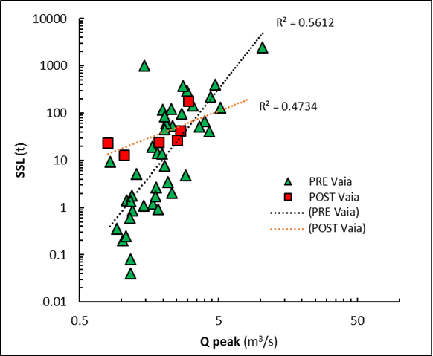
NEXT STEPS….
Overall (Prior and post Vaia) events by comparison
SSL trend - Snowmelt period

Slide 6
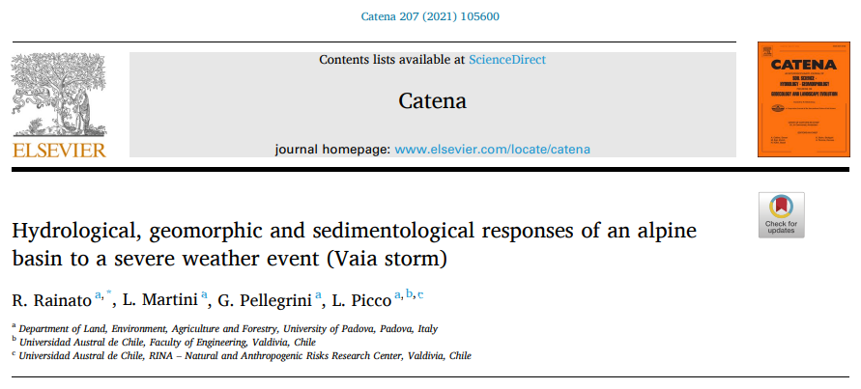

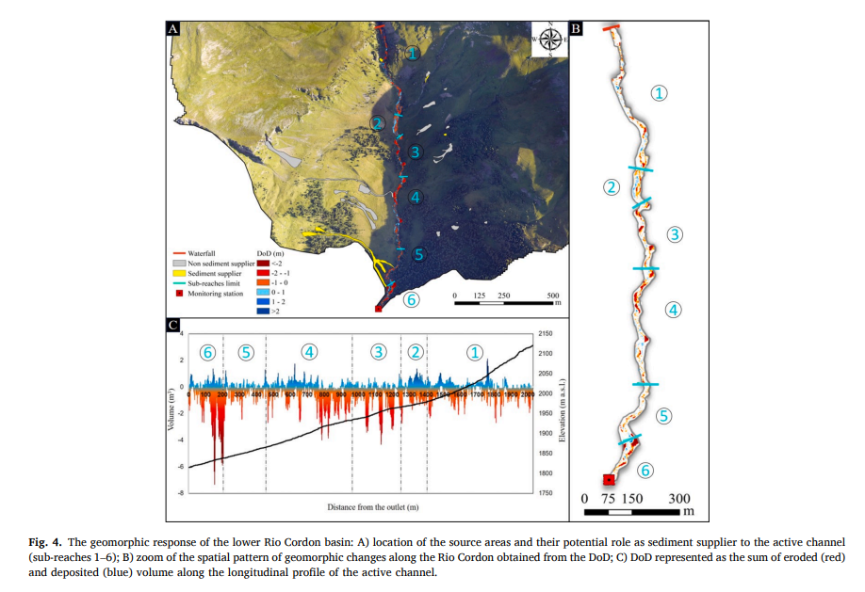
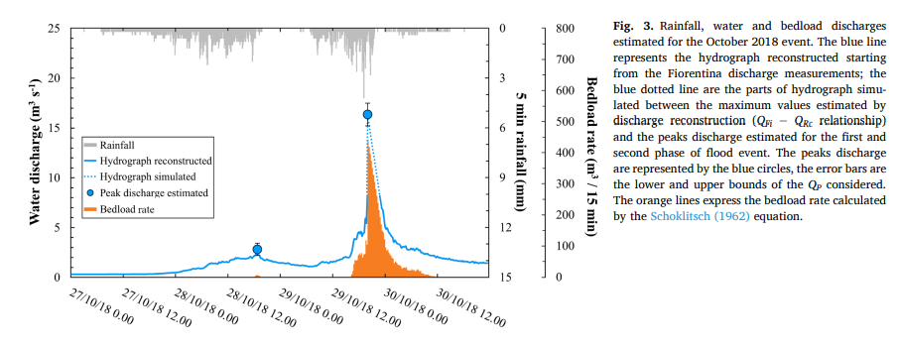
Doi: https://doi.org/10.1016/j.catena.2021.105600

