Slide 1
On differences in climate feedback evolution in abrupt4xCO2 climate model experiments
Kai-Uwe Eiselt and Rune Grand Graversen
University of Tromsø
EGU22 Generaly Assembly

Slide 2
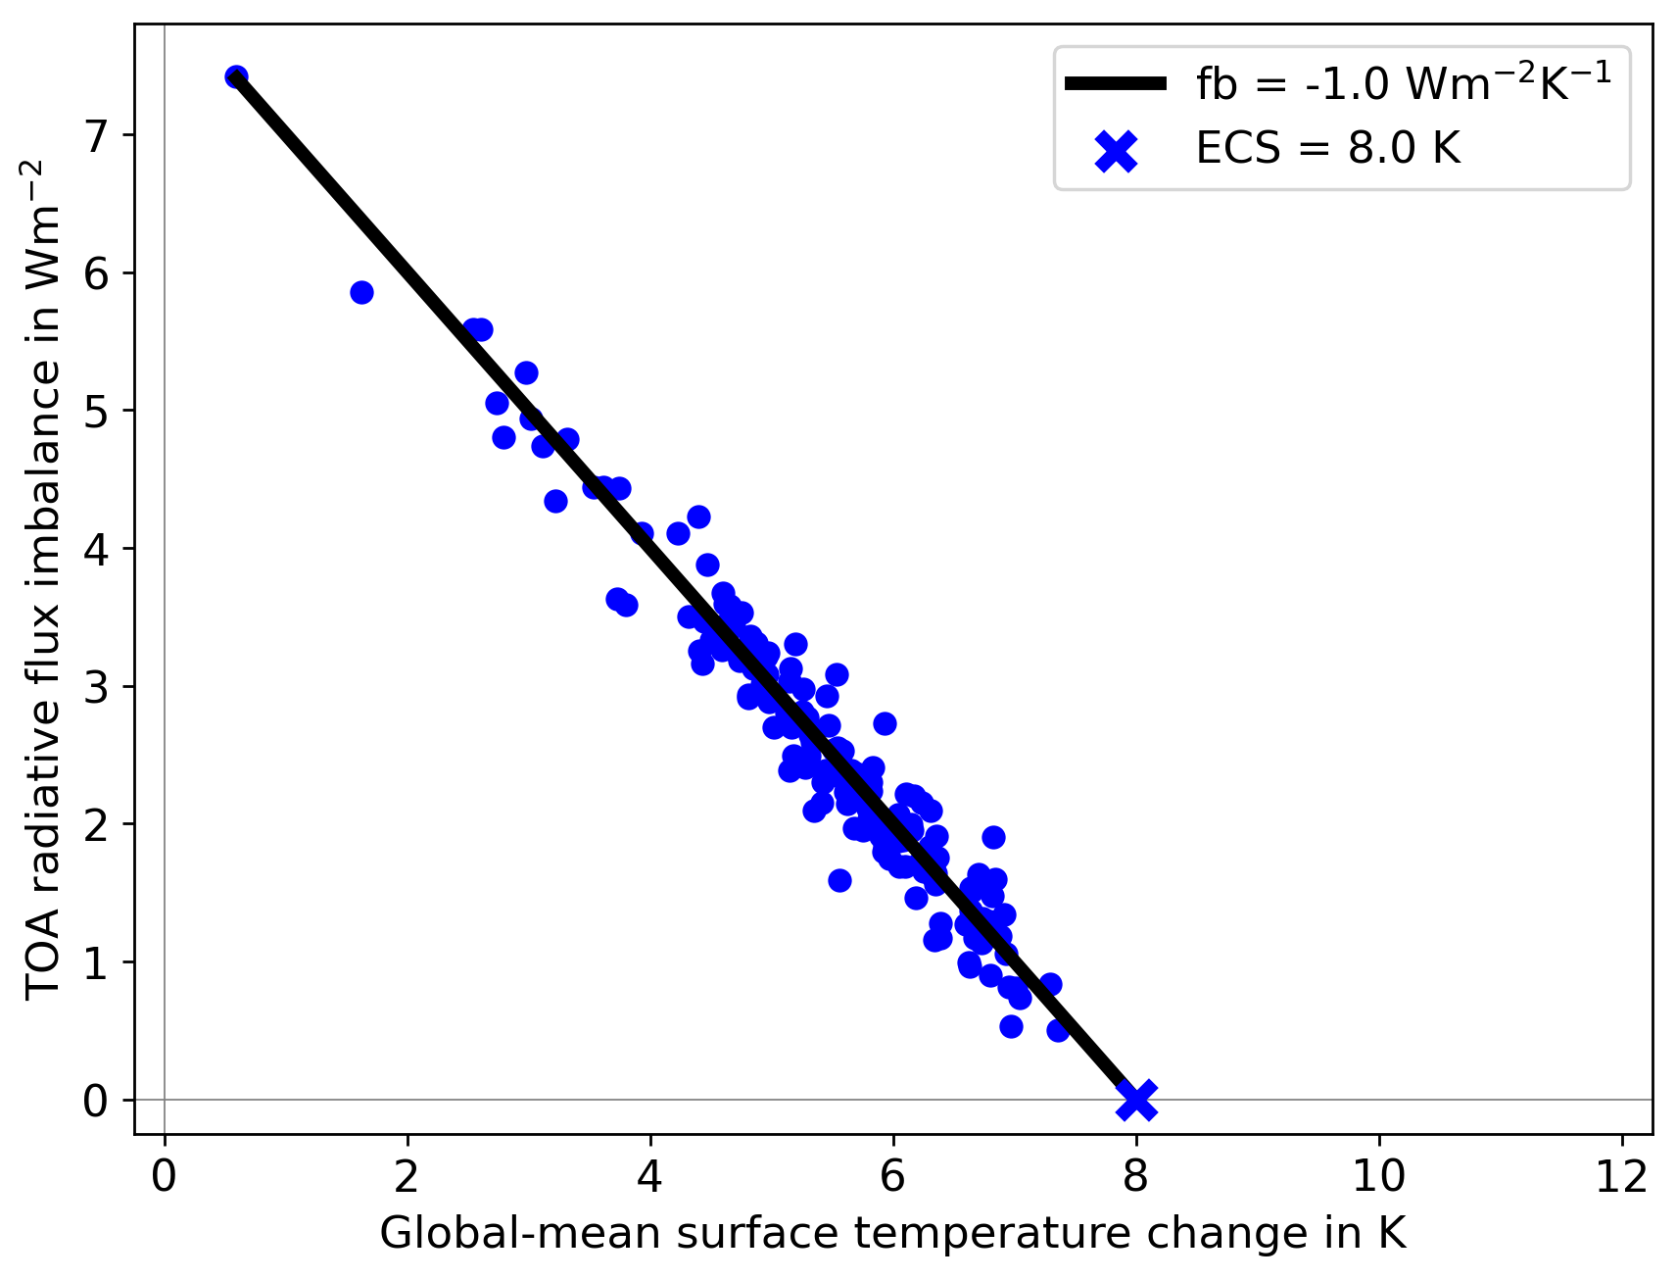
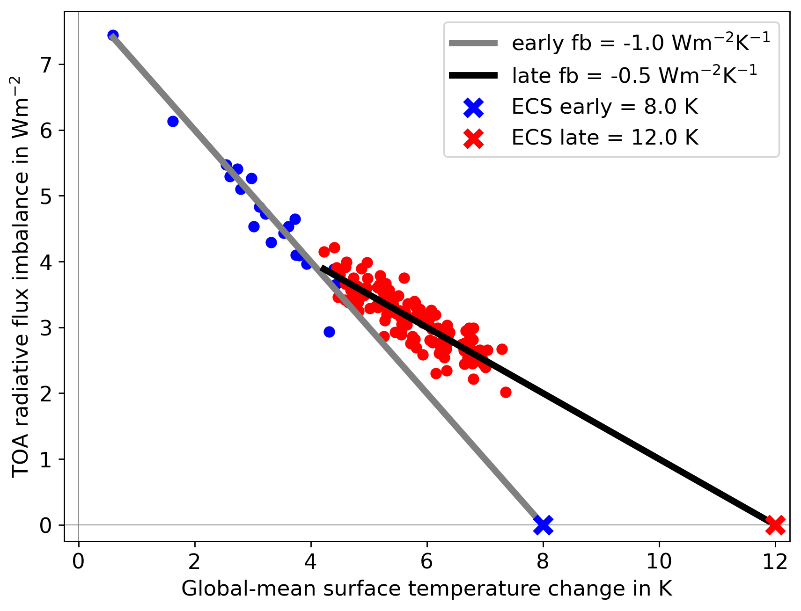
Changing Climate Feedback
slope = feedback

Slide 3
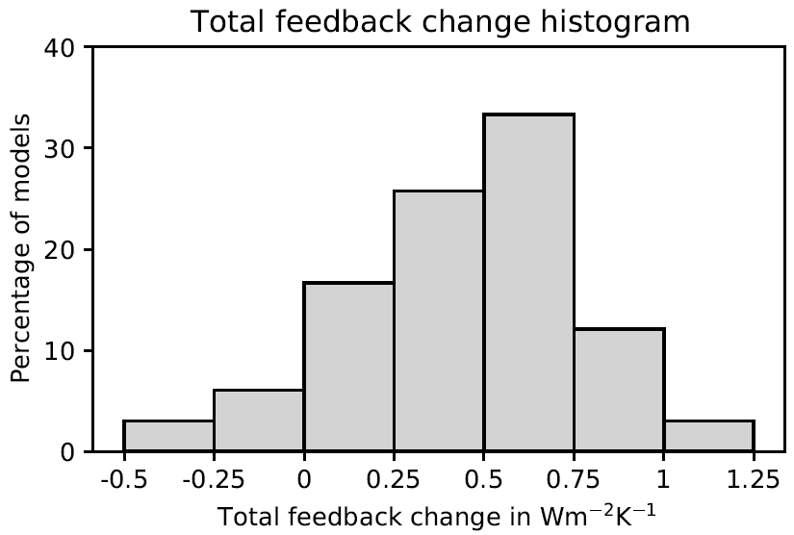
Changing Climate Feedback
decompose into process-related feedbacks
process-related feedbacks:
Planck
water vapour (WV)
cloud
surface albedo (SA)
lapse rate (LR)
extract two groups of models:
“G1” with small LR feedback change
“G2” with large LR feedback change
Eiselt and Graversen (2022), https://doi.org/10.1175/JCLI-D-21-0623.1

Slide 4
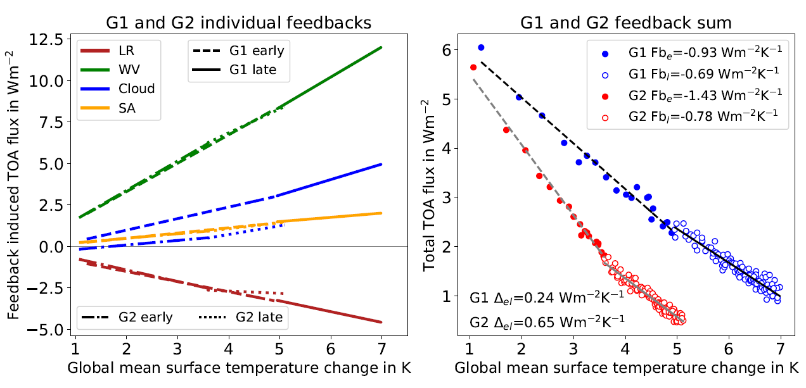
G1 – G2 Feedback Comparison

Slide 5
G1 – G2 Surface Warming Patterns

Slide 6
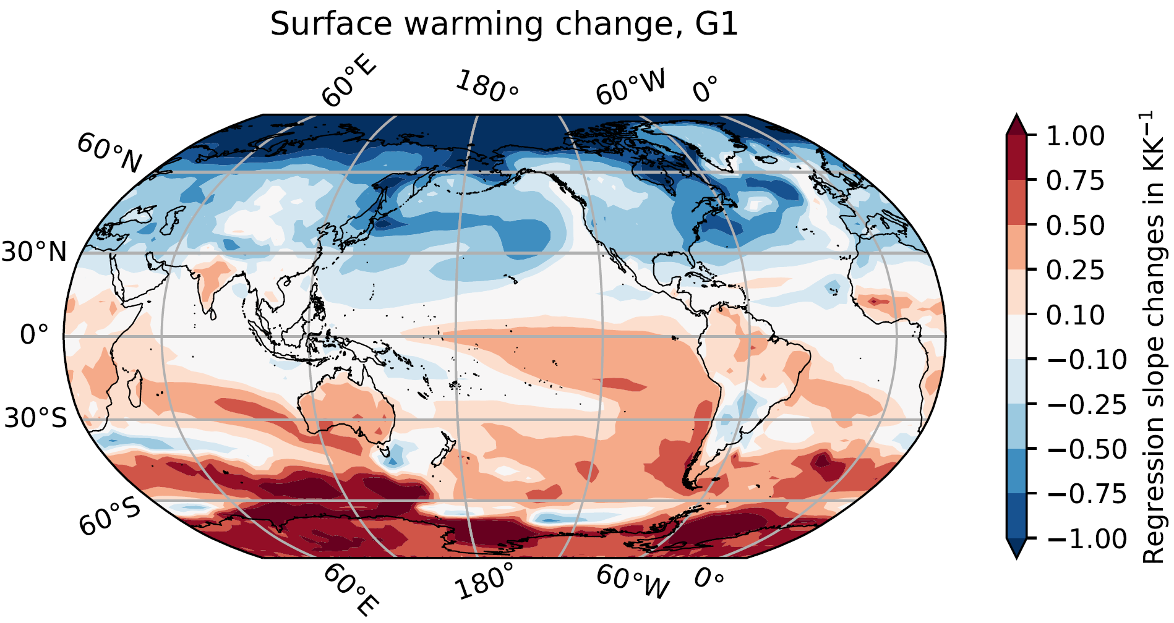
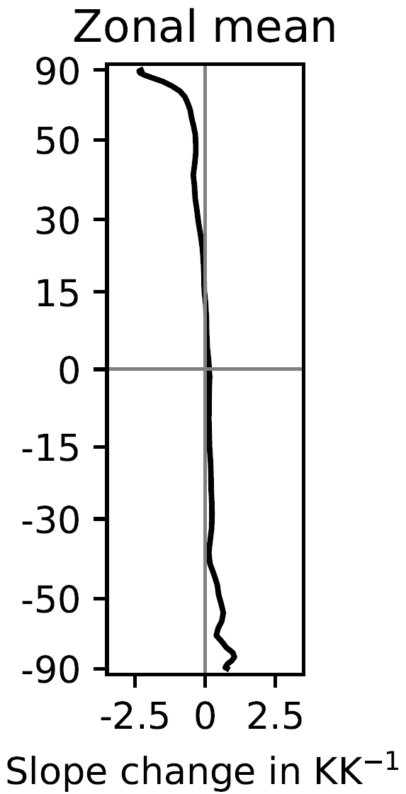
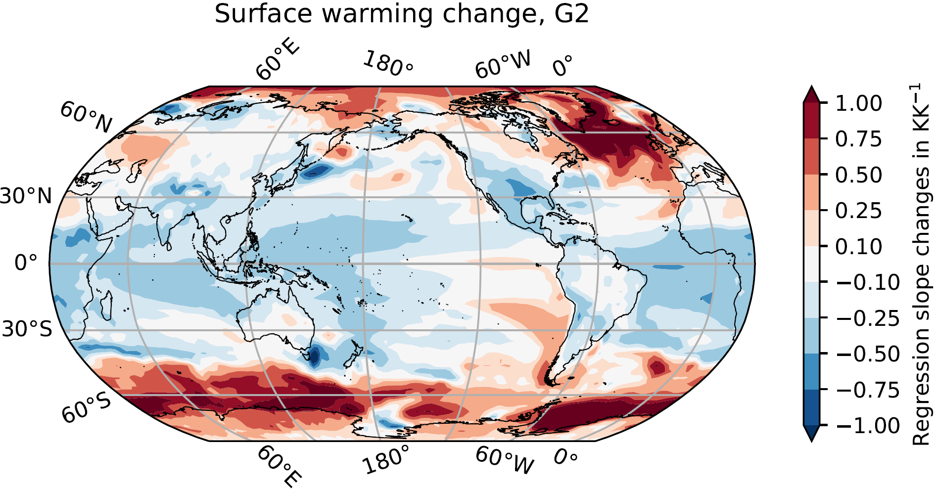
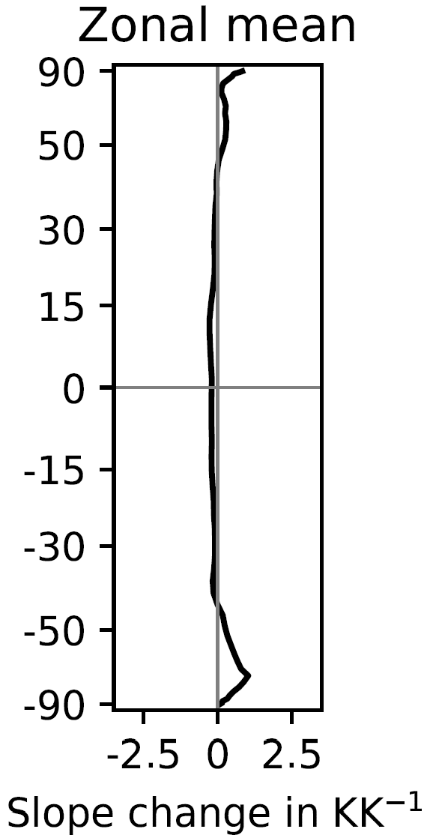
← small feedback change
Arctic
large feedback change →

Slide 7
Arctic Warming and Sea-Ice Extent (G1 and G2)

Slide 8
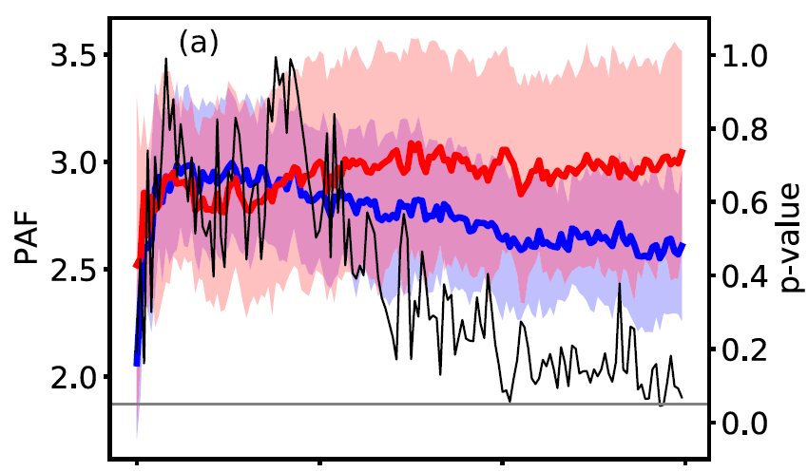
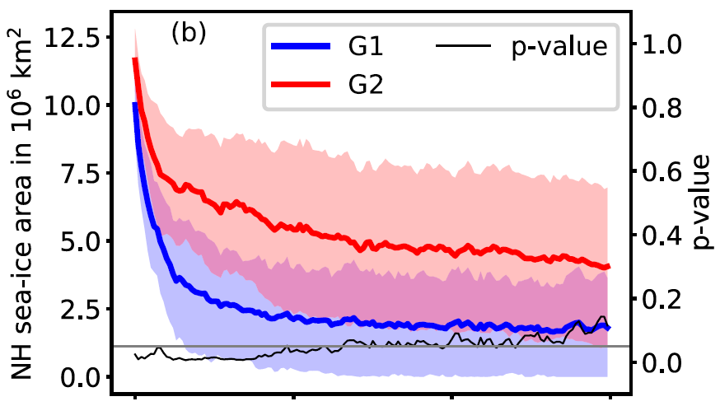
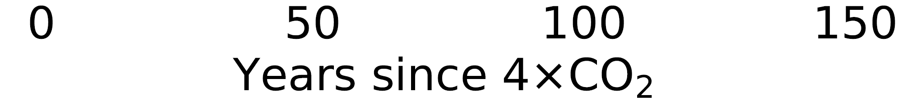
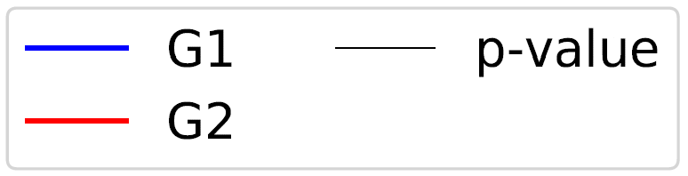
Arctic Amplification
Arctic Sea Ice

Slide 9
Summary
climate models disagree on feedback change over time
two model groups distinguished:
G1 with small (LR) feedback change
G2 with large (LR) feedback change
G1 and G2 exhibit distinctly different surface warming pattern changes; exceptionally large difference in the Arctic
Arctic differences traced to sea-ice development
Question: Causal connection between Arctic (sea ice) and global feedback change?

