Slide 1


Towards energy autonomy of small Mediterranean islands: Challenges, perspectives and solutions
European Geosciences Union General Assembly, Vienna, Austria & Online | 23–27 May 2022
HS5.2 – Innovation in Hydropower Operations and Planning to Integrate Renewable Energy Sources and Optimize the Water-Energy Nexus
Athanasios Zisos, Maria-Eleni Pantazi, Marianna Diamanta, Ifigeneia Koutsouradi, Anna Kontaxopoulou, Ioannis Tsoukalas, Georgia-Konstantina Sakki, and Andreas Efstratiadis Department of Water Resources & Environmental Engineering National Technical University of Athens, Greece

Slide 2
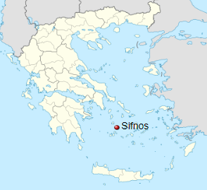
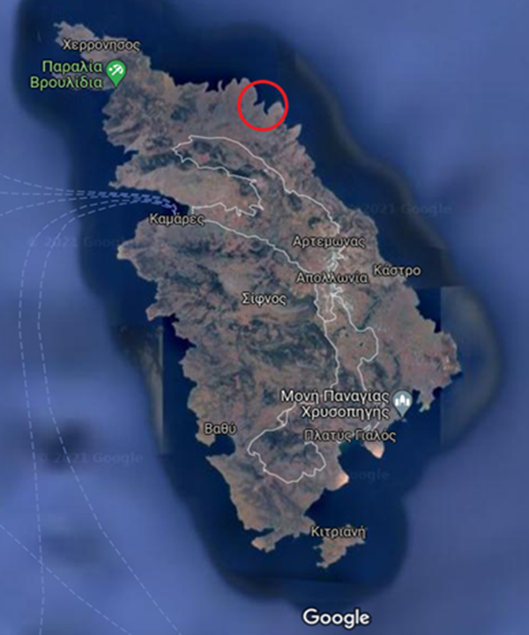

Motivation: Ensuring energy autonomy for Sifnos island
General characteristics:
Located in the western Cyclades complex
Area: 74 km²
Permanent population: 3 203 inhabitants
Up to 100 000 tourists during summer
Major geological formation: Dolomitic marble
Source: Wikipedia
Profile of current energy supply system:
Non-interconnected island
Energy production from a 9.0 MW oil power station
Small share from renewables (1.2 MW wind, 0.2 MW PV)
Total annual energy demand (2021): 17.3 GWh
Peak energy demand (summer period): 5.4 MW
Projected peak demand: 8.0 MW
Source: Google Earth
Research objective: Design of a hybrid power system based on seawater pumped-storage and two renewables (solar, wind)
Further info: Katsaprakakis & Voumvoulakis (2018)

Slide 3
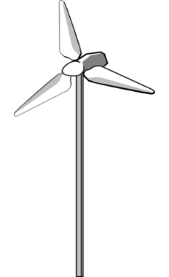

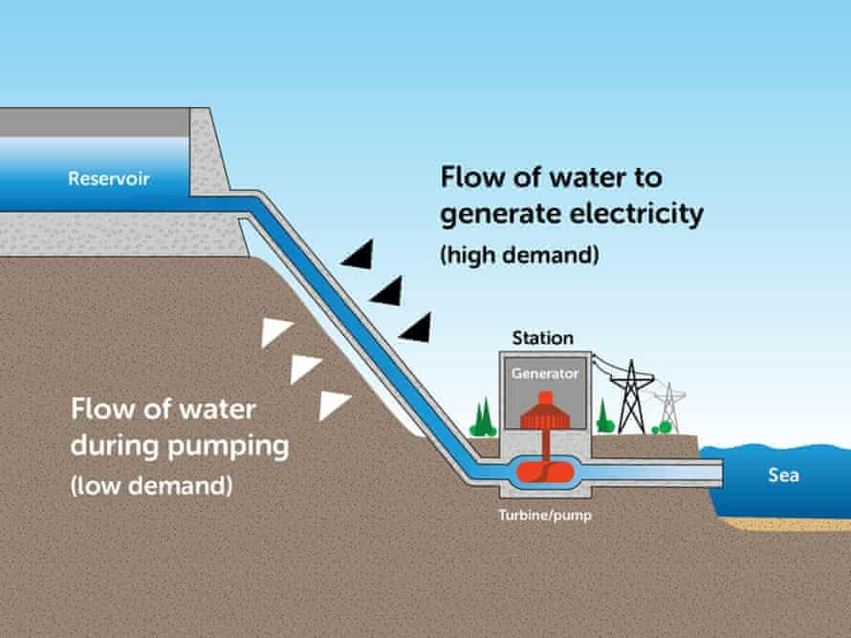
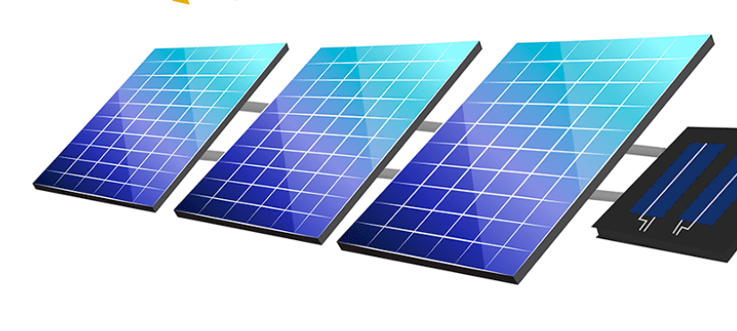
Conceptual scheme of proposed hybrid power system
Wind turbines Enercon E70 & E44
Rainfall
Evaporation
Power demand
Wind velocity
Reservoir
Power surplus/ deficit
Power station
Wind power
Actual storage S
Penstock
Generator
Power accounting
Sea
Solar radiation
Storage capacity: S_{max}
Total head: 320 m
Hydraulic losses: 15 m
Efficiency: 80-85%
Solar power
Turbine/pump
Photovoltaic park
Number of panels: N_{P}
Nominal power: 340 kW
Panel area: 1.94 m²
Setup of design optimization: Estimation of reservoir capacity and PV park size (number of panels) in order to maximize the anticipated net profit and system’s reliability

Slide 4
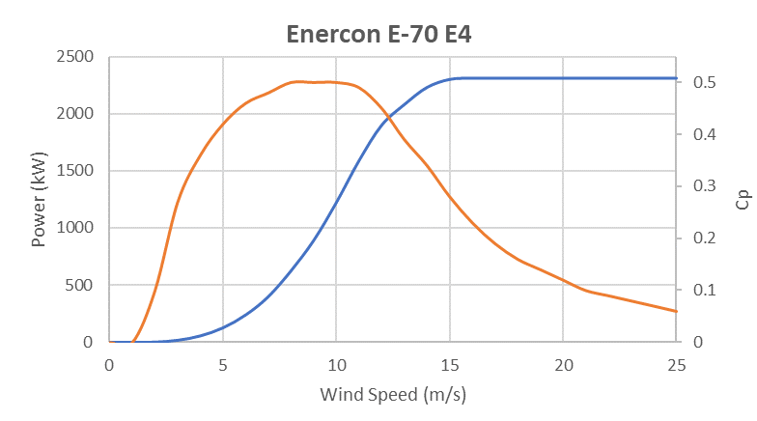
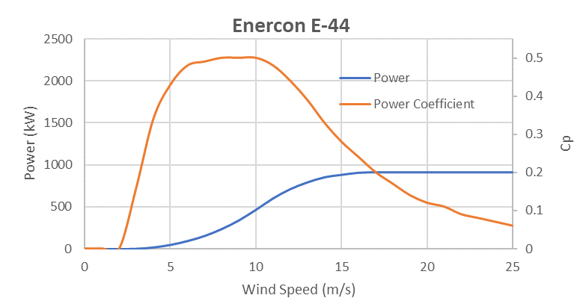
Stochastic simulation-optimization approach
System driven by inherently uncertain processes, i.e., meteorological and socioeconomic.
Stochastic simulation-optimization approach (Sakki et al., 2022), by using the anySim model (Tsoukalas et al., 2020) to provide synthetically generated hourly data for:
Wind velocity
Power demand (socioeconomic process)
Application of a typical annual profile for other meteo-rological processes (solar radiation, rainfall, evaporation).
System design optimization under multiple input data scenarios of 10 years length.
Preliminary investigations impose the use of a suitable turbine mix to maximize the available wind potential (key challenge: avoid energy losses due to often cut-offs).

Slide 5
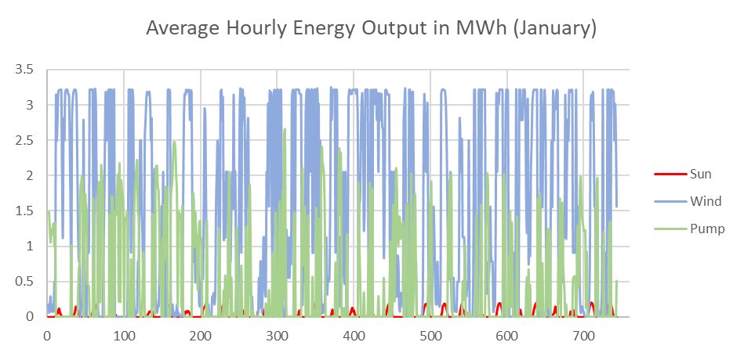
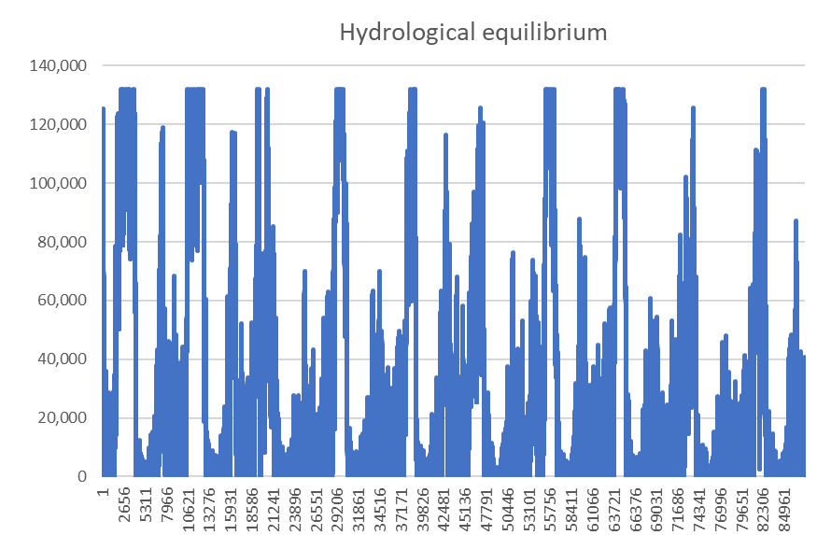
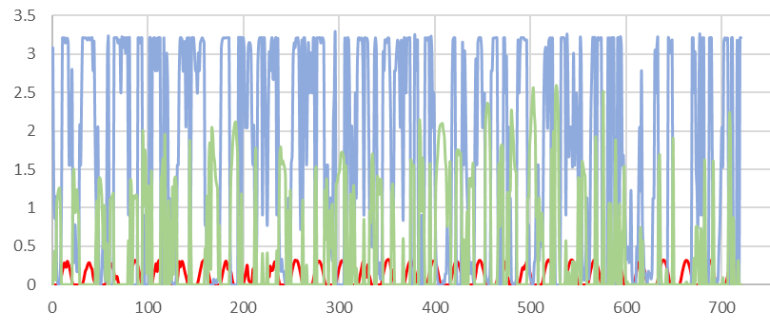
Outcomes of simulation procedure
System outputs:
Energy fluxes (power generation per source, power consumption due to pumping)
Water fluxes (reservoir storage, penstock flow)
Financial fluxes (depreciated construction costs, maintenance costs, energy production revenues)
Sharing of energy production (MWh)
January
Reservoir storage (m³)
June

Slide 6
Optimization under uncertainty
Investigation of two optimization settings:
Setting A: Minimization of system’s failure probability (= frequency of power deficits)
Setting B: Full depreciation of investment costs for given time horizon
The two settings provide substantially different results, yet setting B ensures a more economic design (impressive reduction of reservoir size, reduction of PV panels), with minimal decrease of reliability.
Multiple combinations of optimized design variables, induced by wind and power demand uncertainty.
Summary results of the two stochastic optimization settings (mean values of synthetic scenarios, standard deviations in parentheses)
 | Setting A | Setting B
Number of solar panels | 3 587 (562) | 2 825 (1 085)
Reservoir capacity | 443 340 (170 019) | 89 313 (17 914)
Reliability (%) | 82.81 (1.22) | 78.58 (1.51)
Investment costs (10⁶ €) | 30.60 | 19.60

Slide 7
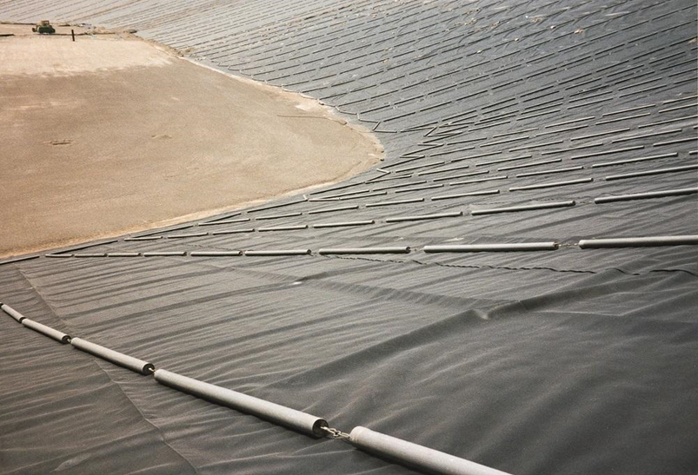
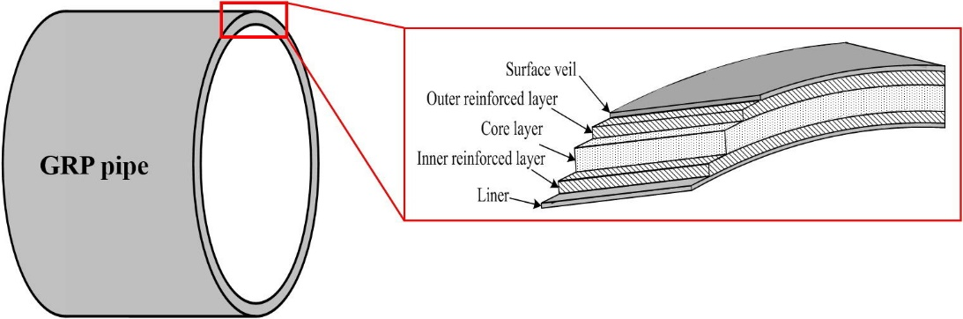
Other engineering challenges & provided solutions
Pipe erosion:
Pipe material: GRP
Significant reduction of friction losses
Increased durability to UV radiation
Achieving flow velocity within safety limits (0.6 – 6.0 m/s)
Tank waterproofing:
Application of HDPE geomembranes
High resistance in tension, puncture, environmental stress cracking and chemicals
Erosion of electro-mechanical equipment:
Stainless steel equipment
High resistance in seawater erosion
Source: Yoon and Oh (2015)
Source: Plastika Kritis S.A.

Slide 8
References
Katsaprakakis, D. A., and M. Voumvoulakis, A hybrid power plant towards 100% energy autonomy for the island of Sifnos, Greece. Perspectives created from energy cooperatives, Energy, 161, 680-698, doi:10.1016/j.energy.2018.07.198, 2018.
Sakki, G.-K., I. Tsoukalas, P. Kossieris, I. C. Makropoulos, and A. Efstratiadis, Stochastic simulation-optimisation framework for the design and assessment of renewable energy systems under uncertainty, Renewable and Sustainable Energy Reviews, 2022 (submitted; preprint available at https://ssrn.com/abstract=4109850).
Tsoukalas, I., P. Kossieris, and C. Makropoulos, Simulation of non-Gaussian correlated random variables, stochastic processes and random fields: Introducing the anySim R-Package for environmental applications and beyond, Water, 12(6), 1645, doi:10.3390/w12061645, 2020.
Yoon, S. H., and J. O. Oh, Prediction of long term performance for GRP pipes under sustained internal pressure, Composite Structures, 185-189, 134, doi:10.1016/j.compstruct.2015.08.075, 2015.
Zisos et al., Towards energy autonomy of small Mediterranean islands: Challenges, perspectives and solutions

