Slide 1

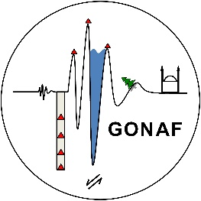

3D lithospheric structure below Marmara Sea from gravity modelling and seismic tomography
Naiara Fernandez¹, Magdalena Scheck-Wenderoth^{1,2},
Judith Bott¹, Mauro Cacace¹, Ershad Gholamrezaie³
naiara@gfz-potsdam.de
1. GFZ Helmholtz-Zentrum Potsdam - German Research Centre for Geosciences, Potsdam Germany
2. Faculty of Georesources and Materials Engineering, RWTH Aachen University, Germany
3. Department of Informatics, University of Umea, Sweden
DEMMAF: DEformation Mechanisms along the Main MArmara Fault

Slide 2
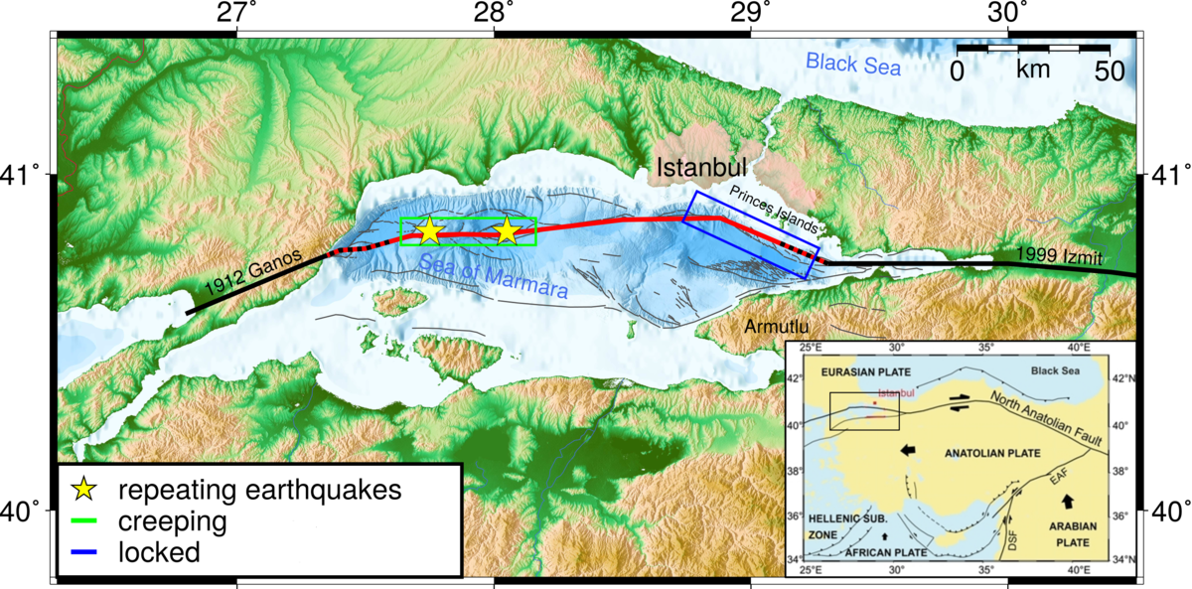
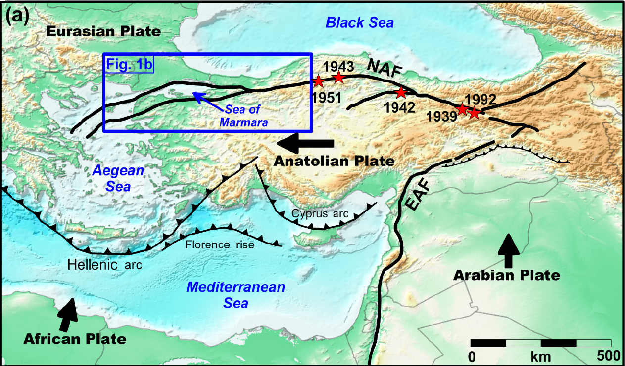
Deformation along Main Marmara Fault
Gholamrezaie et al., 2019
Does rheological configuration control deformation mechanisms along-fault?
What is Crustal and Lithosphere Structure + Thermal State?
Image from https://www.gonaf-network.org/

Slide 3
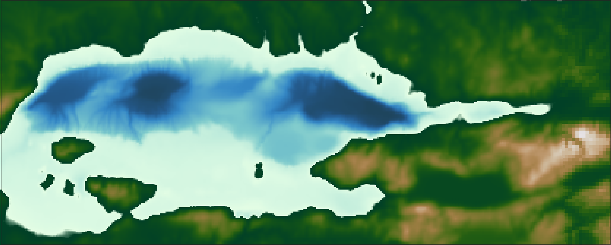
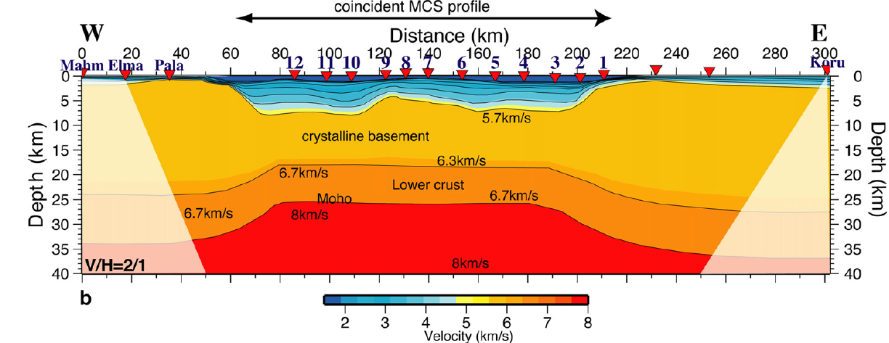
Constraints on Crustal Structure
cross-section
100 km
Sedimentary basins: seismic surveys, isopachs maps, geological maps…
250 km
Observation from 2D
refraction/reflection:
Moho uplifted below
Marmara Sea
Crustal
structure?
Moho topography: seismic reflection/refraction surveys, receiver functions…
(from Becel et al., 2009)

Slide 4
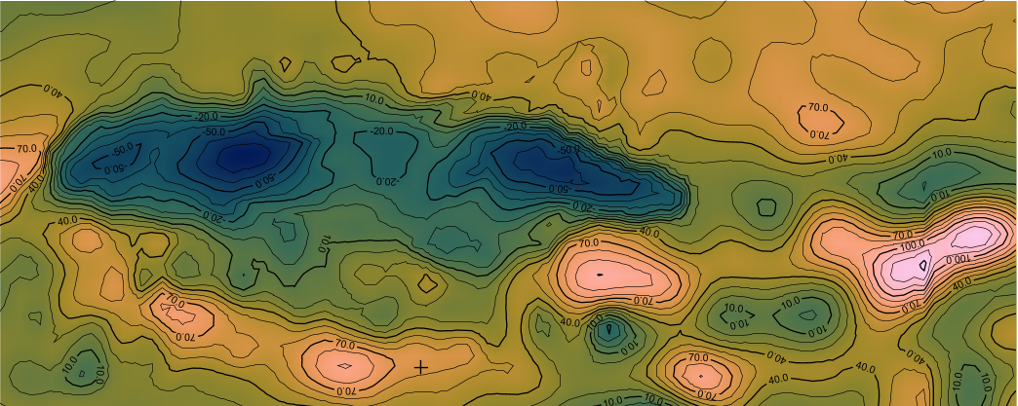
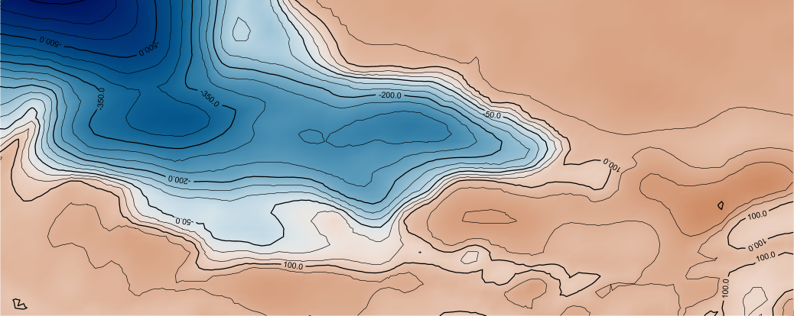
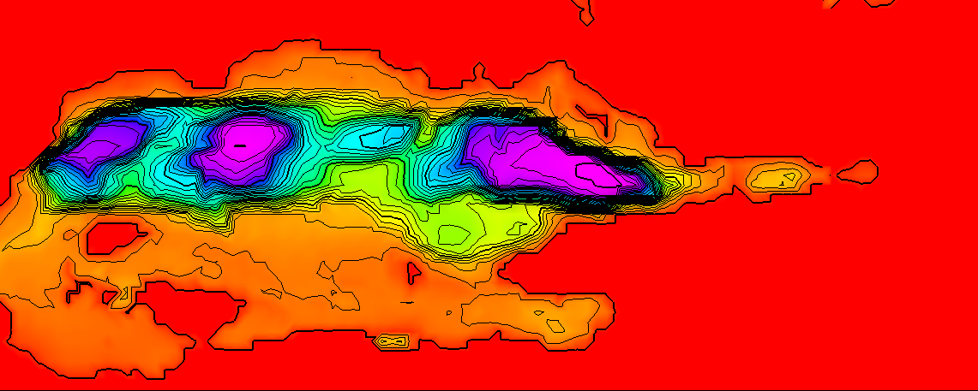
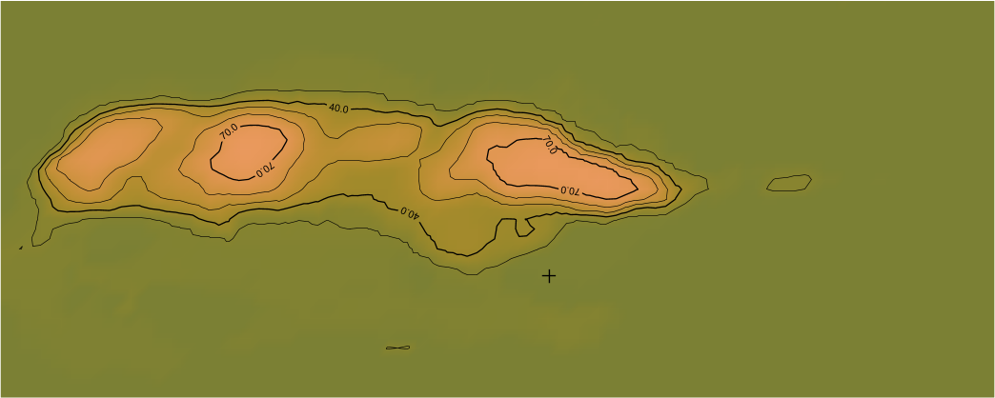
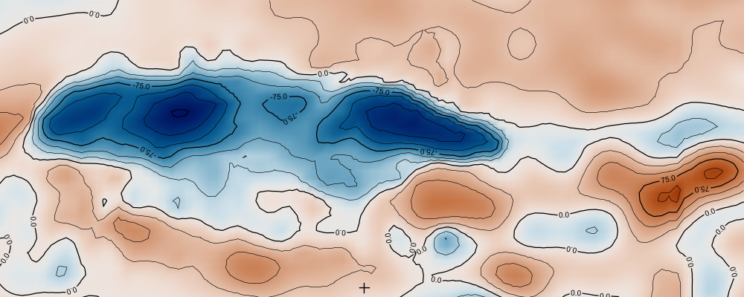

Gravity Back-Stripping
Measured Gravity Field
1. Calculate gravity effect of each unit/layer.
2. Remove gravity effect from gravity field.
3. Obtain residual gravity anomalies.
Water Column
Water Gravity signal (1025 kg/m³)
Residual Anomaly
Residual gravity anomaly, free of water and sediments.
Contains signal from crust and mantle and Moho
Thick
Thin
Low
High
Negative
Positive
Thickness
Calculated Anomaly
Residual Anomaly
Free-air gravity dataset from Kende et al., 2017
Forward gravity modelling performed with IGMAS+ software

Slide 5
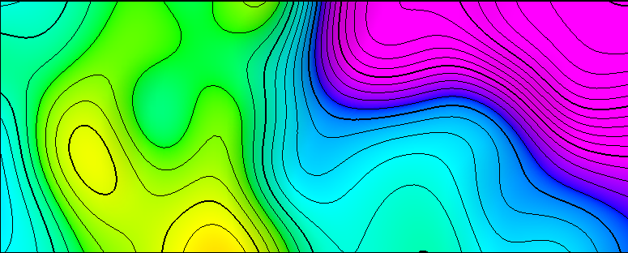
Moho Topography in Study Area
100 km
Moho by Jenkins et al. 2021. Based on receiver functions and local 3D full-waveform tomography.
250 km
Depth
Surface was filtered with a Low Pass Filter, wavelength = 80 km
-35 km
-25 km

Slide 6
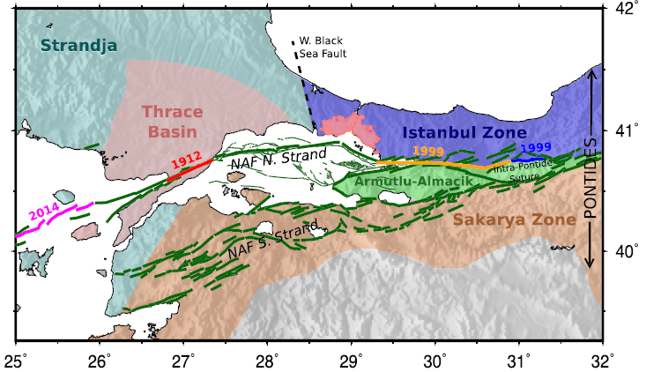
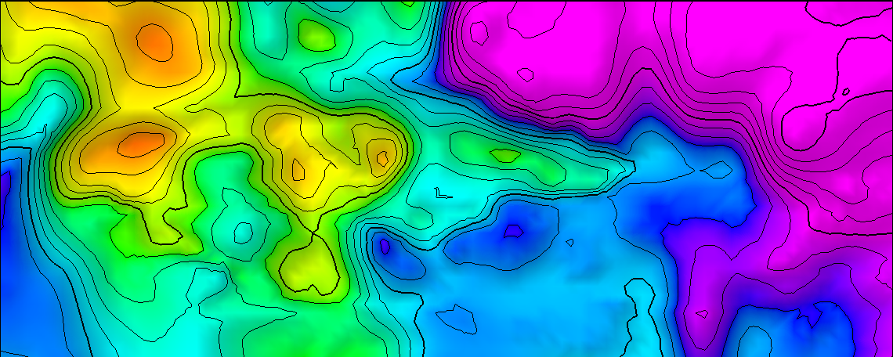
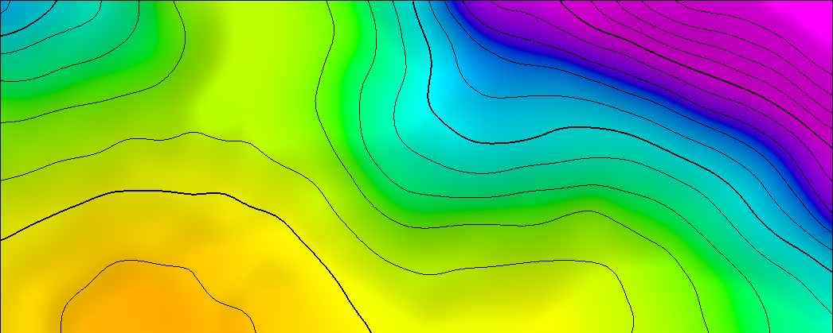
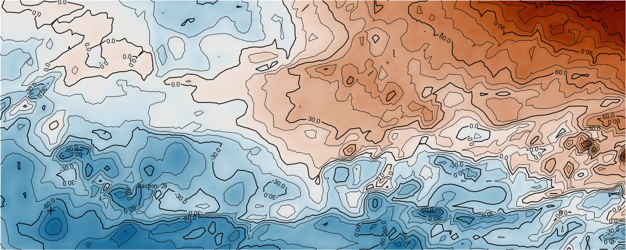
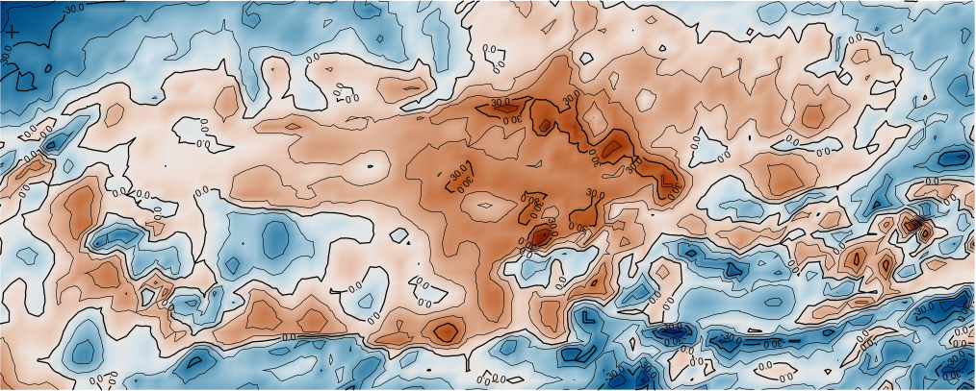
Gravity Inversion for Crustal Structure
Total Crustal Thickness
(Jenkins et al. 2021)
Inverted Lower (denser) Layer Thickness
20 km
High density
Crust
Thicker
Crustal Thickness
Layer Thickness
35 km
Thinner
Positive
Single Crustal Layer Gravity Residual
Gravity Residual for Two Crustal Layers
Gravity Residual
Negative
Gravity Inversion performed with Fatiando a Terra / Harvester (Ueida & Barbosa, 2012).
Excess density of the lower crustal layer: 250 kg/m³

Slide 7
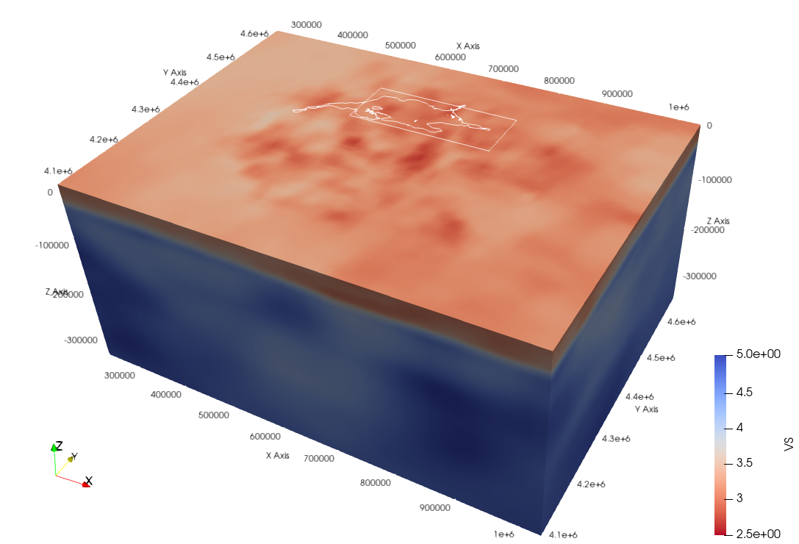
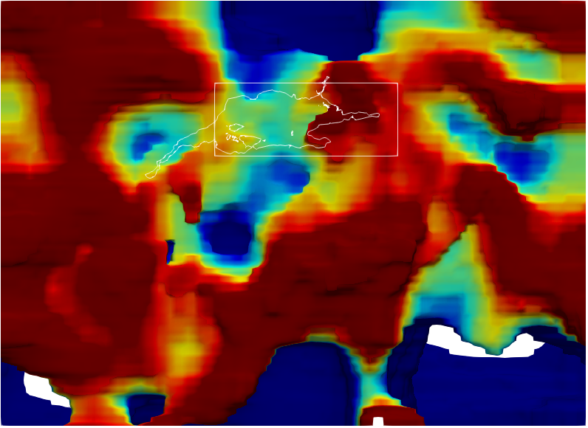
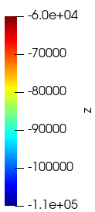
Thermal Structure from Tomography
Vs can be used to obtain T of the lithospheric mantle (depths > 50 km).
80 km
Depth
110 km
1330 C Isotherm (thermal LAB) extracted from converted T values
CSEM East_Med tomography model (Blom et al., 2020)
Vs to T conversion performed with Python application by Kumar et al., 2022

Slide 8
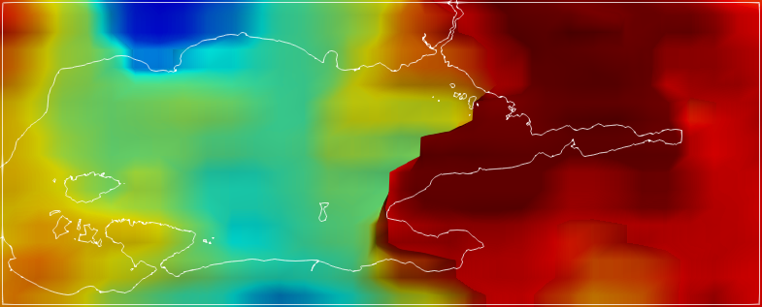
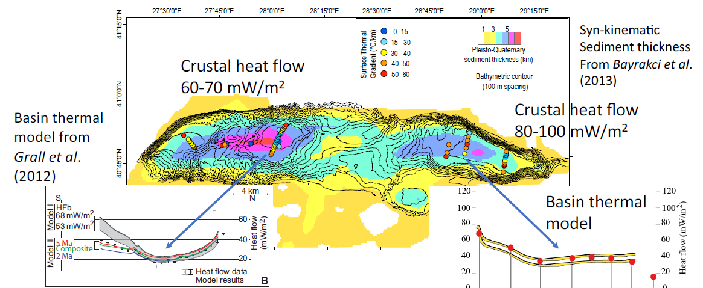
Thermal Structure from Tomography
Isotherm of T = 1330 C (~LAB)
Eastern Marmara Sea:
-Shallower 1330 C isotherm
-Higher Temperatures
Central Marmara Sea:
-Deeper 1330 C isotherm
-Lower Temperatures
80 km
(from Henry et al., EGU2020)
Depth
110 km

Slide 9
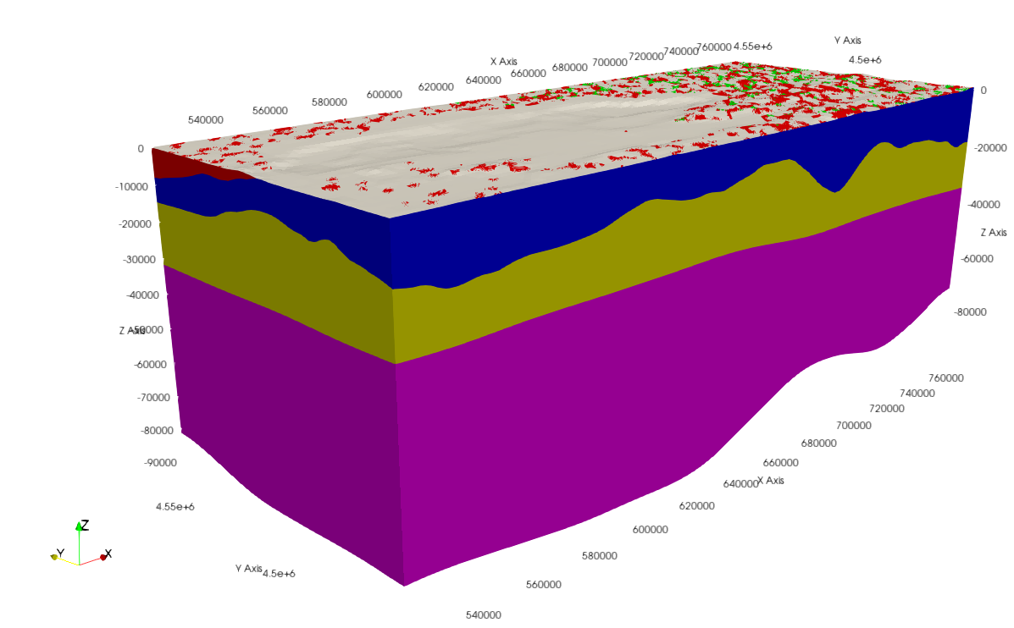
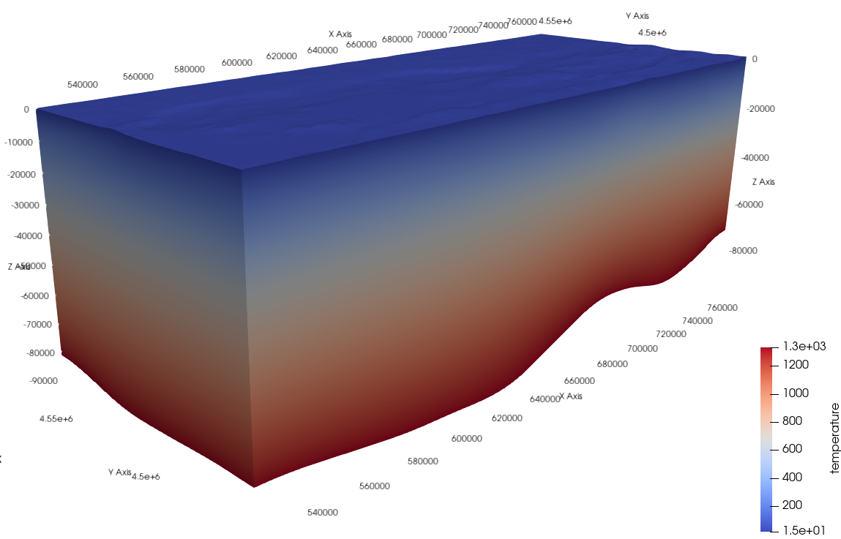

What is next? Outlook
Moho
Thrace Basin
Crustal/Lithosphere Structure
+
Thermal State
UC/LC
Moho
LAB
LAB
Thermal Modelling
Next step:
Rheological configuration controls on deformation mechanisms along-fault?
Modelling performed with GOLEM (Jackey & Cacace, 2017)

Slide 10
Thank you!
naiara@gfz-potsdam.de
Acknowledgements:
Pierre Henry from CEREGE for providing the gravity dataset
Collaborative Seismic Earth Model (CSEM) at ETH Zurich for providing the tomography datasets
DEMMAF: DEformation Mechanisms along the Main MArmara Fault

