Slide 1




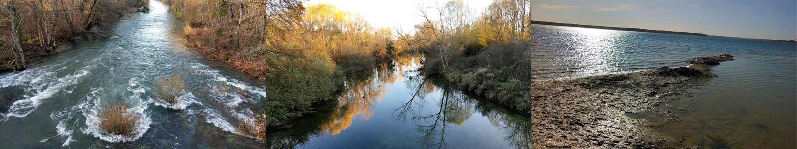
Reservoirs change downstream water quality and pCO₂: a case study in reservoirs of the Seine Basin (France)
Xingcheng Yan, Vincent Thieu, Josette Garnier
Sorbonne University, UMR 7619, METIS
2022.05.23

Slide 2
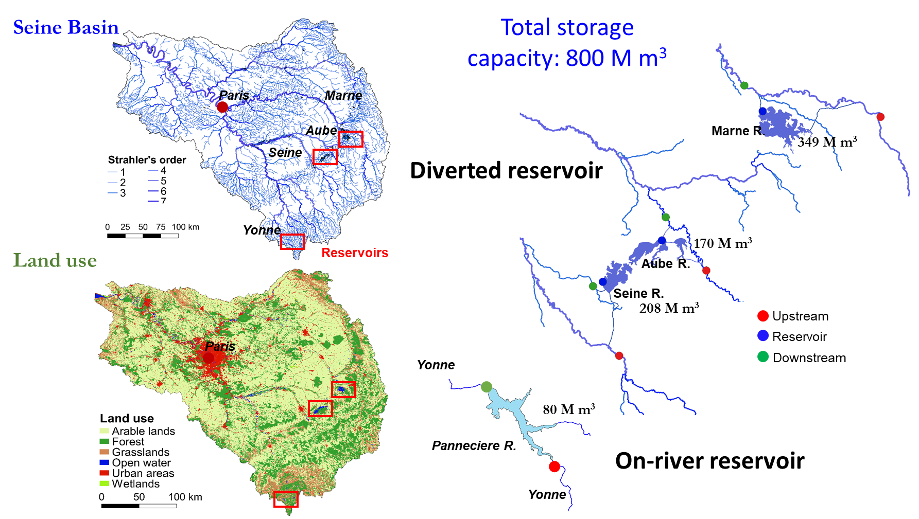
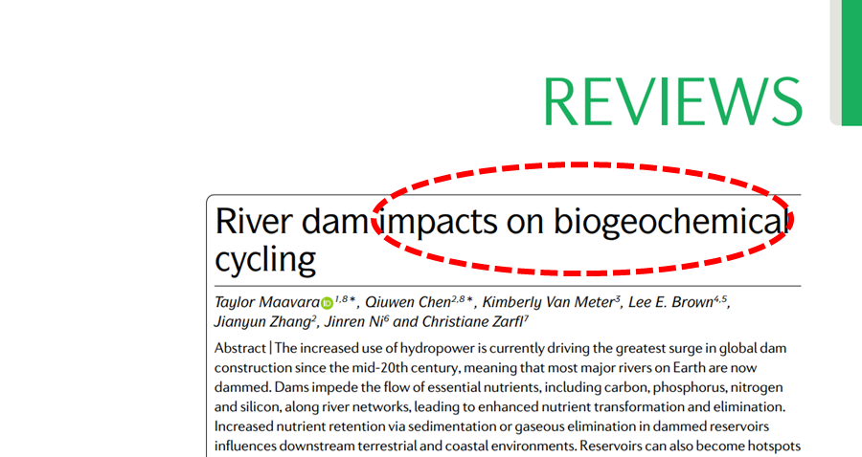
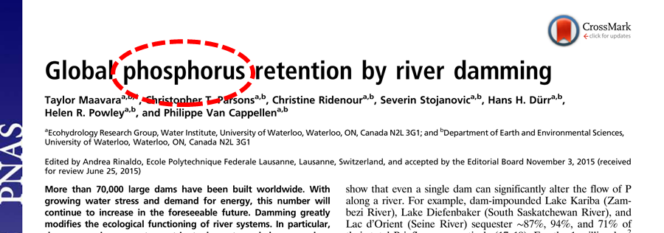
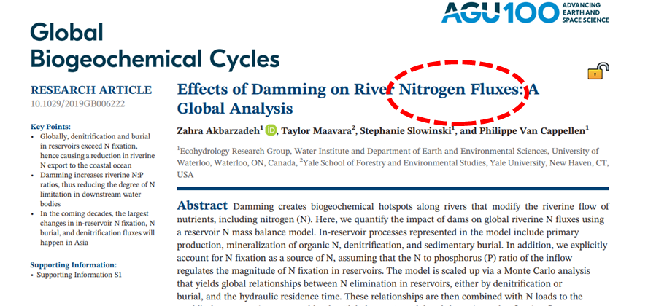
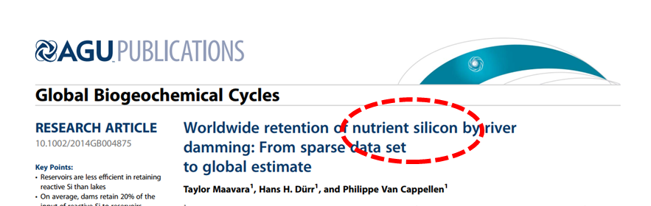
Research context
Study sites
Reservoirs impact the biogeochemical cycling of C, N, P, and Si along the land-to-ocean aquatic continuum.
Four reservoirs in the upstream of the Seine Basin
Main objective of this study is to explore the impact of these reservoirs on their downstream water quality, including nutrient concentrations and pCO₂.

Slide 3
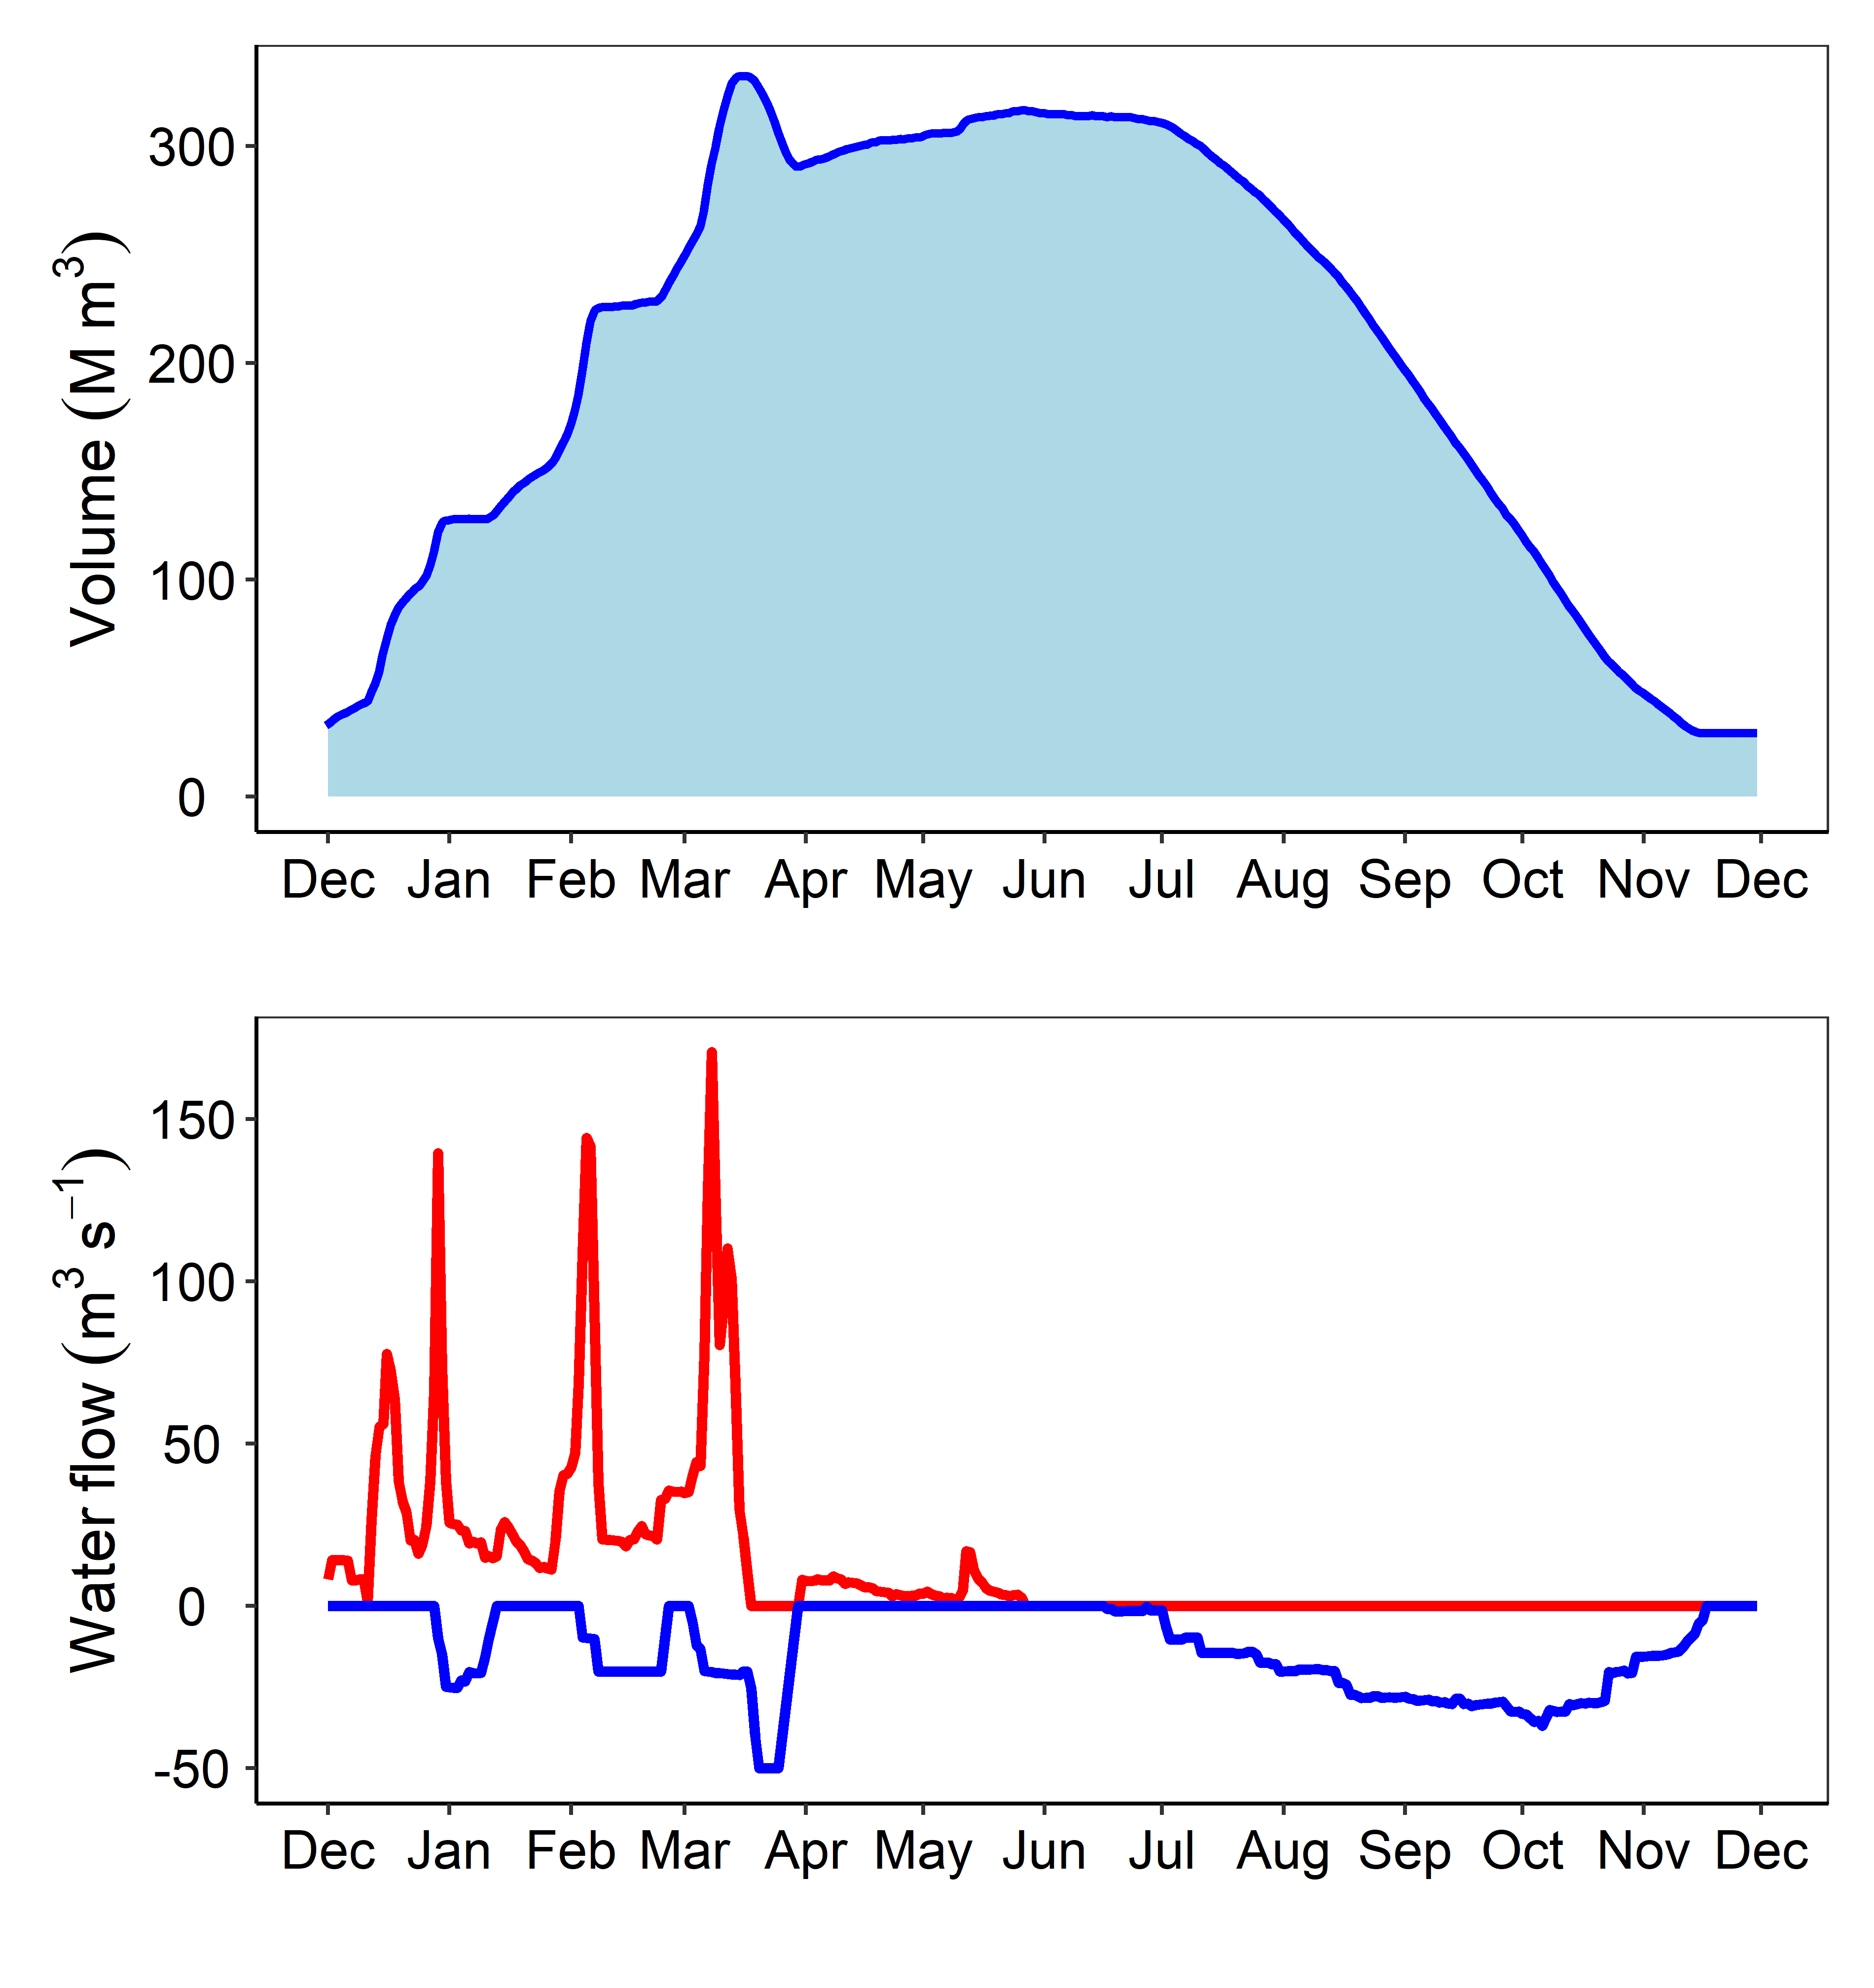
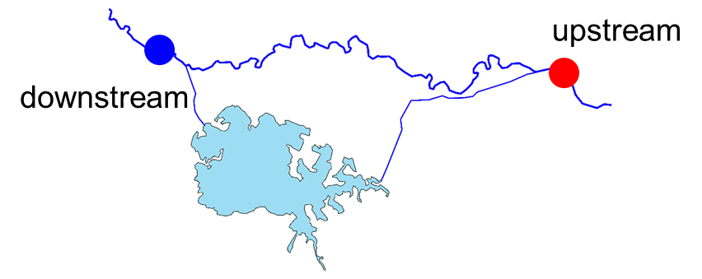
How to identify the impact of the reservoirs on their downstream rivers?
Hydrological characteristics
Comparing upstream and downstream water quality respectively during the filling period and the emptying period.
Emptying period
Filling period
Flow in
Flow out
Hypothesis:
Significant difference in water quality variables between upstream and downstream will be found during the emptying period, while not during the filling period.

Slide 4
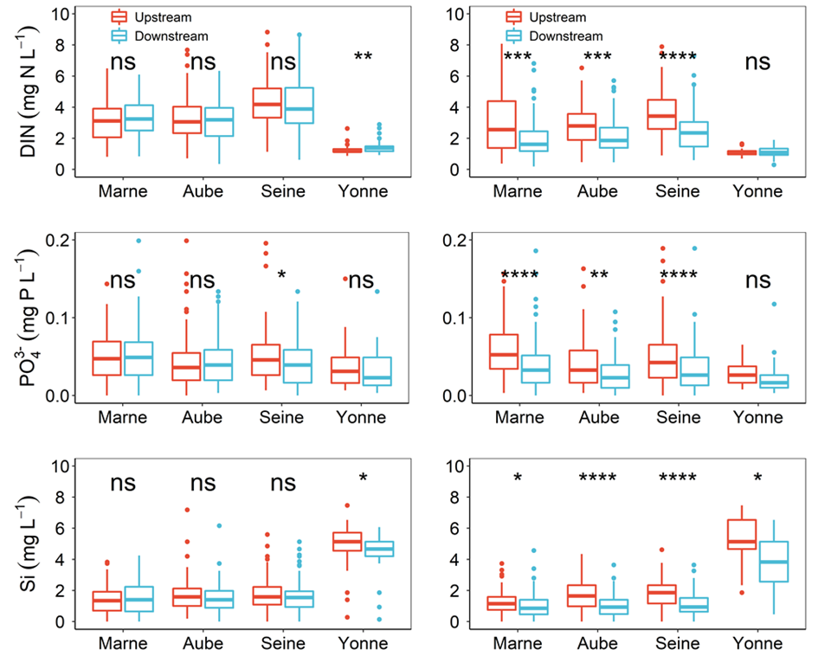
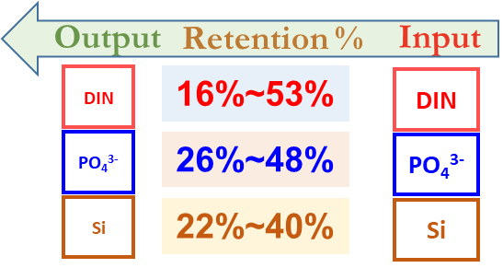
Results: reservoirs change downstream water quality (nutrient concentrations)
Filling period
Emptying period
Three diverted reservoirs (Marne, Aube, and Seine) significantly decline downstream DIN, PO₄³⁻-P, and DSi concentrations during the emptying period.
Nutrient retention rates in the four reservoirs
The four reservoirs play important roles in the retentions of DIN, PO₄³⁻-P, and DSi.
Yan et al., 2021, STOTEN (data used from 1998 to 2018)

Slide 5
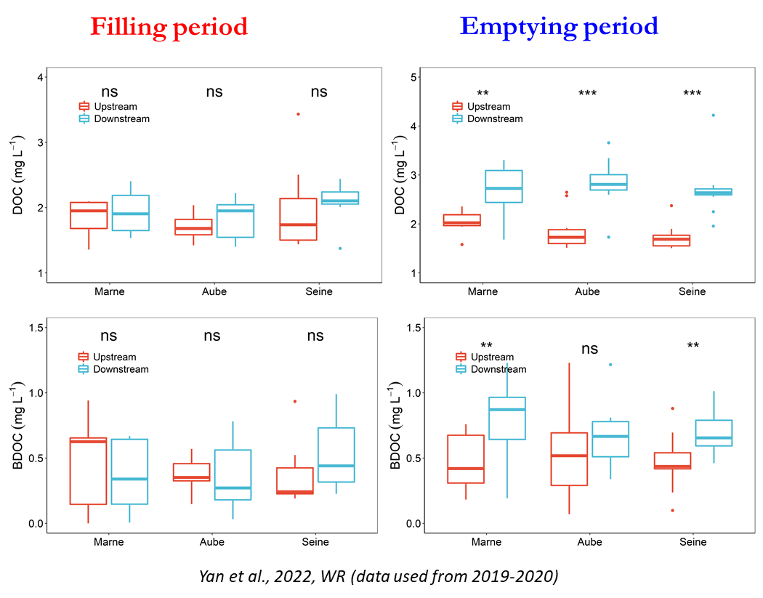
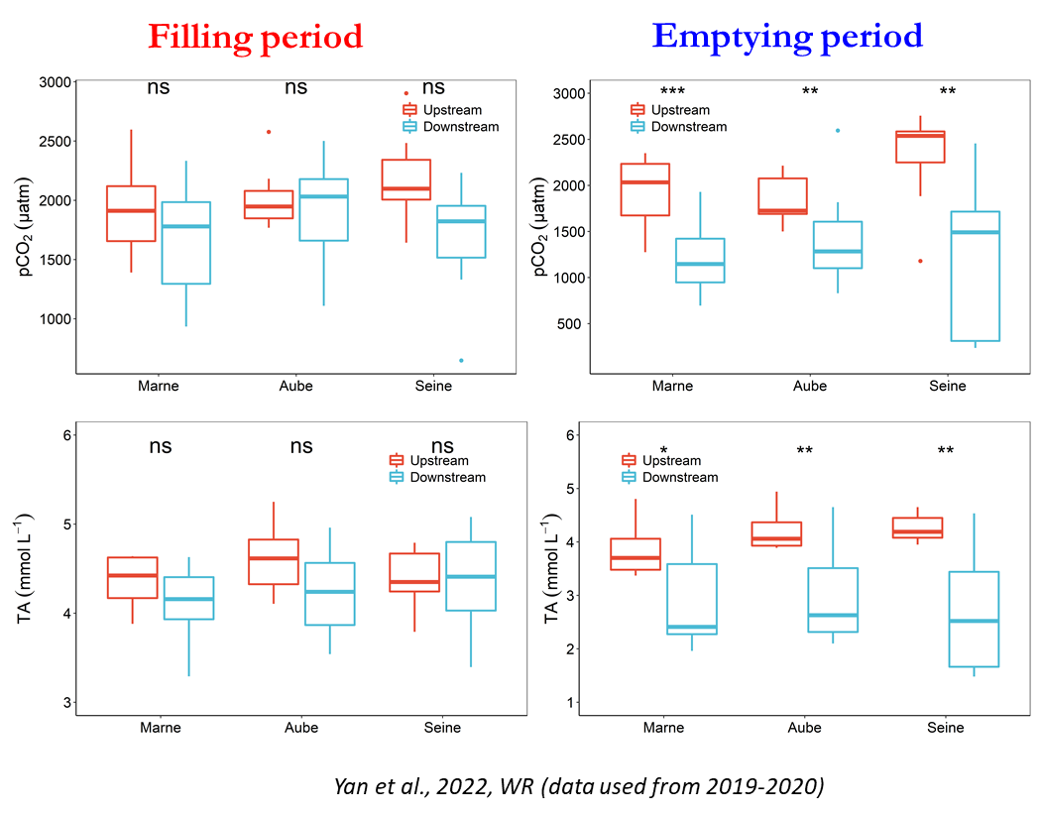
Results: reservoirs change downstream water quality (DOC, BDOC, TA and pCO₂)
Three diverted reservoirs (Marne, Aube, and Seine) significantly increase downstream DOC and BDOC concentrations during emptying period.
Three diverted reservoirs (Marne, Aube, and Seine) significantly decline downstream pCO₂ and TA during emptying period.

Slide 6
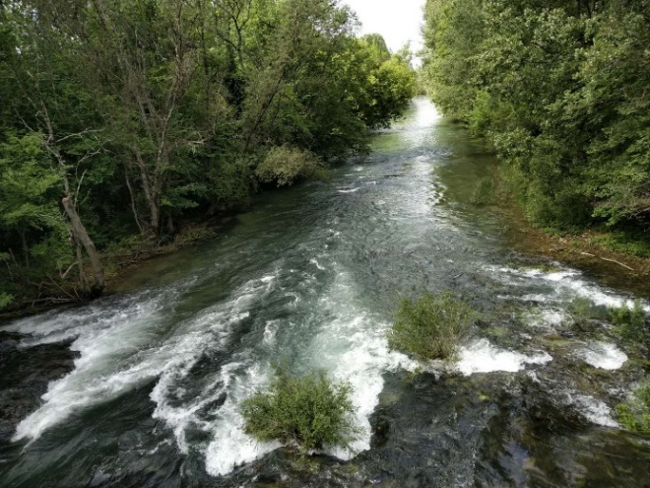
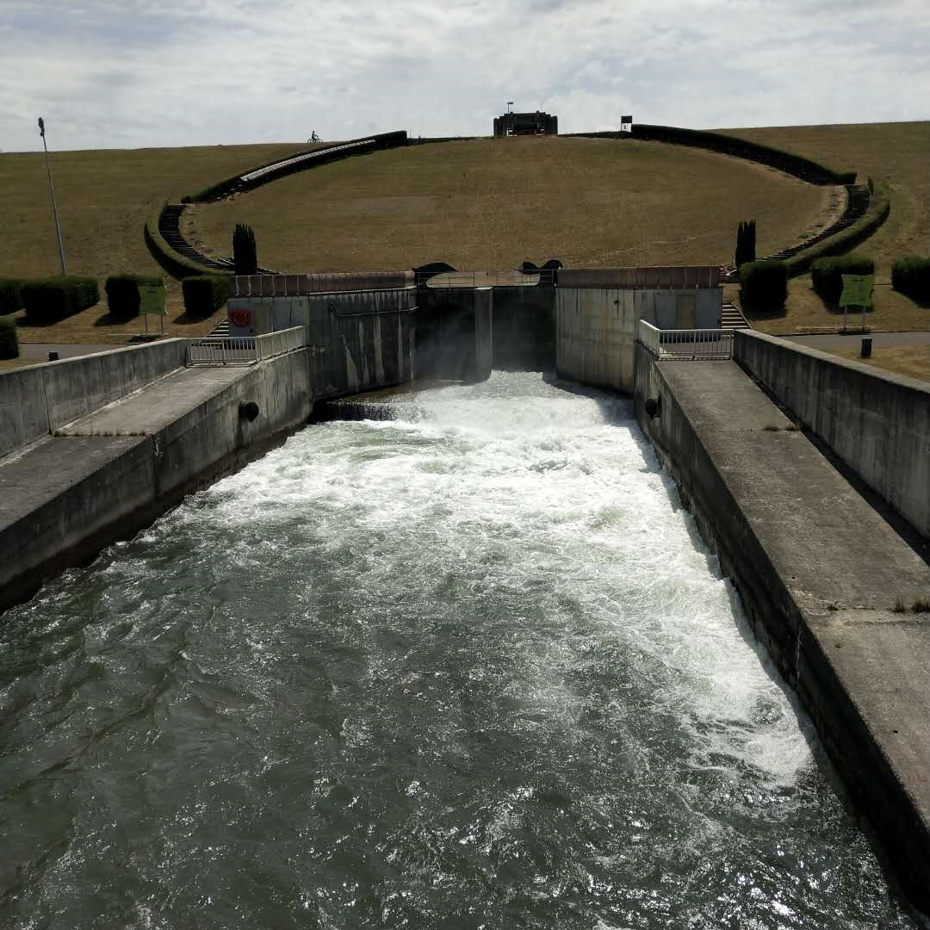
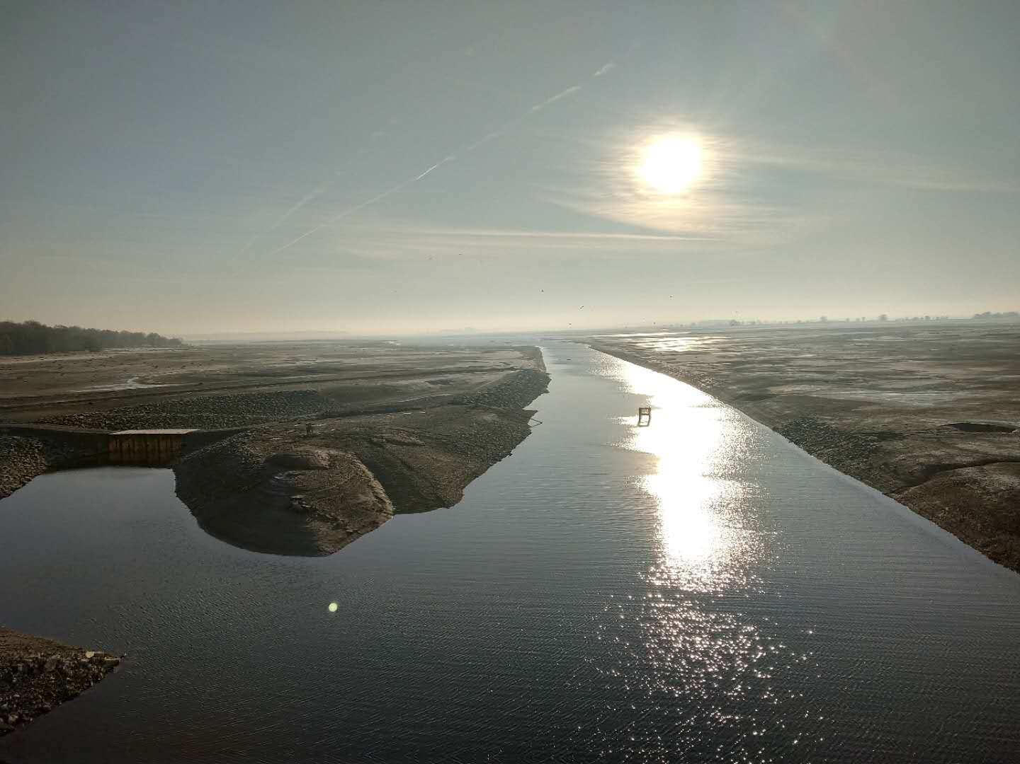

Conclusion
The four reservoirs play important roles in the retentions of DIN, PO₄³⁻-P, and DSi;
The three diverted reservoirs significantly change downstream water quality, e.g., decrease downstream nutrient concentrations, pCO₂ and TA, and increase DOC and BDOC concentrations;
Further analysis revealed that the cooperation between biogeochemical processes and hydrological management strategies of the reservoirs is important for the observed effects on downstream rivers.
Thanks for your attention!
For further information, contact xingcheng.yan@upmc.fr

