Slide 1
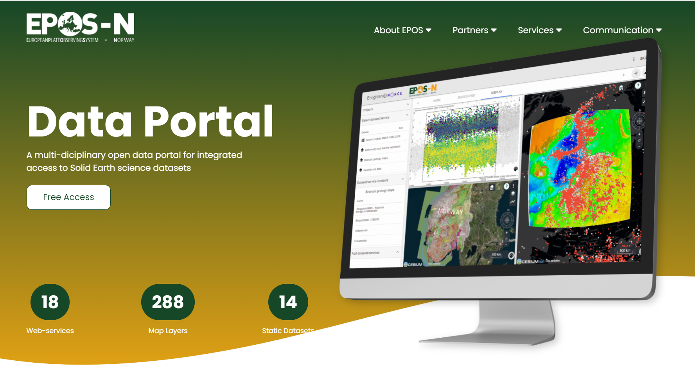
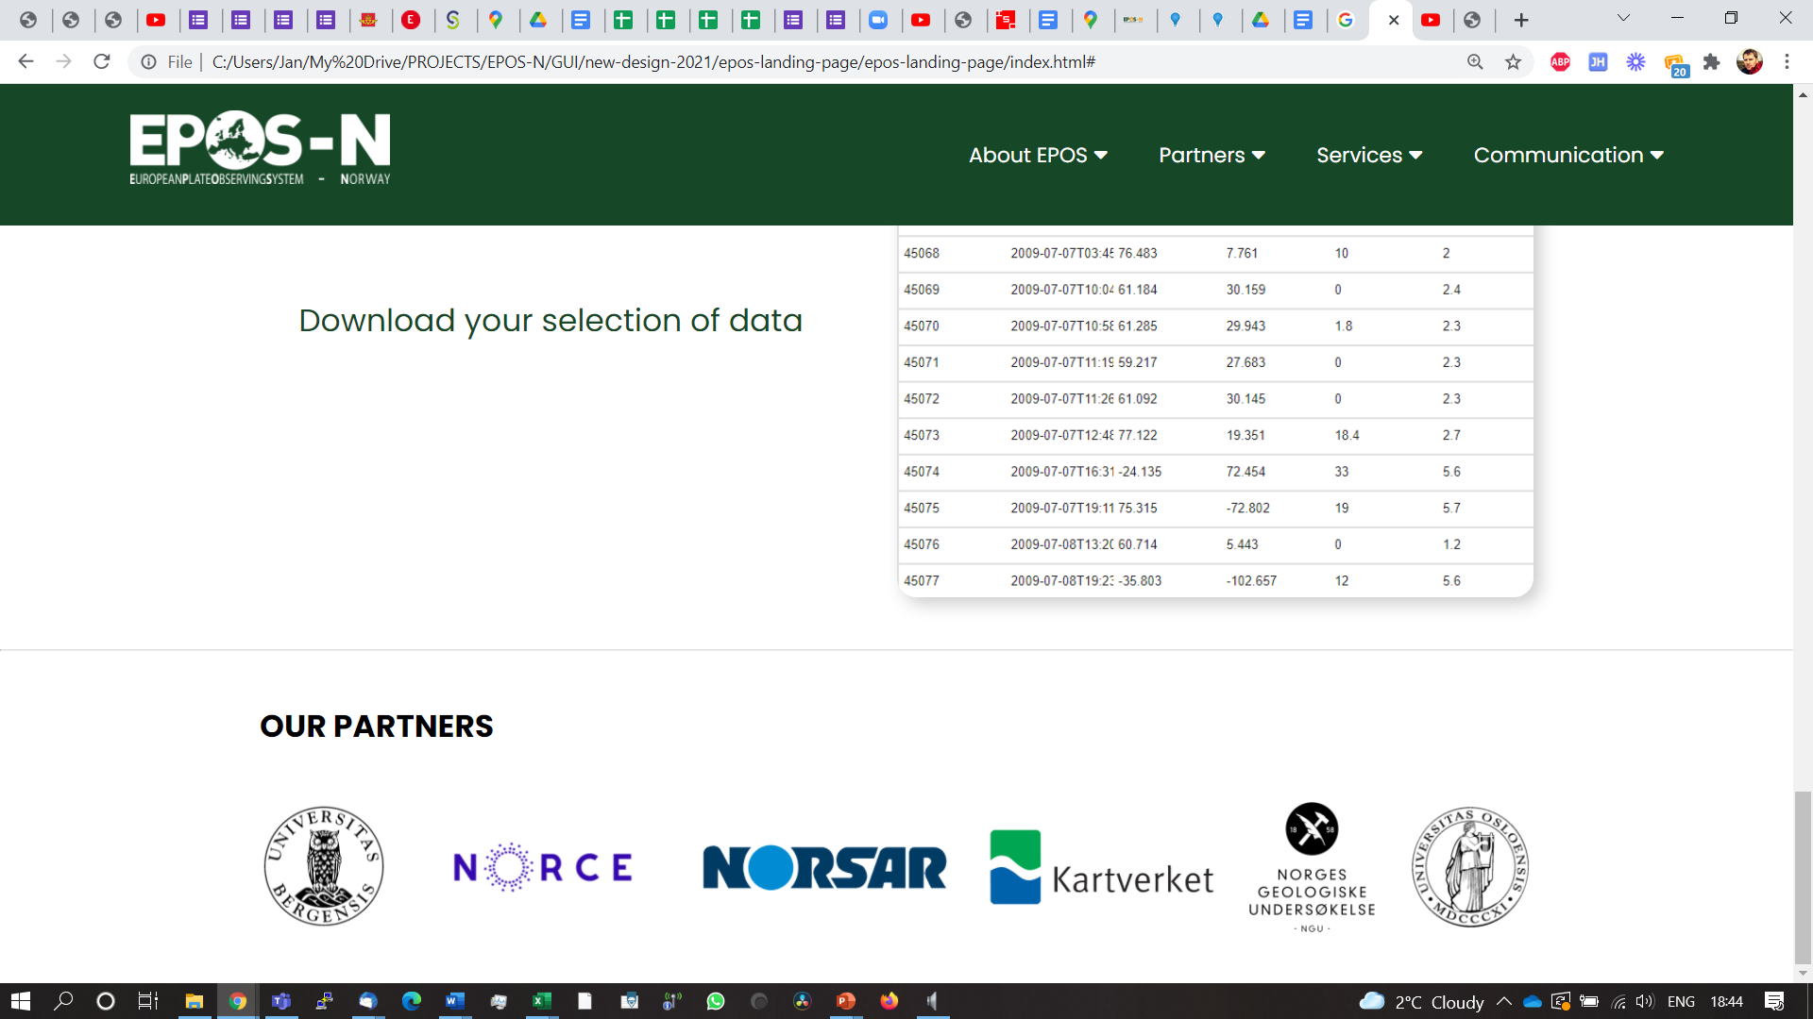
Jan Michálek, Kuvvet Atakan, Christian Rønnevik, Sara Kverme, Lars Ottemøller, Øyvind Natvik (University of Bergen)
Tor Langeland, Ove Daae Lampe, Gro Fonnes, Jeremy Cook (NORCE) Jon Magnus Christensen, Ulf Baadshaug (NORSAR)
Halfdan Pascal Kierulf (Norwegian Mapping Authority)
Bjørn-Ove Grøtan, Odleiv Olesen, John Dehls (Geological Survey of Norway)
Valerie Maupin (University of Oslo)

Slide 2
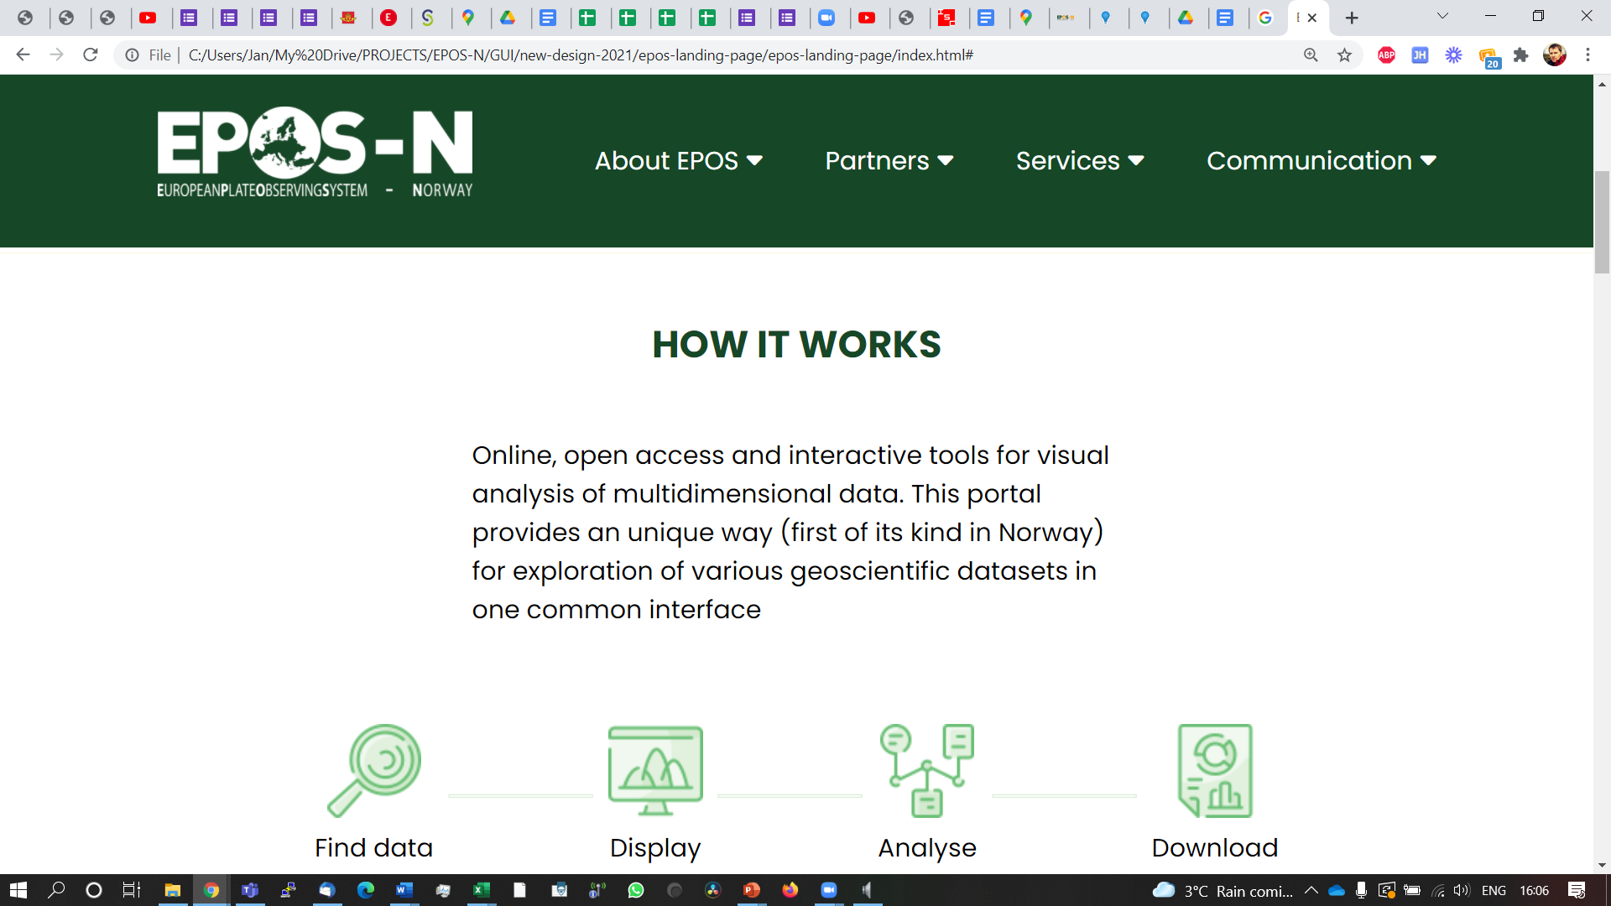

Slide 3
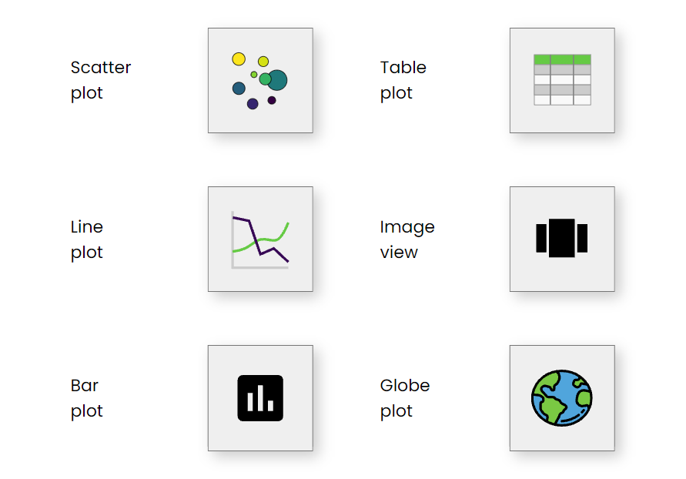

Slide 4
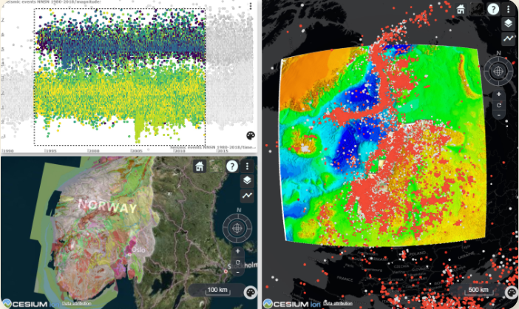
BRUSHING & LINKING

Slide 5
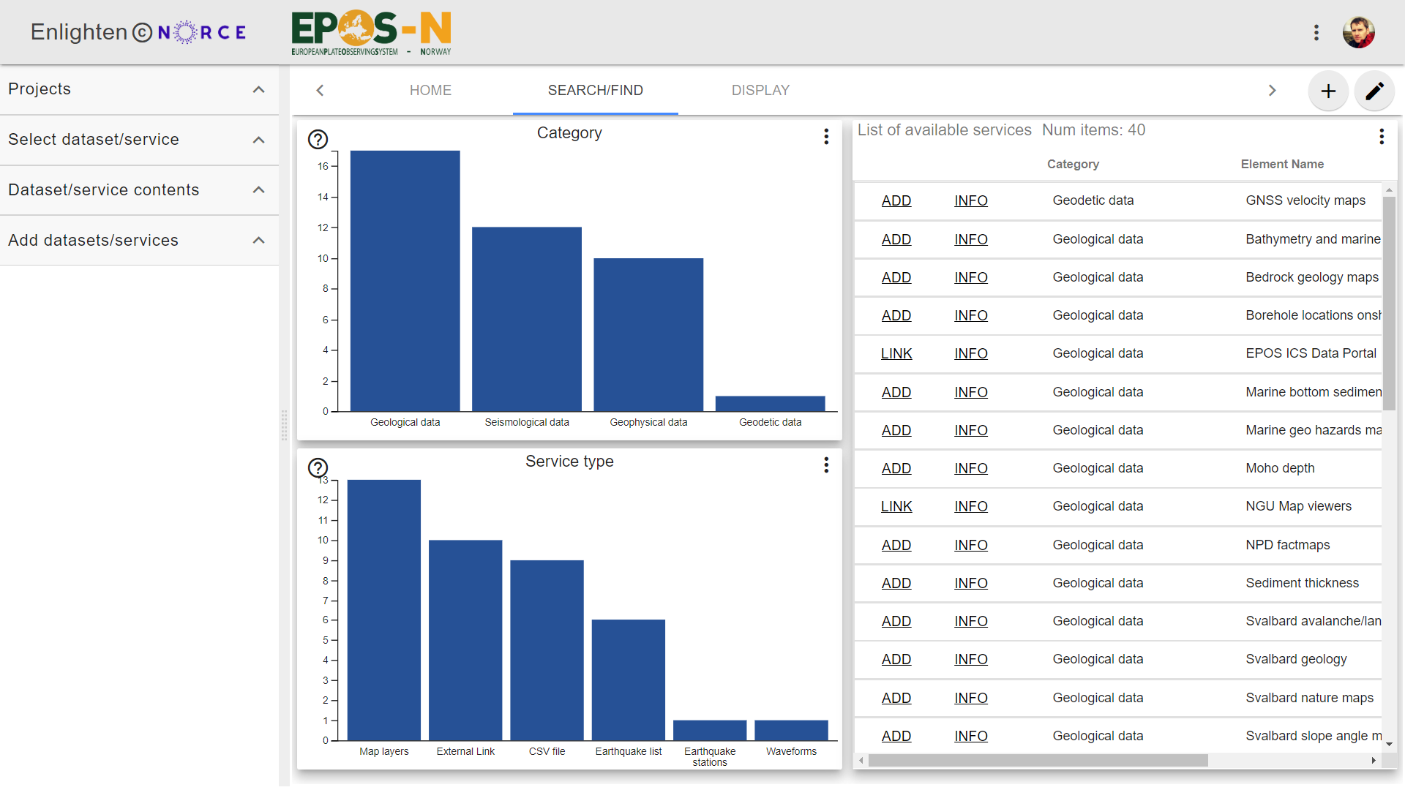


Slide 6
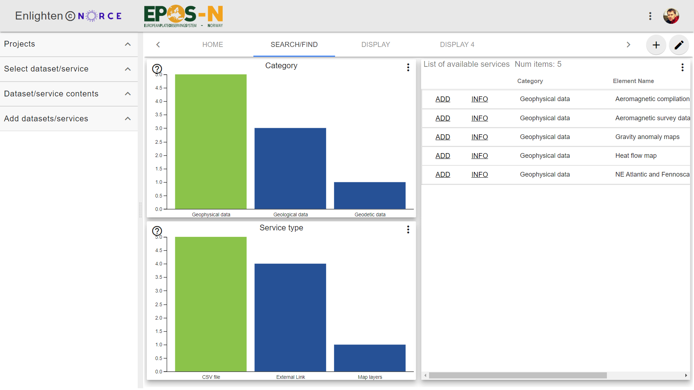

Slide 7
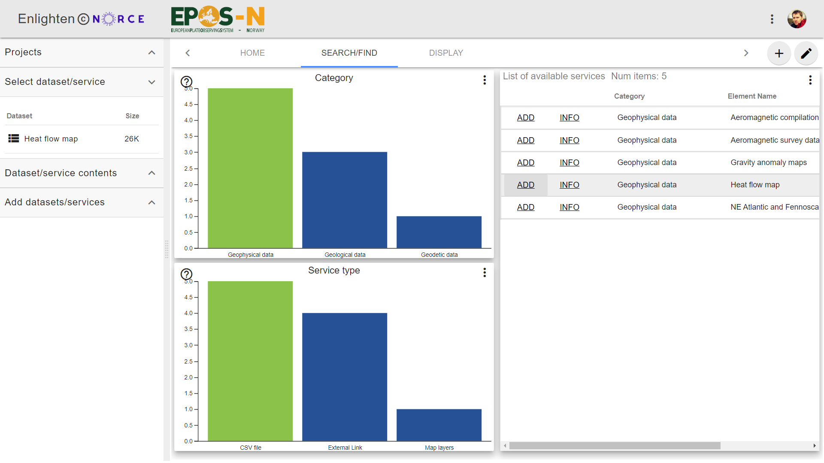

Slide 8


Slide 9
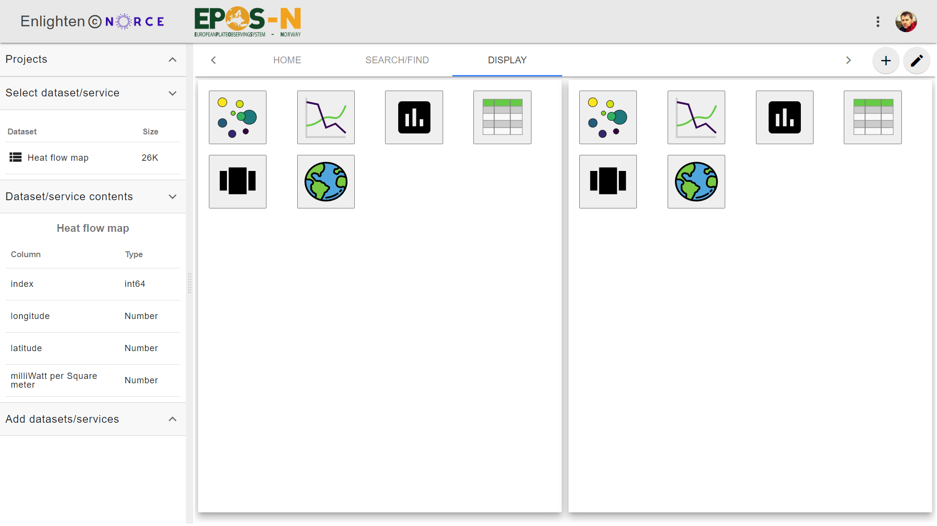

Slide 10
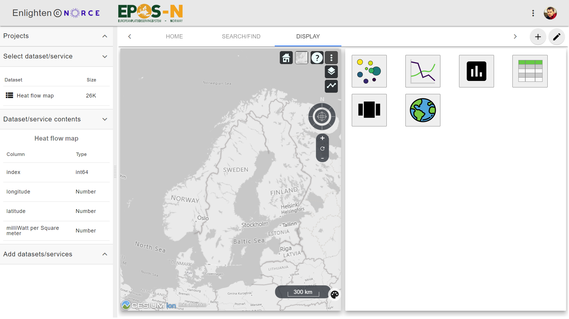

Slide 11
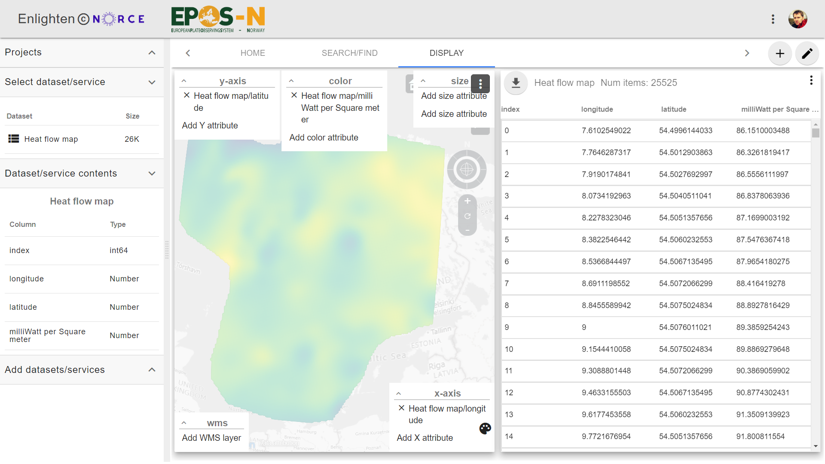

Slide 12
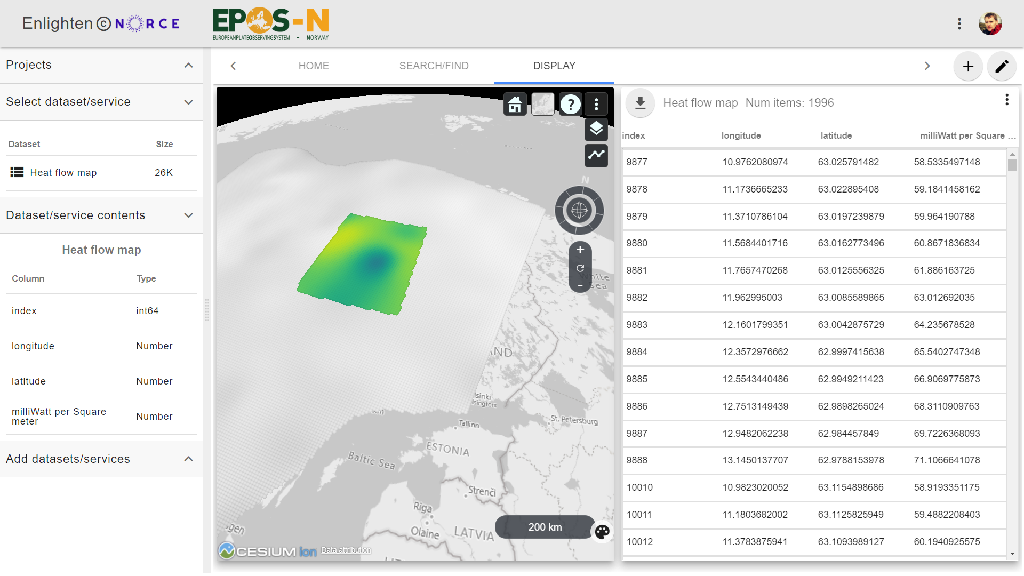

Slide 13
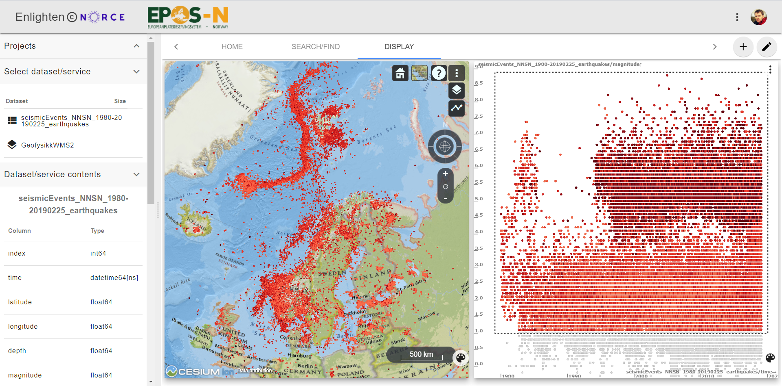
Example: Earthquakes registered by NNSN

Slide 14
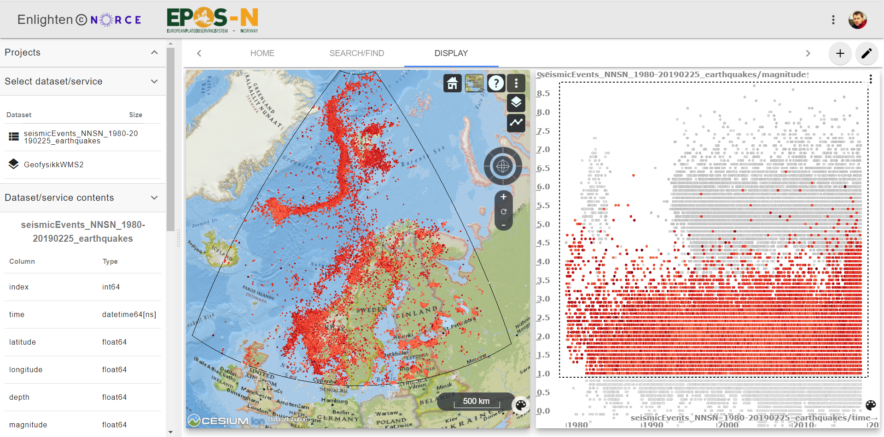
BRUSHING & LINKING
spatial filter

Slide 15
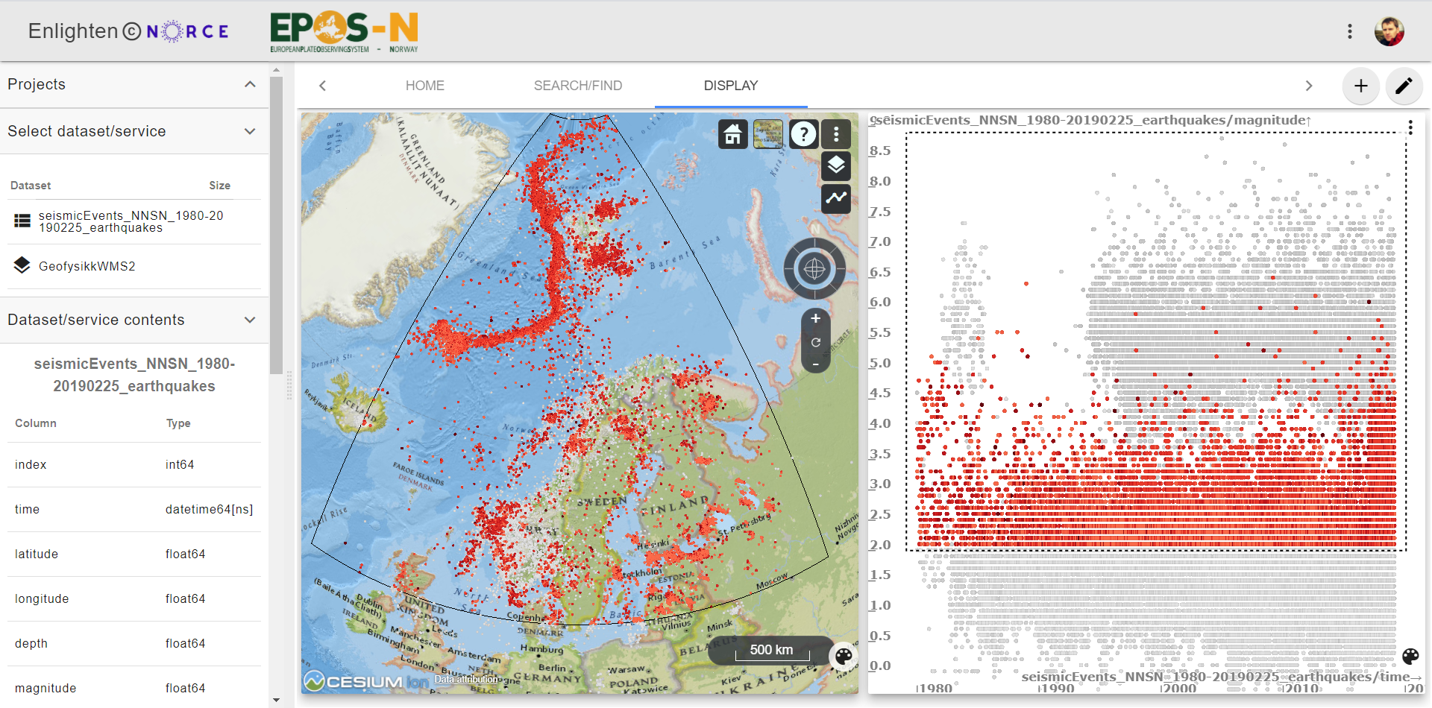
BRUSHING & LINKING
magnitude vs. time - filter

Slide 16
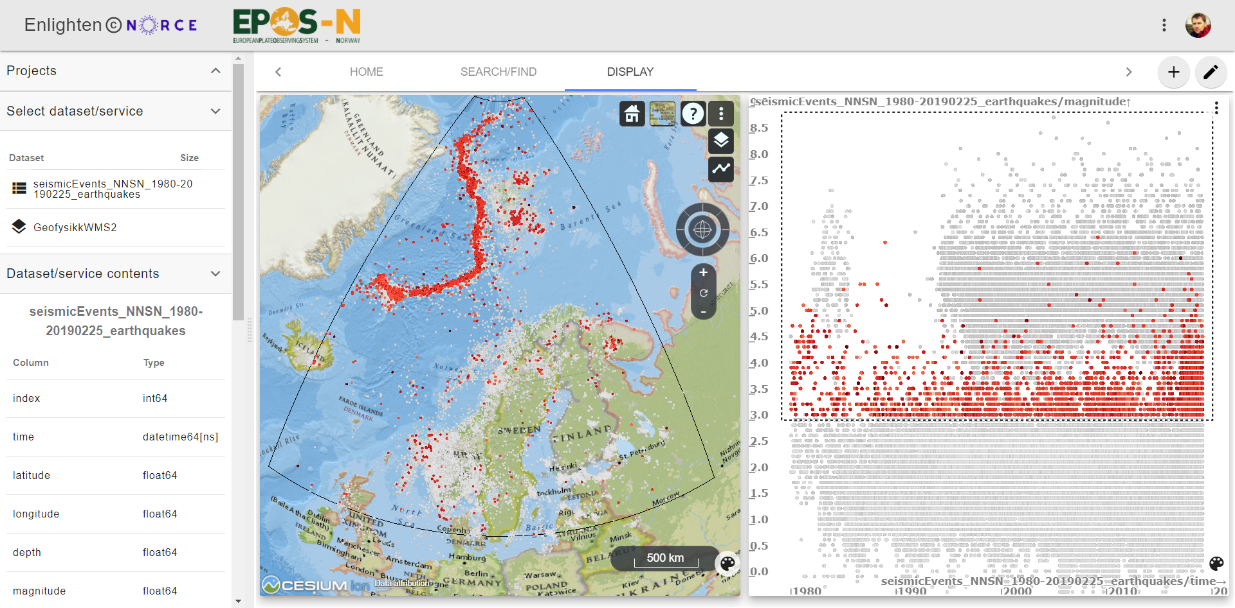
BRUSHING & LINKING
magnitude vs. time - filter

Slide 17
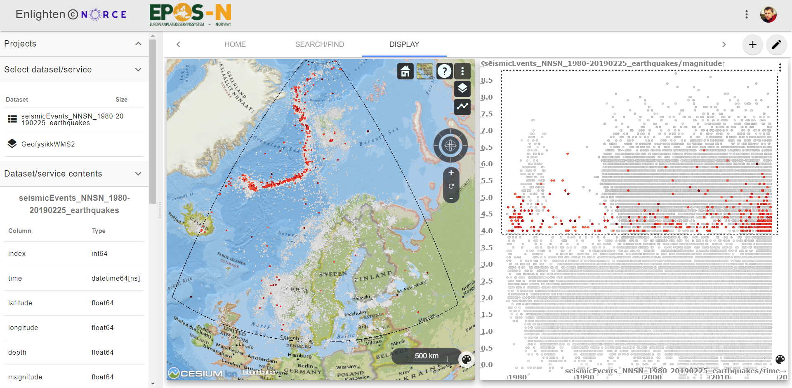
BRUSHING & LINKING
magnitude vs. time - filter

Slide 18
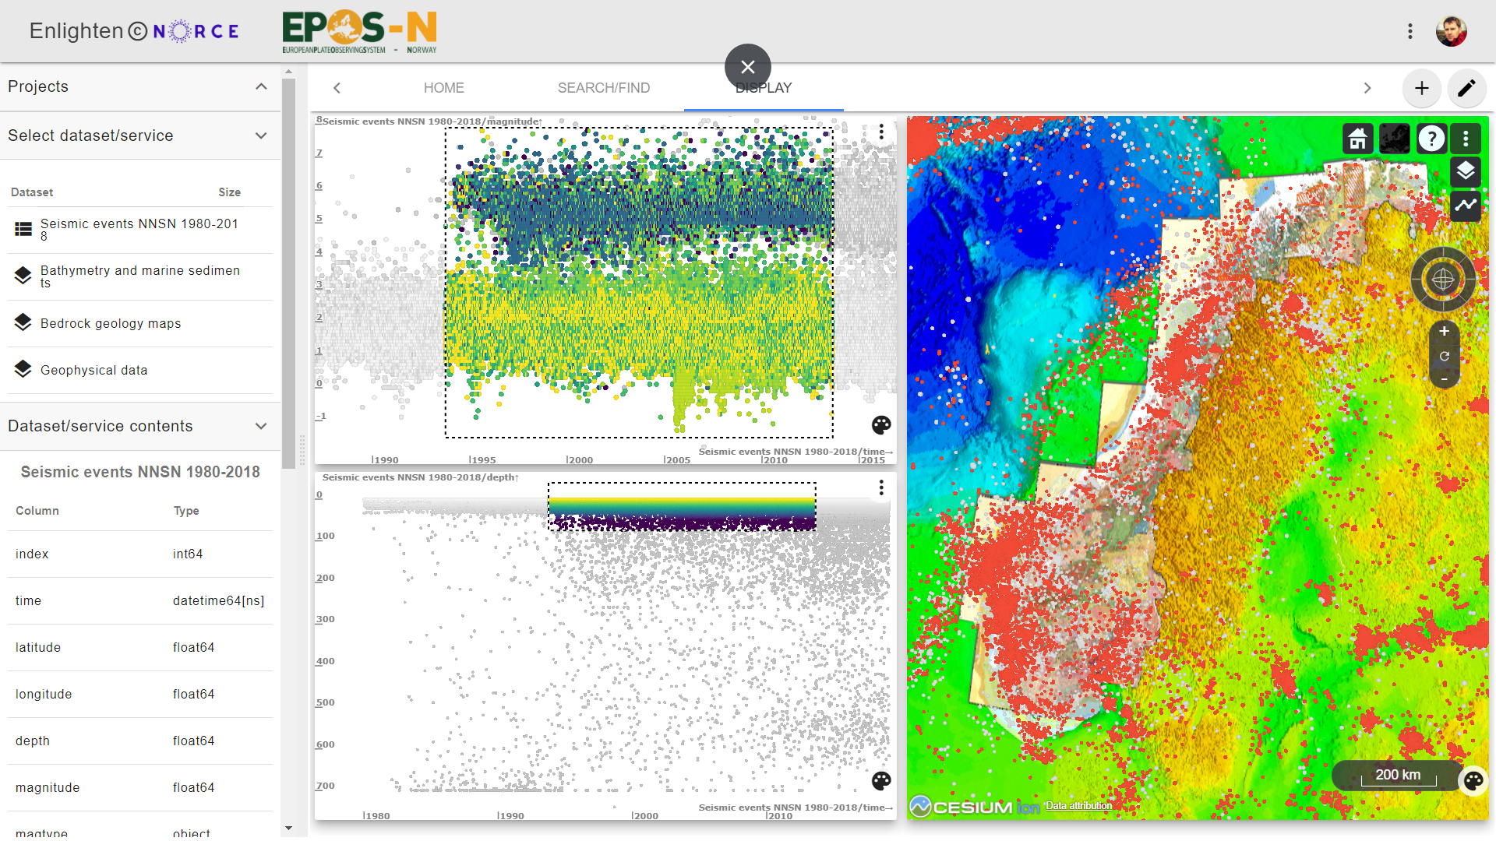
magnitude vs. time
earthquakes geology
DEM
depth vs. time

Slide 19
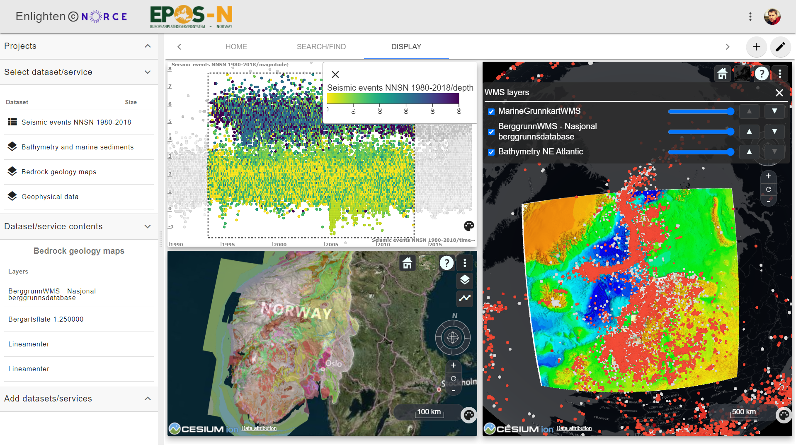

Slide 20
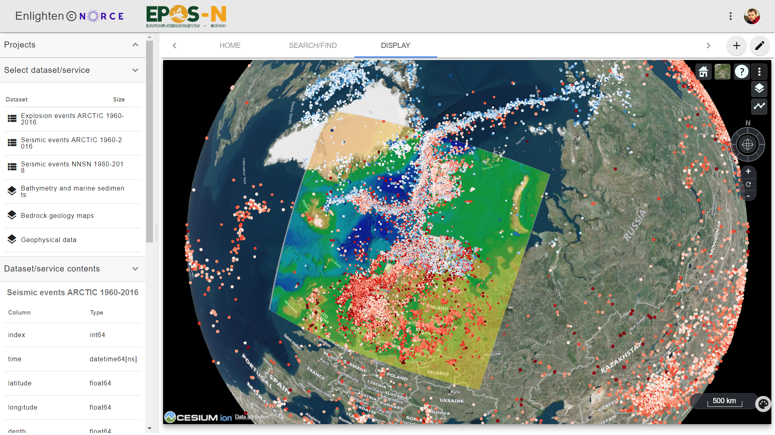
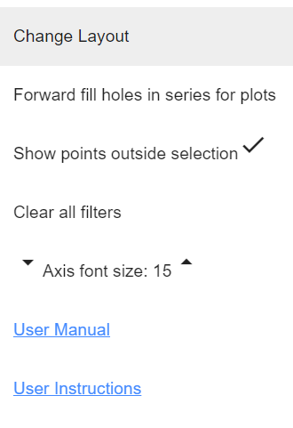
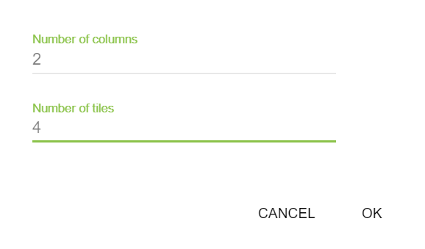

Slide 21
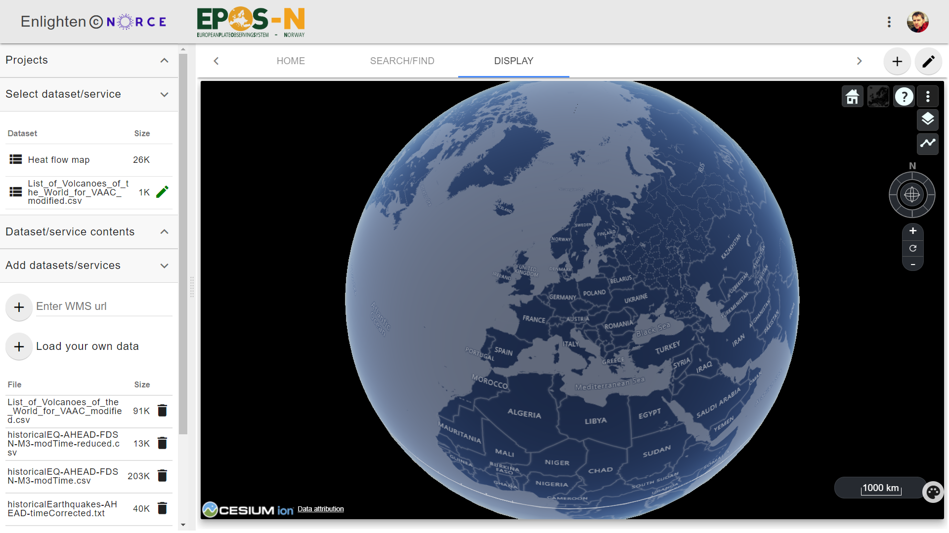
Add external WMS layers
Upload your own data - CSV

Slide 22
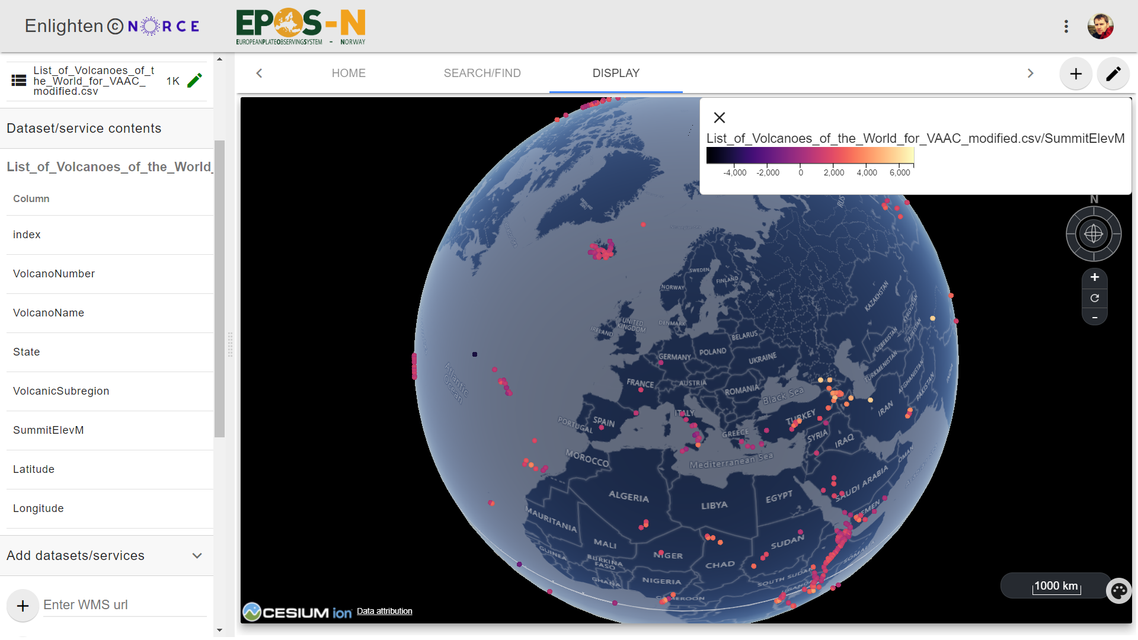

Slide 23
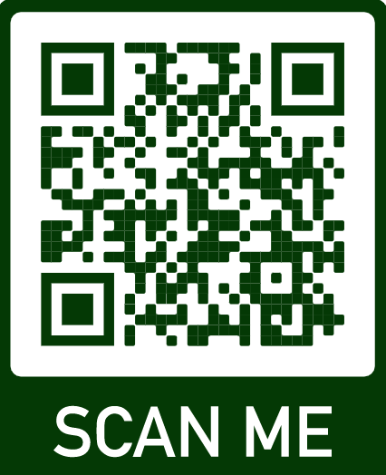
epos-no.uib.no
Notes:
Interactive visual analysis of multidimensional data
Web GIS functionality
Maps and 2D plots in linked visualizations

