Slide 1


Hellenic Mediterranean University
Department of Electronic Engineering
3D Mapping of Active Underground Faults
enabled by
Heterogeneous Parallel Processing
Spatio-Temporal
Proximity and Clustering Algorithms
A. Moshou, A.J. Konstantaras, N. Menounos, P. Argyrakis

Slide 2

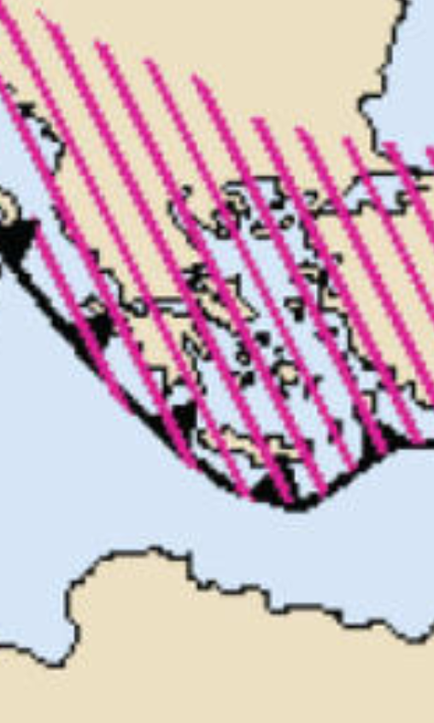
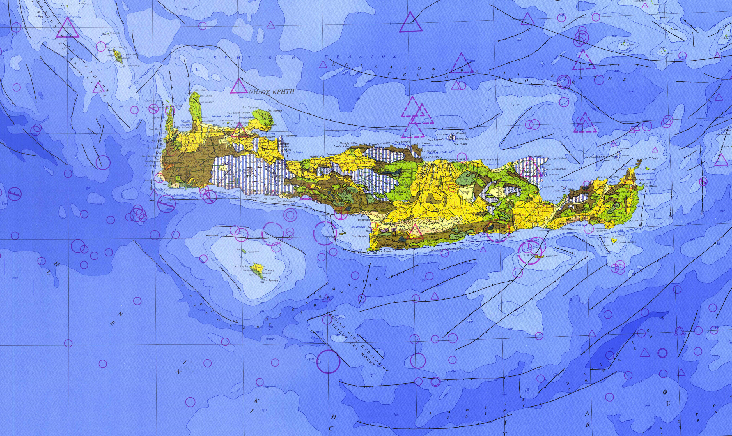
Hellenic Mediterranean University
Department of Electronic Engineering
A. Moshou, A.J. Konstantaras, N. Menounos, P. Argyrakis
Underground faults cast energy storage elements of the accumulated strain energy in border areas of active tectonic plates.
(a) (b)
In the southern front of the Hellenic seismic arc, a steady yearly flow in the accumulation of strain energy occurs due to the constant rate of motion at which the African plate approaches the Eurasian plate.
Sources: a) USGS www.usgs.gov , b) IGME https://www.eagme.gr/

Slide 3
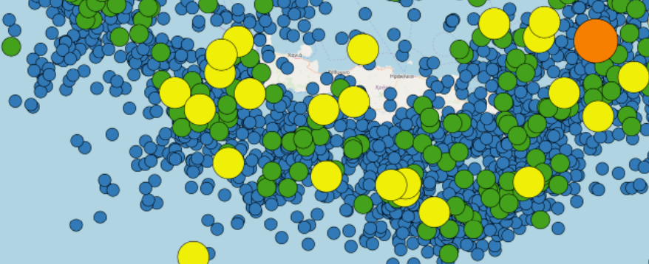
Hellenic Mediterranean University
Department of Electronic Engineering
A. Moshou, A.J. Konstantaras, N. Menounos, P. Argyrakis
Partial release of the stored energy from a particular underground fault manifests in the form of an earthquake once reaching the surface of the Earth’s crust.
The information obtained for each recorded earthquake includes among others the surface location and the estimated hypocentre depth.
Source: USGS www.usgs.gov

Slide 4
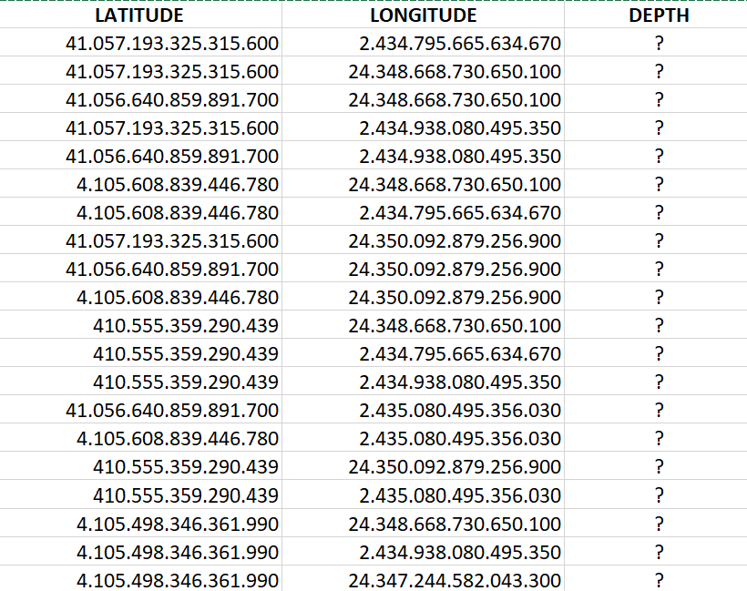
Hellenic Mediterranean University
Department of Electronic Engineering
A. Moshou, A.J. Konstantaras, N. Menounos, P. Argyrakis
Considering that hundreds of thousands earthquakes have been recorded in that particular area,
the accumulated hypocentre depths provide a most valuable source of information
regarding the in-depth extent of the seismically active parts of the underground faults.
Snapshot of an underground fault’s points coordinates.

Slide 5
Hellenic Mediterranean University
Department of Electronic Engineering
A. Moshou, A.J. Konstantaras, N. Menounos, P. Argyrakis
This research work applies expert knowledge spatio-temporal clustering in previously reported distinct seismic cluster zones, aiming to associate each individual main earthquake along with its recoded foreshocks and aftershocks to a single underground fault in existing two-dimensional mappings.
This process is being enabled by heterogeneous parallel processing algorithms encompassing both proximity and agglomerative density-based clustering algorithms upon main seismic events only to mapped.
Agglomerative density-based clustering algorithms were used to identify possible distinct seismic regions,
whilst proximity was used as input to deep learning neural networks to associate particular main earthquakes to a single underground fault.

Slide 6
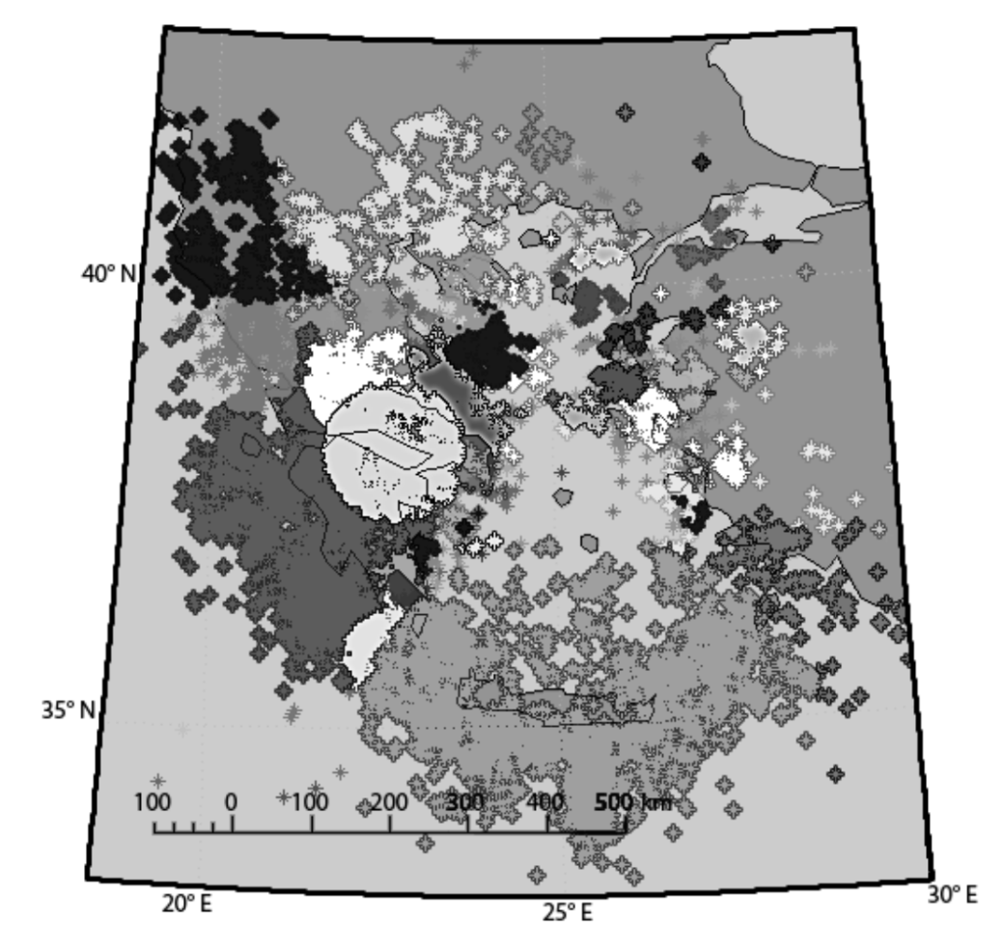
Hellenic Mediterranean University
Department of Electronic Engineering
A. Moshou, A.J. Konstantaras, N. Menounos, P. Argyrakis
Spatio-temporal clustering applied upon the entire dataset of earthquakes in Greece depicts a potentially distinct seismic region at the southern front of the Hellenic Seismic Arc.

Slide 7
Hellenic Mediterranean University
Department of Electronic Engineering
A. Moshou, A.J. Konstantaras, N. Menounos, P. Argyrakis
The deep learning neural networks receives four input data sets of
[EQ Latitude, EQ Longitude, EQ Depth, EQ Fault Proximity]
and returns at its output the ID of a single particular underground fault.
Once a main earthquake is being associated to a particular known underground fault, then the underground fault’s point with maximum proximity to the earthquake’s hypocentre appends its location parameters, additionally incorporating the dimension of depth to the initial planar dimensions of latitude and longitude.
The same applies for the hypocentre depths of all foreshock and aftershock seismic events, respectively.
Lat
D.L.N.N.
Lon
Depth
Fault ID
Proximity

Slide 8

Hellenic Mediterranean University
Department of Electronic Engineering
A. Moshou, A.J. Konstantaras, N. Menounos, P. Argyrakis
The range of depth variations provide a notable indication of the in-depth extent of the seismically active part(s) of an underground fault.
Future work shall aim to concatenate, render and visually display three-dimensional model mappings of the seismically active parts of underground faults in particular distinct seismic zones.
THANK YOY FOR YOUR ATTENTION!
Questions: akonstantaras@hmu.gr

