Slide 1
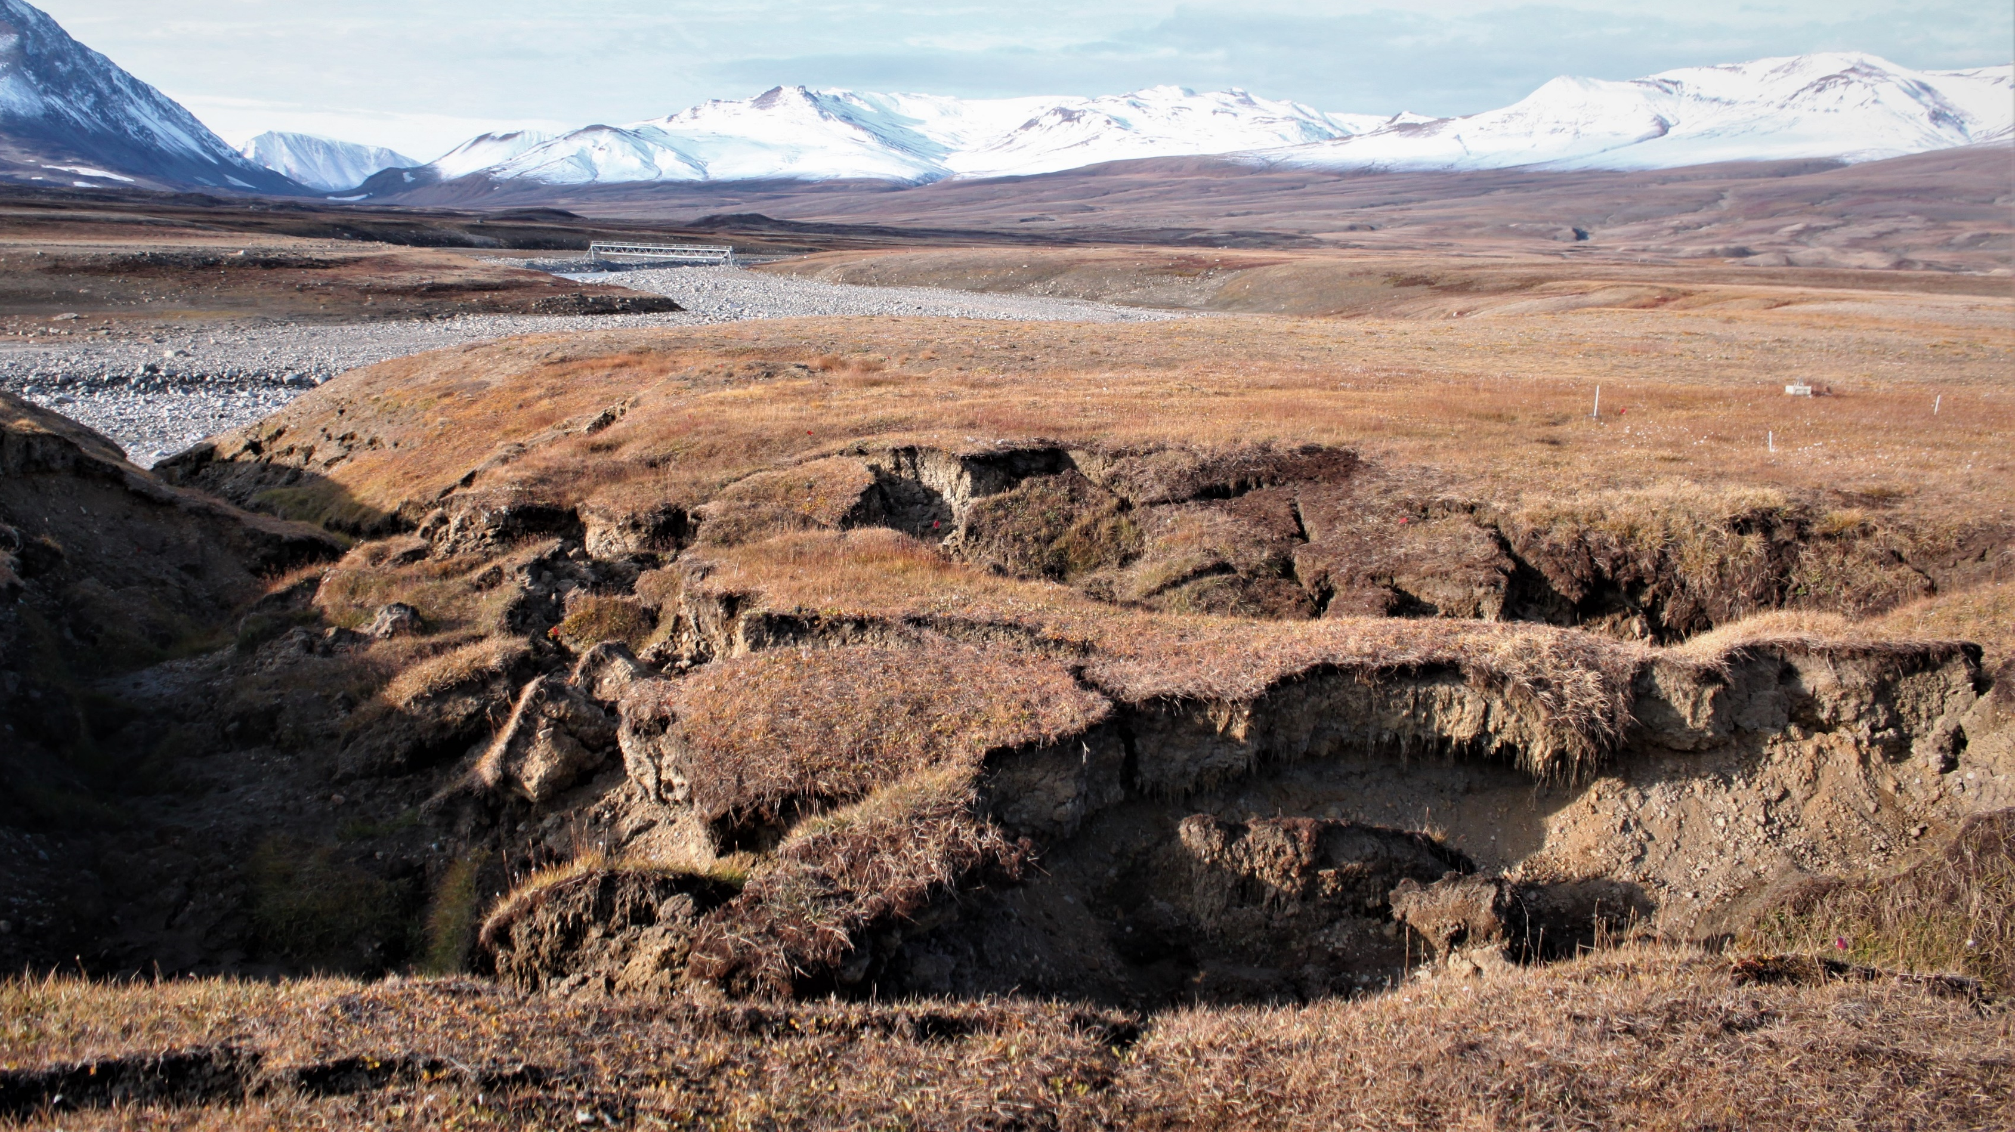


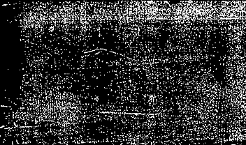


Should I grow or should I go?
Transcriptomic responses of permafrost soil microbiomes to sudden thaw and erosion
Notes:
Story twofold, predation as response to ancient ecosystem change under climate threat

Slide 2
Overview
Context
Research questions
Methodology
rRNA – active community
mRNA – actively transcribed genes
Conclusions

Slide 3
1. Context

Slide 4

Permafrost
thaw
Permafrost = frozen for ≥ 2 years (often millennia)
Northern PF zone = 2x C_{atm} & > 0.5x of all soil carbon (Schuur and Mack, 2018)
Thaw: 20% of all PF areas = ~50% of all PF C (Turetsky et al., 2020)
Currently: 5 – 15% of PF C susceptible to (microbial!) decomposition into GHGs (Cavicchioli et al., 2019; Jansson and Hofmockel, 2019)
+1.5-2 °C: 28 – 53% loss
gradual & abrupt
This Photo by Unknown Author is licensed under CC BY-SA

Slide 5
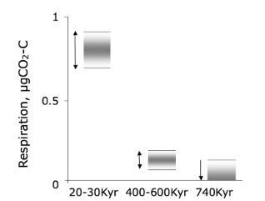
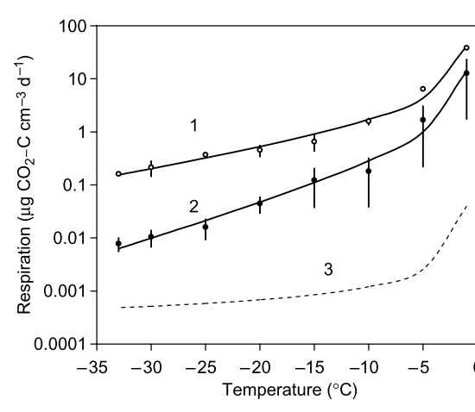
Cryophilic microorganisms
prokaryotes, viruses and eukaryotes
(e.g. fungi, protozoa) < 50 μm
Johnson et al. 2007
cold-loving
Adaptation to: <0 °C, ground radiation, low nutrient, energy and OC availability, high salinity
Viability in frozen soil by: resistance (low metabolic rates, membrane fluidity and enzyme activity, spores) and resilience (high growth rates)
Panikov et al. 2006
Notes:
My hook from marine biology to permafrost
Extremophiles → my hook from marine to arctic
= unseen majority of soil biomass → bottom-up impact on a ecosystem level, are still largely underestimated (Cavicchioli et al., 2019)
Adaptaation: through membrane fluidity, spore formation and metabolising of complex organic sources

Slide 6
Motivation
AL
TZ1
DNA: total but mostly ~95% dead community
RNA: ~95% ribosomal RNA → protein production ~activity!
Which species are active in thawing permafrost (TZ) then?
TZ2
PF

Slide 7
Research Questions
Which taxa are putatively active in abruptly thawing, ancient permafrost material?
Are abiotic (edaphic) or biotic (predatory) factors driving the differences between communities at different depths?
What is the community’s metabolic and stress response to thaw?

Slide 8
3. Methodology

Slide 9
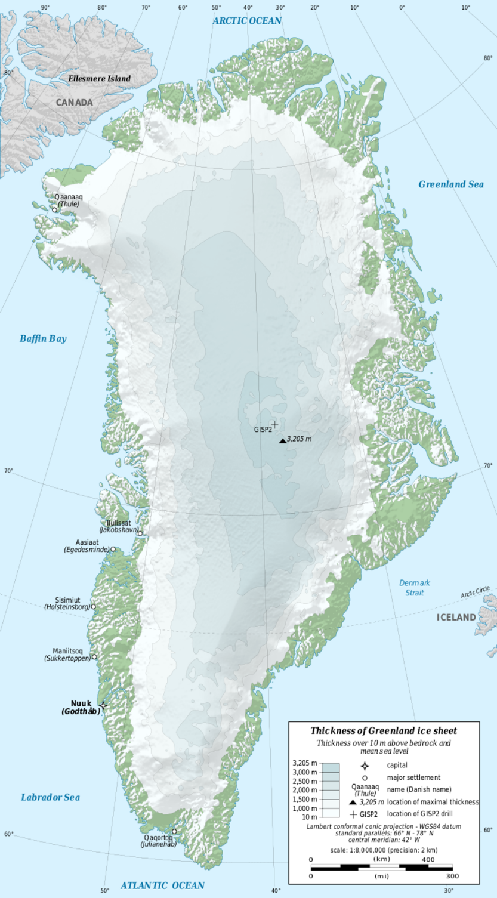
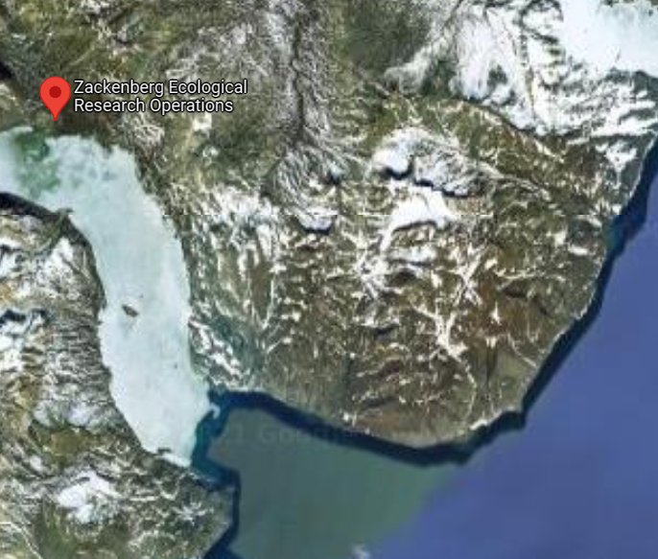
Study area
Notes:
thermal erosion gully 270 m northeast of station → discovered after snow-melt in 2018 → UAV monitoring to document changes in thermokarst progression

Slide 10
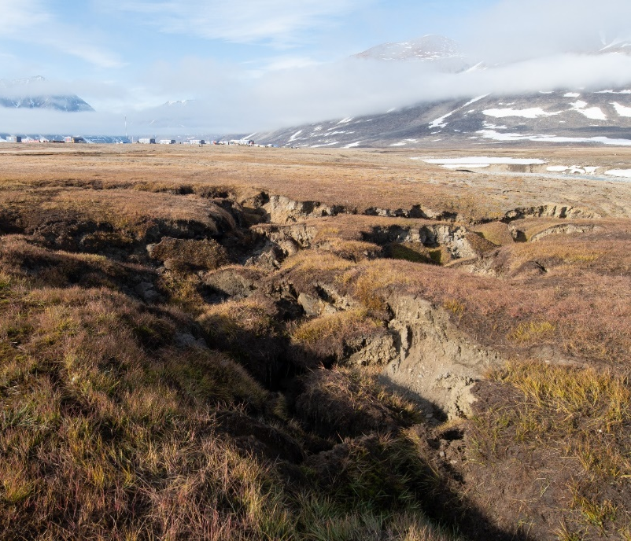
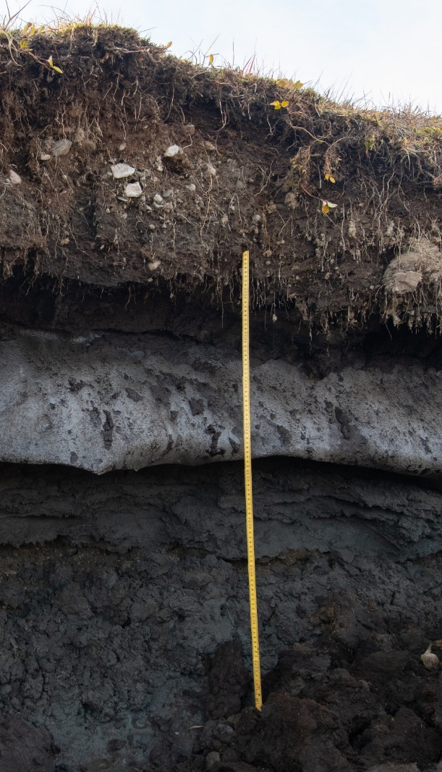
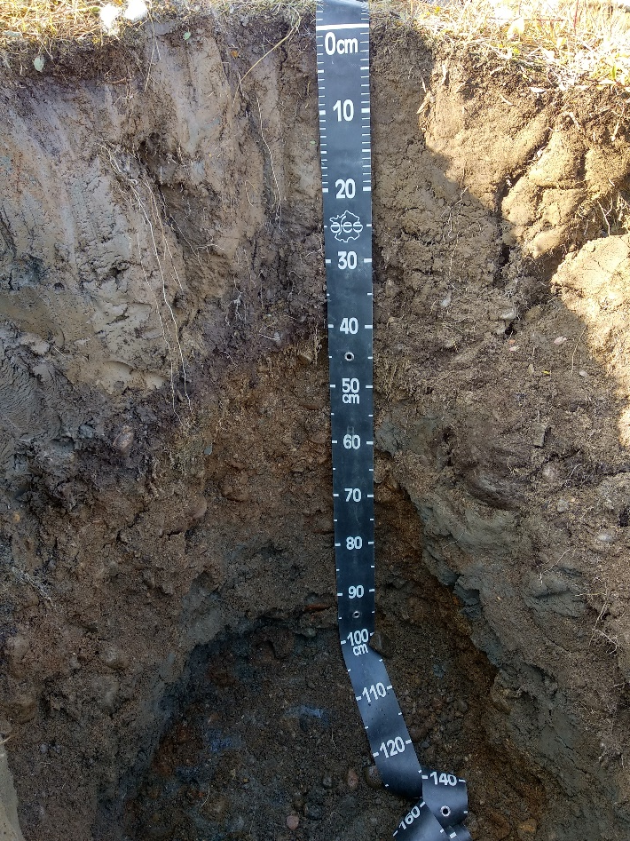
Study area
Notes:
thermal erosion gully 270 m northeast of station → discovered after snow-melt in 2018 → UAV monitoring to document changes in thermokarst progression

Slide 11
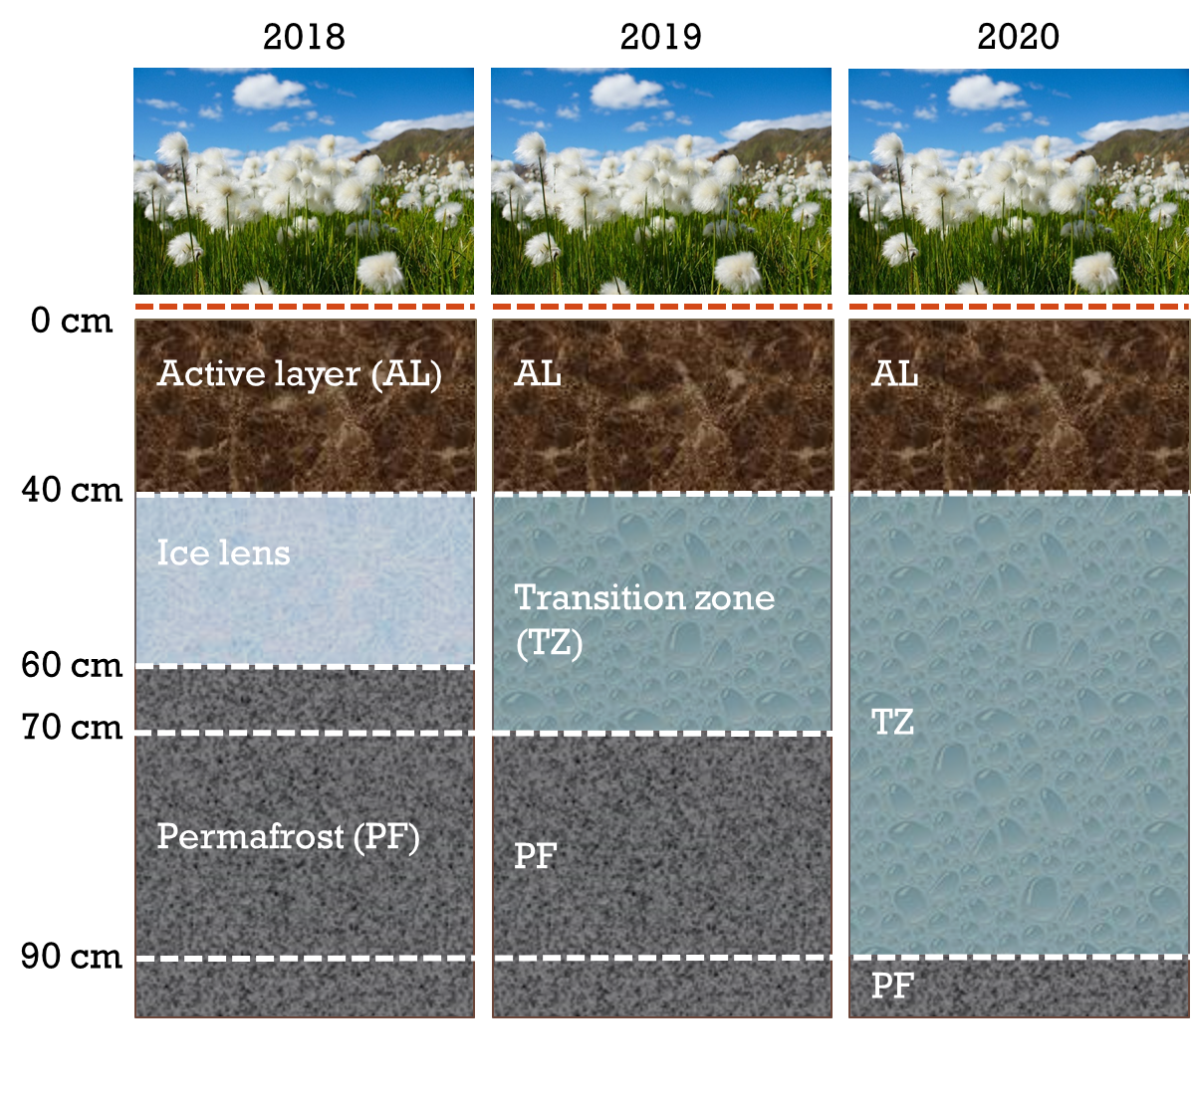
Soil conditions

Slide 12
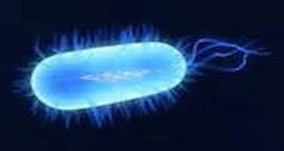
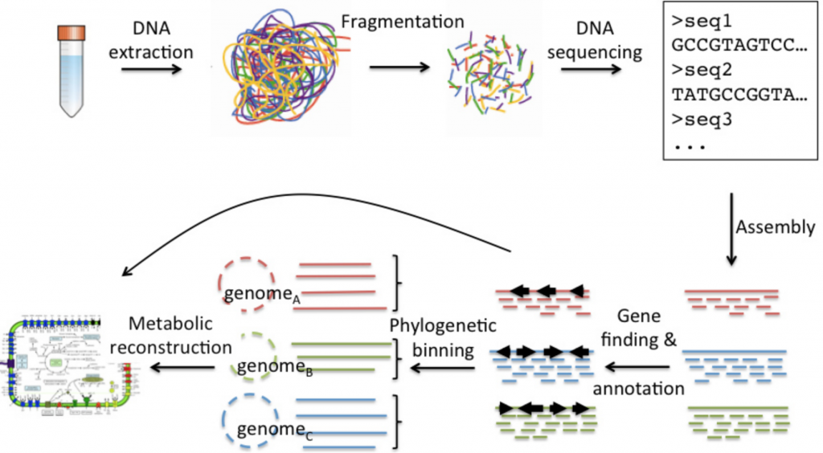
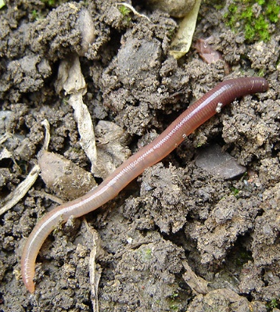
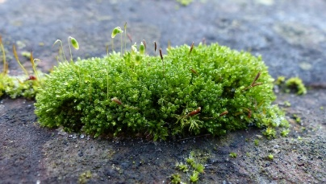


Digging deeper: transcriptomics

Slide 13
Methodology
1
in situ sampling (10cm horizons until 1m depth), frozen storage and transport
2
Soil characterization (loss on ignition for rel. SOM and H2O content, ¹⁴C dating)
3
DNA/RNA coextraction, shotgun total RNA sequencing (Illumina NextSeq)
4
QC, MetaRib RNA sorting (SSU → rRNA, neither SSU nor LSU → mRNA)
7
Vegan & phyloseq: diversity measures, ordination, statistical analysis (ANOSIM, adonis)
5
rRNA: QUAST OTU assembly, mapping, CREST annotation with SILVA 128
6
mRNA: Trinity contig assembly, mapping (BWA), annotation (Anwar et al 2019)
8
DESeq2 & ANCOM-BC for differential abundance (logFC and heatmaps)

Slide 14
4. Active community (rRNA)

Slide 15
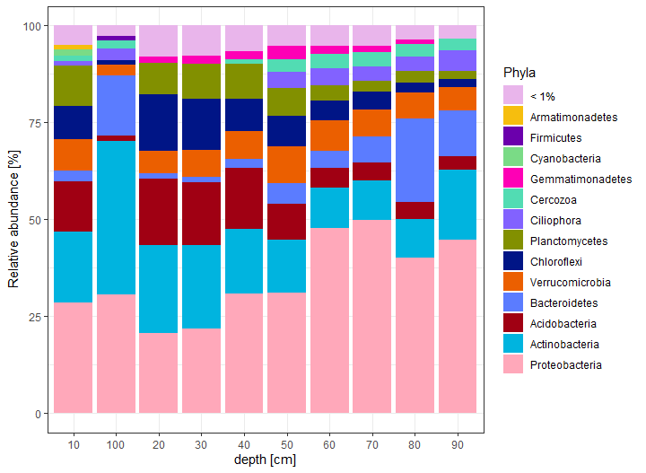
Community composition
Exploring the total community:
Ø10.5% of rel. abundance = predators of bacteria (bacterivores)

Slide 16
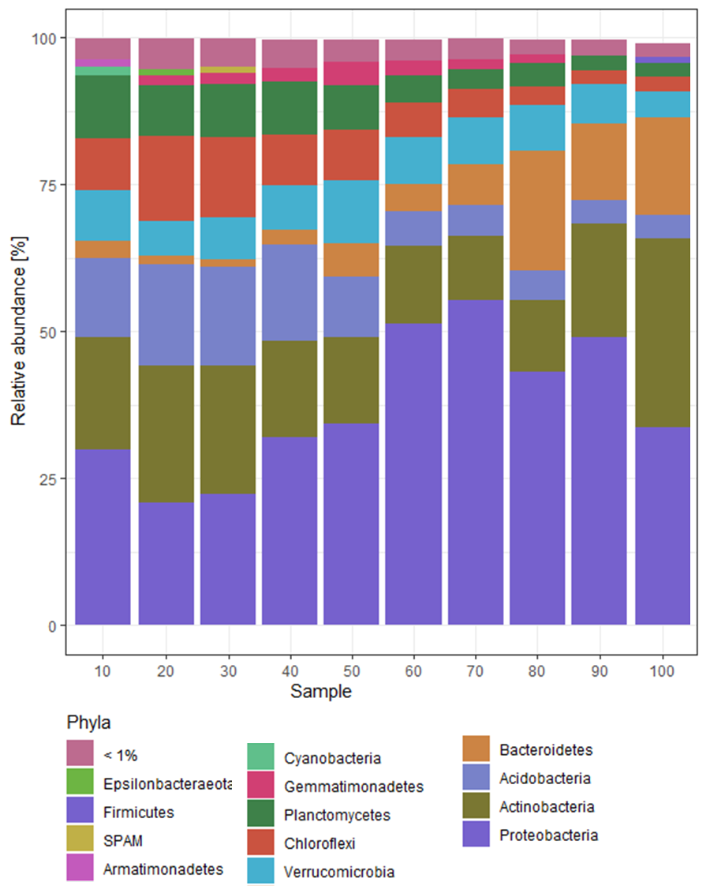
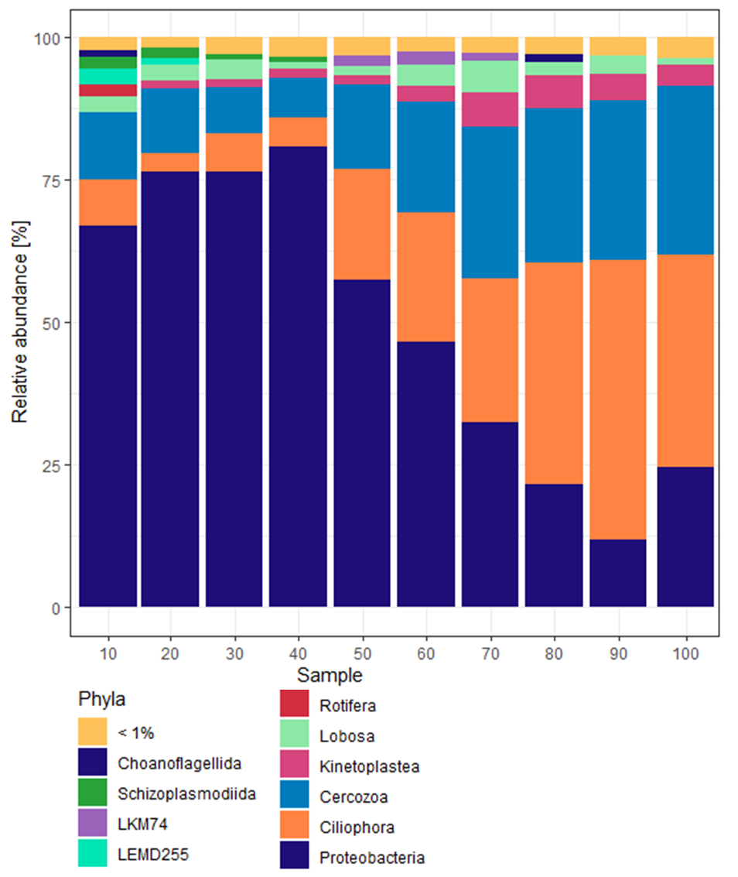
Permafrost prokarya & their predators
Cercozoa
Ciliophora
bacterial predators
Notes:
Replace protozoa with bacterivores

Slide 17
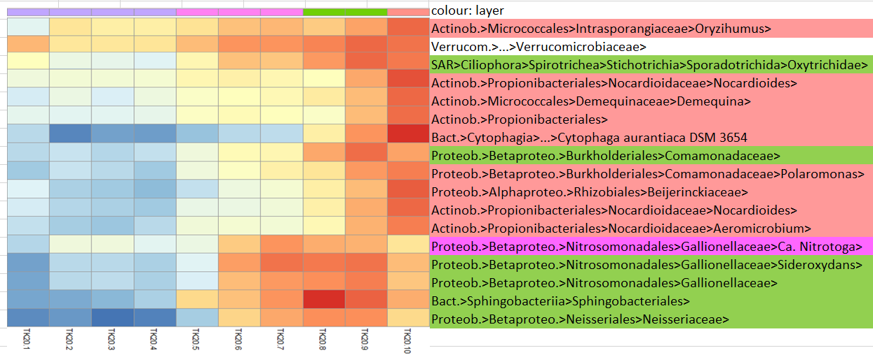
DeSeq2 & ANCOM-BC
Notes:
Micrococcales (Arthrobater Willerslev 2004)
Cytophagales nonsporeforming
Fibrobact = rumen bacteria Rhizobiales = plant-symbionts, e.g. lichen

Slide 18
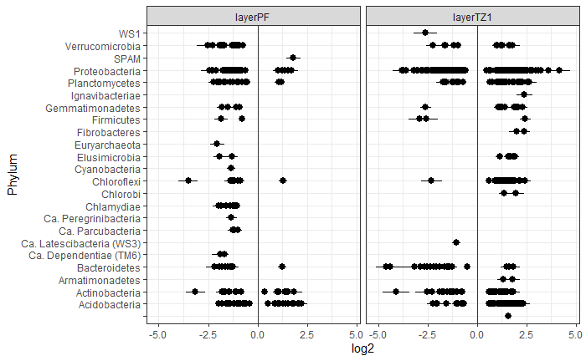
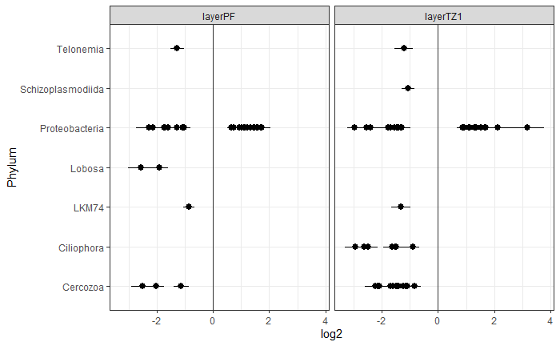
DeSeq2 & ANCOM-BC
Prokaryotes
Bacterivores
Significant (p<0.05) differenty abundant phyla contrasted against TZ2
Notes:
Micrococcales (Arthrobater Willerslev 2004)
Cytophagales nonsporeforming
Fibrobact = rumen bacteria Rhizobiales = plant-symbionts, e.g. lichen

Slide 19



Possible “Grow or go” strategists*
* Based on ANCOM-BC and/or DESeq2 significant (p<0.05) logFC contrasts
PF:
None-spore-forming Actinobact.: Micrococcales (Oryzihumus, Demequina) and Propionibacterales (Nocardiodes)
Cytophagales (C. aurantiaca, Bact.)
Sphingomonadales (α-Proteo.)
Spore-forming Bacilli (Firmi.)
TZ & PF:
Multiple β-Proteo.: Burkholderiales (Polaro-monas), Gallionellaceae (Sideroxydans), Neisseriales
Sphingobacteriales (Pedobacter, Bact.)
Ciliophora
Spore-forming Clostridia (Firm.)
TZ & AL:
Most bacterivores
Rhizobiales (α-Proteo.)
spore-forming Clostidiales & Myxococcales
Fibrobacterales (Fibr.)
Notes:
Micrococcales (Arthrobater Willerslev 2004)
Cytophagales nonsporeforming
Fibrobact = rumen bacteria Rhizobiales = plant-symbionts, e.g. lichen

Slide 20
Biotic Effects: Predation
Bacterivores impact prokaryotic community dissimilarity (Protozoa** & bact. predators*)
ADONIS P-value: * <0.05; ** <0.01; *** <0.005
depth | 10 | 20 | 30 | 40 | 50 | 60 | 70 | 80 | 90 | 100
bacterial predators | 6.31 | 6.11 | 6.47 | 11.46 | 13.58 | 5.31 | 7.45 | 3.31 | 1.66 | 2.10
Bdellovibrionales | 0.21 | 0.13 | 0.13 | 0.20 | 0.31 | 0.25 | 0.35 | 0.48 | 0.35 | 0.23
Myxococcales | 6.10 | 5.99 | 6.34 | 11.25 | 13.27 | 5.07 | 7.09 | 2.83 | 1.30 | 1.86
Haliangium | 2.25 | 2.10 | 2.32 | 4.85 | 6.90 | 2.02 | 4.18 | 0.89 | 0.21 | 0.61
Polyangium | 0.91 | 0.76 | 0.51 | 0.94 | 0.87 | 0.38 | 0.39 | 0.29 | 0.40 | 0.32
Protozoa | 3.56 | 1.64 | 2.14 | 3.20 | 6.00 | 5.56 | 7.06 | 5.27 | 4.89 | 3.76
Amoebozoa | 1.21 | 0.64 | 0.72 | 0.94 | 1.17 | 1.23 | 1.12 | 0.50 | 0.48 | 1.07
Excavata | 0.34 | 0.24 | 0.26 | 0.49 | 0.59 | 0.50 | 0.83 | 0.69 | 0.54 | 0.38
Choanoflagellata | 0.13 | 0.04 | 0.07 | 0.11 | 0.17 | 0.11 | 0.12 | 0.12 | 0.08 | 0.12
Cercozoa | 1.27 | 0.76 | 0.76 | 1.21 | 2.96 | 2.80 | 3.48 | 2.66 | 2.50 | 1.54
Ciliophora | 0.60 | 0.13 | 0.44 | 0.57 | 1.18 | 0.98 | 1.52 | 1.34 | 1.34 | 0.68
all Bacterivores | 10.81 | 6.81 | 9.31 | 16.81 | 17.36 | 13.47 | 11.38 | 7.40 | 5.95 | 5.74
Prokaryotes | 75.69 | 93.56 | 92.46 | 89.97 | 82.12 | 81.81 | 80.11 | 80.04 | 75.81 | 83.94
?

Slide 21
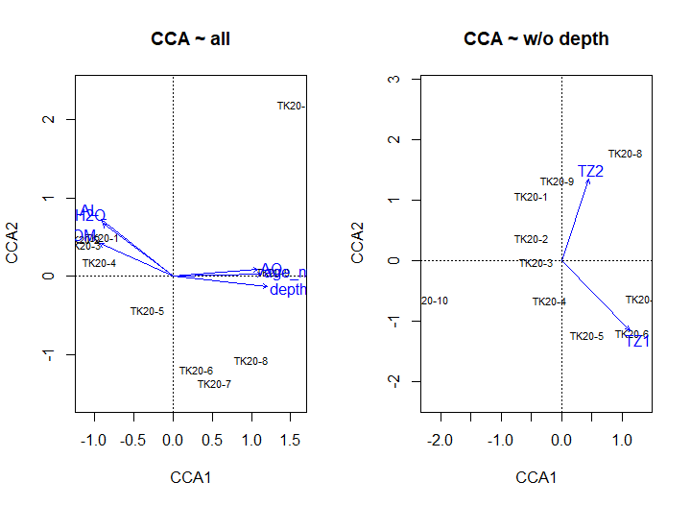
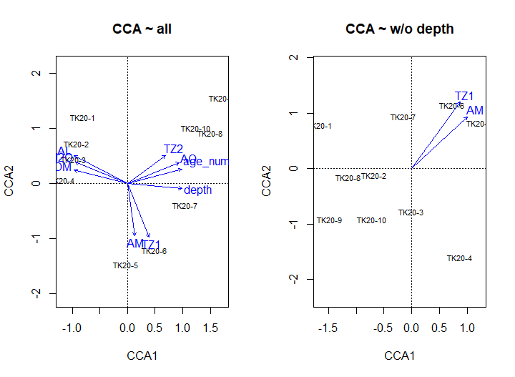
Abiotic effects: Soil Properties
Prokaryotes
Bacterivores
Significant (p<0.05) metadata → without depth only TZ1/2 and AM
Notes:
depth-independent significance only TZ1 for EUK
top (H2O, SOM, AL) vs. bottom (depth, age, pH)

Slide 22
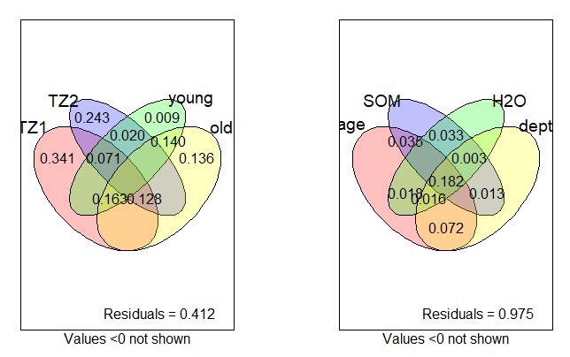
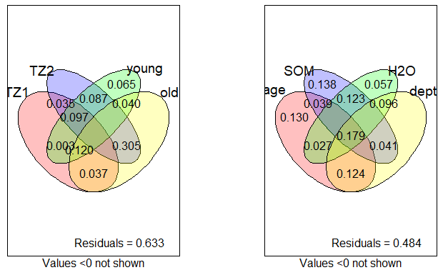
Variance partitioning
Prokaryotes
Bacterivores
Prokaryotic community variation well explained with TZ, bacterivores better with edaphic properties

Slide 23
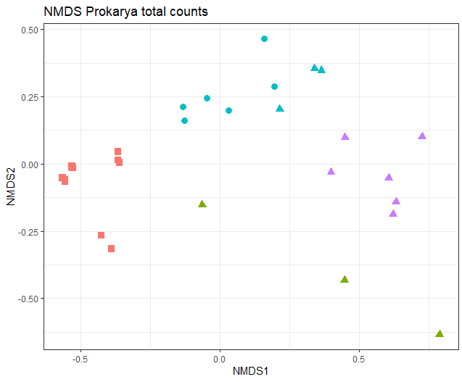
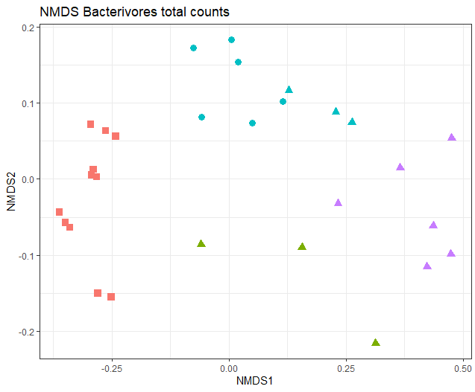
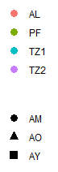
Ordination
→ clear differentiation AL + inconsistent PF community

Slide 24
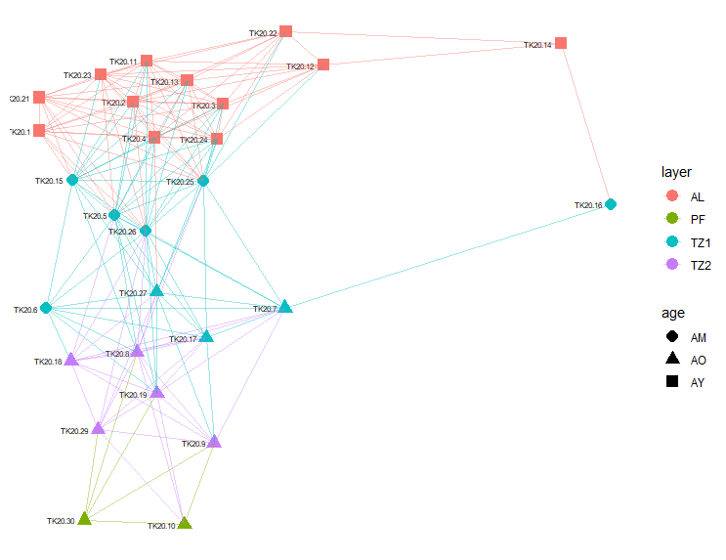
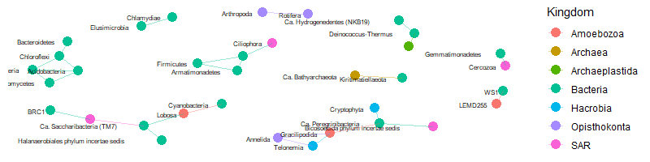
Networks
networks indicates connectivity along depth gradient and between kingdoms

Slide 25
5. mRNA & Outlook

Slide 26
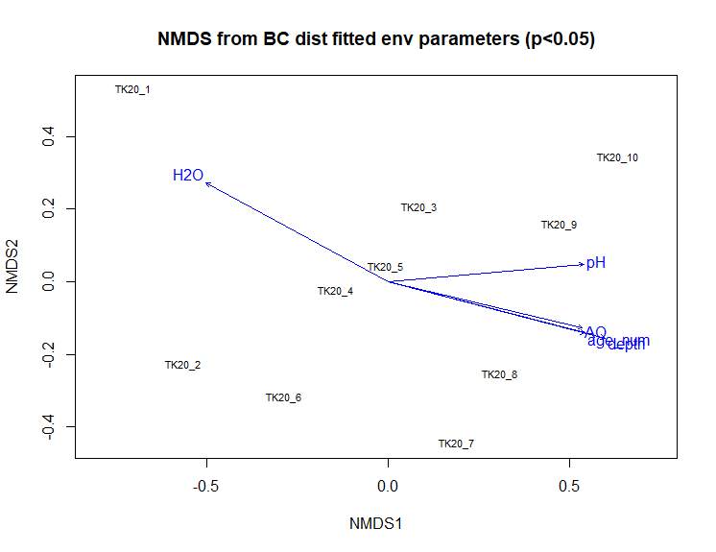
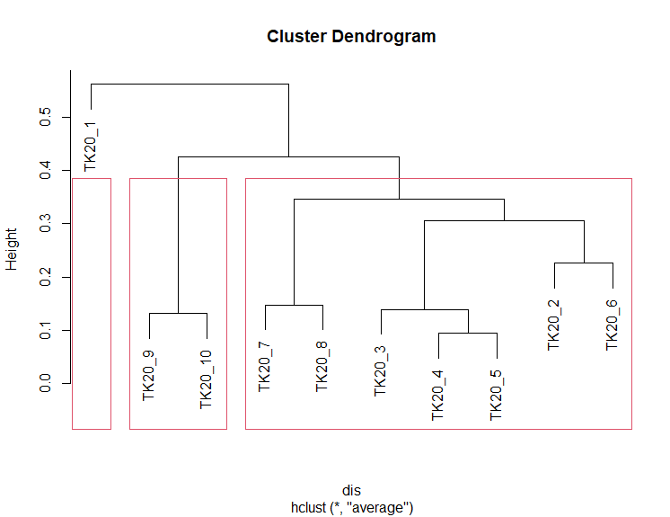
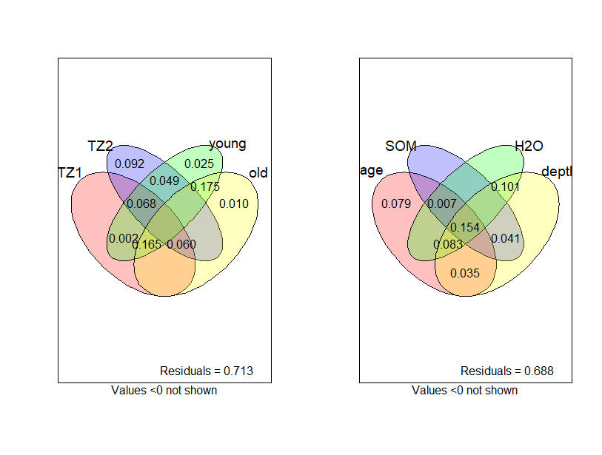
mRNA – gene abundances
H₂O, pH, depth, age drive dissimilarity
No significance without depth or along layers
Surface sample (photosynthesis?) and deepest samples (cold-adaptation) clustering apart
only up to 30% of variance explained by edaphic parameters

Slide 27
6. Conclusions
Who?
What drives them?
What do they do?
β-Proteobacteria & Bacteroidota, while eukaryotes dominated by bacterivores (Ciliophora)
edaphic properties (depth, age, SOM, H₂O), and especially thaw, while predations is added as biotic factor
We don’t know yet: annotating mRNA (in progress) in order to evaluate mRNA statistical results

Slide 28
References
Cavicchioli, R., et al. (2019). Scientists’ warning to humanity: microorganisms and climate change. Nat. Rev. Microbiol. 17, 569–586. doi:10.1038/s41579-019-0222-5.
Jansson, J. K., and Hofmockel, K. S. (2019). Soil microbiomes and climate change. Nat. Rev. Microbiol., 12. doi:10.1038/s41579-019-0265-7.
Johnson, S. S., et al. (2007). Ancient bacteria show evidence of DNA repair. PNAS 105, 10631–10631. doi:10.1073/pnas.0710637105.
Panikov, N. S., et al. (2006). Microbial activity in soils frozen to below -39°C. Soil Biol. Biochem. 38, 785–794. doi:10.1016/j.soilbio.2005.07.004.
Scheel, M., et al. (2022). Microbial Community Changes in 26,500-Year-Old Thawing Permafrost. Front. Microbiol. 13, 1–14. doi:10.3389/fmicb.2022.787146.
Schuur, E. A. G., and Mack, M. C. (2018). Ecological Response to Permafrost Thaw and Consequences for Local and Global Ecosystem Services. Annu. Rev. Ecol. Evol. Syst. 49, 279–301. doi:10.1146/annurev-ecolsys-121415-032349.
Sipes, K., et al. (2021). Eight Metagenome-Assembled Genomes Provide Evidence for Permafrost. Appl. Environ. Microbiol. doi:https://doi .org/10.1128/AEM.00972-21.
Turetsky, M., et al. (2020). Carbon release through abrupt permafrost thaw. Nat. Geosci. 13, 138–143. doi:10.1038/s41561-019-0526-0.

Slide 29
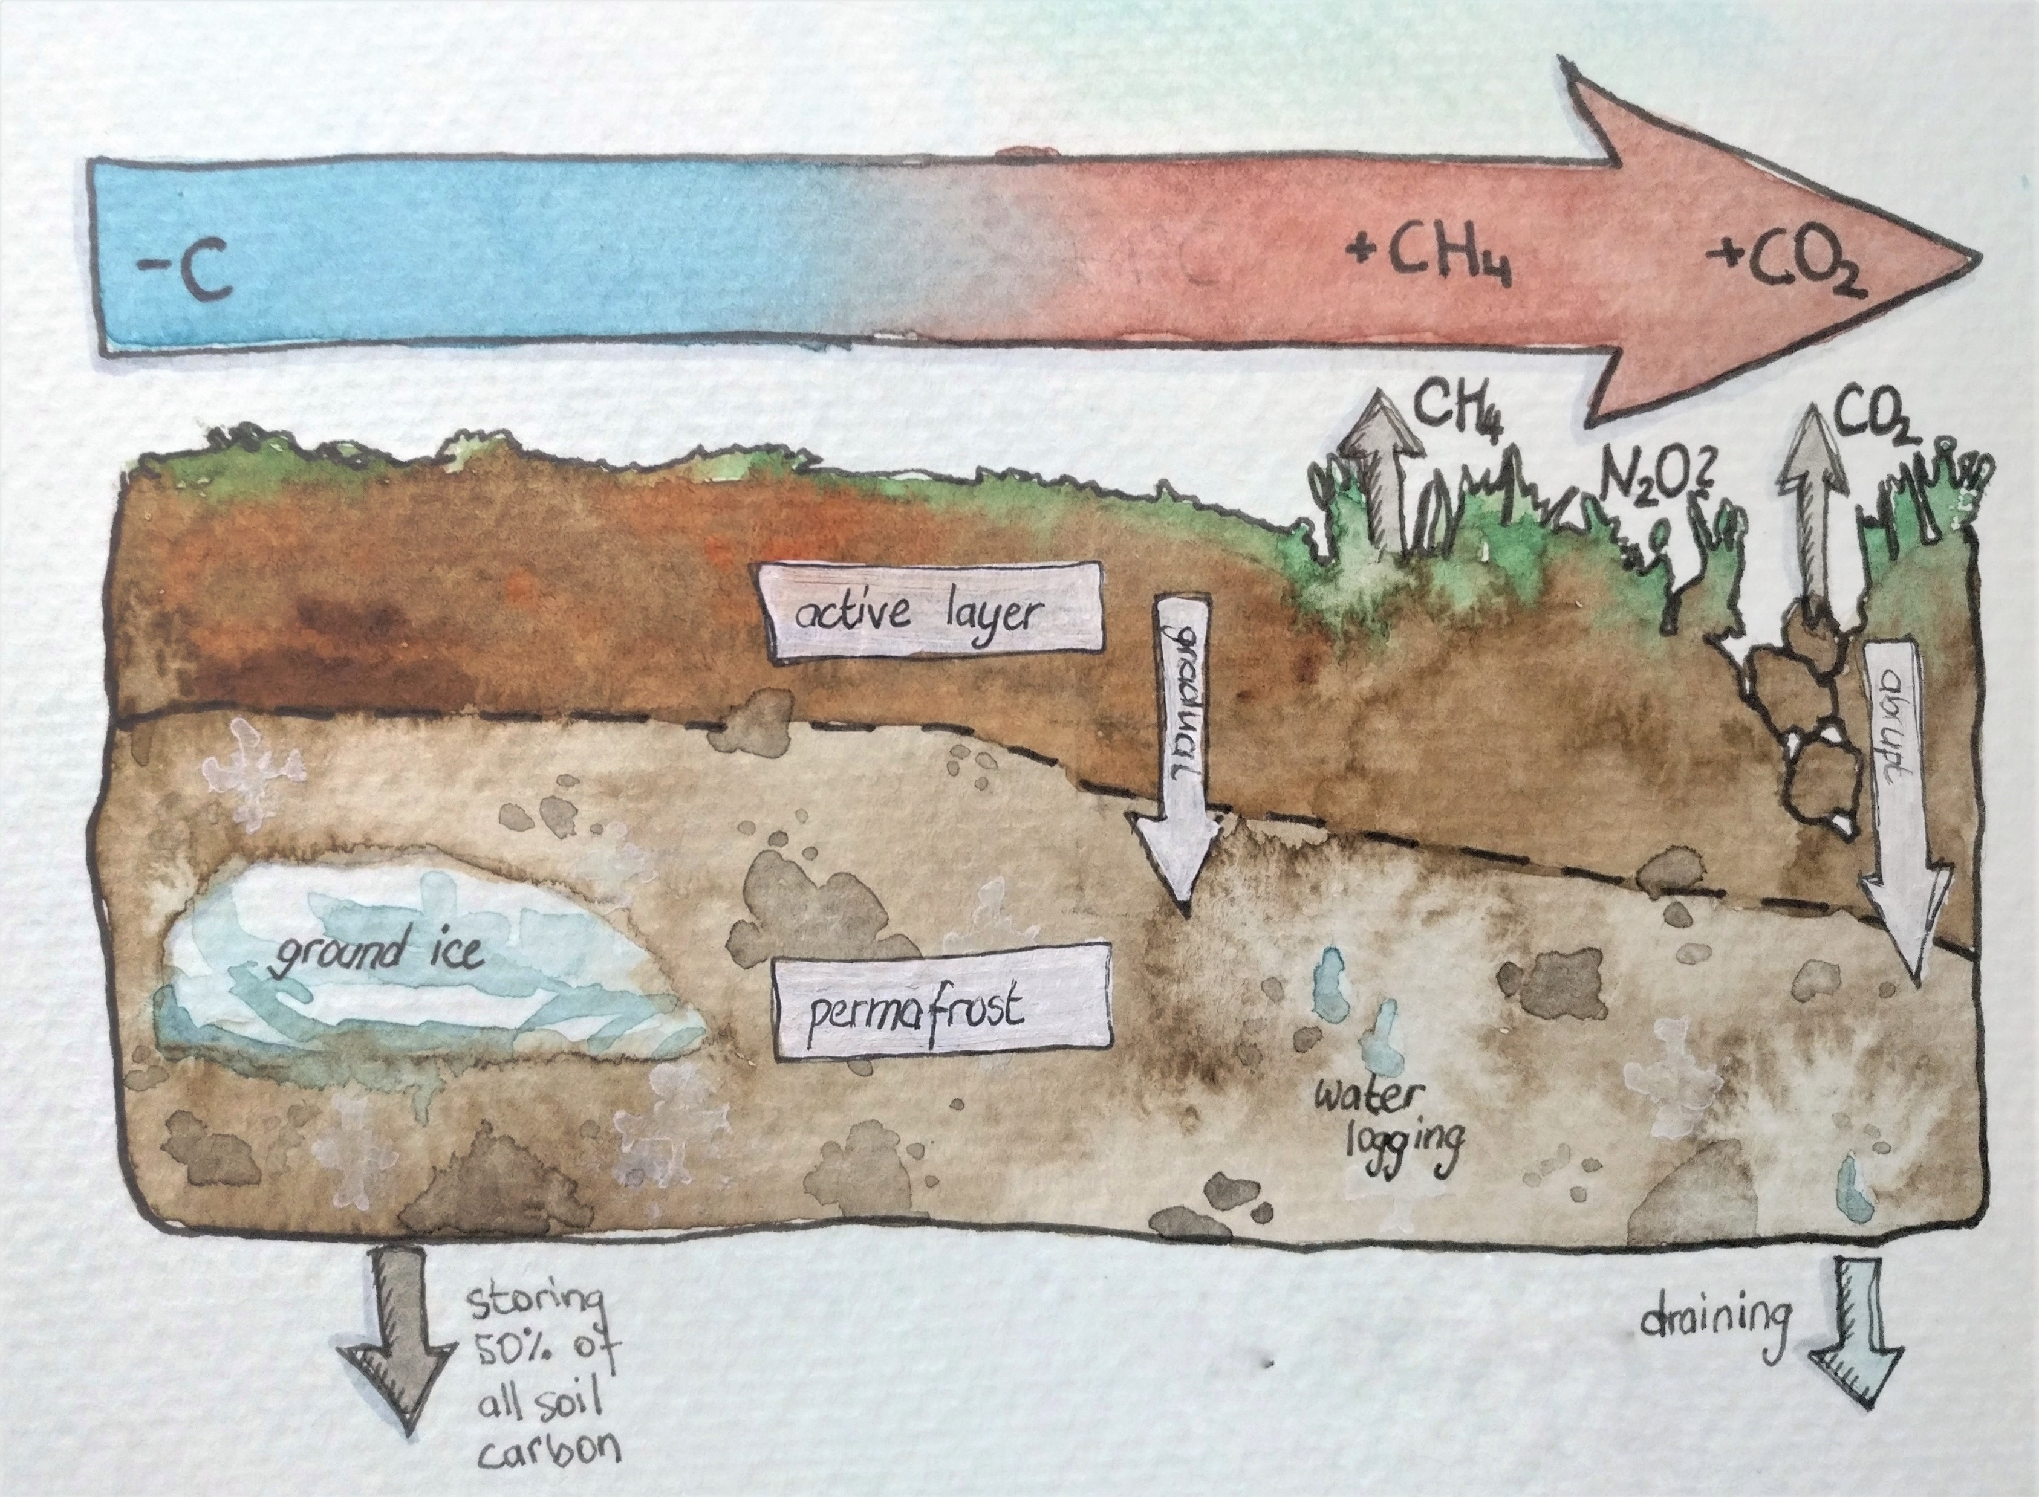



Thanks!
@Maria_Scheel_
maria.scheel@ecos.au.dk
… and let’s chat in person!
Abstract and material:

