Slide 1
Developing forecast information for institutional decision-makers
Mirianna Budimir, Alison Sneddon, Issy Nelder, Sarah Brown, Amy Donovan, and Linda Speight
EGU 2022
Dr Mirianna Budimir
mirianna.budimir@practicalaction.org.uk
@MBudimir

Slide 2
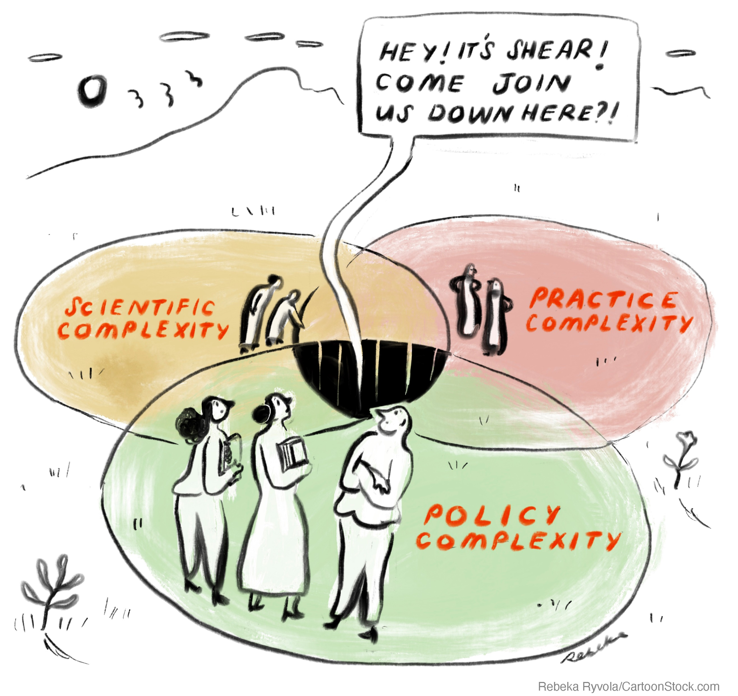
Challenge
Gap between the production of scientific forecasts and warnings and the operational use of such information by institutional stakeholders in official decision-making roles.
Share learning from developing early warning bulletins for institutional decision-makers.
Case studies from SHEAR:
Prototype landslide forecast bulletins in Nilgiris and Darjeeling Districts of India
Daily reports in response to Cyclones Idai and Kenneth in Mozambique

Slide 3
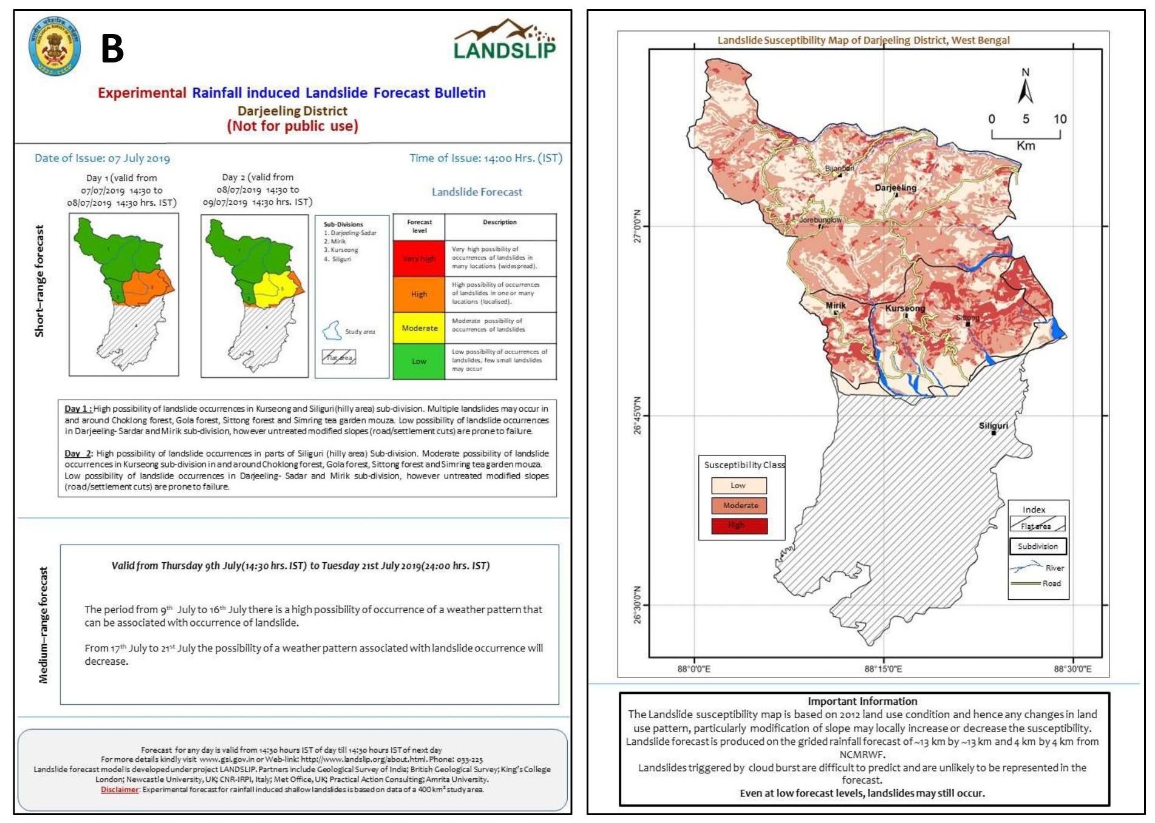
Case study: Landslide forecasting in India
LANDSLIP project
Landslide forecasts in 2 Districts in India
18+ months development
Pre-operational experimental phase
Issued daily during monsoon (2020+)
District Authority users

Slide 4
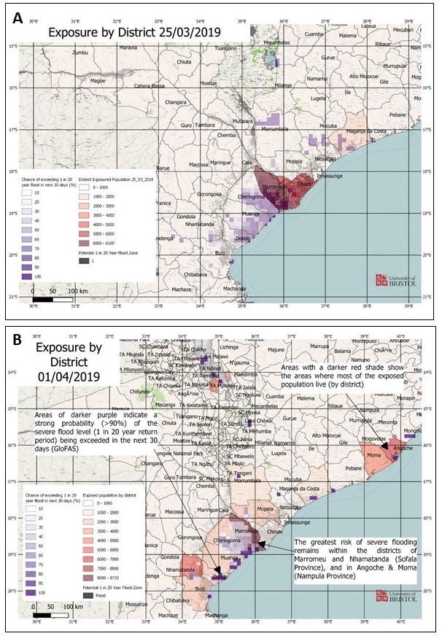
Case study: Cyclone flood forecasting in Mozambique
FATHUM, ECMWF & University of Bristol project team
Request by FCDO in response to Cyclone Idai and Kenneth
Ongoing humanitarian response
Daily reports issued over two intense emergency periods
Humanitarian response users in Mozambique

Slide 5
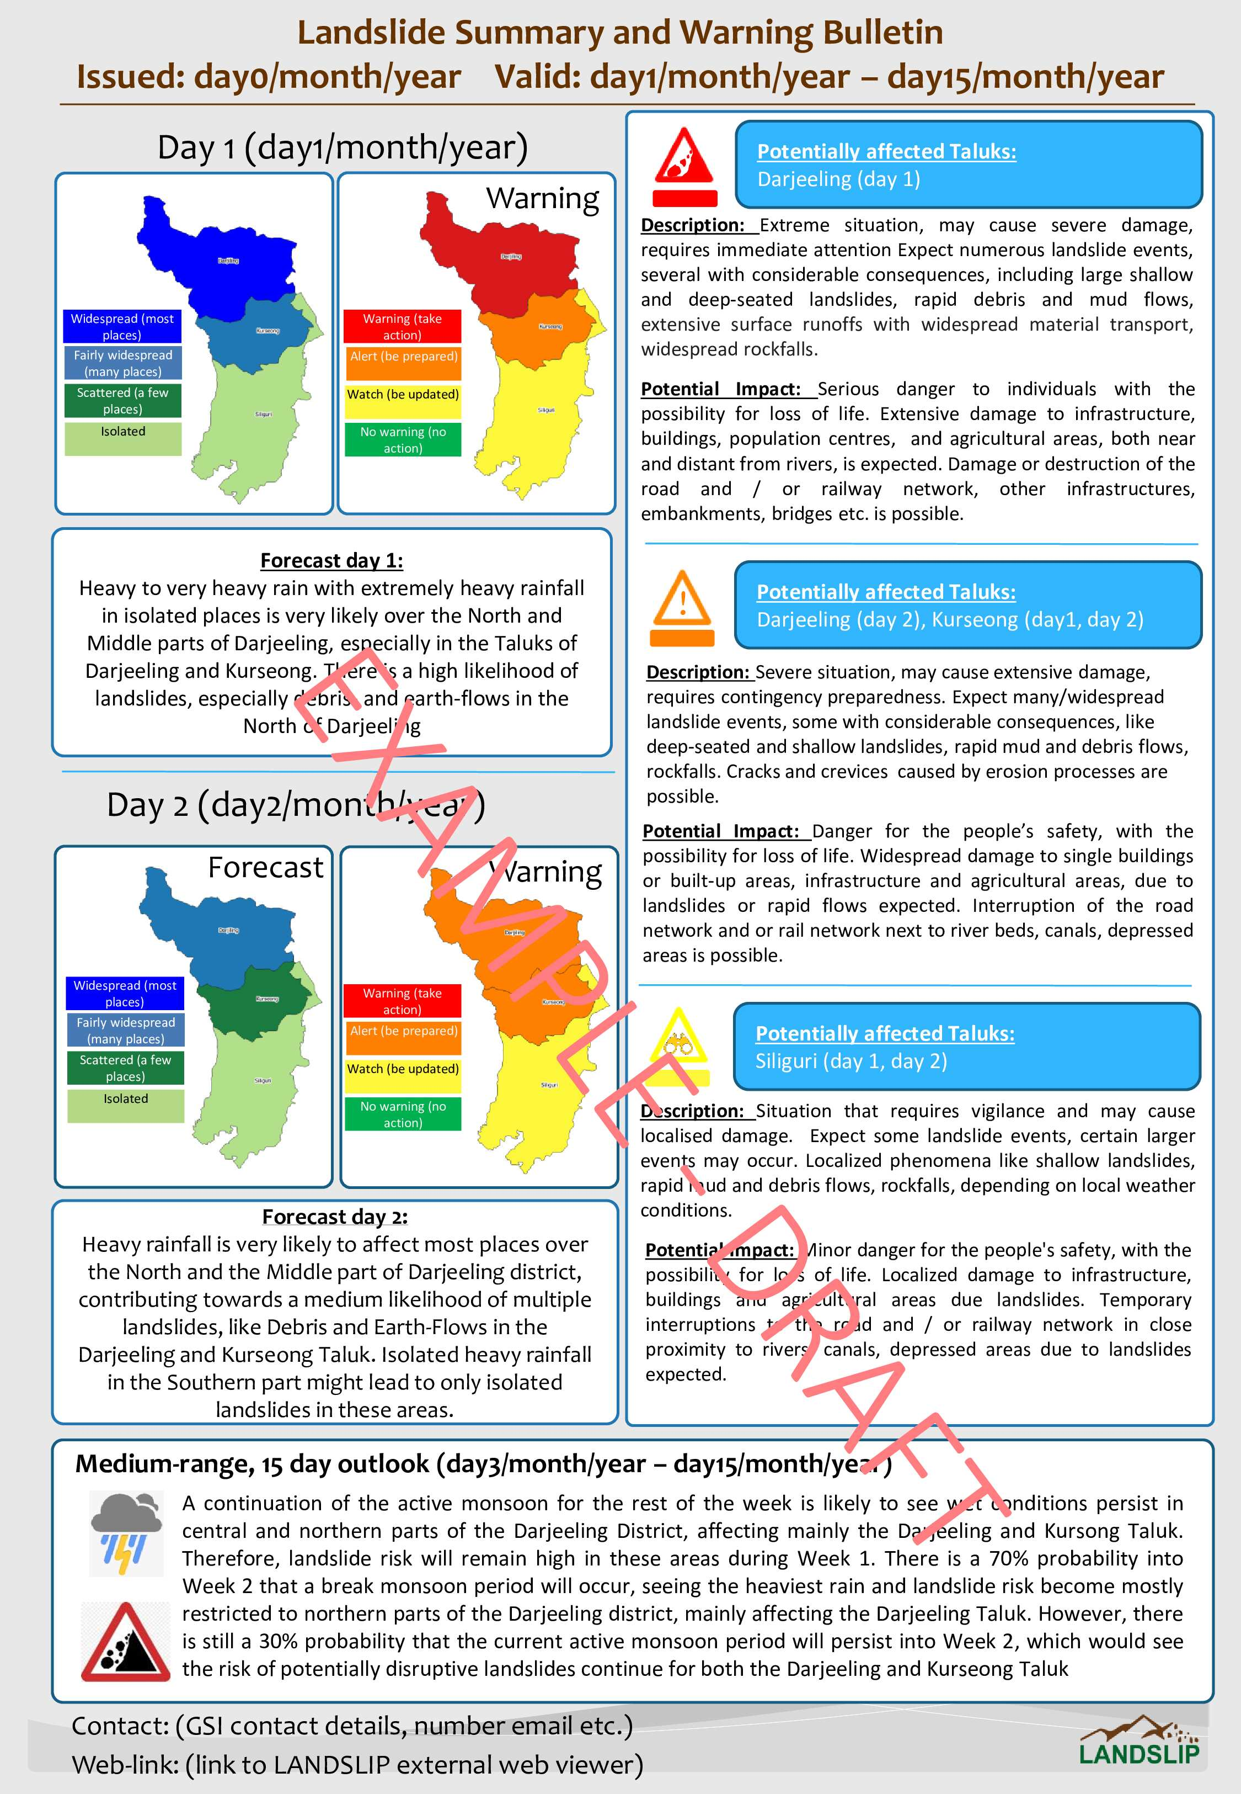
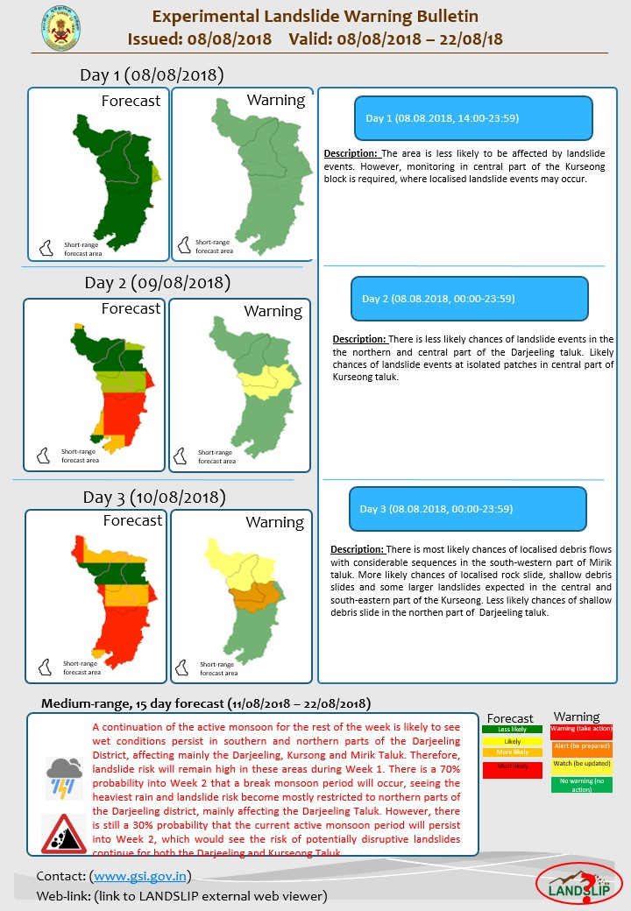
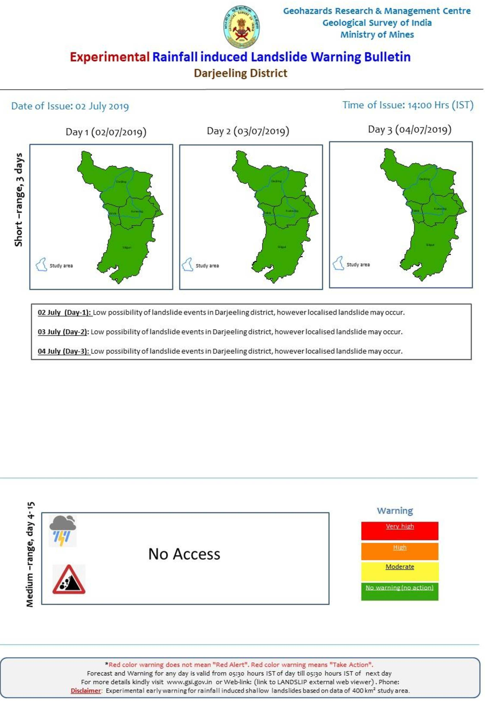
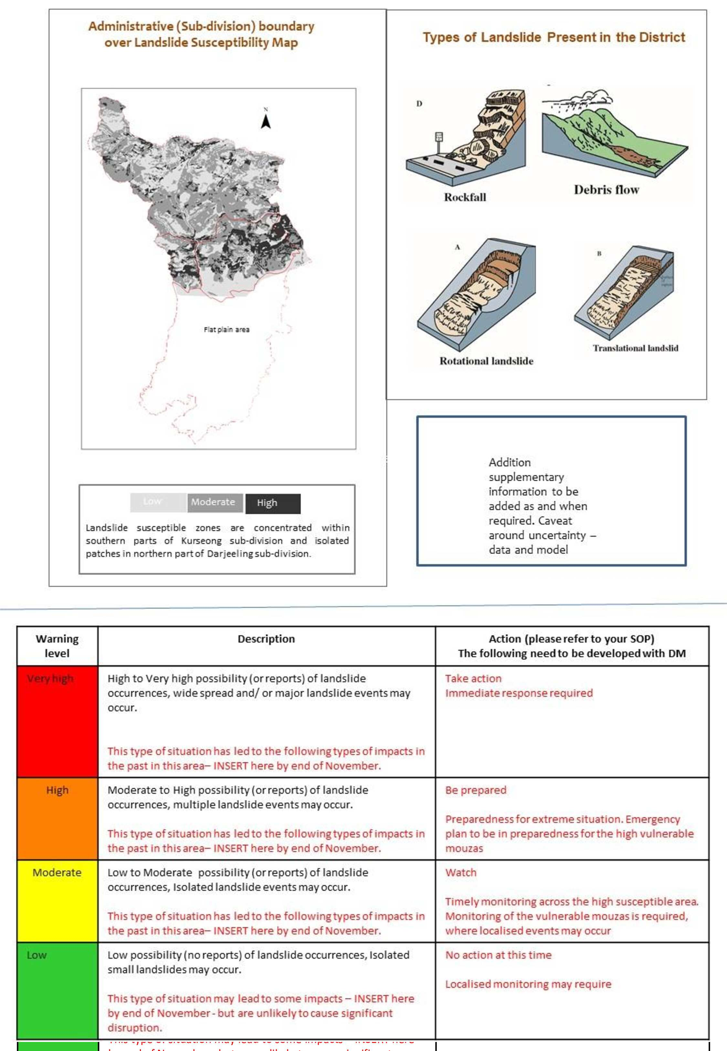
Methodology
18 Key informant interviews (producers and intermediaries):
Eleven from landslide bulletins
Seven from cyclone bulletins
Secondary data from meetings, workshops, focus group discussions, emails, internal communications (including data from interactions with users).
Iterations of bulletins.

Slide 6
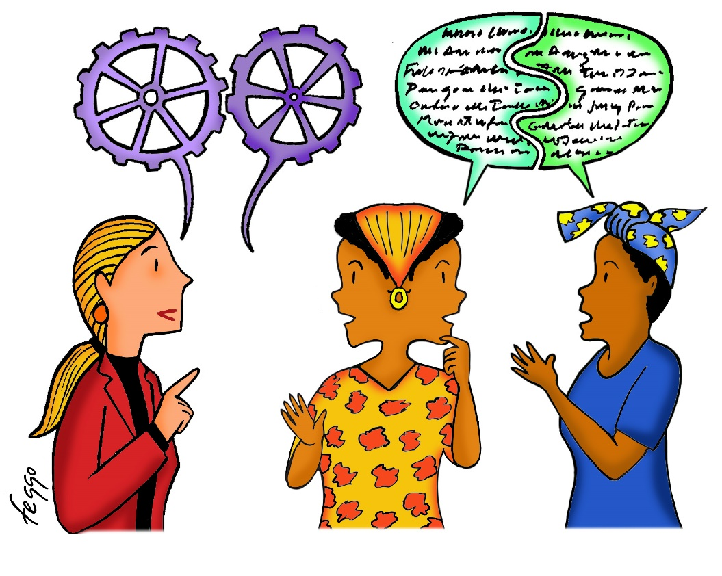
Findings
Iterative development and the role of co-production.
Content:
Layout – summary information, highlights.
Text, choice of language, terminology, less text.
Use of simple visuals, accompanied by text and annotations, maps with local information a challenge.
The inclusion/exclusion of exposure, vulnerability, and impact information.
Information vs advice.
Communicating complexity but avoiding oversimplification.
Team roles and skills.
Interdisciplinary, importance of social science and practitioner/intermediary roles.

Slide 7
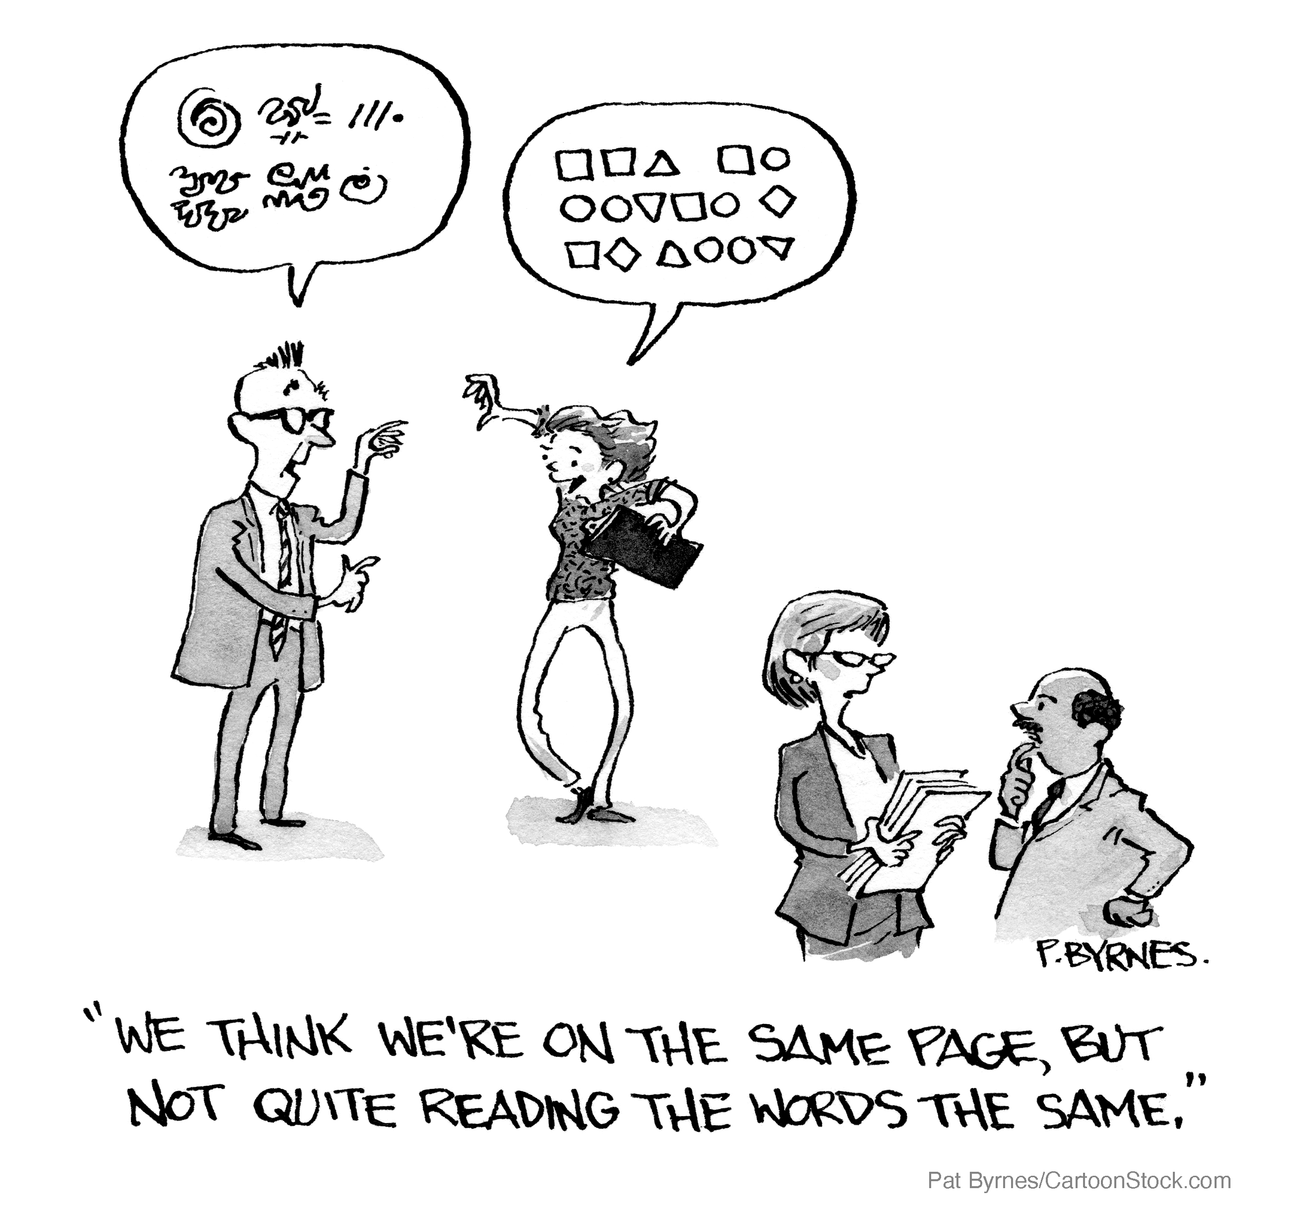
Findings (cont.)
Priorities and relationships.
Tensions, challenge, learning, process. Physical proximity, previous relationships, openness, transparency, and time. Formal and informal opportunities.
Accuracy and evaluation.
Balance - what is possible for the science to produce in terms of spatial and temporal detail and certainty against user needs. Time/data challenges in evaluating forecasts.
Understanding users.
Cyclone bulletins produced during period of crisis. Landslide bulletin users and engagement evolved over time.
Preparedness and protocols.
Training, templates and time outside of emergencies. Supporting communication, coordination and collaboration. SOPs for sustainability, quality assurance, and consistency.

Slide 8
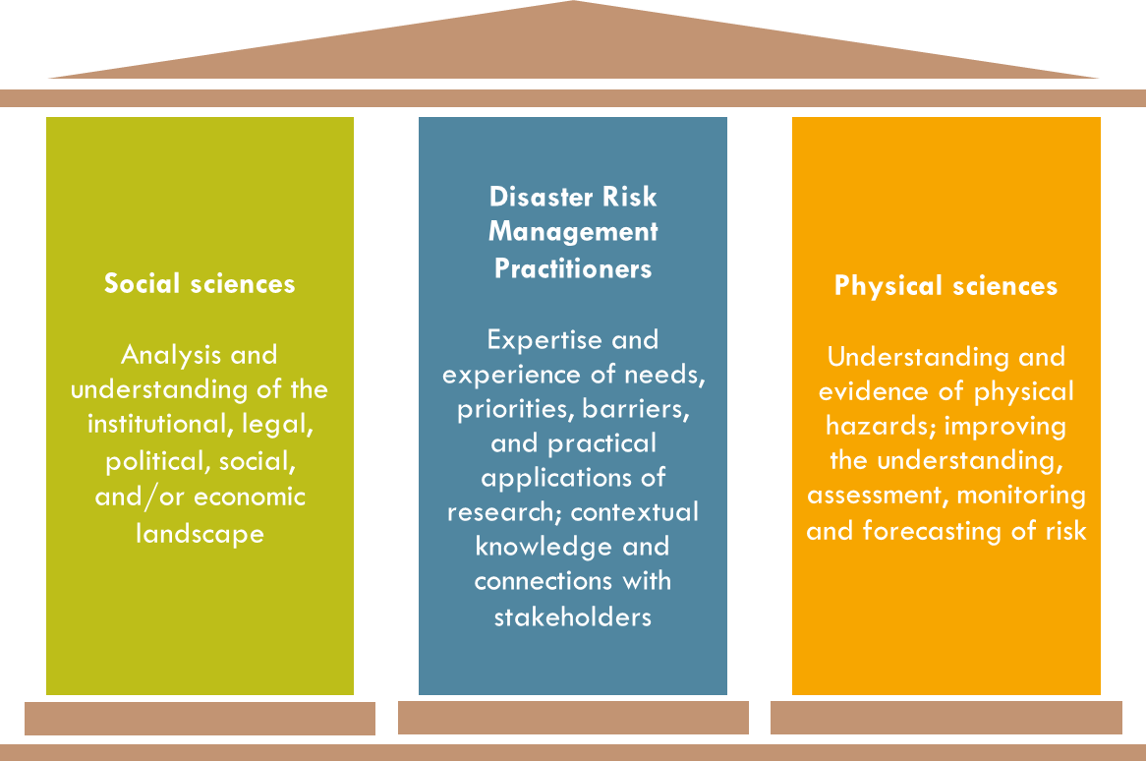
Recommendations and lessons
Engage with users to understand what they need to know and work with them transparently.
Build an interdisciplinary team including social scientists, physical scientists, and practitioners or intermediaries.
Facilitate and build strong interdisciplinary collaboration, with good communication skills and an ability to work across disciplines.
Where possible, utilise time outside of intensive hazard or crisis periods to develop plans and protocols to improve efficiency of operational mechanisms.

Slide 9
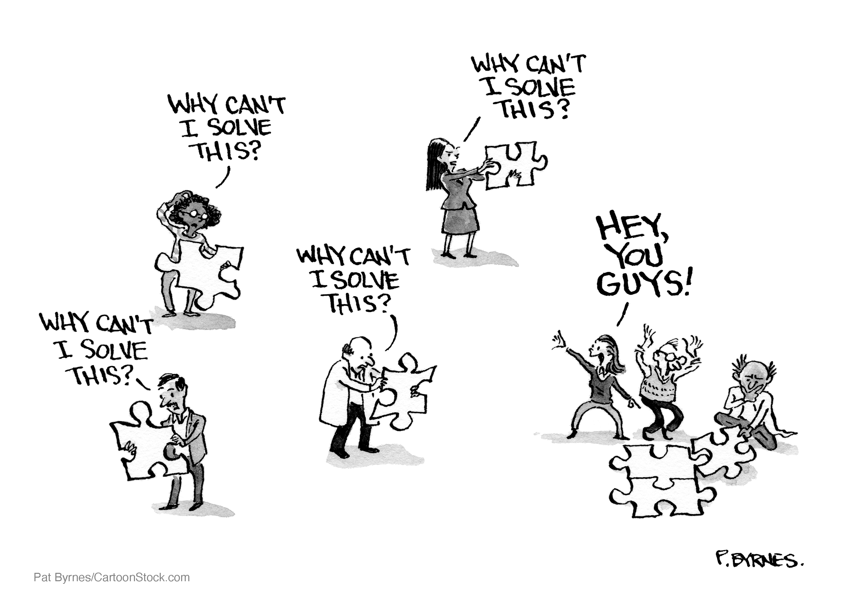
Recommendations and lessons (cont.)
Use interdisciplinary skills and delegation of roles to your advantage.
Be realistic and transparent within the project team and with external stakeholders about what can be achieved in the time available.
Value and actively build relationships between people in the team.
Embrace an iterative approach by actively seeking feedback to optimise and improve the bulletins and processes.

Slide 10
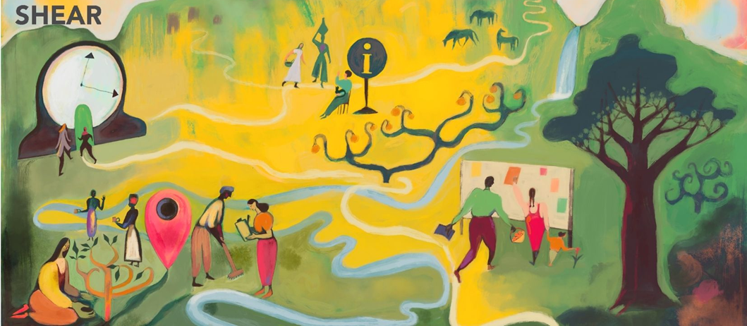
Gaps and ways forward
Literature emphasises the importance of collaboration between disciplines, tailoring to users, and the importance of trust and protocols - little operational guidance of how to do this in practice.
Guidance is needed to provide structures and approaches for producers of forecasts to do this well, drawing on operational experience as well as academic published research.
Guidance is also needed to define the specific skills needed from social science or intermediaries, better articulation of their benefits, and guidance on specific areas where the natural hazard community need to improve their skills.
The findings indicate that whilst more research is needed, there is a significant body of experiential and intuitive knowledge and learning that already exists. Capturing this knowledge would be of significant benefit and interest to those developing forecast information.

Slide 11
Thank you
Dr Mirianna Budimir
mirianna.budimir@practicalaction.org.uk
@MBudimir
SHEAR.org.uk
Paper pre-print
Geoscience Communication
https://gc.copernicus.org/preprints/gc-2021-31/

