Slide 1
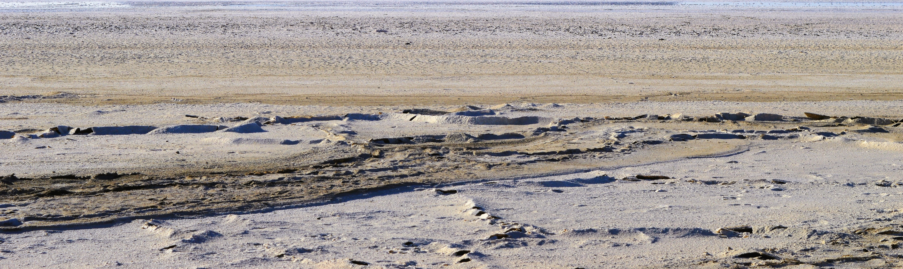
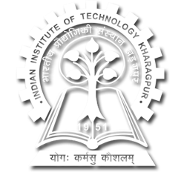




Glimpse of the Rann of Kachchh, western India
Carbon isotope and organic geochemistry of the Holocene sediments from Rann of Kachchh: implications to the preservation of organic matter and climate during the Indus Valley Civilisation
Fulmati Ram, Mahesh Thakkar, Gaurav Chauhan, Ravi Bhusan, Navin Juyal, and Anindya Sarkar
EGU General Assembly 2022
EGU22-555
Session BG2.1/GMPV1.4/SSS5.8
24.05.2022

Slide 2
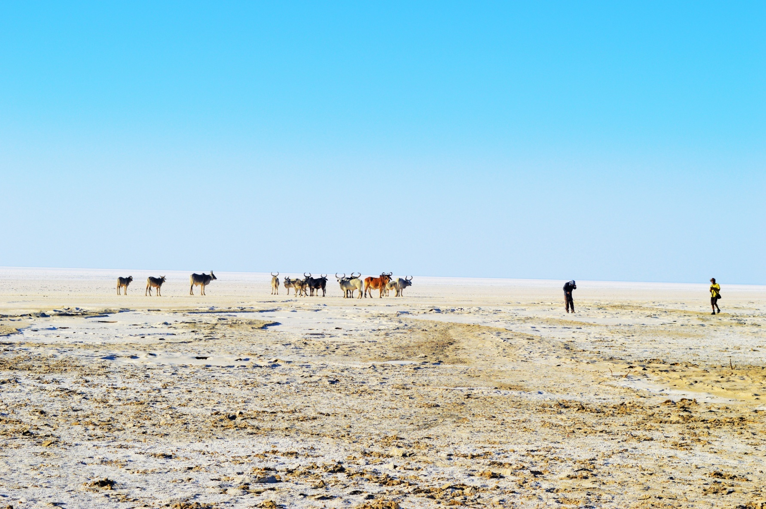
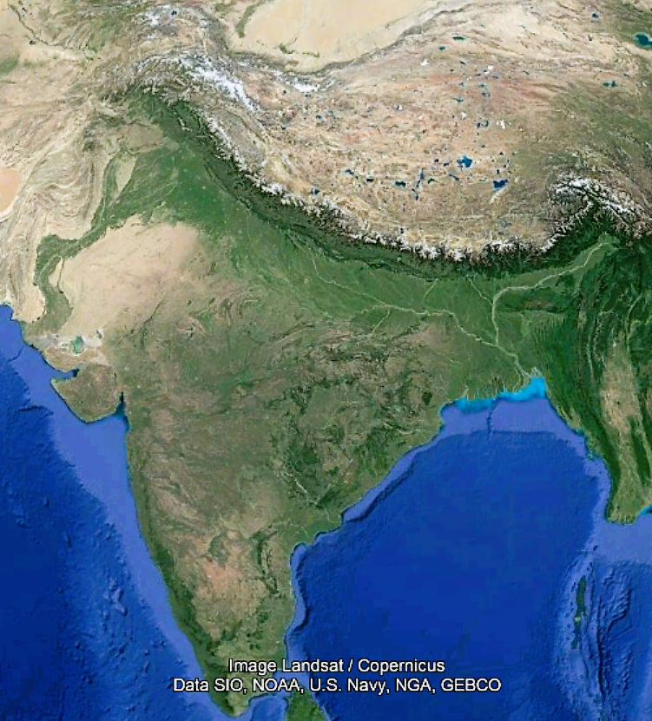
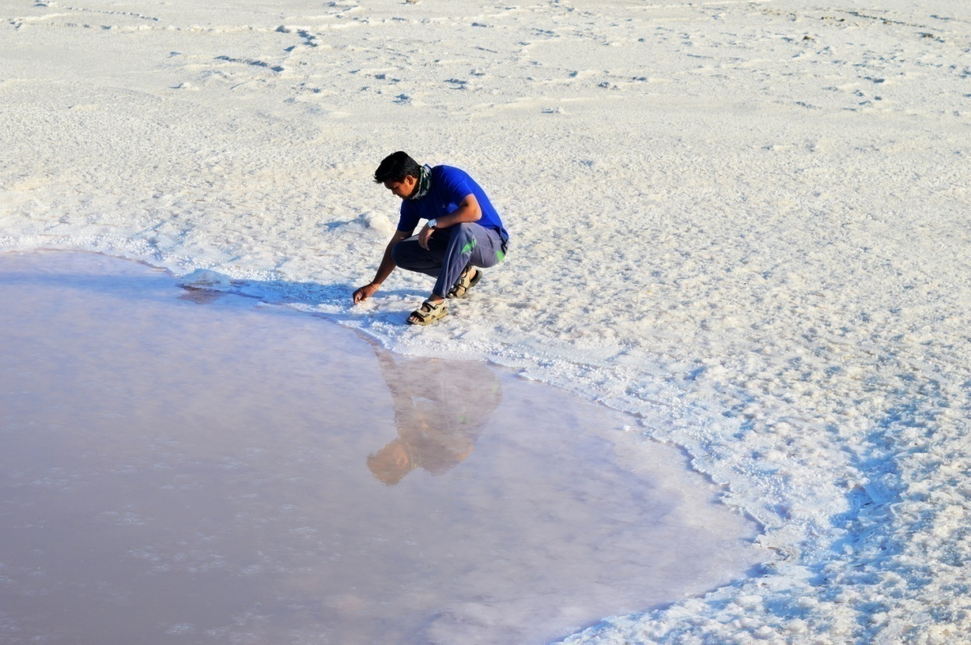
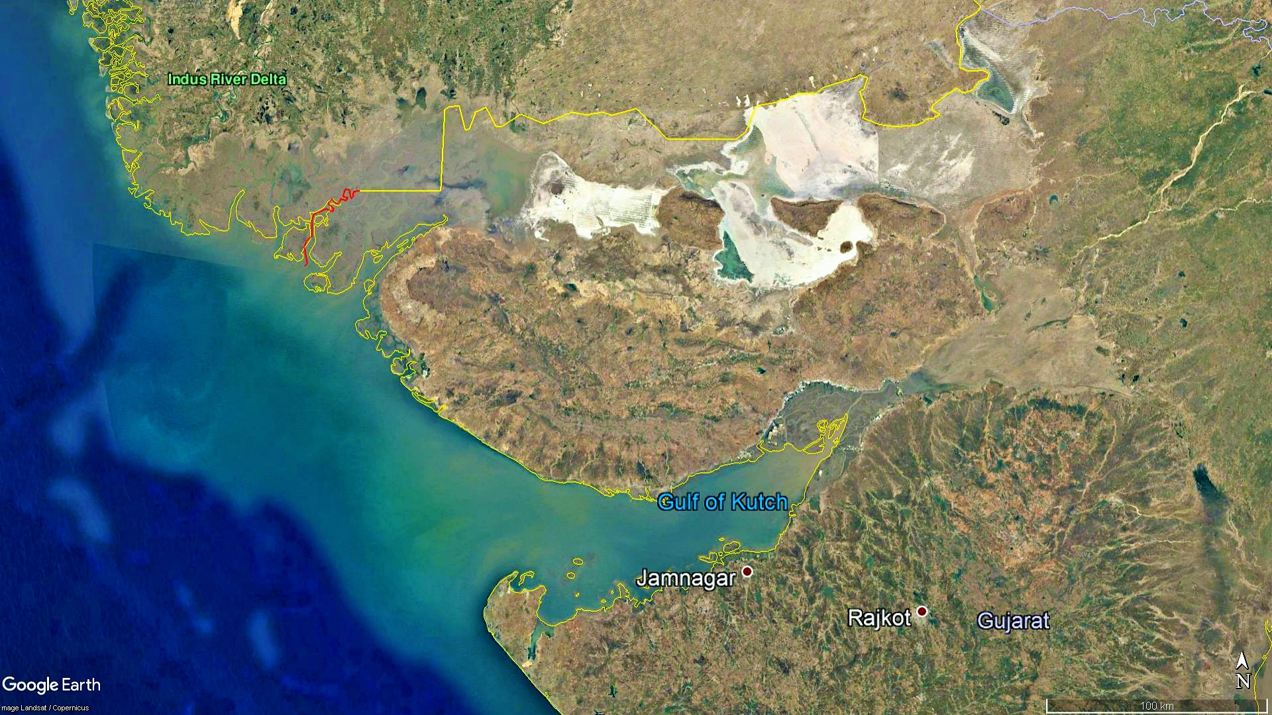

Kori Creek
Gulf of Kachchh
Arabian Sea

Slide 3
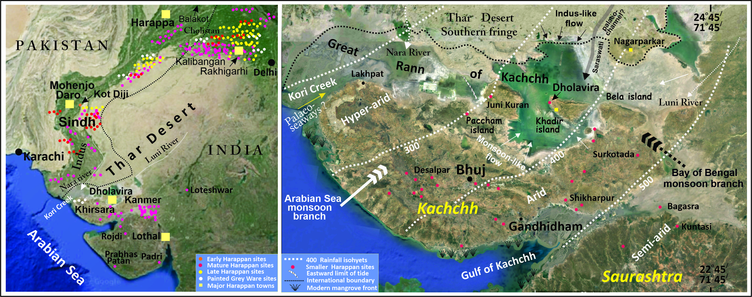
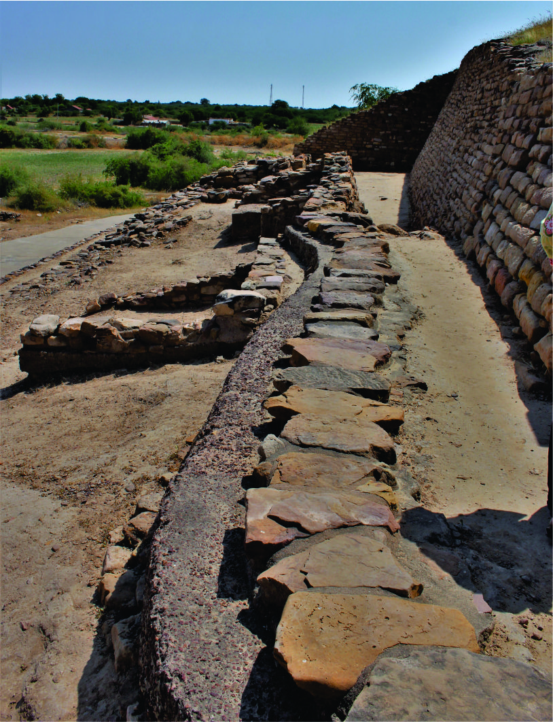
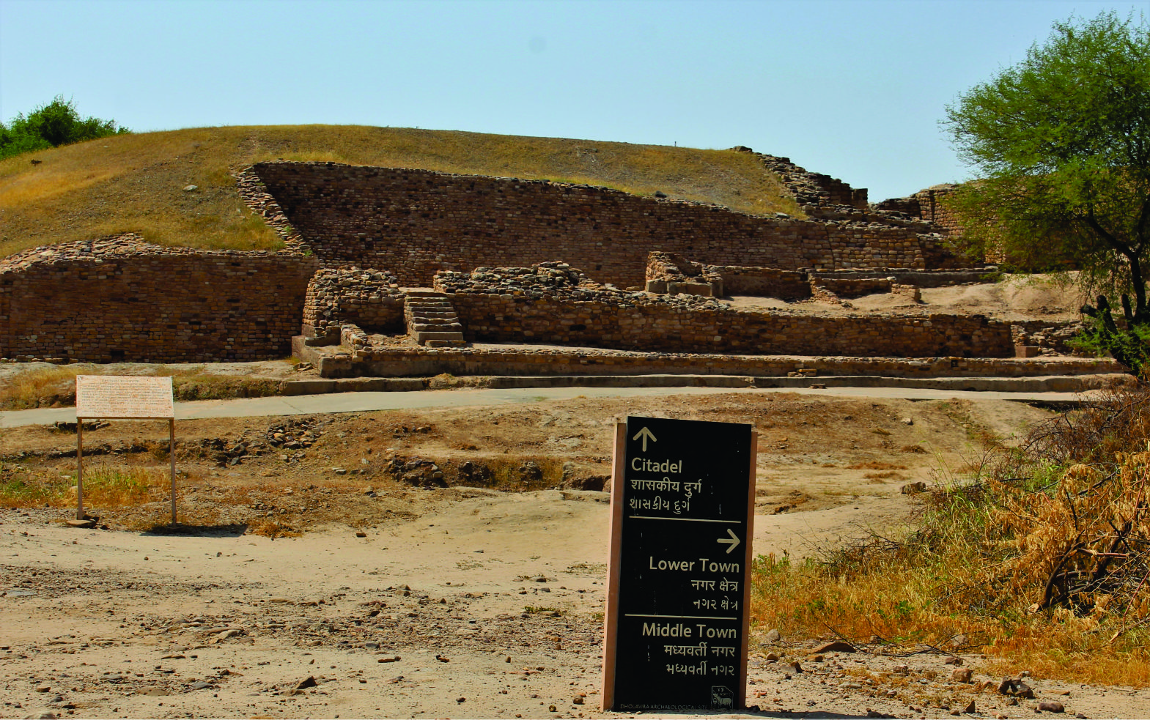
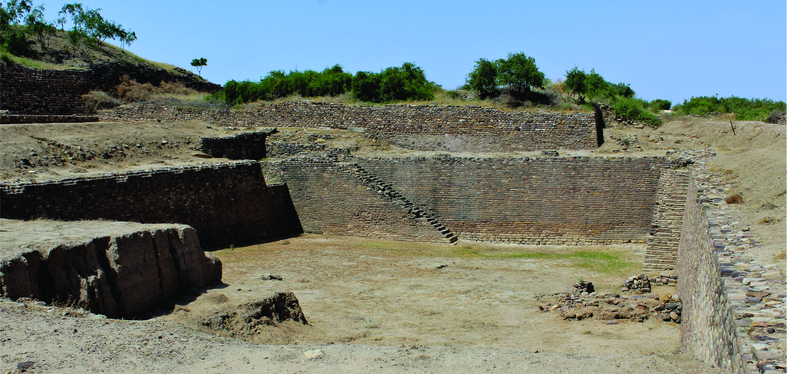
Sengupta et al., 2020
Dholavira site
Dholavira archaeological mound
Dholavira large eastern reservoir

Slide 4
Key Questions?
1. Does the Rann sediments preserve the original organic carbon source signatures through time?
2. How was the climate and environment that led to the flourishment of such a mega Indus Valley settlement in this region?
3. Does the climate had any role in the growth and collapse of the Indus Valley metropolis (Dholavira) in this region?

Slide 5
In a marginal setting like the Rann of Kachchh, high δ¹³C values of bulk sedimentary organic matter (SOM) can occur due to:-
Microbial degradation of organic matter
Increase in marine-derived organic matter input
Increase in the C4-derived organic matter due to low precipitation
¹³C enrichment of the C3 end-member only, caused due to decreasing precipitation, considering negligible C4 contribution

Slide 6
Wet oxidation treatment (OROC)
Oven dried sediment samples were treated with 0.1M K₂Cr₂O₇
in 2M H₂SO₄ solution at 60 ⁰C (for 72 hours)
Sedimentary organic matter (SOM)
Wet oxidation reaction
Oxidation Resistant Organic Carbon (OROC)
Active Soil Organic Carbon (ASOC)
(Reaction residue)
(Outgassed during oxidation)
Removes easily degradable and partially degraded organic matter from the bulk sediment
following Wynn and Bird, 2007

Slide 7
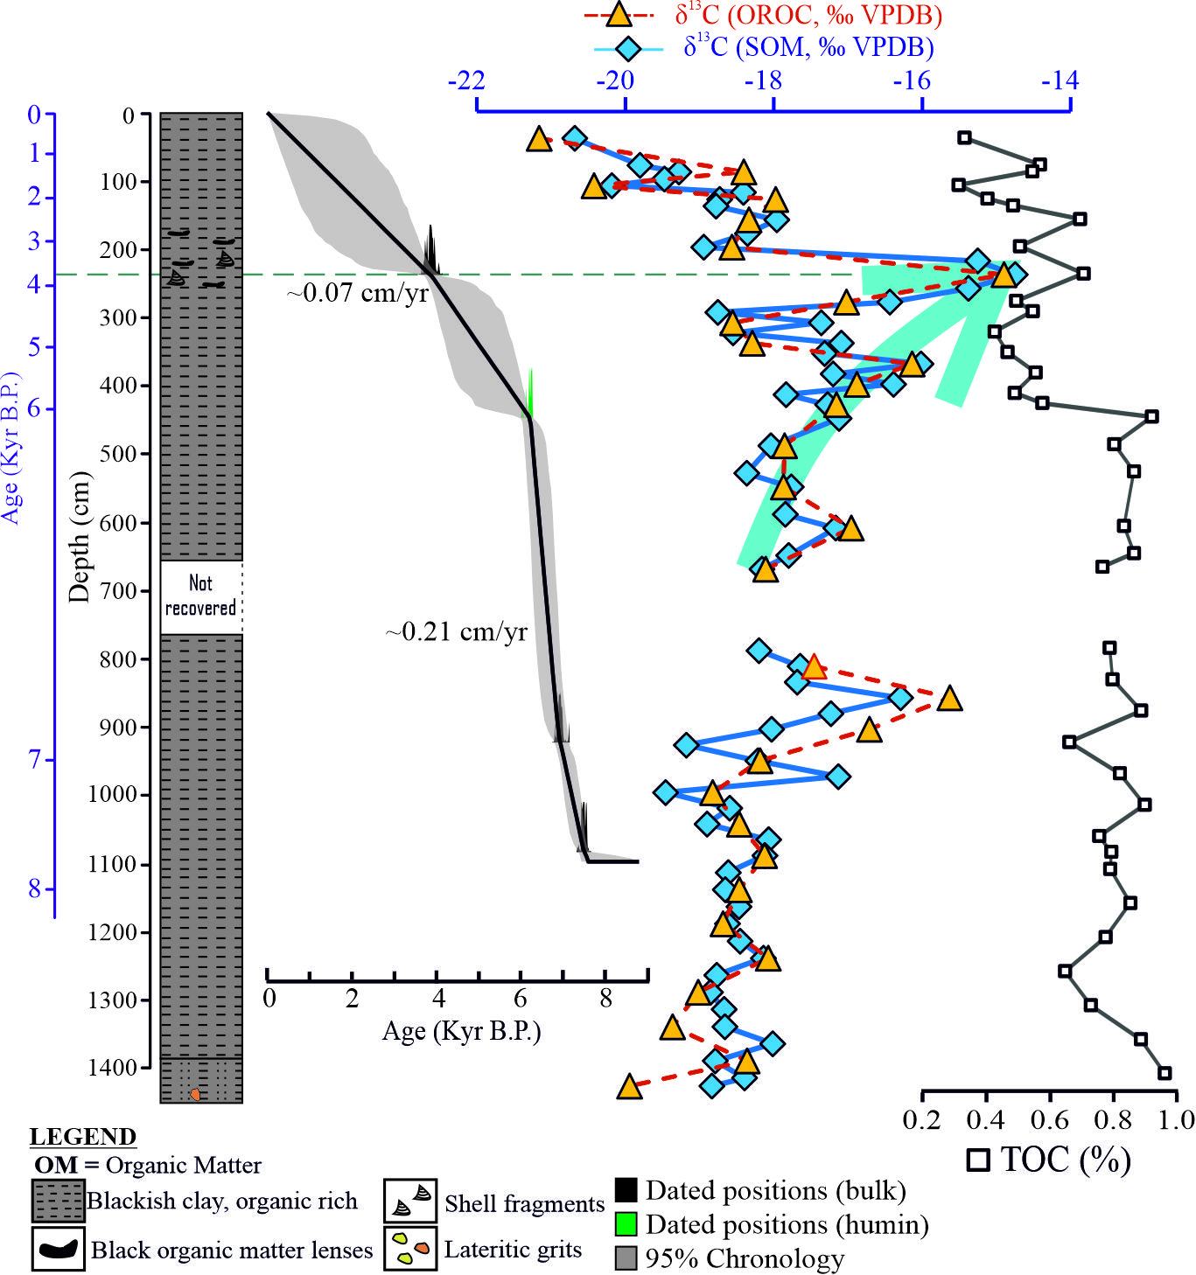
Conclusions
1. The Rann sediments preserve the original organic carbon source signatures without much post depositional changes.
2. A mixture of C3, C4 and marine (?) organic matter throughout the Holocene period.
3. Significant increase of C4 type vegetation around 4 Kyr corresponding to the Meghalayan Age Drought period.
4. The 4 Kyr aridity possibly drove the fall of the Indus Valley settlements in this region.

Slide 8
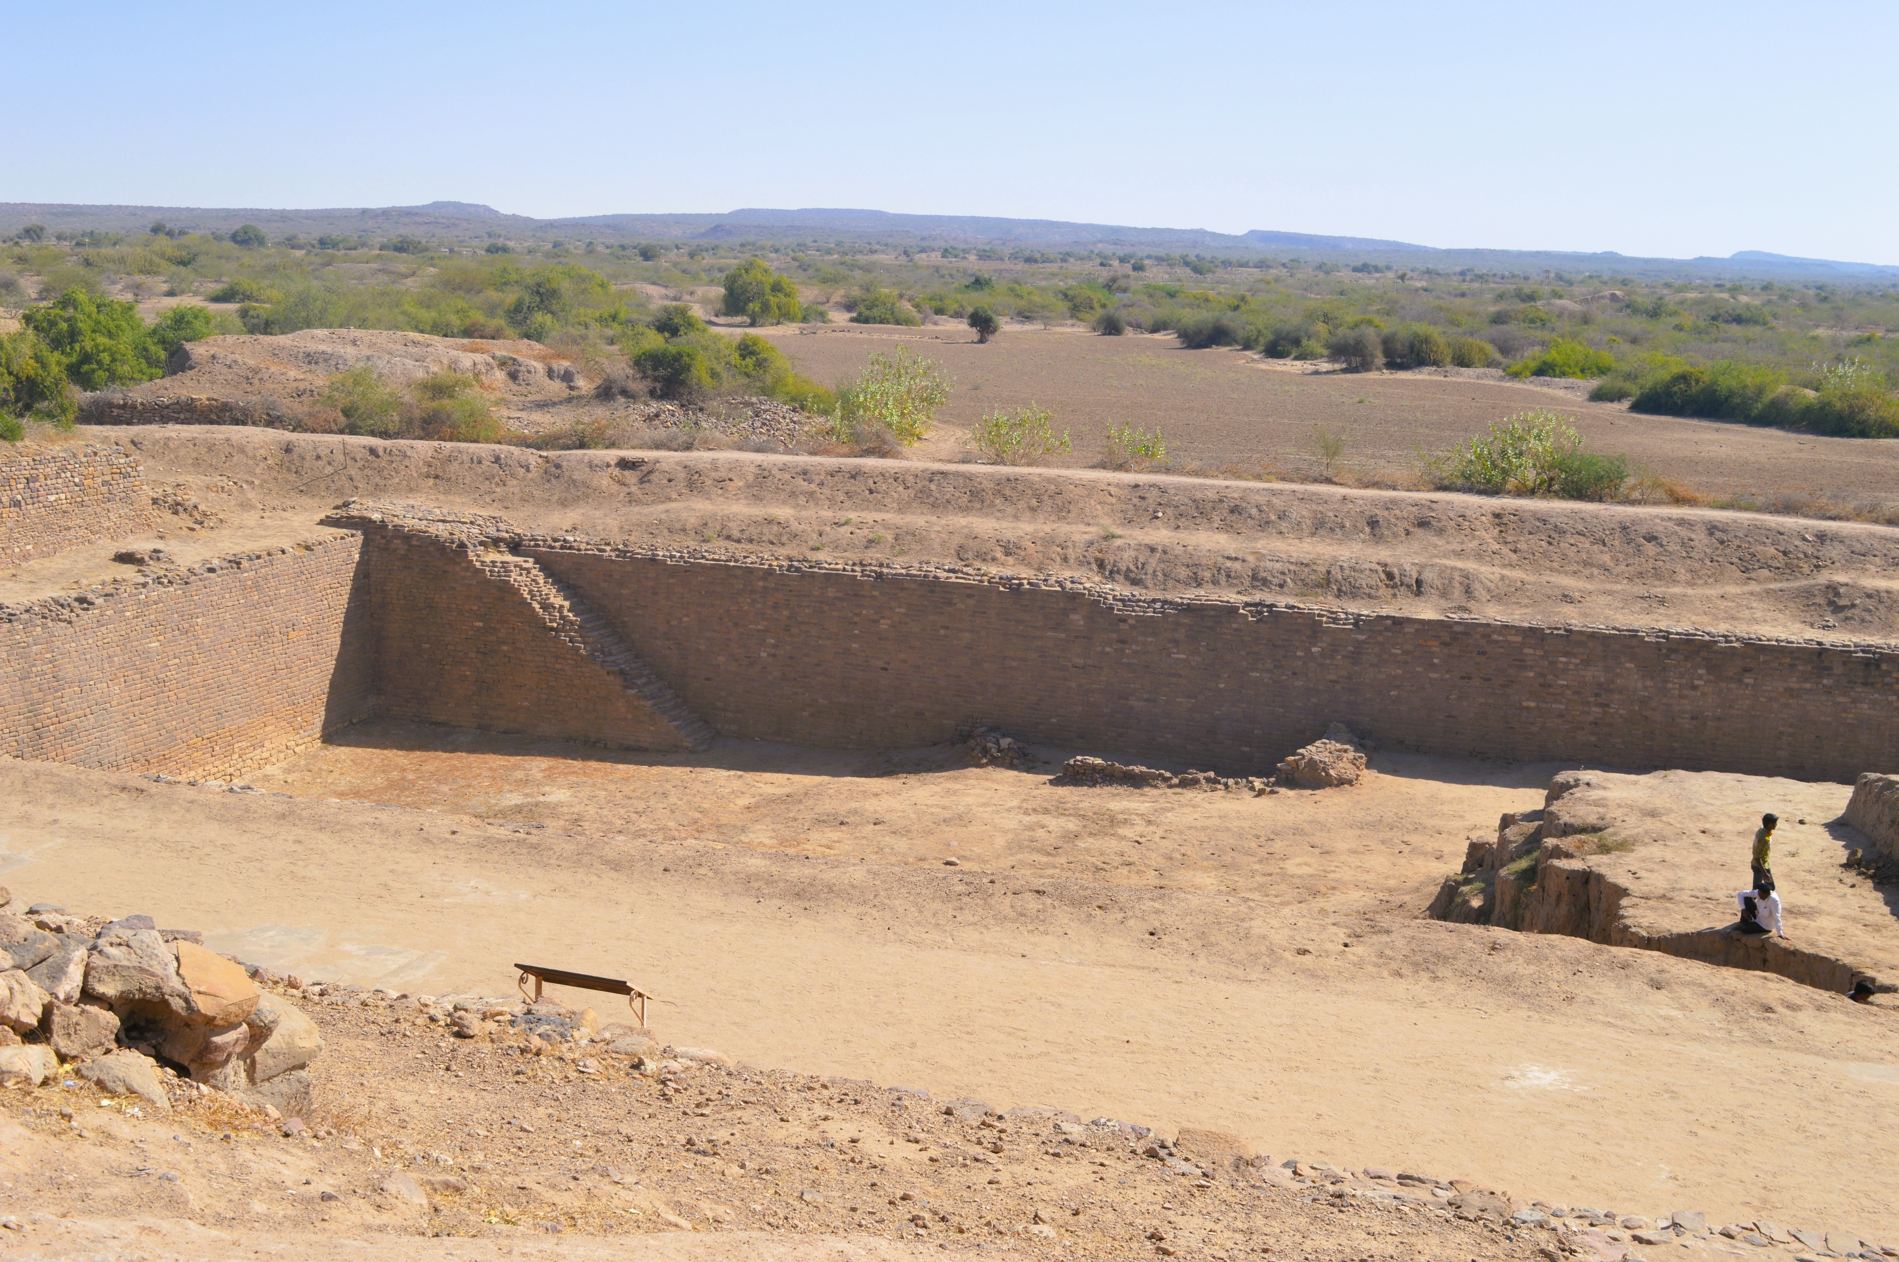

THANK YOU
I look forward to receive any questions, comments or suggestions.
fulmati.ram@gmail.com

