Slide 1



ASSESSING THE GENERALIZATION POWER OF THREE MACHINE LEARNING MODELS AND THREE EVAPOTRANSPIRATION FORMULAS USING 124 FLUXNET TOWERS DATA
Alireza Amani, Marie-Amélie Boucher, Alexandre R. Cabral, and Daniel F. Nadeau

Slide 2
Context
Evapotranspiration (ET) is an important but very difficult water balance quantity to measure
Machine Learning (ML) models, an alternative way, are they reliable estimators?
1

Slide 3
Context
We are interested in:
Realistic assessment of ML models generalization ability
Multi-site (124) development and evaluation
FLUXNET2015 dataset
Limited to the growing season
Daily ET
Benchmark models
Hypothesis
ML models will generalize well and will outperform ET equations
2

Slide 4
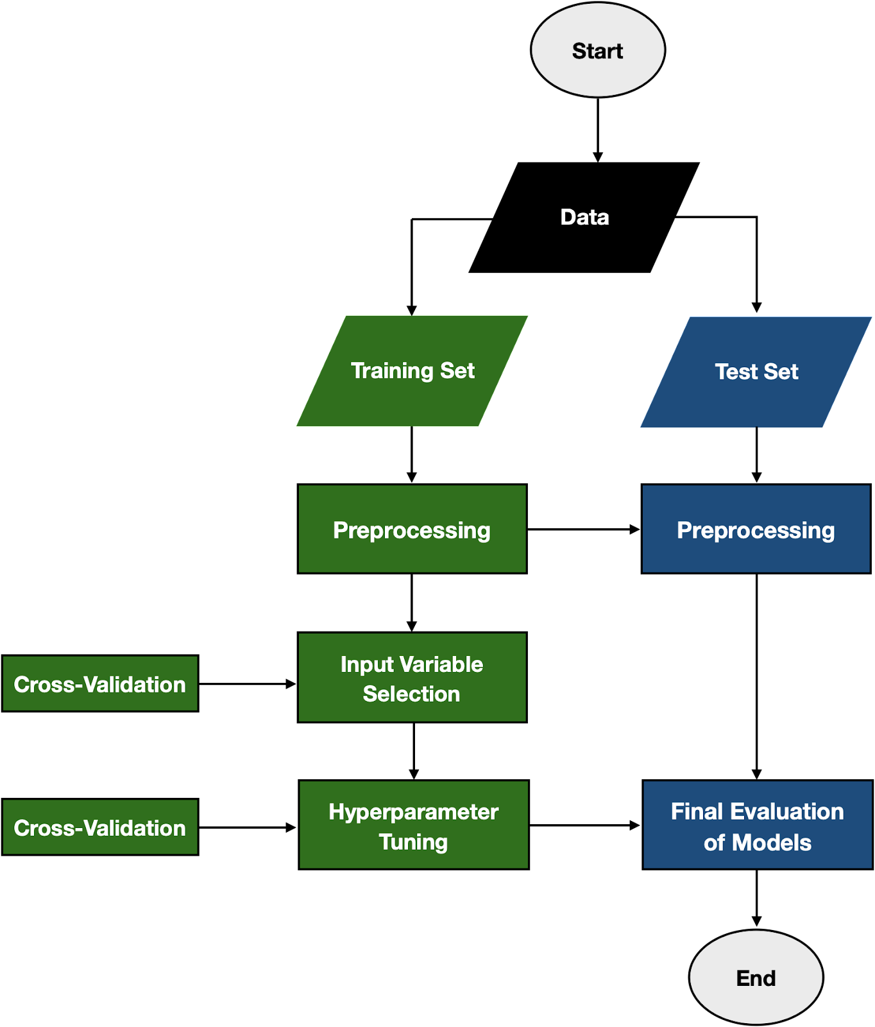
Workflow
3

Slide 5
Models
ML models
Neural Nets (TensorFlow)
Random Forest (scikit-learn)
Gradient Boosting Machine (lightgbm)
Calibrated ET equation
Penman
Priestley-Taylor
Oudin
4

Slide 6
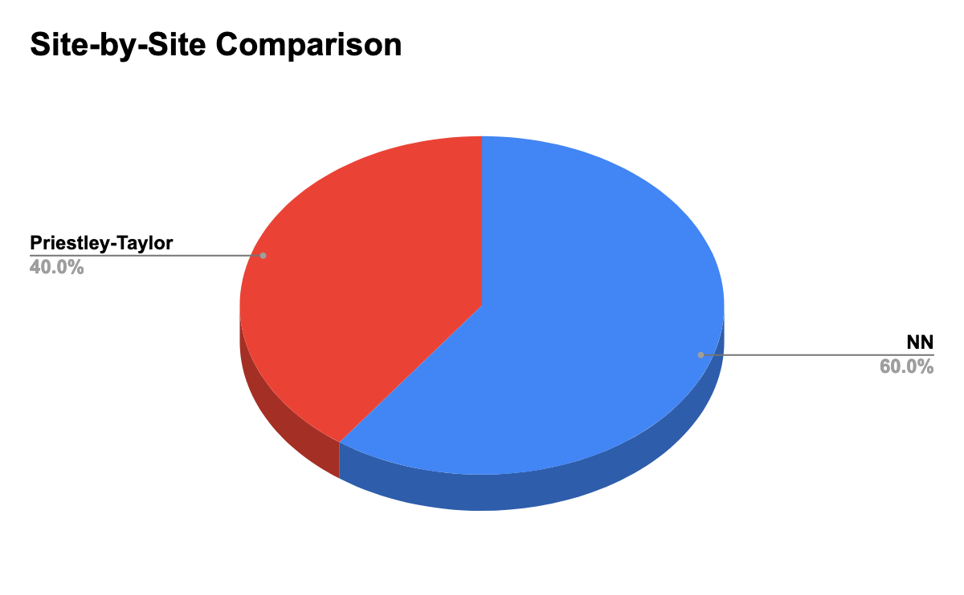
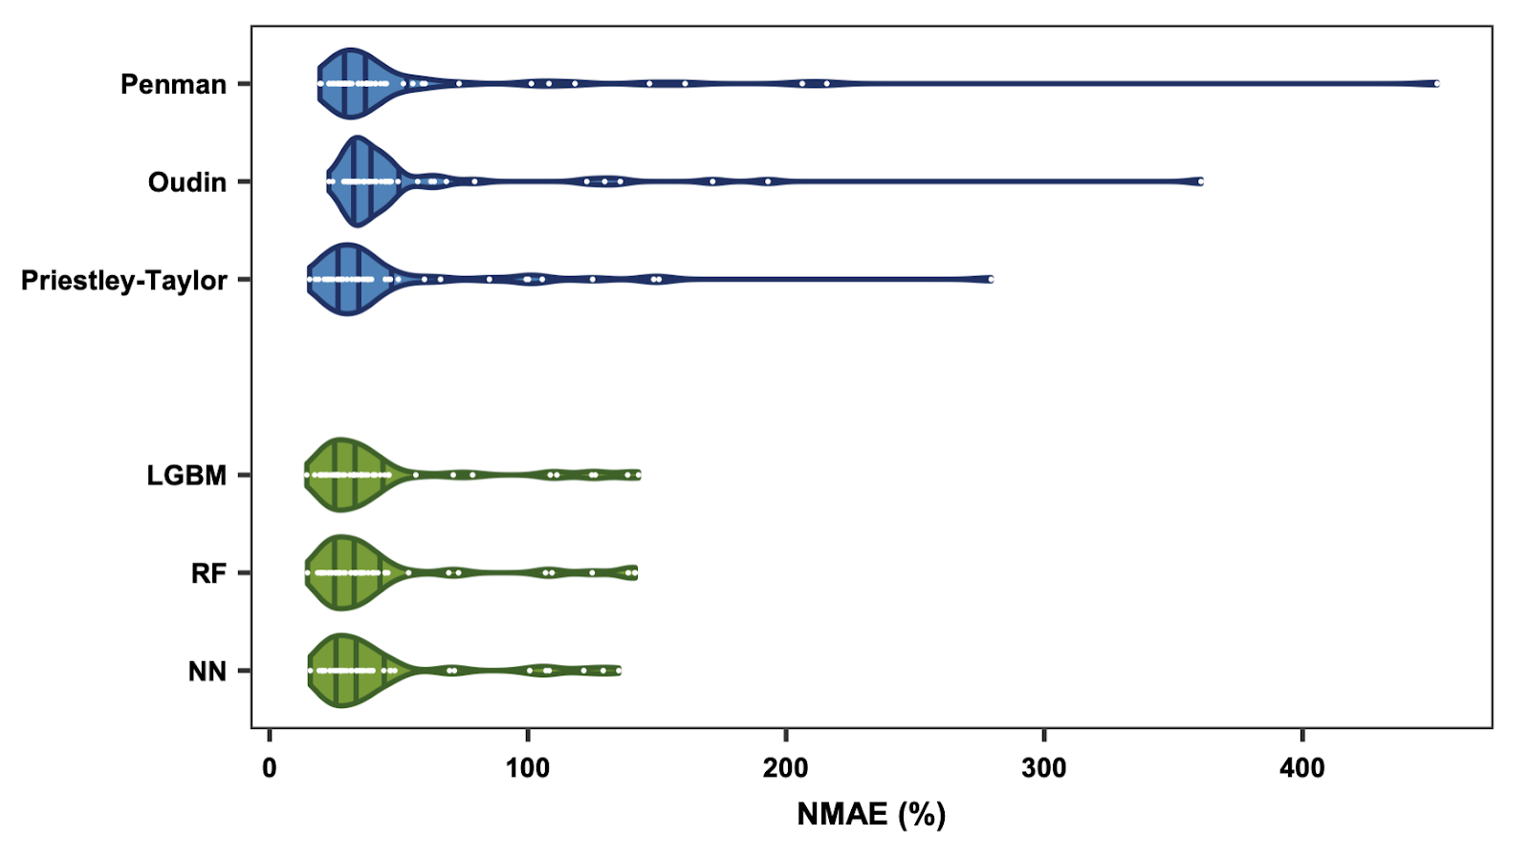
Results
Accuracy of MLMs vs ET equations (50 test sites)
5

Slide 7
Conclusion
Concluding remarks
ML models do generalize well (except arid sites)
ML models slightly superior to ET equations
Similar performance of ML models: noisy data?
6

Slide 8

THANK YOU!
alireza.amani@usherbrooke.ca

Slide 9
Extra slides
alireza.amani@usherbrooke.ca

Slide 10
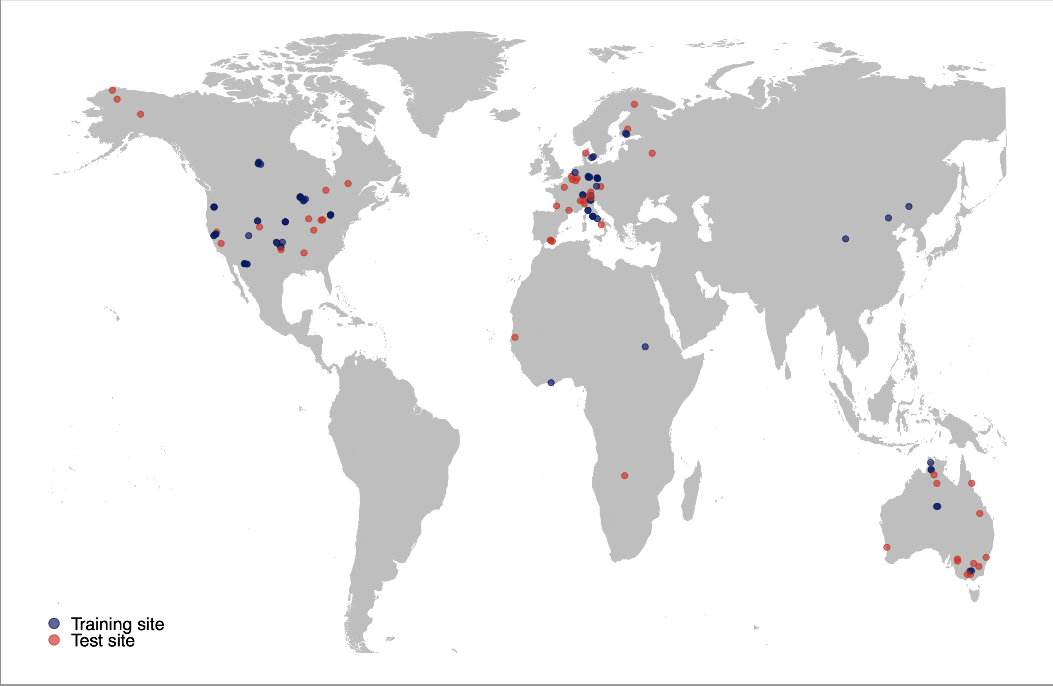
Conclusion
6

Slide 11
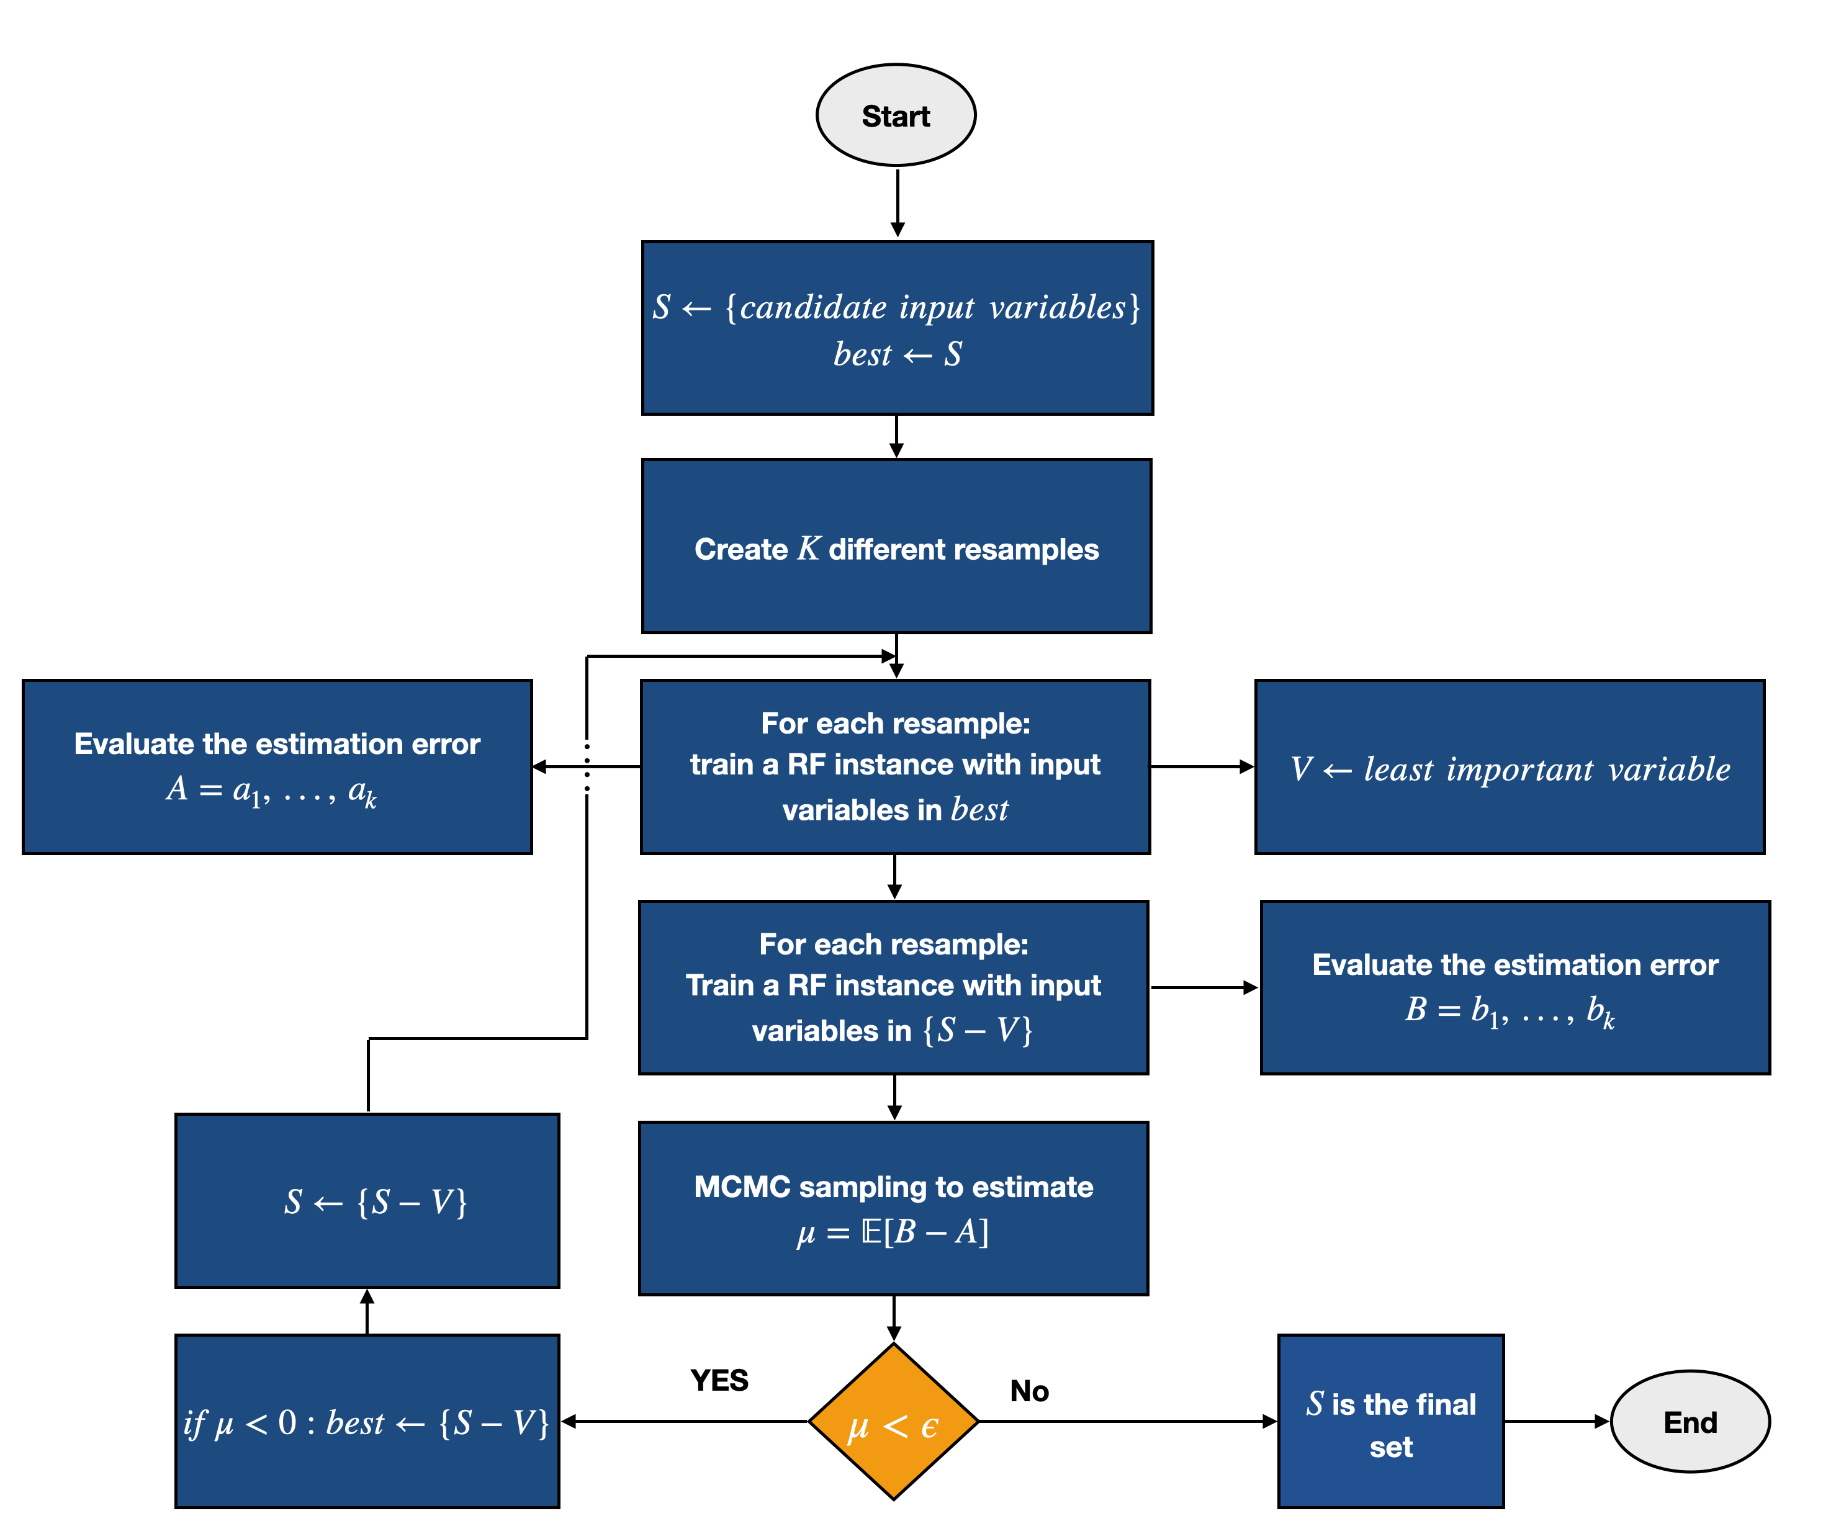
Conclusion
6

