Slide 1


Multi-Channel Landscape Evolution Approaches to Stratigraphic Grain Size Modelling
Amanda Wild, Jean Braun, Alex Whittaker, Sebastien Castelltort, Charlotte Fillon
Contact: awild@gfz-potsdam.de

Slide 2
Grain Size in the Stratigraphic Record
Grain size as an indicator of external forcing
Autogenic Dynamics (channel mobility)
Transfer Zone (Foreland basins)
Longer time scales (stratigraphy and not local hydraulic details at the bed)
Brian Washburn

Slide 3
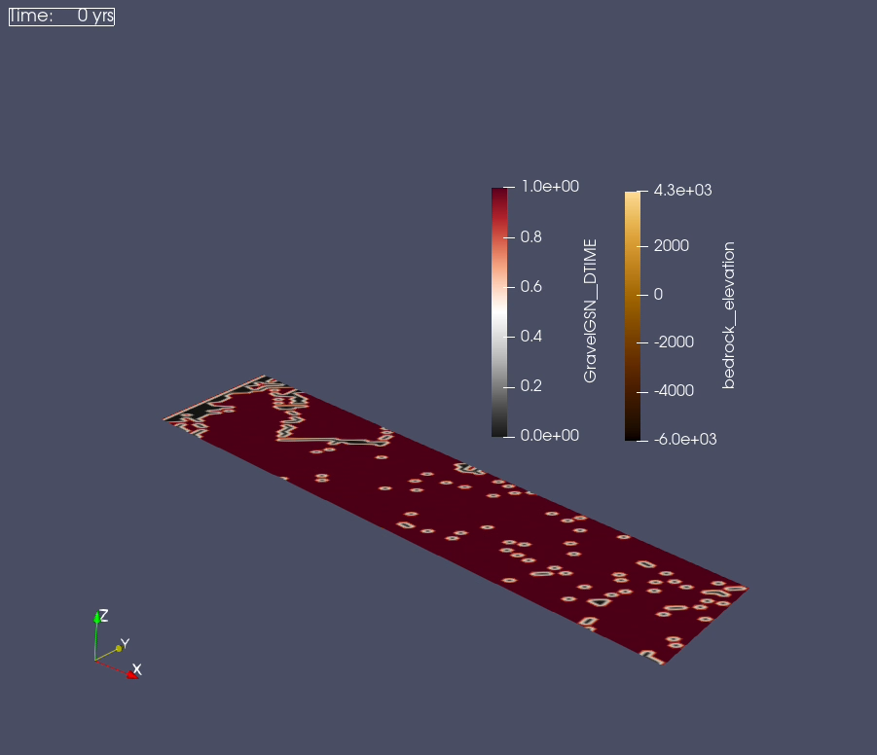
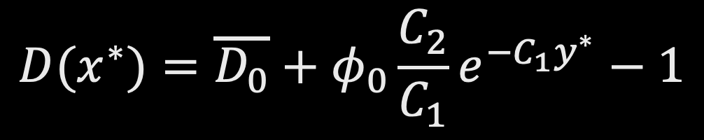
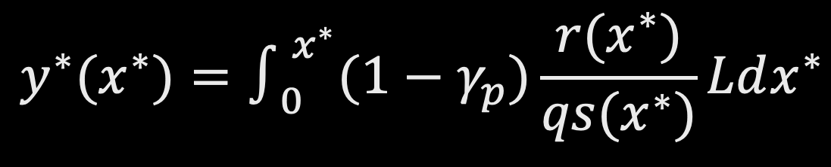
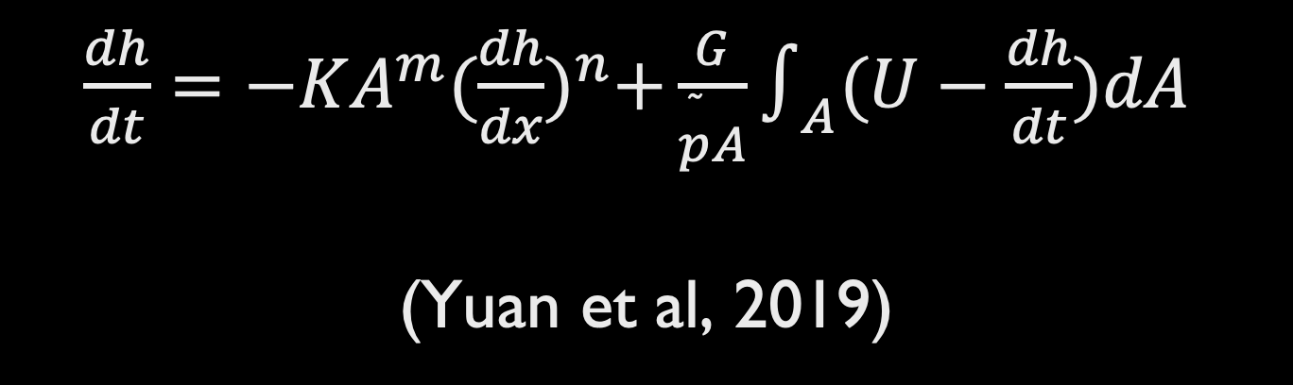
FASTSCAPE (Landscape Evolution Model)
Method
+
Fedele & Paola (2007) Self-Similar Grain Size
=
GSFast
$\frac{dh}{dt}=−KA^{m}{(\frac{dh}{dx})}^{n}+\frac{G}{\overset{˜}{p}A}∫_{A}(U−\frac{dh}{dt})dA$
(Yuan et al, 2019)
$$D(x^{∗})=\overline{D_{0}}+φ_{0}\frac{C_{2}}{C_{1}}e^{−C_{1}y^{∗}}−1$$
$$y^{∗}(x^{∗})=∫_{0}^{x^{∗}}(1−γ_{p})\frac{r(x^{∗})}{qs(x^{∗})}Ldx^{∗}$$

Slide 4
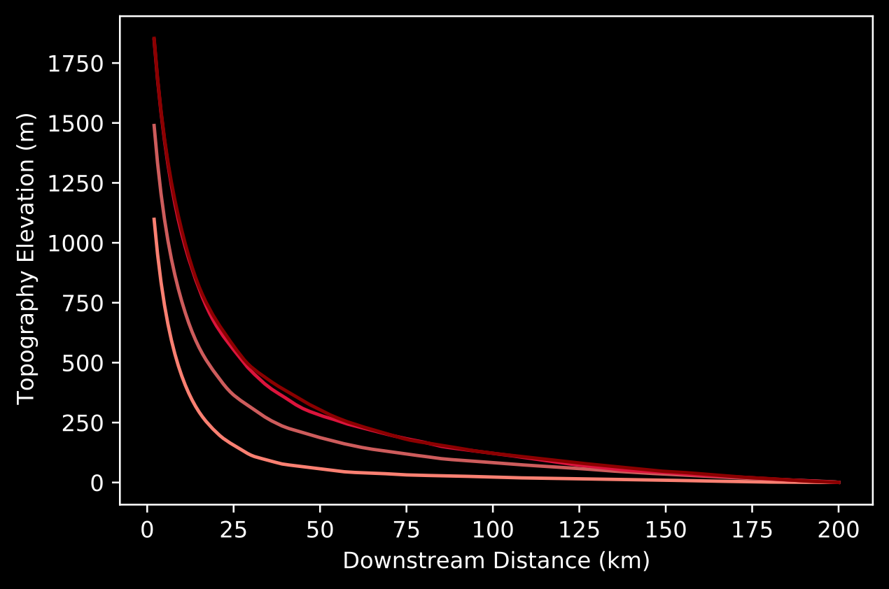
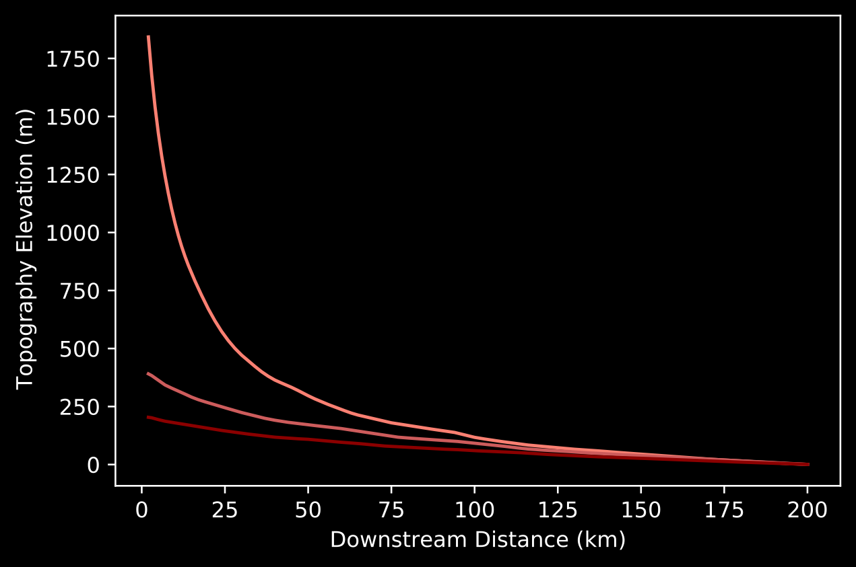
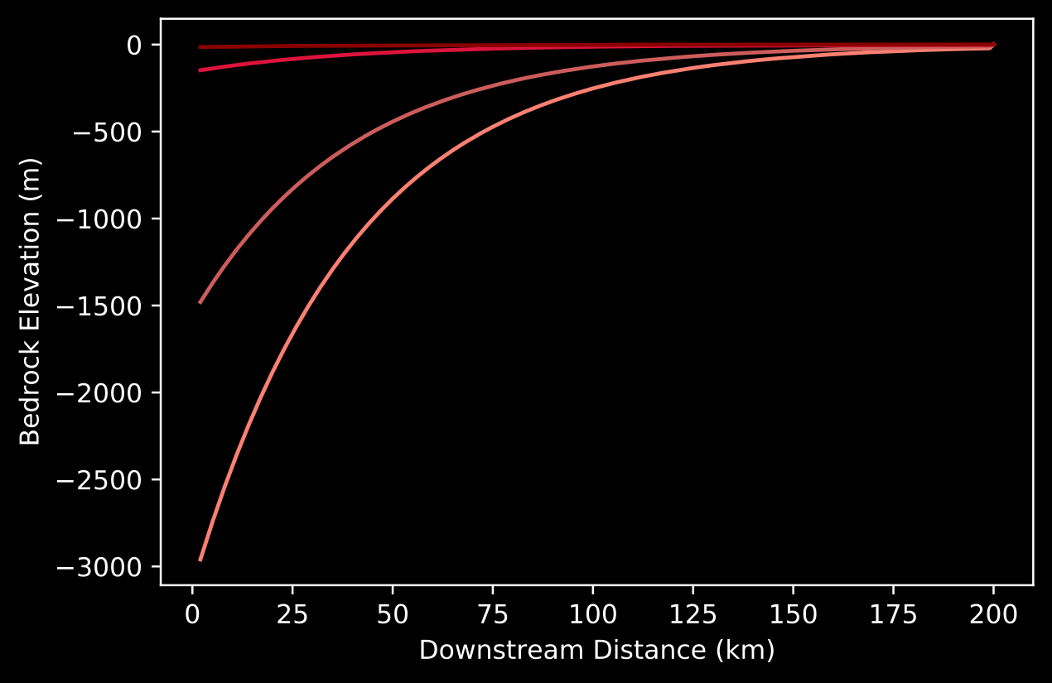
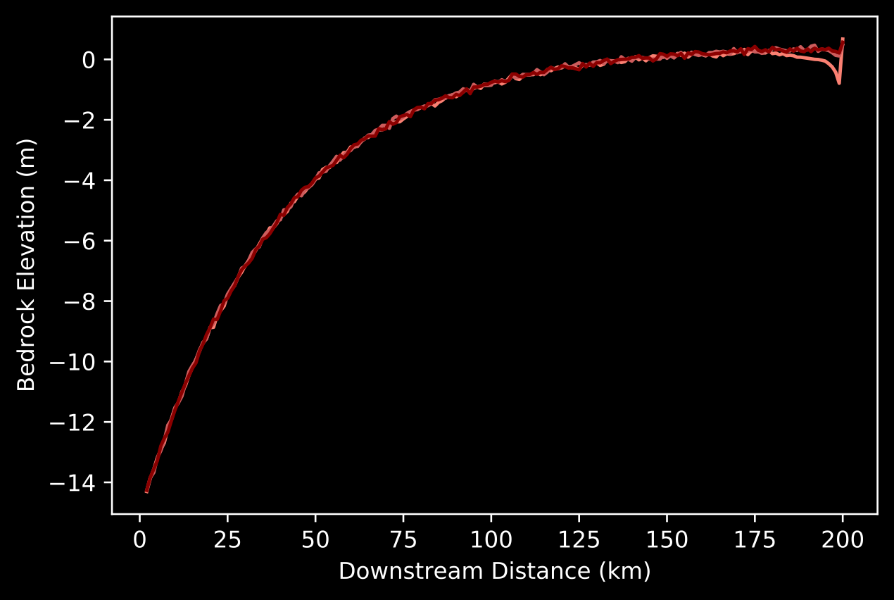
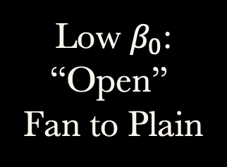


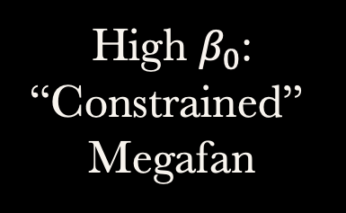
Subsidence Control: Basin Fill
Topography Control: Fan Extent
$$F=\frac{qs_{0}}{(1−γ_{p})L∫_{0}^{1}σ(x^{′})dx^{′}}$$
$$β_{0}=\frac{ν_{M}L_{M}α}{ν_{B}L_{B}}$$
Braun (2022)
Duller et al. (2010)
High $β_{0}$:
“Constrained”
Megafan
High F:
High Bypass
Topography
Topography
Low F:
Fill
Low $β_{0}$:
“Open”
Fan to Plain
Subsidence
Subsidence
Metadata: Cell size 1km, 200 cell length, 20 cell wide, 20Myr (last ~5 Myr at steady-state), m=0.4, uplift*area=10m2/yr (0.01 m/yr), precip catchment/basin =5, alpha=5, K soil = 1e-5, K bedrock= 2e-5, G= 1, diffusion bedrock = 0.03, diffusion soil = 0.1, source SD 0.75, source D0 = 1

Slide 5
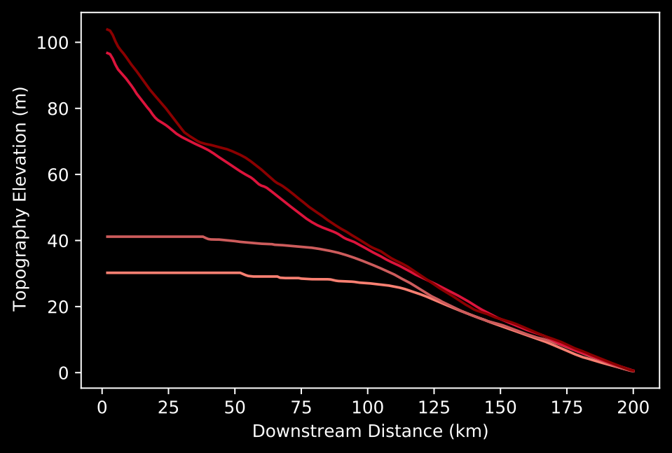

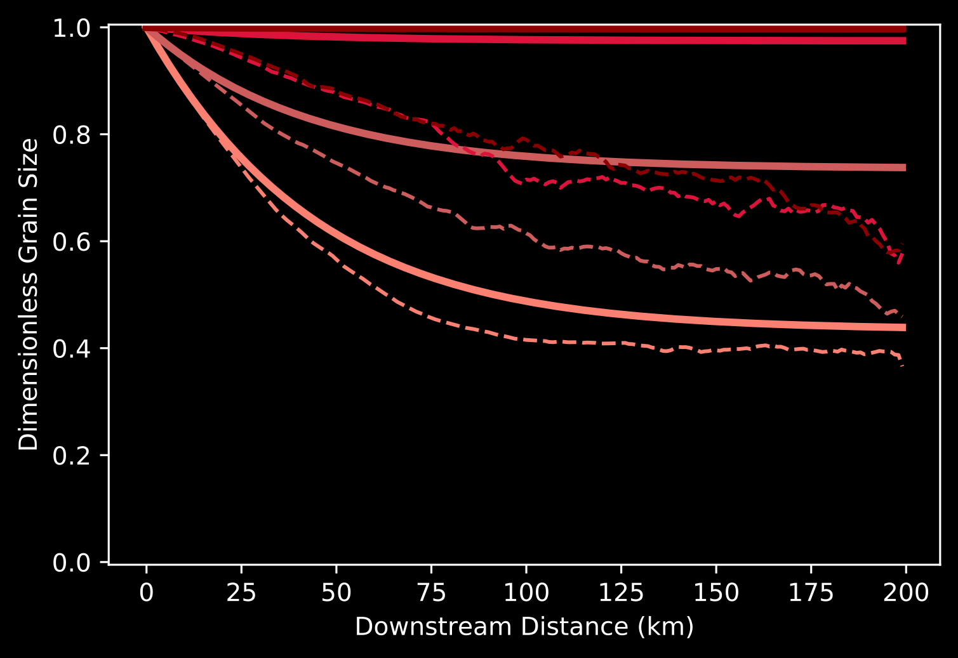
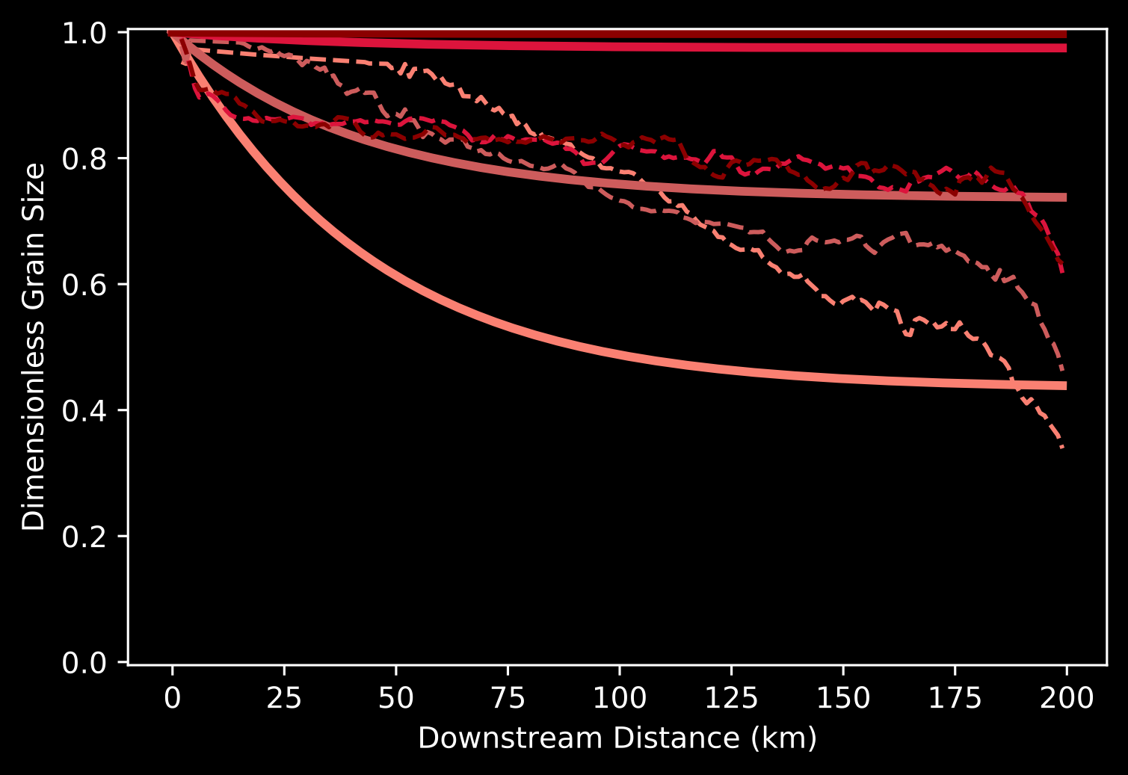
Result: Multi-channel ≠ Single Channel Grain Size Fining
“Open” Fan to Plain (Concave Topography)
“Constrained” Megafan (ConvexTopography)
Topography
Topography
Subsidence
Subsidence
Grain Size
Grain Size
High F:
High Bypass
Low F:
Fill
Metadata: Cell size 1km, 200 cell length, 20 cell wide, 20Myr (last ~5 Myr at steady-state), m=0.4, uplift*area=10m2/yr (0.01 m/yr), precip catchment/basin =5, alpha=5, K soil = 1e-5, K bedrock= 2e-5, G= 1, diffusion bedrock = 0.03, diffusion soil = 0.1, source SD 0.75, source D0 = 1

Slide 6
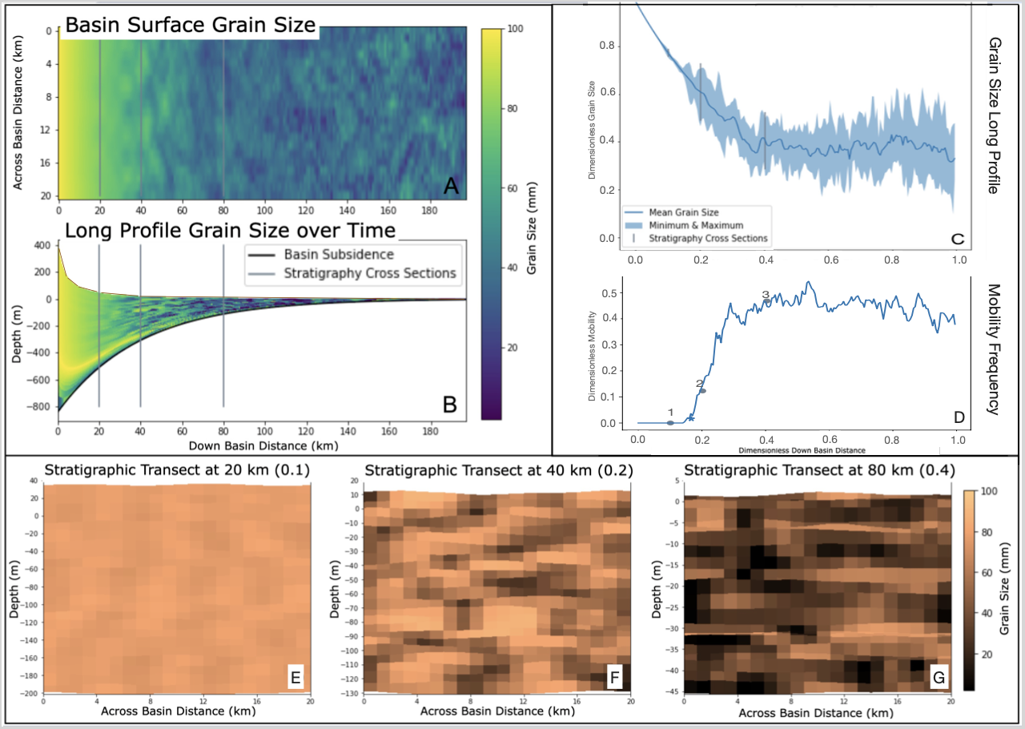
Questions?
Contact: awild@gfz-potsdam.de
Channel mobility increases the channel length and causes variation in the deposition rate across the basin. This deviates from past assumptions of a deposition rate uniformly equal to the subsidence (eg: Duller et al., 2010).
There are no pure bypass scenarios where coarse grain sizes propagate to the sink without fining within GSFast3D.
Autogenic dynamic alter the grain size fining signal enough that it could be misinterpreted as an allogenic signal.
Challenges/Uncertainty in apply this approach to convex and flat fans where local minima form
Future work will be to constrain the impact of autogenic dynamics on grain size fining within varied topographies, subsidence curves, and forcing conditions by comparing the model to real world data.

Slide 7
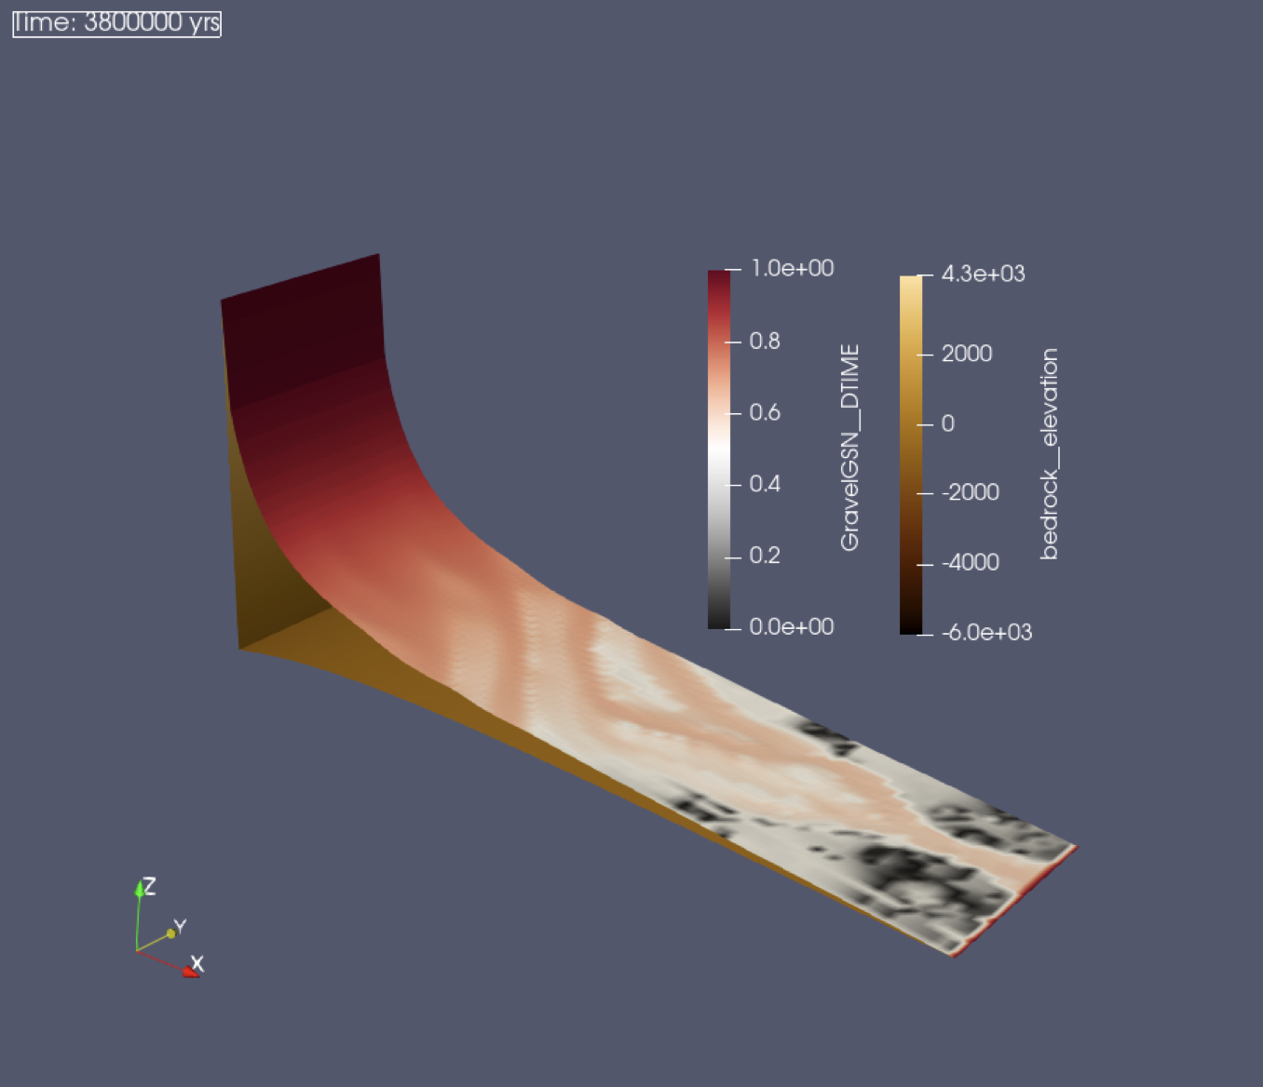
References
Braun, J., & Willett, S. D. (2013). A very efficient O(n), implicit and parallel method to solve the stream power equation governing fluvial incision and landscape evolution. Geomorphology, 180, 170-179. doi:10.1016/j.geomorph.2012.10.008
Braun, J. (2022). Comparing the transport-limited and ξ–q models for sediment transport. Earth Surface Dynamics, 10(2), 301-327.
Duller, R. A., Whittaker, A. C., Fedele, J. J., Whitchurch, A. L., Springett, J., Smithells, R., ... & Allen, P. A. (2010). From grain size to tectonics. Journal of Geophysical Research: Earth Surface, 115(F3).
Fedele, J. J., & Paola, C. (2007). Similarity solutions for fluvial sediment fining by selective deposition. Journal of Geophysical Research: Earth Surface, 112(F2).
Yuan, X. P., Braun, J., Guerit, L., Rouby, D., & Cordonnier, G. (2019). A New Efficient Method to Solve the Stream Power Law Model Taking Into Account Sediment Deposition. Journal of Geophysical Research: Earth Surface, 124(6), 1346-1365. doi:10.1029/2018jf004867
Metadata: Cell size 1km, 200 cell length, 20 cell wide, 20Myr (last ~5 Myr at steady-state), m=0.4, uplift*area=10m2/yr (0.01 m/yr), precip catchment/basin =5, alpha=5, K soil = 1e-5, K bedrock= 2e-5, G= 1, diffusion bedrock = 0.03, diffusion soil = 0.1, source SD 0.75, source D0 = 1

