Slide 1

Evaluating the Impact of Topography on Initiation of Nor’westers over Eastern India
Rajesh Kumar Sahu¹, Kuvar Satya Singh², Hara Prasad Nayak³, Bhishma Tyagi¹
¹Department of Earth and Atmospheric Sciences,
National Institute of Technology Rourkela, Rourkela-769008, Odisha, India
E-mail: rsahu657@gmail.com, tyagib@nitrkl.ac.in
²Department of Mathematics, VIT University, Vellore 632014, India; kuvarsatya.singh@vit.ac.in
³Department of Geography, University of California Los Angeles, CA 90095, USA; hpmaths@gmail.com
EGU22-558
Vienna, Austria & Online | 23–27 May 2022

Slide 2
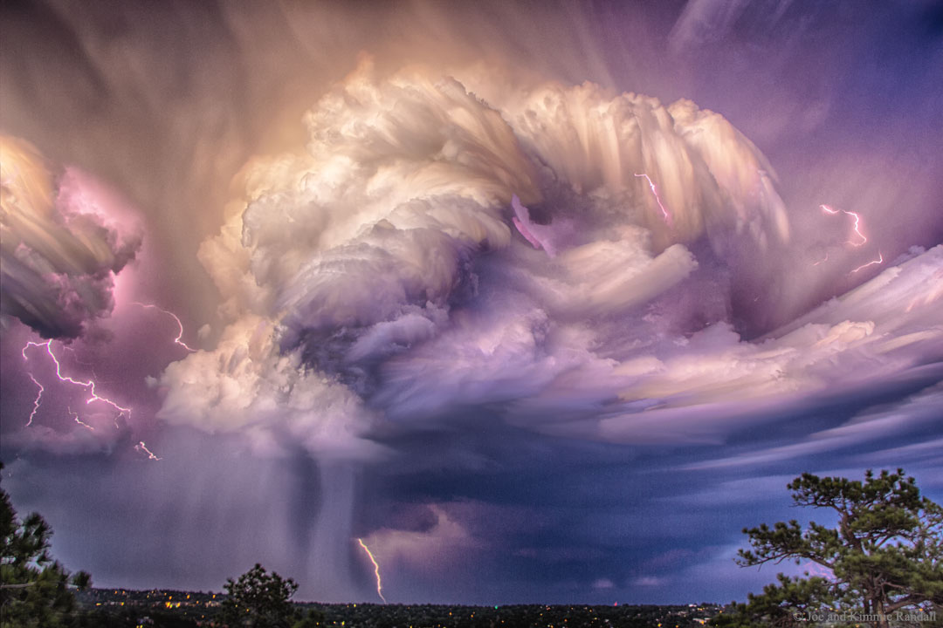
Introduction
Pre-monsoon season (March-May) in eastern India is characterised by increased frequency and intensity convective activity across the country (Tyagi et al., 2011; Sahu et al., 2020a).
These thunderstorms frequently arise over the Bihar plateau and nearby areas and move southeast. This type of convection is known as "Nor'westers" or "Kal-Baishakhi.“
The use of stability indices is one of the popular method for nowcasting thunderstorms. These indices are calculated hours before an event and have shown usefulness in prediction (Kunz, 2007; Tyagi et al., 2011; Sahu et al., 2020b).
Figure 1: Thunderstorms and associated Lightning (adopted from https://apod.nasa.gov/apod/ap161205.html)

Slide 3
Introduction (Contd.)
Topography substantially impacts weather processes by transferring momentum and energy among mesoscale and large-scale weather systems (Rotach et al., 2015).
It plays an essential role in developing convection and later results in the formation of thunderstorms. It has been reported that most of the thunderstorms formed over Eastern India are initiated at the Chhotanagpur Plateau (STORM Science Plan, 2005). So, in this work, we have tried to see the impact of topography by changing its heights (increasing and decreasing) over the Chhotanagpur plateau (CNP).
The indices used in this work is Convective Available Potential Energy (CAPE), Convective Inhibition (CIN), Severe Weather Threat Index (SWEAT), Cross Total Index (CTI), Vertical Total Index (VTI), Totals Total Index (TTI), K Index (KI), Humidity Index (HI).
The model analysis shows that when the topography of the CNP changes (increases/decreases) from its actual topography, the characteristics of several thermodynamic indices change substantially.

Slide 4
Site description, Data and Methodology
For this study Eastern India area which covers the Chhota Nagpur Plateau (CNP) area have been chosen. The CNP region covers the parts of Odisha, West Bengal, Jharkhand, Bihar, Chhattisgarh and a small part of Uttar Pradesh.
Thunderstorm occurrence information has been obtained from Storm Project Report of India Meteorological Department (IMD).
For this study NCEP/NCAR FNL data is utilized as initial condition to the WRF-ARW model (Version 3.9) . The model was run for 30 hours, starting at 0000 UTC, to examine 10 thunderstorm scenarios. For comparison of model with observation radiosonde (Vertical) data and MOSDAC (Meteorological & Oceanographic Satellite Data Archival Centre, ISRO, India) (Horizontal) data was utilized.
For this experiment, a triple-nested domain structure was used. The first domain (d01) has a 27-kilometer resolution, while the second (d02) and third domains (d03) have 9-kilometer and 3-kilometer resolutions, respectively.
Figure 2: Study area showing CNP region

Slide 5
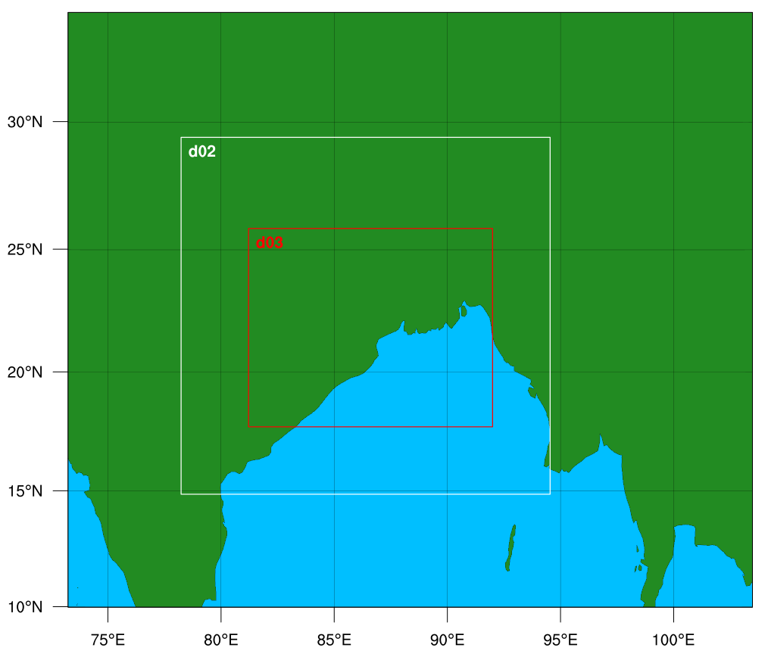
Methodology (Contd.)
Mellor–Yamada–Janjic (MYJ) scheme for Planetary Boundary Layer (PBL), WRF single–moment 6–class (WSM6) scheme for microphysics, and Betts–Miller–Janjic (BMJ) scheme for cumulus parameterisation were used in the model.
In domain (d03), no convection technique is used to investigate if WRF can directly capture convection. The Noah Land Surface Model was used for the land surface, while the Rapid Radiation Transfer Model (RRTM) for longwave radiation (Mlawer, 1997) and the Dudhia scheme (Dudhia, 1989) for shortwave radiation were used for the microphysics options.
d01
Figure 3: WRF-ARW Domain
For each thunderstorm instance, three model simulations were run without modifying the topography of CNP (CNTL), with the height of the topography of CNP decreased by 1/4th time (Expt.1), and with the height of the topography doubled (Expt.2).
Figure 4: Topography change over CNP region marked in the white box

Slide 6
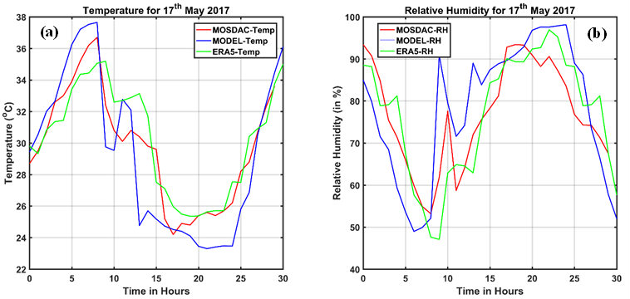
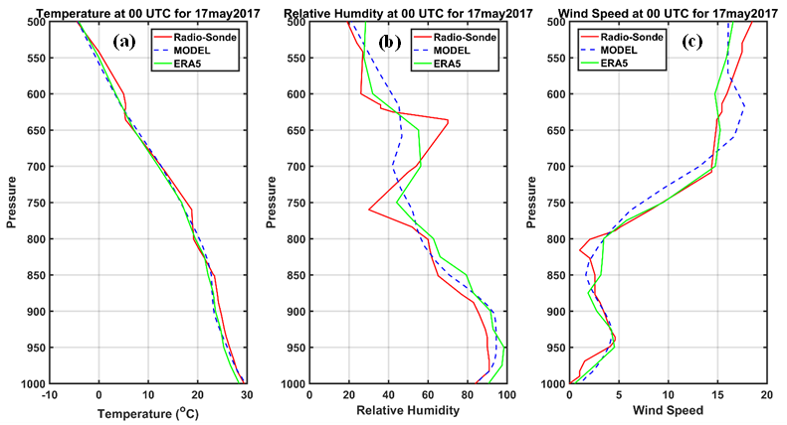
Results
Surface and vertical meteorological parameters Variations for thunderstorm days
Figure 5: Comparison of Model simulated surface meteorological parameters (a) Temperature (in °C) (b) Relative humidity (in %), with MOSDAC and ERA5 data over Kolkata from 00 UTC to 06 UTC on 17th to 18th May 2017
Figure 6: Vertical variation of model-simulated profiles of temperature (in °C), Relative humidity (in %) and wind speed (m/sec) with Radiosonde observation and ERA5 reanalysis data over Kolkata region for 00 UTC on 17th May 2017
All ten thunderstorm cases were varied, and the meteorological parameters were well simulated with the model for vertical variation at 00 UTC, but the bias was greater at 12 UTC on the day of the thunderstorm occurrence.

Slide 7
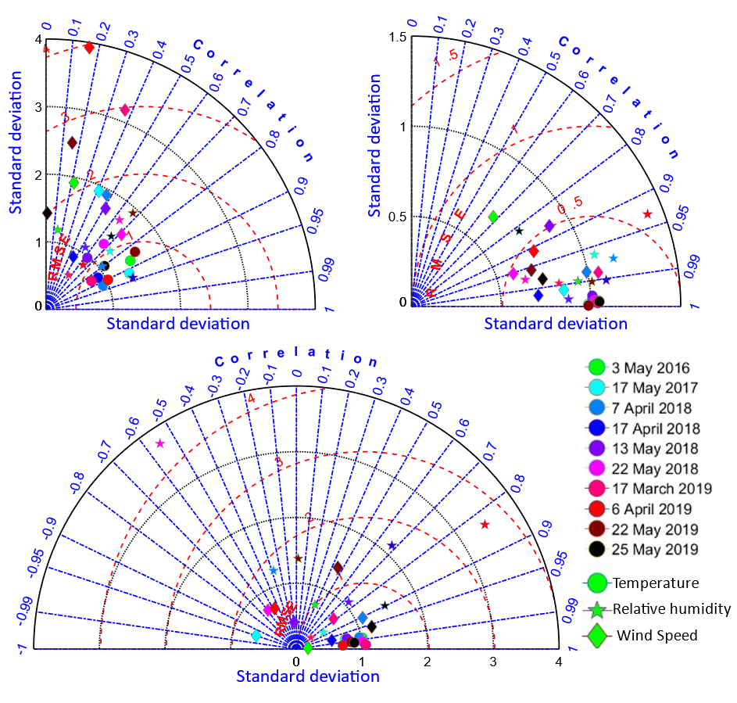
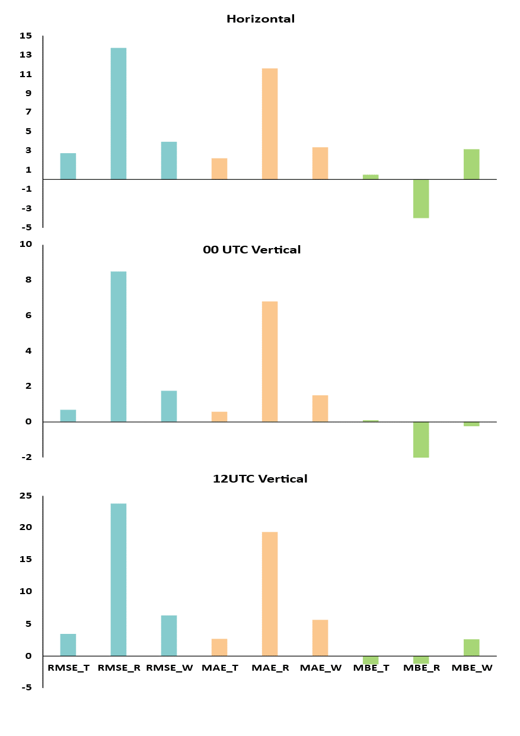
Statistical analysis of model performance analysis for thunderstorm days
Figure 7: Taylor plots of temperature (in °C), Relative humidity (in %) and wind speed (m/sec) (a) Surface variation, (b) Vertical 00 UTC variation and (c) Vertical 12 UTC variation over Kolkata region for ten thunderstorm cases
Figure 8: Mean RMSE, MAE and MBE of temperature (in °C), Relative humidity (in %) and wind speed (m/sec) over Kolkata region for Surface and Vertical (00 and 12 UTC) variation for ten thunderstorm cases.

Slide 8
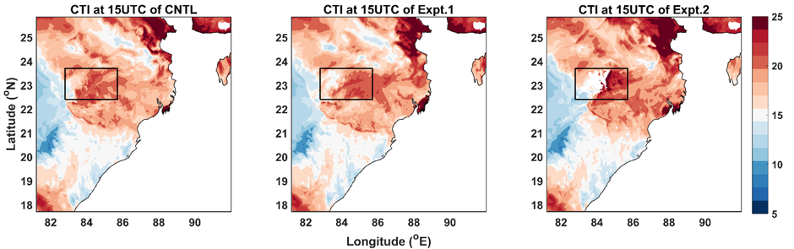
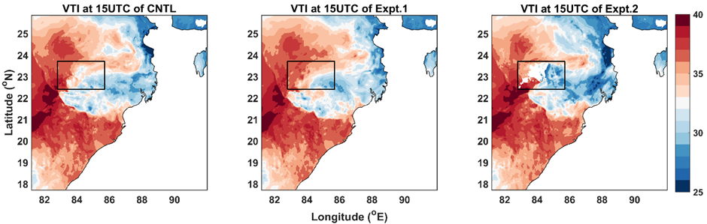
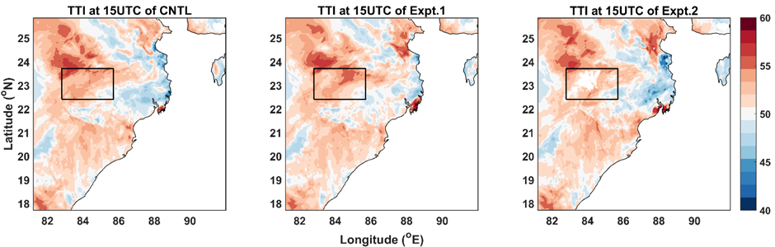
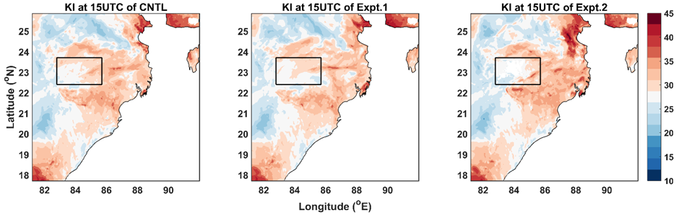
Experiments with changed topography and its impact on thermodynamic indices
Figure 9: CTI, VTI, TTI, HI, SWEAT and KI at 15 UTC with changing topography obtained from the three simulation (CNTL, Expt.1 and Expt.2) of a thunderstorm case on 6th April 2019

Slide 9
Conclusions
Observed temperature and model temperatures are well correlated with less MBE, RMSE than RH and WS in both surface and vertical profiles.
Wind speed is poorly co-related with observation while RH is well co-related in 00 UTC and less significant with observation at 12 UTC.
CTI, HI, CIN, and SWEAT show considerable changes in their values when the topography is changed for most thunderstorm cases.
The changes of thermodynamic indices is not prominent for the whole eastern India region but the variation is significant in the CNP and the adjacent regions.
The study suggest that as the thermodynamic indices values are changing with the changing topography of CNP, which may result in impacting the thunderstorm activity over the study region.

Slide 10
References
Dudhia, J., 1989. Numerical study of convection observed during the winter monsoon experiment using a mesoscale two-dimensional model. Journal of Atmospheric Sciences, 46(20), pp.3077-3107.
Kunz, M., 2007. The skill of convective parameters and indices to predict isolated and severe thunderstorms. Nat.l Hazards Earth Syst. Sci., 7(2), 327-342. https://doi.org/10.5194/nhess-7-327-2007.
Mlawer, E.J., Taubman, S.J., Brown, P.D., Iacono, M.J. and Clough, S.A., 1997. Radiative transfer for inhomogeneous atmospheres: RRTM, a validated correlated‐k model for the longwave. Journal of Geophysical Research: Atmospheres, 102(D14), pp.16663-16682.
Rotach, M.W., Gohm, A., Lang, M.N., Leukauf, D., Stiperski, I. and Wagner, J.S., 2015. On the vertical exchange of heat, mass, and momentum over complex, mountainous terrain. Frontiers in Earth Science, 3, p.76.
Sahu, R.K., Dadich, J., Tyagi, B., Vissa, N.K. and Singh, J., 2020 a. Evaluating the impact of climate change in threshold values of thermodynamic indices during pre monsoon thunderstorm season over Eastern India. Nat. Hazards, 102(3), 1541-1569. https://doi.org/10.1007/s11069-020-03978-x.
Sahu, R.K., Dadich, J., Tyagi, B, and Vissa, N.K., 2020 b. Trends of thermodynamic indices thresholds over two tropical stations of north east India during pre monsoon thunderstorms. J. Atmos. Sol. Terr. Phys., 211, 105472. https://doi.org/10.1016/j.jastp.2020.105472.
STORM (Severe Thunderstorms—Observations and Regional Modeling) Programme, 2005 Science plan Department of Science and Technology Government of India.
Tyagi, B., Krishna, V.N., and Satyanarayana, A.N.V., 2011. Study of thermodynamic indices in forecasting pre monsoon thunderstorms over Kolkata during STORM pilot phase 2006-2008. Nat. Hazards, 56(3), 681-698. https://doi.org/10.1007/s11069-010-9582-x.

Slide 11
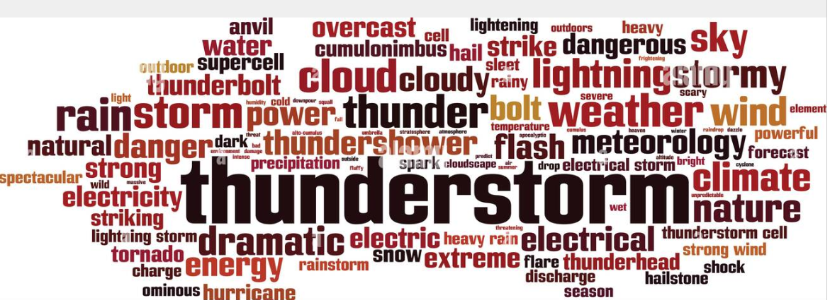
Thank you

