Slide 1
Ruffling feathers:
An appraisal of tail flood losses using grey swan scenarios in London, UK
Antonia.MacDonald@jbarisk.com
Philip.Oldham@jbarisk.com

Slide 2
Flood Catastrophe model
Exposure
Hazard
Stochastic / Deterministic
Vulnerability
Model output
(financial loss)

Slide 3
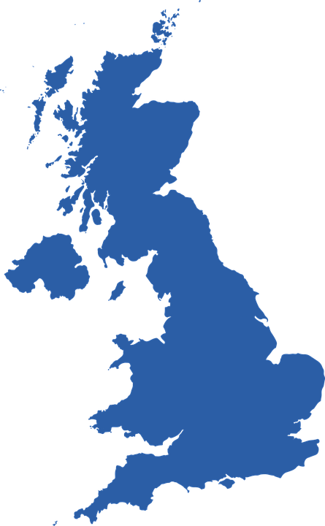

What IF Scenarios
Scenarios for portfolio stress testing
THAMES BARRIER FAILURE
What if the barrier remains open?
What if defences upstream are also breached?
What if defences downstream are also breached?

Slide 4
Loss return periods
Scenario | Mean Loss | Mean Loss Return Period
Barrier Open | £2.6 billion | 50
Upstream Defences Breached | £6.6 billion | 358
Up & Downstream Defences Breached | £13.2 billion | 8,813

Slide 5
What IF Scenarios
Summary
“What If” scenarios useful for stress testing by re/insurers
Consistent modelling architecture between deterministic and stochastic results (used for business decisions)
Flexible architecture allows reaction to ongoing flood events by estimating loss to aid with emergency response
Functionality is also paired with JBA global stochastic modelling: what scenario can you dream up?

