Slide 1
REE potentials and extraction from waste products
Ana T. Lima
In collaboration with G.M. Kirkelund, F. Ntuli, L.M. Ottosen
Marie Sklodowska-Curie grant agreement no. 713683 (COFUNDfellowsDTU)

Slide 2
What are rare earth elements?
Marie Sklodowska-Curie grant agreement no. 713683 (COFUNDfellowsDTU)
Marie Sklodowska-Curie grant agreement no. 713683 (COFUNDfellowsDTU)

Slide 3
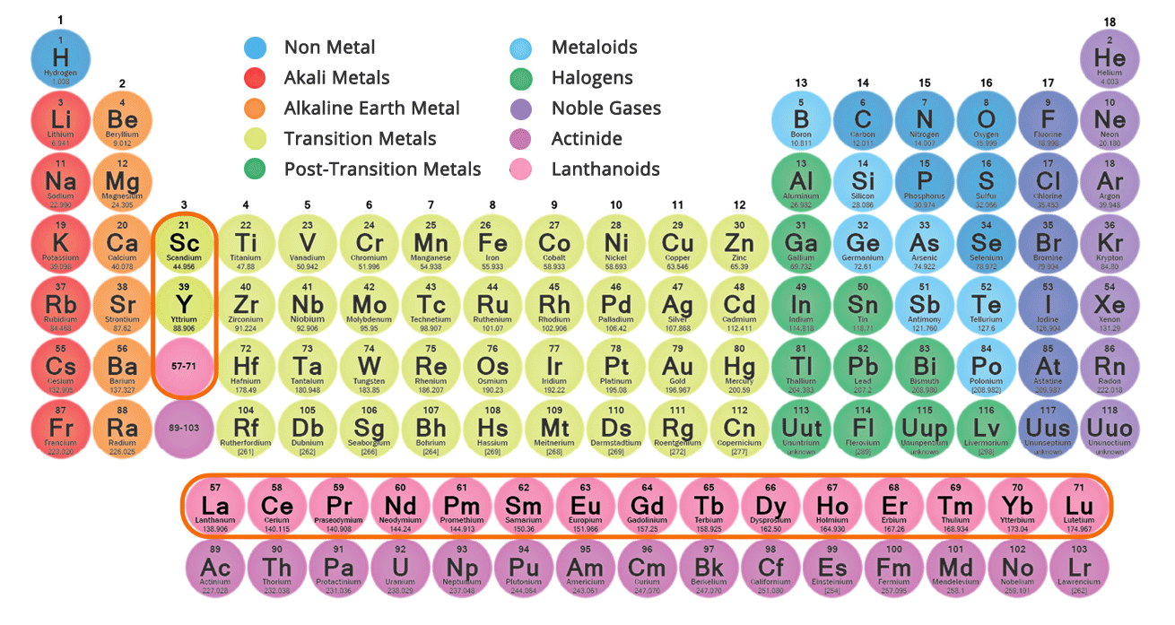
Light: La-Sm
Heavy: Eu-Lu (+Y)
Marie Sklodowska-Curie grant agreement no. 713683 (COFUNDfellowsDTU)

Slide 4
Background on rare earth elements (REE)
REEs are soft, malleable, ductile, and good electrical conductors
Used in automotive, nuclear, petroleum, electronic, renewable energy technologies
Group of 17 elements
Light and heavy REE have been listed as critical
Essential for current industries
Marie Sklodowska-Curie grant agreement no. 713683 (COFUNDfellowsDTU)
Marie Sklodowska-Curie grant agreement no. 713683 (COFUNDfellowsDTU)

Slide 5
REE geochemical behaviour in short
M^{n+} + L^{y−} ⇔ ML^{(n−y)+}
where M stands for metal ion, L for ligand, n the oxidation number of M and y the oxidation number of L.
Determinants for REE solubility in porous media:
pH
Sulfate content
Al-, Fe- and Mn-oxides
Carbonates
Lima & Ottosen (2021) Recovering Rare Earth Elements from contaminated soils: Critical overview of current remediation technologies, Chemosphere, 265, 129163
Marie Sklodowska-Curie grant agreement no. 713683 (COFUNDfellowsDTU)

Slide 6
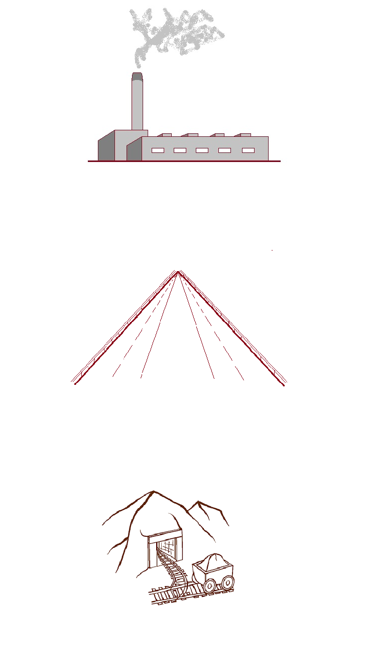
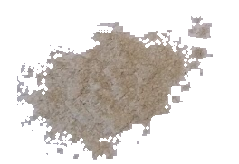
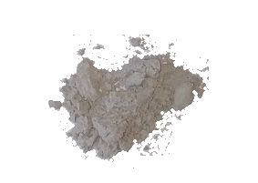
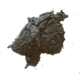
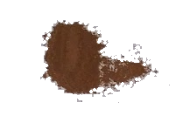

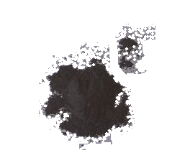
Different screened wastes
MSW ashes
Wood ashes
Incineration
Coal ashes
Sewage sludge ashes
Sediments from Stormwater ponds
Road Infrastructure
Mining residue
Mining
Marie Sklodowska-Curie grant agreement no. 713683 (COFUNDfellowsDTU)
Marie Sklodowska-Curie grant agreement no. 713683 (COFUNDfellowsDTU)

Slide 7
Critical REE Concentrations (mg/kg) – HF digestion
Sample | Y | Nd | Eu | Tb | Dy | Er
Urban retention pond | 11,7 | 11,5 | 0,5 | 0,3 | 1,7 | 1,0
Coal ash | 43,5 | 52,7 | 2,3 | 1,5 | 8,6 | 4,9
Wood bottom ash | 7,0 | 8,3 | 0,4 | 0,2 | 1,4 | 0,8
MSW 1 fly ash | 4,2 | 4,1 | 0,2 | 0,1 | 0,4 | 0,2
MSW (ARC) fly ash | 2,8 | 2,3 | 0,2 | 0,07 | 0,3 | 0,2
Wood fly ash | 11,8 | 14,8 | 0,6 | 0,3 | 2,1 | 1,2
SSA Avedøre | 12,1 | 15,8 | 0,6 | 0,4 | 1,9 | 1,1
SSA Germany | 12,2 | 16,0 | 0,4 | 0,2 | 1,2 | 0,7
SSA Lynetten | 16,2 | 19,5 | 0,7 | 0,4 | 2,4 | 1,4
Harbour sediment | 21,2 | 28,6 | 1,1 | 0,6 | 3,4 | 1,9
Fe-Cr South Africa | 12,3 | 11,8 | 0,5 | 0,3 | 1,9 | 1,1
Marie Sklodowska-Curie grant agreement no. 713683 (COFUNDfellowsDTU)
Marie Sklodowska-Curie grant agreement no. 713683 (COFUNDfellowsDTU)

Slide 8
Critical REE Concentrations (mg/kg) – HF digestion
Sample | Y | Nd | Eu | Tb | Dy | Er
Urban retention pond | 11,7 | 11,5 | 0,5 | 0,3 | 1,7 | 1,0
Coal ash | 43,5 | 52,7 | 2,3 | 1,5 | 8,6 | 4,9
Wood bottom ash | 7,0 | 8,3 | 0,4 | 0,2 | 1,4 | 0,8
MSW 1 fly ash | 4,2 | 4,1 | 0,2 | 0,1 | 0,4 | 0,2
MSW (ARC) fly ash | 2,8 | 2,3 | 0,2 | 0,07 | 0,3 | 0,2
Wood fly ash | 11,8 | 14,8 | 0,6 | 0,3 | 2,1 | 1,2
SSA Avedøre | 12,1 | 15,8 | 0,6 | 0,4 | 1,9 | 1,1
SSA Germany | 12,2 | 16,0 | 0,4 | 0,2 | 1,2 | 0,7
SSA Lynetten | 16,2 | 19,5 | 0,7 | 0,4 | 2,4 | 1,4
Harbour sediment | 21,2 | 28,6 | 1,1 | 0,6 | 3,4 | 1,9
Fe-Cr South Africa | 12,3 | 11,8 | 0,5 | 0,3 | 1,9 | 1,1
Marie Sklodowska-Curie grant agreement no. 713683 (COFUNDfellowsDTU)
Marie Sklodowska-Curie grant agreement no. 713683 (COFUNDfellowsDTU)

Slide 9
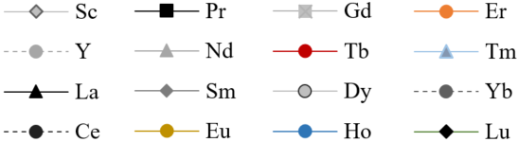
pH desorption curves
Marie Sklodowska-Curie grant agreement no. 713683 (COFUNDfellowsDTU)

Slide 10
Extraction ratios at pH 0-1
 | Sediment_ Stormwater | Coal_Fly | Wood_Bottom | Wood_Fly | MSW_Nuuk | MSW_ARC | SSA_Avedøre | SSA_Germany | SSA_Lynetten | Mine_SA
Sc | 12 | 15.0 | 19 | 49 | 29 | 40 | 86 | 73 | 59 | 16
Y | 100 | 27.4 | 41 | 67 | 88 | 94 | 100 | 100 | 100 | 16
La | 100 | 25.6 | 45 | 76 | 67 | 2 | 49 | 100 | 40 | 18
Ce | 100 | 24.8 | 40 | 67 | 52 | 4 | 26 | 87 | 20 | 17
Pr | 100 | 22.7 | 42 | 70 | 65 | 18 | 27 | 82 | 20 | 16
Nd | 100 | 24.2 | 44 | 74 | 68 | 39 | 31 | 88 | 23 | 15
Sm | 100 | 24.2 | 42 | 72 | 71 | 67 | 47 | 100 | 30 | 15
Eu | 100 | 22.9 | 35 | 60 | 66 | 62 | 40 | 95 | 35 | 19
Gd | 100 | 22.6 | 39 | 71 | 68 | 67 | 79 | 100 | 50 | 15
Tb | 100 | 21.1 | 33 | 63 | 53 | 69 | 64 | 100 | 39 | 13
Dy | 100 | 20.6 | 33 | 63 | 68 | 71 | 76 | 100 | 47 | 14
Ho | 100 | 19.4 | 29 | 57 | 61 | 65 | 80 | 100 | 51 | 12
Er | 100 | 18.1 | 27 | 55 | 61 | 66 | 88 | 100 | 56 | 13
Tm | 100 | 16.7 | 25 | 52 | 62 | 76 | 76 | 100 | 48 | 12
Yb | 100 | 15.7 | 24 | 52 | 62 | 64 | 76 | 100 | 46 | 13
Lu | 100 | 15.9 | 25 | 48 | 50 | 81 | 77 | 100 | 46 | 13

Slide 11
Most promising DILUTE sources of Rare Earth Elements
MSW ashes
Wood ashes
Highest total REE contents
Incineration
Coal ashes
Sewage sludge ashes
Sediments from Stormwater ponds
Highest leachable REE contents
Road Infrastructure
Mining residue
Mining

Slide 12
Final considerations
Extraction and recovery efforts should have into account REE complexation in wastes
Stormwater retention pond sediments have the most acid leachable REE at room temperature
Coal fly ashes and stormwater retention pond sediments are the most promising REE dilute sources
See the link for more details: https://www.sciencedirect.com/science/article/pii/S0375674222000589

Slide 13
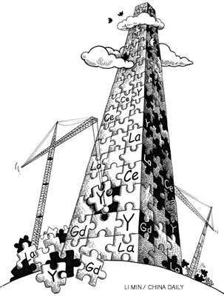
Thank you!
Questions?
Welcome atmli@dtu.dk
Marie Sklodowska-Curie grant agreement no. 713683 (COFUNDfellowsDTU)

