Slide 1
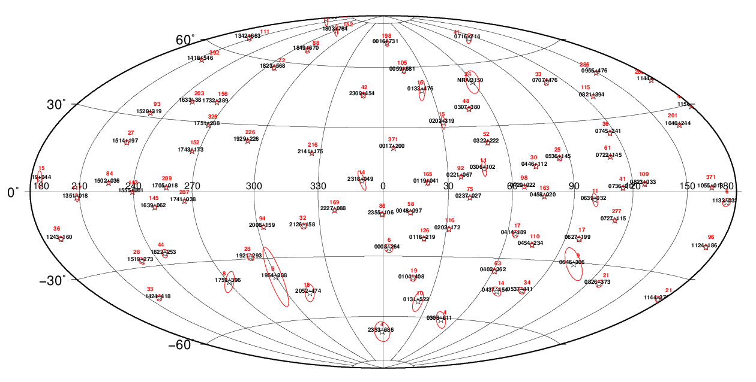


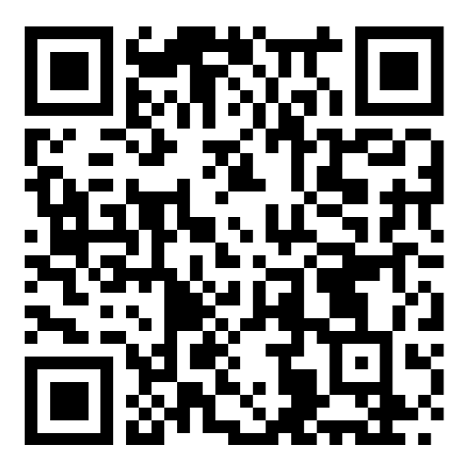

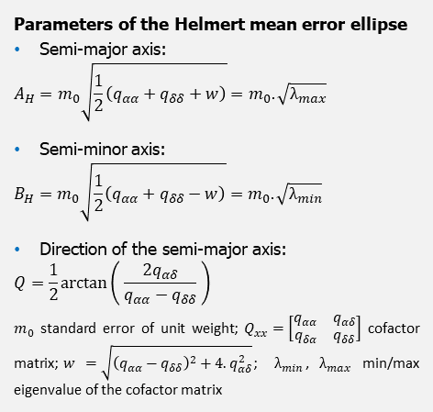
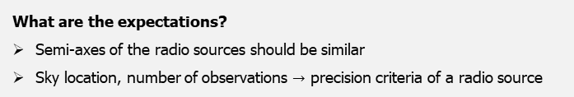
Applying Precision Criteria to the Radio Sources in the Daily IVS Sessions
Pakize Küreç Nehbit¹, Susanne Glaser², Susanne Lunz³, Robert Heinkelmann², Harald Schuh^{3,2}, and Haluk Konak¹
¹ Kocaeli University, Department of Geomatics Engineering, Kocaeli, Turkey; ² GFZ German Research Centre for Geosciences, Potsdam, Germany; ³ Technische Universität Berlin, Chair of Satellite Geodesy, Berlin, Germany
Parameters of the Helmert mean error ellipse
Semi-major axis:
$$A_{H}=m_{0}\sqrt{\frac{1}{2}\left(q_{αα}+q_{δδ}+w\right)}=m_{0}.\sqrt{λ_{max}}$$
Semi-minor axis:
$$B_{H}=m_{0}\sqrt{\frac{1}{2}\left(q_{αα}+q_{δδ}−w\right)}=m_{0}.\sqrt{λ_{min}}$$
Direction of the semi-major axis:
$$Q=\frac{1}{2}\arctan\left( \frac{2q_{αδ}}{q_{αα}−q_{δδ}} \right)$$
$m_{0}$ standard error of unit weight; $Q_{xx}=\left[\begin{matrix}q_{αα} & q_{αδ} \\ q_{δα} & q_{δδ}\end{matrix}\right]$ cofactor matrix;$w$ $=\sqrt{{\left(q_{αα}−q_{δδ}\right)}^{2}+4.q_{αδ}^{2}}$; $λ_{min}$, $λ_{max}$ min/max eigenvalue of the cofactor matrix
What are the expectations?
Semi-axes of the radio sources should be similar
Sky location, number of observations $→$ precision criteria of a radio source
Figure 1: Radio sources observed in the session 17DEC07XB. The red numbers are the number of observations of the respective radio source.
EGU General Assembly 2022
Vienna, Austria & Online | 23–27 May 2022

