Slide 1
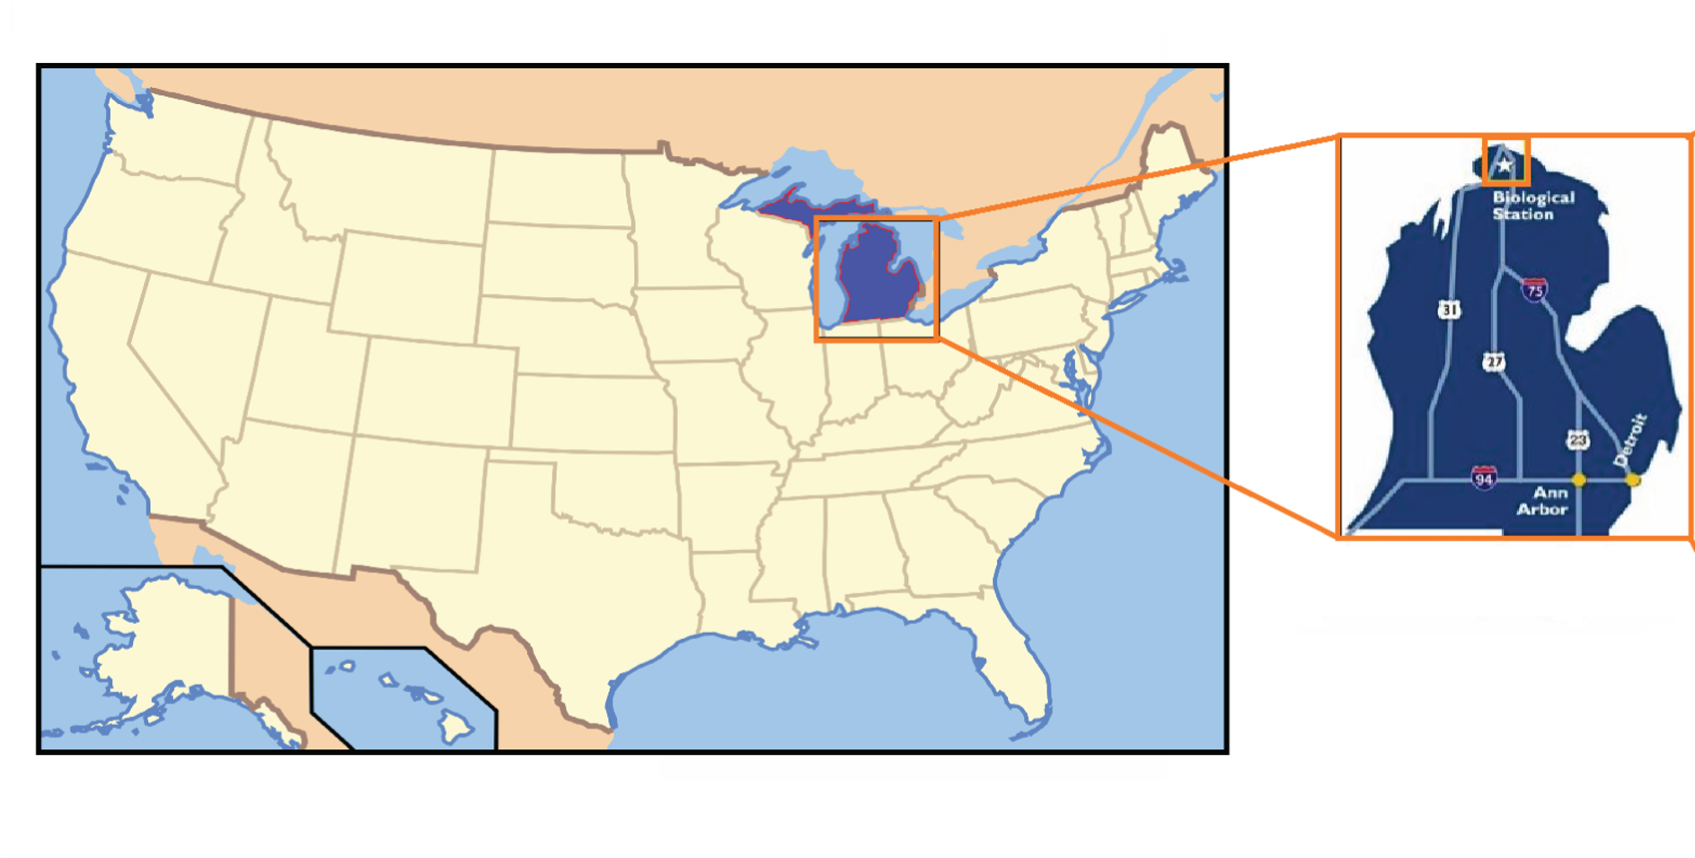
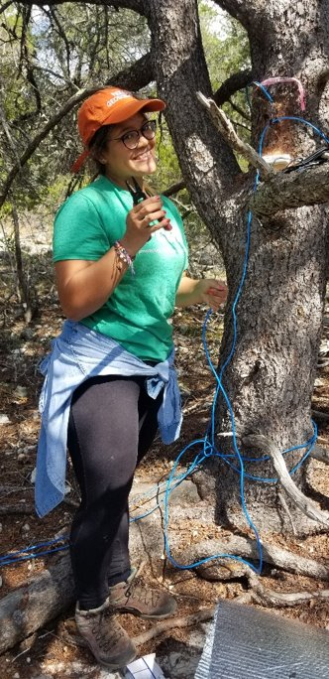
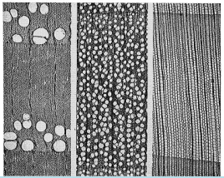

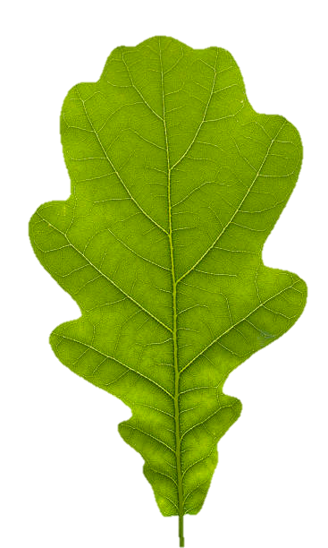

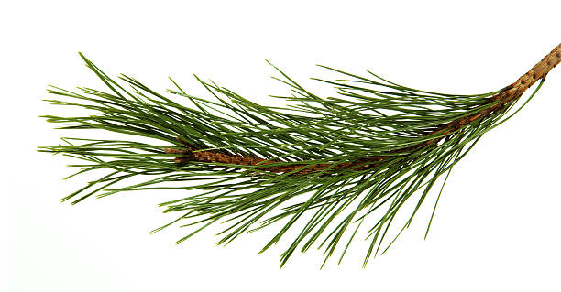
Wood water content influences sap flux estimations under water limited conditions in a deciduous forest in Michigan. Ana María Restrepo Acevedo PhD Candidate University of Texas at Austin (anarestrepo@utexas.edu) Co-authors: Dr. Elizabeth Agee and Dr. Ashley Matheny.
Red
Oaks
Red
Maples
White Pines

Slide 2
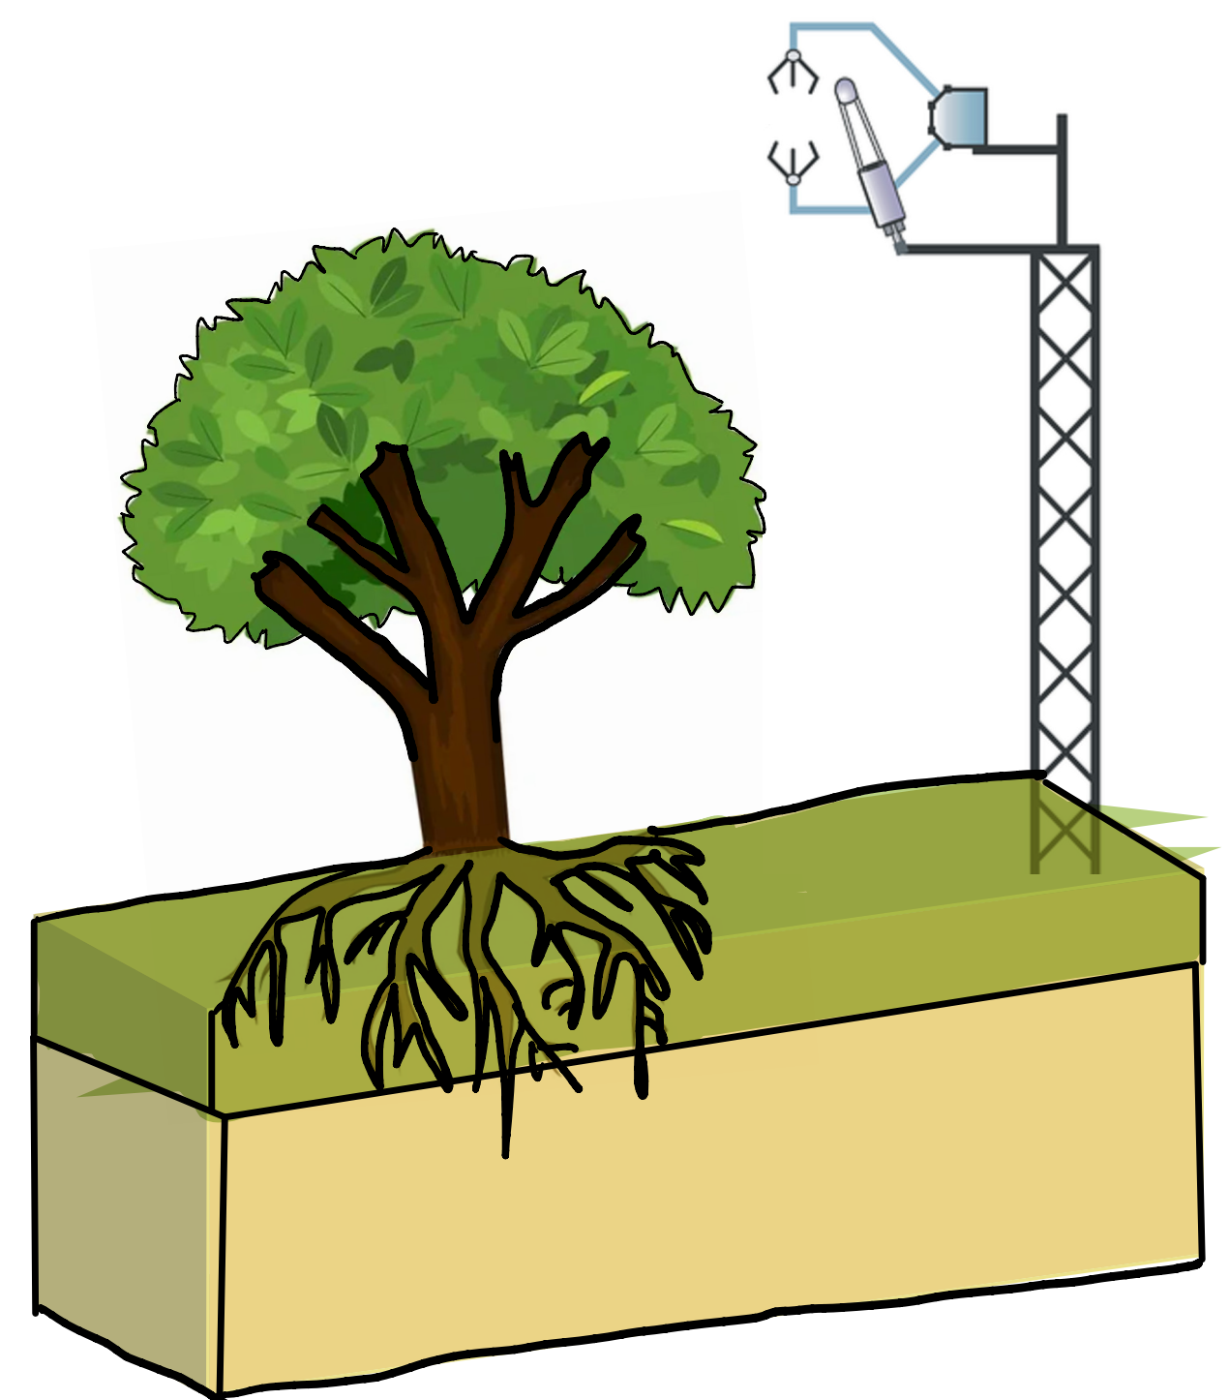
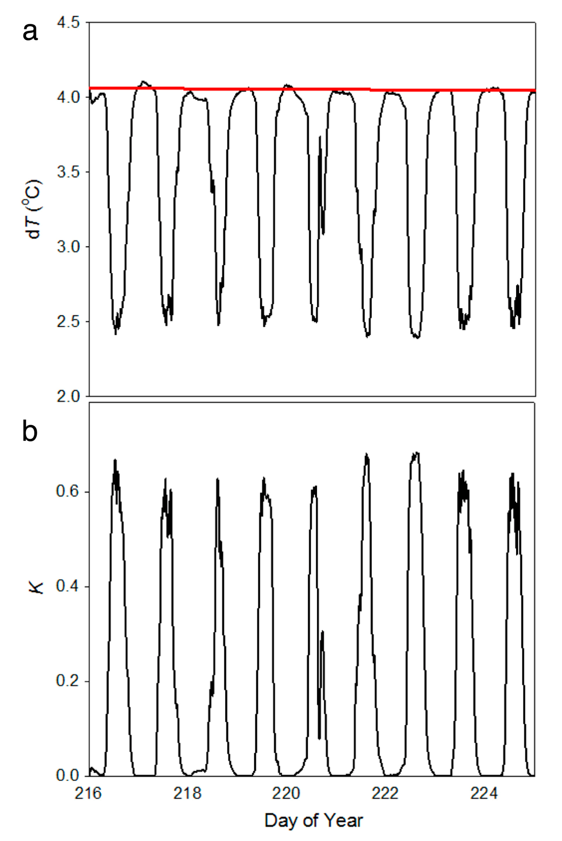
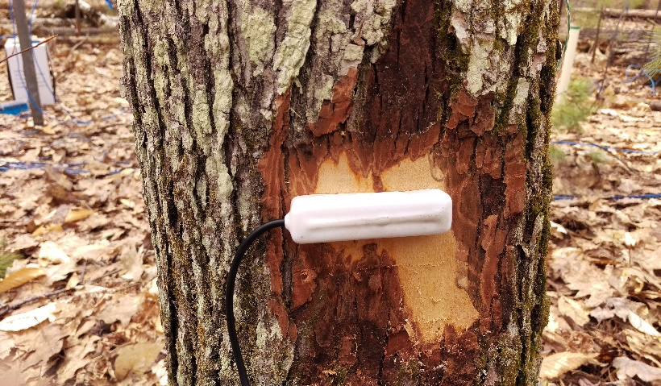
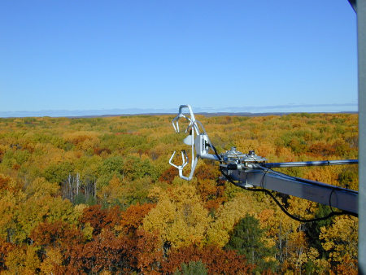
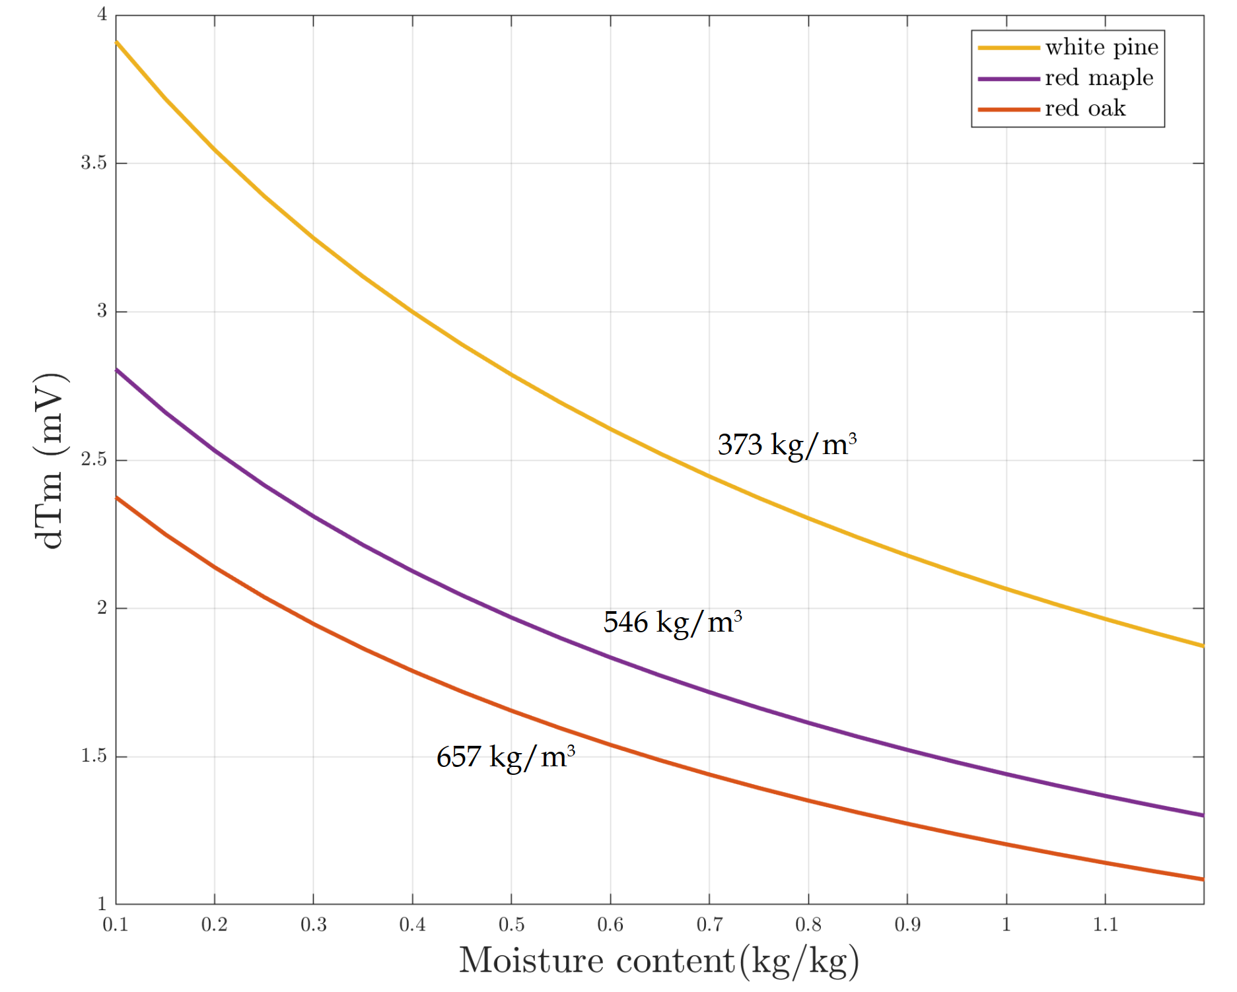
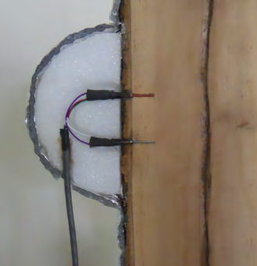

From Oishi et al., (2016)
Climate and Environmental Conditions
How changes in WWC can potentially influence dT_{max} observations retrieved from Granier style sap flow sensors in our different species?
Do changes in atmospheric and soil moisture conditions were reflected in the strength of the dT_{max}/WWC relationship?
From Vergeynst et al., (2014) - Modified to our specific site conditions.
Wood Water Content (WWC)
Eddy covariance tower
Tree-Level Measurements
Soil Water Content
Sap flow (SF)

Slide 3
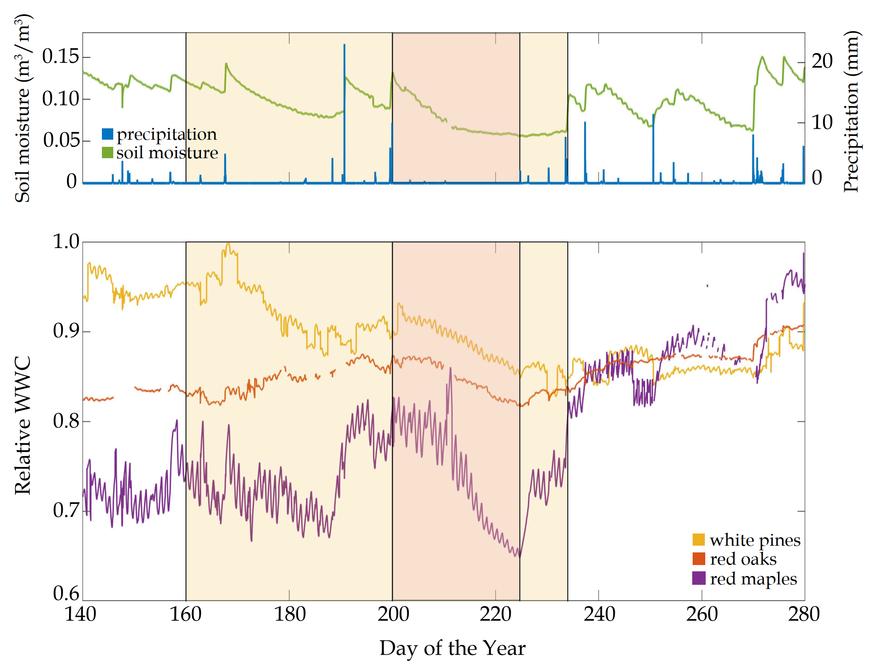
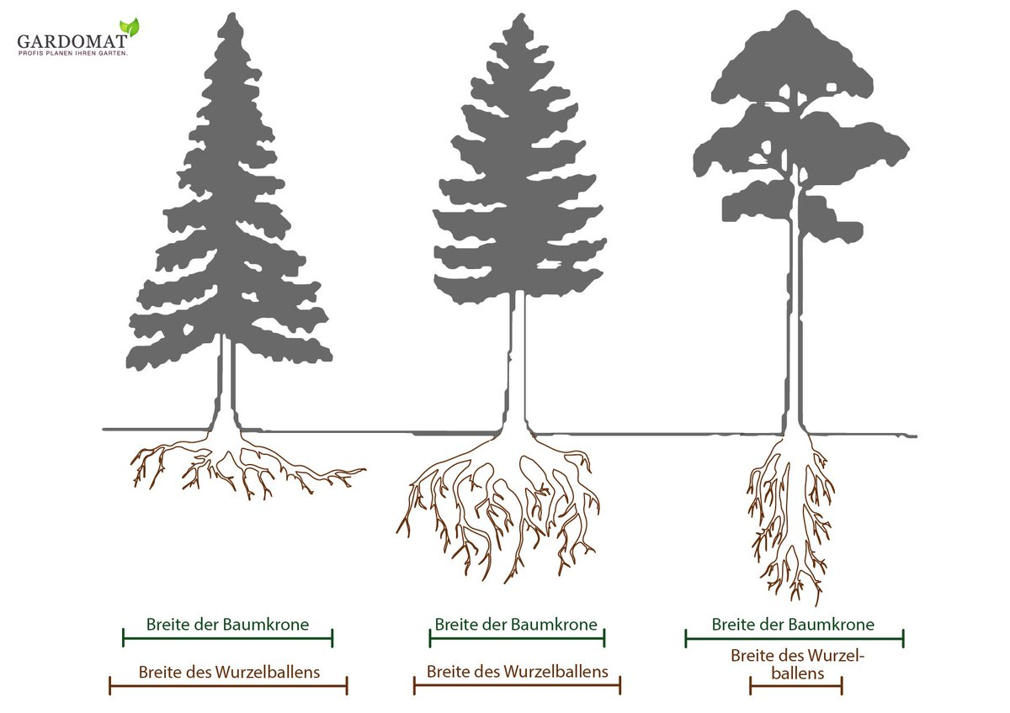
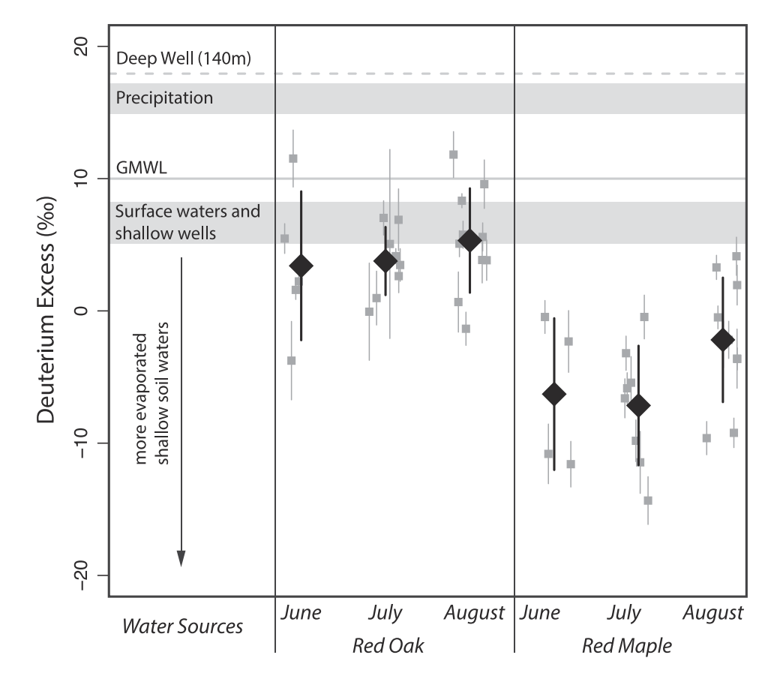
(A)
(B)
(C)
Red
oaks
Red
maples
Restrepo Acevedo et al., (In revision)
From Matheny et al., (2016) - Ecohydrology

Slide 4
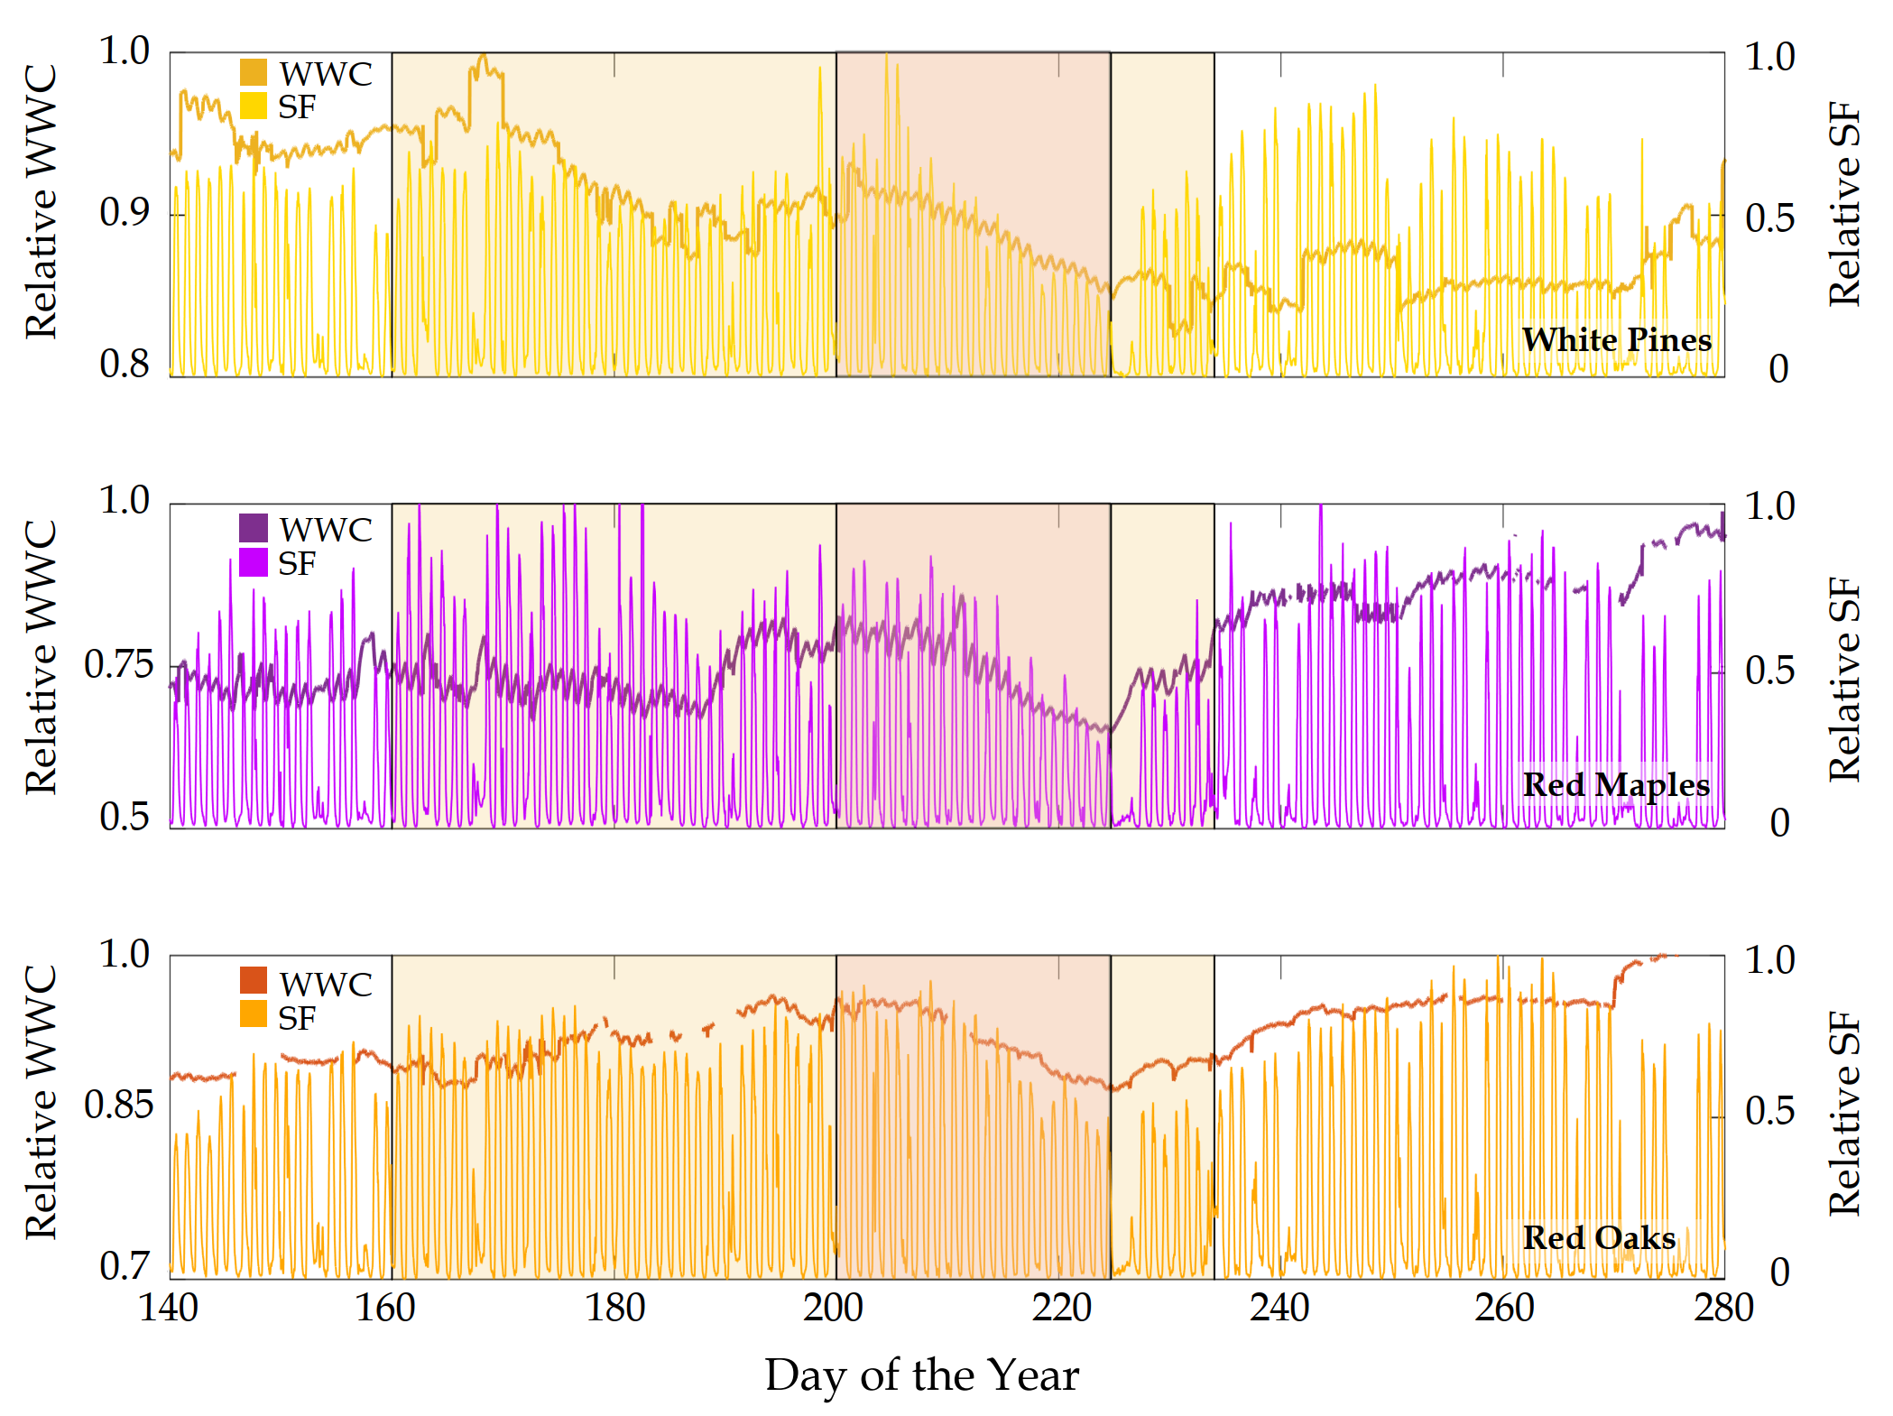
(A)
(B)
(C)
Restrepo Acevedo et al., (In revision)

Slide 5
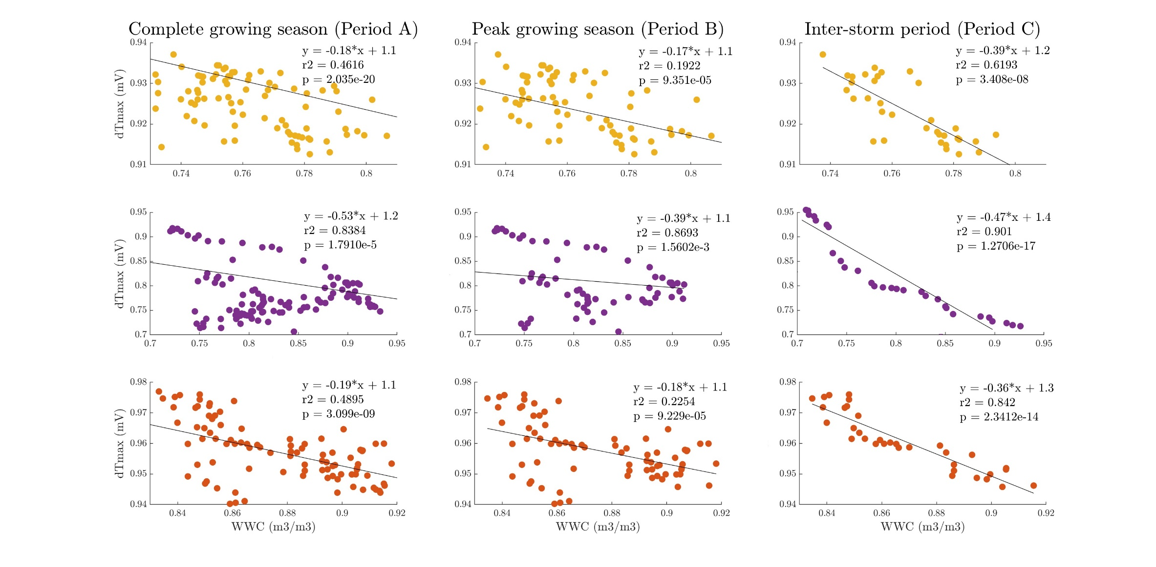
WWC and dT_{max}, are inversely correlated particularly during water limited conditions
(Period C) for all our species.
We attribute the negative WWC-dT_{max} relationships to changes in the thermal properties of wood which are strongly influenced by the relative volume of water present in the matrix.
Restrepo Acevedo et al., (In revision)

Slide 6
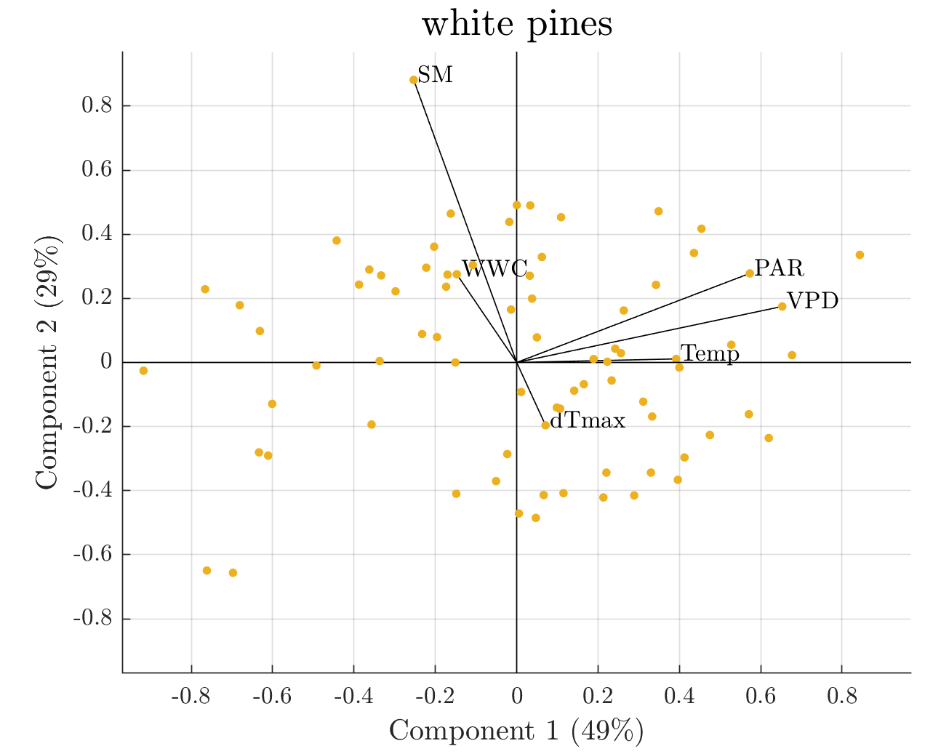
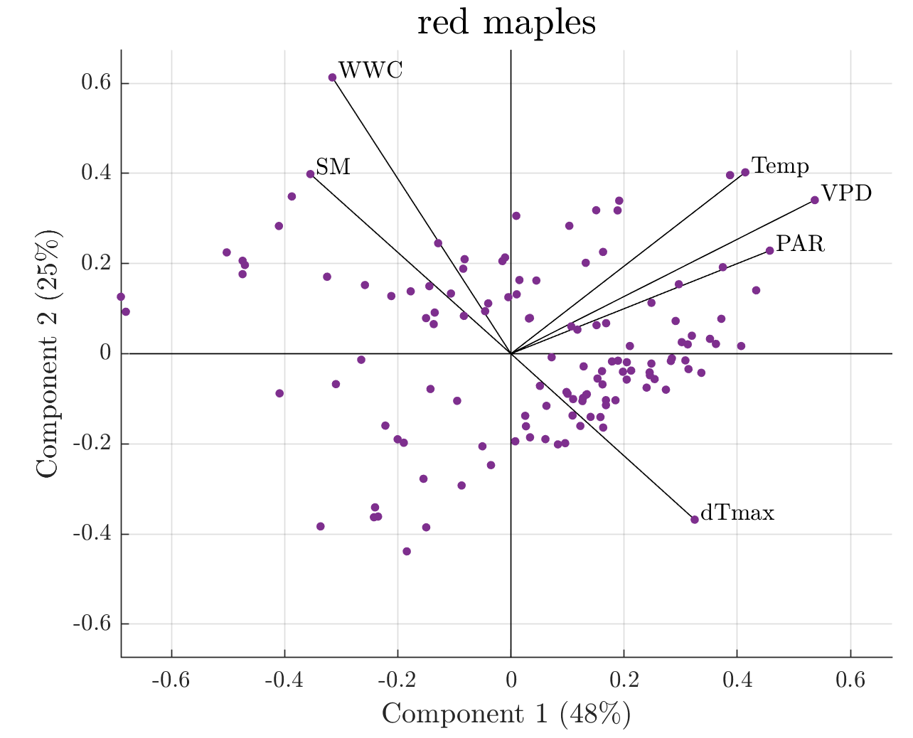
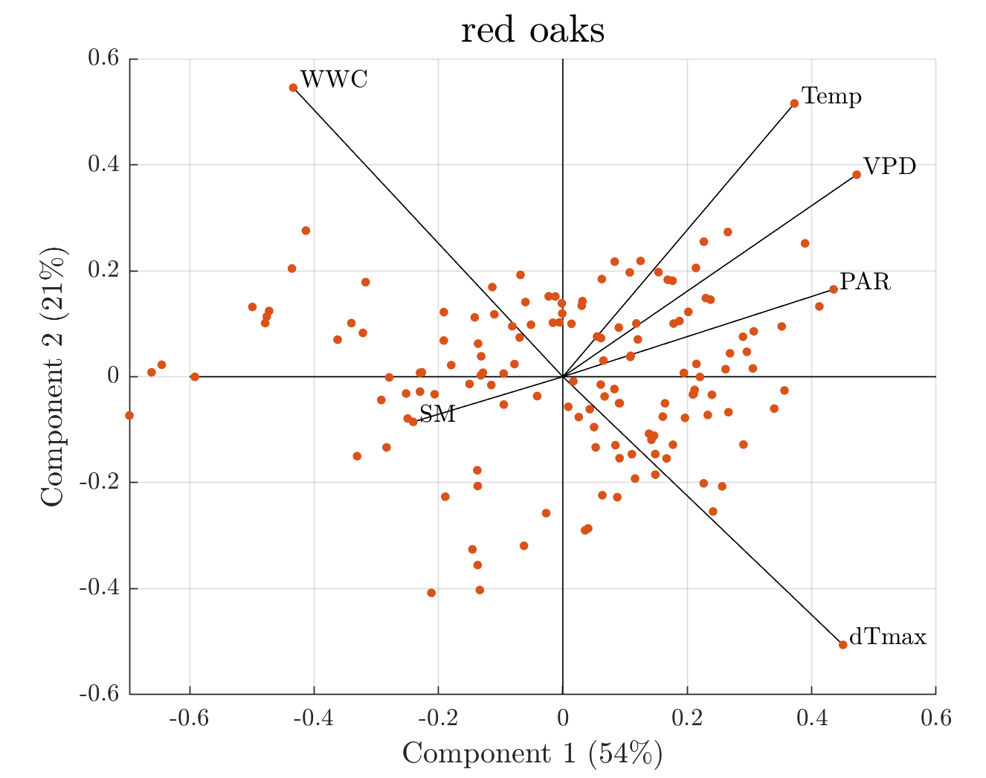
Restrepo Acevedo et al., (In revision)

Slide 7
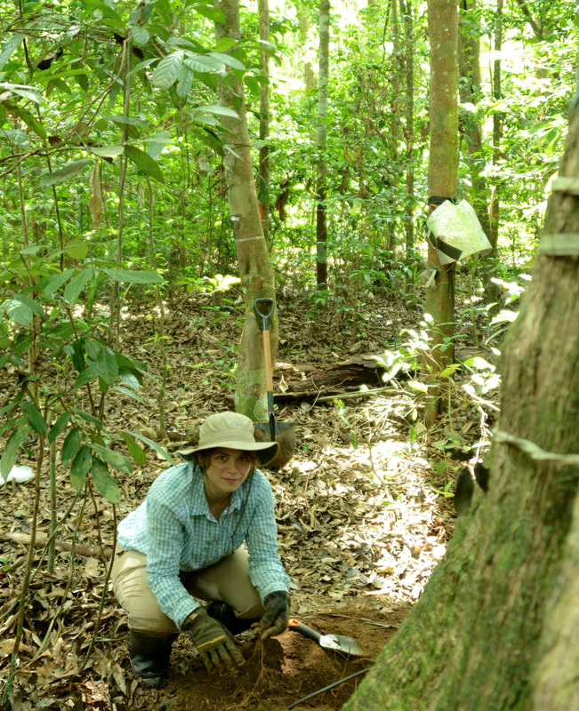

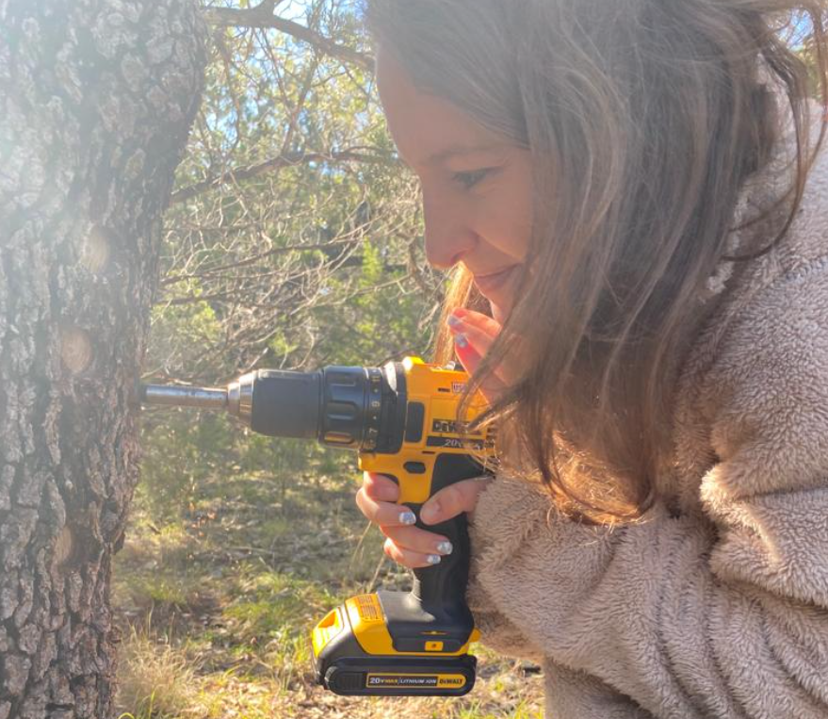
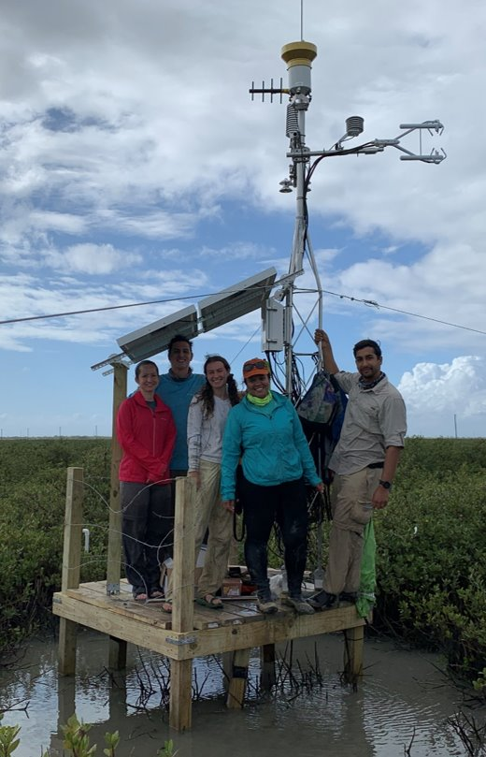




Implications of our results:
The relationship between WWC and dT_{max} is particularly strong under soil water limited conditions
Raw voltage data from Granier style sensors might capture more information than the community currently uses.
Potential reservoir of untapped data from thermometric sap flow sensors that could be used to infer changes in WWC at the individual scale under water limited conditions.
Dr. Elizabeth Agee
Dr. Ashley Matheny
Contact : Ana María Restrepo A. (anarestrepo@utexas.edu)

