Slide 1



Spectral Induced Polarization: Laboratory measurements on artificial soils with varying water saturation, salinity and clay content
2022
24th May
¹Veronika Iván, ¹Benjamin Mary, ²Nimrod Schwartz, ¹ Massimiliano Ghinassi, ¹Giorgio Cassiani
¹Department of Geosciences, University of Padova, Via Gradenigo 6, 35131, Padova, Italy
²Department of Soil and Water Sciences, The Hebrew University of Jerusalem, Rehovot 7610001, Israel

Slide 2
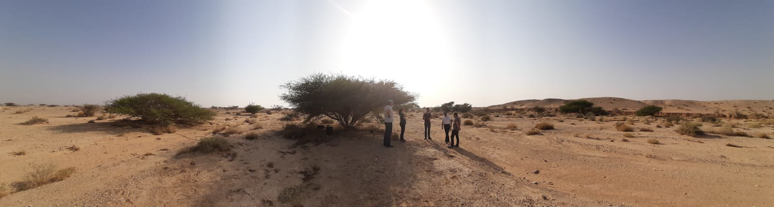
1. Aims of the study
24.05.2022.
i
1
arid / semi-arid agricultural and natural ecosystems: fundamentally constrained by water availability and soil water dynamics
understanding of the distribution and fluxes of soil-water in semi-arid environments
resistivity: inversely related both to soil solution salinity and to soil water content → hard to interpret
Spectral Induced Polarization measurements → discriminate between the effects of water content and water salinity on soil resistivity → Aims of the lab experiments
experiment setup: SIP response on „artificial soil” samples (sand-clay mixtures) with 3 gradually changing variables:
clay content: 0 – 2 – 4 – 6 – 8 %
water saturation: 5 – 100%
salinity: 0,05 – 0,1 – 0,35 – 0,7 S/m
DRYLANDS:
highly heterogenous soil
varying salt content, typically high in upper soil layers
low levels of soil moisture
potentially deep water uptake by plants

Slide 3
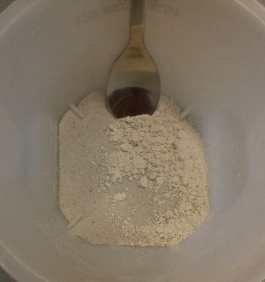
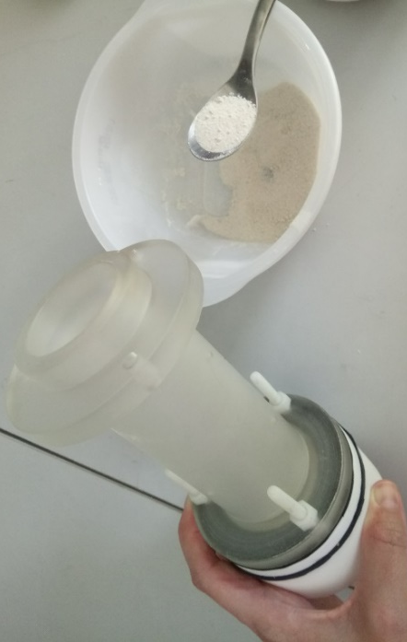
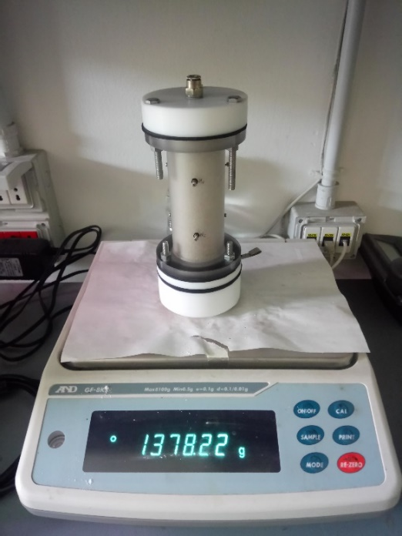
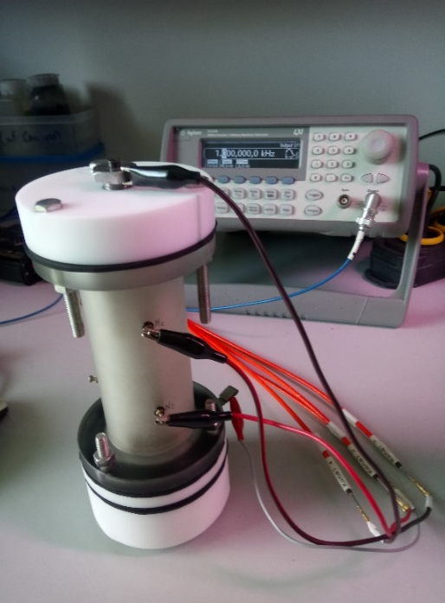
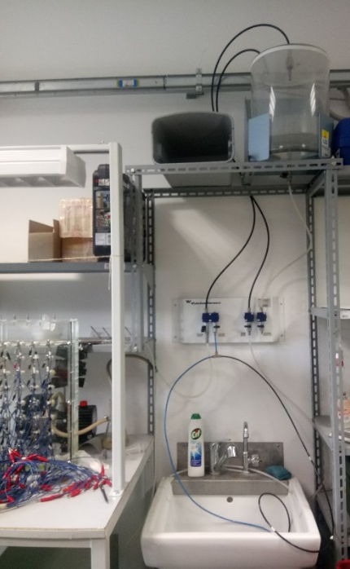
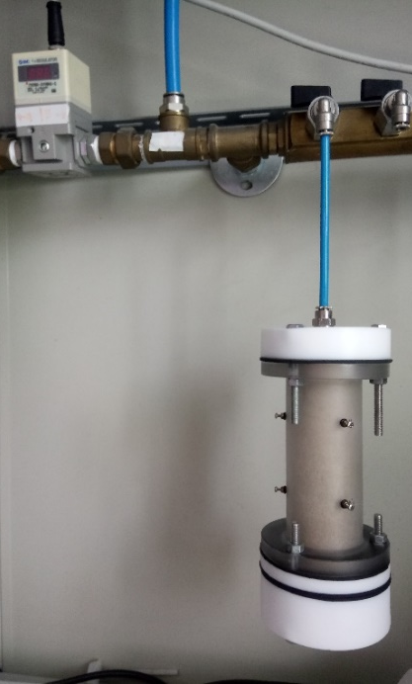
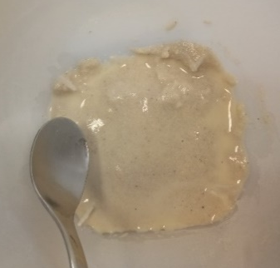
2. Experiment setup - Methods and materials
24.05.2022.
i
2
EQUIPMENT
SIP equipment: ZEL-SIP04-V02 impedance meter + Agilent 33220A function generator
saturation-desaturation equipment
oven for constant temperature
plexiglass sample holder cells
MATERIALS
sand (SiO₂ > 99.6%; very fine-coarse d= 0,1 - 0,6 mm)
clay powder (Ca-montmorillonite)
NaCl – for increase pore water salinity
STEPS
Creating the artificial soil samples
Filling the sample holder cells under dry conditions
Saturation of samples with tapwater / saline water
Decreasing water content obtained by air injection (0,05-2 bar)
Weight measurement at each de-saturation steps
SIP measurement at each de-saturation steps (21 °C; 0.01 Hz - 45 kHz; 5 V)
2.
3.
5.
6.
4.
1.

Slide 4
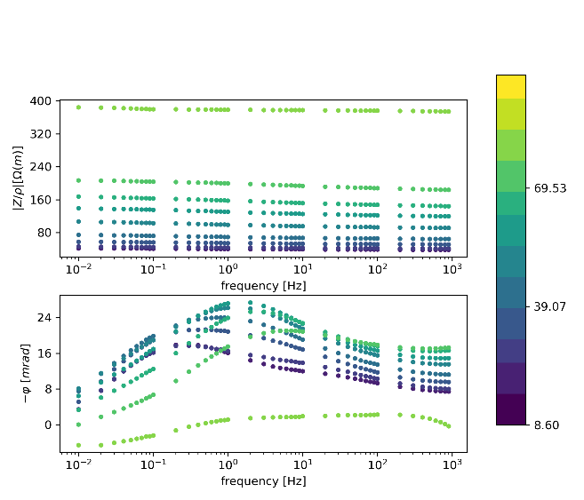
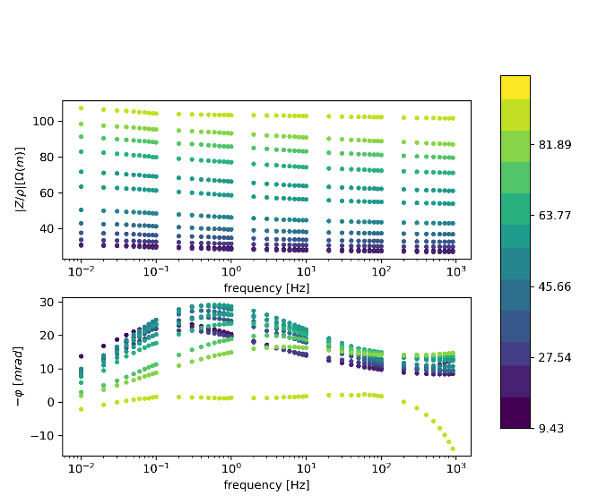
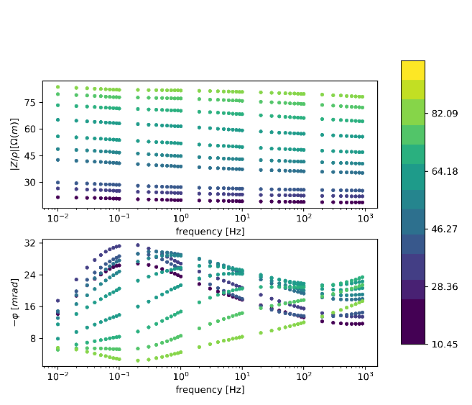
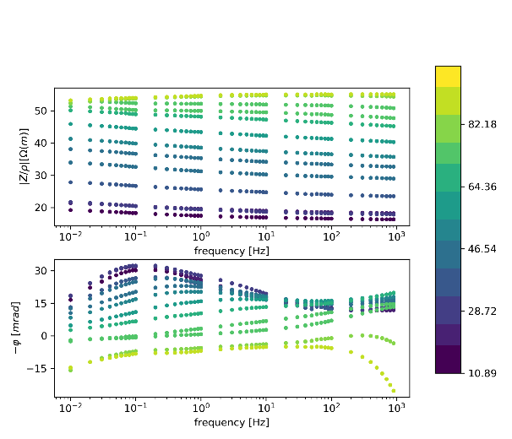
3. Results – Raw data
24.05.2022.
i
3
salinity: 0,1 S/m
clay content: 4%
clay content: 2%
clay content: 8%
clay content: 6%
Notes:
raw SIP resistivity and phase spectra

Slide 5

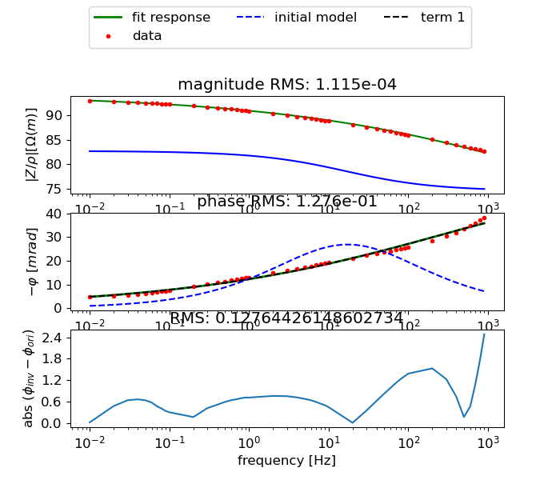
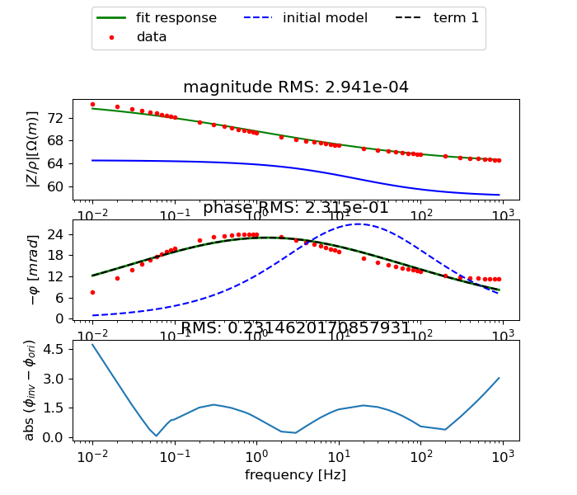
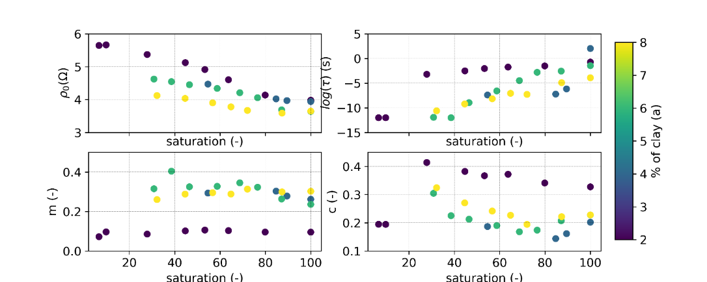
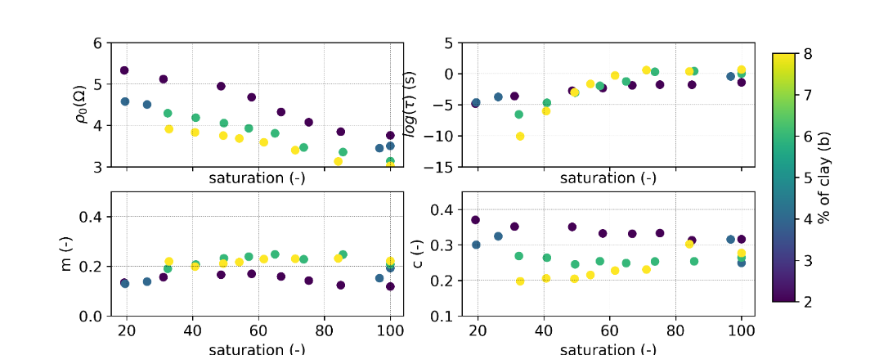
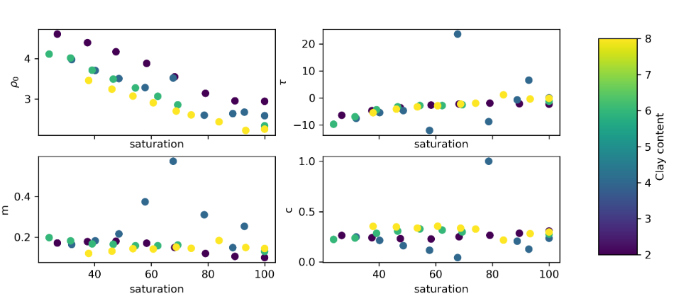
4. Results: Fitting a Cole-Cole model
24.05.2022.
i
4
clay: 6%
saturation: 39 %
salinity:0,05 S/m
clay: 2%
saturation: 67 %
salinity:0,1 S/m
Fitting a Cole-Cole model according to the routine from M. Weigand*
where
i: imaginary unit
ρ₀ : DC resistivity τ: relaxation time
m: chargeability c : Cole-Cole exponent
salinity: 0,05 S/m
salinity: 0,1 S/m
salinity: 0,35 S/m
* Weigand, M. (2017). Time-lapse Cole-Cole decomposition routines. https://m-weigand.github.io/ccd_tools/doc_ccd/index.html.
Weigand, M., & Kemna, A. (2016). Debye decomposition of time-lapse spectral induced polarisation data. Computers Geosciences, 86, 34– 45.
Notes:
The interpretation of spectral induced polarization data is generally carried out by means of macroscopic relaxation models, i.e
complex resistivity
i is the imaginary unit,
m is the chargeability defined as m = 1-ρ∞/ρo, where ρ∞ is the resistivity at very high frequency,
ρ₀ is the resistivity at DC current (ρ0 >ρ∞ are the two asymptotes of the resistivity module curve),
τ is a time constant directly related to the mean soil grain size (e.g., Vanhala 1997) and
c is Cole-Cole exponent (tipicaly in the range 0.1–0.6, with smaller values associated to wider grain (and pore) size distribution
ω is angular frequency

Slide 6
5. Conclusions
24.05.2022.
i
5
sensitivity of the IP method to water content clay content and salinity is demonstrated
the method is perspectivic for the separation between pore water salinity and water content
same resistivity
associated phase spectra
CC matrix parameters
Notes:
The interpretation of spectral induced polarization data is generally carried out by means of macroscopic relaxation models, i.e
complex resistivity
i is the imaginary unit,
m is the chargeability defined as m = 1-ρ∞/ρo, where ρ∞ is the resistivity at very high frequency,
ρ₀ is the resistivity at DC current (ρ0 >ρ∞ are the two asymptotes of the resistivity module curve),
τ is a time constant directly related to the mean soil grain size (e.g., Vanhala 1997) and
c is Cole-Cole exponent (tipicaly in the range 0.1–0.6, with smaller values associated to wider grain (and pore) size distribution
ω is angular frequency

