Slide 1



Occurrence of asbestiform minerals in the Pollino Massif (Southern Italy): Environmental and health implications
Roberto Buccione¹, Giovanna Rizzo¹, Michele Paternoster¹, Giovanni Mongelli¹,
Angela De Bonis¹
Department of Sciences, University of Basilicata

Slide 2
AIM OF THE WORK
This work aims the investigation of asbestiform minerals coming from metamorphic rocks (serpentinites and schists) of the Frido Unit (Pollino Massif, southern Apennines) in order to assess the environmental and health implications.

Slide 3
INTRODUCTION
The problem of toxicity of asbestos minerals has long been discussed since the 20 century because their inhalation may be at the origin of diffuse interstitial pulmonary illness known as “Asbestosis”.
In Basilicata, naturally occurring asbestos (NOA) are mainly concentrated in the ophiolitic sequences cropping out in the Pollino Massif (southern Italy). In this area, the most common types of asbestos minerals are serpentine, tremolite, edenite and Mg-riebeckite.

Slide 4
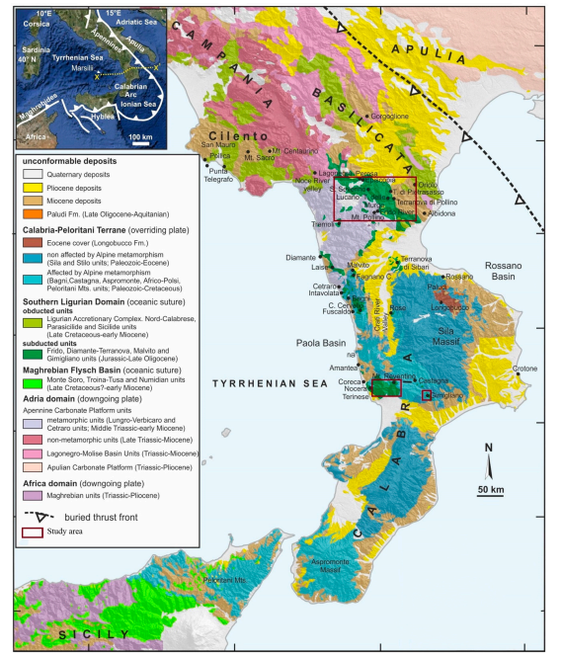
GEOLOGICAL SETTING
The southern Apennine chain is a fold-and-thrust belt formed between the upper Oligocene and Quaternary.
It results from the convergence between the African and European plates and the simultaneous rollback of the SE-directed Ionian subduction, which in turn caused the opening of the Tyrrhenian back-arc basin (Doglioni et al., 1999).
Dichicco et al., 2019

Slide 5
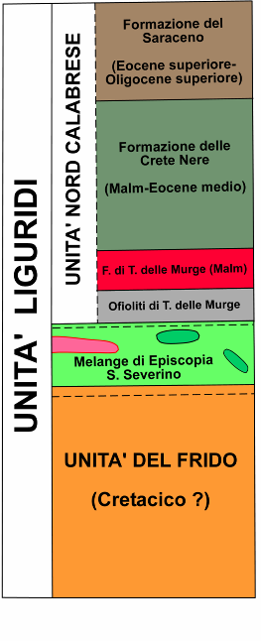
THE FRIDO UNIT
The Frido Unit (Amodio-Morelli et al., 1976) almost entirely corresponds to the Frido Formation defined by Vezzani (1969).
This unit is exposed for about 10 km, from the Frido Valley to NW, to the Sarmento valley to SE. It’s overthrust on the North-Calabrian Unit (Di Leo et al., 2005) as well as on the Calabro- Lucano Flysch.
Overall the Frido Unit is composed of metamorphic rocks englobing olistoliths of various size made of ophiolite and basement rocks of continental origin.
Bonardi et al. 1988

Slide 6
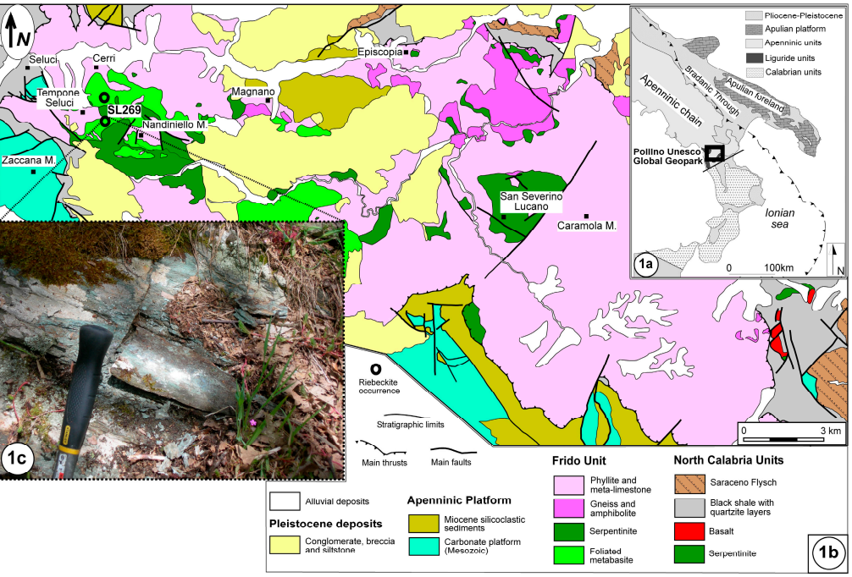
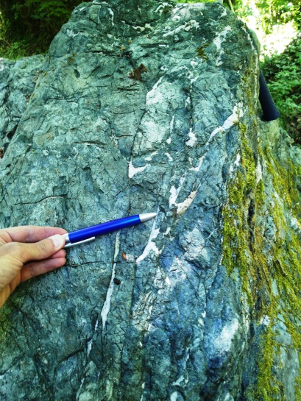
SAMPLING ACTIVITY
In which rocks of the Pollino Massif are observed asbestiform minerals?
Serpentinites
Schists

Slide 7
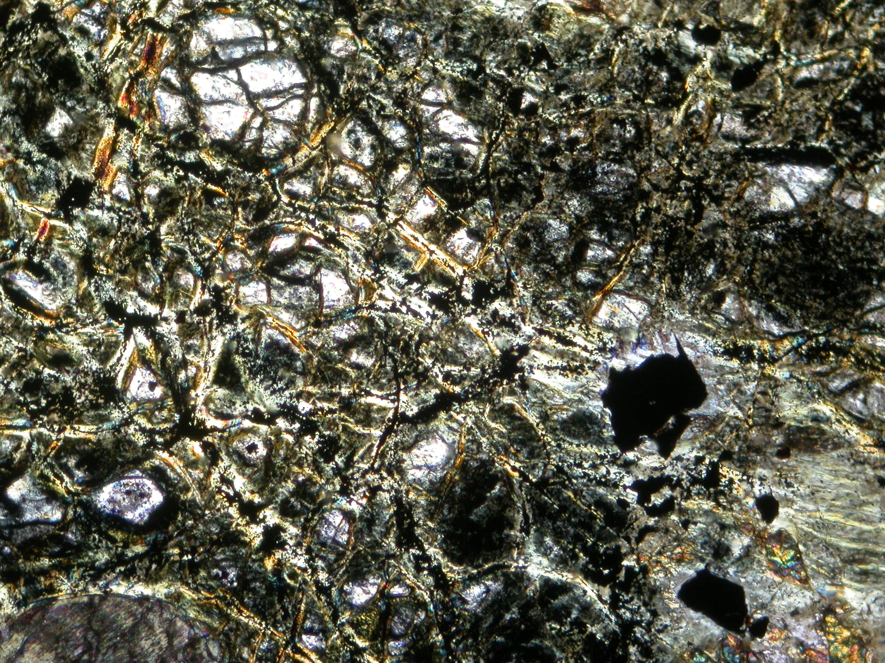
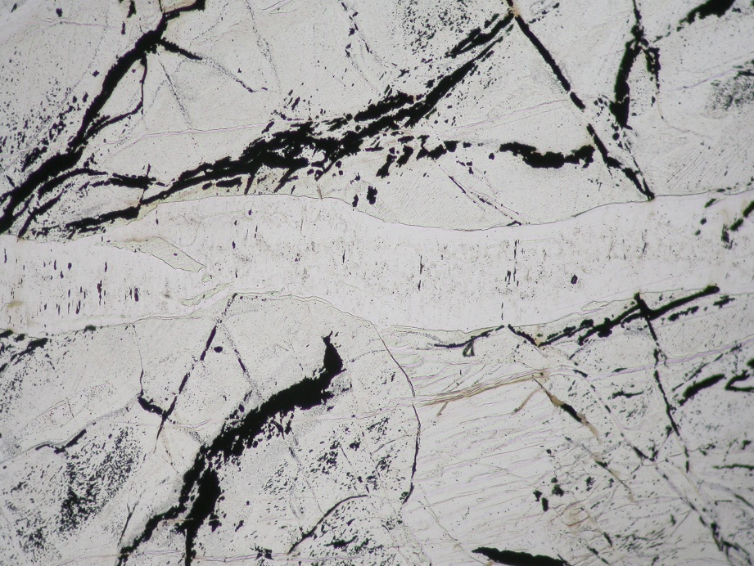
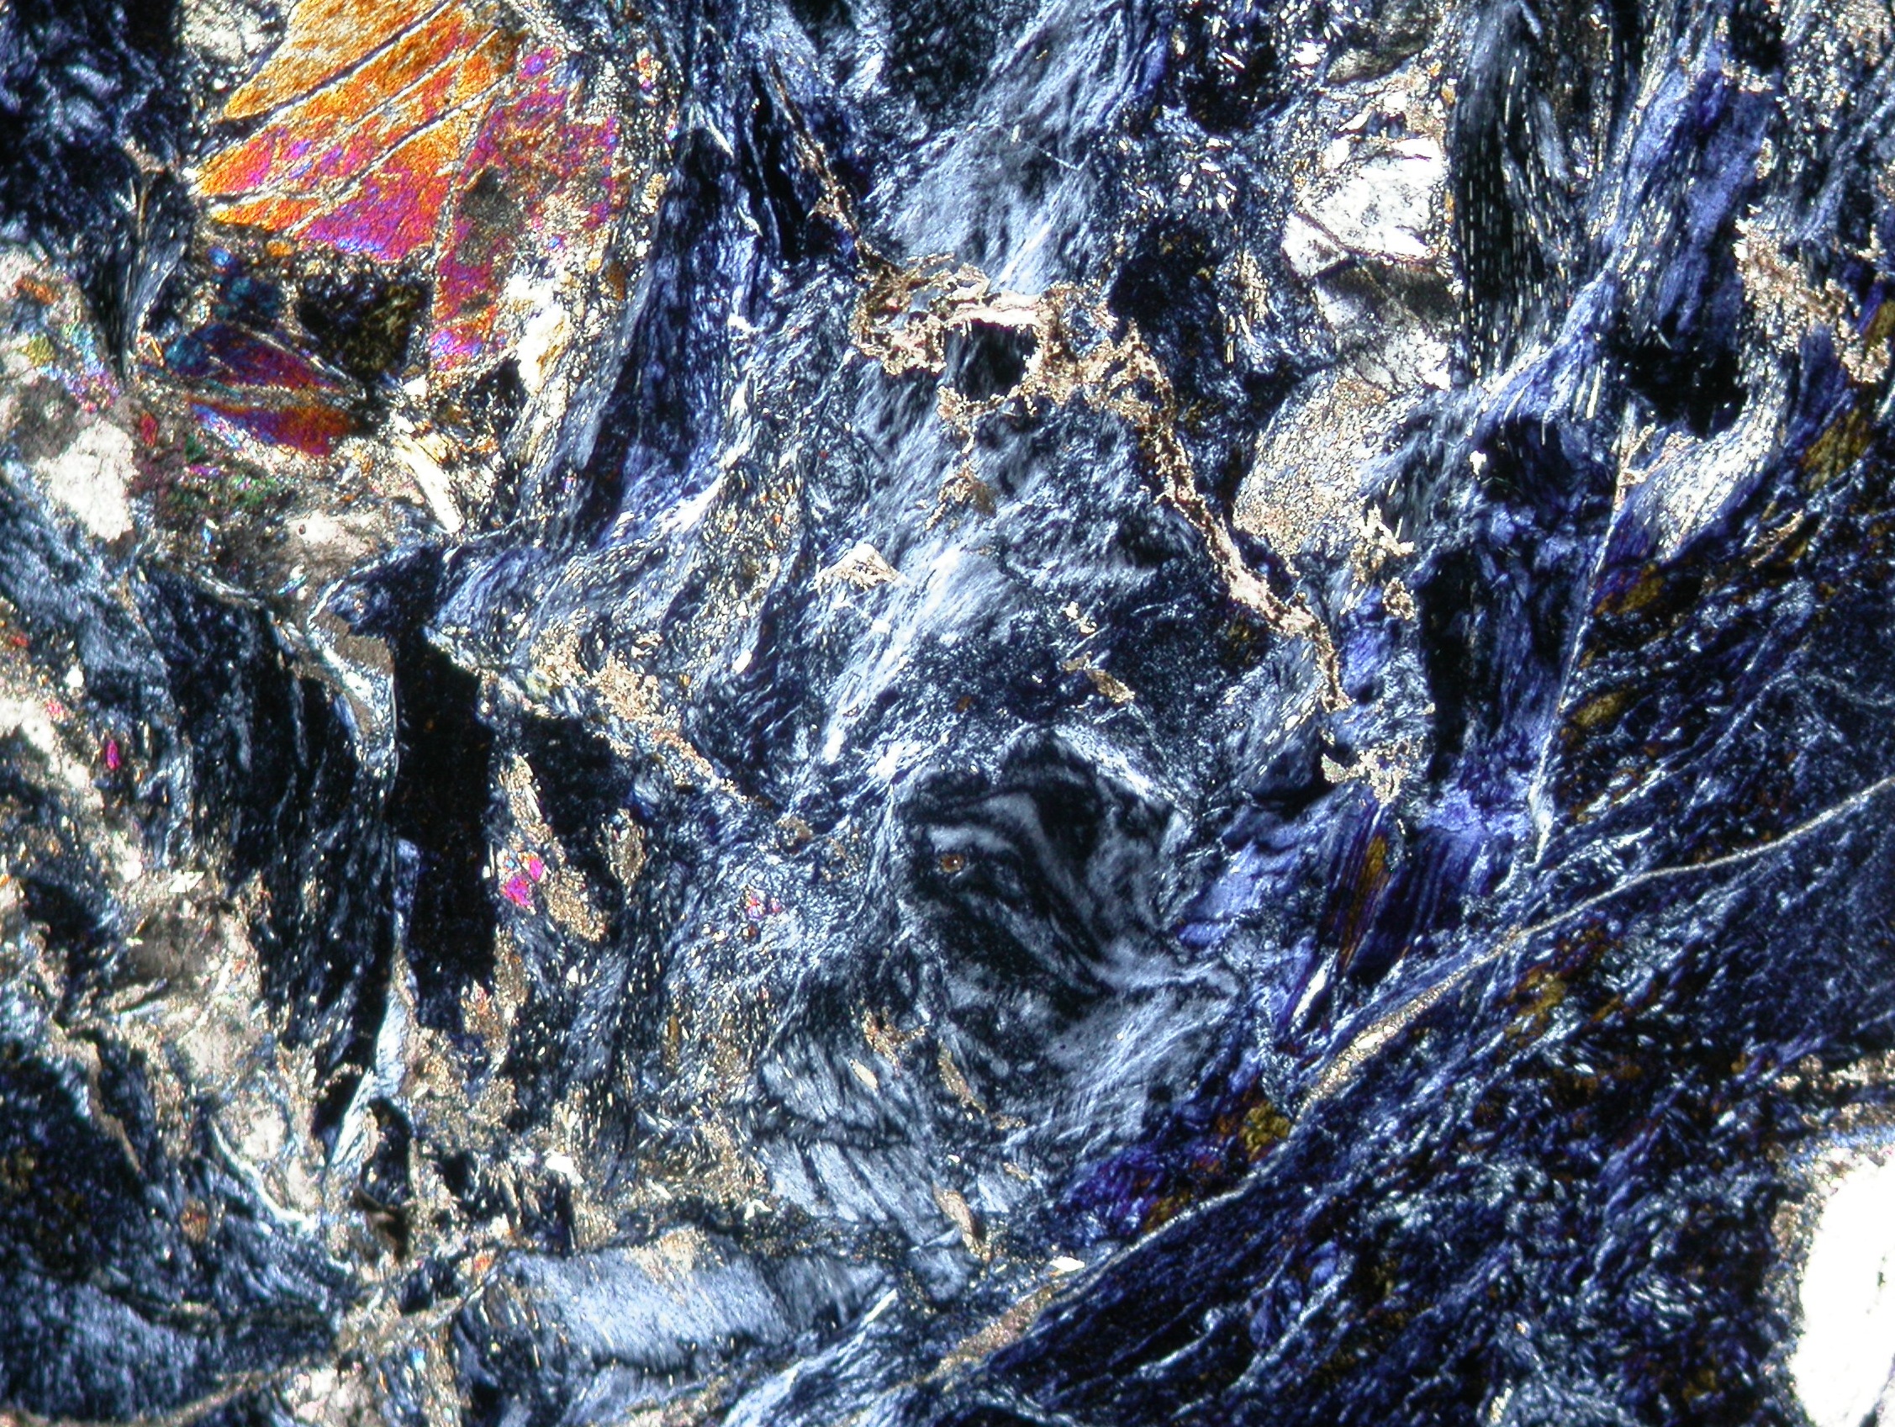
ASBESTIFORM MINERALS IN SERPENTINITES
Ol
Srp
SERPENTINITES: olivine, ortopyroxene, clinopyroxene, spinels, epidote, chlorite, opaque, actinolite, crisotile and tremolite.
Srp
Ol
240μm
mesh texture
Srp
bastites
192 µm
cataclastic texture
veins

Slide 8
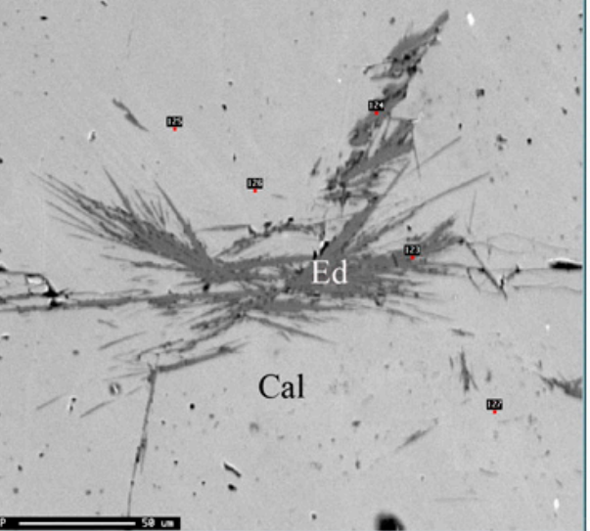
AND FOR THE FIRST TIME, EDENITE WAS FOUND IN SERPENTINITES

Slide 9
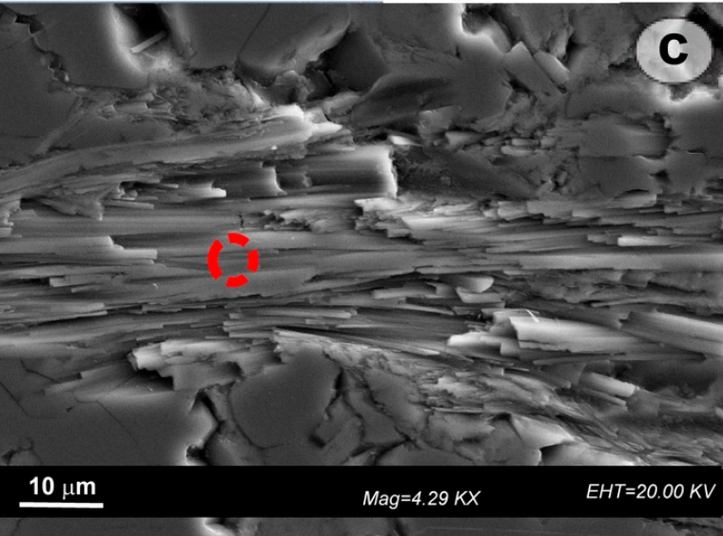
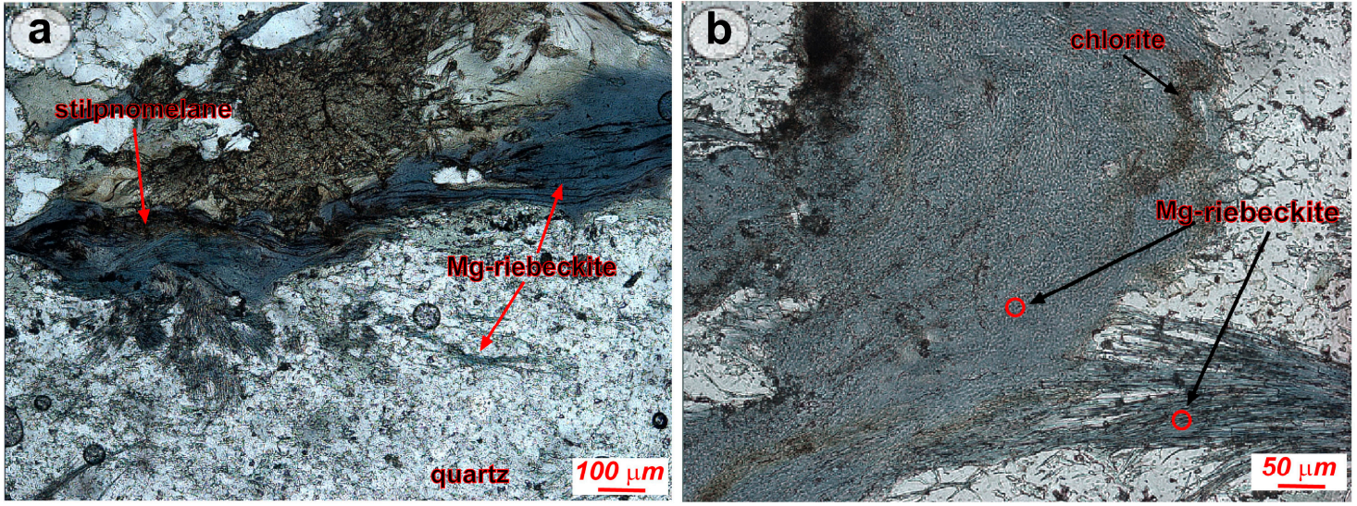
ASBESTIFORM MINERALS IN SCHISTS
SCHISTS: Mg-riebeckite, glaucophane, epidote, stilpnomelane, quartz, chlorite,

Slide 10
ENVIRONMENTAL AND HEALTH IMPLICATIONS
In the Pollino Massif an epidemiological study ascribed 17/90 mesothelioma cases associated to environmental factors, such as the human exposure to naturally outcropping asbestos-bearing rocks.
These minerals, when inhaled, may cause neoplasms with a high mortality rate as asbestosis, lung cancer, and malignant mesothelioma.
Furthermore, several researches have been demonstrated the correlation between mesothelioma and a series of environmental factors, such as the exposure to asbestos minerals.
In particular, the presence of Fe, its structural coordination, and furthermore, the Fe exposed on the fiber surface are important factors in the reactive oxygen species (ROS) production.

Slide 11
CONCLUSIONS
The crystal-chemical characterization of asbestiform minerals is extremely relevant for environmental and health issues because serpentinites and Mg-riebeckite schists are employed as civil constructions and building stones and this could lead the release of fibers in the air, which effects are not negligible.
The presence of Fe to ideal chemical composition in tremolite asbestos and Mg-riebeckite, even in small amounts, is responsible for many pathological effects on the humans living in this area.

Slide 12
