Slide 1


Semi-Analytical Method for Simulating
Rotational Ground Motion in Two-Dimensional Heterogeneous Elastic Half-Space
Varun Kumar Singla¹ and Ivan Lokmer²
¹Department of Earthquake Engineering, IIT Roorkee, India (Email: singlav.iitk@gmail.com)
²School of Earth Sciences, University College Dublin, Ireland (Email: ivan.lokmer@ucd.ie)

Slide 2
Introduction
Seismic ground motion consists of both translational and rotational components.
Rotational components can contribute significantly to the seismic response of civil engineering structures.
Rotational ground motion data is exceptionally sparse.
  Consequently, the effect of subsurface heterogeneity on rotational motions has been relatively poorly researched.
Semi-analytical approach for evaluating rotational motions in 2-D heterogeneous elastic medium proposed here.

Slide 3





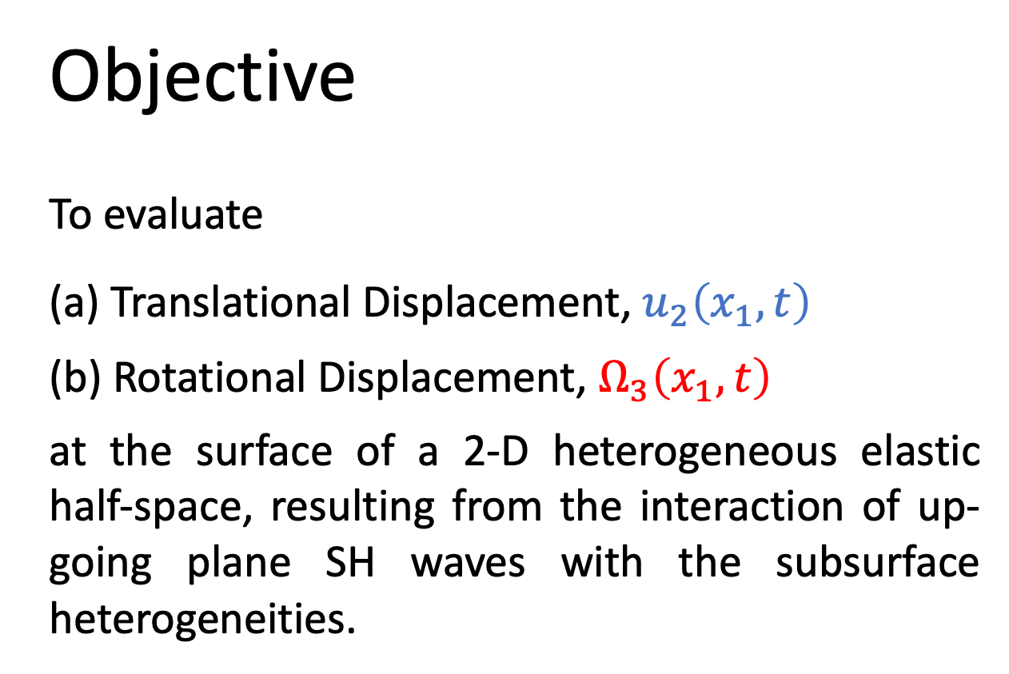



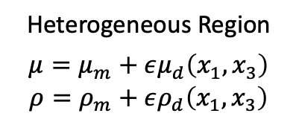
$$Ω_{3}$$
Objective
To evaluate
(a) Translational Displacement, $u_{2}\left(x_{1},t\right)$
(b) Rotational Displacement, $Ω_{3}\left(x_{1},t\right)$
at the surface of a 2-D heterogeneous elastic half-space, resulting from the interaction of up-going plane SH waves with the subsurface heterogeneities.
$$x_{3}$$
$$u_{2}$$
$$x_{2}$$
$$x_{1}$$
Heterogeneous Region
$${μ=μ}_{m}+εμ_{d}\left(x_{1},x_{3}\right)$$
$${ρ=ρ}_{m}+ερ_{d}\left(x_{1},x_{3}\right)$$
$$θ$$
$μ_{m}$ , $ρ_{m}$ : shear modulus, density of background homogeneous medium
Incident SH Waves

Slide 4
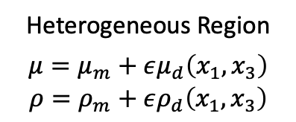

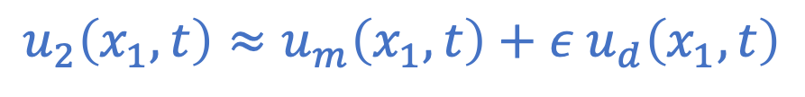





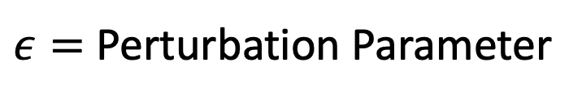





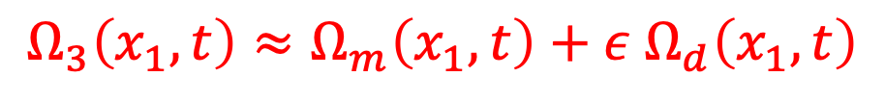



Methodology: Perturbation-Based Approach
$$Ω_{3}$$
$$Ω_{m}$$
$$Ω_{d}$$
$$x_{3}$$
$$u_{2}$$
$$x_{3}$$
$$u_{m}$$
$$x_{3}$$
$$u_{d}$$
$$x_{2}$$
$$x_{2}$$
$$x_{2}$$
$$x_{1}$$
$$x_{1}$$
$$x_{1}$$
$$θ$$
Heterogeneous Region
$${μ=μ}_{m}+εμ_{d}\left(x_{1},x_{3}\right)$$
$${ρ=ρ}_{m}+ερ_{d}\left(x_{1},x_{3}\right)$$
Equivalent Body Forces
Incident SH Waves
$$θ$$
Background homogeneous medium
Background homogeneous medium
Background homogeneous medium
Incident SH Waves
$$u_{2}\left(x_{1},t\right)≈u_{m}\left(x_{1},t\right)+ε u_{d}\left(x_{1},t\right)$$
$ε=$ Perturbation Parameter
$$Ω_{3}\left(x_{1},t\right)≈Ω_{m}\left(x_{1},t\right)+ε Ω_{d}\left(x_{1},t\right)$$

Slide 5


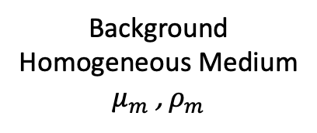



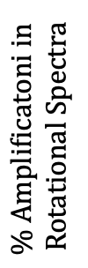







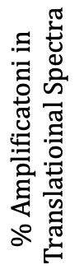



Results: Example 2-D Heterogeneous Medium
$$Ω_{3}$$
To know further details, please join
SM2.2
“Direct observation of seismic wavefield gradients – a new approach to seismic experiments”
at
18:03 (CEST)
https://meetingorganizer.copernicus.org/EGU22/session/42867#
$$x_{3}$$
$$u_{2}$$
10% heterogeneous
20% heterogeneous
$$x_{2}$$
$$x_{1}$$
$$400 m$$
$$\text{\% }\text{Amplificatoni} \text{in} \text{Rotational} \text{Spectra}$$
$$μ_{m},ρ$$
$$200 m$$
$$200 m$$
Frequency$\left(Hz\right)$
Frequency$\left(Hz\right)$
$$10°$$
Background Homogeneous Medium
$μ_{m}$ , $ρ_{m}$
$$\text{\% }\text{Amplificatoni} \text{in} \text{Translatioinal} \text{Spectr}\text{a}$$
Incident SH Waves
Frequency$\left(Hz\right)$
Frequency$\left(Hz\right)$

Slide 6
Acknowledgement
The authors are grateful to Geological Survey Ireland (GSI) for funding this research.

