Slide 1
Magnetospheric Responses to Solar Wind Pc5 Density Fluctuations From 2D Hybrid Vlasov Simulation
Hongyang Zhou, Lucile Turc, & the Vlasiator team
University of Helsinki

Slide 2
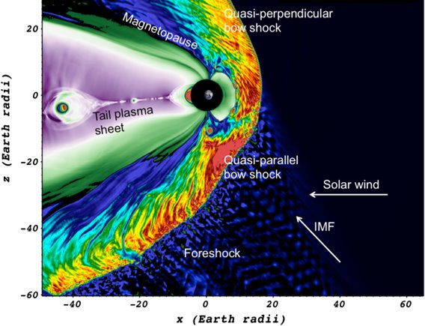

Vlasiator: A Collisionless Hybrid Vlasov Plasma Model
Direct Vlasov equation solver for each ion species
Massless electrons
Generalized Ohm’s law up to ∇P_{e} term
2D + 3V
NEW: time-varying Maxwellian boundary conditions

Slide 3
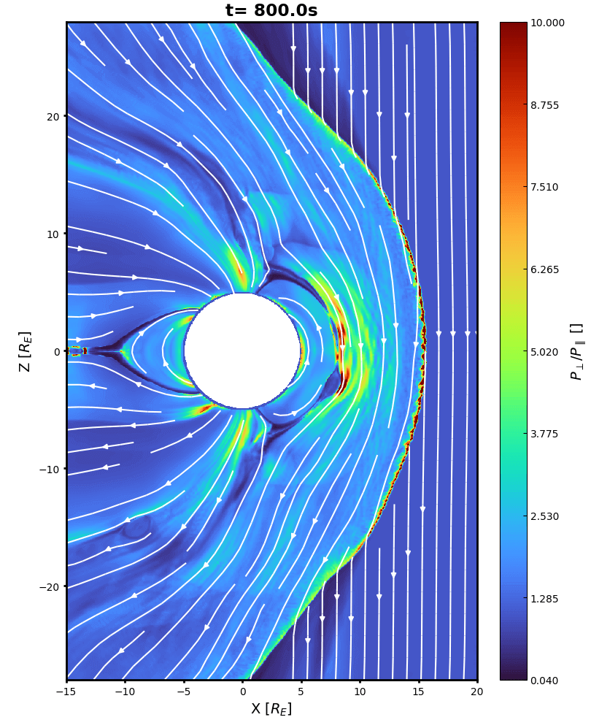
Global View
Proton only for this run
Meridional plane
Solar wind conditions:
n = 2 amu/cc
v = 600 km/s
T = 5e5 K, Maxwellian
B = [0, 0, -5] nT
Δn = 1 amu/cc, period = 150 s
Avg MA = 7.8

Slide 4
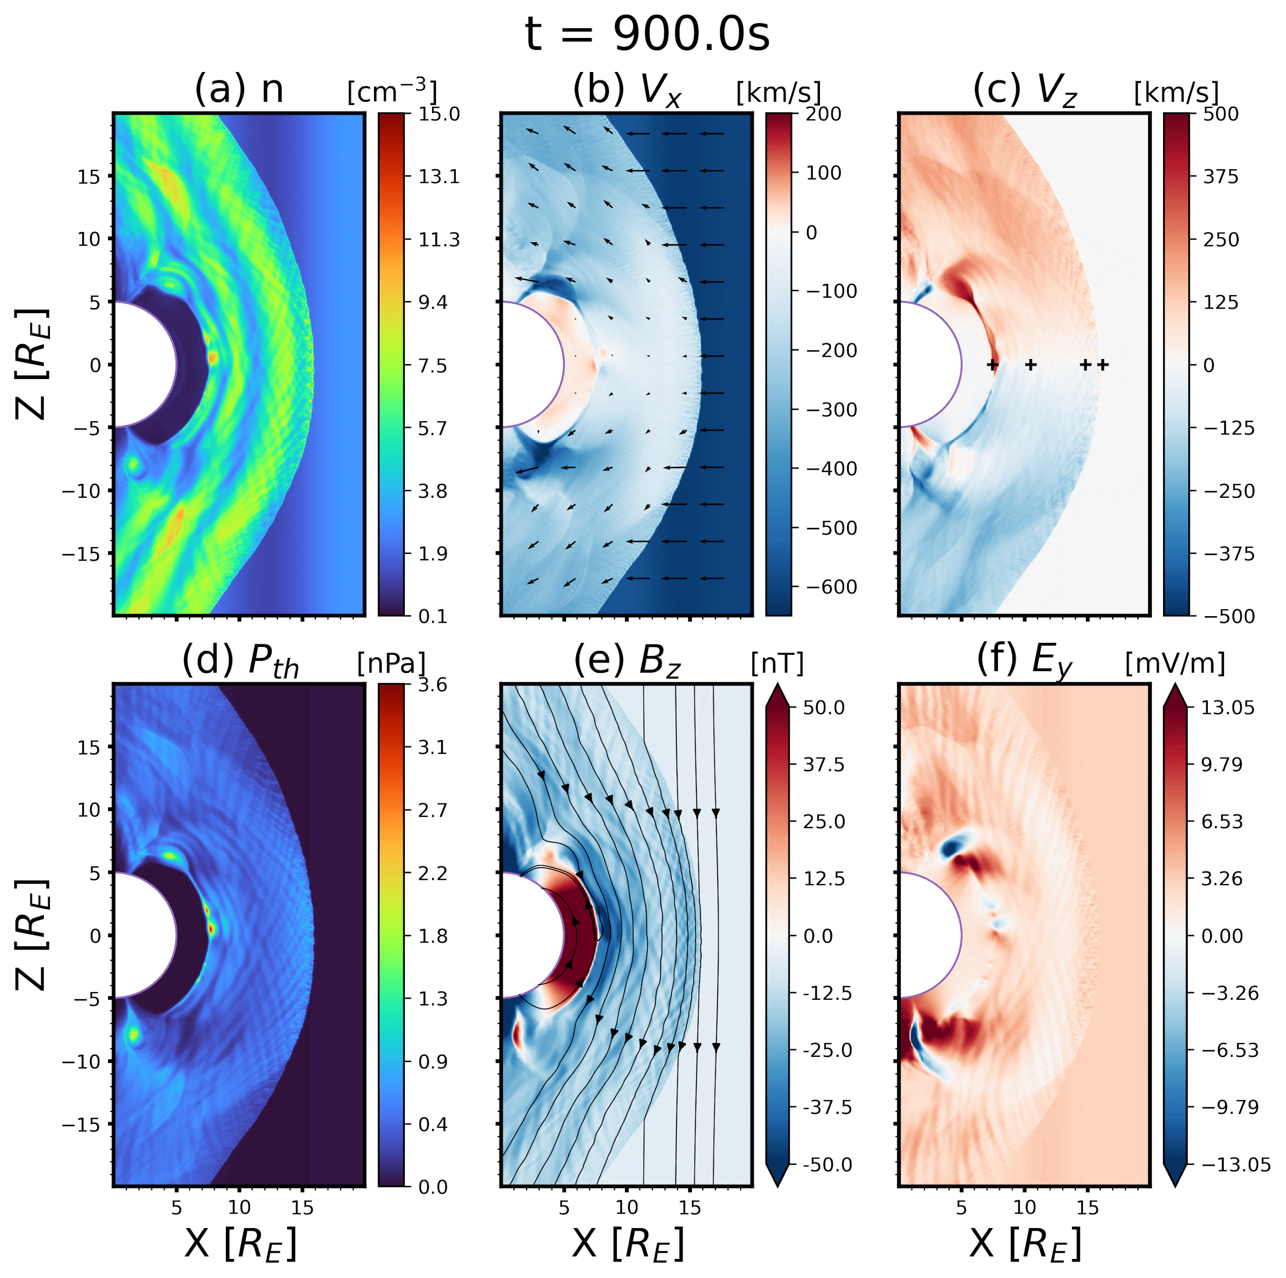
Global View

Slide 5
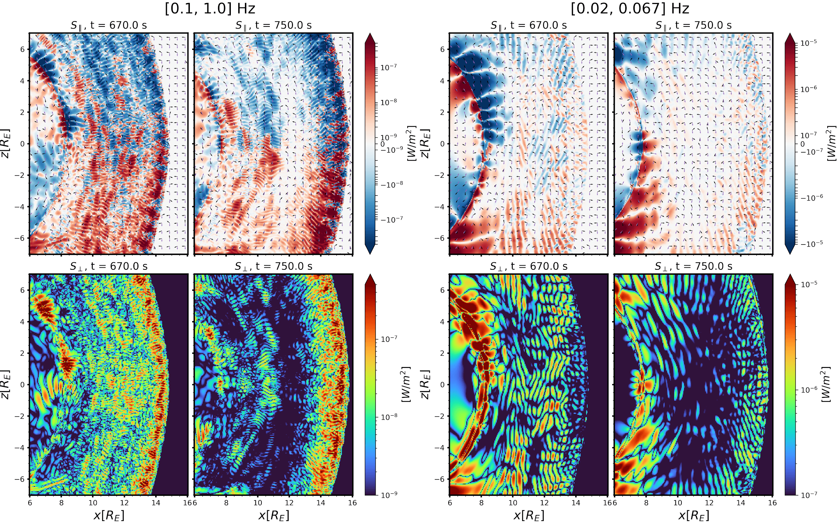
Poynting Fluxes

Slide 6
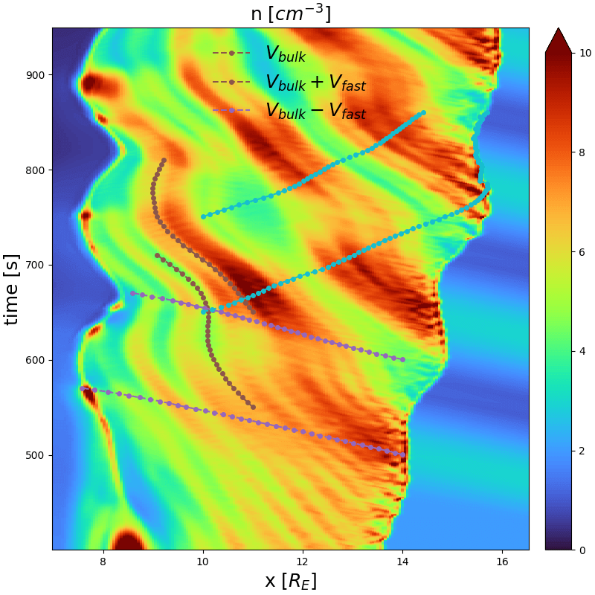
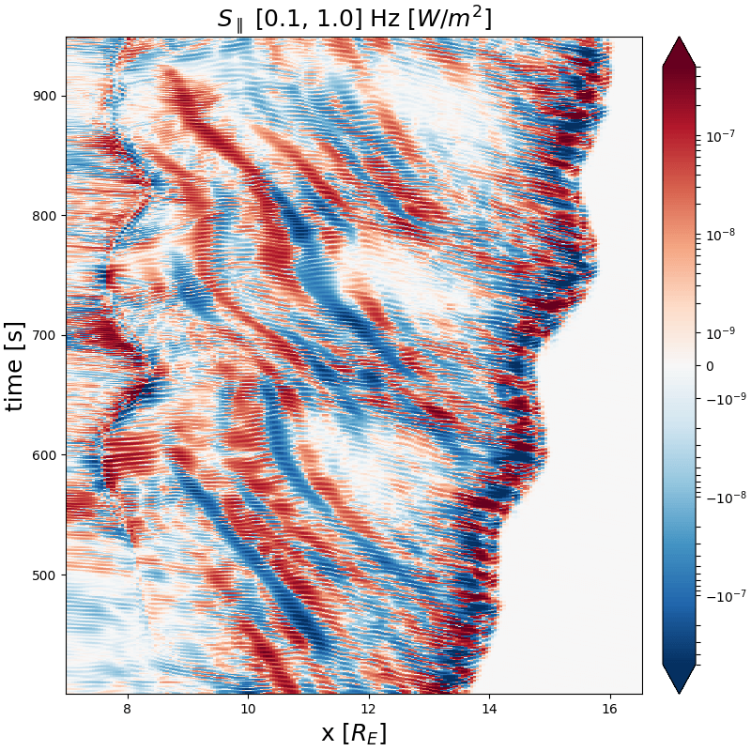
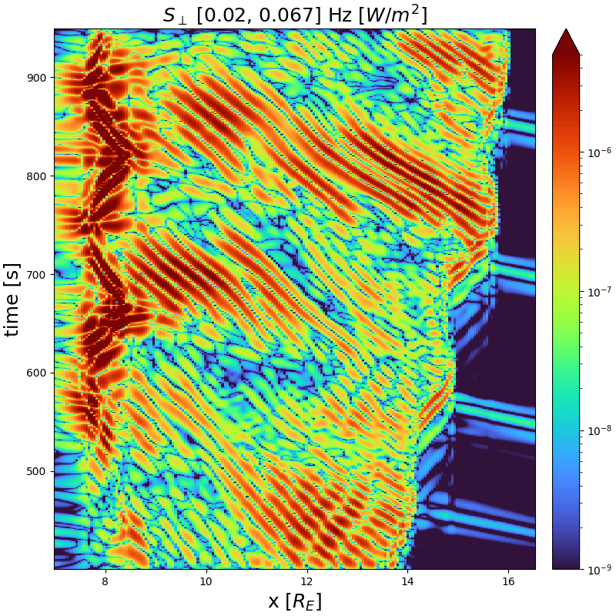
Space-Time Analysis
MA~5
MA~10

Slide 7
Summary
Time-varying boundary conditions for the hybrid Vlasov model Vlasiator
2D global magnetosphere run with varying upstream density
Signatures of various wave modes’ propagation
Modulations to the magnetosheath and magnetopause primarily led by fast modes
Modulation of mirror mode/EMIC mode wave powers as a function of upstream conditions
[Zhou+ 2022], to be submitted

Slide 8
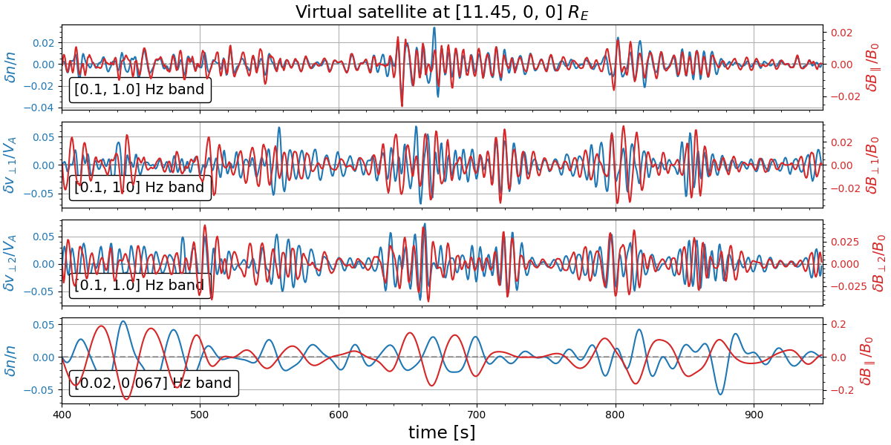
Virtual Satellite Analysis

Slide 9
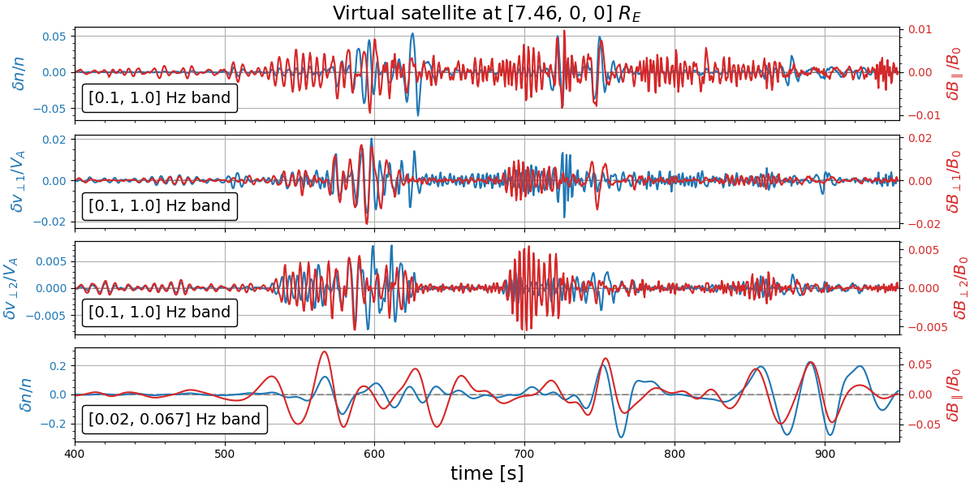
Virtual Satellite Analysis

Slide 10
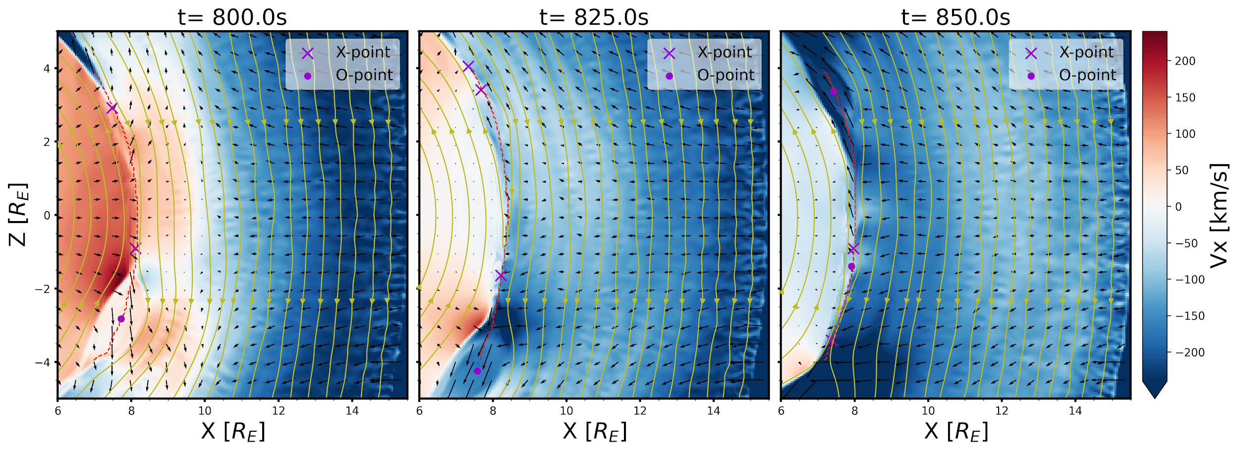
Impact Near the Magnetopause

