Slide 1
Temporal compound events: Are they represented in Catastrophe Models
Stephanie Hodsman
Session NH10.2 – Compound weather and climate events
Tuesday 24th May 2022

Slide 2
Concepts
  Temporal Compound Events – successive storms which have hit the UK
  Hazard event or a hazard event set – simulated historical events
  Insurance event or insurance event set – simulated historical events with criteria applied

Slide 3
Aims and objectives
Aim: to explore how temporally compounding flood events could be represented in a stochastic event set
Objective: to use JBA Risk Management’s stochastic event set for their UK Flood Catastrophe Model to decipher the following hypothesis could be accepted:-
temporal compound events should be simulated as a combined event in an event set to represent the losses associated with temporal compound events more effectively

Slide 4
Methodology for the investigation
 | Hazard Event Set | Insurance Event Set
Triggering Return Period | 2 | 10
Hour’s clause | N/A | 504 hours
Number of times an OP can be active | Unlimited | Once
Reconstruction Period | N/A | 180 days for river and coastal 60 days for rainfall

Slide 5
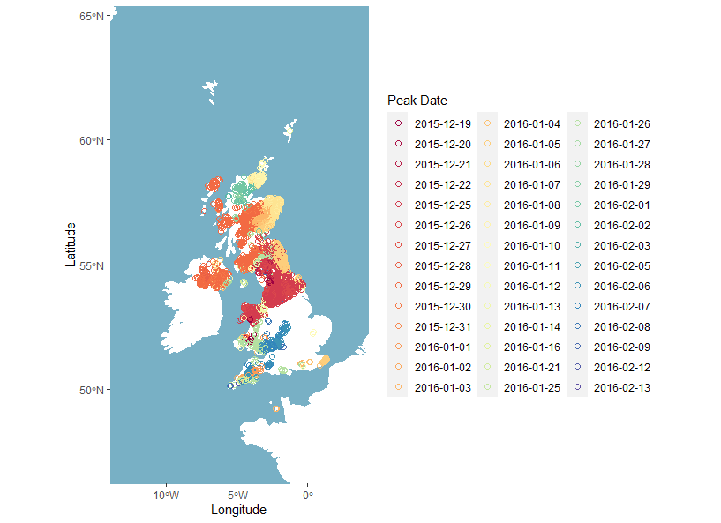
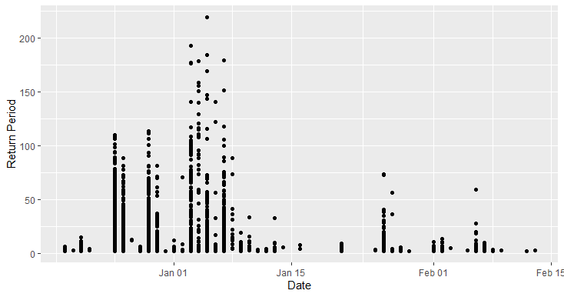
Hazard event set
Figure 1: December 2015 hazard event - Maximum Return Period peak day per Observation point
Figure 2: December 2015 hazard event - Spatial plot for the maximum return period peak day per observation point

Slide 6
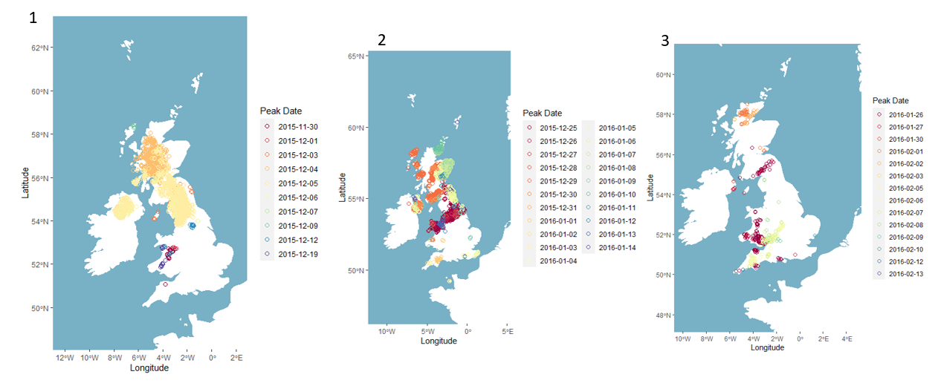
Insurance event set
Figure 3: December 2015 Insurance events- maximum return period peak day per OP

Slide 7
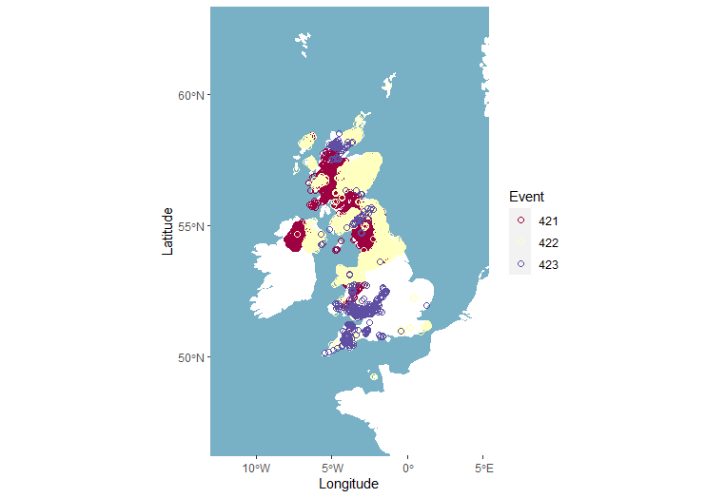
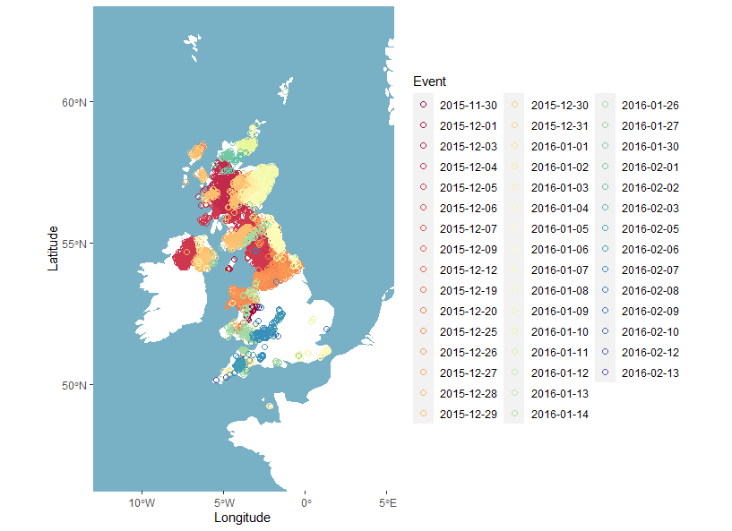
Combined Insurance event set
Figure 4: December 2015 insurance events combined - split per event (number represents the number within the event set)
Figure 5: December 2015 combined insurance events - maximum RP peak day per OP

Slide 8
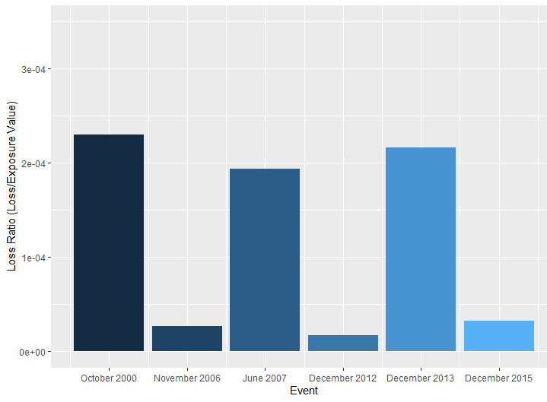
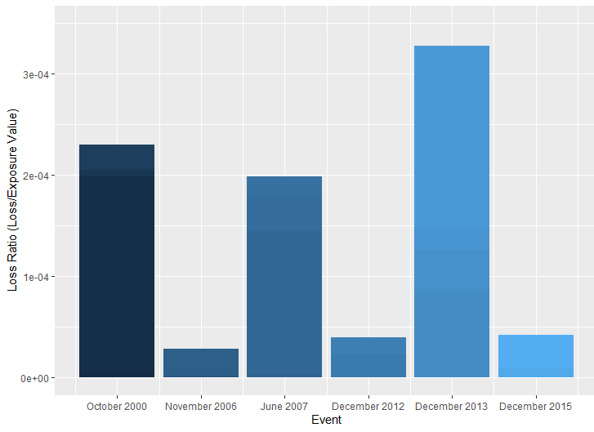
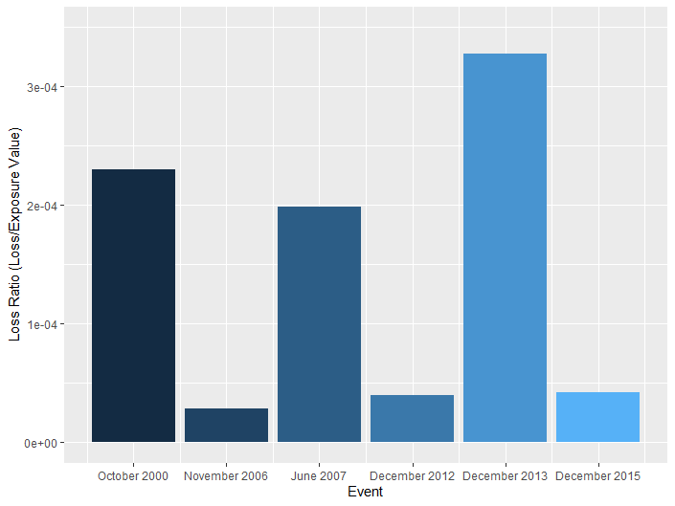
Loss model results – Event by event
Figure 6: Hazard event set loss ratios per event
Figure 7: Separate insurance event set loss ratios summed, per event
Figure 8: Combined insurance event set loss ratios per event

Slide 9
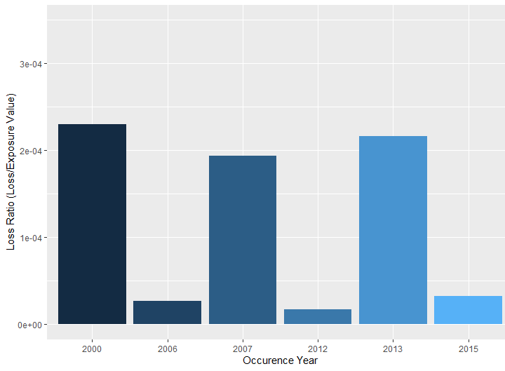
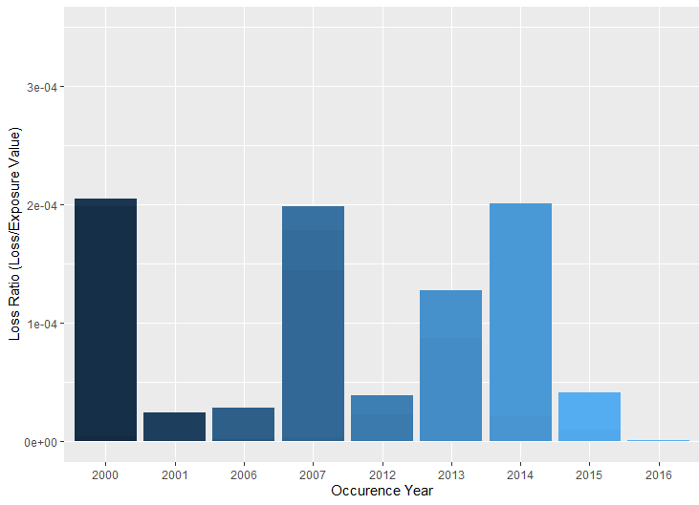
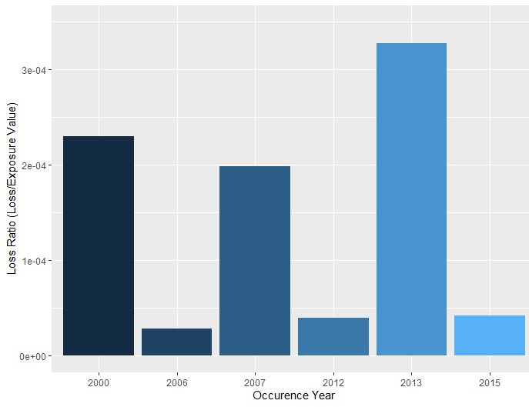
Loss model results – year by year basis
Figure 9: Hazard event set losses per year
Figure 10: Separate insurance event set losses per year
Figure 11: Combined insurance event set losses per year

Slide 10
Main conclusions
  The event set method does not underrepresent the risks associated with temporally compounding events
  Depending on the event year attribution the losses are represented differently
Future investigations:
  Altering the year definition of the event set
  Length of the hours clause
  How an event could be triggered

Slide 11

Any questions?

